Slide 1
Illinois State Physical Activity & Nutrition Program: Built Environment Overview
10/8/20

Slide 2
ISPAN OVERVIEW
Five-year, $4.6 million initiative to implement physical activity and nutrition interventions in Illinois
Funded by the Centers for Disease Control and Prevention (CDC)
Focused on communities hardest hit by chronic diseases like type 2 diabetes and heart disease
Led by the Illinois Public Health Institute (IPHI), in collaboration with the Illinois Department of Public Health (IDPH) and multiple partners

Slide 3
BUILT ENVIRONMENT
Supporting local implementation of bike and pedestrian plans, or complete streets policies in Chicago and Cook County, Peoria, Tazewell, and Woodford tri-county region, and Jackson County to create activity-friendly routes to everyday destinations.
Notes:
ISPAN’s BE work with focus on three priority areas: 1) Peoria City/County is developing a Complete Streets Project Delivery and Design manual 2) Jackson County has conducted a walk audit and now a bike trail network audit. They will implement recommendations/improvements/interventions identified through those projects in the next three years of ISPAN. 3) CCDPH/SSMMA – integrated health considerations into STP criteria and adopting a number of CS policies in SSMMA municipalities. ISPAN is also providing TA at a state level through the Illinois Bike/Walk Learning Collaborative.

Slide 4
Active People, Health Nation

Slide 5
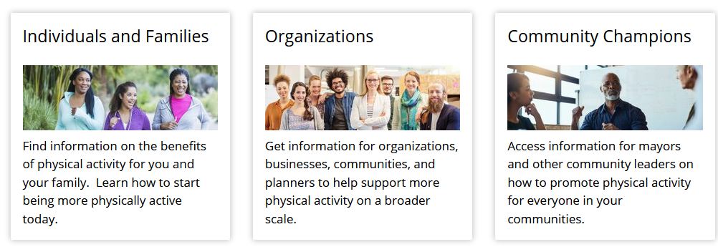
Resources
Mayors as Physical Activity Champions
https://www.cdc.gov/physicalactivity/activepeoplehealthynation/join-active-people-healthy-nation/index.html
Notes:
Illinois Mayors: Join your fellow state and local elected leaders in creating a more active America, together! Sign up here (middle right-hand side of page) to join the “Active People, Healthy Nation Community Champions” email list and get access to mayor-only resources and learning opportunities, and funding opportunities. Active People, Healthy Nation is a Centers for Disease Control and Prevention initiative to get 27 million Americans moving more by 2027.

Slide 6
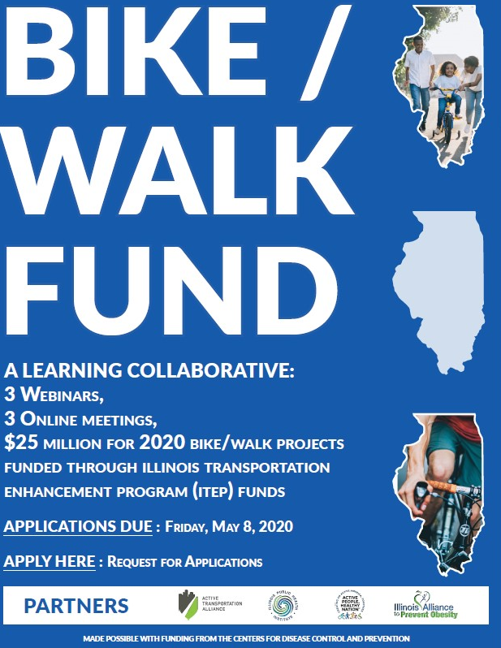
Illinois Bike/Walk Fund Learning Collaborative
https://activetrans.org/itep
Notes:
This year the Illinois Transportation Enhancement Program (ITEP) will provide $105.6 million in state and federal funding for walking, biking, and trail projects around the state. The call for projects will be open from August 21 to November 2, 2020. Through the Illinois State Physical Activity and Nutrition Program and funding from the Centers for Disease Control and Prevention, the Active Transportation Alliance and Illinois Public Health Institute are partnering to help build the capacity of communities to successfully apply for ITEP funds

Slide 7
Thank you!
Questions/concerns: Sarah Chusid
Program Manager
Center for Policy & Partnership Initiatives
Illinois Public Health Institute
Sarah.Chusid@iphionline.org
Notes:
Hope to host future webinars on these topics of interest. Will add you all to the IAPO listserve to receive updates on our built environment work to promote physical activity. Thank you for joining!

