Slide 1
Age Friendly Collaboratives: National Research & Potential Models

Slide 2
Overview
MMC staff are exploring how best to grow our collaborative through:
Individual Interviews with AFCC Members
Research on Other Collaboratives Like Ours
Identification of Grant Funding
This is just a taste to get us going. We are seeking Member participation to develop the most effective ideas.

Slide 3
Individual Interviews: What We Learned
In February and March, MMC staff interviewed some AFCC members to identify needs:
1). Peer Sharing and Repository: Learn from other communities, including resolutions, applications, outreach materials, etc.
2). Assessments: Need help formulating a “next step” but not a full plan.
3). Interns or Fellows: Place expertise within municipalities, based on Oak Park dementia-friendly model

Slide 4
National Interviews: What We Learned
There are a number of aging-in-place municipal or regional collaboratives, like ours!
Mid-America Regional Council Communities for All Ages (Kansas City region)
Dementia-friendly Massachusetts (Statewide)
Age-friendly Arizona (Phoenix region)
Age-friendly Atlanta (Atlanta region)
Miami-Dade Age-friendly Initiative (Miami-Dade County)
Age-friendly Silicon Valley (Santa Clara County)
Tri-state Collaborative on Aging (Maine, New Hampshire, and Vermont)
Age-friendly Louisville (Louisville, KY)

Slide 5
What We Learned: Peer Sharing
Most collaboratives serve as learning networks like ours, offering a “menu” of ideas but no “one size fits all”.
Standing meetings on a particular policy topic (housing, transportation, health)
Shared toolkits – Grant Makers In Aging Toolkit
Interdisciplinary membership includes municipalities, AARP, AAAs, health departments
Full time staff person sends research, reports, etc.

Slide 6
What We Learned: Technical Assistance
Collaboratives provide assistance to help communities in various phases of age/dementia friendly plans.
Assessment Data and Profiles: Help communities better understand their population by age cohort and how their needs will evolve in the future.
Demographic Profiles of Aging Population (Age-friendly Arizona)
Gerontological Community Profiles, Data and Qualitative (Dementia-friendly Massachusetts)

Slide 7
What We Learned: Technical Assistance
Collaboratives provide assistance to help communities advance various phases of age/dementia friendly plans.
Assessment Planning: Help define the first strategic steps to become age-friendly:
Business Plans for Aging (Age-friendly AZ)
Department Head Trainings (KC Communities for All Ages)
Bronze-Silver-Gold Program (KC Communities for All Ages)

Slide 8
What We Learned: Grants
Collaboratives utilize grant funding, either for the facilitating organization (for staffing) or as shared resources among collaborative members.
Shared grants include:
Transportation Incubator (Age-friendly AZ): Competitive grant program to incubate creative solutions to senior transportation
Mini-Grants (Age Friendly Miami-Dade FL): Grants are awarded to support start up age-friendly projects across the county

Slide 9
What We Learned: Interns and Fellows
Some collaboratives place Encore Fellows within municipalities to help them advance age/dementia initiatives.
Age Friendly Silicon Valley
Age Friendly Arizona
We did not hear of any collaboratives placing graduate students or experts in gerontology.

Slide 10
Internships: Our Options
We identified three options for an internship or fellowship program, modeled on success in Oak Park:
1). AmeriCorps: The Metropolitan Mayors Caucus has an AmeriCorps contract for the Greenest Region Compact that could be expanded to include the AFCC.
2). Kott Gerontology Institute Scholars Program: The Kott Foundation awards paid internships to graduate internship placements to work with senior citizens.
3). Encore Fellows: Work placements for mid-to-late career professionals in not-for-profits or in social impact roles.
Any graduate placements would need to include structured cohort learning, so placements aren’t “lost” with minimal supervision within municipalities.

Slide 11
Chat Box: What Intrigues You?
We’ve learned a lot and need your input. Which of these items would most help you with your age- or dementia-friendly work?
Dedicated staff person to manage peer sharing and collaborative
Technical assistance: Data profiles on older adults
Technical assistance: Assessments and/or local planning to guide local work
Recognition program
Shared grants
Internships or fellowships to implement initiatives

Slide 12
Let’s Talk More: Week of June 15
We want a cohort of the AFCC and partners to brainstorm with us about how best to build capacity and which of these activities make the most sense for our Members.
Week of June 15
Zoom call
Please let us know in the chat box if you’d like to be included.

Slide 13
Village of Maywood Community Response to COVID-19
Village of Maywood, Trustee Nathaniel George Booker

Slide 14
What are we doing to support older adults during this public health crisis?
Education
Wellness Check Town Hall
Prevention of Social Isolation
PPE Delivery Everyday
Funding for the most vulnerable residents
Health & Safety
Stay Home Save Lives Campaign
Sharing Stories to Promote Engagement
Census Campaign: Reminder to Older Adults that While at Home they can complete the Census
Senior Living Weekly Outside Prayer
Weekly Prayer Call
Food Delivery Everyday
Washable Facemask Initiative
Social Distancing Community Clean Up

Slide 15
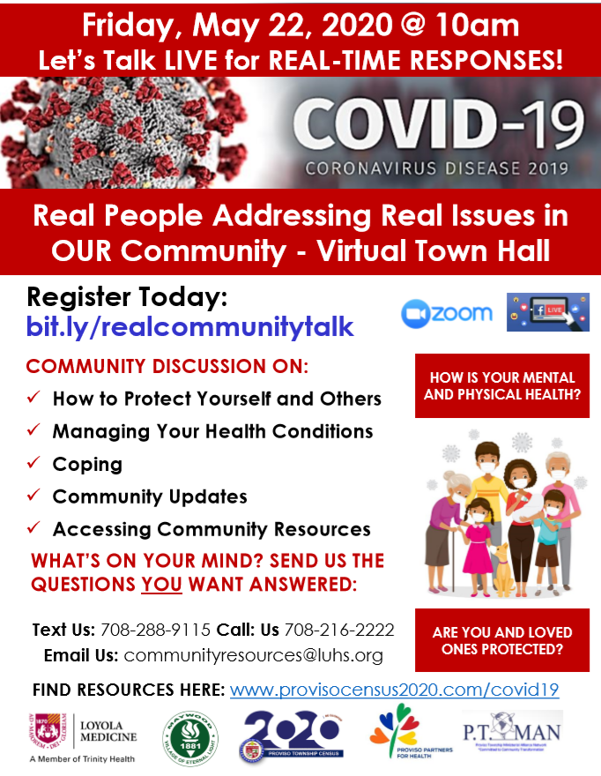
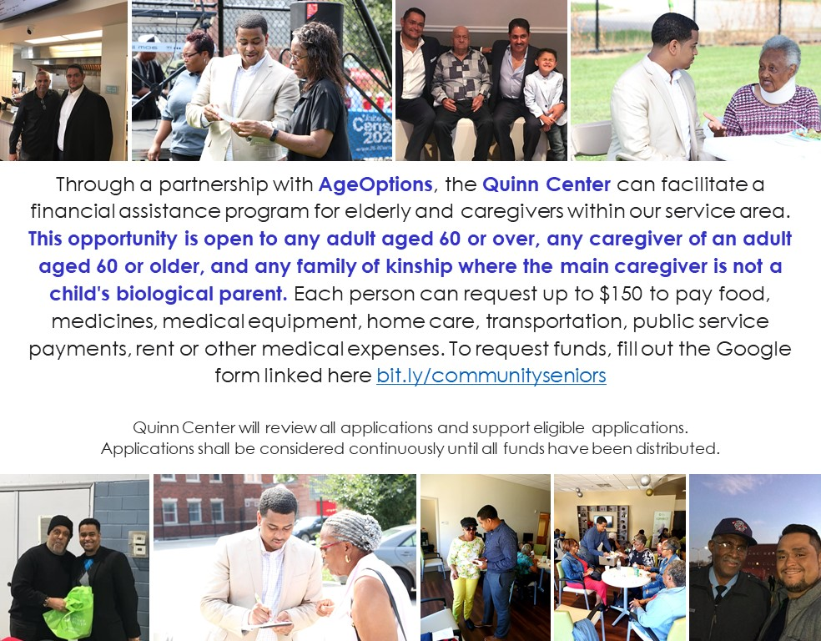
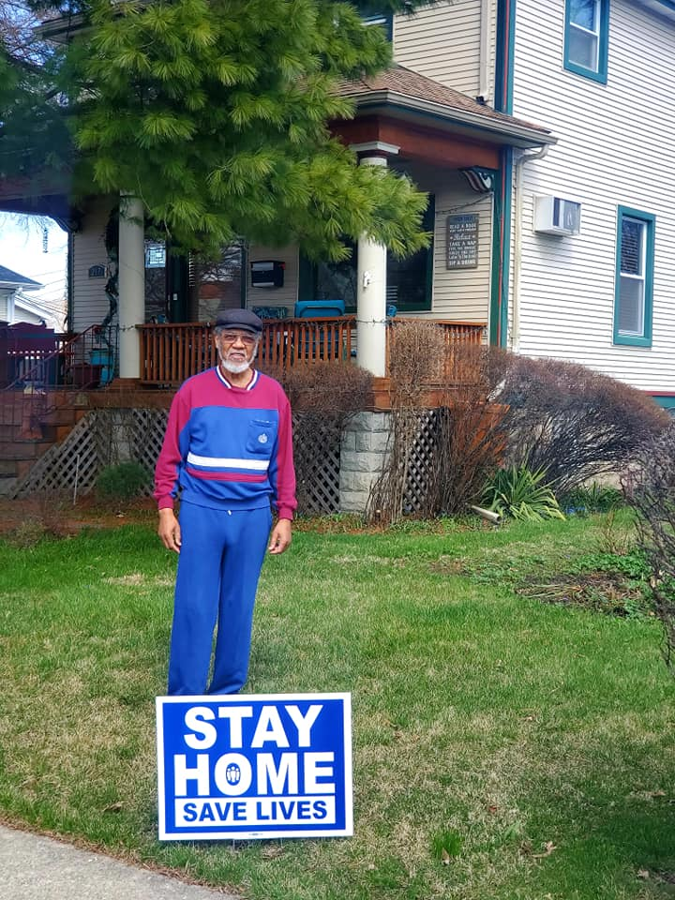
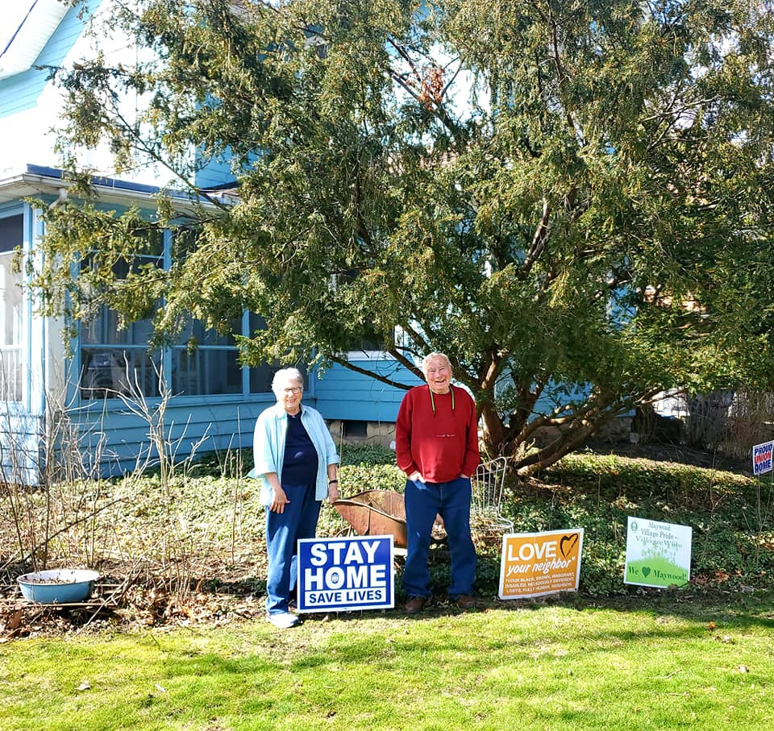
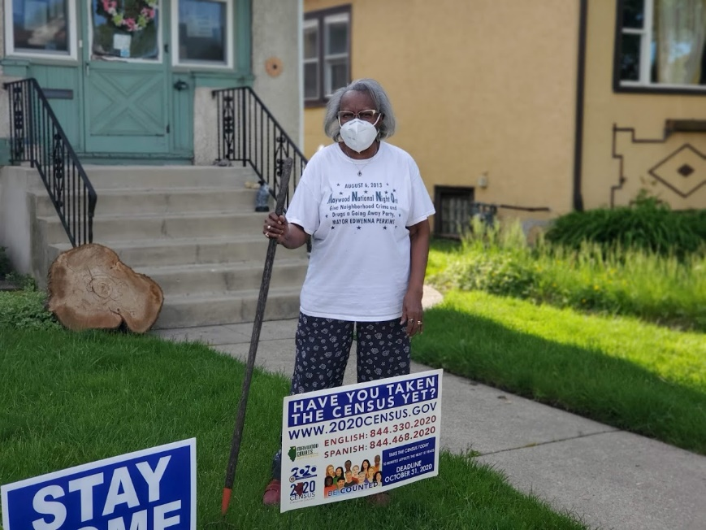
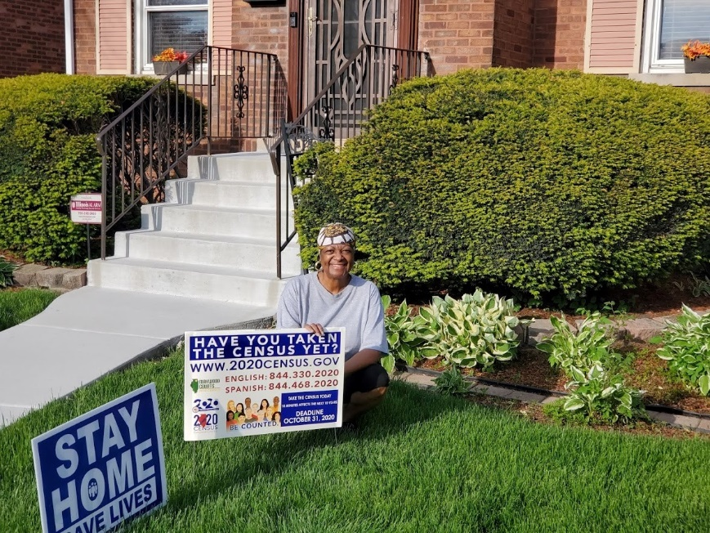
Share Your Story
Wellness Check Townhall
Funding for Seniors
Stay Home Safe Lives March Campaign
Have You Taken the Census Yet May Campaign

Slide 16
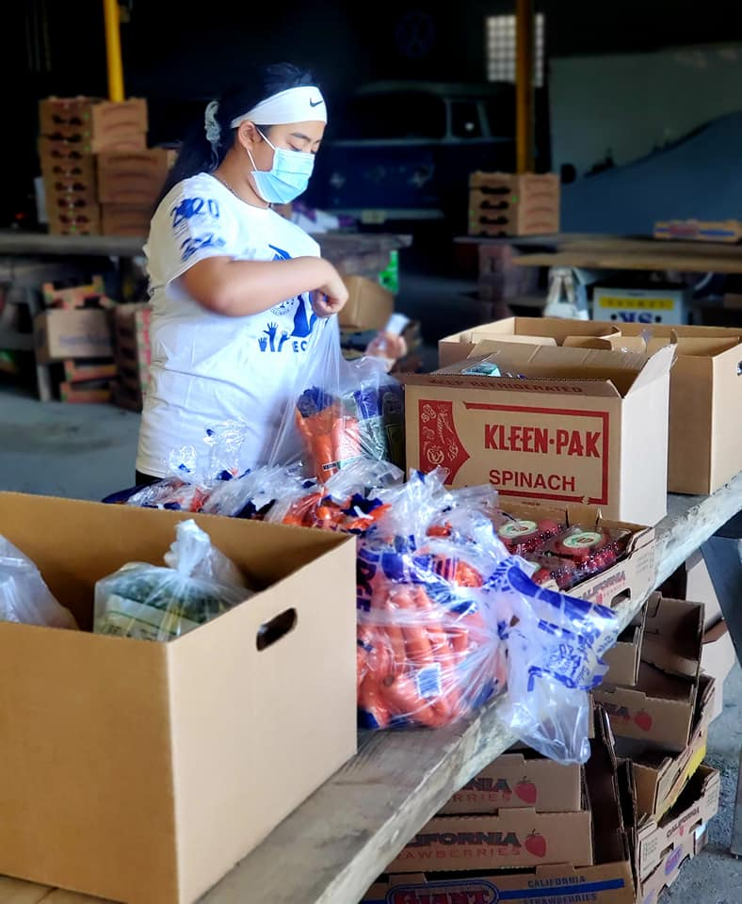
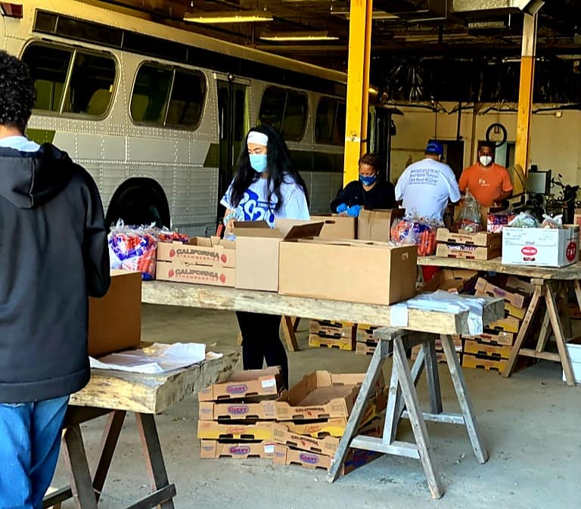
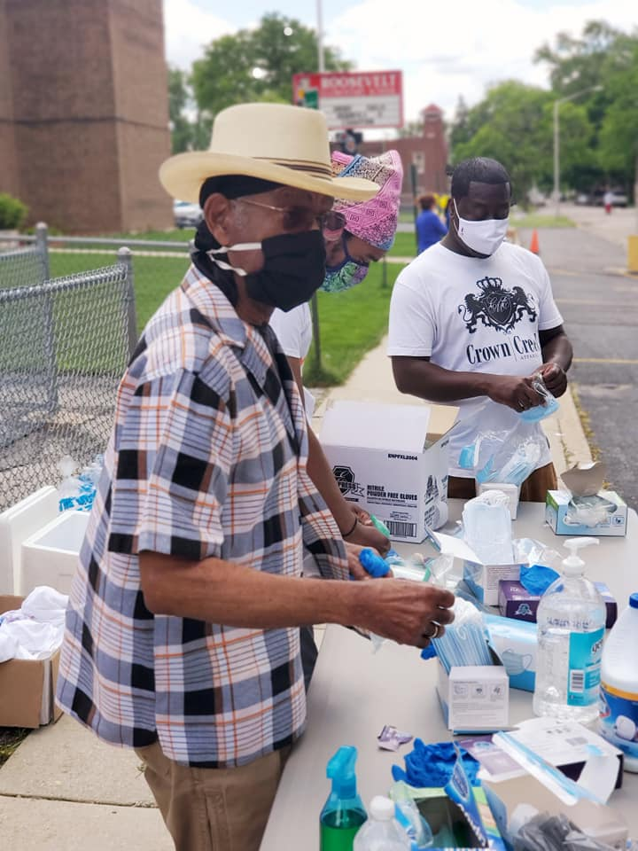
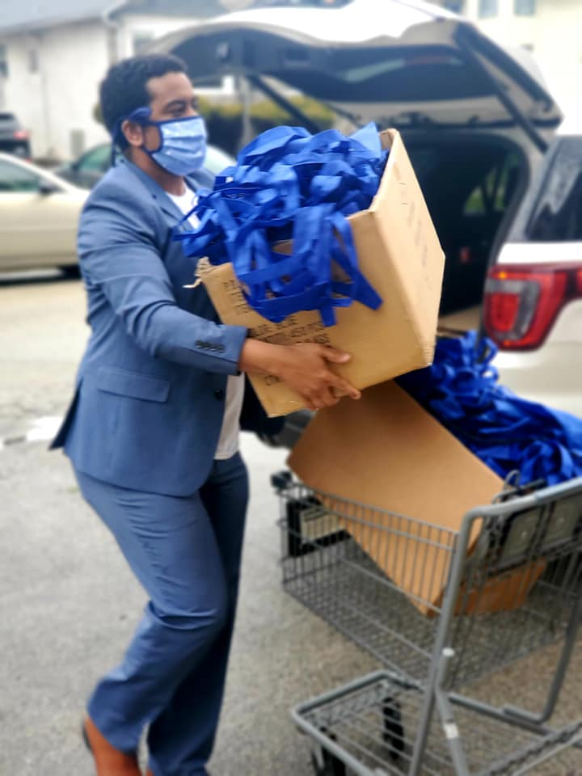
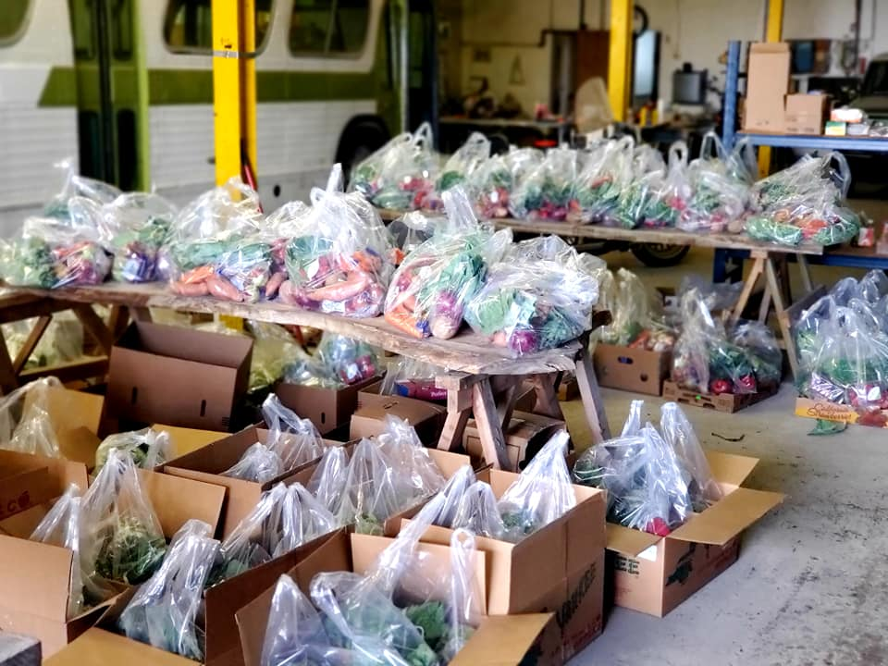
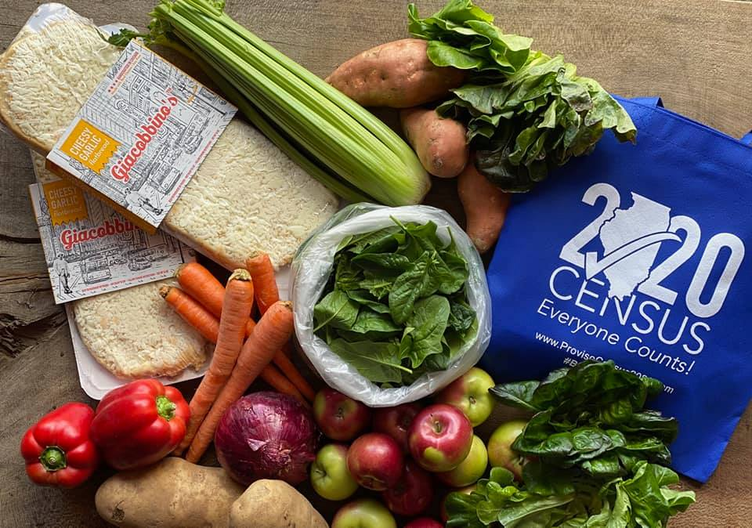
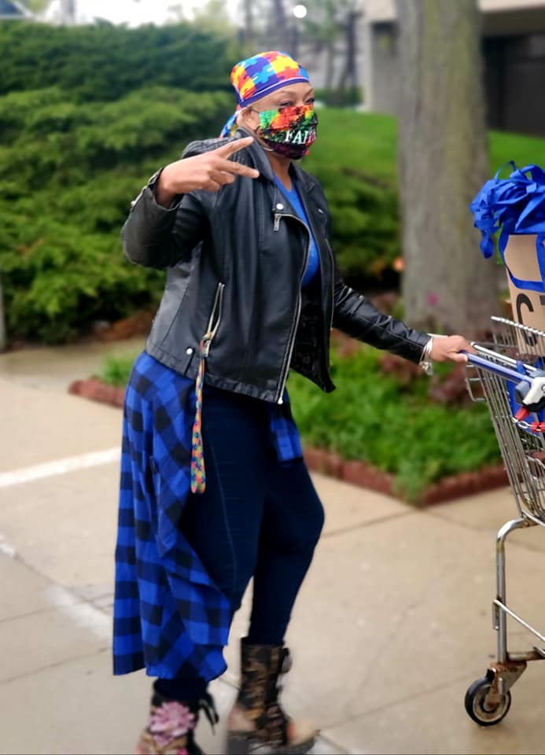
Food & PPE Delivery EVERY Friday

Slide 17
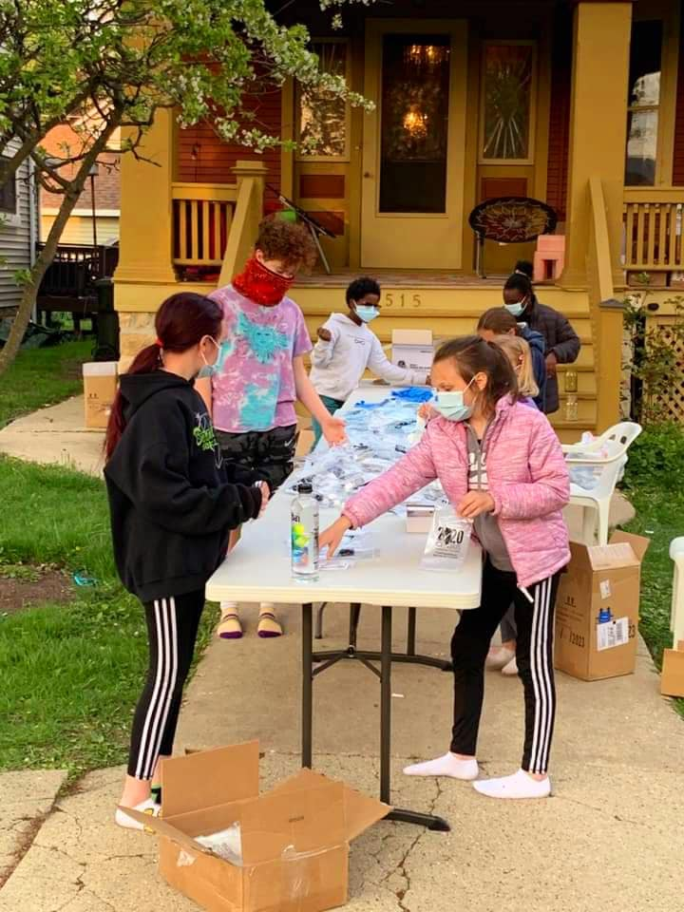
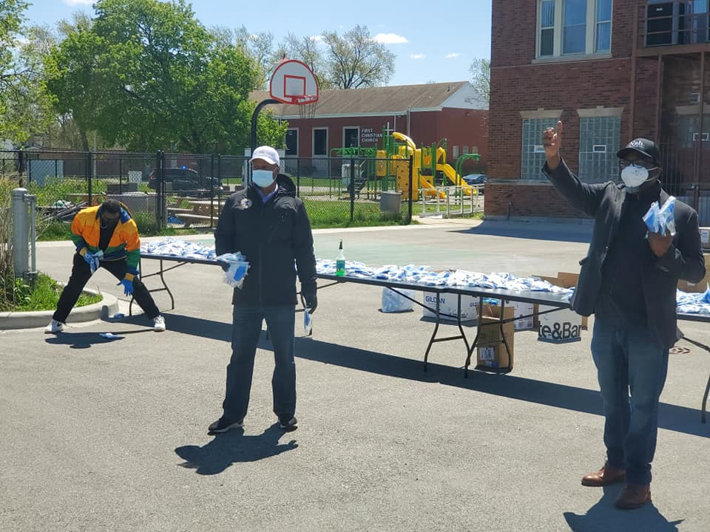
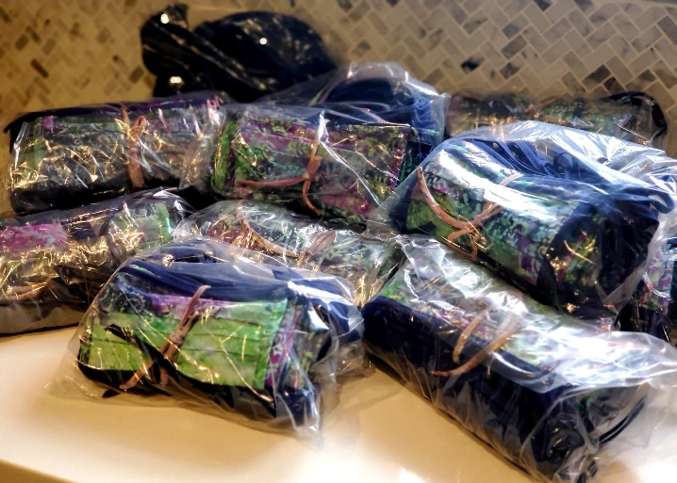
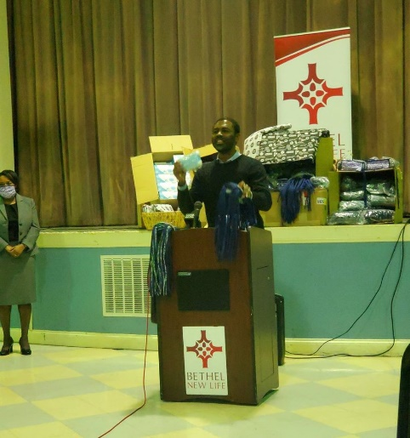
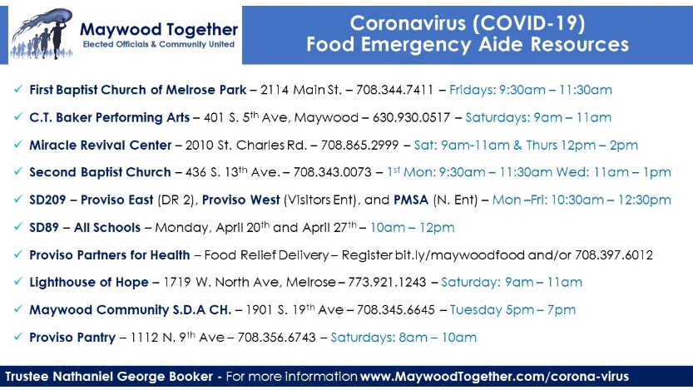
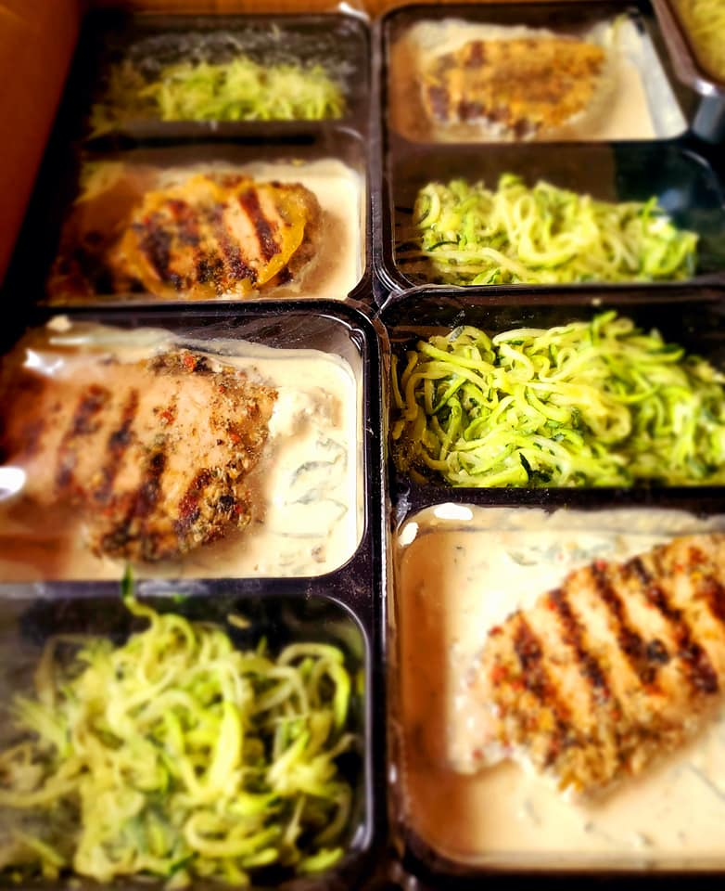
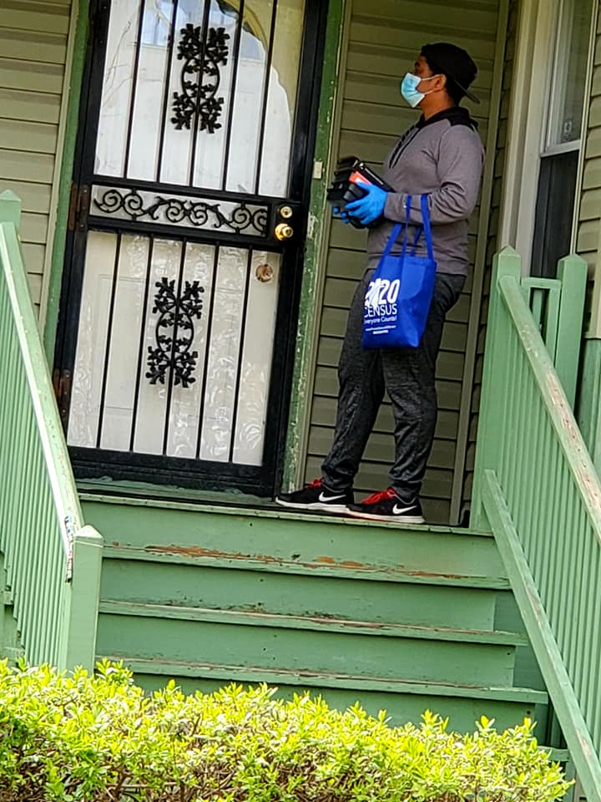
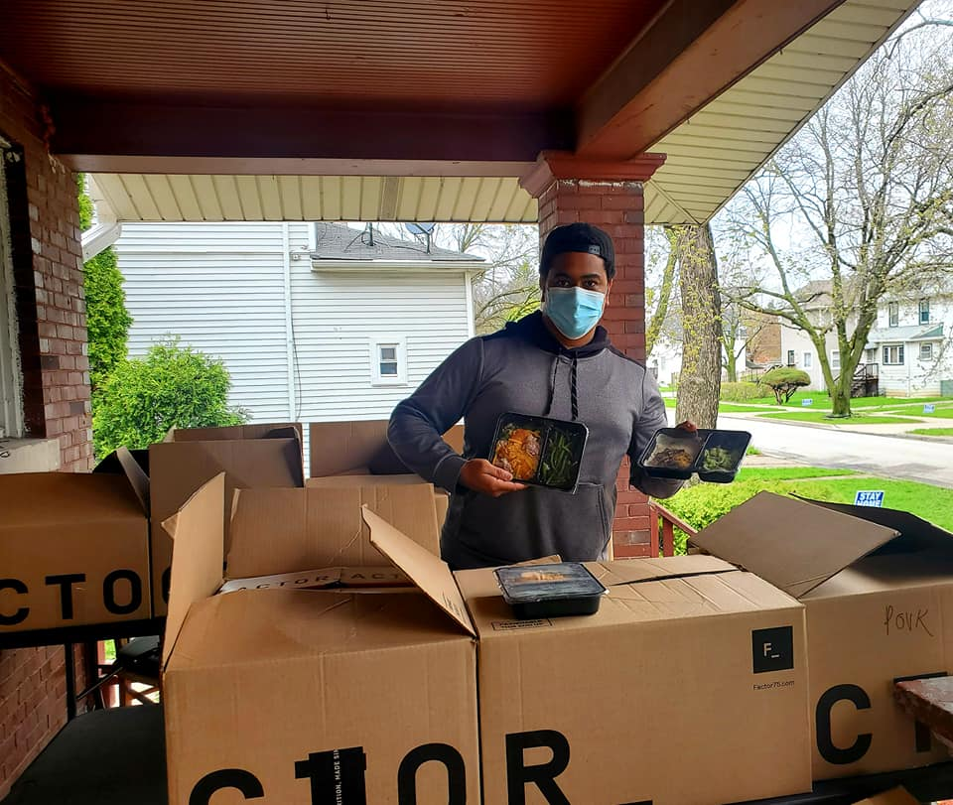
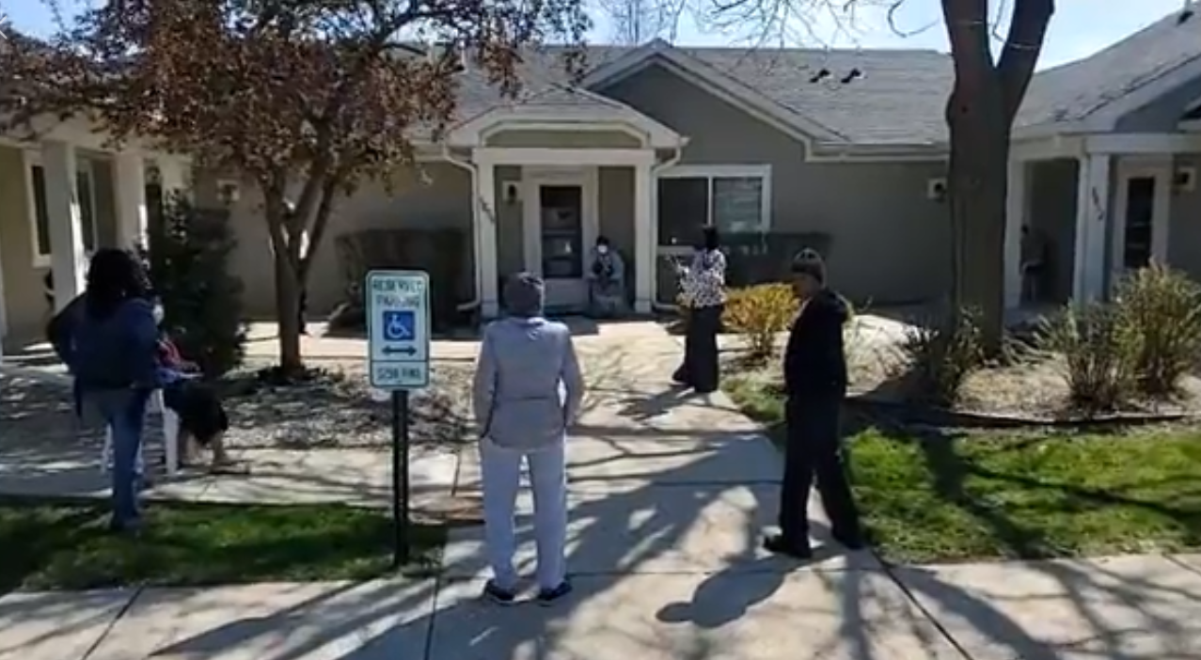
PPE Giveaway with State Representative Welch and Commissioner Johnson
Social Distancing Community Clean Up with Litterati
Mailer with Food Resources
Washable Face Mask for Seniors with State Representative Ford & JoAnn Fabrics
Weekly Prayer Call
Special Request Microwave Meal Delivery
Senior Living Weekly Outside Prayer

Slide 18
The Village of Glencoe Community Response to COVID-19
Emily Mysel, LCSW, Senior Program Manager
Family Service of Glencoe

Slide 19
Approach – What are we doing to support older adults during this public health crisis?
Community Volunteers
Virtual Vibrant Living Senior Discussion Group
Monthly in-person senior discussion group transitioned to an every other week virtual discussion group.
Shopping Trips for groceries and essential supplies
47 shopping trips that included 17 volunteers and 14 older adults.
3 sessions have occurred with attendance of 12-14 group members.
-Transitioning from in-person therapy to phone and/or Zoom sessions.
Tele-therapy

Slide 20
Village of Arlington Heights Community Response to COVID-19
David Robb, Disability Services Coordinator

Slide 21
Approach – What are we doing to support older adults during this public health crisis?
Emergency Financial Assistance and Counseling Subsidy
Arlington Heights Social Services
Arlington Heights Senior Center and Agencies at the Senior Center
Senior Center and Agency Status Report

Slide 22
Gail Borden Public Library District Community Response COVID-19
Glena Godinsky, Life Enrichment Liaison

Slide 23
Village of Mount Prospect Human Services Department Community Response COVID-19
Ginny Thomas, Senior Services Social Worker
Jill Heinking, Public Health Nurse

Slide 24
What are we doing to support older adults during this public health crisis?
Nutrition
Food Resources
Food pantry access through curbside pick up or delivery
Grocery store gift card donation program
Outreach
Connection and Information
Health & Safety Programs
Linked residents to meals on wheels program through AgeOptions and our local senior service agencies
Intergenerational Connections
Senior Newsletter (special COVID-19 editions)
Mask donations
Homebound visits for most vulnerable residents
Ageless Grace programs via MPTV
“Mental Health Matters” virtual event
Premise Alert registry well being checks
Telephone and Senior Housing Outreach
Health

Slide 25
Food Pantry Curbside Pick-Up

Slide 26
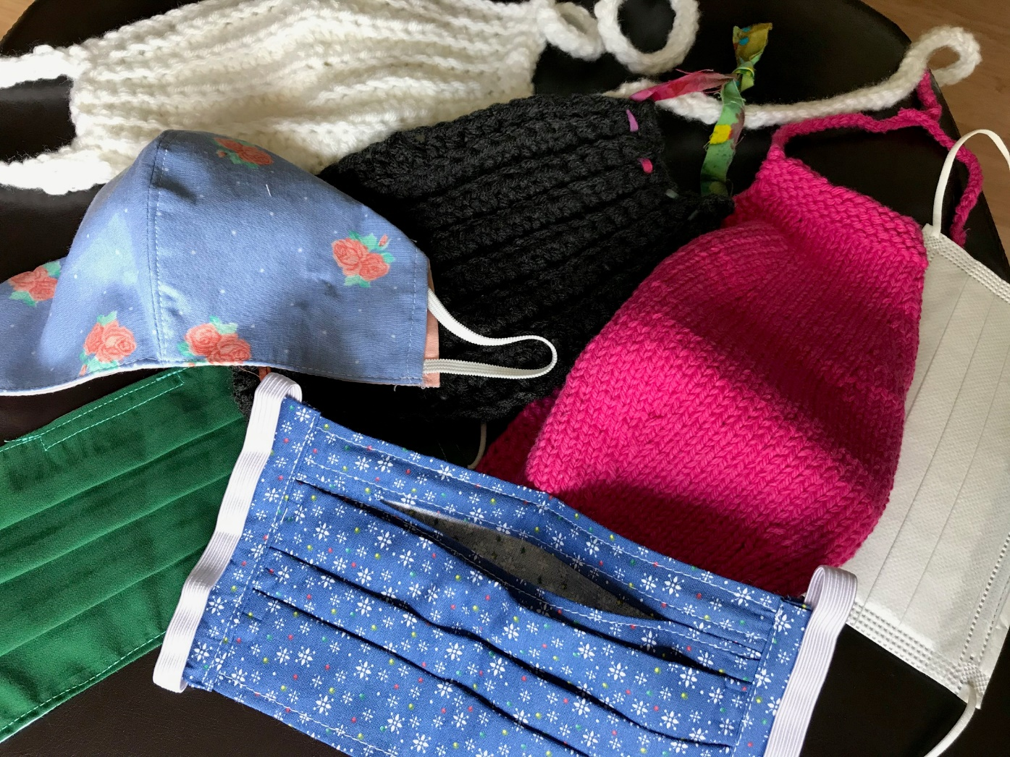
Mask Donations

Slide 27
Village of Grayslake Community Response COVID-19
Mike Steiner, Owner of Right at Home Assistance

Slide 28
Village of River Forest Community Response COVID-19
Village of River Forest, Trustee Respicio Vasquez

