Slide 1



Dementia Friendly training for first responders
10/08/2020
Notes:
Good morning and thank you for inviting me to ______ to offer this Dementia Friendly First Responder overview.
We at AgeGuide understand the importance of training First Responders in Dementia Capable practices to aid them to identify people with memory loss that may wander and become lost, and be prime targets for fraud, financial exploitation and physical, psychological and emotional abuse.
As part of our Dementia Friendly Communities initiatives, we offer a one-hour training (currently via webinar) for First Responders, Transportation, Healthcare, Elder Rights, Faith Communities and for the General Public. Since AgeGuide began conducting the trainings in 2018, we have offered First Responder training to the North Chicago Police & Fire Dpts, Lake County Sherriff, Westmont Police & Fire, Naperville PD and Manteno Fire Dpt.
All in all, AgeGuide staff have trained more that 8,000 employees from different sectors and outreach activities to thousands more.

Slide 2
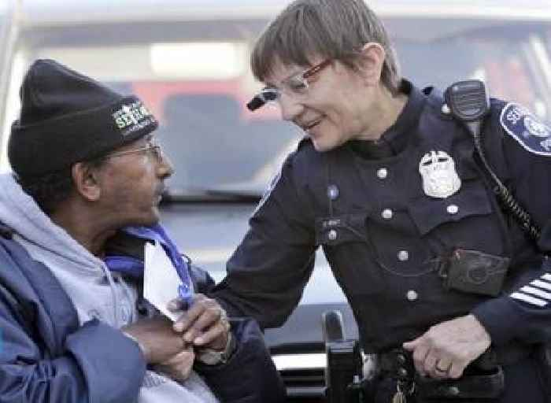
Training Objectives
Introduce Dementia Friendly Community concept
Define dementia
Present dementia facts & statistics
Identify challenges for persons with dementia
Outline and discuss positive approach and communication strategies
Present and discuss dementia-friendly challenges and strategies for first responders
List and describe physical characteristics of Dementia-Friendly Environments
Case Studies
Notes:
The Objectives for the full one-hour training provided by AgeGuide:
Introduce Dementia Friendly Community concept
Define dementia
Present dementia facts & statistics
Identify dementia signs & symptoms
Outline and discuss positive approach and communication strategies
Present dementia-friendly first responder practice strategies
List and describe physical characteristics of Dementia-Friendly Environments
Case Studies where you can offer your ideas if you were to encounter a similar situation.

Slide 3
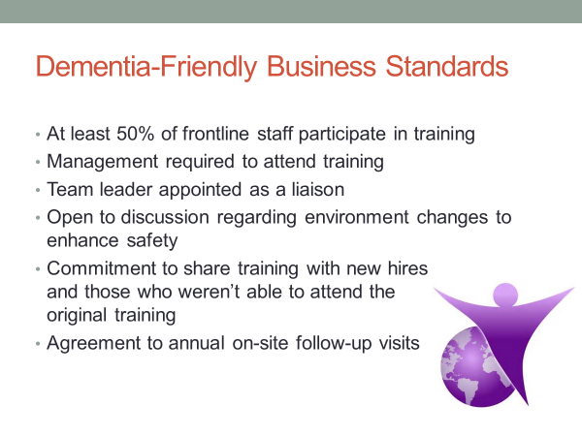
Dementia-Friendly Business Standards
Notes:
AgeGuide follows Dementia Friendly America’s standards for the trainings.
At least 50% of frontline staff participate in training
Management required to attend training
Team leader appointed as a liaison
Open to discussion regarding environment changes to enhance safety
Commitment to share training with new hires and those who weren’t able to attend the original training
Agreement to annual follow-up visits to assess need

Slide 4
Benefits: Dementia-Friendly Organizations
Recognition as a community partner and social leader
Increased consumer satisfaction
Opportunities for publicity and marketing
Increased staff satisfaction
Providing better customer service and improved community relations
Notes:
What are the benefits of having your business designated as Dementia Friendly?
• Recognition as a community partner and social leader
• Increased consumer satisfaction
• Opportunities for publicity and marketing
• Increased staff satisfaction
• Providing better customer service and improve community relations
Upon completion AgeGuide offers:
1. Purple Angel Window Cling for prominent display
2. Dementia Friendly Business Certificate for prominent display
3. 12 month Follow-up from the Agency on Aging
4. Business name listed on the Ageguide.org website Dementia Friendly page stating your business has earned designation as a DF business.

Slide 5
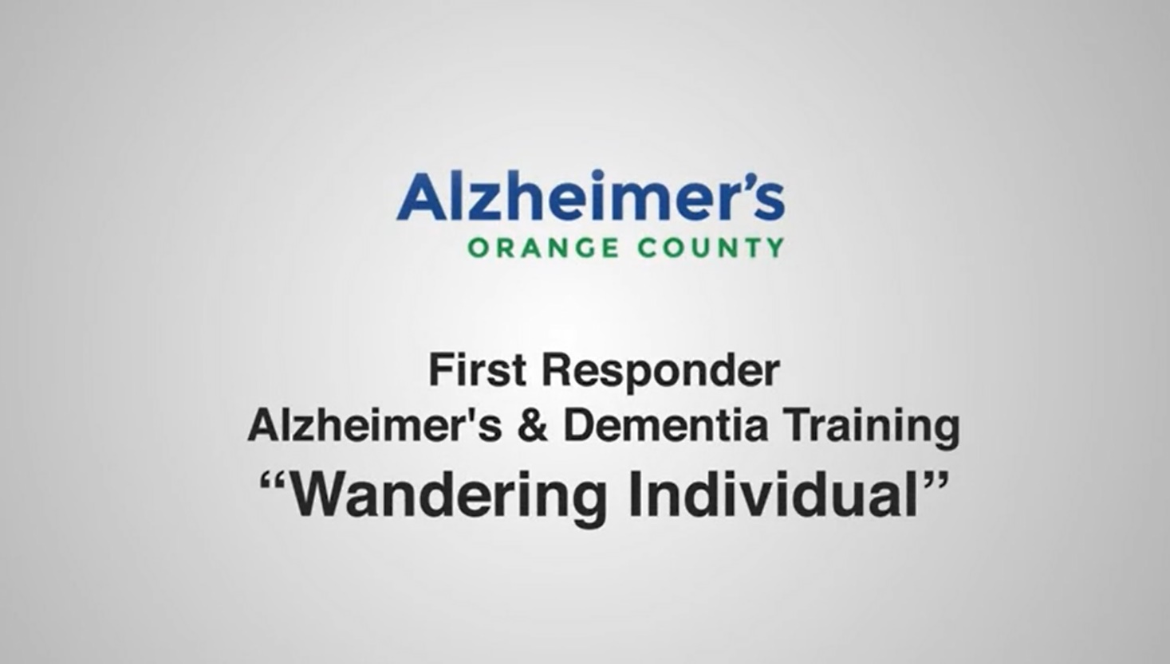
Wandering
Notes:
https://www.youtube.com/watch?v=Xx-o-dSP5-U&list=PLyUU5QfNKxwhm7NTgcmUGUsfKxs_qCb20&index=3&t=6s
I would like to show a short 2-minute video of an example of 1 of 4 training videos provided by Orange County PD and are available on You Tube. This video is focused on wandering and depicts a simple strategy that can be used to manage this all-to-common scenario.

Slide 6

AgeGuide Northeastern Illinois
630-293-5990
Marla Fronczak: mfronczak@ageguide.org
Colette Jordan: cjordan@ageguide.org
https://ageguide.org/advocacy/dementia-friendly-initiative/
Notes:
Please contact AgeGuide with any questions or to schedule a training for your business. There is also a link on our website https://ageguide.org/advocacy/dementia-friendly-initiative/ where businesses can fill out a simple form to request a training.

Slide 7
Resources
Alzheimer’s Association [AA]. (2018). 2018 Alzheimer’s Disease Facts and Figures. Retrieved from https://www.alz.org/media/HomeOffice/Facts%20and%20Figures/facts-and-figures.pdf
Alzheimer’s Association [AA]. (2010). Quick tips for first responders. Retrieved from https://www.alz.org/media/Documents/alzheimers-dementia-first-responder-quick-tips.pdf
Alzheimer’s Association: San Diego [AA-SD]. (n.d.). Partnering with law enforcement to support people with dementia. Retrieved from https://nadrc.acl.gov/sites/default/files/uploads/docs/Final-LawEnforcementEMS-8-7-18_508.pdf.
Alzheimer’s Orange County [AAOC]. (2018). First responder dementia training [4 videos]. Retrieved from https://www.youtube.com/playlist?list=PLyUU5QfNKxwhm7NTgcmUGUsfKxs_qCb20
U.S. Census Bureau. (2017). Quick facts Illinois. Retrieved from https://www.census.gov/quickfacts/il.
Wisconsin Department of Health Services [WDPS]. (2016). Dementia-friendly law enforcement and first responders. Retrieved from https://www.dhs.wisconsin.gov/publications/p01269e.pdf
Notes:
Included in these resources are “Quick tips for first responders” which is a handy pocket guide provided by the ALZ Association and the training videos like the one just shown.
*Now I’d like to introduce you to Cherie Aschenbrenner from the Elgin Police Dpt who will share an exciting program with you.

Slide 8

Family Finder Program
https://www.cityofelgin.org/929/Family-Finder-Program
Notes:
For Cherie

