Slide 1
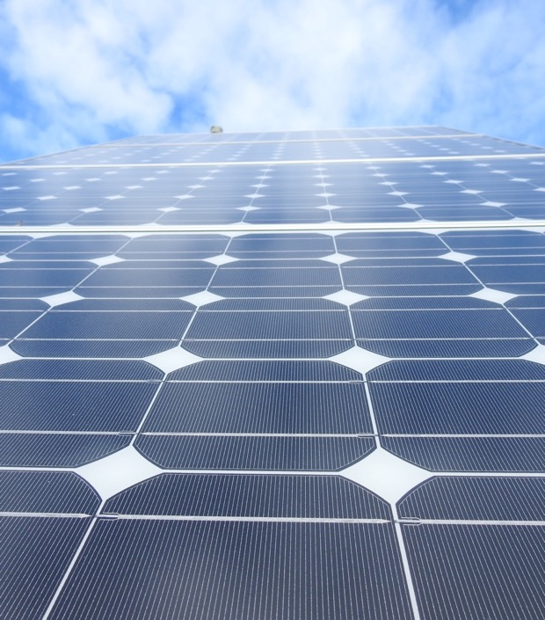
SOLAR POWER AT THE PARK FOREST WATER PLANT
Haley Crim
Greenest Region Corps Member ‘19-20

Slide 2
GUIDING DOCUMENTS
Notes:
Our interest in renewables is backed by the Greenest Region Compact and Park Forest’s Climate Action and Resilience Plan, or CARP, developed with the help of last year’s GRC member Andrew Brown.
Specifically, we were interested in meeting GRC Goal E12, to install and operate renewable energy systems at municipal facilities, and meeting our CARP goal of converting village-owned buildings to renewables and reducing our community-wide greenhouse gas emissions by 26% by 2025.

Slide 3
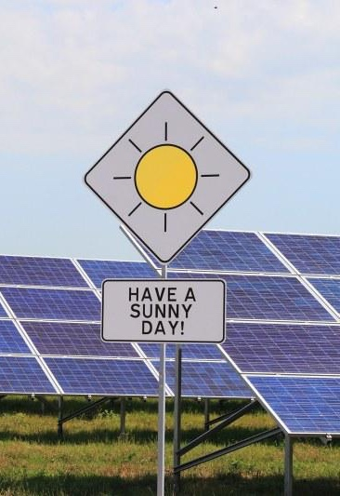
JARGON WATCH!
01
02
03
Renewable Energy Credit (REC)
Certificate of purchase of a 1 megawatt of renewable energy
Franchise Agreement
Municipalities only pay for the electricity used by profit-generating buildings
Adjustable Block Grant
Array owners sell 25 years of RECs to the state at a set price
Notes:
Renewable Energy Credit (REC)
Certificate of purchase of a 1 megawatt of renewable energy
REC owner has the rights to say they’re using that renewable energy
Franchise Agreement
Contract between ComEd and the municipality
Residents pay for municipal electricity use on their ComEd bill
Only applies to municipal buildings that don’t create profit
Adjustable Block Grant
Solar financing mechanism
Program where Solar array owners agrees to sell 25 years of RECs to the state for a set price
Finite

Slide 4
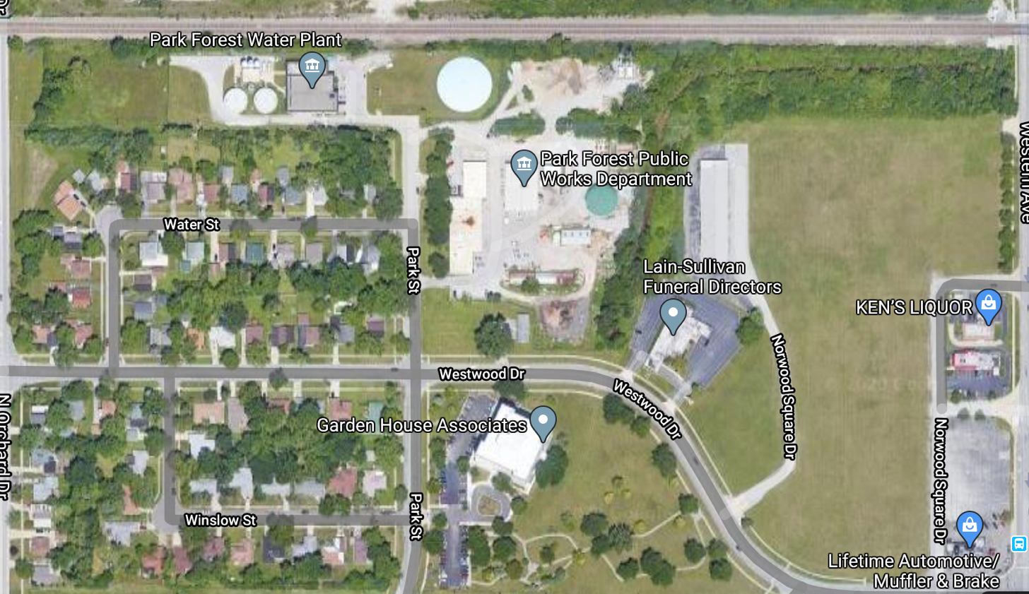
THE SITE
Notes:
Park Forest processes and distributes its own drinking water. The water plant is the largest municipal energy consumer, and it isn’t covered by our franchise agreement as it produces a profit in the form of water bills. Therefore, the village has to pay for this electricity, which is passed on to residents as taxes. This, and the large amount of open space near the plant, made the water plant the ideal place for our first foray into solar.

Slide 5
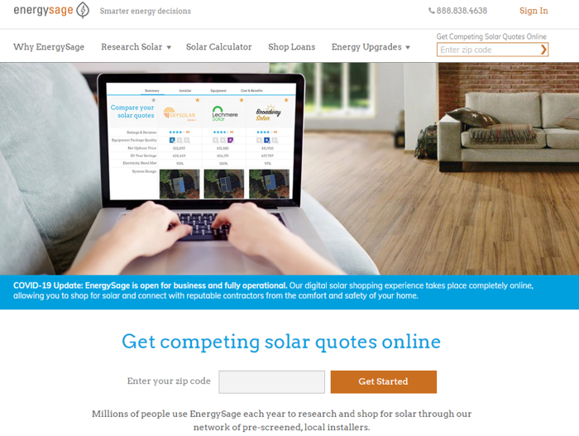
PROPOSAL PROCESS
Variety of options for finance and installation
Local, proven companies
EnergySage
Research
Notes:
Proposal process was open-ended - in order to see what was possible, we didn’t specify the type of financing mechanism or a strict size requirement, and we ended up getting a wide range of proposals. We looked for local, proven companies and requested quotes 2 ways - though EnergySage, a website specifically for finding solar installers, and through our own research and reaching out to companies we were interested in.

Slide 6
THE PROPOSAL
496 kW total
1,239 QCELLS Duo 400 Watt Panels
Notes:
We received 3 competitive bids that covered a wide range of cost, power produced, and financing mechanisms. We ended up moving forward with the once in the middle, which offered the best return on investment and the most opportunity to expand in the future. The proposed array would be composed of 1,239 solar panels on the ground to the west of the water plant and on the roof. It would cover roughly 46% of the plant’s annual electricity use.

Slide 7
$56,630
Estimated utility bill savings per year
Notes:
That would also reduce our annual electricity bill at the plant by 46%, saving us around $57,000 per year.

Slide 8
ENVIRONMENTAL BENEFITS
218 acres
460
metric tons
30%
Environmental equivalent in acres of trees planted
CO₂ Emissions Avoided Per Year
Reduction in municipal electricity emissions
Notes:
The power produced by the panels would avoid 460 metric tons of emissions per year. This is the equivalent of planting 218 acres of trees - or 10% of the village’s land area. Installing solar at the water plant would reduce our total municipal emissions from electricity use by 30%, which is a huge step towards meeting our emissions targets.

Slide 9
ADDITIONAL BENEFITS
Creative use of space
Financing flexibility
US made equipment
Notes:
Some other things that caught our eye about this proposal were the efficient use of space, with both ground and roof-mounted panels, the focus on using us-made equipment, and the flexibility to either lease or purchase the panels outright.

Slide 10
FINANCING
$660,500
$457,340
$79,000
Sticker Price
Post-Incentive Price
Net Price 5 years after Adjustable Block Grant
Includes site surveys, site preparation, installation, and insurance
ComEd Commercial Solar Incentive
CollectiveSun Tax Break Financing
Selling RECs brings in $370,000 over 5 years
Notes:
Here’s the part everyone’s waiting for - financing it! We looked at power purchase agreements, which is effectively a lease on the panels, but outright purchase made the most sense. We were quoted 660 thousand 500 dollars for the whole array. After incentives from ComEd and CollectiveSun, which reduces the cost by about $200,000. If we choose to sell 25 years of our renewable energy credits to the state, we could make $370,000 over 5 years - making the net price after 5 years just $79,000.

Slide 11
4 YEARS
Payback period
Notes:
With all of the incentives, selling our RECs, and including the savings off of our electricity bill, the array will pay for itself in 4 years. If we chose to keep our RECs and not join the adjustable block grant program, our payback period would still be only 8 years.
Effective Non-Taxable Compound Annual Rate of Return (IRR) over 25 years: 20%

Slide 12
TIME CONSIDERATIONS
Wait
Go!
COVID Capital Projects freeze
Adjustable Block Grant closure
Policy opportunities
INCENTIVES TO:
Federal incentive expiration
Environmental benefit
Notes:
This project is still in development, and there are pressures to both hold off and start breaking ground. First, the village isn’t spending money on capital projects this year due to COVID, so that stops things for a while. Then, the adjustable block grant program, which significantly reduces the price of the array, has run out of money and is no longer paying. This could be fixed with the passage of several bills currently at the state house. Potential federal policy changes also may impact financial feasibility as well.
The pressures to go are that the federal tax incentive is currently scheduled to decrease from 26% this year to 22% next year and then disappear completely in 2022, which will increase the price of the array. Also, we’d like to reduce emissions as soon as possible - the climate can’t wait.
The sweet spot to install is probably late next year or early 2022, but of course things could change.

Slide 13
WHERE DO WE GO NOW?
Join Block Grant Waitlist
Install!
01
02
03
04
Presentation to Village Staff
Explore Other Financing Options
2021-2022?
ASAP
August 2020
Before July 2021

Slide 14
WHAT WE’VE LEARNED
Residents are excited about solar!
Solar is accessible for municipalities.
Policy has a huge affect on price.
Solar has a steep learning curve - municipalities should share what they’ve learned.

Slide 15
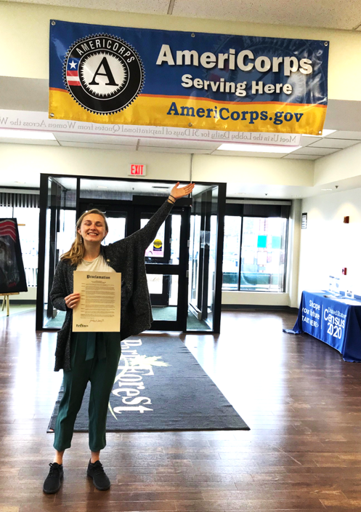
QUESTIONS?
Me: haleycrim18@gmail.com
Carrie: cmalfeo@vopf.com
708-503-8153
vopf.com/sustainability

