Slide 1
Mentimeter #01
What do you expect to learn from this workshop?

Slide 2
The GRC Framework In Use
Metropolitan Mayors Caucus
Environment Committee Meeting
City of Highland Park
July 18th, 2019
Notes:
Welcome and introductions

Slide 3
Greenest Region Compact
Overview
Edith Makra
Director of Environmental Initiatives
Metropolitan Mayors Caucus

Slide 4

GRC Framework workshop
Edith Makra, Metropolitan Mayors caucus
July 18, 2019

Slide 5
Overview
Building the GRC
The GRC in 3 parts
  Compact
  Framework
  Collaborative programs to advance GRC goals

Slide 6
GRC Goal
To align environmental issues, resources, and actions at the local, regional and national levels to guide municipalities to achieve greater environmental sustainability.
Notes:
Ostenburg
Ok to read the goal –
Bottom line.
We have to work together and strategically.
Not enough resources to get much done without aligning efforts

Slide 7
Building the GRC

Slide 8
Building the GRC
1. What is already underway in the region?
2. What existing programs will be helpful?
TO ANSWER THOSE QUESTIONS -
Inventoried environmental achievements for 290 municipalities

Slide 9
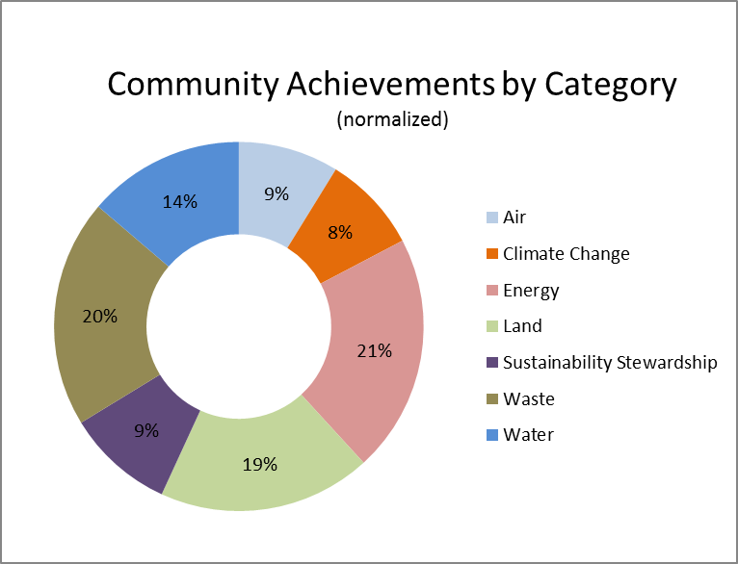
Environmental Achievements by Category
Notes:
Edith
Normalized – land achievements nearly 30%
Normalized for dominance of land and scarcity of waste achievements

Slide 10
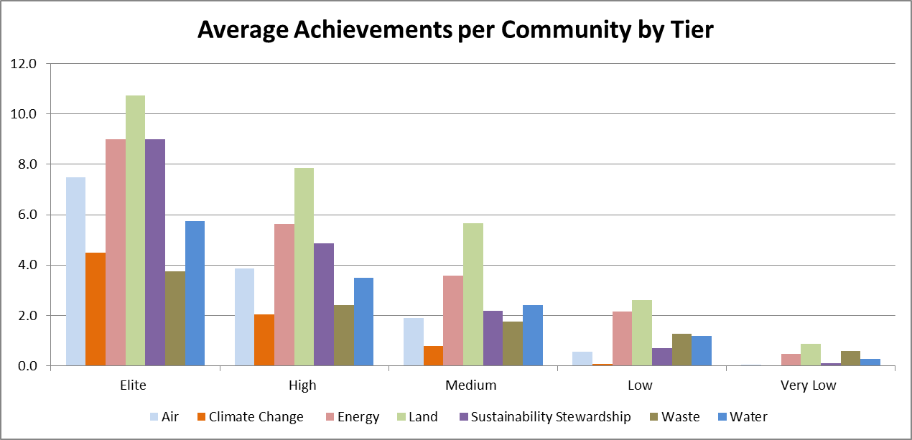
Which communities are sustainable?
9%
71%
1%

Slide 11
Building the GRC2
What is already planned?
What are common priorities?
TO ANSWER THOSE QUESTIONS -
Analyzed existing sustainability plans
  30 local plans
  9 regional/national plans
  1149 specific sustainability goals

Slide 12
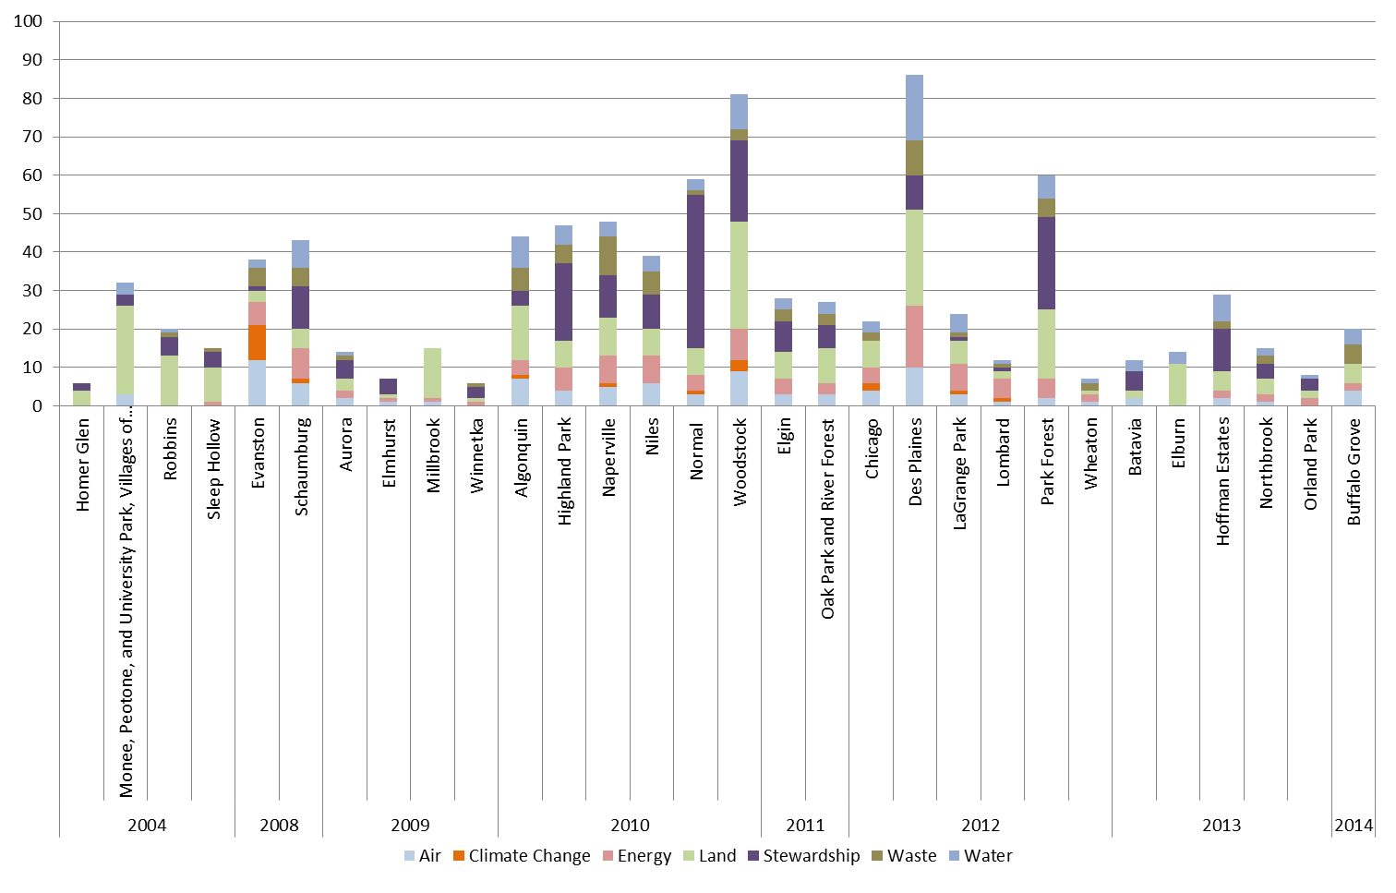


ALL LOCAL SUSTAINABILITY PLANS IN GRC
*based on GRC+2 categories

Slide 13
Putting it all together
Consensus GRC goals

Slide 14

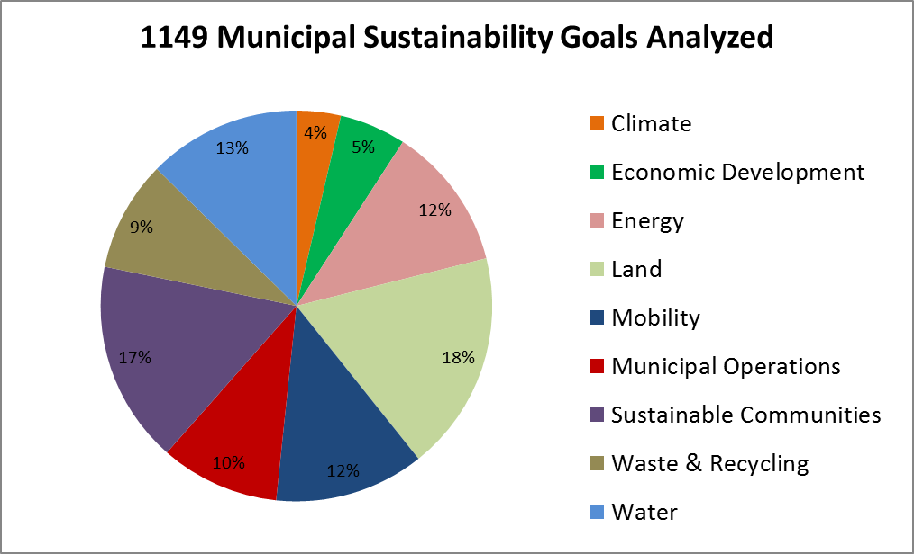

Consensus GRC Goals
From ALL Sustainability Goals
To GRC Goals

Slide 15
Greenest Region Compact
consensus sustainability for communities and the region
In three parts

Slide 16
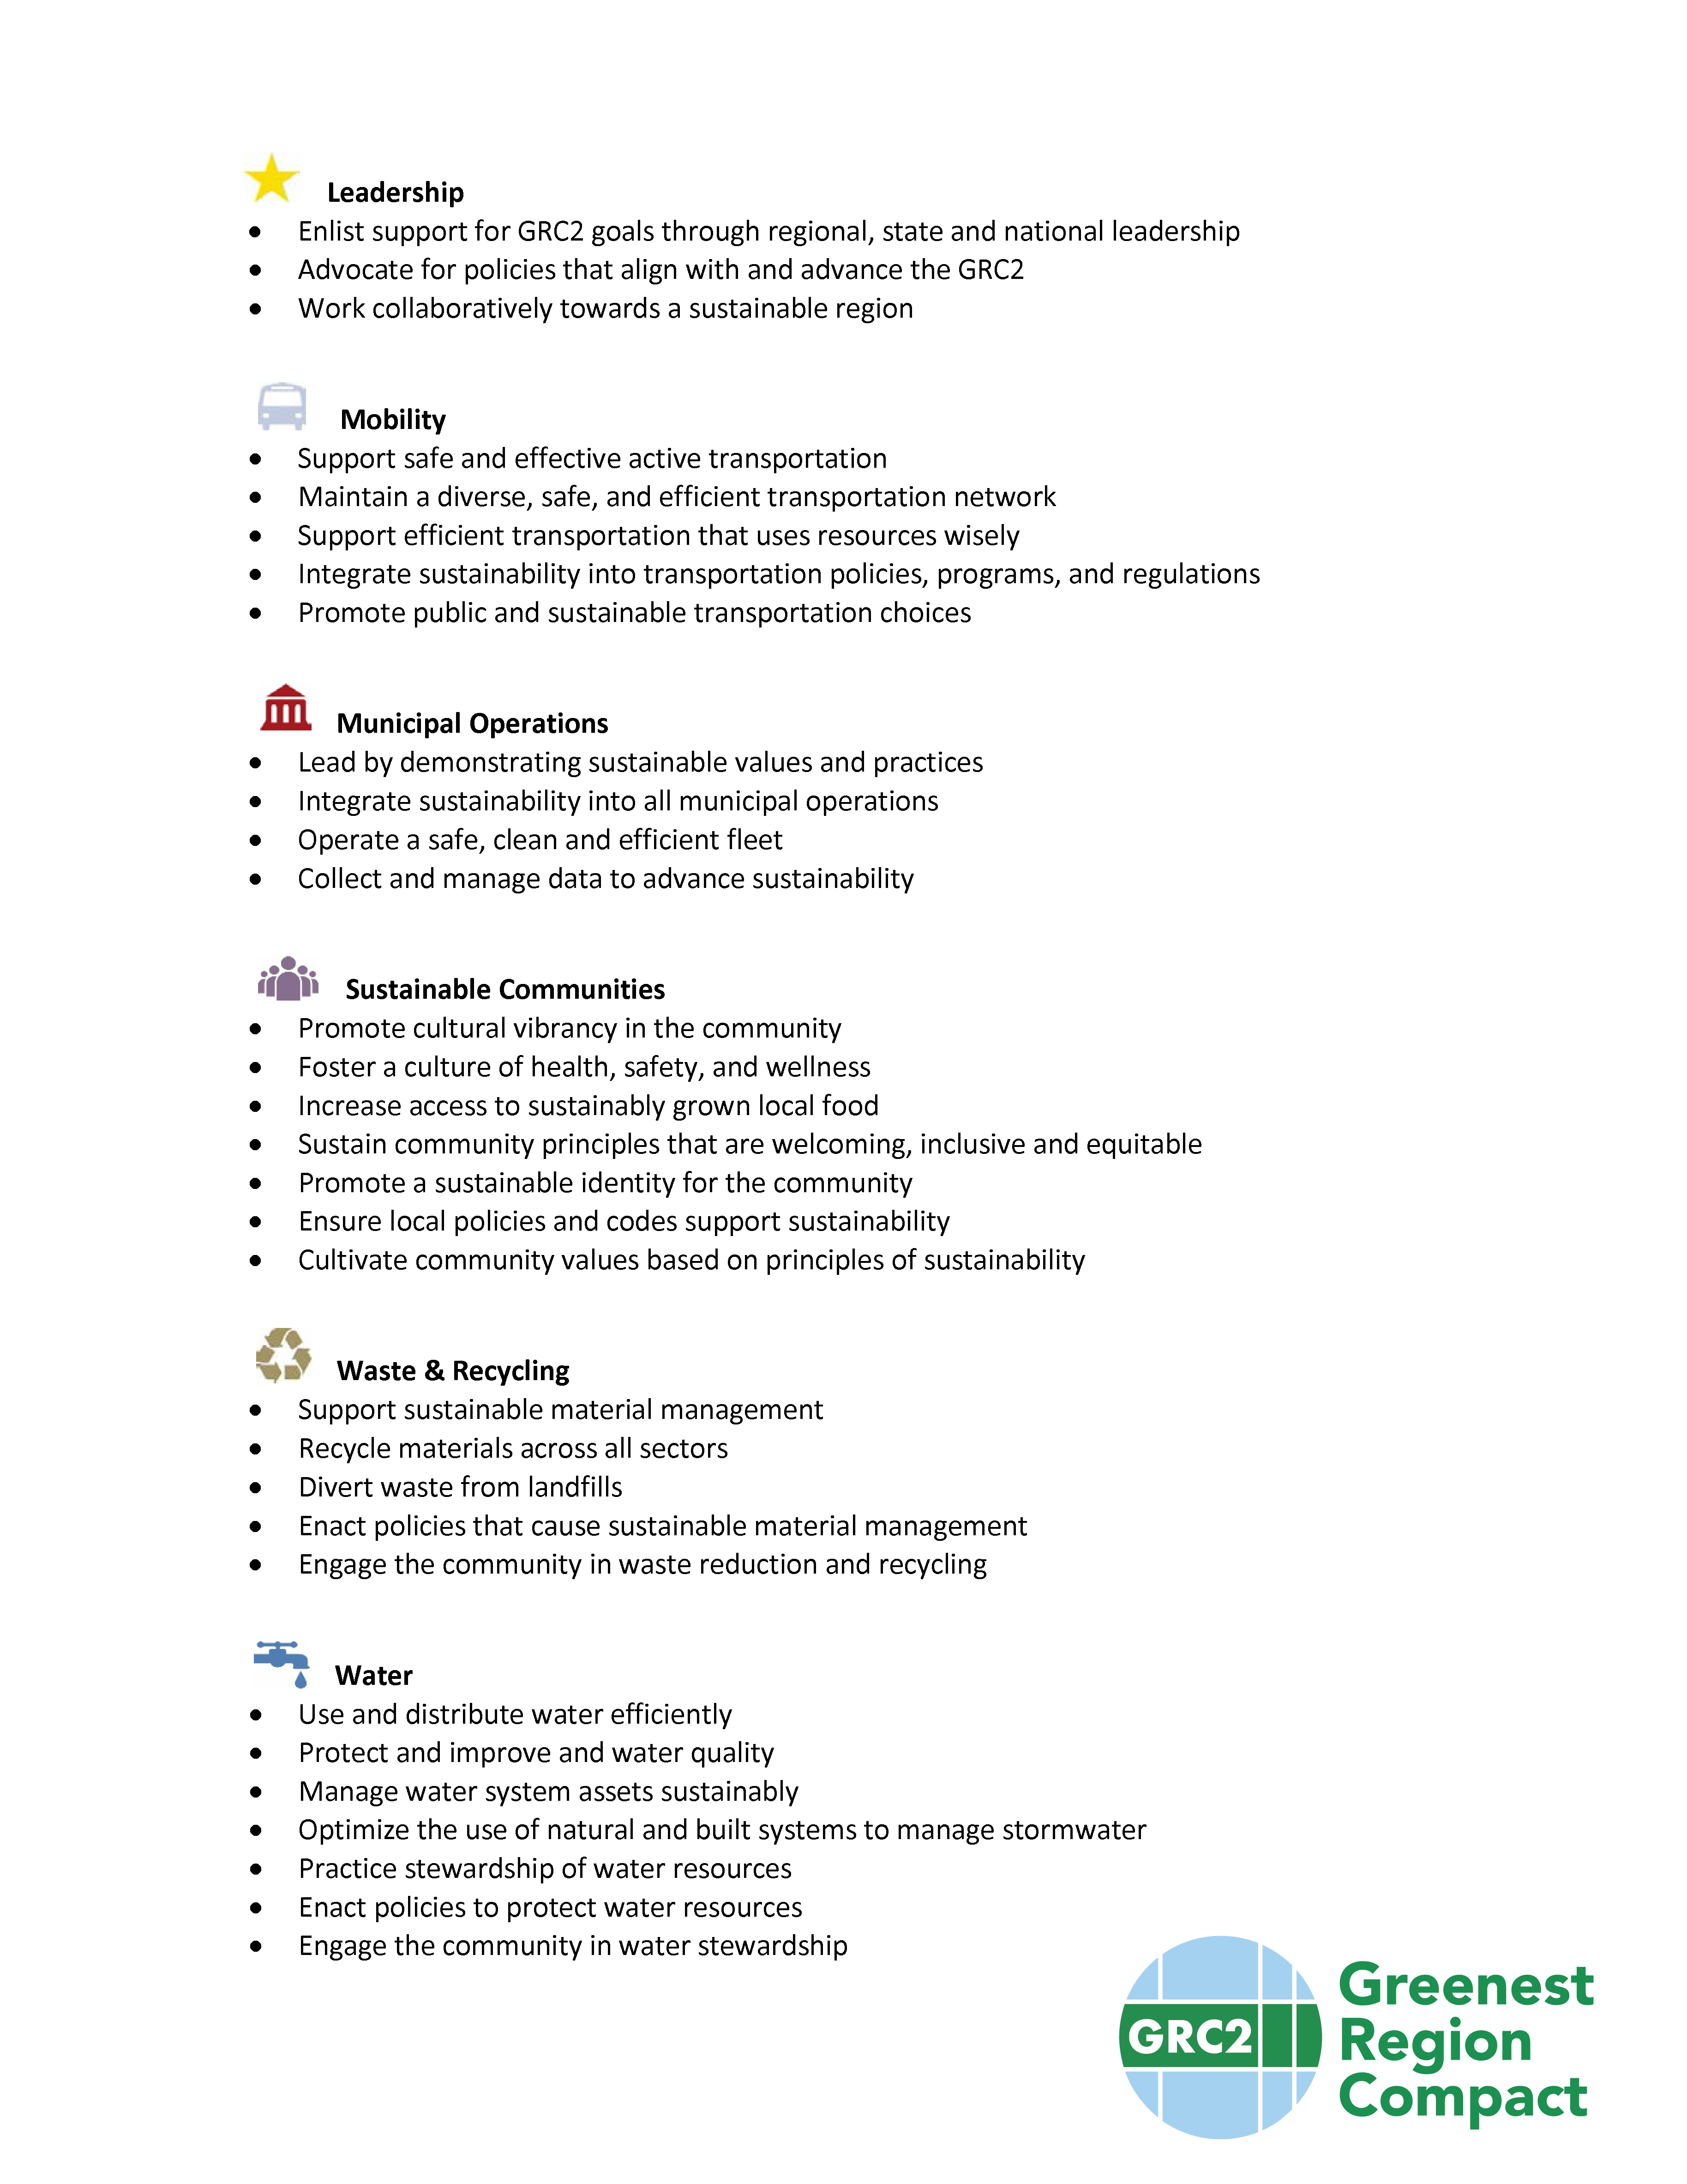
Part 1
The Compact – Just Goals

Slide 17
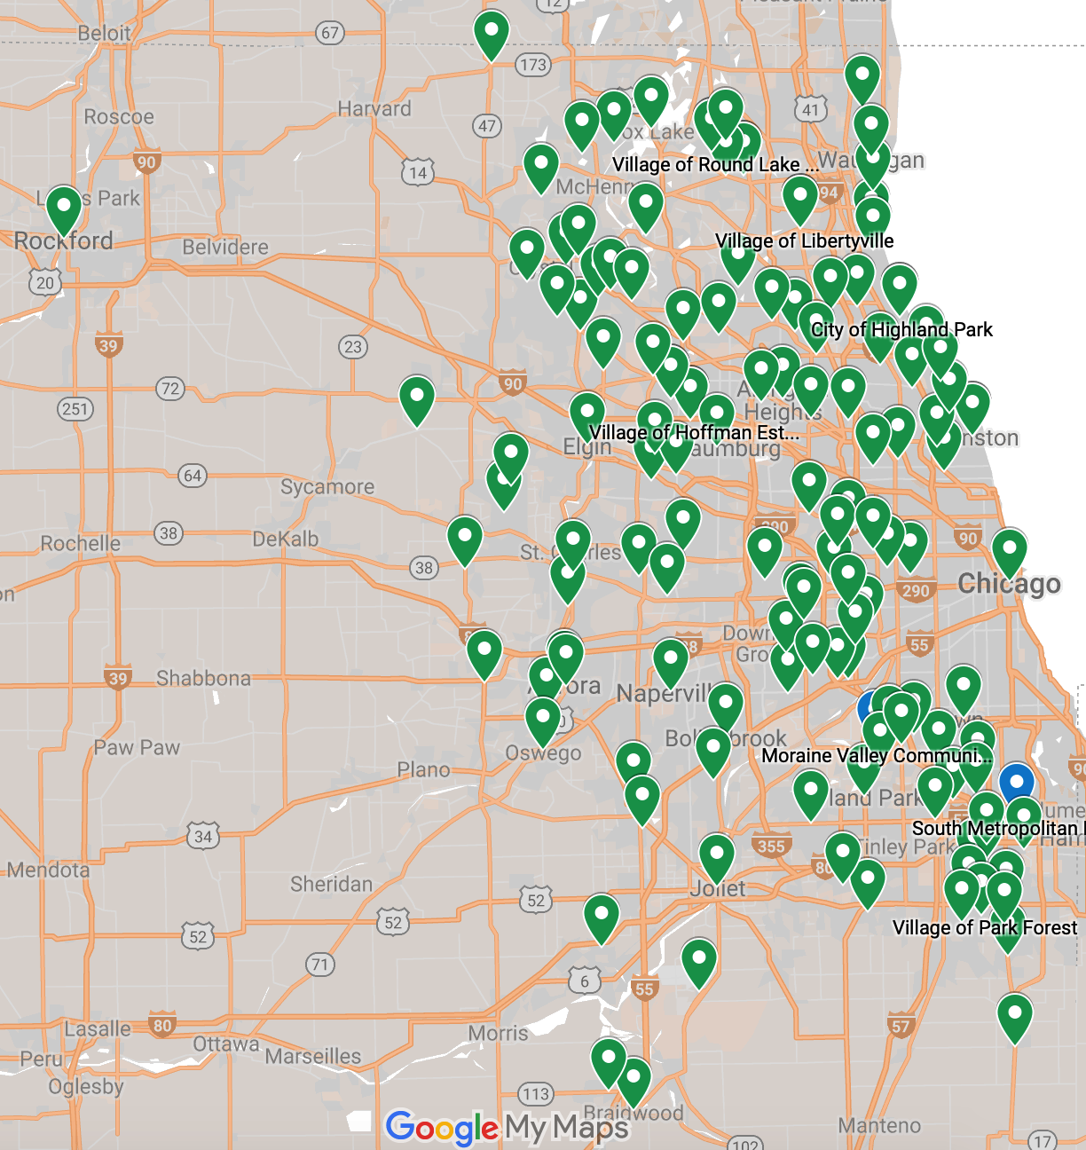
GRC Adopters
121 municipalities
3counties
10 COGS
Barrington Area Council of Governments
Lake County Municipal League
McHenry County Council of Governments
Metro West Council of Governments
Northwest Municipal Conference
South Suburban Mayors & Managers
Southwest Conference of Mayors
West Central Municipal Conference
Will County Government League
DuPage Mayors and Managers Conference

Slide 18
Part 2 - The GRC Framework
Compilation of all Common Objectives, Strategies
  Aligns with regional, national, global objectives
  Links to resources & existing programs
Can be the Framework for your own sustainability plan
No reporting or commitment required

Slide 19

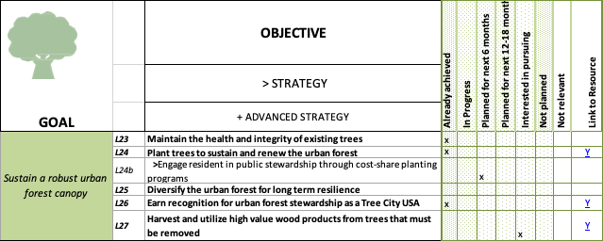
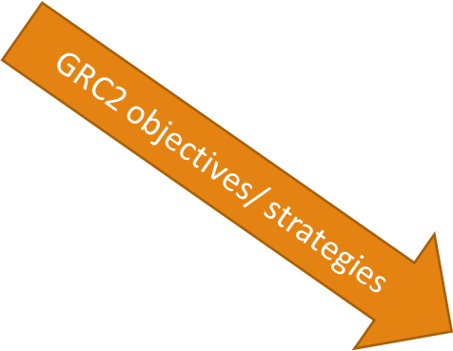


Slide 20
Part 3 –GRC Collaborative Programs
Collaborative programs to realize GRC goals regionally
Leverage municipal consensus
Grants
  Collaborative grant seeking
  Preferred to receive grants
Collaboration to address specific GRC goals

Slide 21



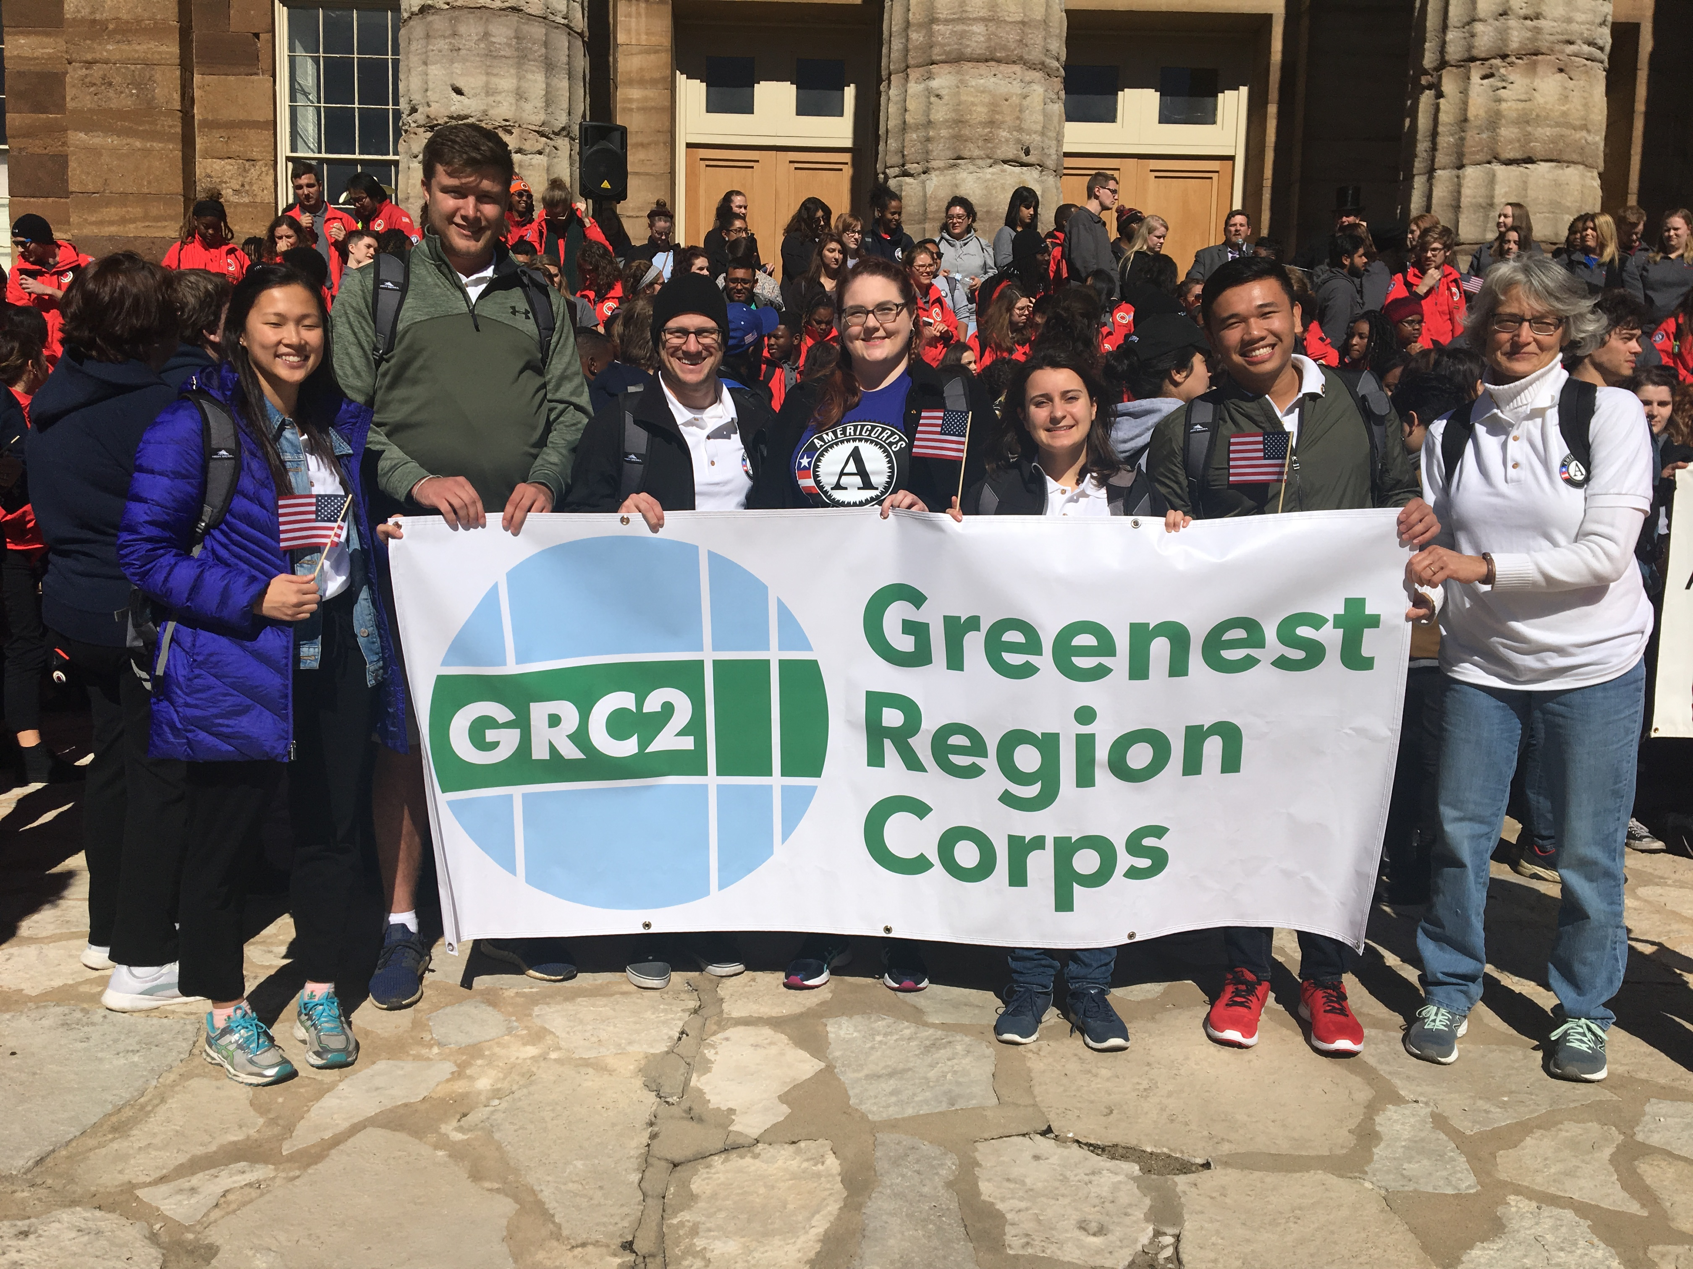
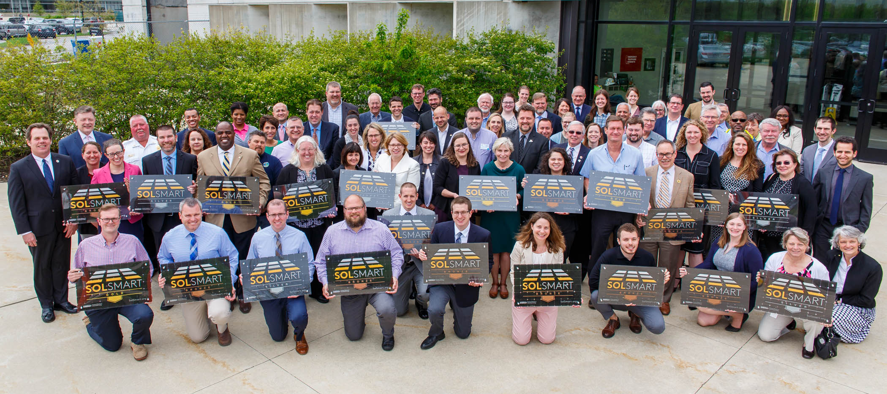
Addressing GRC Goals together
Advance renewable energy
Led 35 local gov’s to earn SolSmart by streamlining solar codes & policies making IL #1
Dedicate staff to sustainability initiatives

Slide 22
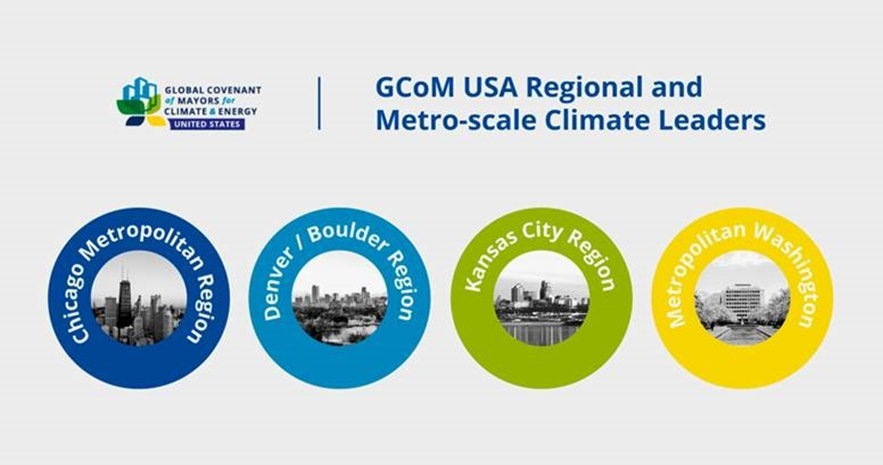
Part 3 –GRC Supportive Programs
Planned programs to realize GRC goals
  Track achievement of specific goals
  Regional greenhouse gas tracking & reporting
  Tiered recognition program

Slide 23
Joins us!
Edith Makra
Director of Environmental Initiatives
Metropolitan Mayors Caucus
312-201-4506
emakra@mayorscaucus.org
http://mayorscaucus.org/initiatives/environment/rec/

Slide 24
The GRC in Highland Park
A Fully Operational Sustainability Plan
Rob Sabo
Assistant City Manager
City of Highland Park
Grace Rink
President and CEO
Quercus Consulting

Slide 25
GRC in Highland Park
Metropolitan Mayor’s Caucus Environmental Committee
GRC Framework Workshop
July 18, 2019

Slide 26
Sustainability Achievements
Over 100 impactful sustainability achievements accomplished:
  Street light replacements with LED’s
  Phosphorous fertilizers and coal tar sealants bans
  Adoption of Environmentally Friendly Vehicles Policy and use of hybrid/electric vehicles in City fleet
  Created a Bike/Pedestrian Plan to improve connectivity and identify barriers to active modes of travel
  Provide alternative fuel infrastructure through electric vehicle charging stations
  Volume based “pay as you throw” refuse services and composting implemented with refuse hauler
  Recycling Center 1180 Half Day Road – textiles, clothing, shoes, electronics, #6 foam, batteries
  Launched Sustainable HP, online searchable map of local actions

Slide 27
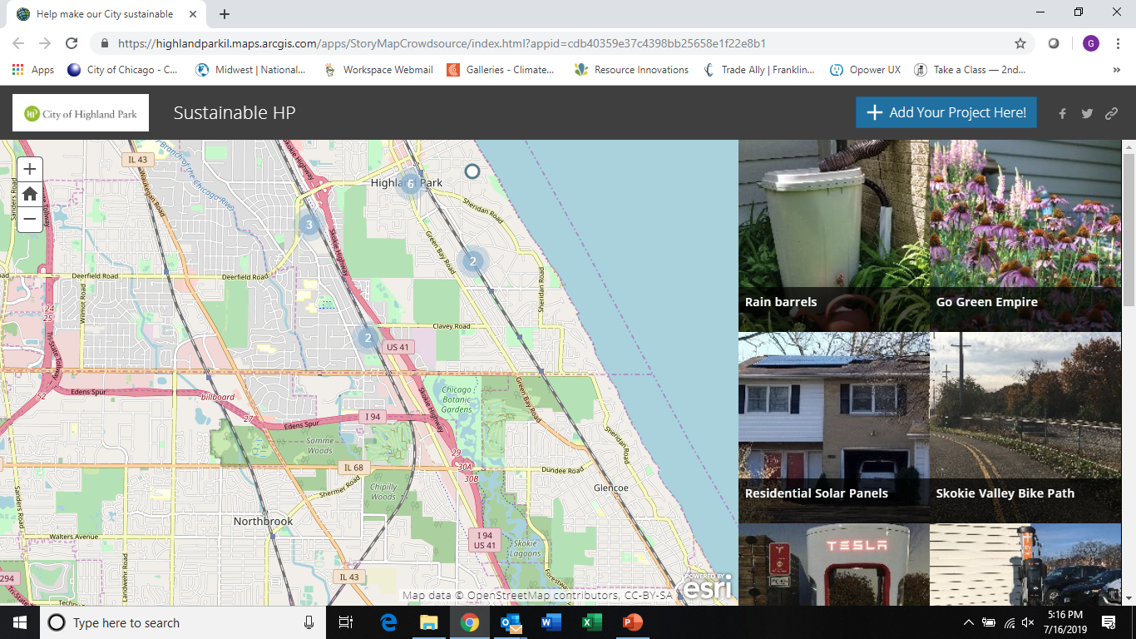
http://tiny.cc/aigt9y

Slide 28
Sustainability Plan Background
Metropolitan Mayors Caucus Greenest Region Compact I
  Approved August 13, 2007
20-Year Sustainability Plan (HarneTech LLC)
  Approved August 23, 2010
  Collaboration with Green Alliance
Metropolitan Mayors Caucus Greenest Region Compact II (“GRC2”)
  Approved May 23, 2016
SolSmart Designation
  Achieved SolSmart Bronze in 2018
3-Year Sustainability Plan
  2017-2019
  Updating now for 2020-2022

Slide 29
3-Year Sustainability Plan Components
Collaborative effort between staff, Sustainability Advisory Group*, and Green Alliance
Initiatives organized by categories:
  Communication
  Economic Development
  Energy
  Leadership
  Mobility
  Natural Areas
  Waste Management
  Water
*Formerly the Natural Resources Commission

Slide 30
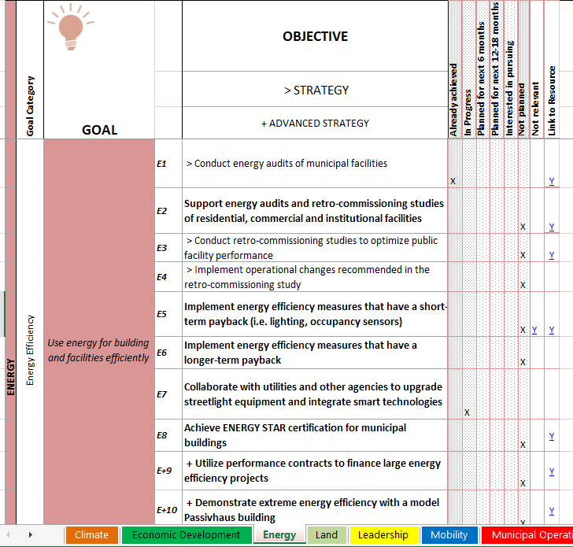
2010 SUSTAINABILITY PLAN
GRC2 WORKBOOK
SOLSMART CHECKLIST

Slide 31
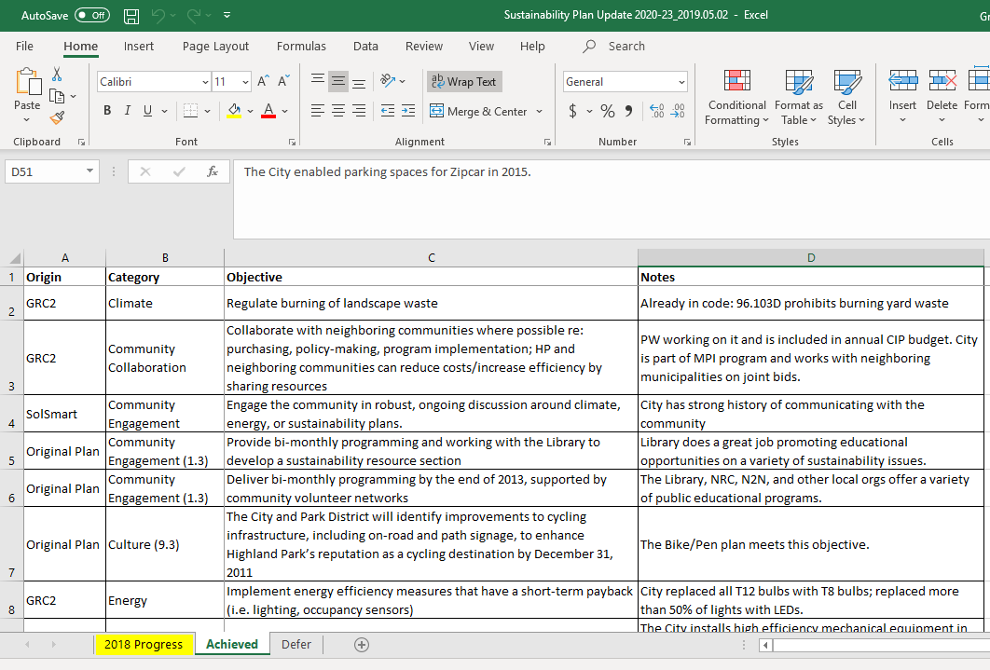

Slide 33

GRC in Highland Park
Rob Sabo
Assistant City Manager
City of Highland Park
847.926.1004
rsabo@cityhpil.com
Grace Troccolo Rink
President and CEO
Quercus Consulting
312.622.6265
grace.rink@quercusconsult.com

Slide 34
The Greenest Region Corps
Advancing Sustainability Goals in Highland Park
Katie Friedman
Greenest Region Corps - Sustainability Fellow
City of Highland Park

Slide 35

The Greenest Region Corps is a program to bring AmeriCorps volunteers into municipalities for a ten-month period to assist with a sustainability project of your choice.
Program Highlights
GRCorps Members are college graduates with sustainability expertise.
GRCorps Members dedicate full-time staff hours towards achieving the sustainability objectives of your community.
GRCorps stipends are funded by the Americorps grant and a municipal match.
GRCorps members are provided with ongoing training and professional development opportunities throughout their term of service.
Participating Communities
2018-2019
City of Highland Park
City of Evanston
Village of Hoffman Estates
Village of Libertyville
Village of Grayslake
Village of South Barrington
Village of Park Forest
Village of Round Lake Beach
Southern Metropolitan Higher Education Consortium (SMHEC)

Slide 36







Mobility
Researched the history and connectivity of HP bike paths
EV Charging Station Analysis and Recommendation
in the City of Highland Park
Climate
Municipal Operations
Global Covenant of Mayors
Supported Data Collection and Reporting
Drafted Resolution and Staff Report
Prepared Letter of Intent
Supported Sustainability Plan Update
Sustainable Communities
Economic Development
LEED for Cities Research
Backyard Chicken Keeping policy research and recommendations
Partnered with GGHP, SGA, IFSC, and MPP
Sustainable HP interactive online map
Supported local businesses in adopt better waste diversion practices
Promoted composting businesses and other green initiatives in the City
Waste and Recycling
Land
Researched state and federal regulations of pesticide application
Connected City Staff with Million Pollinator Garden Challenge
Supported Arbor Day event
Recycling and composting at City facilities
HP Composts Restaurant Composting project
Multi-family Recycling
Textile Recycling at HP train station
Promotion of residential composting

Slide 37
The GRC in Hoffman Estates
A Sustainability Plan Update
Kimberly White
Greenest Region Corps – Sustainability Coordinator
Village of Hoffman Estates

Slide 38

Using the GRC2 framework in Hoffman Estates
Kimberly White
Greenest Region Corps, Hoffman Estates

Slide 39
Planning with the GRC2
Establish the starting point and context
  Resident and business community, desired end product, department/staff lead
Use the framework to tally accomplishments
  Knowing where you are reveals where you can improve
Identify guiding principles
  Long-term vision, sets parameters for choosing objectives from the GRC2

Slide 40
Planning with the GRC2
Review existing documents and plans
  Capital Improvements and Comp. Plan may already incorporate GRC objectives
Choose objectives from the GRC2
  Applicable, achievable, supports the vision
Customize the objectives to fit your context

Slide 41
The GRC in Wilmette
Advocating for Sustainability and Adopting the Framework
Nancy Hoying
Co-President
League of Women Voters Wilmette

Slide 42

Building Community Commitment To Build A Sustainability Plan

Slide 43
About Wilmette….
Population 27,087; 9,742 households
Home rule community; Village President, Board of Trustees & Village Manager
Village members serve on boards & commissions; appointed by Village President
Environmental and Energy Commission (EEC):
  advisory body to the Village Board,
  provide advice and education on environmental and energy-related issues and is currently charged with creating a sustainability plan
20 Parks (188.3 acres) and 63 acres of lakefront parks
Notes:
Population is 27,087 with 9,742 households
Is a home rule community with a Village President and Board of Trustees elected at large and a Village Manager who runs the day to day operations of the Village
Over 100 Wilmette residents serve on 13 boards and commissions. The Village President appoints members to the boards and commissions with the approval of the Village Board
The Environmental and Energy Commission (EEC) is an advisory body to the Village Board, and its purpose shall be to provide advice and education on environmental and energy-related issues and is currently charged with creating a sustainability plan
Has 20 Parks (188.3 acres) and 63 acres of lakefront parks

Slide 44
About League of Women Voters of Wilmette….
24 Board of Directors and 200 current members
The League’s position on natural resources and the environment.
  preserve the physical, chemical, and biological integrity of the ecosystem, with maximum protection of public health and the environment
  promote an environment beneficial to life through the protection and wise management of natural resources in the public interest.
Participant in the Annual Conference of the Parties to the 1992 United Nations Framework Convention on Climate Change (UNFCCC), which formulated the Kyoto Protocol and negotiated the Paris Agreement.
LWV-US sends delegates to the UNFCC annually and our local league member, Rebecca Boyd has attended as a delegate in Poland in 2019.
LWV-IL and LWV-Wilmette have advocacy chairs and environmental teams working to provide ongoing advocacy on a local, state and national level.
Notes:
24 Board of Directors and 200 current members
The League’s support is based on our position on natural resources and the environment. Our position states, in part, to: 1) preserve the physical, chemical, and biological integrity of the ecosystem, with maximum protection of public health and the environment; and 2) promote an environment beneficial to life through the protection and wise management of natural resources in the public interest.
In accordance with the LWV position, the LWV has been a longstanding participant in the Annual Conference of the Parties to the 1992 United Nations Framework Convention on Climate Change (UNFCCC), which formulated the Kyoto Protocol and negotiated the Paris Agreement.
LWV-US sends delegates to the UNFCC annually and our local league member , Rebecca Boyd has attended as a delegate in Poland in 2019.
LWV-IL and LWV-Wilmette have advocacy chairs and environmental teams working to provide ongoing advocacy on a local, state and national level.

Slide 45
Education and Awareness Initiatives
Invite Board of Trustees to Attend Mayor’s Caucus (December 2017)
Letter campaign to encourage Wilmette join Climate Mayors and Endorse GRC2 (Spring 2018)
  Village President joins Climate Mayors and Village Board endorses sustainability effort and passes a resolution endorsing the Metropolitan Mayors Caucus’ GRC. (August, 2018)
Climate Action Event: Thinking Globally, Acting Locally co-sponsored by Go Green and LWV-Wilmette 100 attendees (February, 2019) Local community experts sign-up to offer assistance supporting EEC.
Go Green Environmental Fair: 100 exhibits and 1,500 guests, volunteers and exhibitors
Notes:
Invite Board of Trustees to Attend Mayor’s Caucus (December 2017)
Letter campaign asking Village Board of Trustees and Energy and Environmental Commission to join Climate Mayors and Endorse GRC2 (Spring 2018)
Village President joins Climate Mayors and Village Board endorses sustainability effort and passes a resolution endorsing the Metropolitan Mayors Caucus’ GRC. (August, 2018)
Climate Action Event: Thinking Globally, Acting Locally co-sponsored by Go Green and LWV-Wilmette 100 attendees (February, 2019) Local community experts sign-up to offer assistance supporting EEC.
Go Green Environmental Fair: 100 exhibits and 1,500 guests, volunteers and exhibitors

Slide 46
EEC Timeline/Process
Director of Environmental Initiatives, Metropolitan Mayors Caucus meets with EEC. (March, 2018)
EEC recommends the Village of Wilmette adopt the resolutions to join the GRC2. (July, 2018)
Greenest Region Process Discussion; Developing Consensus Goals. (October, 2018)
Benchmarking & best practice review; Delegate Commissioner focus area & align citizen experts (January, 2019).
Commissioners review and continue evolving ‘working draft.’
Goal is to have a working draft delivered to the EEC to consider this summer.
Notes:
Edith Makra, Director of Environmental Initiatives, Metropolitan Mayors Caucus meets with EEC. (March, 2018)
EEC recommends the Village of Wilmette adopt the resolutions to join the GRC2. (July, 2018)
Greenest Region Process Discussion. Decided that each commissioner to submit the 1-2 Consensus Goals that they wish to develop based on interest and expertise. (October, 2018)
Other municipality sustainability plans reviewed to determine format and process. Each Commissioner assigned a GRC Consensus Goal to work on and submit first draft. Each commissioner provided citizen experts to optionally use as support. (January, 2019).
Commissioners reviewed with the EEC the highlights of each submitted draft. Two commissioners assigned to create a “working draft” to compile drafts into a consistent format. Intent is to have a working draft delivered to the EEC to consider this summer.

Slide 47
Green Initiatives Show Promise
Composting program
Bike Program
Streetscape
Rain Ready
Coal Tar Ban
Gas-Powered Leaf Blower Ban
Solar Panel program
Business Certification Process
Storm Water Management

Slide 48
Moving Forward
Build on strong leadership commitment
Continue collaboration with community based alliances and partnerships
Continue to support Village of Wilmette staff
Promote initiatives and ideas to engage more community members
Show strength in numbers
Provide both incremental change ideas and transformational change ideas
See as a priority: Set consistent standard meeting times

Slide 49
Mentimeter #02
Top 3 GRC categories

Slide 50
GRC Framework Exercise
Jordan Francisco
Greenest Region Corps – Sustainability Advisor
Villages of Grayslake / Libertyville

Slide 51










Ten GRC Framework Categories
Notes:
Tell the audience to refer to the handout on the framework categories overview

Slide 52
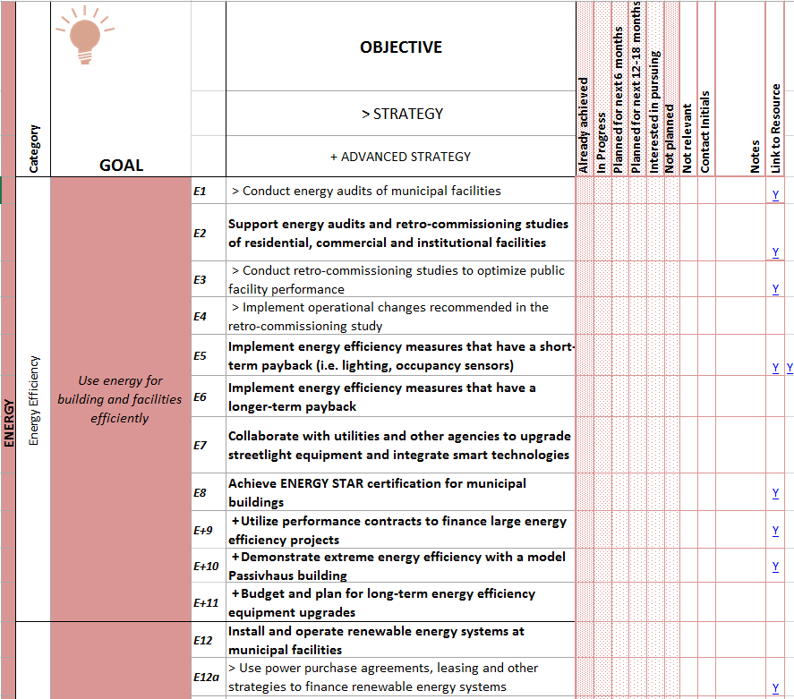

Notes:
In each of the ten sustainable categories, there are sub categories.

Slide 53
Notes:
Followed by specific goals that are letter, symbol, and number coded. The letter(s) are after the sustainability category, the symbol tells what kind of goal it is, and the number helps with organization.

Slide 54
Notes:
In this section, the main objectives are bolded, strategy objectives have a guillemet (gi-emi), while the advanced strategy objectives have plus sign and are also bolded.

Slide 55
Notes:
The final section is where your municipality can mark up the status of each objective. It’s important to note that if multiple contacts within a village are marking up the framework that they fill out the contact initials. There are also resource links to some of the objectives. You can also add your own links to refer back to.

Slide 56
Group Activity
Greenest Region Corps Facilitators
Andrew Brown, Village of Park Forest
Tom Cordell, Village of South Barrington
Jordan Francisco, Village of Grayslake/Libertyville
Kimberly White, Village of Hoffman Estates
Katie Friedman, City of Highland Park

Slide 57
Mentimeter #03
What did you find helpful?

Slide 58
Thank you for participating!

