Slide 1
Mentimeter #01
Visit https://www.menti.com/

Slide 2
The GRC Framework In Use
Metropolitan Mayors Caucus
Environment Committee Meeting
Village of Grayslake
August 6, 2019
Notes:
Welcome and introductions

Slide 3
Welcome to the Village of Grayslake
Chase Muscato
Management Analyst, Village of Grayslake
Notes:
Welcome and introductions

Slide 4
Greenest Region Compact Overview
Edith Makra
Director of Environmental Initiatives
Metropolitan Mayors Caucus

Slide 5
GRC FRAMEWORK WORKSHOP
EDITH MAKRA, METROPOLITAN MAYORS CAUCUS
JULY 18, 2019

Slide 6
Overview
Building the GRC
The GRC in 3 parts
Compact
Framework
Collaborative programs to advance GRC goals

Slide 7
GRC Goal
To align environmental issues, resources, and actions at the local, regional and national levels to guide municipalities to achieve greater environmental sustainability.
Notes:
Ostenburg
Ok to read the goal –
Bottom line.
We have to work together and strategically.
Not enough resources to get much done without aligning efforts

Slide 8
Building the GRC

Slide 9
Building the GRC
1. What is already underway in the region?
2. What existing programs will be helpful?
TO ANSWER THOSE QUESTIONS -
Inventoried environmental achievements for 290 municipalities

Slide 10
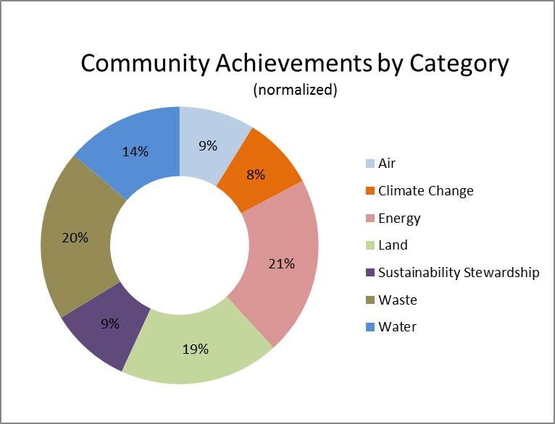
Environmental Achievements by Category
Notes:
Edith
Normalized – land achievements nearly 30%
Normalized for dominance of land and scarcity of waste achievements

Slide 11
Which communities are sustainable?
9%
71%
1%

Slide 12
Building the GRC2
What is already planned?
What are common priorities?
TO ANSWER THOSE QUESTIONS -
Analyzed existing sustainability plans
30 local plans
9 regional/national plans
1149 specific sustainability goals

Slide 13
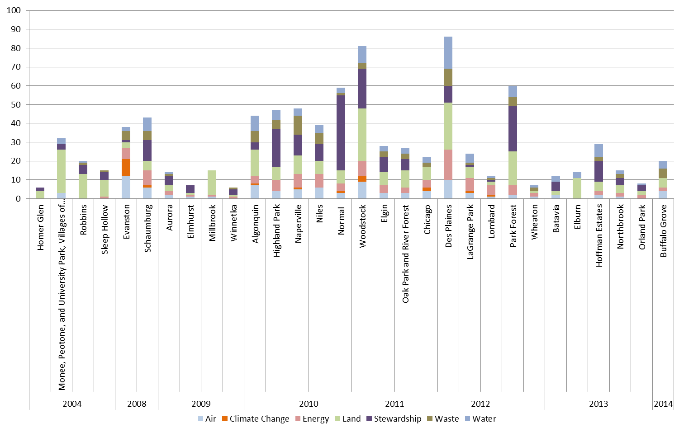
ALL LOCAL SUSTAINABILITY PLANS IN GRC
*based on GRC+2 categories

Slide 14
Putting it all together
CONSENSUS GRC GOALS

Slide 15
Consensus GRC Goals
From ALL Sustainability Goals
To GRC Goals

Slide 16
Greenest Region Compact
CONSENSUS SUSTAINABILITY FOR COMMUNITIES AND THE REGION
IN THREE PARTS

Slide 17
Part 1
The Compact – Just Goals

Slide 18
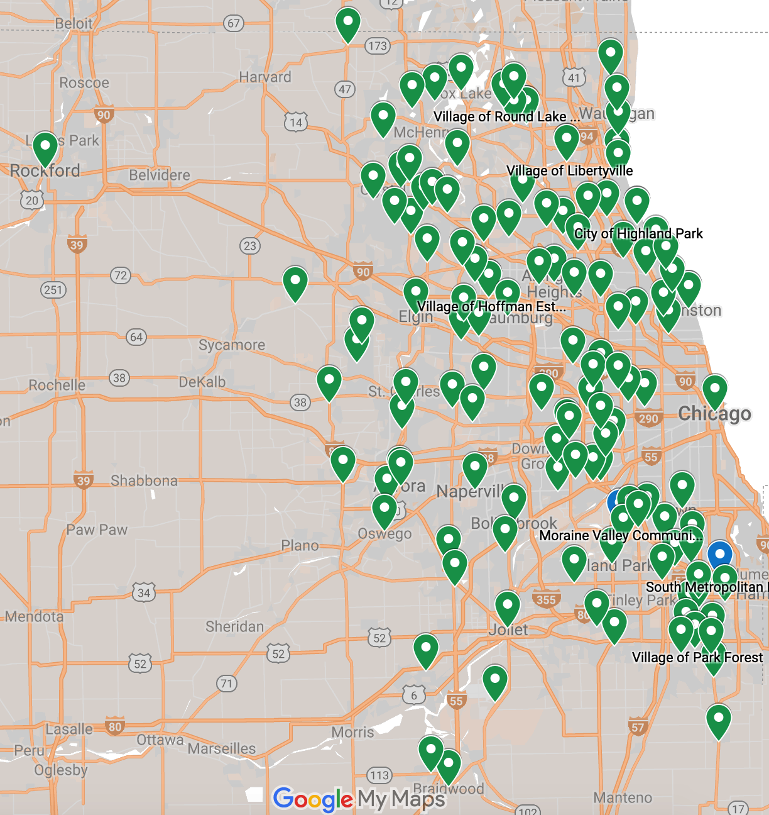
GRC Adopters
121 municipalities
3counties
10 COGS
Barrington Area Council of Governments
Lake County Municipal League
McHenry County Council of Governments
Metro West Council of Governments
Northwest Municipal Conference
South Suburban Mayors & Managers
Southwest Conference of Mayors
West Central Municipal Conference
Will County Government League
DuPage Mayors and Managers Conference

Slide 19
Part 2 - The GRC Framework
Compilation of all Common Objectives, Strategies
Aligns with regional, national, global objectives
Links to resources & existing programs
Can be the Framework for your own sustainability plan
No reporting or commitment required

Slide 20
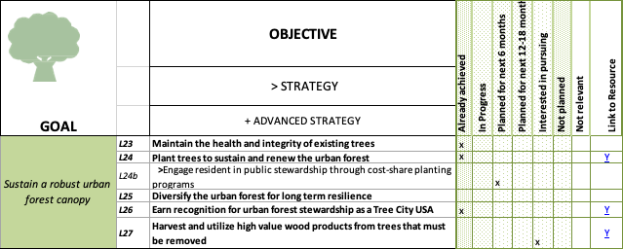
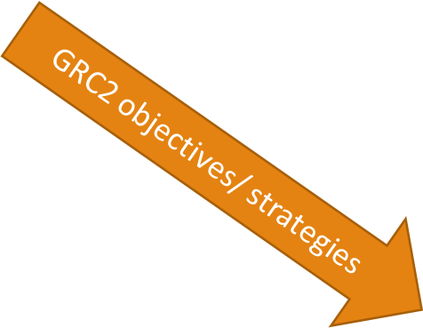

Slide 21
Part 3 –GRC Collaborative Programs
Collaborative programs to realize GRC goals regionally
Leverage municipal consensus
Grants
Collaborative grant seeking
Preferred to receive grants
Collaboration to address specific GRC goals

Slide 22
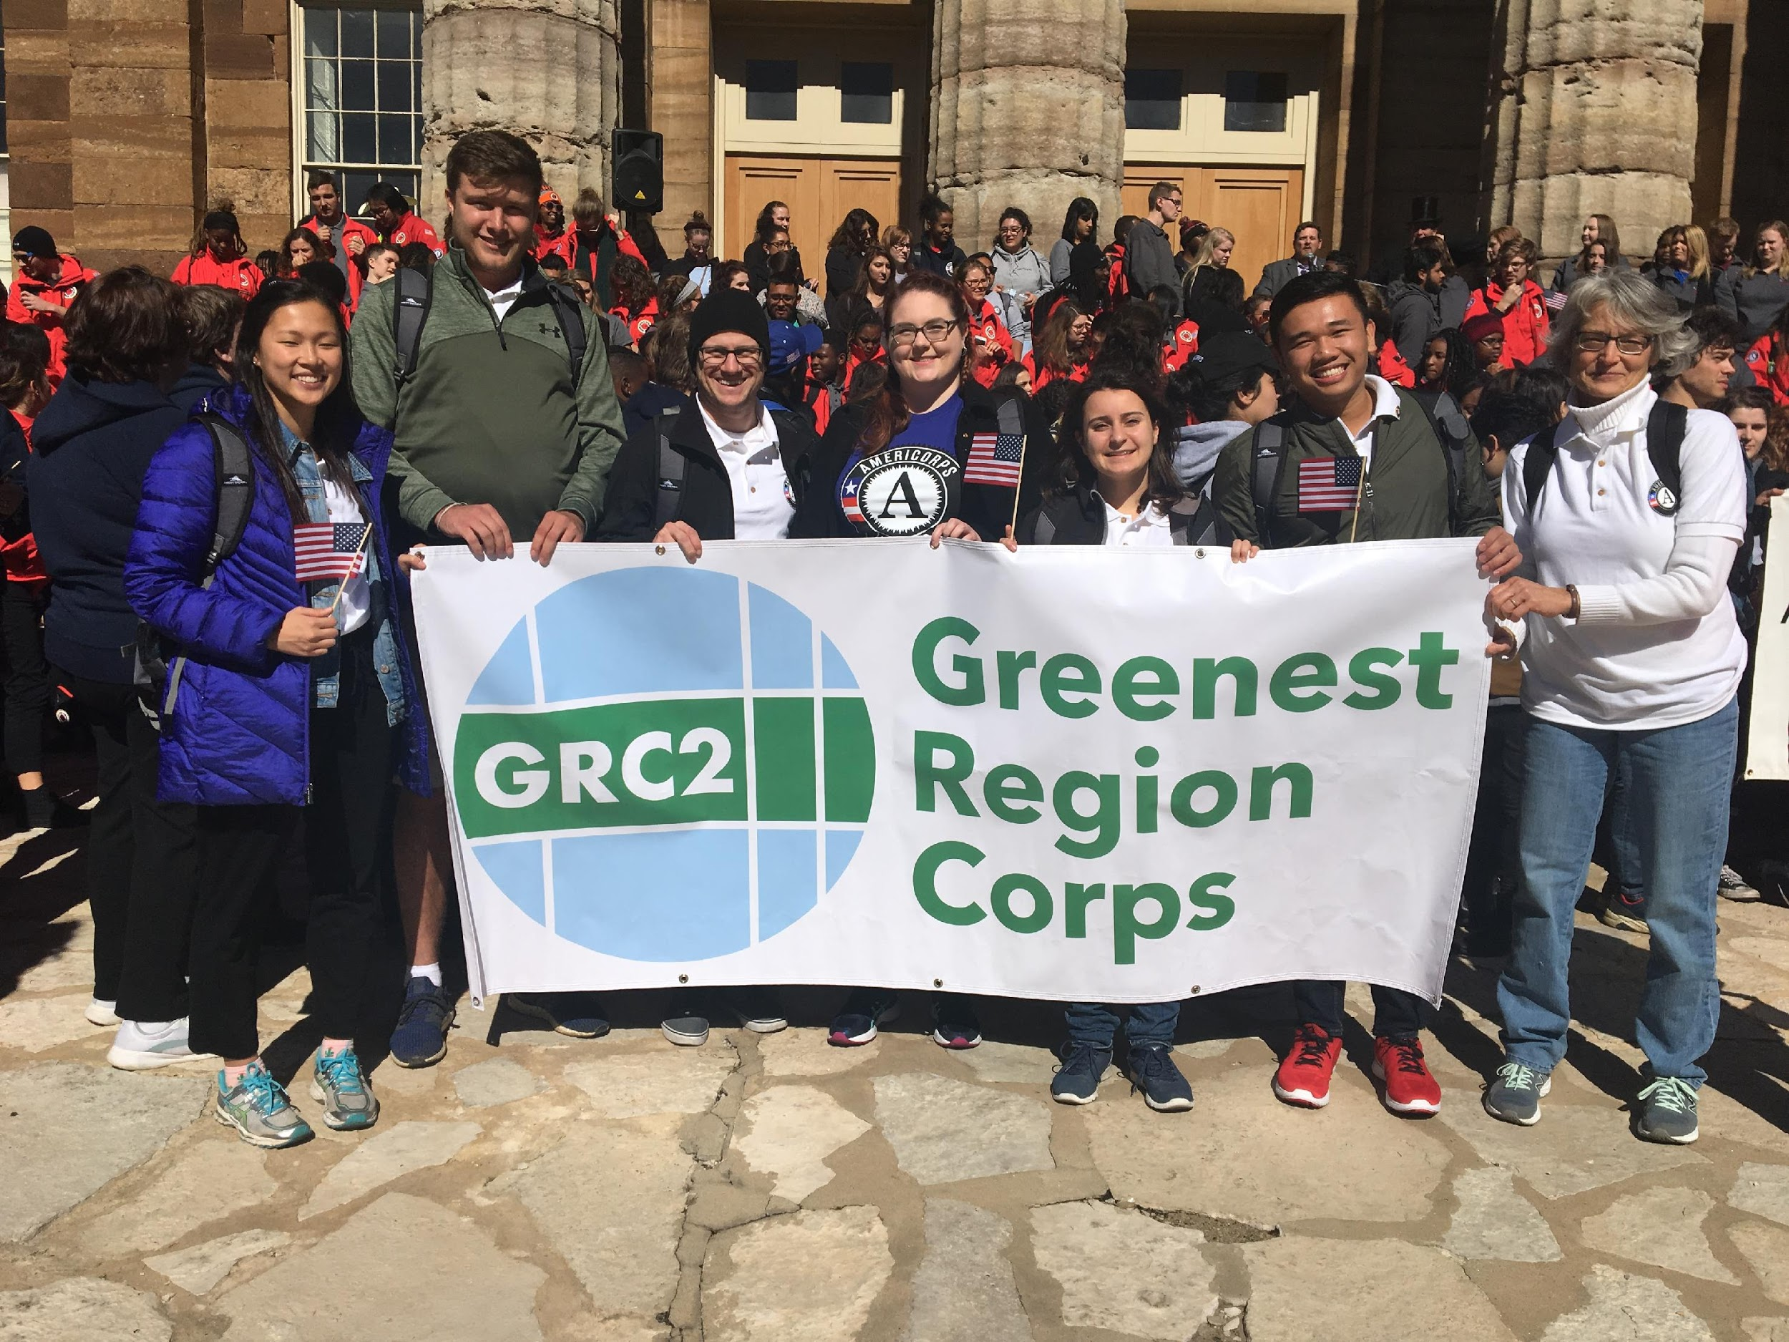
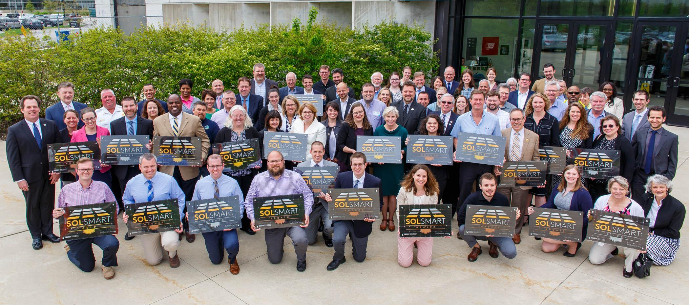
Addressing GRC Goals together
Advance renewable energy
Led 35 local gov’s to earn SolSmart by streamlining solar codes & policies making IL #1
Dedicate staff to sustainability initiatives

Slide 23
Part 3 –GRC Supportive Programs
Planned programs to realize GRC goals
Track achievement of specific goals
Regional greenhouse gas tracking & reporting
Tiered recognition program

Slide 24
Joins us!
Edith Makra
Director of Environmental Initiatives
Metropolitan Mayors Caucus
312-201-4506
emakra@mayorscaucus.org
http://mayorscaucus.org/initiatives/environment/rec/

Slide 25
The Greenest Region Corps Advancing Sustainability Goals in Chicago Region
Jordan Francisco
Greenest Region Corps - Sustainability Advisor Villages of Grayslake and Libertyville

Slide 26
The Greenest Region Corps is a program to bring AmeriCorps volunteers into municipalities for a ten-month period to assist with a sustainability project of your choice.
GRCorps Projects
Educating Residents and Businesses on Recycling/Composting
Tree Inventory (Emerald Ash Borer damage and tree replacements)
Community Events Coordinator
Residential Chicken Coop Ordinance
Sustainability Planning
Village wide LEED Certification
Wetland Restoration
Participating Communities
2018-2019
City of Highland Park
City of Evanston
Village of Hoffman Estates
Village of Libertyville
Village of Grayslake
Village of South Barrington
Village of Park Forest
Village of Round Lake Beach
Southern Metropolitan Higher Education Consortium (SMHEC)

Slide 27
Program Highlights
GRCorps Members are college graduates with sustainability expertise.
GRCorps stipends are funded by the Americorps grant and a municipal match.
GRCorps Members dedicate full-time staff hours towards achieving the sustainability objectives of your community.
GRCorps members are provided with ongoing training and professional development opportunities throughout their term of service.

Slide 28
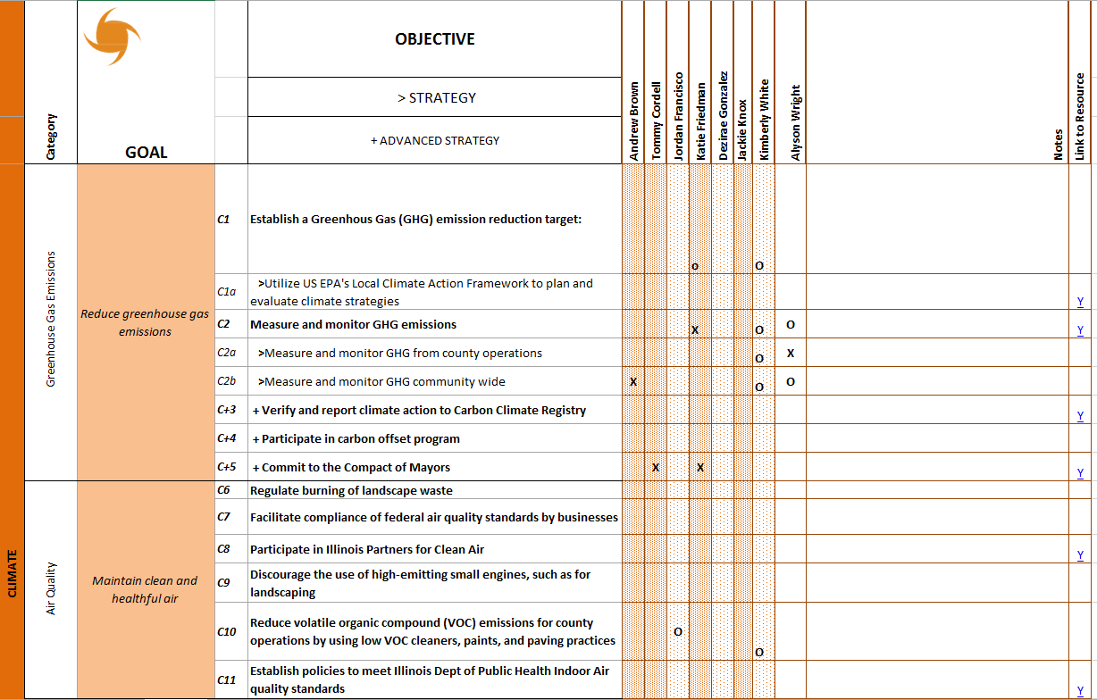
GRCorps Framework Accomplishments
Individually, GRCorps members have completed 168 objectives and are in progress with 172 objectives.
Out of the 52 total goals, 39 are completed and 12 are in progress.
x = completed
o = in progress

Slide 29
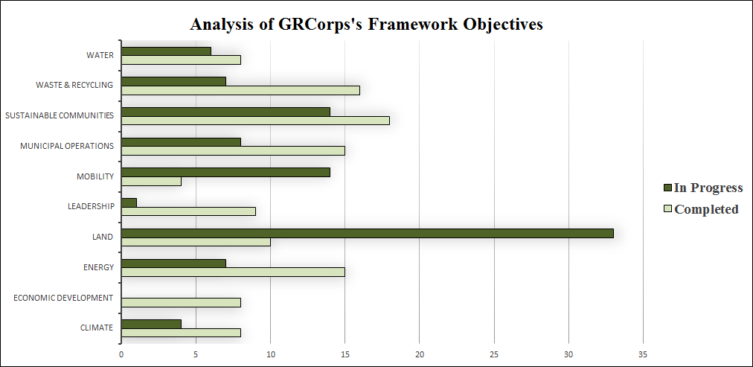
421 Total Objectives in the Framework
GRCorps has completed 111 objectives and have 94 objectives in progress (worked on 48% of the framework)
Top Three Completed Categories: Leadership (90%), Municipal Operations (69.7%), and Waste & Recycling (67.6%)

Slide 30
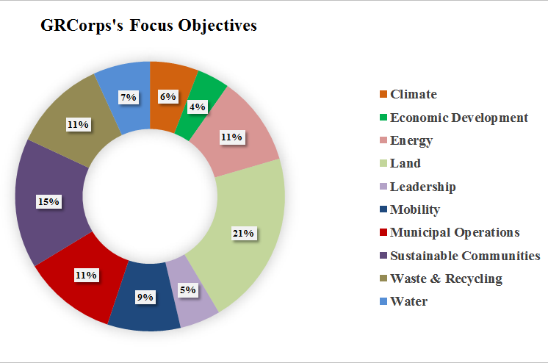
205 objectives completed or in progress
1. Land, 43 objectives
2. Sustainable Communities, 32 objectives
3. Waste & Recycling and Municipal Operations, 23 objectives

Slide 31
Sustainability Planning Using the GRC Framework
Grayslake Village Hall August 6, 2019
Karen Ann Miller, AICP
Executive Planner
Kane County Development Department
millerkaren@co.kane.il.us

Slide 32
The Fox Valley Sustainability Network brings together the public and private sectors from around the Fox Valley to cut across boundaries and create a healthy, sustainable and vibrant Fox Valley.

Slide 33
GRC Framework
Analysis

Slide 34
GRC Framework
Analysis
Kane County Departments
◆ Environmental Management
◆ Planning Division
◆ Water Resources
◆ Office of Emergency Management
◆ Health Department
◆ Department of Transportation
◆ Forest Preserve District
◆ Facilities Department
◆ Historic Preservation
◆ Office of Community Reinvestment

Slide 35
GRC Framework
Analysis

Slide 36
GRC Framework
Analysis Results
Category | Already Achieved | In Progress | Interested in Pursuing | TOTAL Goals in Category | % of Goals Already Achieved or In Progress
Climate | 5 | 4 | 3 | 21 | 43%
Economic Development | -- | 4 | 5 | 12 | 33%
Energy | 13 | 7 | 9 | 37 | 54%
Land | 32 | 39 | 7 | 83 | 86%
Leadership | 10 | -- | -- | 11 | 91%
Mobility | 18 | 11 | 2 | 34 | 85%
County Operations | 11 | 12 | 1 | 32 | 72%
Sustainable Communities | 15 | 6 | 9 | 41 | 51%
Waste & Recycling | 14 | 4 | 5 | 31 | 58%
Water | 33 | 14 | 5 | 62 | 76%

Slide 37
GRC Framework
Endorsement – First County

Slide 38
GRC Framework
Analysis Results
Category | Already Achieved | In Progress | Interested in Pursuing | TOTAL Goals in Category | % of Goals Already Achieved or In Progress
Climate | 5 | 4 | 3 | 21 | 43%
Economic Development | -- | 4 | 5 | 12 | 33%
Energy | 13 | 7 | 9 | 37 | 54%
Land | 32 | 39 | 7 | 83 | 86%
Leadership | 10 | -- | -- | 11 | 91%
Mobility | 18 | 11 | 2 | 34 | 85%
County Operations | 11 | 12 | 1 | 32 | 72%
Sustainable Communities | 15 | 6 | 9 | 41 | 51%
Waste & Recycling | 14 | 4 | 5 | 31 | 58%
Water | 33 | 14 | 5 | 62 | 76%

Slide 39
Karen Ann Miller, AICP
Executive Planner
Kane County Development Department
millerkaren@co.kane.il.us

Slide 40
The GRC in Hoffman Estates A Sustainability Plan Update
Kimberly White
Greenest Region Corps – Sustainability Coordinator
Village of Hoffman Estates

Slide 41
Using the GRC Framework in Hoffman Estates
KIMBERLY WHITE
GREENEST REGION CORPS, HOFFMAN ESTATES

Slide 42
Planning with the GRC
Establish the starting point and context
Resident and business community, desired end product, department/staff lead
Use the framework to tally accomplishments
Knowing where you are reveals where you can improve
Identify guiding principles
Long-term vision, sets parameters for choosing objectives from the GRC2

Slide 43
Planning with the GRC
Review existing documents and plans
Capital Improvements and Comp. Plan may already incorporate GRC objectives
Choose objectives from the GRC2
Applicable, achievable, supports the vision
Customize the objectives to fit your context

Slide 44
Mentimeter #02
Top 3 GRC categories

Slide 45
GRC Framework Exercise
Jordan Francisco
Greenest Region Corps – Sustainability Advisor
Villages of Grayslake / Libertyville

Slide 46
Ten GRC Framework Categories
Notes:
Tell the audience to refer to the handout on the framework categories overview

Slide 47
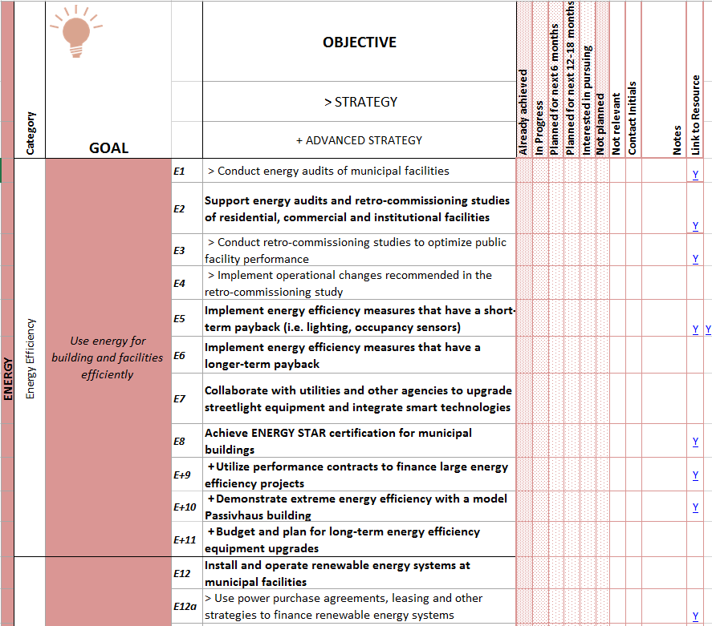
Notes:
In each of the ten sustainable categories, there are sub categories.

Slide 48
Notes:
Followed by specific goals that are letter, symbol, and number coded. The letter(s) are after the sustainability category, the symbol tells what kind of goal it is, and the number helps with organization.

Slide 49
Notes:
In this section, the main objectives are bolded, strategy objectives have a guillemet (gi-emi), while the advanced strategy objectives have plus sign and are also bolded.

Slide 50
Notes:
The final section is where your municipality can mark up the status of each objective. It’s important to note that if multiple contacts within a village are marking up the framework that they fill out the contact initials. There are also resource links to some of the objectives. You can also add your own links to refer back to.

Slide 51
JF
JF
JF
JF
JF
JF
JF

Slide 52
JF
JF
JF
JF
JF
JF
JF

Slide 53
Additional Framework Tip
Keep track of your achieved, in progress, and future goals.

Slide 54
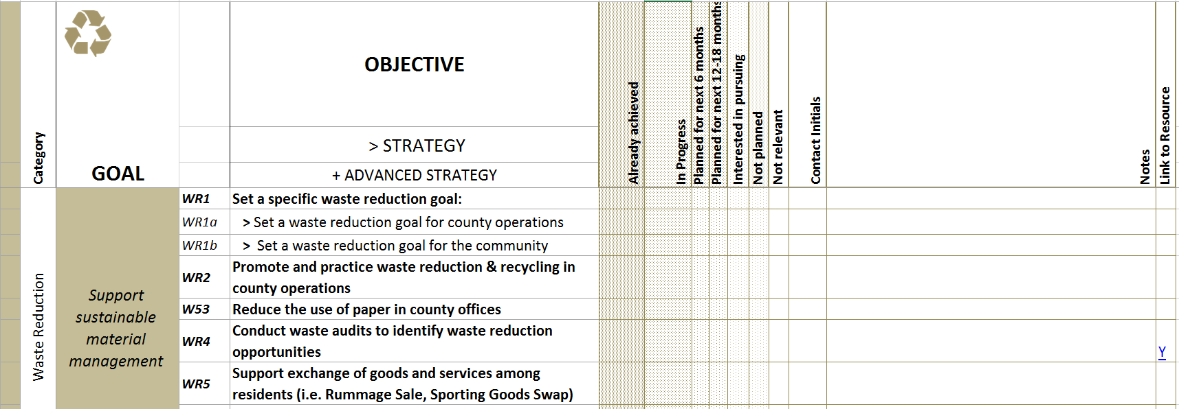
Additional Tips
Change the time frame to better suit your community’s needs.
Use shorter time frames for continual reviewing of your sustainability plan.

Slide 55
Filling out the Framework
Method #1:
Have the directors fill out sections of the framework.
Method #2:
Have a planner, commission, or one person fill out the framework.
Method #3:
Get groups of Village employees within a department and go over specific categories.
Notes:
Welcome and introductions

Slide 56
Method #1:
Have the directors fill out sections of the framework.
&
Method #3:
Get groups of Village employees within a department and go over specific categories.
Important to have a designated Framework leader present at the time of filling out.
-Meet with directors or groups
-Take notes
Notes:
Welcome and introductions

Slide 57
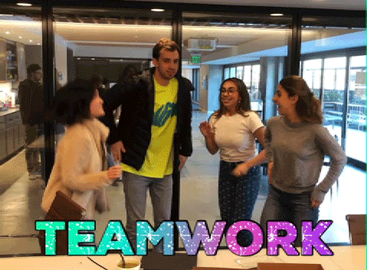
Framework In Use Summary
The GRC Framework is a living document that is customisable.
Find key players to fill out the framework.
Keep organized
Mark initials
Take notes
Collaboration is Key

Slide 58
Mentimeter #03
What did you find helpful?

Slide 59
