Slide 1

Center for Urban Resilience and Environmental Sustainability
(CURES)

Slide 2
CURES Expertise
Urban Resilience and Environmental Sustainability
University of Illinois Subject Matter Experts
Research, Education and Engagement
Global Change
Resource Provisioning
Economic Prosperity
Equity & Justice
Health

Slide 3
CURES Mission & Goals
MISSION
CURES works closely with cities and stakeholders to develop integrated sustainable solutions to improve community-wide health and prosperity now and in the future
GOAL
Help cities/ stakeholders meet key sustainability challenges
Problem-driven and solutions-oriented focus
Utilize a diverse set of tools to shape a critical set of interconnected urban systems

Slide 4
CURES Urban Resilience & Sustainability Solutions
Perform
  Analyses that are
  integrated across systems
Establish
  Educational programs
  and community
  programs
Foster
  Collaborations with cities
  to help them with the
  issues that matter most
Engage
  Research for sustainable
  practices and innovations
Develop
  Partnerships with
  universities, research
  institutions, and public
  and private entities
Leverage
  Emerging technologies to
  improve urban resiliency
  and sustainability

Slide 5
Critical Systems Interaction Approach
Energy Management & Access
Transportation & Mobility
Water & Sanitation
Waste & Recycling
Housing and Neighborhoods
Land & Natural Systems
Health

Slide 6
Diverse Tools and Techniques
Planning
Finance
Technology
Public-Private Partnership
Policy
Infrastructure
Entrepreneurship

Slide 7










Team
Founders
  Don Wuebbles (Director), Amy Ando, Elizabeth Kocs, Ann-Marie Hanson
Executive Leadership Team
  Moira Zellner, Tim Lindsey, Tom Theis, Cynthia Klein-Banai, Ken Kriz
60+ Member UofI System Leadership Committee
Collaborators and Partnerships

Slide 8




CURES Projects
NSF – CURES Connections
Interactive workshop to establish new multi-disciplinary multi-stakeholder research network to deliver actionable research-based on cost-effective solutions for urban communities of many sizes
FACT-B Chicago – French American Climate Talks – Biodiversity Panel of French and American experts discuss the challenges facing biodiversity and the changes to ensure the continuity of our ecosystems.
iSEE - CyberGIS for Urban Sustainability
Develop innovative framework to diagnose & tackle complex urban challenges, integrating analysis, measurement, and modelling with novel cyberGIS
DPI – Activating CURES
Deliver operating infrastructure, curate analytical capacity, initiate a pilot project, cultivate relationships, identify funding paths
Network Growth, Capability Development, Core Functions

Slide 9
Strong Alignment between DPI and CURES
DPI Focal Points
CURES Focal Points
Energy Management & Access
Computing, Data, & Analytics
Transportation & Mobility
Water & Sanitation
Health and Wellness
Waste & Recycling
Food & Agriculture
Housing & Neighborhoods
Land & Natural Systems
Environment & Water
Health

Slide 10
Strong Alignment with MMC Issues
MMC Issues
CURES Focal Points
Air Quality
Alternative Fuel Solutions
Green Infrastructure
Clean Energy Strategies
Water Supply
Engaging Community in Sustainability
Home Owners Associations & Coops
Climate Mitigation & Resilience Planning
GRC Tracking and Reporting
Energy Management & Access
Transportation & Mobility
Water & Sanitation
Waste & Recycling
Housing & Neighborhoods
Land & Natural Systems
Health

Slide 11
CURES: Collaboration to Meet MMC Needs
CURES: The Right Expertise
CURES has the expertise to help MMC municipalities address their sustainability needs.

Slide 12
Website: http://leam.illinois.edu/CURES/
Primary Contacts:
Don Wuebbles wuebbles@illinois.edu
Amy Ando amyando@illinois.edu
Elizabeth Kócs ekocs@uic.edu
Anne-Marie Hanson ahans4@uis.edu

Slide 13

FOCUS AREAS FOR
PROJECT DEVELOPMENT
CURES: Collaboration to Meet MMC Needs
Edith Makra, Director of Environmental Initiatives, MMC
Kevin Burns, Chairman, MMC Environment Committee and Mayor, City of Geneva

Slide 14

1 Air Quality
Air pollution is worsening
Methane (potent GHG) is not adequately monitored
Inadequate monitoring & regulation
  Sterigenics & VW
Possible collaboration with Array of Things to monitor

Slide 15

2 Alternate Fuel Solutions
Municipal interest in greener fleets
Lack of knowledge about municipal fleet options
Markets favor private fleets
Fleet study
Regional fueling infrastructure planning

Slide 16
3 Green Infrastructure
Green Infrastructure top-ranked goal in GRC study
Partners addressing green infrastructure
  Calumet Stormwater Collaborative
  MWRD partnerships & grants
Support scaling-up green infrastructure initiatives

Slide 17
4 Clean Energy Strategies
Visible campaigns for 100% renewable energy pledges
Municipal strengths to address clean energy
  Policies (SolSmart, building energy codes)
  Partnerships (utility energy efficiency programs)
  Not just procurement
Barriers
  Franchise agreements
Community energy analysis & planning (CEST)
Solutions that leverage municipal strengths

Slide 18
5 Water Supply
State or federal leadership on water supply lacking
  Water 2050
Local governments must collaborate on their own
Water supply crises
  Shared water resources (Fox River)
  Joliet & Kankakee region
  Private well monitoring
Great Lakes water supply of increasing value
Support water supply planning & protection

Slide 19
6 Engaging Communities in Sustainability
Municipal commissions are locally effective
Commissions are not regionally connected nor supported
Engaged community is critical for resilience & social cohesion
Municipalities asked to do more with less
Better understand municipal commissions and leverage potential

Slide 20
7 Homeowners Associations
Homeowners associations (HOA) manage natural resources
  20% of residential land under HOA management
HOAs are local governance structure & community outside of the city
HOAs are not connected to one another, nor resources
Better understand HOAs and role in suburban sustainability

Slide 21
8 Climate
Greenhouse gas emission (GHG) tracking & climate action planning
Best strategies for mitigation
Tracking and reporting of actions towards GRC goals
Resilience

Slide 22
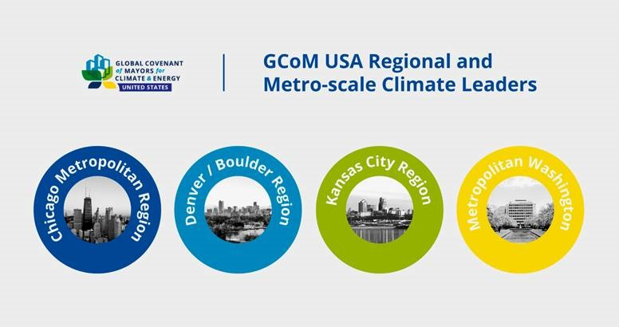
8 Regional Climate Planning

Slide 23


Regional Climate Plan
Build on existing GHG inventory
Set regional target
Assess regional risk & vulnerability
to climate change impacts
Include all municipalities in climate action planning
Adaptation plan

Slide 24
9 GRC Reporting & Tracking
  Develop GRC reporting and tracking system
    Recognize GRC community accomplishments
  Capture ‘practical’ sustainability measures
    i.e. warm-mix asphalt
  Integrate into climate action plan

Slide 25


Discussion
What are the most important urban sustainability
challenges CURES should address?
What research is needed?
What tools and assistance are needed?
How should CURES and MMC/GRC communities
work together?
How do we coordinate to help cities?
Industry
Foundations
Other partners

Slide 26


CURES + MMC: Next Steps
  CURES Connections Workshop: New Voices
  and Paths to Urban Sustainability
  Secure joint support from both organizations for coordination of efforts
  Identify funding pathways
  Develop partnerships with industry
  Set roadmap for projects

Slide 27
+

