Slide 1
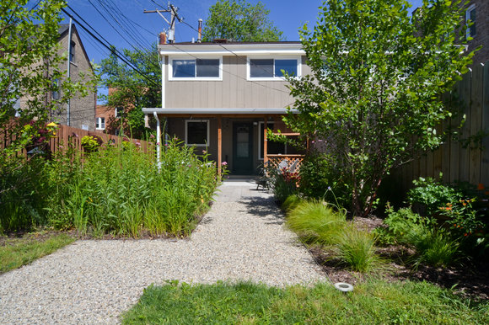

Stormwater Management 101
Green Infrastructure and other Recommendations For Preventing
Urban (Non-Riverine) Flooding
Hal Sprague | Center for Neighborhood Technology
Chicago, Illinois | July 19, 2016

Slide 2
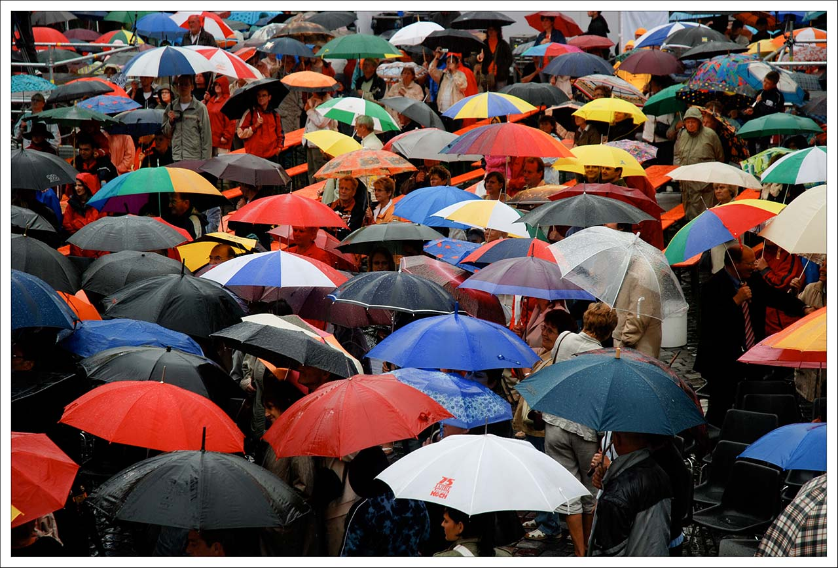

CNT
Innovations laboratory for urban sustainability
    Original research
    Services, tools & business ventures
    Policy Advocacy
Photo Credit: solidether (real name Michael Backhaus)/Flickr, Creative Commons License

Slide 3
Agenda
The Problem: Too much runoff from urban landscape – “urban flooding”
Consequences: Stream erosion; sewer overflows; pollution; flooding of streets, homes and businesses
Proposed solution: Green infrastructure
Specific retrofit strategy: “Green Infrastructure Portfolio Standard”

Slide 4
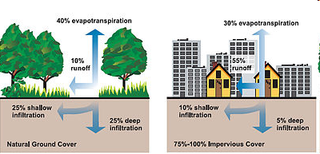
Urban Stormwater Runoff

Slide 5
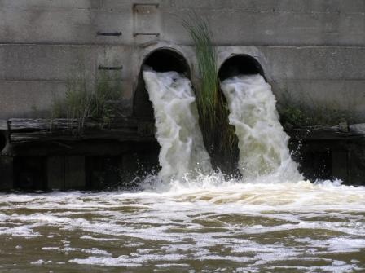
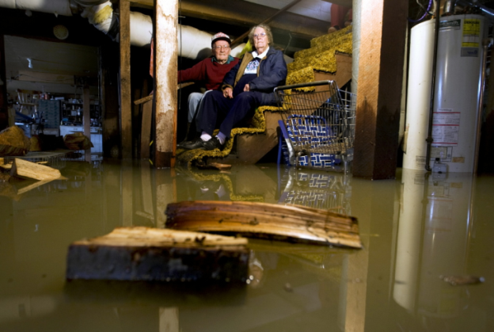
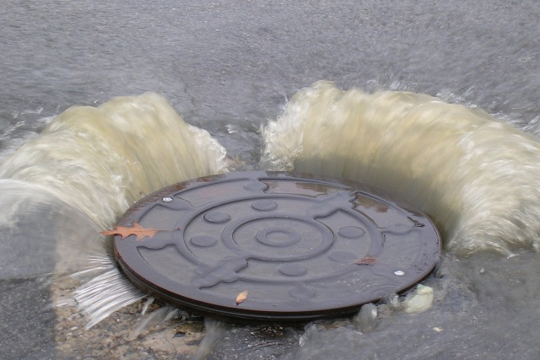
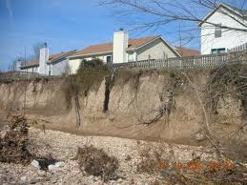

Some of the Consequences
CSO Pollution
Flooded Basements
Flooded Streets
Eroded Streams

Slide 6
What is the biggest problem?
It depends on who you ask!
CSO Pollution
Flooded Basements
Flooded Streets
Eroded Streams

Slide 7


Survey Sample: Urban Flooding
CNT Research (2012-14)
    Surveyed 30 most populous cities in Great Lakes region
    Interviewed flood victims
    Held community gatherings
    Analyzed claims paid out:
      FEMA Disaster Relief
      National Flood Insurance Program
      Private Insurance claims
      (2007-2011; data by zip code; Cook County)
Notes:
Urban flooding (cover of GL urban flooding report)
48 most populous cities in the Great Lakes region
30 responded: 63%.
They serve 23% of the total population of the Great Lakes states and province

Slide 8
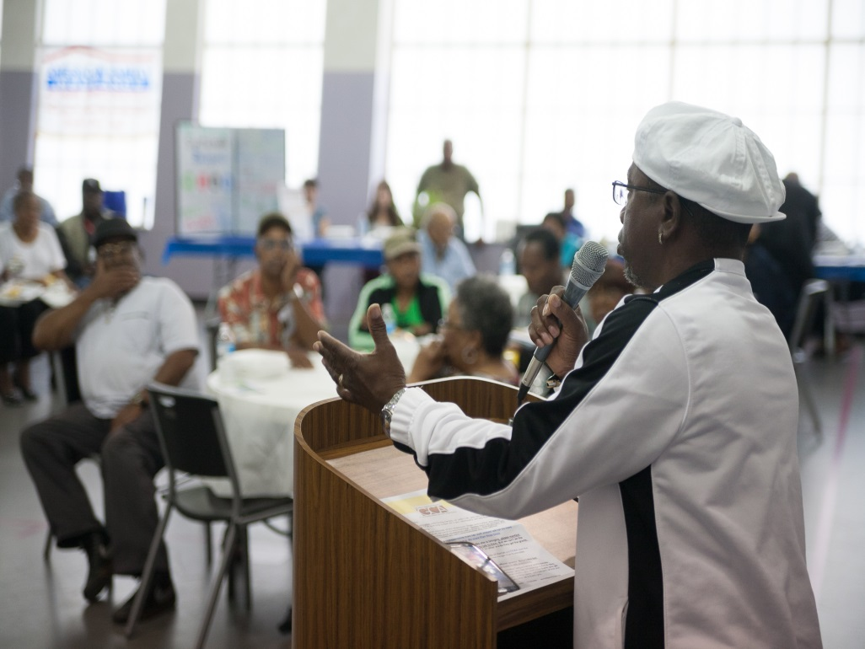
Notes:
Do we want each of these items to have its own slide/image?

Slide 9
Major Findings:
Claims in 97% of zip codes (900 sq.mi.; 130 communities)
>$770 Million over 5 years
Average pay-out > $4,000
Low income areas suffered most
Impacts included impaired health, property loss, lost time and wages
Most suffered repetitive losses
Remedial measures did not solve the problem
Large percentage of claims outside floodplain

Slide 10
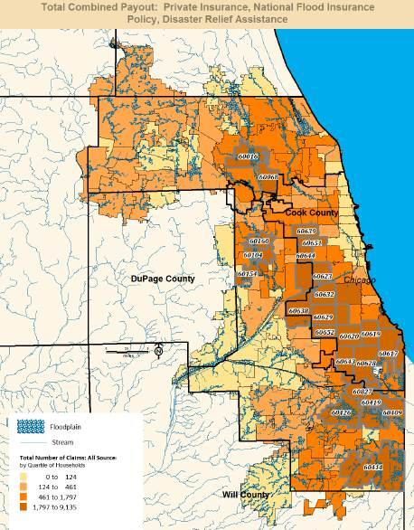
Large percentage of claims outside any designated floodplain?

Slide 11
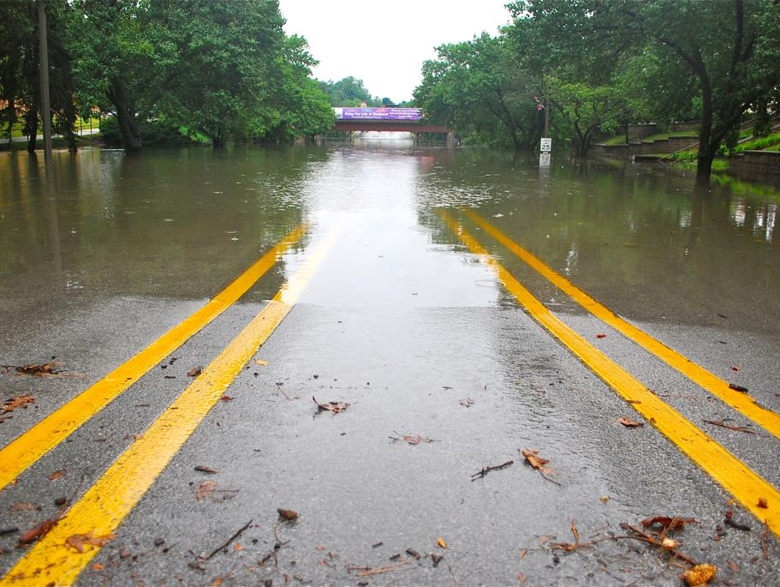

Urban flooding not caused by rivers overflowing,
but rather runoff from the urban
landscape overwhelming our sewers…
Why is this happening now?
Photo Credit: clarkmaxwell/Flickr, Creative Commons License
Notes:
Transparent charcoal box = RGB 38/38/38 @ 12% transparency
Title = RGB 242/242/242; Tw Cen MT size 44; all caps
Text box (title) = 1.68” x 8”
Horizontal distance from top left corner = .92”
Vertical distance from top left corner = 2.49”

Slide 12
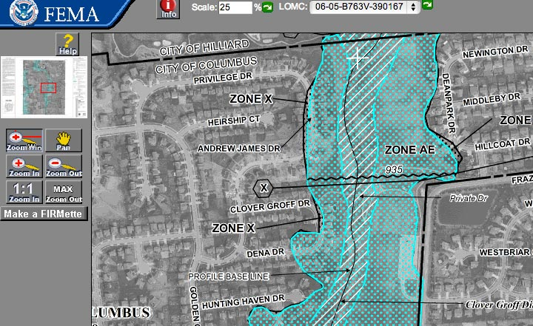
FEMA’s Approach to Flood Risk Analysis: Floodplain Mapping

Slide 13
Floodplain mapping (as a flood risk tool)
is less useful as the landscape
becomes more densely developed.
Photo Credit: clarkmaxwell/Flickr, Creative Commons License
Notes:
Transparent charcoal box = RGB 38/38/38 @ 12% transparency
Title = RGB 242/242/242; Tw Cen MT size 44; all caps
Text box (title) = 1.68” x 8”
Horizontal distance from top left corner = .92”
Vertical distance from top left corner = 2.49”

Slide 14

URBAN FLOODING AWARENESS ACT Illinois Legislature
Passed and signed into law August 2014.
Directed IL IDNR to conduct a study of urban flooding across the state, in consultation with other stakeholders.
Study used much more comprehensive set of private policy claim data; completed June 2015

Slide 15
Major finding:
>92% of all claims were
outside the floodplains!
33 Recommendations:
IL General Assembly (15)
IL Congressional Delegation (3)
Local Government (9)
State Government (6)

Slide 16
Recommendations for Local Government
Complete pre-disaster planning
Establish and enforce SW flow pathways
Implement property flood risk assessment programs
Adopt ordinances to encourage or require reduction in impervious surfaces, installation of green infrastructure
Consider real-time monitoring of CSSs
Update storm sewer atlas with size and design data
Participate in NFIP, CRS programs
Participate in IAFSM
Upgrade building code re below grade construction

Slide 17
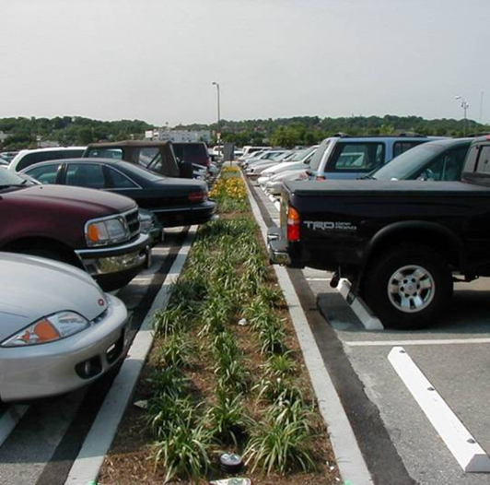
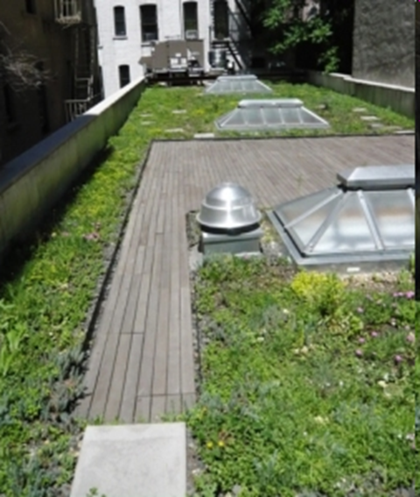
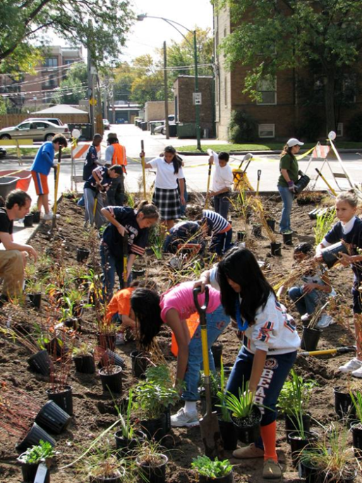
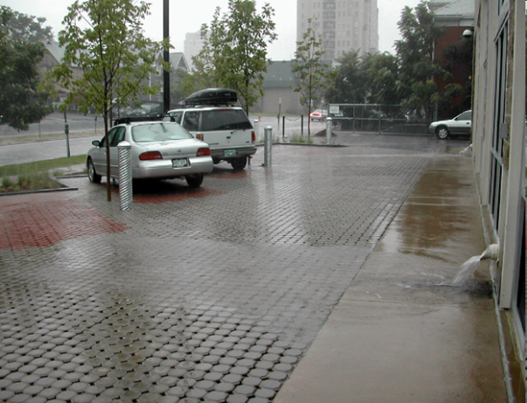
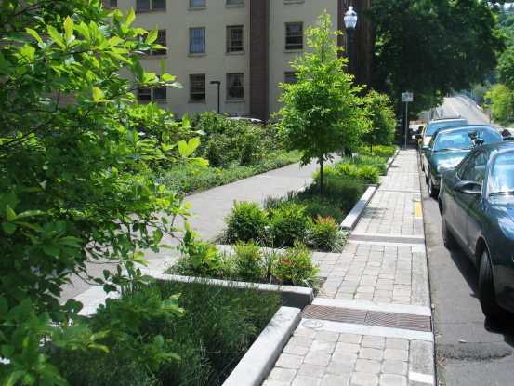
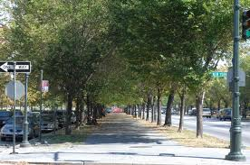
Green Infrastructure

Slide 18
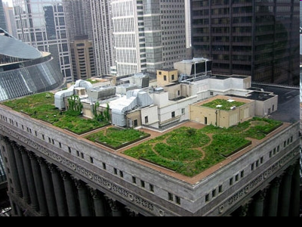
“Capturing rain drops where they fall”
Wet weather management practices that infiltrate, evapotranspirate or harvest rainwater, and at least partially restore the natural water cycle
An there are many other benefits to the community……

Slide 19
Green Infrastructure Co-Benefits
Energy savings
Air quality improvement
Cooling and shading
Increased property values (taxes)
Crime reduction
Development cost savings
Water quality improvement
Reduction in streambank erosion
Reduction in flooding
Reduction in sewer overflows
Reduction in waste water treatment

Slide 20
Cost-Effectiveness: Seattle SEA Streets
vegetated strips, no curbs = 11% reduction in impermeable surface
90+% runoff reduction
25% cost savings compared to conventional design

Slide 21

Strategies for Reducing Runoff
Stormwater ordinances with retention requirements –
apply only to new and re-development projects
Enforcement actions addressing CSOs and SSOs – often mandate costly grey infrastructure that takes many years to install; very disruptive and has only one benefit: stormwater management
We need a cost-effective approach to reducing runoff from existing developed land (retrofitting)
Notes:
<<in case you are using a footer or are making flyers>>

Slide 22
Green Infrastructure
Portfolio Standard
A planning and evaluation tool
for stormwater runoff retrofits
Can be implemented at the
county or local level
Notes:
<<in case you are using a footer or are making flyers>>

Slide 23
GIPS History:
Pilot Project (2011-2012…)
Partners: Center for Neighborhood Technology (CNT)
American Rivers
Great Lakes and St. Lawrence Cities Initiative
Funded by: USEPA Region V
Participating Cities: Milwaukee, Wisconsin
Grand Rapids, Michigan
Notes:
<<in case you are using a footer or are making flyers>>

Slide 24
What is a Green Infrastructure
Portfolio Standard?
The concept is adapted from the
“renewable energy portfolio standards”
that exist around the country (“RPS”)
Notes:
<<in case you are using a footer or are making flyers>>

Slide 25
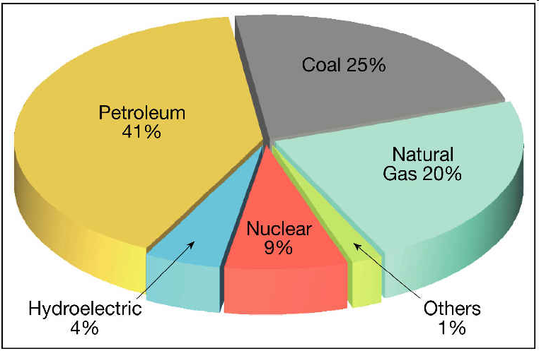
Renewable Energy
Portfolio Standard
Sources of Electrical Power
Notes:
<<in case you are using a footer or are making flyers>>

Slide 26
Renewable Energy Standards
OR: 25% by 2025 (large utilities)*
5% - 10% by 2025 (smaller utilities)
NY: 30% by 2015
PA: 18% by 2021
IL: 25% by 2026
VA: 15% by 2025*
AZ: 15% by 2025
State renewable portfolio standard
State renewable portfolio goal
From: Interstate Renewable Energy Council
Notes:
<<in case you are using a footer or are making flyers>>

Slide 27
Illinois RPS Requirements
Energy Year | Overall Standard (% of Retail Electricity Sales to come from Renewables)
2009 | 2%
2010 | 4%
2011 | 5%
2012 | 6%
2013 | 7%
… | …
2024 | 22.%
2025 | 23.5%
2026 | 25%
Notes:
<<in case you are using a footer or are making flyers>>

Slide 28

Stormwater Runoff Portfolio in an Urban Sewer Shed
Infiltrated into the soil
Discharged to the storm sewer, treatment plant, local waterway
Evaporated or transpired
Notes:
<<in case you are using a footer or are making flyers>>

Slide 29
Green Infrastructure
Portfolio Standard
Goal:
Gradually increase retention of stormwater runoff in developed areas using green infrastructure – reducing what goes into storm sewer.
Methods:
  Infiltration
  Evapotranspiration
  Harvesting for reuse
Notes:
<<in case you are using a footer or are making flyers>>

Slide 30
Some Benefits
Long-term program: 10 – 20 years or more
Small annual goals: 1% – 3% per year
Flexible: allows use of infiltration, evapotranspiration and harvesting water for reuse
Gives staff the ability to plan ahead, learn from experience, adjust
Cost effective way to make progress
Notes:
<<in case you are using a footer or are making flyers>>

Slide 31
GI Portfolio Standard Process
Step 0: Obtain Senior Management Buy-In
Step 1: Establish Task Force
Representation from: Planning; Engineering; Streets; Public Works; Forestry; Stormwater Management; Economic Development; Community Organizations; Business Organizations
Step 2: Select Project Areas
Milwaukee: 75 and 750 acres
Grand Rapids: 200 acres
“Sewer Sheds,” drainage areas
Notes:
<<in case you are using a footer or are making flyers>>

Slide 32
GI Portfolio Standard Process
Step 3: Determine Baseline Runoff Volume
Estimate total annual runoff volume into storm sewer system from project area (in gallons).
Step 4: Identify GI Projects
The Heart of the Program:
Task force identifies all projects (public and private) with potential to incorporate GI; prepare specific GI project designs; select most cost effective options
Notes:
<<in case you are using a footer or are making flyers>>

Slide 33
GI Portfolio Standard Process
Step 5: Calculate Retention Capacity of Projects
Determine percentage of the Baseline Volume
In Grd Rapids & Milwaukee: 1% - 3% of baseline
Step 6: GIPS Annual Goals
Set annual goals for 5, 10, 15 years
Step 7: Plan and Construct GI Projects
  Establish annual process
  Monitor, Measure, Record, Report
Notes:
<<in case you are using a footer or are making flyers>>

Slide 34
Milwaukee
GIPS Project
Site Selection: used GIS to identify sewer shed where runoff could be reduced to mitigate flooding effects downstream.
GI Projects: green roofs, bioswales, porous pavement, rainwater harvesting
Notes:
<<in case you are using a footer or are making flyers>>

Slide 35
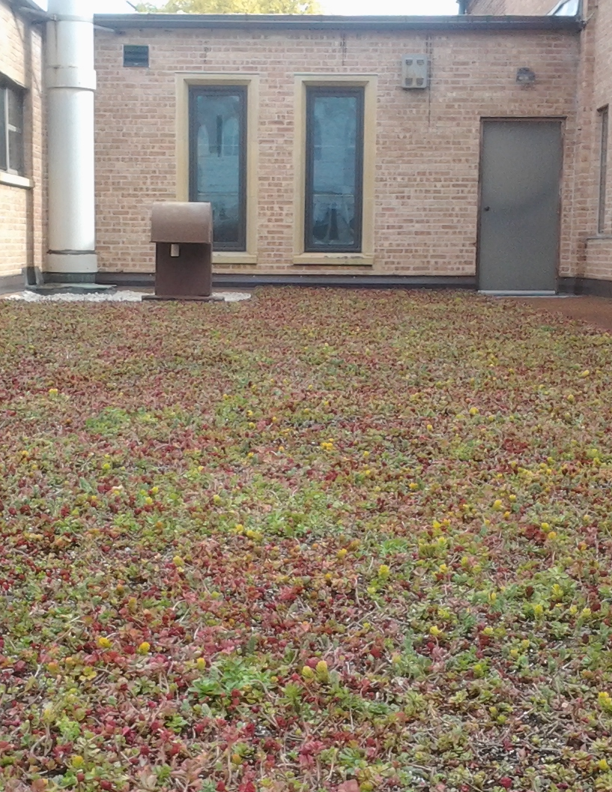
Milwaukee
GIPS Project
Green Roof
Notes:
<<in case you are using a footer or are making flyers>>

Slide 36
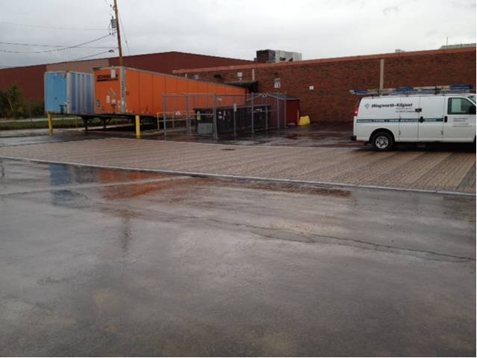
Milwaukee
Porous Parking Lot at General Mills
Notes:
<<in case you are using a footer or are making flyers>>

Slide 37
Opportunity for Greenest
Region Compact Members
Advantages:
Knowledgeable and supportive leadership
Educated and engaged stakeholders
Skilled and knowledgeable local and county staff
Regulatory motivation – consent decrees; MS4s
Community support – water quality, flooding, cost
Notes:
<<in case you are using a footer or are making flyers>>

Slide 38
Questions?
THANK YOU
www.cnt.org/water
hal@cnt.org
Notes:
<<in case you are using a footer or are making flyers>>

