Slide 1
Warm-Mix Asphalt
Presentation Courtesy of:
An Opportunity for Environmental Protection
Presented by Edith Makra - Metropolitan Mayors Caucus
Prepared by US EPA
January 22, 2019

Slide 2
Warm Mix Asphalt
Air quality issue
Potential for environmental benefits
EPA seeking to promote WMA
Sustainability opportunity for municipalities
MMC seeking recommendation from public works

Slide 3
Emissions from HMA facilities
EPA Assessed Hot Mix Asphalt impacts
reports https://www3.epa.gov/ttnchie1/ap42/ch11/related/c11s01.html

Slide 4
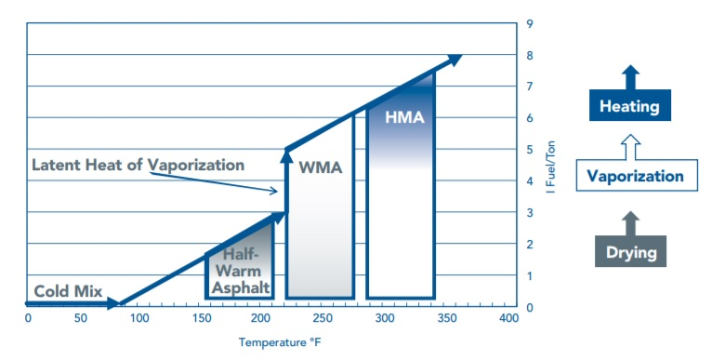
What is Warm-Mix Asphalt?
Hot-Mix Asphalt (HMA)
94% of all roads
Asphalt Binder + Aggregate
300°F - ~350°F
Warm-Mix Asphalt (WMA)
Binder + Aggregate + Additive
270°F - 300°F

Slide 5
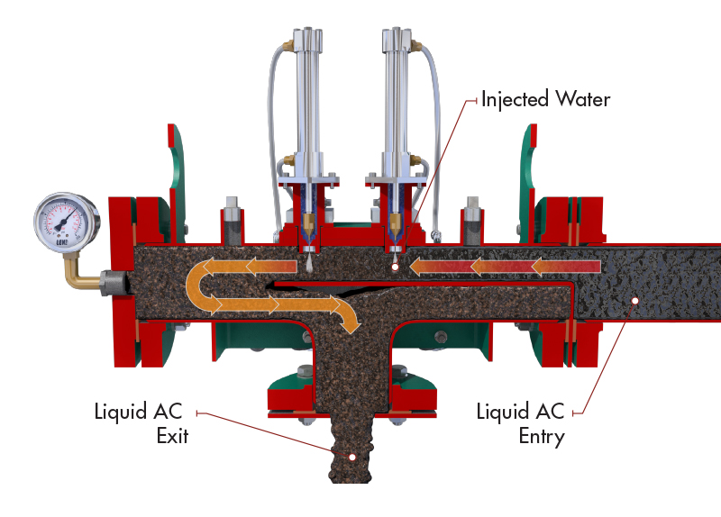
How is Warm-Mix so cool?
Reduced Viscosity
Aggregate coated easier at lower temperatures
3 methods:
Water injection (foaming)
Organic Additives (waxes)
Chemical Additives

Slide 6
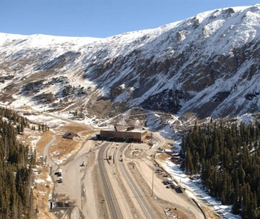
Economic Benefits
Lowering temperatures reduces fuel use by 20%-35%
Increased Production
Shorter project timelines
Longer hauls
Increased use of Reclaimed Asphalt Pavement
Cold-weather paving

Slide 7
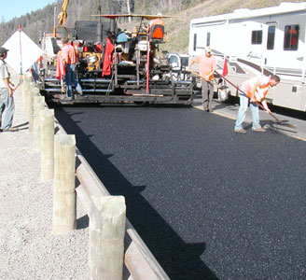
Performance Benefits
Compaction Aid
Improved in-place density
Better Durability – every 1% = 10% increase in pavement life
Decreased Plant Wear
Improved temperature uniformity
Longer placement window
Increased workability

Slide 8
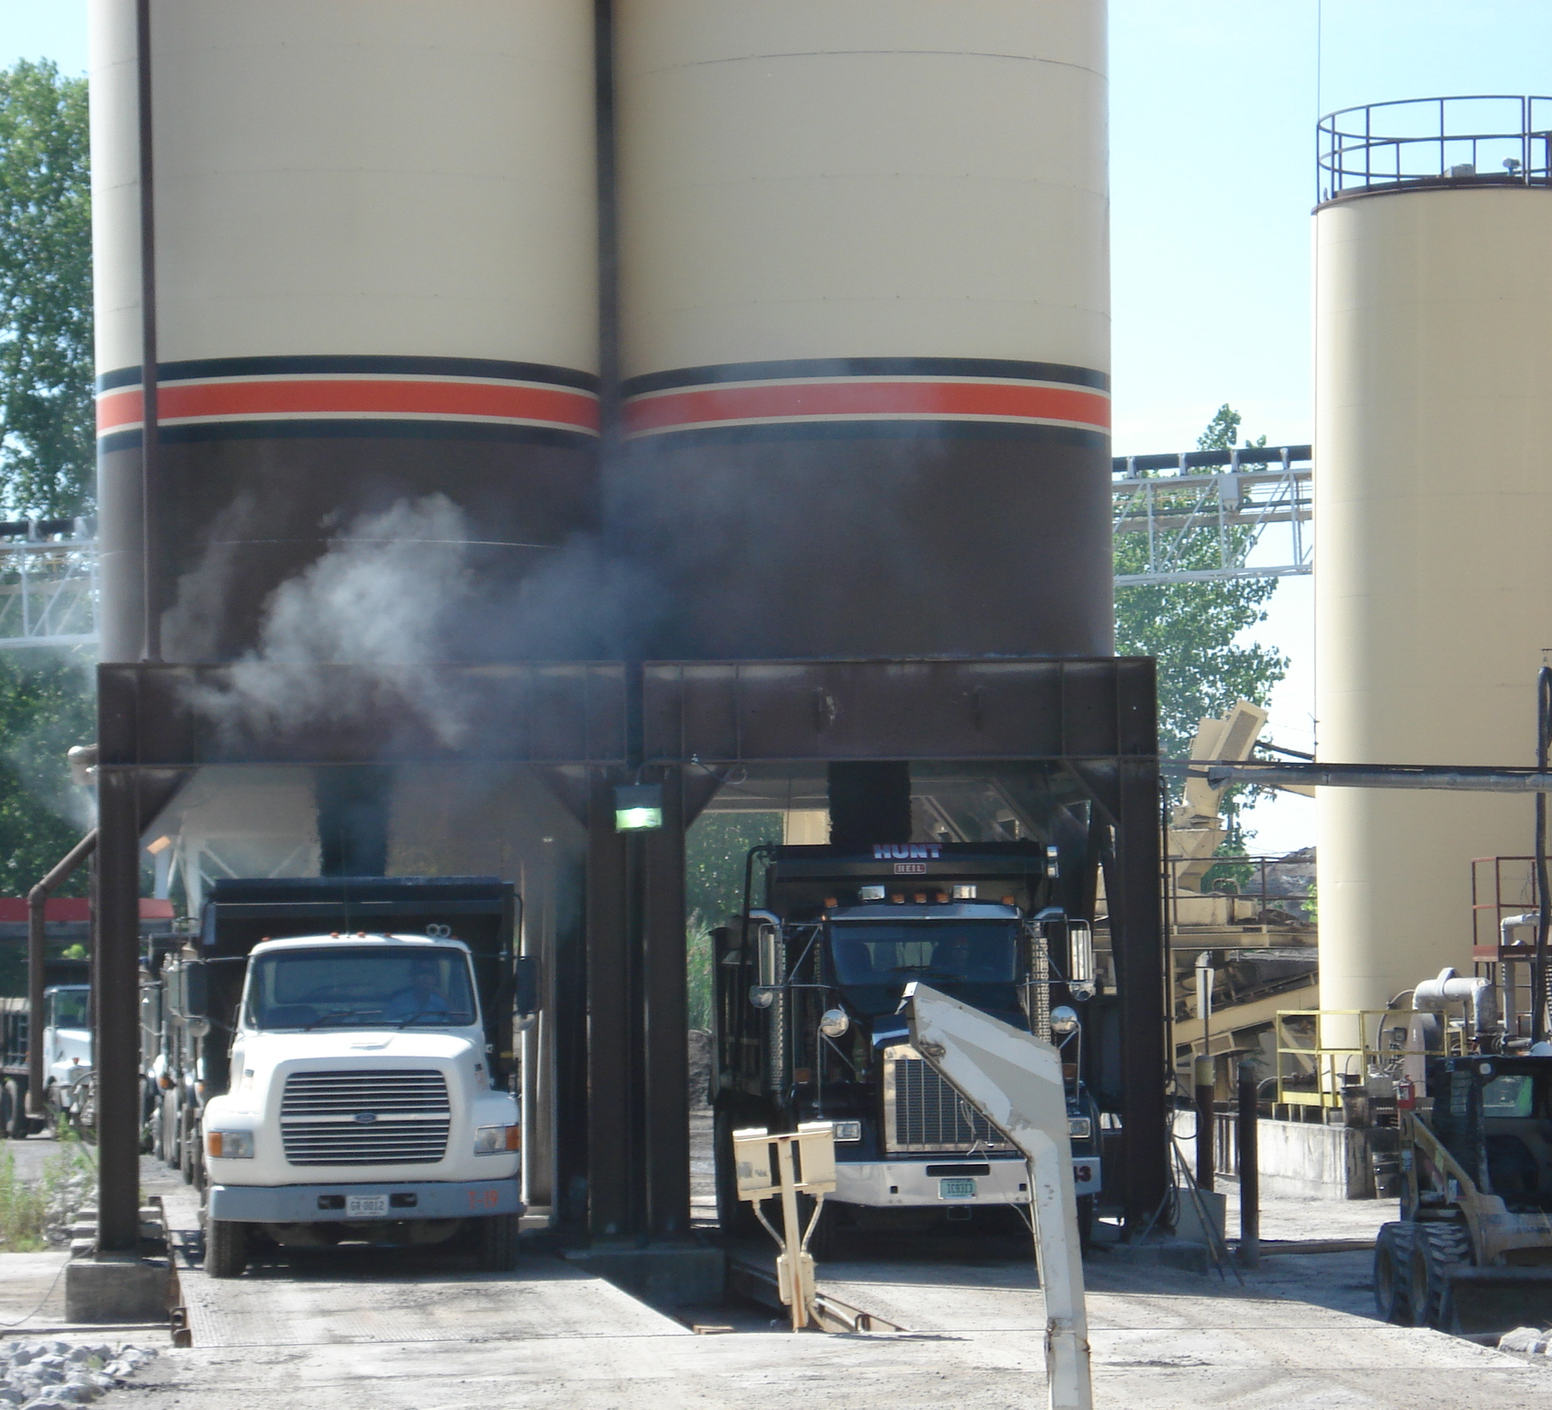
Environmental Benefits WMA vs HMA
Reduces Air Pollution & GHGs:
VOCs – 50%
NOx – 60%-70%
SO2 – 30%-40%
CO – 10%-30%
PM – 20%-25%
CO2 – 30%-40%
Reduces Odors & Fumes
Improved Conditions for Workers
LEED Credits

Slide 9
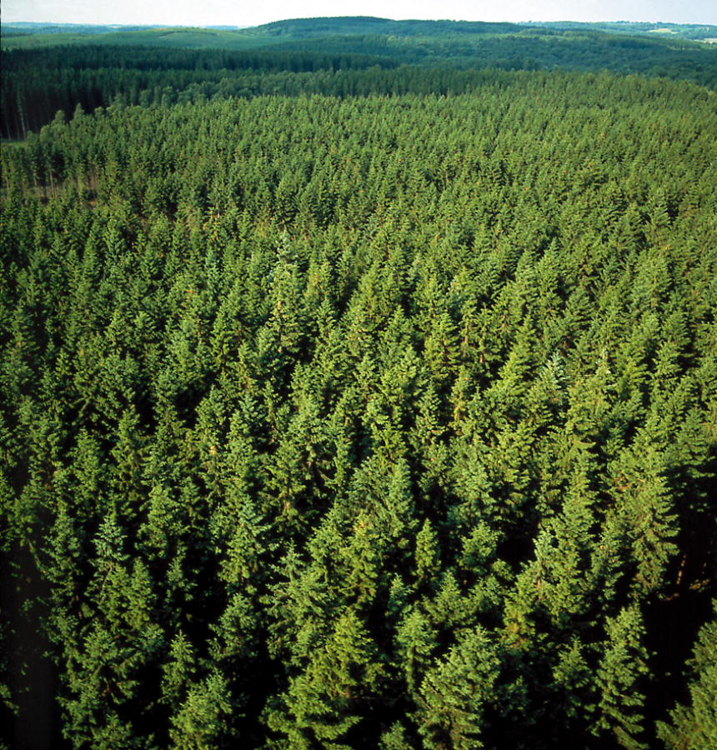
Benefit Quantification
Illinois:
200+ Asphalt Plants
14 million tons of asphalt in 2016
CO2: 69,300 tons
13,400+ Cars
2,000,000+ LEDs
74,000+ Acres

Slide 10
Benefit Quantification
Highland Park:
7500 tons/year
VOCs: 0.03 tons
NOx: 0.06 tons
SO2: 0.004 tons
CO: 0.05 tons
PM: 0.025 tons
CO2: 37.00 tons
7 Cars
1100 LEDs
40 Acres
Contractor:
136,000 tons/year
VOCs: 0.6 tons
NOx: 1.1 tons
SO2: 0.23 tons
CO: 1.0 ton
PM: 0.5 tons
CO2: 673 tons
131 Cars
20,000 LEDs
720 Acres

Slide 11
Sustainability Opportunity for Municipalities

Slide 12
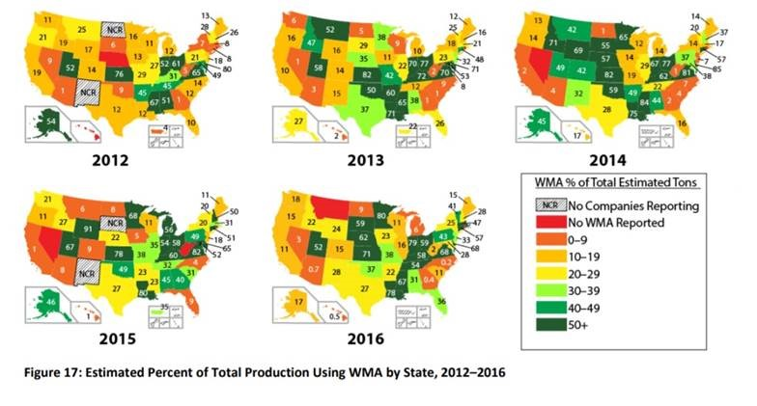
Boost Demand

Slide 13
Sustainable Paving
• Reduce the energy and emissions associated with mixture production by adopting WMA technologies.

Slide 14
Obstacles
Specifications
Contract bids
Initial investment
Lack of supply
Lack of demand
Lack of awareness
Longevity & performance fears

Slide 15
Potential for Municipal Use of WMA
WMA not widely used by municipalities
Asphalt widely used by municipalities
Need guidance & specs
Peer learning
Capture and report environmental benefits

Slide 16
Thank you:
Alexis Cain
312-886-7018
cain.alexis@epa.gov

