Slide 1
Warm-Mix Asphalt Successes
January 22, 2019
Cynthia Williams - Illinois Tollway
Deputy Chief of Program Implementation
Cynthia Williams
Deputy Chief of Program Implementation Illinois Tollway
Illinois Bituminous Paving Conference December 12, 2018
Notes:
Thank you for the invitation to share some information about the Illinois Tollway and our successful implementation of WMA mixtures over the past 10-plus years.

Slide 2
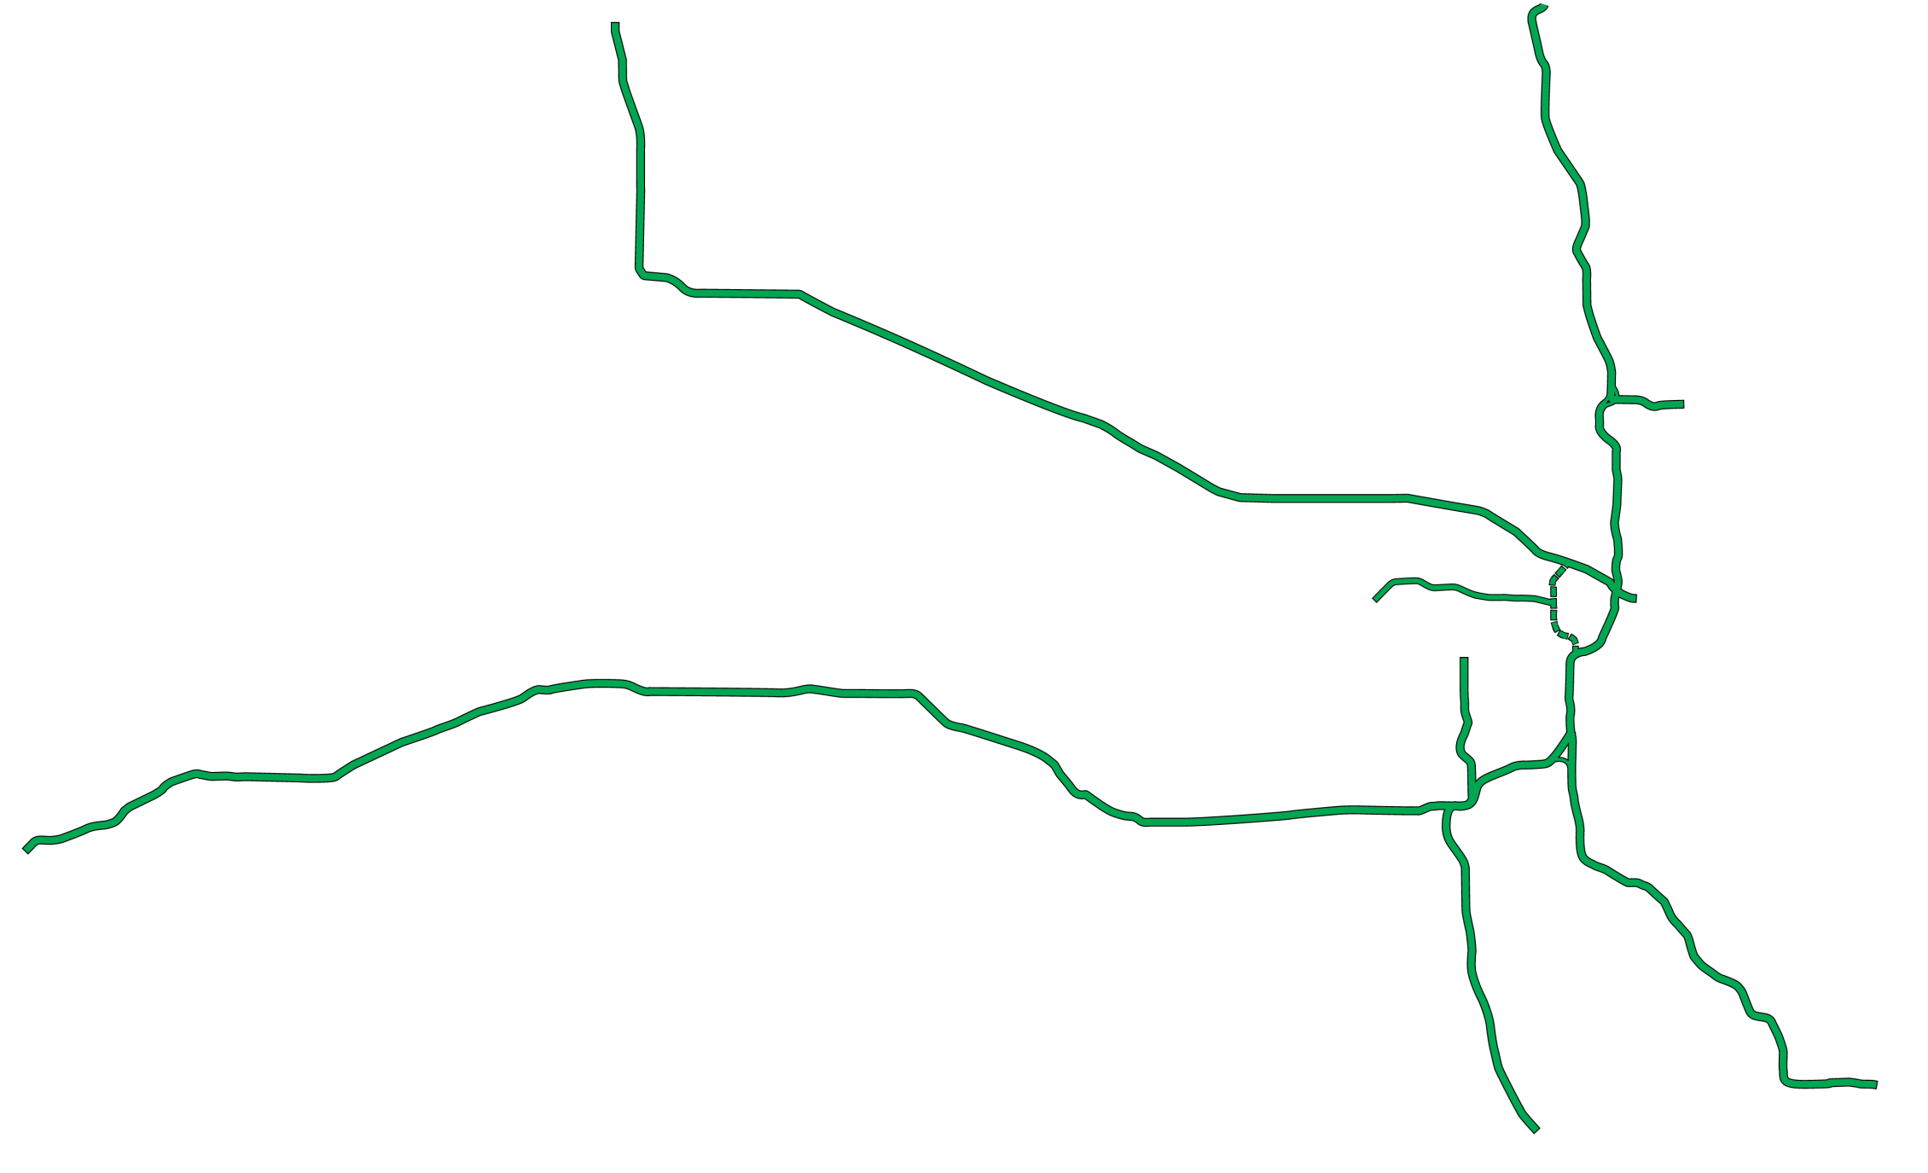
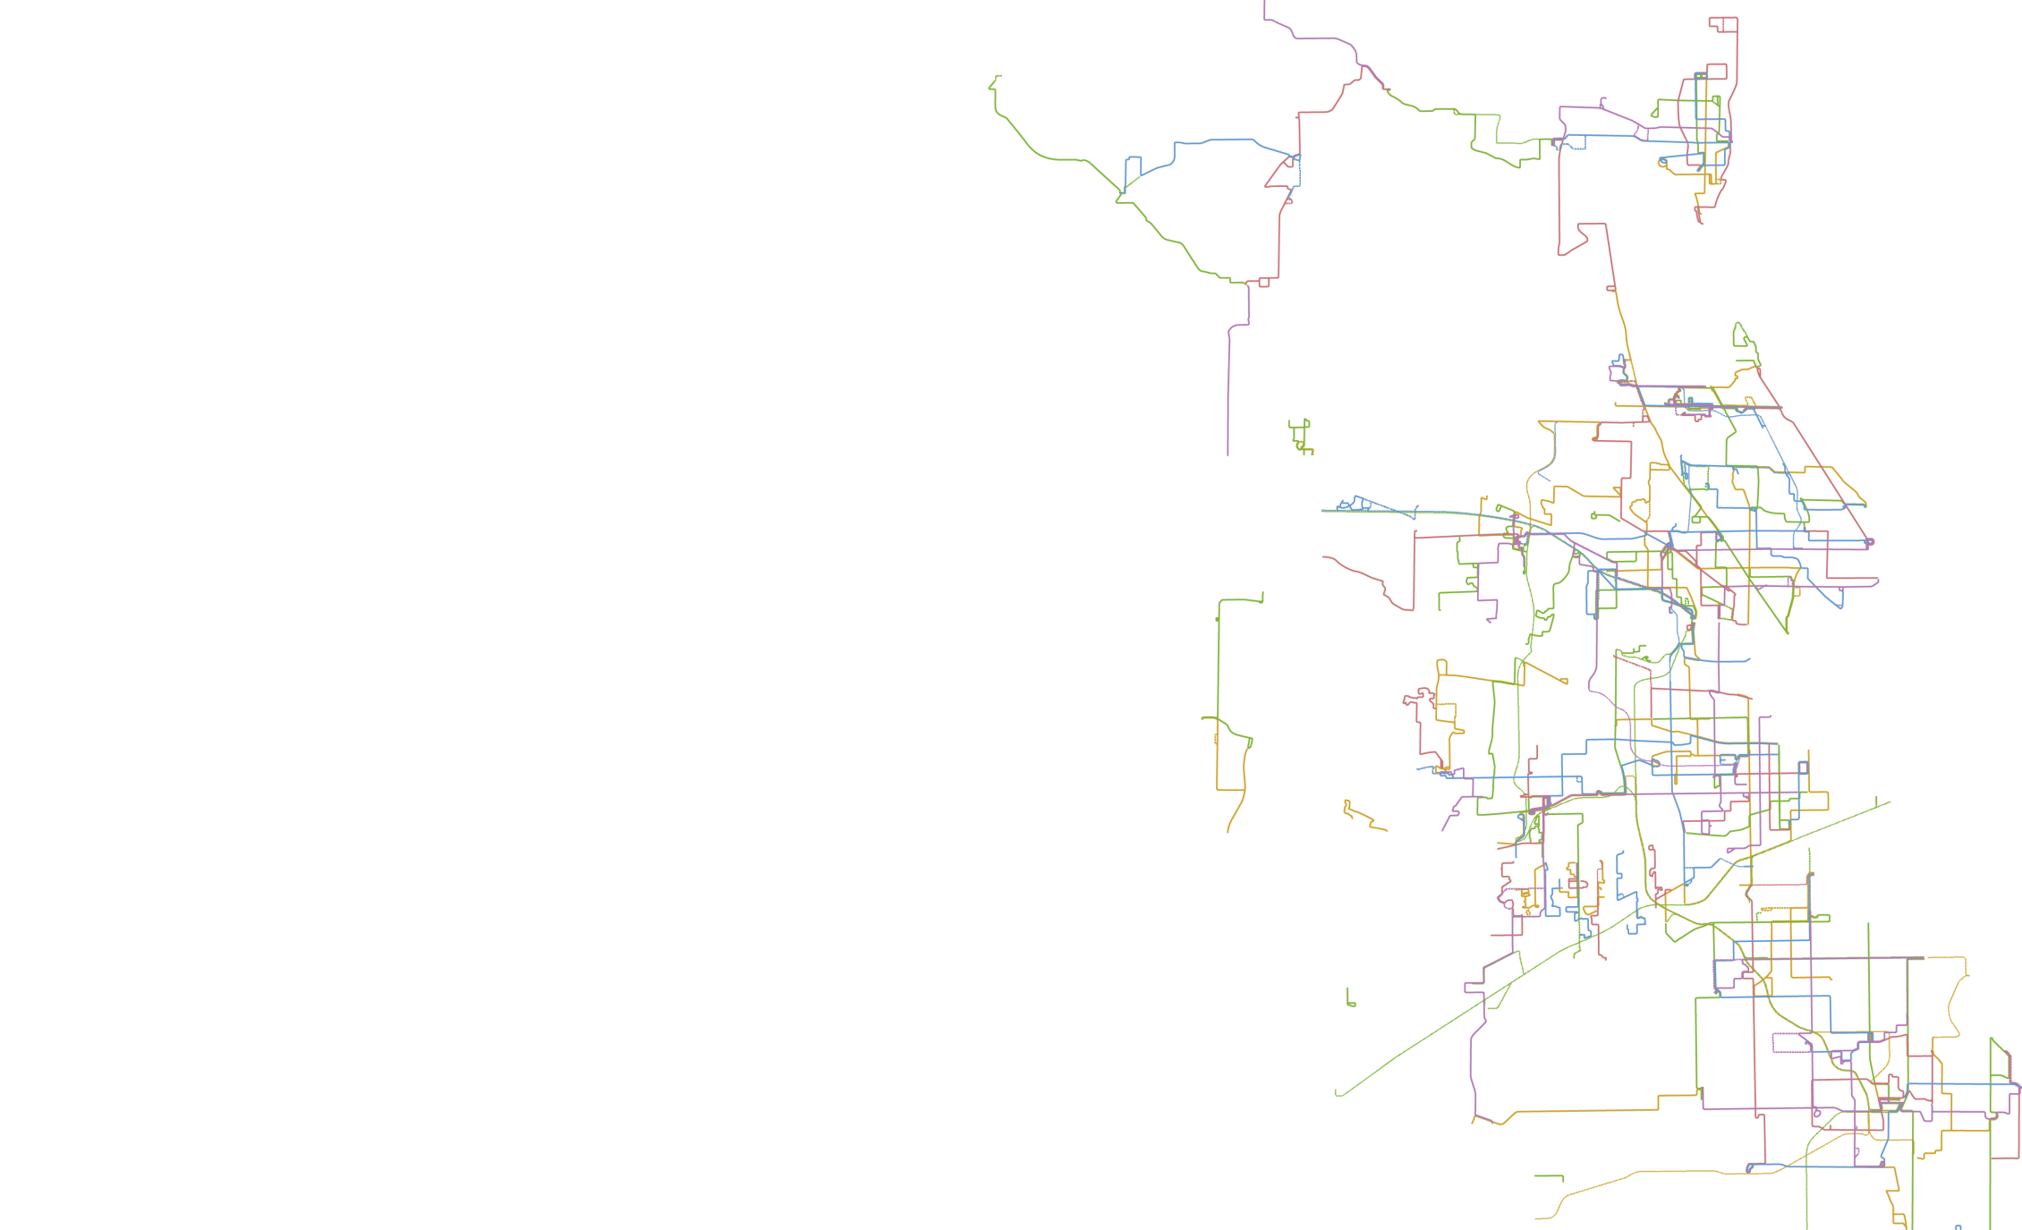
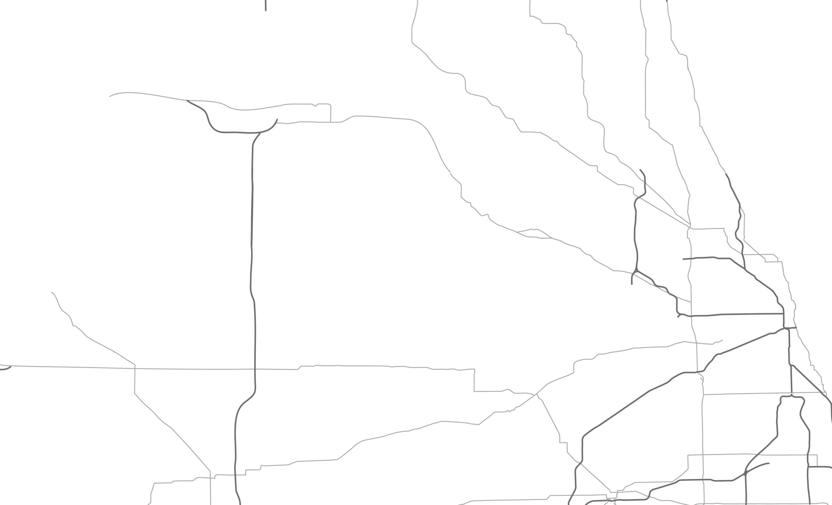
About The Tollway
Part of a dynamic transportation network
Connects to regional transit network
Supports three international airports
Part of one of the nation’s largest interstate systems
Five roadways
294-mile system across 12 counties
Serves more than 1.6 million vehicles a day
Notes:
The Illinois Tollway system serves as the hub for one of the nation’s largest, most dynamic transportation networks.
It connects to the nation’s second largest rail network, supports three international airports and plays a significant role as part of a statewide roadway system that ranks third in most interstate miles and routes.
Together, this network is vital to moving people and goods not only throughout the region, but nationwide.
The Tollway is responsible for the construction, operation, regulation and maintenance of a system of toll highways within Northern Illinois.
We have five roadways that span 294 miles in 12 counties across Northern Illinois.
Tri-State Tollway (I-94/I-294/I-80)
Jane Addams Memorial Tollway (I-90)
Reagan Memorial Tollway (I-88)
Veterans Memorial Tollway (I-355)
Illinois Route 390 Tollway
The Tollway system serves more than 1.6 million vehicles a day, with nearly 88 percent of all toll transactions paid electronically with I-PASS or E-ZPass.
Our mission is to provide and promote a safe and efficient system of highways while ensuring the highest possible level of service to customers.
We are separate from the Illinois Department of Transportation.
The Tollway is a user-fee system. No state or federal tax dollars are used to support the maintenance and operation of the Tollway system. Only those who use the system pay for it.

Slide 3
2018 Asphalt Paving Program
912,625 tons of WMA
Item | Depth, inch | Layer Description | Tons | $/Ton
1 | 2 | Stone matrix WMA surface friction course, IL-12.5, N80 (135 Lb/SY/In) | 204,771 | $81.02
2 | 2 | Stone matrix WMA binder course, IL-12.5, N80 (114 Lb/SY/In) | 118,380 | $87.07
3 | Var | Polymerized WMA binder course (112 Lb/SY/In) | 93,782 | $80.09
4 | Var | WMA surface course (112 Lb/SY/In) | 100,596 | $93.87
5 | 3 | WMA stabilized subbase (112 Lb/SY/In) | 120,291 | $76.90
6 | 6 | Full-depth WMA shoulder | 235,688 | $67.26
7 | 9 | Full-depth WMA shoulder | 74,901 | $72.18
8 | 10.25 | Full-depth WMA lane pavement | 51,171 | $81.07
9 | 9 | Full-depth WMA lane pavement | 13,126 | $74.18
 |  |  | 912,625
Notes:
(This slide has animation)
This is a listing of the 2018 asphalt paving program. As you can see, we estimated just shy of a million tons of asphalt for 2018.
The WMA designation on these mixes is for our required warm mix additive.
Since we are here to discuss SMA, please note……
(CLICK TO ADVANCE SLIDE)
There is over 300,000 tons of SMA in the 2018 paving program.
We think there are great benefits to this mix, and we have for quite some time……

Slide 4
The History Of WMA
1995 Preliminary lab experiments
1997 German Bitumen Forum
2000 Euroasphalt & Eurobitume Congress
2002 NAPA European Scan Tour
2004 First public demonstration in U.S.
2005 WMA Technical Working Group
2007 AASHTO FHWA International Scan Tour
2008 First U.S. International Conference
2010 FHWA emphasizes as part of EDC
2012 Tollway mandates all HMA to be WMA
2015 Chicago Department of Transportation requires (date range)
Notes:
The main takeaway from this slide:
Tollway was the first agency in the country to mandate Warm Mix Asphalt in 2012.
This has continued to evolve, that we will talk about later on, about the different technologies and foaming.

Slide 5
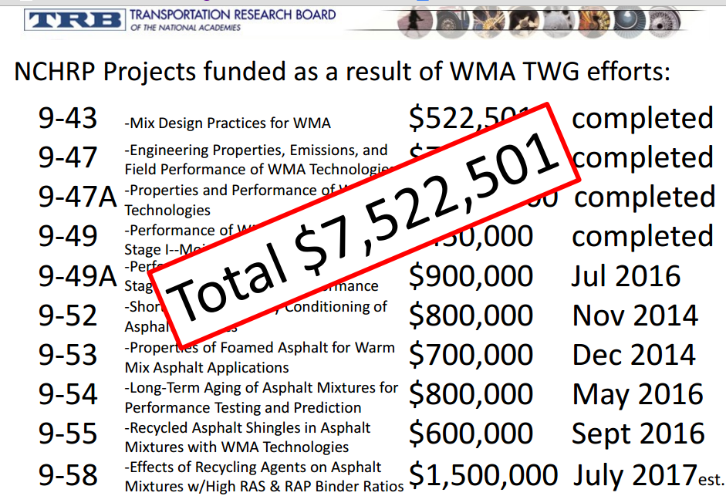
Transportation Research Board
TRB continues to spend a lot of money on WMA research
Notes:
While TRB and other research entities continue to spend millions of dollars on research, we are confident in our experiences working with our suppliers and contractors to evaluate the results on real-time projects using local materials.

Slide 6
Tollway Requirements
WMA is required on Tollway projects (since 2012)
Allow mechanical (foaming) and additives
Restrict foaming with higher recycle content
Require additive with shingles and/or +17% ABR
Require increased dosage (additive) with colder temps
Tollway has an approved list of warm mix technology
Allow use of IDOT asphalt mix design with WMA
Notes:
Tollway first used WMA in trials starting in 2011
Tested/compared different chemicals and waxes. Struggled with waxes.
The foaming process relies on the virgin asphalt liquid in the mix to ‘activate’ or foam; therefore w/higher recycled content there is not as much virgin liquid to achieve benefit of foaming.
Tollway has approved list (so does IDOT)
Tollway requires producer to increase the dosage of the additive 50% when temperatures are outside the prescribed temperatures (for most miixes that is at or below 32F)
Producer must perform a 1-point verification (laboratory test process) to show the mix still meets performance tests with the warm mix asphalt additive.

Slide 7
Benefits of WMA to the Tollway
Compaction aid – achieve better density
Improved long-term performance
Less interruption to motorists
Lower production temperatures
Notes:
The Tollway implemented warm-mix asphalt technologies and have been fortunate to experience its many benefits. These include:
Performance/constructability benefits include better compaction on the road, the ability to haul paving mix for longer distances, and extending the paving season by being able to pave at lower temperatures.
Research has found that Warm Mix Additives reduce oxidation and extend longevity.
By extending paving season and improving performance WMA results in less interruption for Tollway customers – something we as a toll agency take very seriously.
Environmental benefits.
Production at lower temperatures - We are seeing a reduction in the temperatures that producers are making mix at the plants. We have benefit of quantity during production to allow a plant to stay at constant temperature vs. jumping between HOT mix job and our Tollway WARM mix job. However, with the higher amounts of recycle the Tollway allows, the producers are hesitant to significantly reduce the temperature at which they make the mix.
Reductions of any sort have the obvious benefits of cutting fuel consumption and decreasing the production of greenhouse gases. But we should also be cognizant of the benefit gained by the reuse of the existing roadway (grindings) and the recycled roof shingles – avoids mining virgin aggregates, refining petroleum, landfilling roof scrap/waste

Slide 8
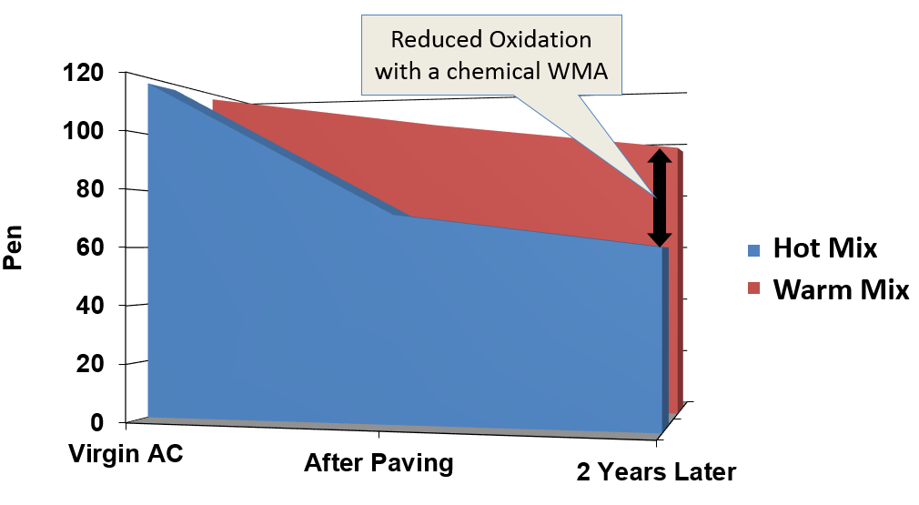
Improved Long-Term Performance verified through Research
Notes:
The Tollway has conducted some of this research, conjunction with ICT (U of IL).
Research has found that Warm Mix Additives reduce oxidation and extend longevity.
“Pen” is a measure of how soft or ductile the asphalt binder in a mixture is…the higher the number, the softer and the better to resist cracking.
Additionally, we have visually seen that mixes using Warm Mix Additives do not fade out as quickly.

Slide 9
Availability of WMA
19 Different producers
42 Plants/locations
32 Have used chemical additive
25 Do NOT have mechanical foaming capability
Notes:
19 Producers
42 Plants/locations
32 Have used chemical additive
24 Do NOT have foaming capability + Lindahl, assume no = 25
All but 7 have had 'recent' work on Tollway; history/knowledge
Bigane (City of Chicago)
Builders (recently bid)
Payne/Dolan – far north, recent was North Tri-State?
Geske – small l northern
MAT – new in City Chicago
Rabine –

Slide 10
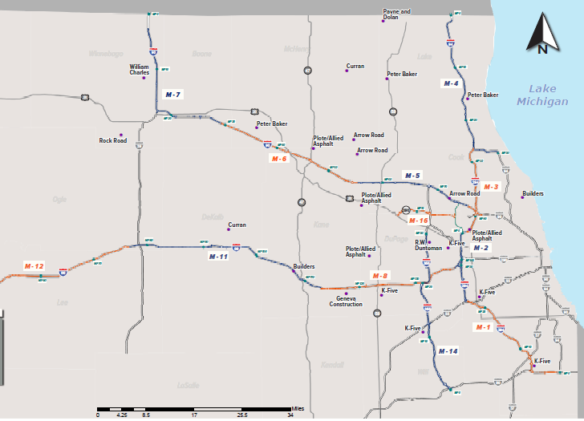
Plant Locations
indicates plant location

Slide 11
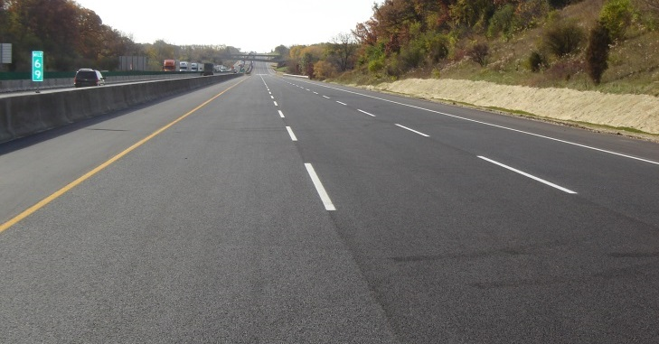
THANK YOU
Notes:
Thanks again. I would be pleased to answer any questions.

