Slide 1
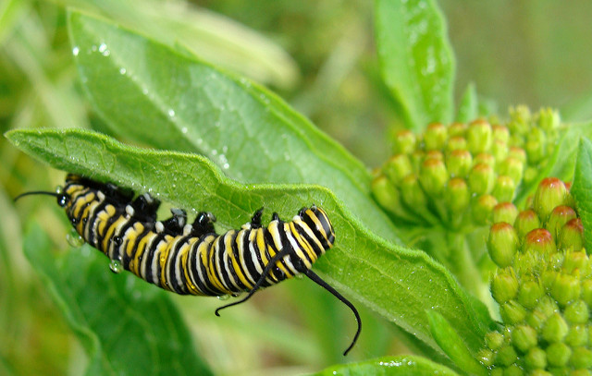
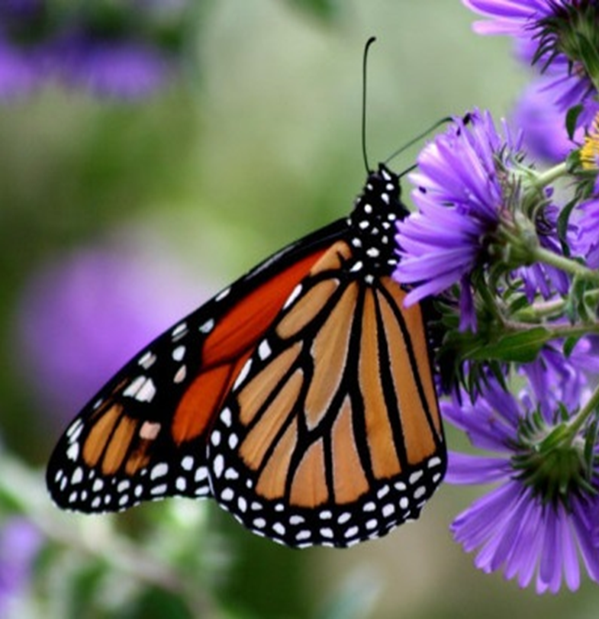
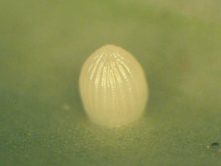
Monarch Butterflies
Time for Civic Action
John Rogner, U.S. Fish and Wildlife Service
Metropolitan Mayors Caucus
March 21, 2017

Slide 2
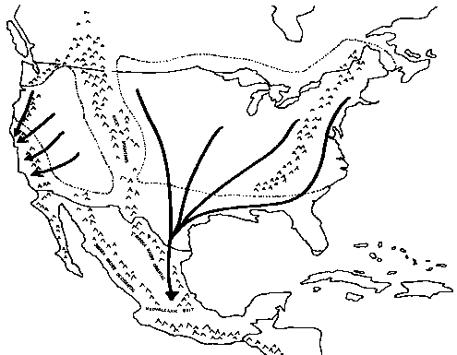
Monarch Life Cycle and Migration
Photos: Michelle Solensky, Denny Brooks, Mary Holland, Dave Astin, Wendy Caldwell.
Maps: Journey North and Monarch Lab.

Slide 3
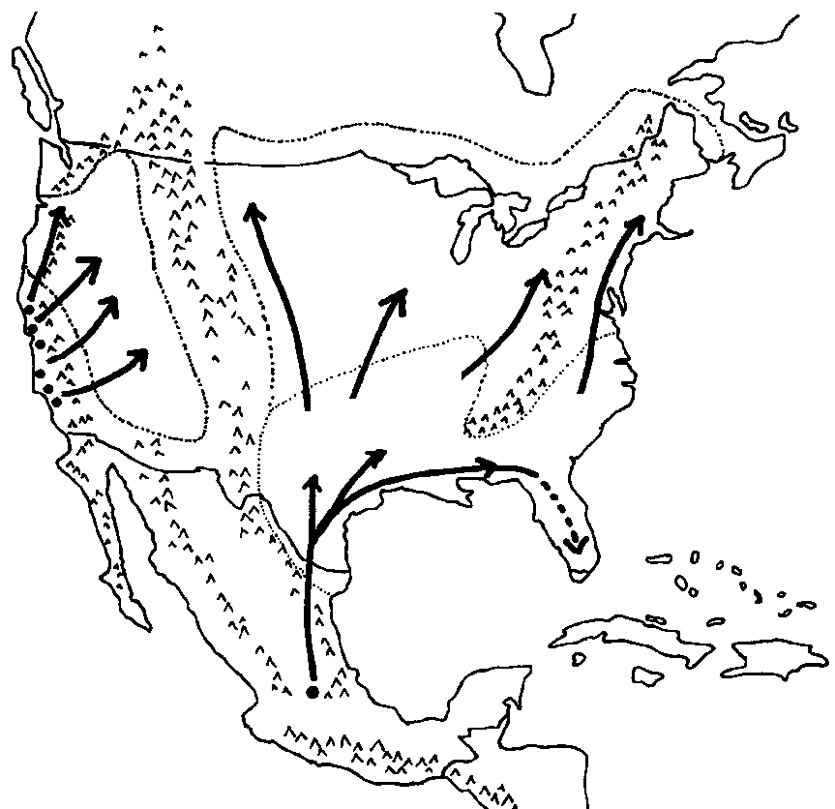
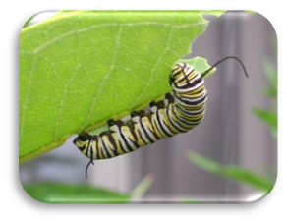
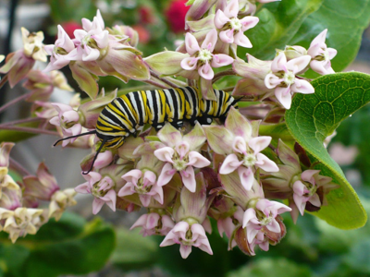
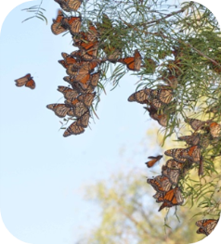
Spring Migration and Breeding Breeding generations live 2-6 weeks.
April – August
Breeding – generations 2 and 3
March – April
Breeding - generation 1
November – March
Overwintering - generation 4
Map courtesy of University of Minnesota Monarch Lab

Slide 4
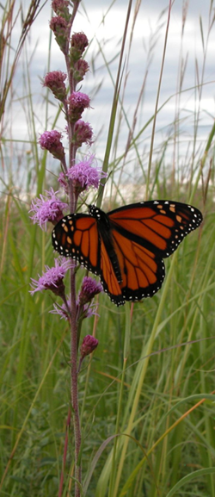
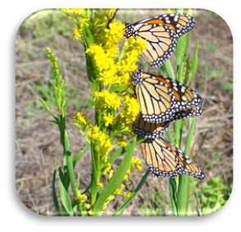
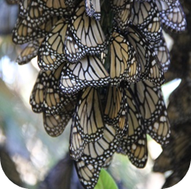
Fall Migration Overwintering generation lives up to 9 months
August - November
Migrating – generation 4
November – March
Overwintering - generation 4
Map courtesy of University of Minnesota Monarch Lab

Slide 5
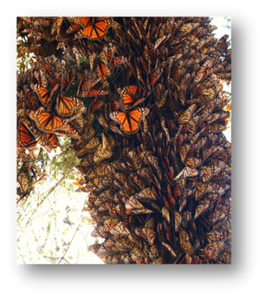
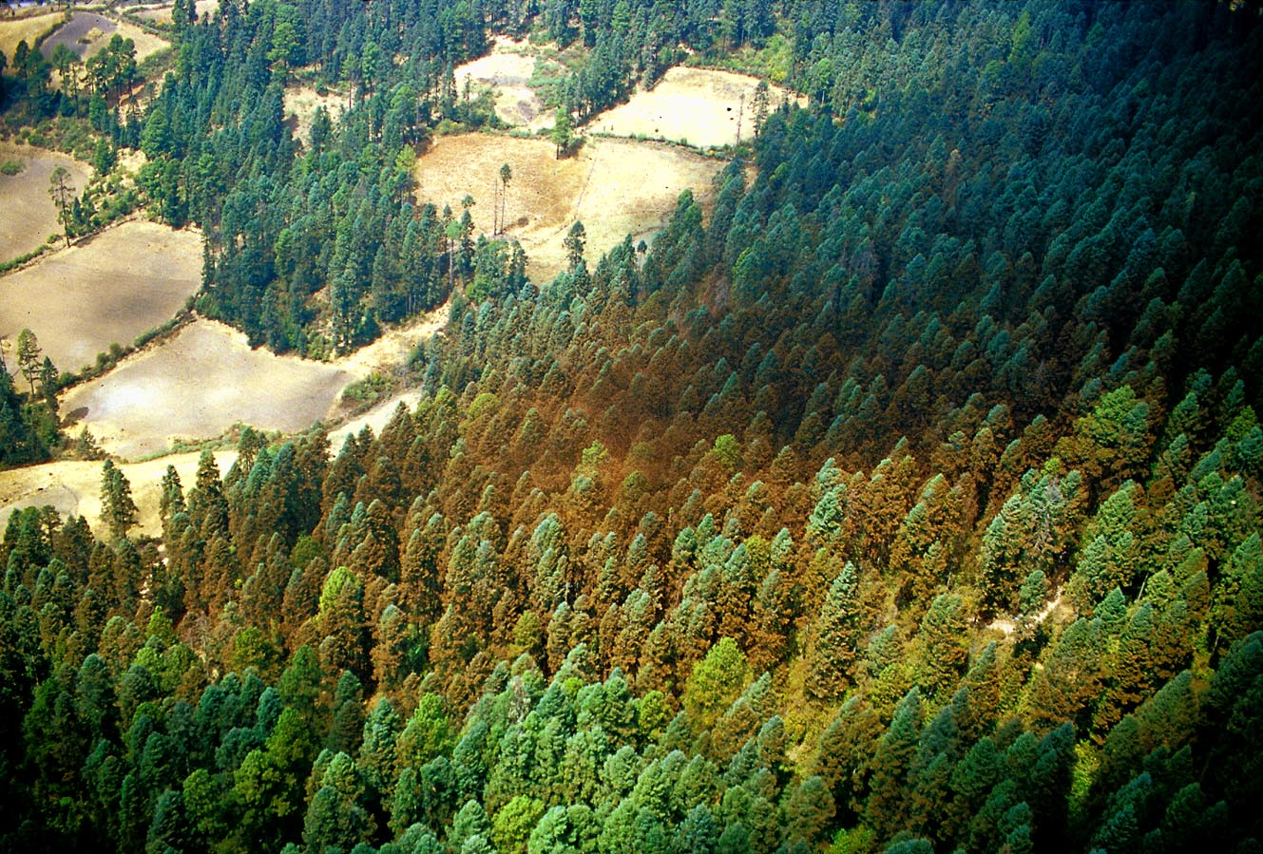
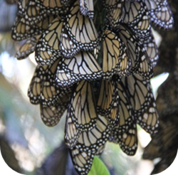
Monarch Population
Estimated based on area occupied in December

Slide 6
2.91

Slide 7
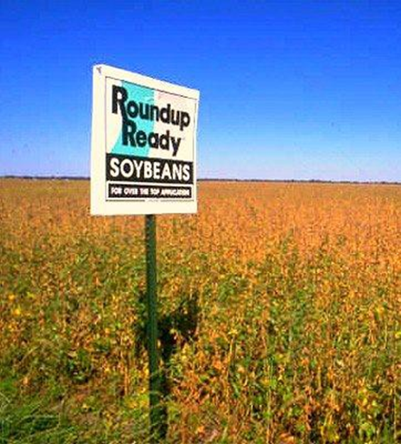
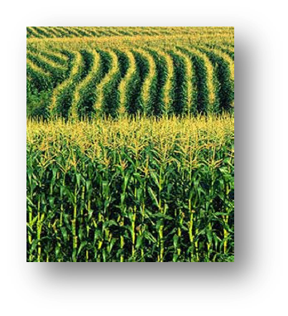
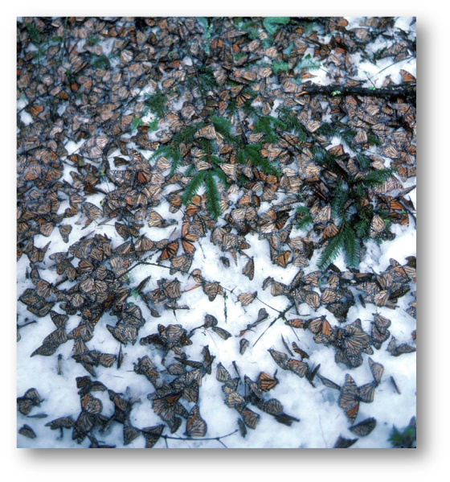
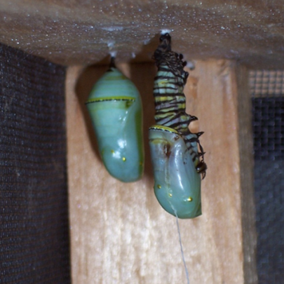
Threats
Pesticides
Neonicotinoids
Habitat Loss
Fencerows and field edges
Increased use of herbicide-tolerant
crops means less milkweed
Development
Illegal logging in overwintering grounds
Natural Causes
Disease/Parasites
Predation
Winter storms

Slide 8
U.S. Fish and Wildlife Service Roles:
International collaboration (Trilateral Monarch
Conservation Science Partnership)
Endangered Species Act
Assess Species Status (Listing decision 2019)
Recovery Planning and Implementation
Coordination with States on state conservation plans
Conservation Partnerships
Funding and projects at
rangewide, State, and local
scales

Slide 9
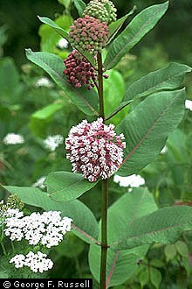
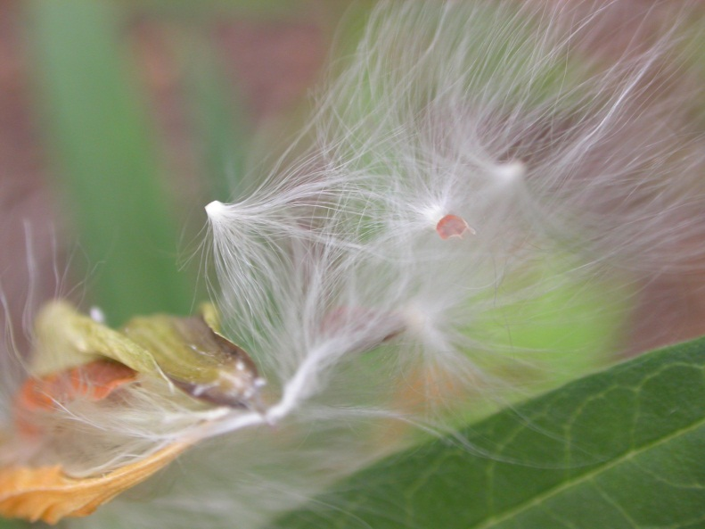
Plant Milkweed!
Giuseppina Croce
Tom Collins
Notes:
One of the best things you can do is plant milkweed! It’s good for other pollinators too, such as bees, butterflies, beetles, ants! Even birds like milkweed! It provides a habitat for many species. Plus, the flowers smell good. Native milkweeds are best – these are well adapted to your climate and precipitation amounts and in general will require less work.

Slide 10
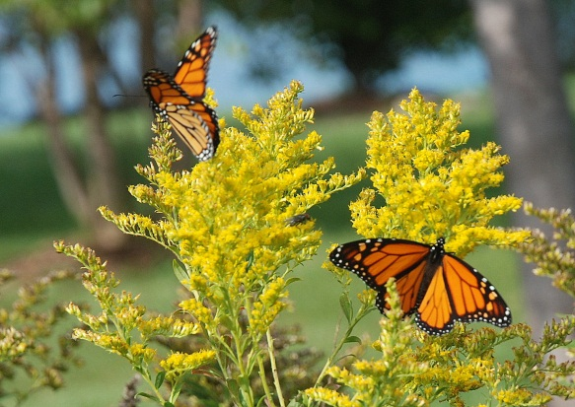
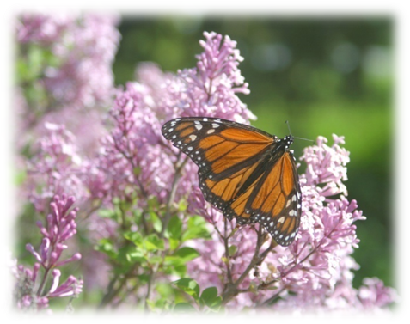
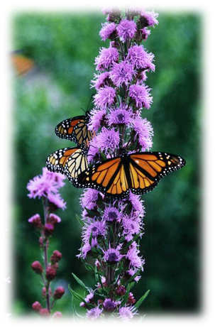
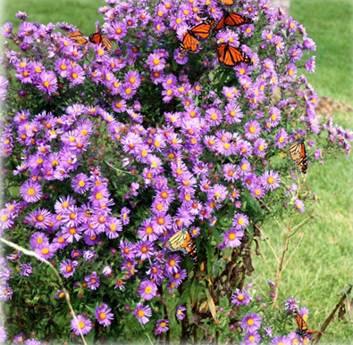
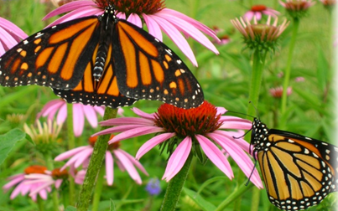
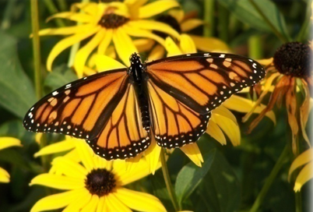
Plant Nectar Plants
Jim Ellis
Continuous bloom through the growing seasons.
Natives are best!
Ed Doering
Dave Astin
Jim Ellis
Judy Kesser
Barbara Powers
Notes:
Nectar plants are also important. Monarchs need a continuous bloom throughout the growing season. In states that monarchs fly through on their migration, nectar plants are an important fuel source for the flight south to Mexico and for the breeding monarchs in the spring.
Plants that grow naturally in your area (not hybrids, cultivars or exotic plants) are usually best, but you can include annuals in your garden if you prefer them. Native perennials are adapted to your climate and generally require less work than a typical annual garden. They can get by with less water than annuals and they are also habitat and food sources for many of the native insects, birds, mammals and pollinators of your area. All of these are important for a healthy ecosystem.

Slide 11
PRIORITY GEOGRAPHIES
Texas, Oklahoma
Spring breeding
“Corn Belt”
Summer breeding
Western pop.
Notes:
The Service’s strategy focuses in three priority geographic areas: Texas and Oklahoma that’s key for first generation spring breeding habitat, America’s “Corn Belt” that’s important for summer breeding, and key areas of the range for the western population. You can see from this map the advantage of leveraging I-35 as a cornerstone of both our conservation and engagement strategies as it lines up perfectly with the monarch’s central flyway.
In addition to the three priority geographic areas, there is much monarch work being accomplished in the Northeast, Southeast and Mountain-Prairie Regions.
$220,000 of the Director’s Deferred funds targeted a 21st Century Conservation Service Corps – to engage youth and communities in key urban areas in Regions 2, 3, 5, 6 and NCTC (with an emphasis on the I35 corridor). These interns will develop outreach and environmental education materials, create schoolyard and community habitats, train volunteers in seed collection and planting. This supports the efforts of the National Wildlife Federation and the Secretary’s goal to provide opportunities for youth to play, learn, serve, and work in America’s great outdoors.

Slide 12
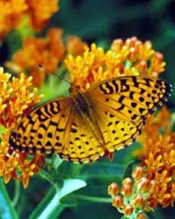
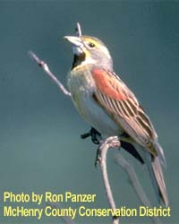
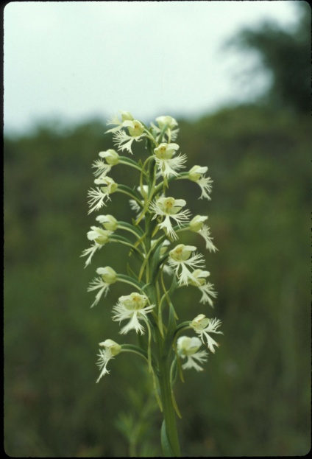
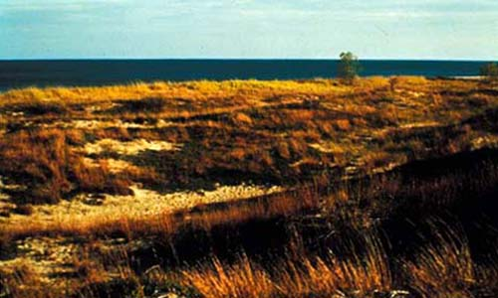
Chicago Wilderness A regional initiative to restore, protect and preserve the biodiversity of the Chicago region

Slide 14
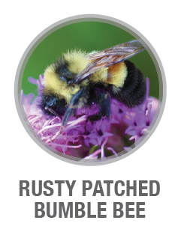
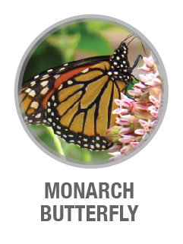
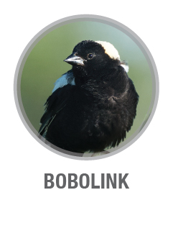
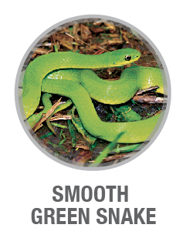
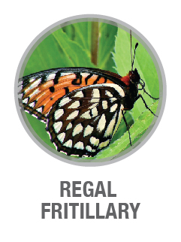
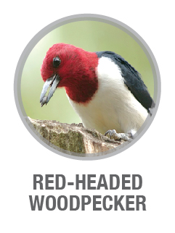
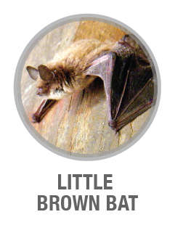
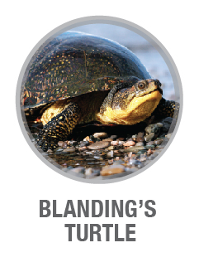
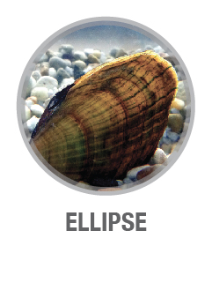
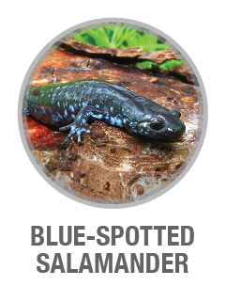
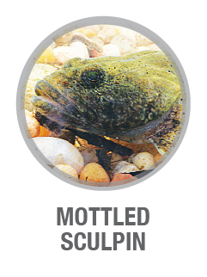
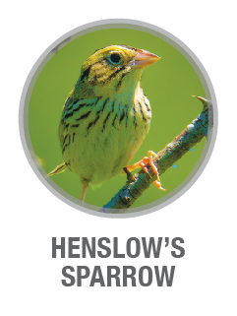
Chicago Wilderness 12 Priority Animal Species

Slide 15
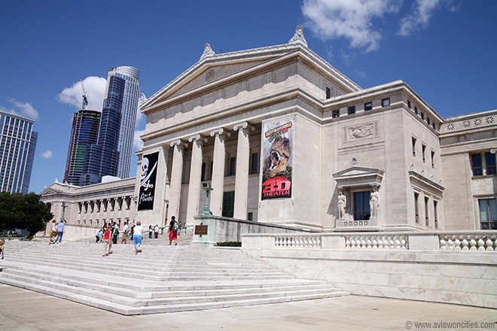
CW Monarch Lead Partners
US Fish and Wildlife Service
Field Museum
Peggy Notebaert Nature Museum

Slide 16
Priority Species: Monarch Butterfly
5-Year measureable outcomes we seek to achieve:
Enhance youth and adult engagement in and understanding of Monarch conservation in the Chicago Wilderness region
Pollinator gardens and Monarch “refuges” proliferate across the Chicago Wilderness Region, providing habitat and cultivating public affection for natural landscapes …LIVING CORRIDORS!
Existing conservation lands increasingly support Monarch and pollinator habitat
Mayors and/or local government Chief Executives throughout the Chicago Wilderness Region commit to Monarch conservation through the National Wildlife Federation’s Mayors’ Monarch Pledge

Slide 17
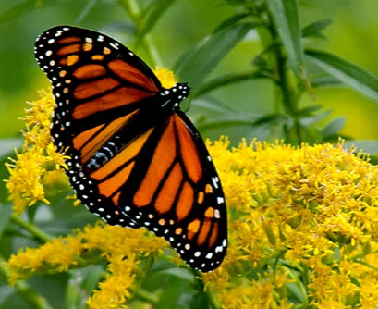
Mayors Monarch Pledge
An Initiative of the
National Wildlife Federation

Slide 18
Mayors’ Monarch Pledge – Steps to taking pledge
Take the pledge online
www.nwf.org/mayorsmonarchpledge
Specify your actions
25 actions to select from
Must pledge to take at least 3 actions
Leadership Circle = 8 or more actions
Take action
Report progress
Quarterly reporting required (<5 min to fill out online form)

Slide 19
Mayors’ Monarch Pledge – Action Items
25 potential action items
Broad categories and examples:
Communications and Convening
Issue a proclamation
Launch a public communication effort
Program and Demonstration Gardens
Expand invasive species removal programs
Add milkweed and nectar producing plants to community gardens
Systems Change
Remove milkweed from list of noxious weed ordinances
Change weed or mowing ordinances

Slide 20
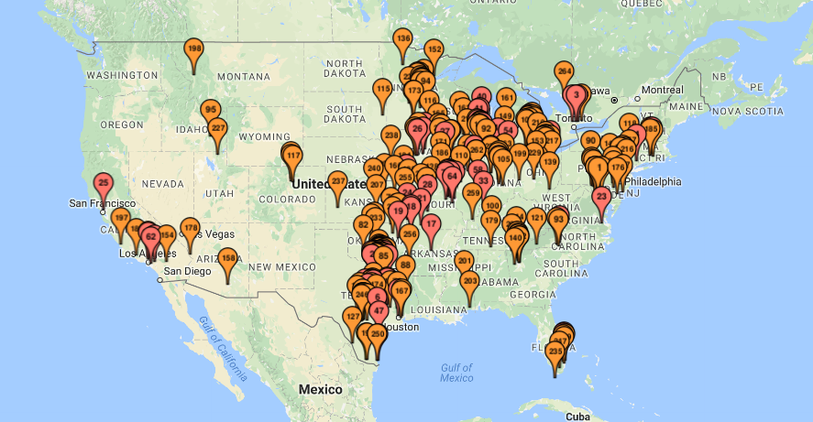
Mayors’ Monarch Pledge Signatories
270 signatories nationally
19 signatories in Illinois

Slide 21
Mayors’ Monarch Pledge
Mayors’ Monarch Pledge Guide and other resources available online:
www.nwf.org
Notes:
State Plans: Key stakeholders – 60 participants representing all key sectors – ag, MI DNR, FWS, NGOs, Farm Bureau, DOT, utilities, etc.
Show San Antonio Plan

Slide 22
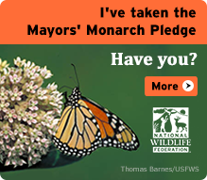
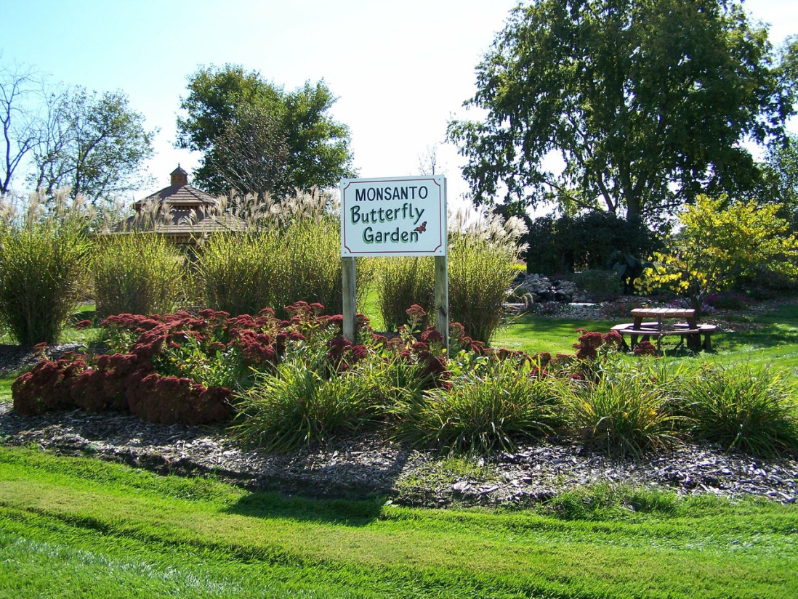
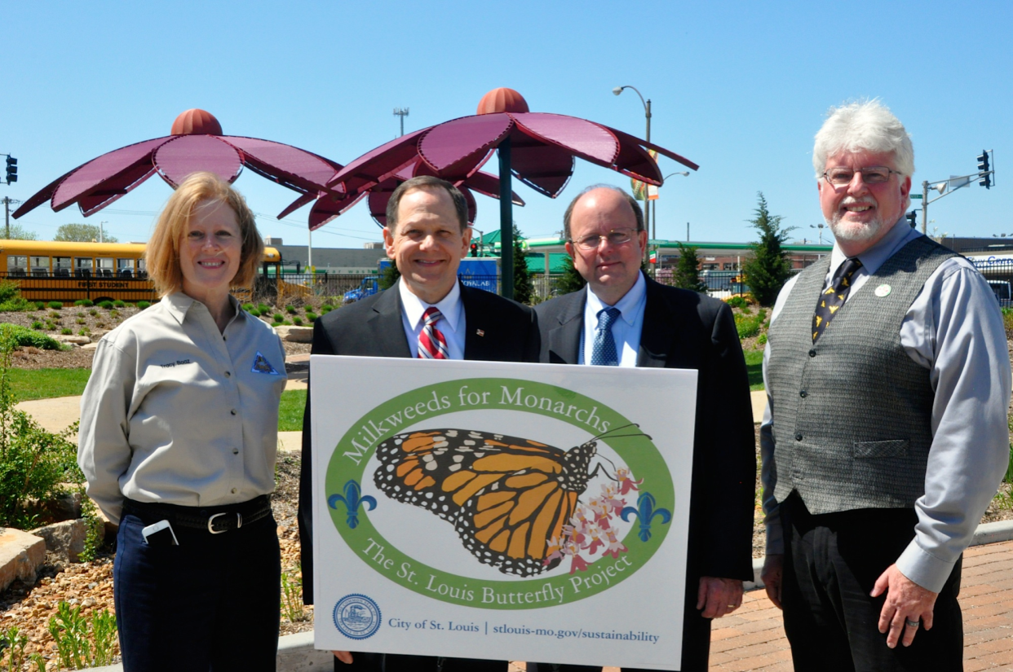
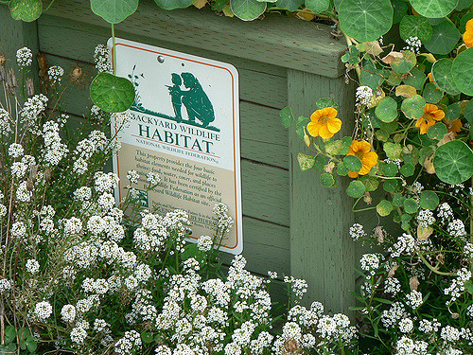
Mayors involved
Photo Credits: Muscatine, IA
Photo Credits: Hunda
Photo Credits: USFWS
Notes:
Where elected officials, government representatives, and corporate leaders pledge their support for pollinator conservation as part of a broader set of civic responsibilities
Muscantine, IA - Muscatine's Monsanto Company Plant covers 585 acres along the Mississippi River. Approximately 160 acres of the site are available for habitat enhancement projects. http://visitmuscatine.com/198/Butterfly-Garden

