Slide 1
GREEN BLOCK PARTIES
BACKYARD AND CURBSIDE COMPOSTING
COMMUNITY HERB GARDEN
SORT IT OUT WASTE STATIONS
HEALTHY LAWN, HEALTHY FAMILY

Slide 2
GREEN BLOCK PARTY OFFERS THE VILLAGE THE OPPORTUNTY TO CONNECT WITH OUR RESIDENTS AND PROMOTE OUR SUSTAINABILITY PROGRAMS
1
2
3
`
CHANGE HABITS
CONNECT
EDUCATE
Why we chose Block Parties: Block Parties are the rare opportunity to reach multi generations at one time, in a relaxed environment and community atmosphere.

Slide 3
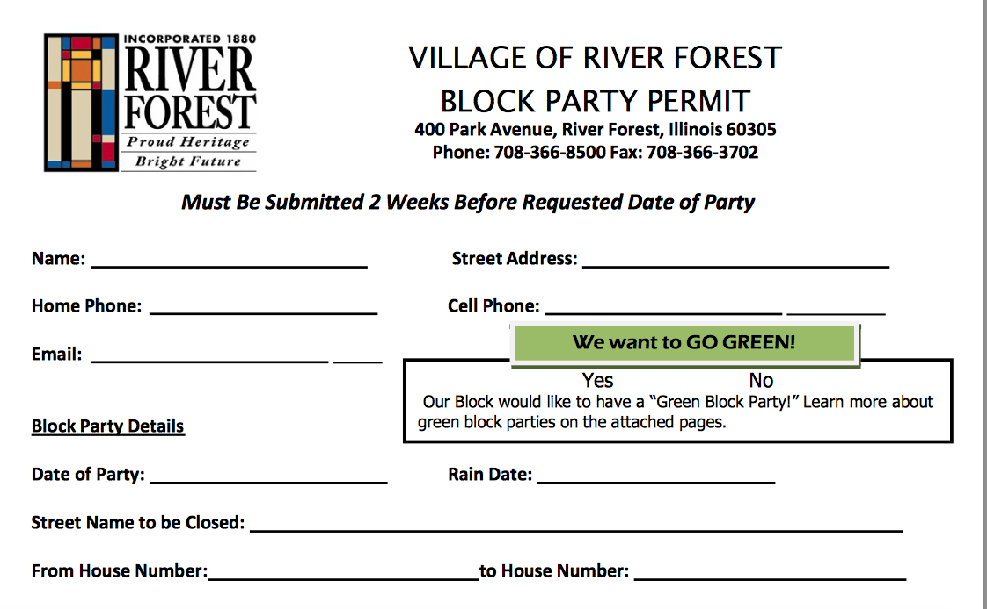

Slide 4
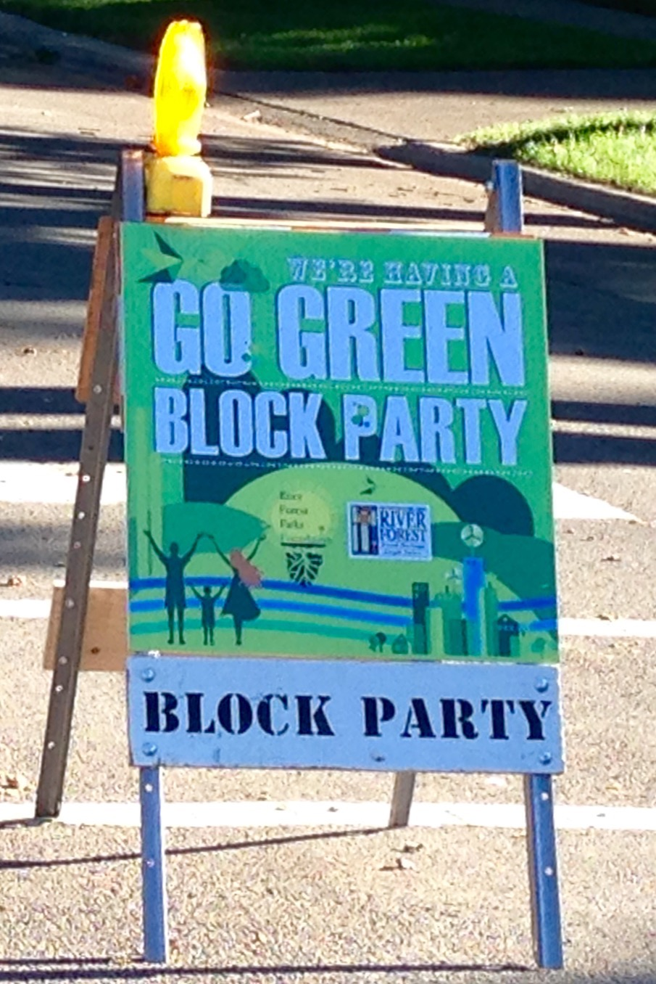

Slide 5
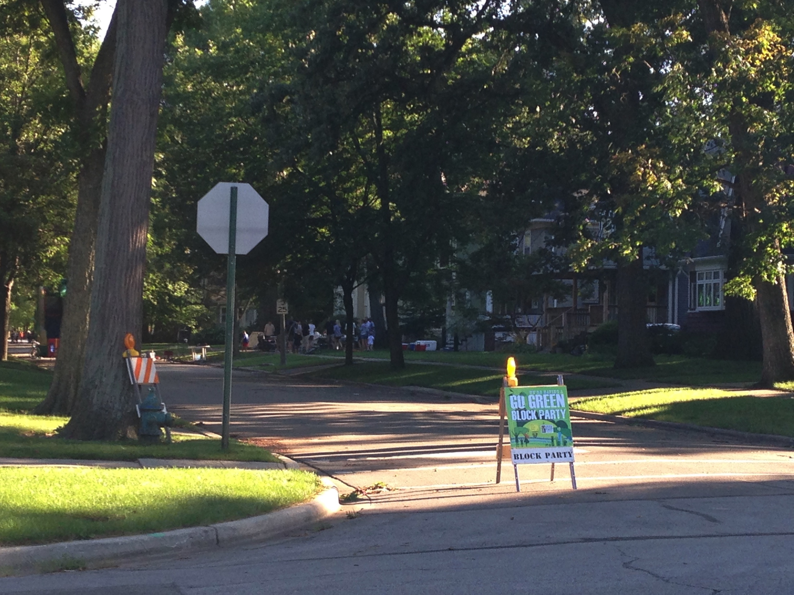
2

Slide 6
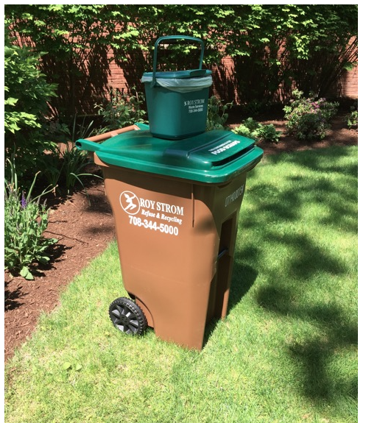

Slide 7
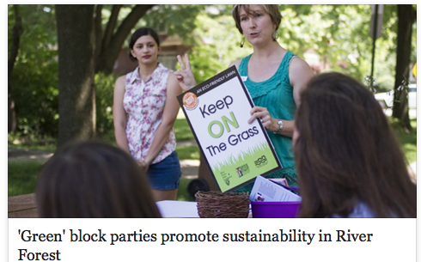

Slide 8
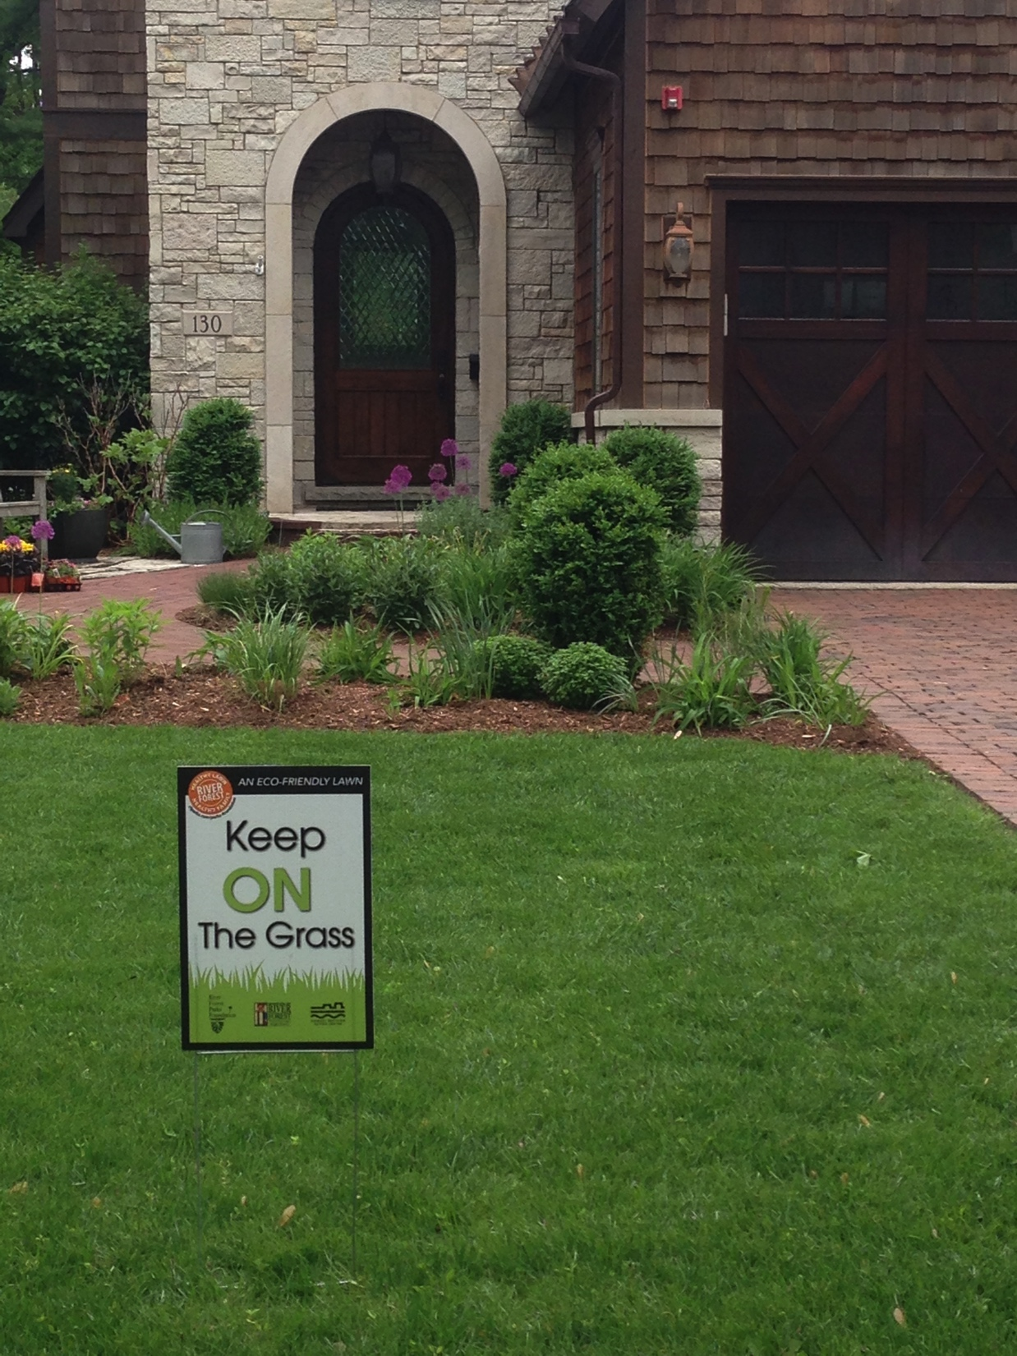
KEEP ON THE GRASS

Slide 9
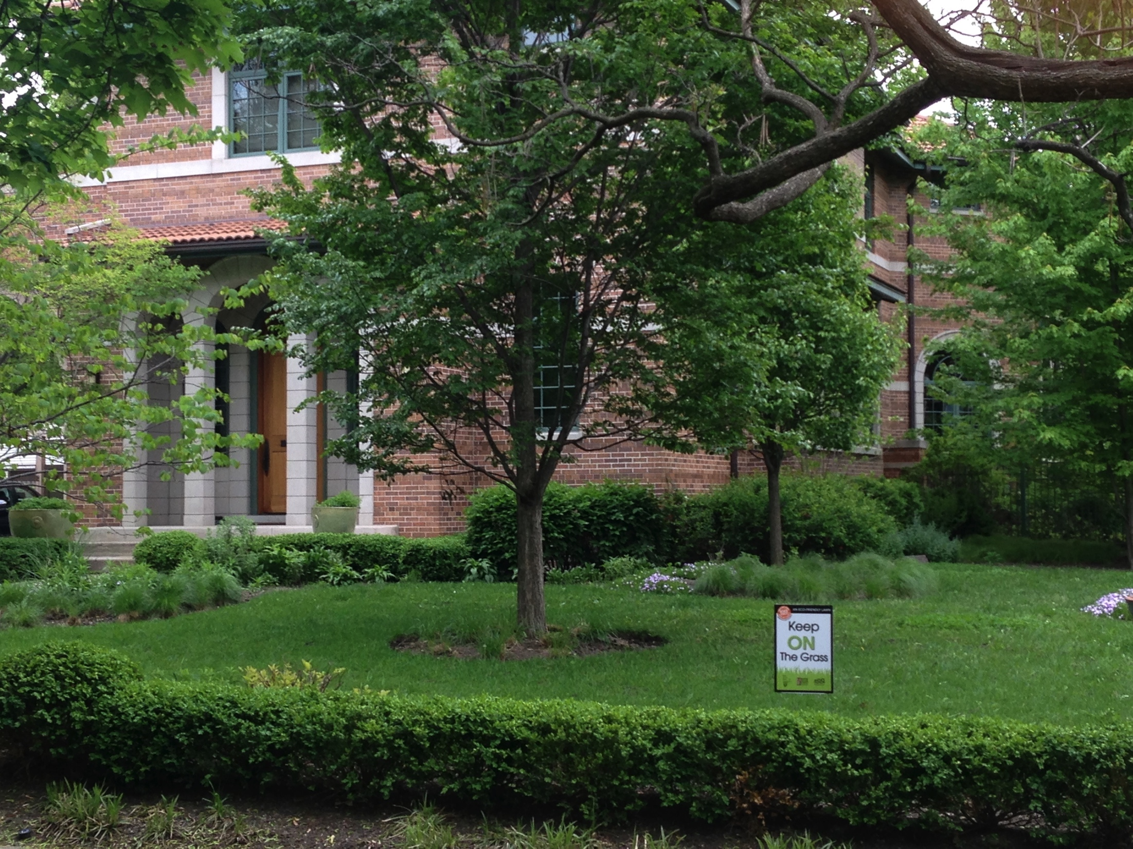
Orgaize with Sections

Slide 10
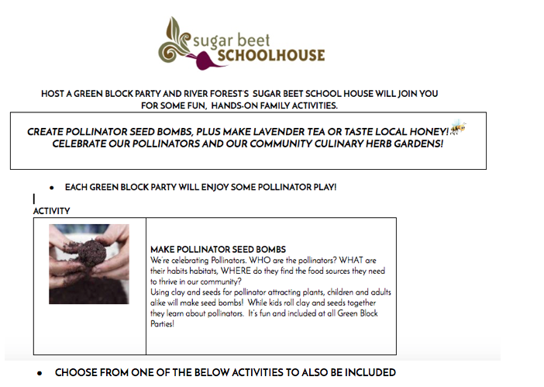

Slide 11
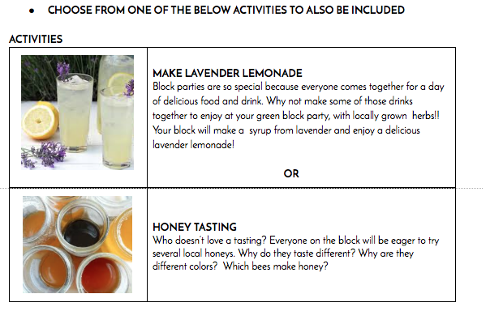

Slide 12
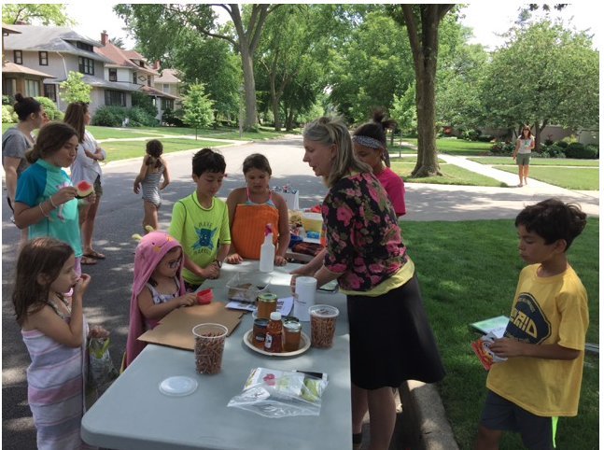
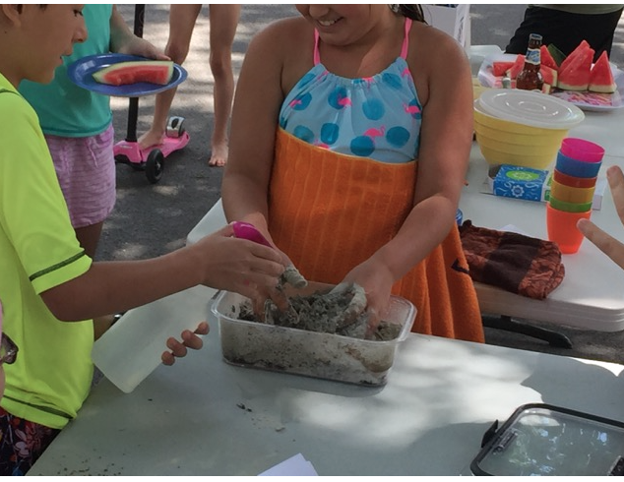

Slide 13
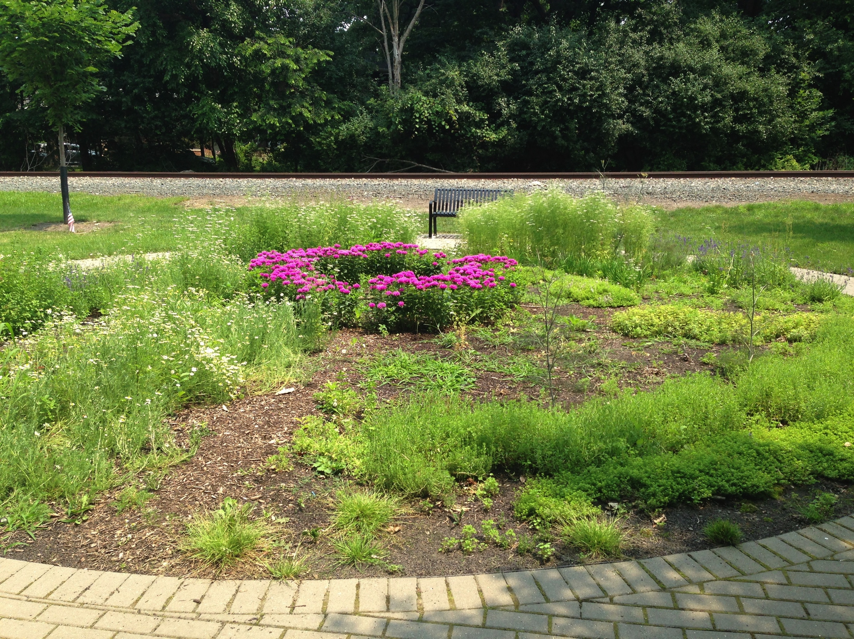
Community Herb Garden.

Slide 14
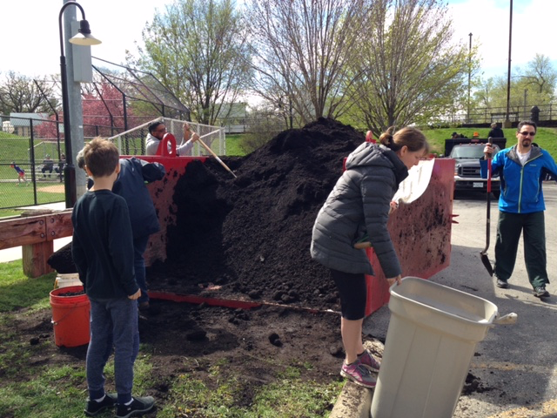
Free compost on Earth Day River Clean up.

Slide 15
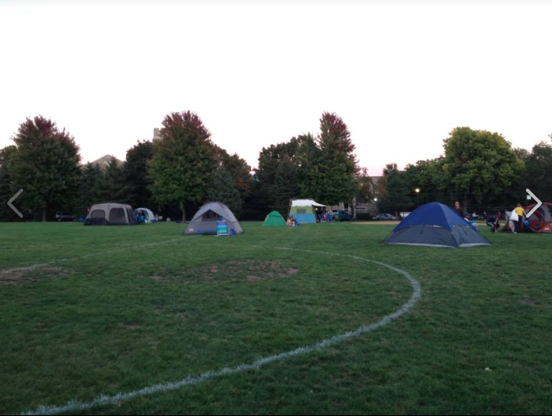

Slide 16
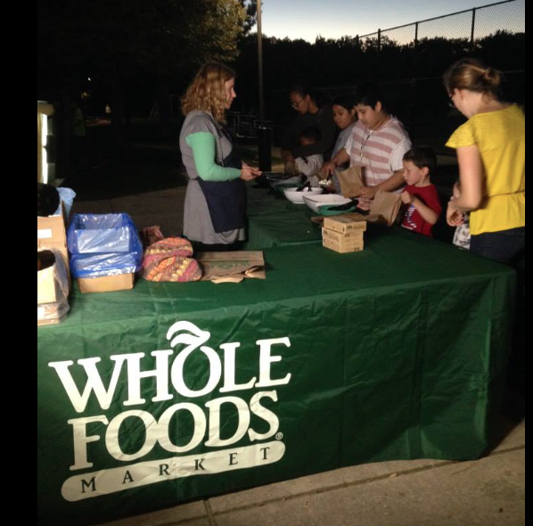
It’s not just about the visuals, but strengthening

Slide 17
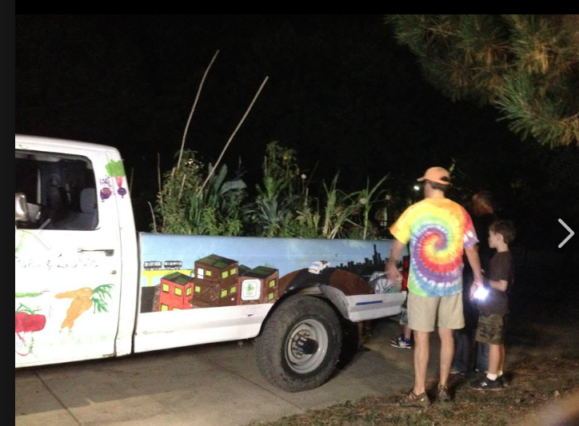
New Picture Effects
Picture

Slide 18
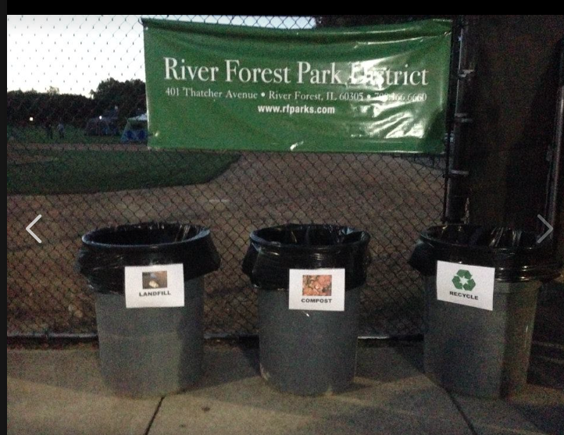

Slide 19
