Slide 1
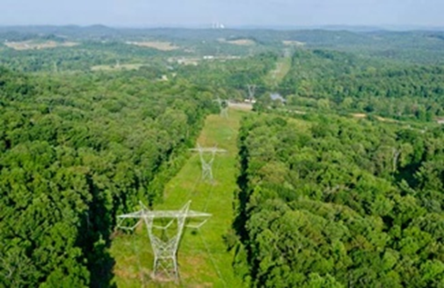
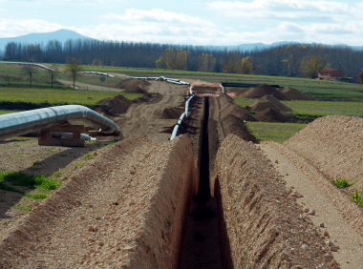
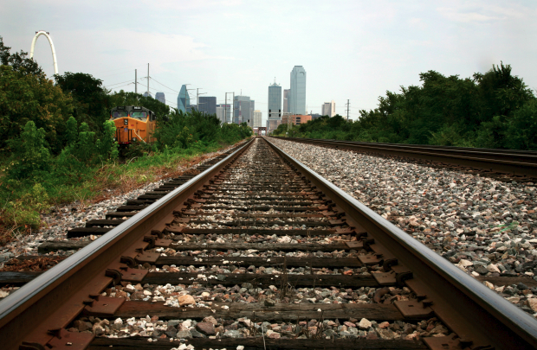
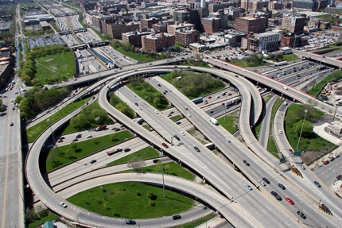
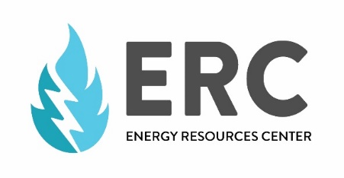
Rights-of-Way as Habitat Working Group
Metropolitan Mayors Caucus
Environmental Committee Meeting
Iris Caldwell, P.E.
March 21, 2017
Notes:
University of Illinois-Chicago in a research group called the Energy Resources Center. Again, I’d like to welcome you to our campus this morning.
Rights-of-Way as Habitat Working Group, which is a working group that I facilitate at the university. I’m going to talk about how we’re working with transportation and utility organizations to promote habitat restoration, native plants, and integrated vegetation management along rights-of-way.

Slide 2
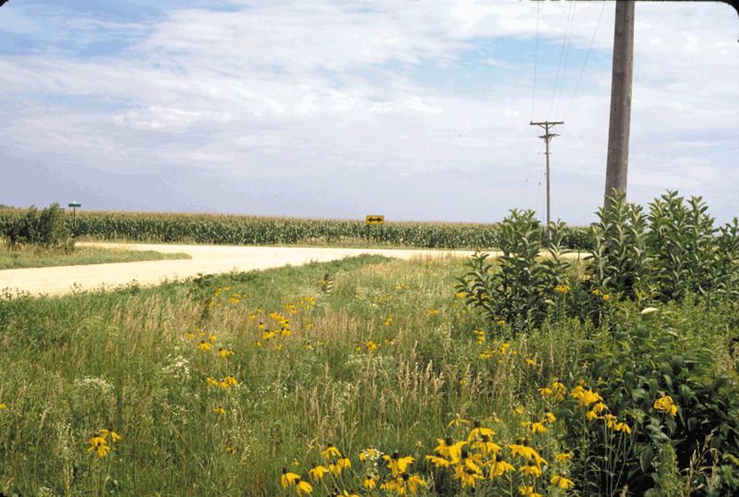
Why Rights-of-Way?
Extensive network
Linear
Intersect various landscapes
Often contain greater plant diversity than adjacent lands
Pollen and nectar sources
Nesting sites and host plants
Generally free of major disturbances
Protected from future development
Studies show that right-of-way habitats work
Photos courtesy of (top to bottom): Godfrey Hoffman Associates, LLC; Geology.com; The Dallas Morning News; St. Olaf College, Rice County Integrated Roadside.
Notes:
Rights-of-way are particularly important for a number of reasons. They are part of extensive linear conveyance networks that crisscross the country. They intersect a variety of other landscapes, including all of the ones I mentioned on the previous slide, and in doing so, connect remnant habitat areas to other favorable landscapes that can support pollinators. This landscape connectivity piece is one of the biggest benefits that rights-of-way offer.
In addition, rights-of-way provide important feeding and breeding habitat for insects and other wildlife, particularly if planted with a diverse mix of plants. In many cases, this habitat is far better than areas adjacent to or surrounding the rights-of-way, which can be intensely managed or developed.
Given that their primary purpose is safety and operational, rights-of-way can be considered semi-permanent and reasonably protected from major disturbances and future development.
However, as you probably guess, there are plenty of challenges to restoring and maintaining habitat along rights-of-way as well. Cost, expertise, invasive species, regulatory concerns, general resistance to changes, and even lack of public support present obstacles for many rights-of-way organizations.

Slide 3
Working Group’s Mission
To engage diverse stakeholders in a collaborative environment that promotes pollinator habitats and healthy ecosystems along rights-of-way by providing expertise, cost-effective best management practices, and industry-driven tools and resources.
Notes:
To help overcome some of those barriers, we initially convened a group of utilities, transportation organizations, and other interested parties in what we called the Rights-of-Way as Habitat Working Group in July 2015. Since then we’ve grown to over 160 organizations. Our mission is to create a collaborative environment that promotes habitat and healthy ecosystems in rights-of-way. We provide expertise, cost-effective BMPs, and industry-driven tools and resources.
What’s unique is that we are building coordination and knowledge sharing across different sectors—taking lessons learned from the roadside ROW and sharing them with electric utilities and railroads, vice versa. What we find is that ROW organizations from different sectors and working in different environments share more similarities than differences when it comes to managing landscapes. And we can build upon these similarities and gain new expertise and insight. We want to avoid situations where we’re reinventing the wheel within each sector or within each organization.

Slide 4
Rights-of-Way as Habitat Working Group
More than 160 industry, government, and non-profit organizations
Electric and gas utilities
Highway and transportation agencies
Railroads
Broad geographic representation across U.S.
Workshops, webinars, online resources library and discussion board, geospatial database
Notes:
We have more than 160 organizations from across the U.S. and most recently Canada that represent mostly electric and gas utilities, highways and state Departments of Transportation, and railroads. We hold workshops and webinars; we’ve developed an online resources library and discussion board; and we’re in the process of developing a geospatial database of current habitat that located in rights-of-way or on other lands managed by rights-of-way organizations.
I personally find all of this work and the enthusiasm among the utility and transportation sectors incredibly promising, particularly in concert with the other corridor initiatives presented today. These large scale rights-of-way corridors play an important role in connecting, building upon, and raising awareness of habitat opportunities.

Slide 5
Thank you
CONTACT INFORMATION:
Iris Caldwell, P.E. Research Engineer
Energy Resources Center University of Illinois at Chicago
Email: iriscald@uic.edu Phone: (312) 355-1483

