Slide 1
Energy Market Update
Update on status of FEJA, PACE Financing and 100% Renewable Goals for the Metropolitan mayors caucus

Slide 2
Overview
Future Energy Jobs Act
Property Assessed Clean Energy (PACE) Financing
100% Renewable Goals
Conclusions

Slide 3
Future Energy Jobs Act
Status, Opportunities, Options

Slide 4
Future Energy Jobs Act (FEJA)
New energy legislation in Illinois
Negotiated by Exelon and a range of environmental & consumer advocates
Passed by legislature on December 1, 2016
Signed by Governor on December 9, 2016
Enacted June 1, 2017
Primary components
Zero Emissions Credits – Purchased from Exelon’s Quad Cities an Clinton plants ($2.35 billion/10 years)
Energy Efficiency – Lifts cost cap and places efficiency expenses into utility ratebase ($350 million/year)
Renewable Energy – Fundamental changes to Illinois Renewable Portfolio Standard
Prioritizes RPS compliance towards long term contracts (15 year REC purchases with utilities)
Positions most RPS transactions between utilities and renewable resource owners
Redirects Renewable Energy Resources Fund towards low income (‘Illinois Solar for All’)
Increases the solar carve out from 6% to 50% of RPS goal

Slide 5
Future Energy Jobs Act (FEJA)
New energy legislation in Illinois
Negotiated by Exelon and a range of environmental & consumer advocates
Passed by legislature on December 1, 2016
Signed by Governor on December 9, 2016
Enacted June 1, 2017
Primary components
Zero Emissions Credits – Purchased from Exelon’s Quad Cities an Clinton plants ($2.35 billion/10 years)
Energy Efficiency – Lifts cost cap and places efficiency expenses into utility ratebase ($350 million/year)
Renewable Energy – Fundamental changes to Illinois Renewable Portfolio Standard
Requires utilities to purchase wind and solar through 15-year contracts
Increases the carve out for solar purchases from 6% to 50%
Establishes separate goals for utility, community, brownfield and residential solar projects
Establishes special funding for ‘income qualified’ communities & consumers

Slide 6
FEJA: Solar Opportunities
Utility Scale Solar (> 2,000 kW nameplate capacity)
Community Solar (<2,000 kW nameplate capacity)
Brownfields / Illinois Solar for All
Generally requires more than 10 acres
Owner can sell electricity outputs to wholesale offtakers
Generally requires less than 10 acres
Retail consumers can subscribe to receive billing credits
Special carve outs for projects on USEPA/IEPA brownfields
Distributed Solar (<2,000 kW nameplate capacity)
Rooftop or land-mounted
Electricity largely consumed where it is generated
~$200 million in funding for Income Qualified communities

Slide 7
Community Solar: What is it?
Alternative to Rooftop Solar
Consumers purchase a portion of the generation from a remote solar resource
Utilities credit the consumer’s portion of monthly solar generation on monthly electricity bills
Potential Benefits
Access to solar for consumers that don’t own their homes, have a suitable roof, or have good credit
Reduces the cost of solar by capturing economies of scale
Funds development of new clean generation in Illinois
Now allowed in Illinois
Future Energy Jobs Act
156 MW in ComEd region by 2020

Slide 8
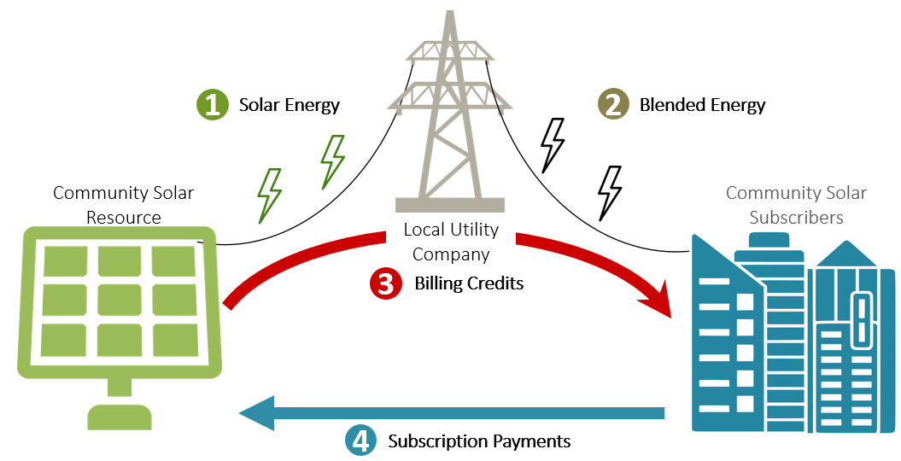
Community Solar: How does it Work?
Community Solar asset delivers energy to the Local Utility.
Local Utility delivers blended energy to consumers
Local Utility applies on-bill credits to Community Solar Subscribers.
Subscribers pay a portion of their on-bill credits to the Community Solar developer
1
2
3
4

Slide 9
Community Solar: Where’s the Value?
Community Solar Cost & Revenue Elements | Low Range (¢/kWh) | High Range (¢/kWh)
A. Costs (Levelized - 20 Years)
Materials & Construction (¢/kWh) | 9.6 | 10.7
Site Acquisition & Preparation (¢/kWh) | 1.7 | 2.7
Operations & Management (¢/kWh) | 1.7 | 1.9
Total Solar Project Costs (¢/kWh) | 13.0 | 15.3
B. Incentives (Levelized - 20 Years)
Investment Tax Credit - Federal (¢/kWh) | 2.1 | 2.3
Accelerated depreciation – Federal (¢/kWh) | 1.5 | 1.6
Renewable Energy Credits – State (¢/kWh) | 5.8 | 5.8
Smart Inverter Grant – Utility (¢/kWh) | 0.9 | 0.9
Total Solar Project Incentives (¢/kWh) | 10.3 | 10.6
C. Energy Sales Requirement (Levelized - 20 Years)
Payments from Subscribers | 2.7¢/kWh | 4.7¢/kWh
Cost to Generate
Value of Incentives
Net Revenue Requirement

Slide 10
Community Solar: Where’s the Value?
Subscription Cost
2.7-4.7¢/kWh
Retail Supply
Paid
Hourly Price
Default Supply
Subscription Cost
Energy Supplier
Contract Type
Paid
Energy Only
Hourly
Energy Only
Capacity + Energy
Energy Only
Hourly
Fixed Price
Fixed Price
Franchise
Fixed Price
Capacity + Energy
Energy Only
Pricing Structure
Subscription Value Basis
Subscription Value
6.1¢/kWh
~3.0¢/kWh
~2.8¢/kWh
~2.8¢/kWh
6.1¢/kWh
~2.8¢/kWh

Slide 11
Community Solar: What’s it Worth?
Pricing Variables for One Small Account | Unit Price (¢/kWh) |  | $/10,000 kWh
 | Default | Supply | Default | Supply
A. Energy Supply Cost
Energy Commodity (¢/kWh) | 3.6 | 3 | $360 | $300
Capacity (¢/kWh) | 2.5 | 2.5 | $250 | $250
Transmission (¢/kWh) | 1.5 | 1.5 | $150 | $150
Energy Supply Cost (¢/kWh) | 7.6 | 7 | $760 | $700
B. Subscription Credit
Energy Commodity (¢/kWh) | -3.6 | -3 | ($360) | ($300)
Capacity (¢/kWh) | -2.5 | 0 | ($250) | -
Gross Subscription Value (¢/kWh) | -6.1 | -3 | ($610) | ($300)
C. Net Price to Consumer
Energy Supply Cost (¢/kWh) | 7.6 | 7 | $760 | $700
Subscription Credit (¢/kWh) | -6.1 | -3 | ($610) | ($300)
Subscription Cost (¢/kWh) | 4.5 | 4.5 | $450 | $450
Net Cost to Consumer (¢/kWh) | 6 | 8.5 | $600 | $850

Slide 12
Community Solar: What’s it Worth?
Pricing Variables for One Small Account | Unit Price (¢/kWh) |  | $/10,000 kWh
 | Default | Supply | Default | Supply
A. Energy Supply Cost
Energy Commodity (¢/kWh) | 3.6 | 3 | $360 | $300
Capacity (¢/kWh) | 2.5 | 2.5 | $250 | $250
Transmission (¢/kWh) | 1.5 | 1.5 | $150 | $150
Energy Supply Cost (¢/kWh) | 7.6 | 7 | $760 | $700
B. Subscription Credit
Energy Commodity (¢/kWh) | -3.6 | -3 | ($360) | ($300)
Capacity (¢/kWh) | -2.5 | 0 | ($250) | -
Gross Subscription Value (¢/kWh) | -6.1 | -3 | ($610) | ($300)
C. Net Price to Consumer
Energy Supply Cost (¢/kWh) | 7.6 | 7 | $760 | $700
Subscription Credit (¢/kWh) | -6.1 | -3 | ($610) | ($300)
Subscription Cost (¢/kWh) | 4.5 | 4.5 | $450 | $450
Net Cost to Consumer (¢/kWh) | 6 | 8.5 | $600 | $850
Default + Subscription
$100 less than Retail only
$160 less than Default only

Slide 13
Community Solar: What’s it Worth?
Pricing Variables for Many Small Accounts | Unit Price (¢/kWh) |  | $/2,000,000 kWh
 | Default | Supply | Default | Supply
A. Energy Supply Cost
Energy Commodity (¢/kWh) | 3.6 | 3 | $72,000 | $60,000
Capacity (¢/kWh) | 2.5 | 2.5 | $50,000 | $50,000
Transmission (¢/kWh) | 1.5 | 1.5 | $30,000 | $30,000
Energy Supply Cost (¢/kWh) | 7.6 | 7 | $152,000 | $140,000
B. Subscription Credit
Energy Commodity (¢/kWh) | -3.6 | -3 | ($72,000) | ($60,000)
Capacity (¢/kWh) | -2.5 | 0 | ($50,000) | -
Gross Subscription Value (¢/kWh) | -6.1 | -3 | ($122,000) | ($60,000)
C. Net Price to Consumer
Energy Supply Cost (¢/kWh) | 7.6 | 7 | $152,000 | $140,000
Subscription Credit (¢/kWh) | -6.1 | -3 | ($122,000) | ($60,000)
Subscription Cost (¢/kWh) | 4.5 | 4.5 | $90,000 | 90,000
Net Cost to Consumer (¢/kWh) | 6 | 8.5 | $120,000 | $170,000
Default + Subscription
$20,000 less than Retail only
$32,000 less than Default only

Slide 14
Community Solar: Challenges
SREC Lottery
- Funding for 156 MW
- 800 MW of projects
- Lottery trigger @200% of funding limit
- Developer cannot guarantee availability
Pre-Lottery commitment is challenging
40% Volume Cap
- A Subscriber may take more than 40% of a single project’s output
- Developer cannot guarantee availability
Incentives
- Economics are best for small accounts, marginal for large accounts
Need access to multiple projects to meet needs
Need to carefully structure the account portfolio
Term
- Projects require long-term guaranteed cash flows
Developers need 15-20 year commitments

Slide 15
Municipal Role in Solar Project development
Inventory. Create an inventory of available land and rooftop space in the community.
Zoning/Permitting. Adopt appropriate zoning for utility, community, and distributed solar.
Financing. Utilize industrial development bonds and enterprise zones to support solar project development.
Subscription. Purchase subscriptions to local or regional community solar projects for municipal facilities.
Hosting. Lease municipal land for use as a solar project site.
Short-listing. Create a preferred developer list for residents and business to use at their option.
Enrollment. Facilitate subscription of local accounts into local solar projects.
Enrollment
Subscription
Value
Zoning / Permitting
Hosting
Short-listing
Financing
Inventory
Municipal Involvement

Slide 16
Community Solar: Municipal Opportunities
Adopt unified rooftop solar permitting processes
Subscribe Municipal Accounts
Update Zoning / Permitting
Prepare zoning for brownfield and community solar development
Combine Solar & Aggregation
Structure supply agreements with prices that match the monthly ComEd rate and require a % of Community Solar content
Recommendation: Select a supplier now that is negotiating Community Solar supply agreements, and negotiate short-term (1-5 year) agreement ahead of 2019.
Subscribe municipal accounts to one or more Community Solar resources to achieve lower net costs
Investigate SolSmart program expansion for more municipalities
Recommendation:
Create a purchasing group to leverage lower prices, manage the 40% rule, optimize small accounts, and protect against IPA lottery.
Recommendations:

Slide 17
Property Assessed Clean Energy (PACE) Financing
Status, Opportunities, Options

Slide 18
PACE Financing: What is It?
Alternative Low-Cost Energy Project Financing
Property Assessed Clean Energy (“PACE”) is a project financing vehicle for owners of commercial, industrial, and other non-residential properties to obtain low-cost, long-term financing for energy efficiency, renewable energy and other types of projects.
Potential Benefits
100% project financing with no up-front costs for up to 30 years
Loan repayment appears as special assessment on property tax bill
Loan obligation automatically transfers to the new owner upon sale
No bonding requirement or reduction in property tax collections for municipality
Now allowed in Illinois
Public act 100-0077
DuPage County and other counties are reviewing

Slide 19
PACE Financing: What is it?
Major Systems (100% Financing)
Building Envelope (100% Financing)
Power Generation (100% Financing)
Solar PV
Heating
Insulation
Air Sealing
Duct Sealing
Windows
Doors
Roofs
Air Conditioning
Ventilation
Water Heating
Lighting
Building Management Systems
Pool Equipment
Solar Thermal
Wind
Geothermal
Water Catchment
Cogeneration

Slide 20
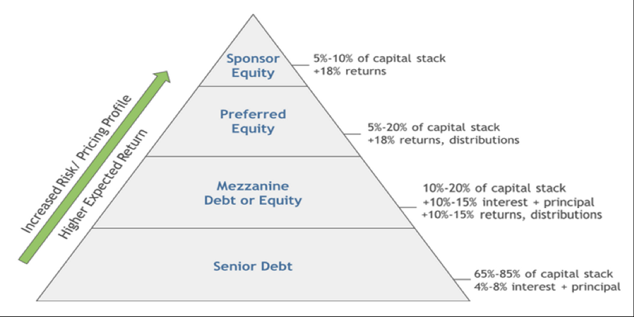
PACE Financing: Where’s the Value?

Slide 21
PACE Financing: Where’s the Value?

Slide 22
PACE Financing: Where’s the Value?
 | Before PACE | $100M Capital Stack | After PACE
Senior Debt | 6.25% | $49.5M | 6.25% | Senior Debt
Tax Credits | 3.00% | $21.9M | 3.00% | Tax Credits
Mezzanine Loan | 15.00% | $23.9M | 6.13% | PACE Finance
Equity | 10.00% | $22.4M | 10.00% | Equity
 | 9.29% | Weighted Average Cost of Capital | 7.46%

Slide 23
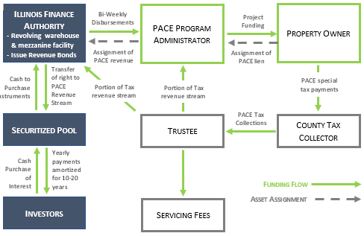
PACE Financing: How does it Work?
Illinois Finance Authority (IFA) securitizes syndicated capital from investors
IFA makes capital available to Program Administrator
Program Administrator issues loan to Property Owner in exchange for PACE lien
County collects PACE Assessment on property tax bills and passes through to Trustee
Trustee distributes PACE Assessment to Administrator, IFA, and other service providers
1
2
3
2
3
1
5
4
4
5

Slide 24
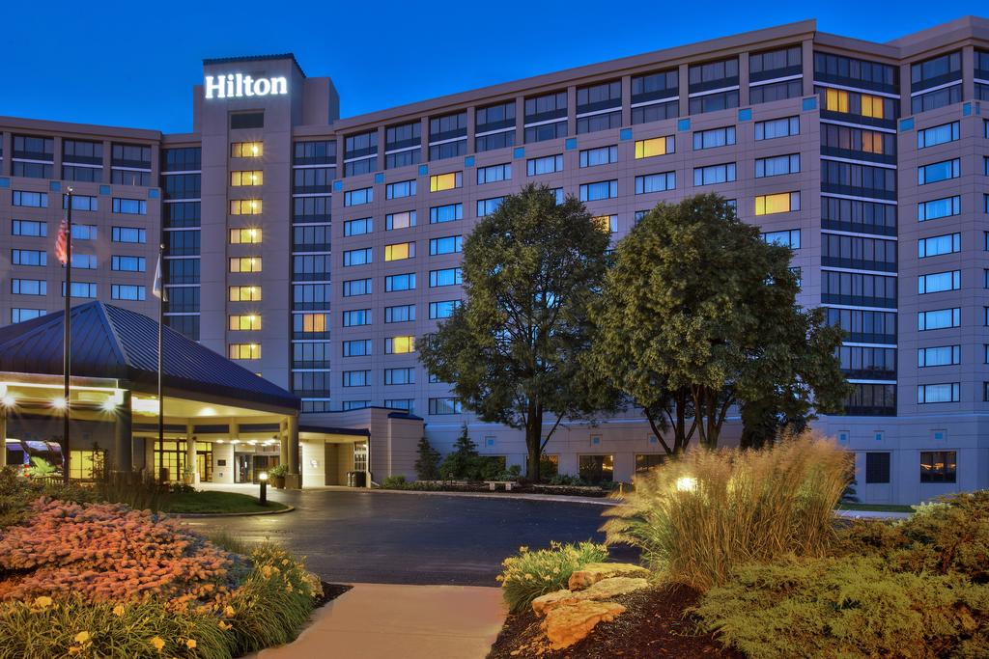
PACE Financing: What’s it Worth?
Oakbrook Hilton
Planned renovation
Energy Conservation Measures
LED lighting
Lighting controls & sensors
Cooling & Refrigeration
VSD & exhaust fans
Building automation system
Energy management system
Kitchen hood controls
Swimming pool covers
Cogeneration system

Slide 25
PACE Financing: What’s it Worth?
Original budget: $1.5 million
Final budget: $4.7 million
20-year funding term
6.5% PACE financing
Impact
100% financing
Off-Balance sheet
Captured all available utility rebates and other tax incentives
$550,000 increase in Net Operating Income

Slide 26
PACE Financing: Municipal Role
Policies
- Single or multiple finance providers
- Ordinance
- County notice
Recommendation:
Select an Open Structure
Administration
- Single or multiple programs within the municipality
- Engage program administrator
Recommendation: Start with a Single Administrator
Capital
- Municipal debt
- Illinois Finance Authority
Recommendation: Use Illinois Finance Authority
Structure
- Assessment
- Commercial
- Control
- Fees
- Amend over time
Recommendation:
Create a Plan of Governance

Slide 27
PACE Financing: Potential Benefits
Lower costs for new construction and renovation development
Policy Fulfillment
Economic Development
Cost Neutrality
Costs borne by developers
Aligns development with sustainability goals
Accelerate project development
Foster compliance with new code requirements
No requirement for municipal funding
Payment obligation transfers with property sale

Slide 28
100% Renewable Energy Initiatives
Status, Opportunities, Options

Slide 29
100% Renewable – What is it?
Organizations are advocating for commitments to “100% renewable energy”
Ready for 100 (Sierra Club)
RE100 (there100.org)
Renewable Energy Challenge (City of Chicago)
Very little detail
RECs or renewable energy?
Wind, solar, biomass, other?
Measurement and verification?
Include efficiency?
Directional assessment for municipalities
What can be accomplished by municipalities?
How can progress be made?

Slide 30
Municipal Role in 100% Renewable
Plan / Benchmark. Community energy benchmarking reports, and inventory of available program options for the community.
Facilitate. Adopt appropriate permitting and zoning to remove barriers to the development of native renewable energy assets.
Sponsor. Create programs that assist community members access renewable energy (i.e. aggregation).
Participate. Purchase renewables for municipal utility accounts.
Impact
Sponsor
Facilitate
Participate
Plan / Benchmark
Municipal Involvement

Slide 31
100% Renewable: Outlook & Options
Likely a concept that advocates will continue to press
It’s conceptually simple
Builds on recent successes (FEJA)
Municipalities face limits that advocates may not appreciate
No control over private sector energy transactions
Resource availability
Municipalities may benefit from crafting their own approach to 100% Renewable
Define terms and compliance
Set standards
Share the cost of developing program options

Slide 32
Thank You Very Much
Mark J. Pruitt
The Power Bureau
P. 219/921-3828
E. markjpruitt@thepowerbureau.com

