Slide 1
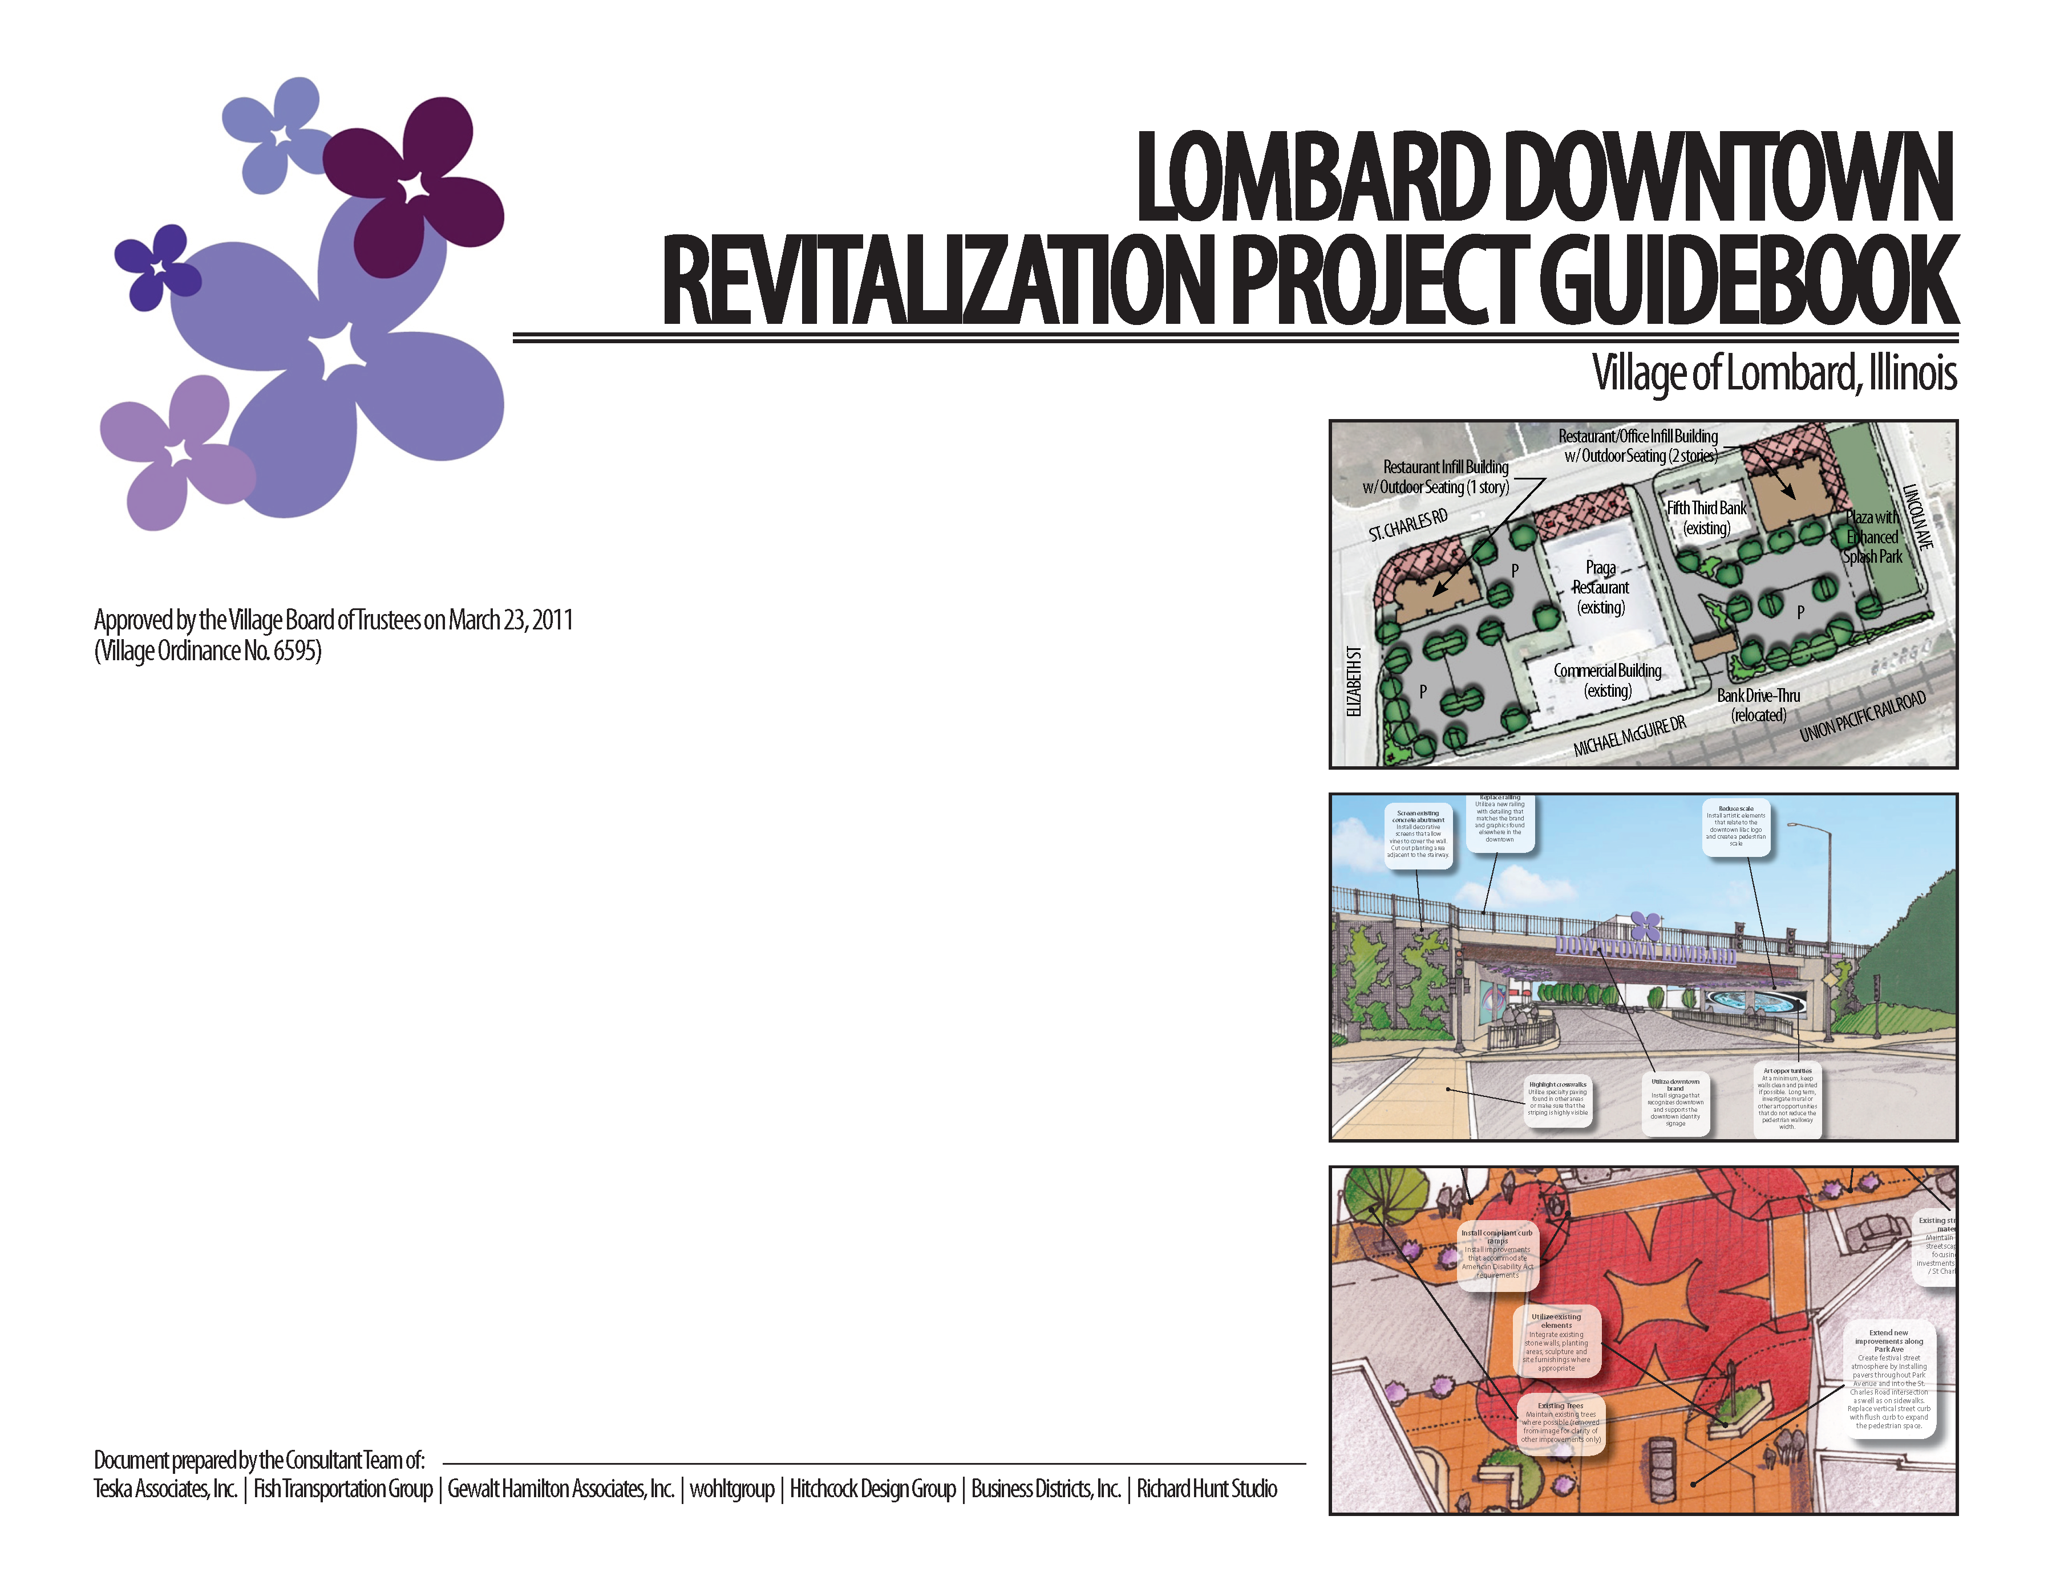
LOMBARD DOWNTOWN REVITALIZATION GUIDEBOOK (2011)
Past planning efforts – parking study, visioning workshops, framework plan, market study
Project Guide (not a plan)
Detailed catalog of projects to put recommended strategies into action
  Economic Development
  Site Development
  Streetscape & Façade Enhancements
  Public Art
  Signage
  Parking
  Roadways & Multi-Modal Transportation

Slide 2
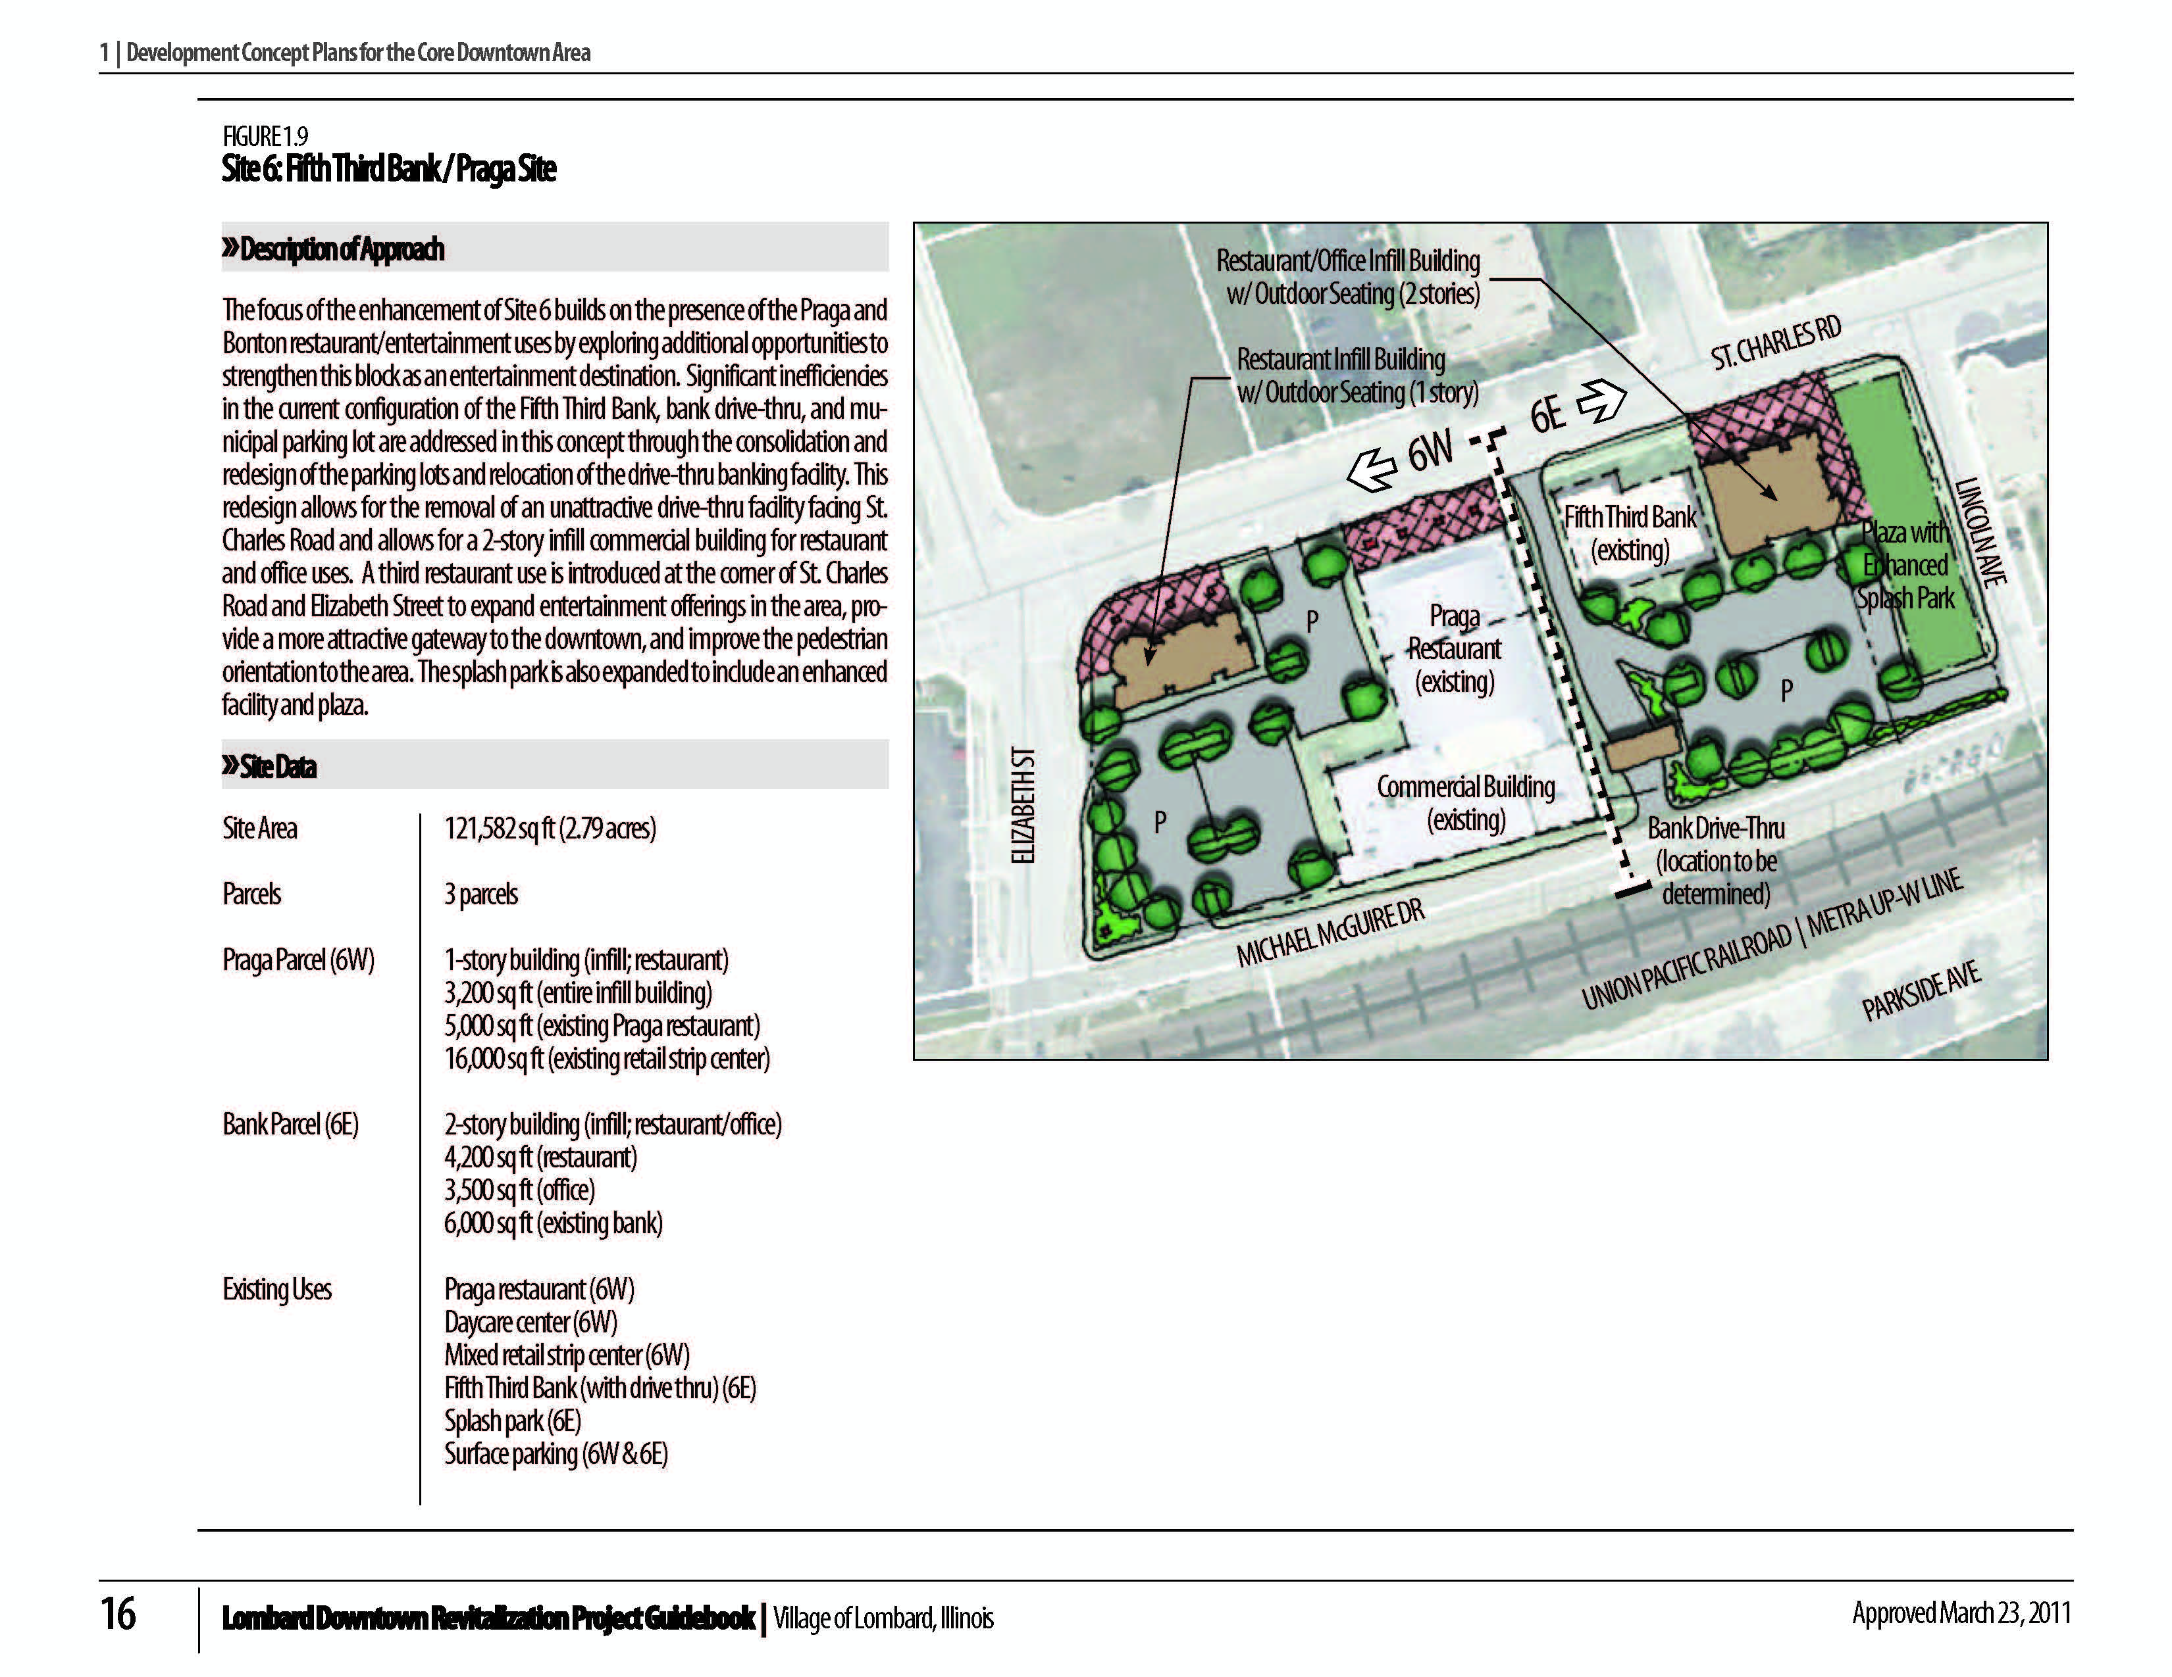
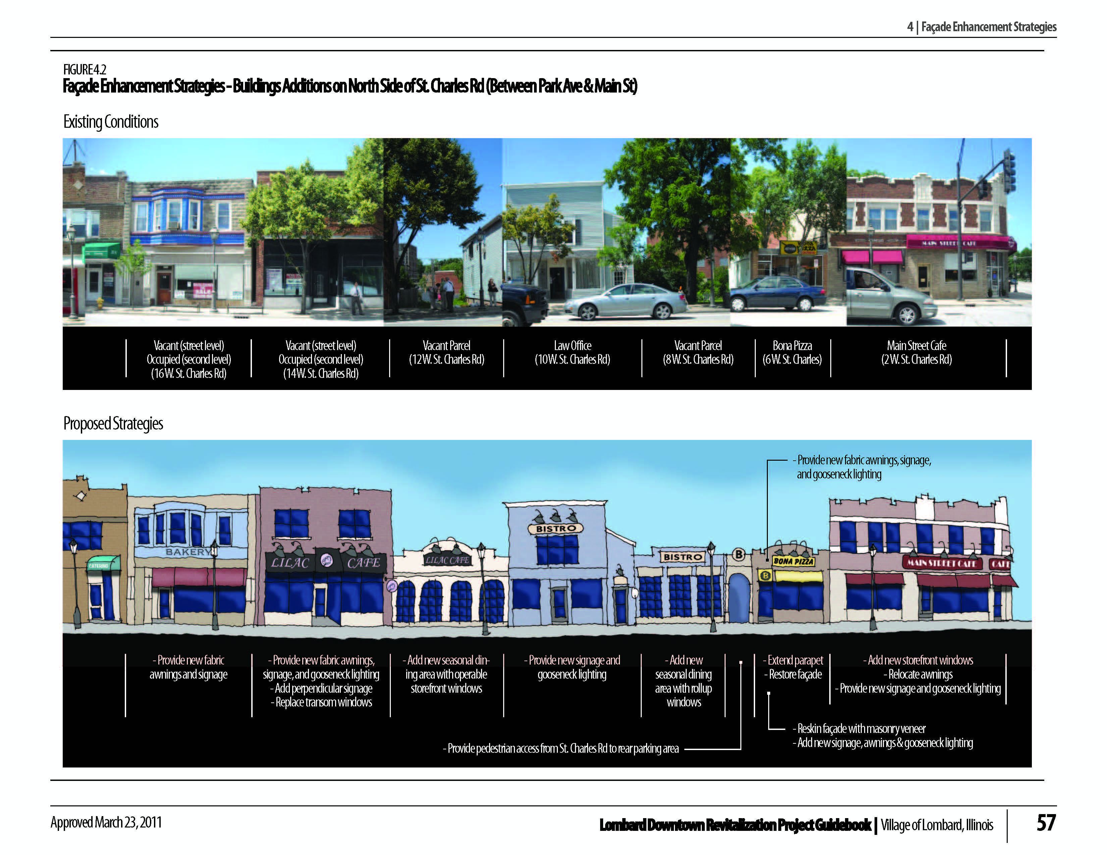
LOMBARD DOWNTOWN REVITALIZATION GUIDEBOOK (2011)

Slide 3
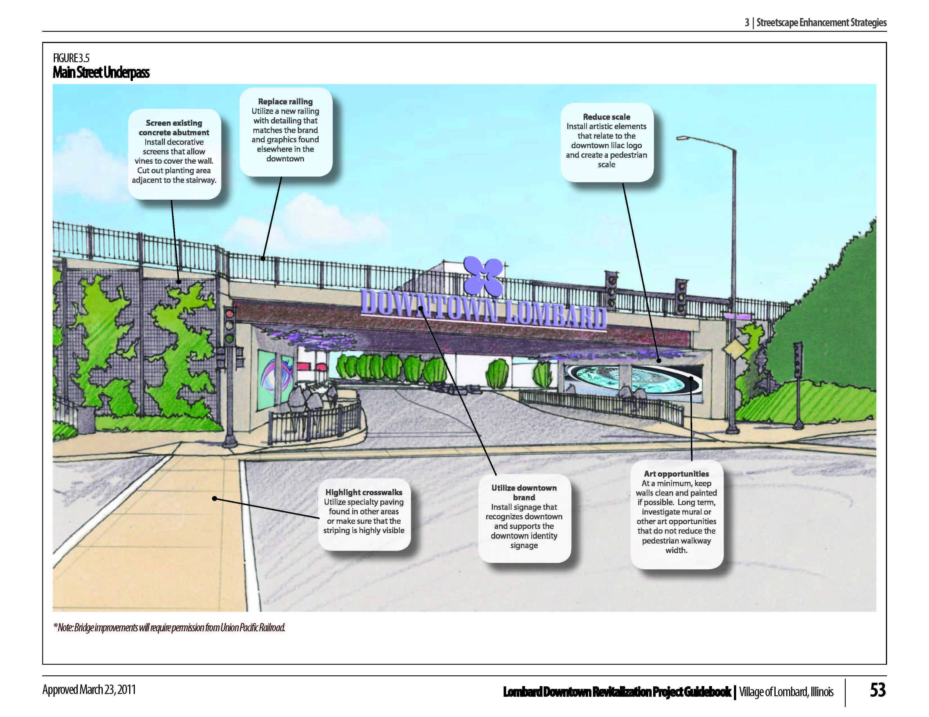
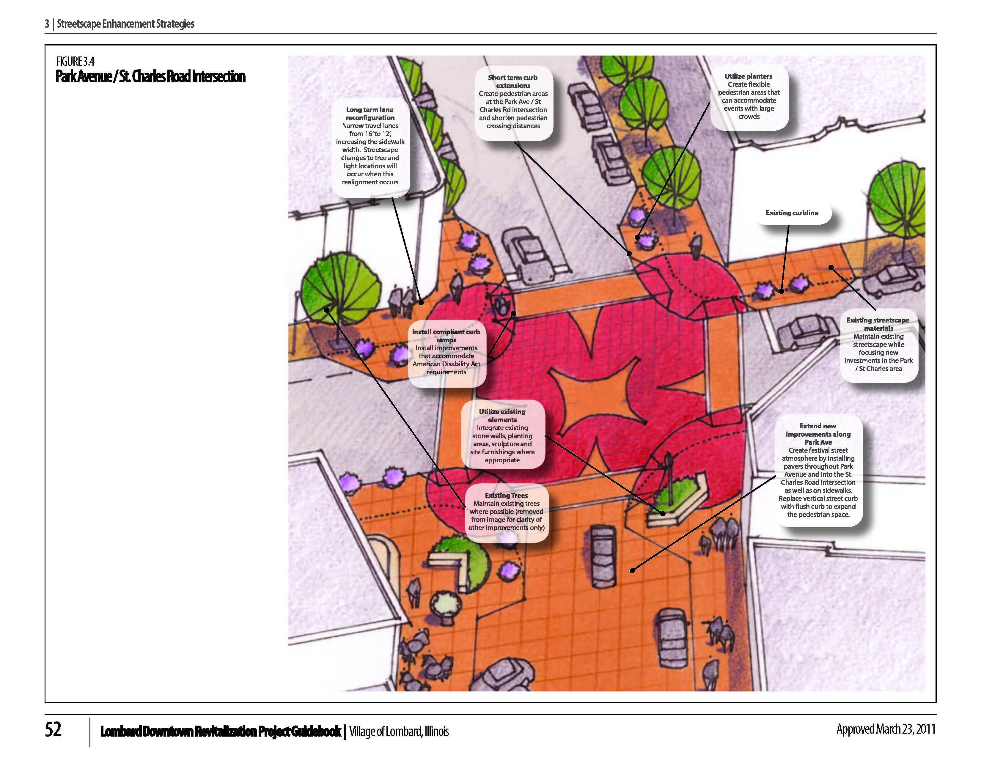
LOMBARD DOWNTOWN REVITALIZATION GUIDEBOOK (2011)

Slide 6
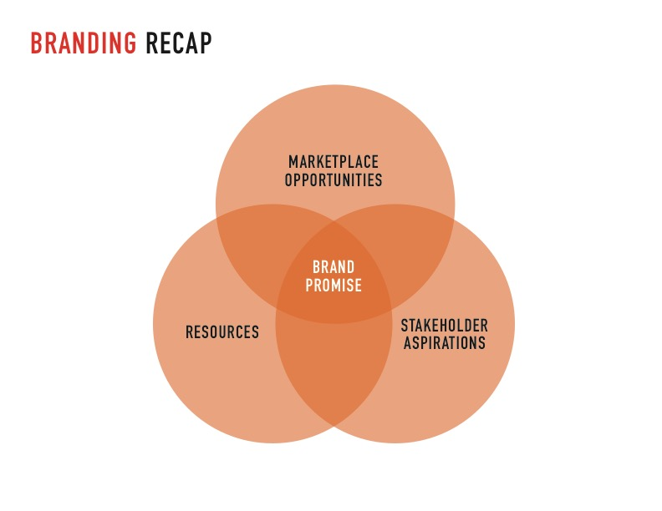

Slide 7
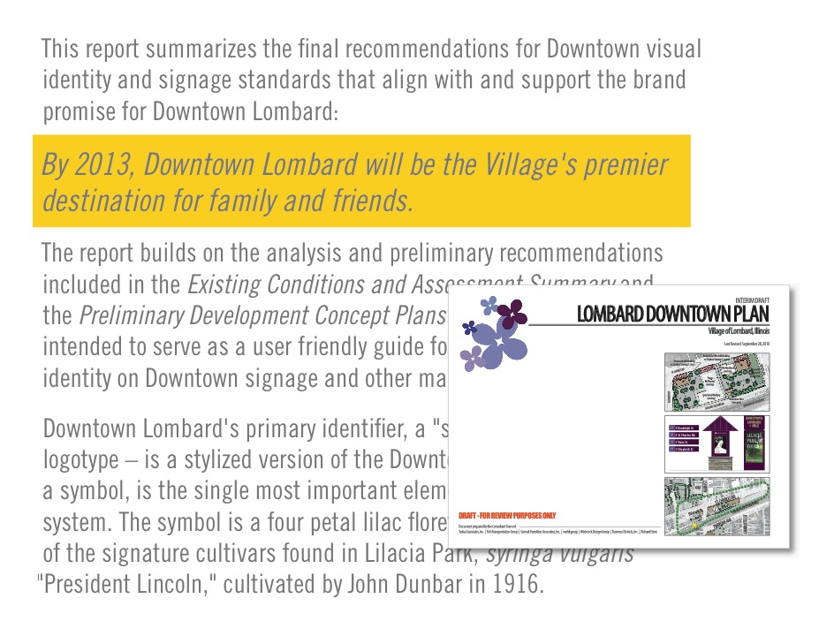

Slide 8
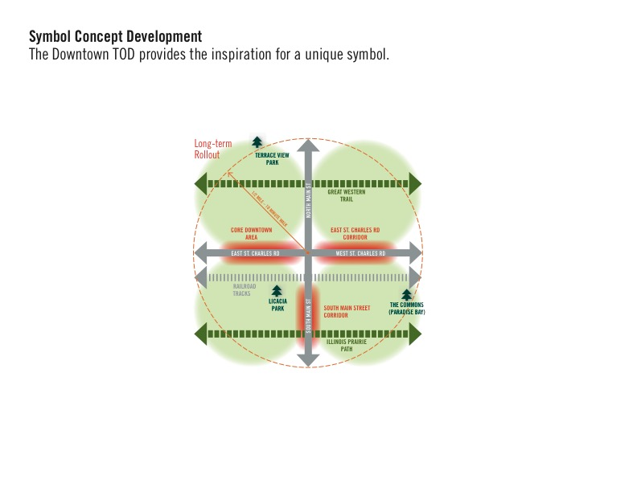

Slide 9
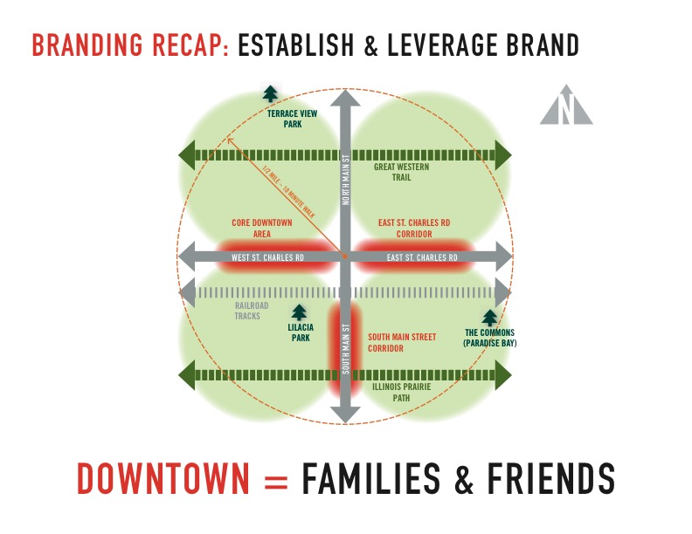

Slide 10
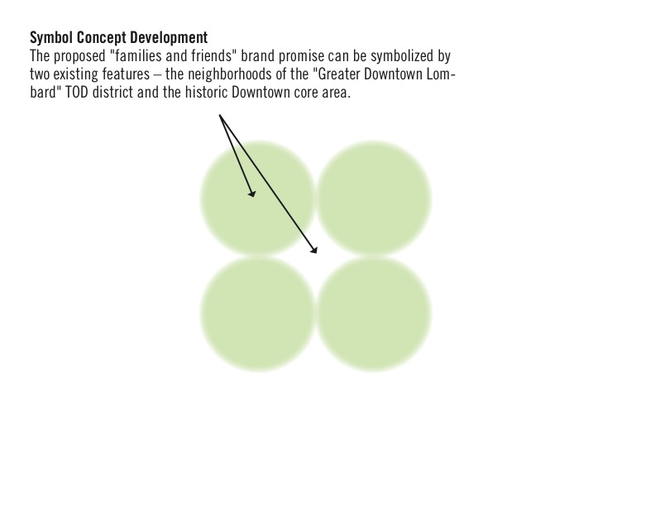

Slide 12
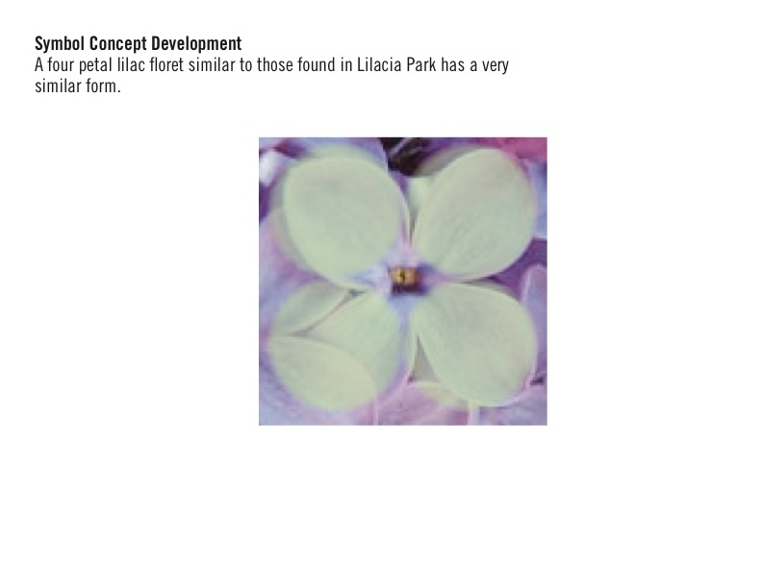

Slide 24
Insert Dave’s Implementation Slides

Slide 26
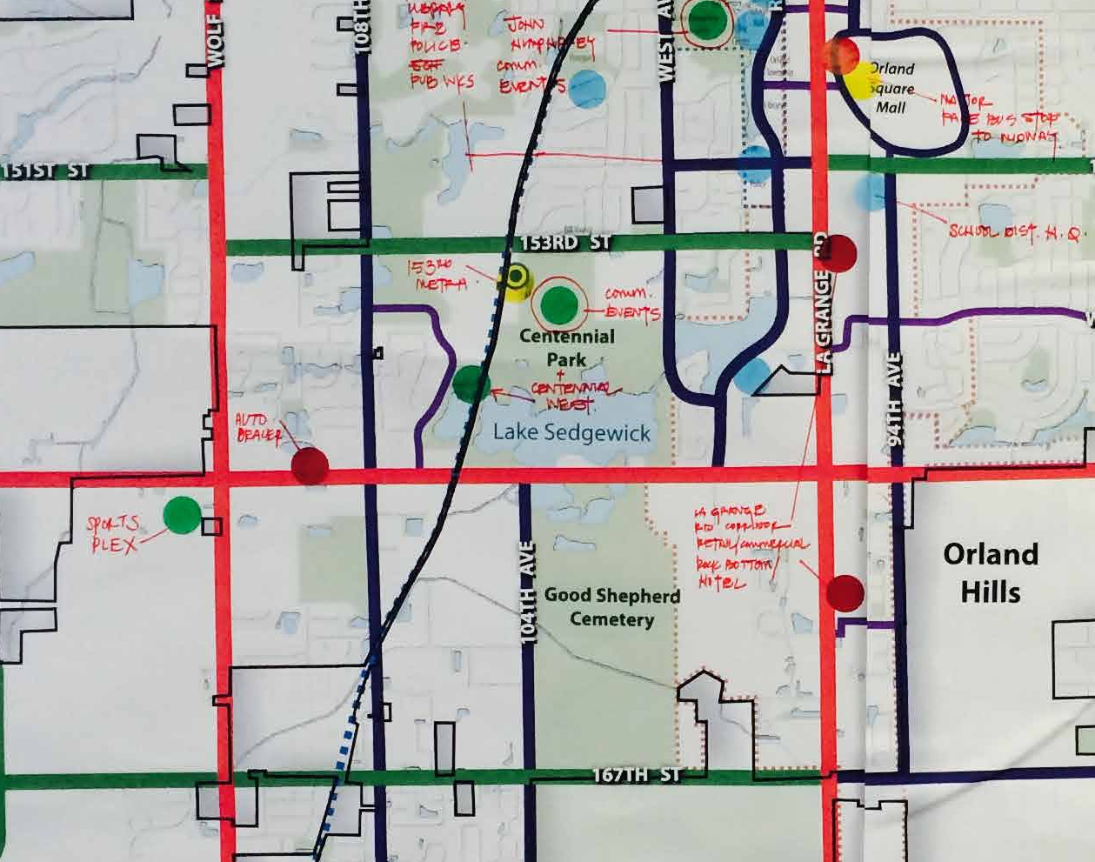
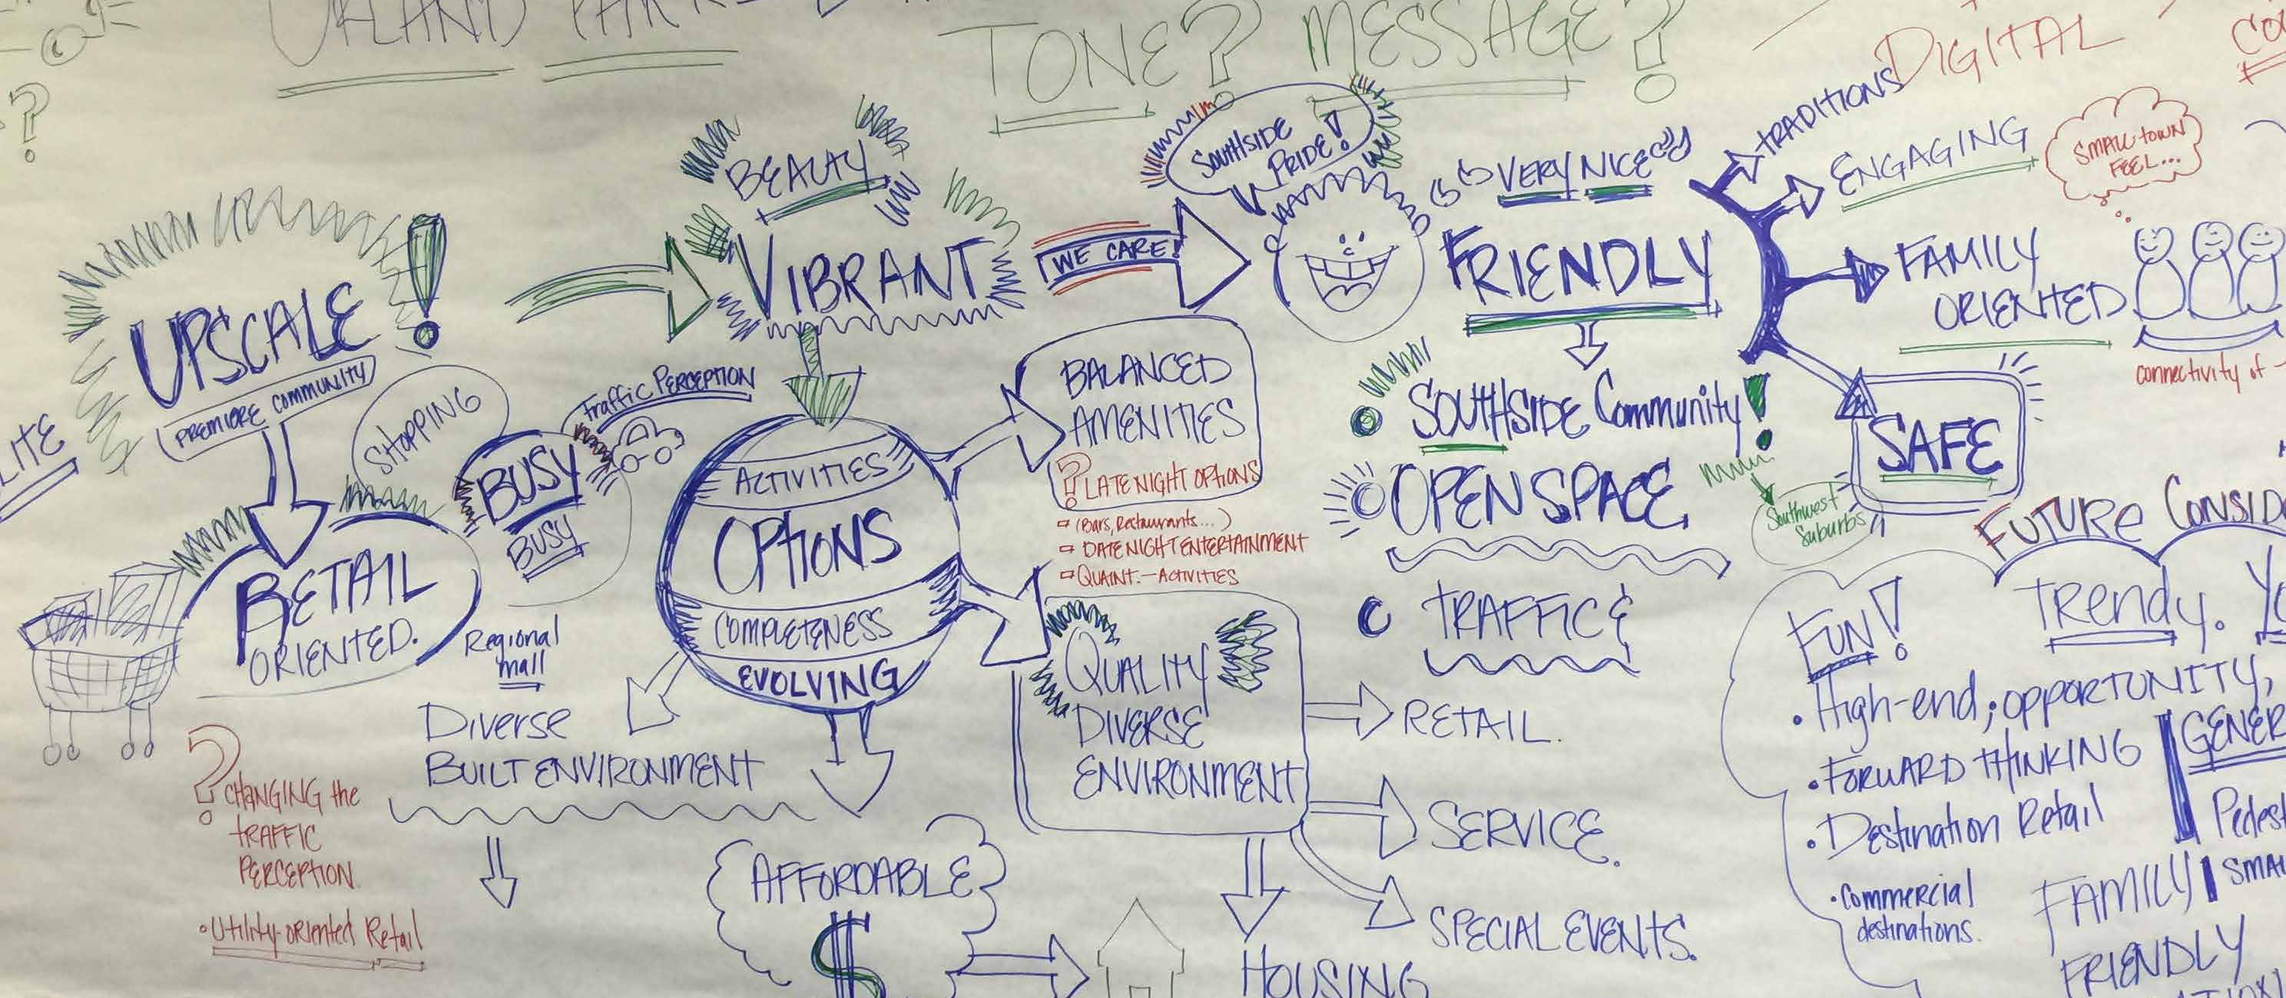
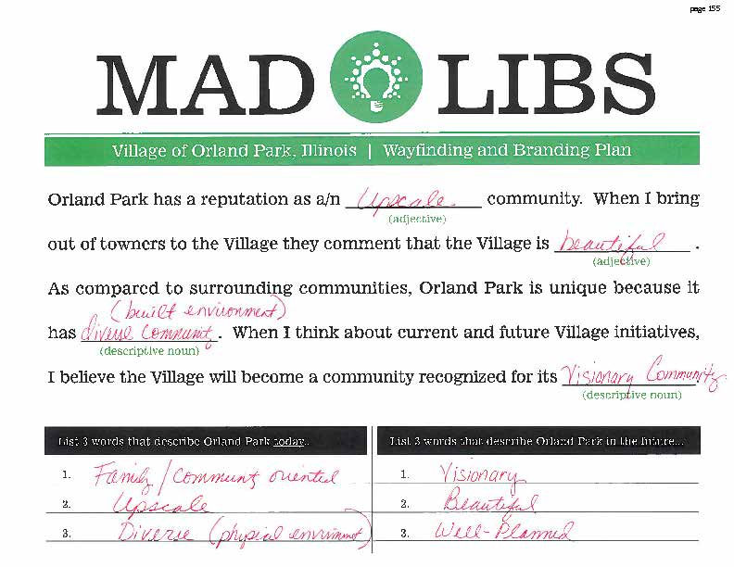
COMMUNITY OUTREACH | STORYTELLING
Committed staff & advisory committee
Web based community survey
Focus group meetings
Public meetings
Elected officials

Slide 27
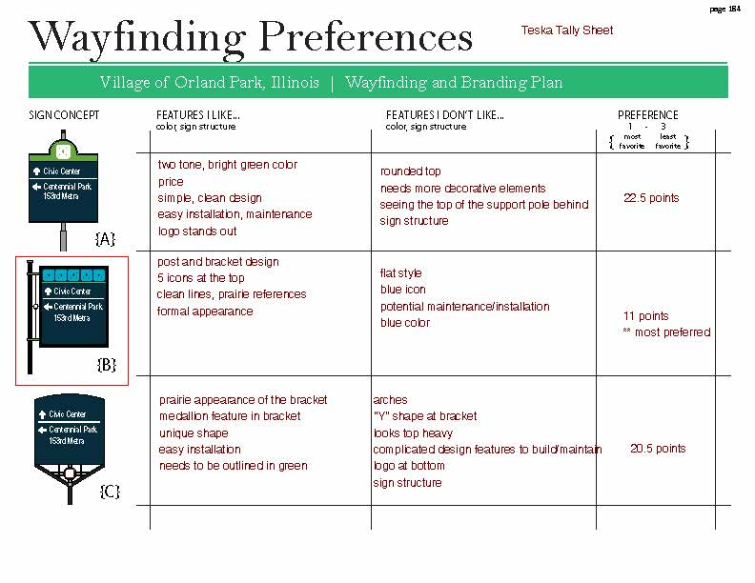
INPUT ACTIVITIES TO GUIDE THE PLAN

Slide 28
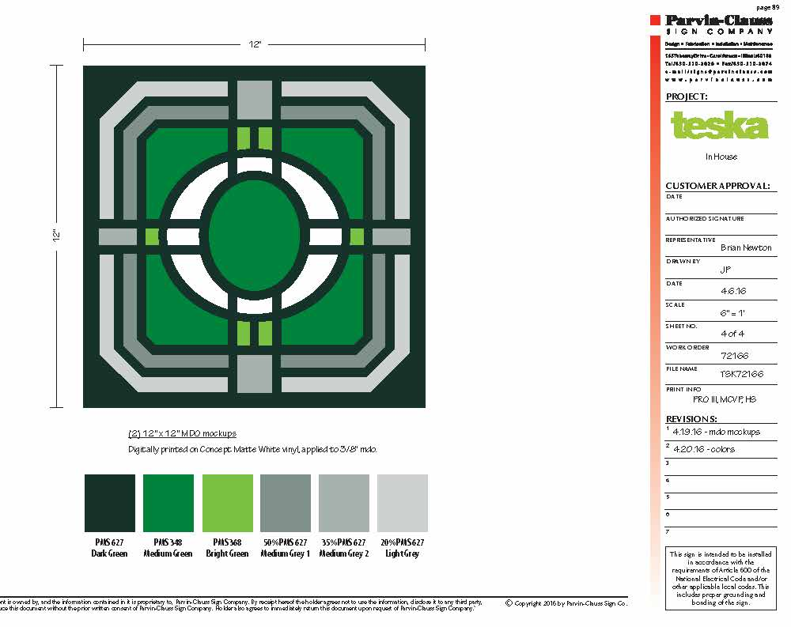
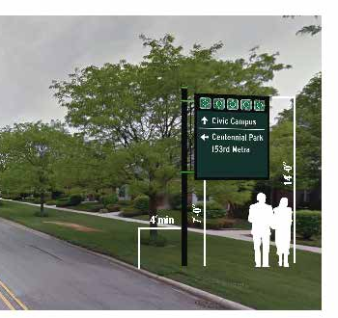
VISUALIZATIONS / SHOP DRAWINGS

Slide 29
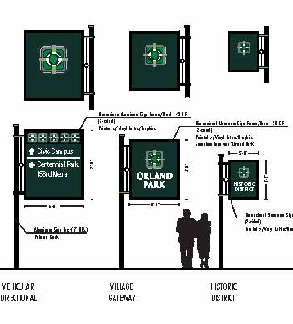
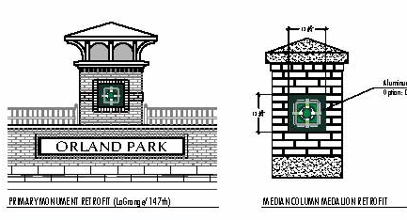
APPLY WAYFINDING SIGN STANDARDS / MUTCD

Slide 30
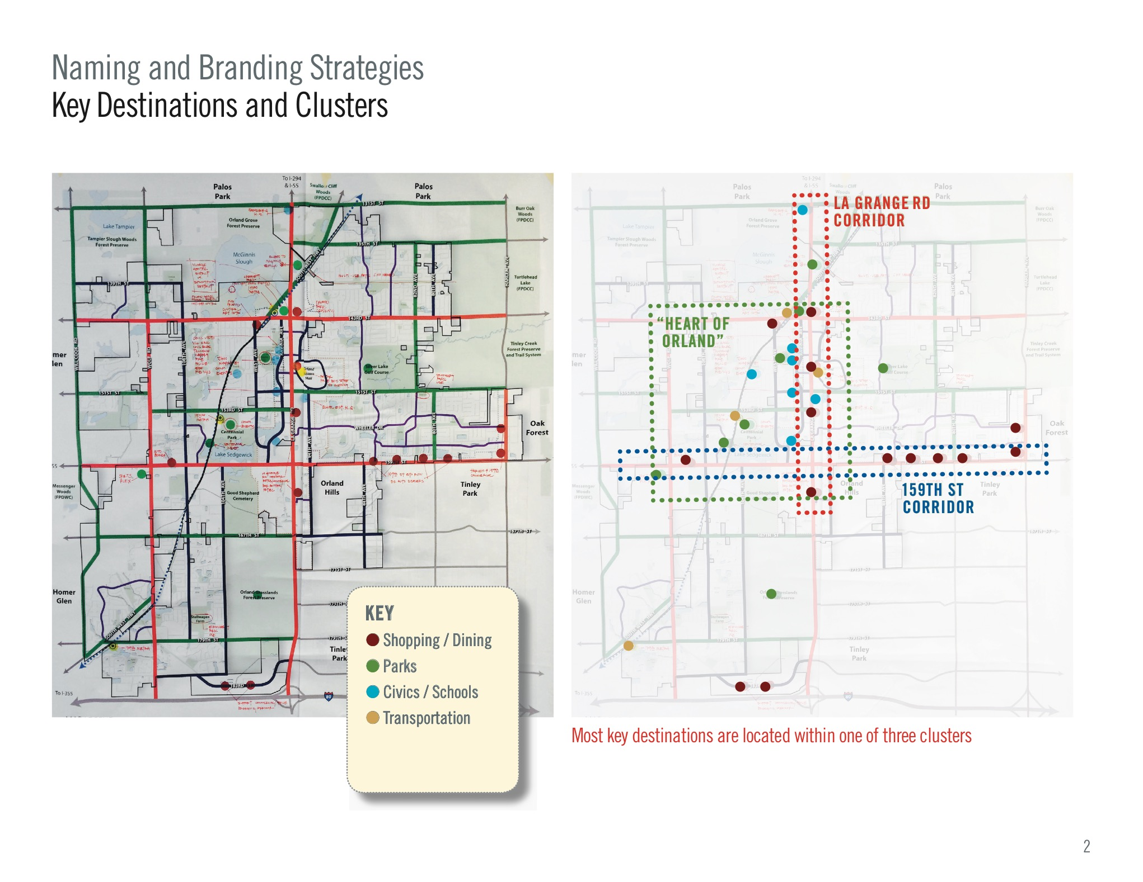

Slide 31
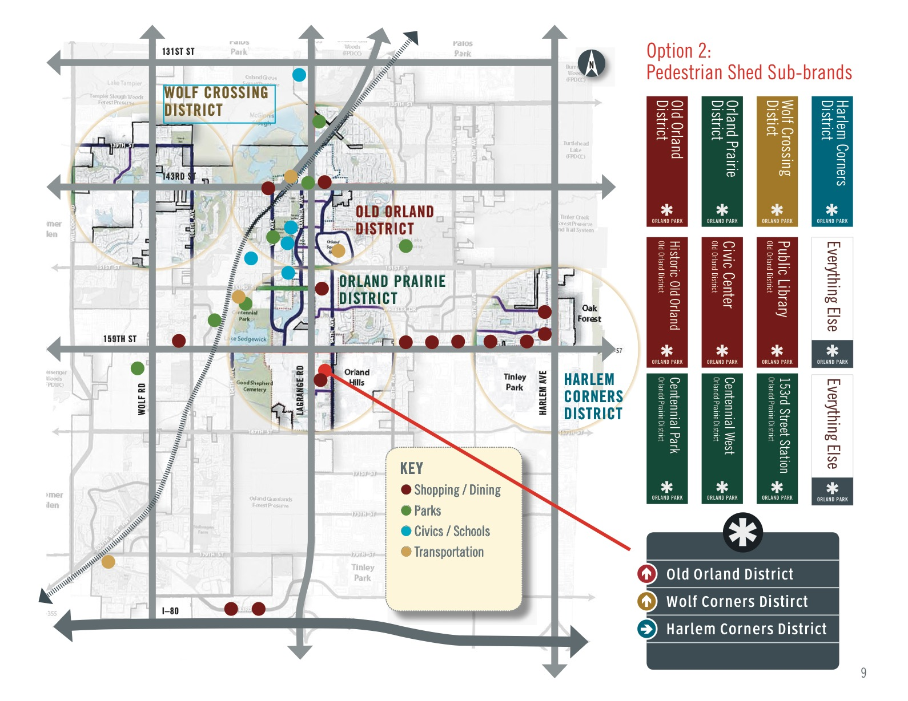

Slide 34
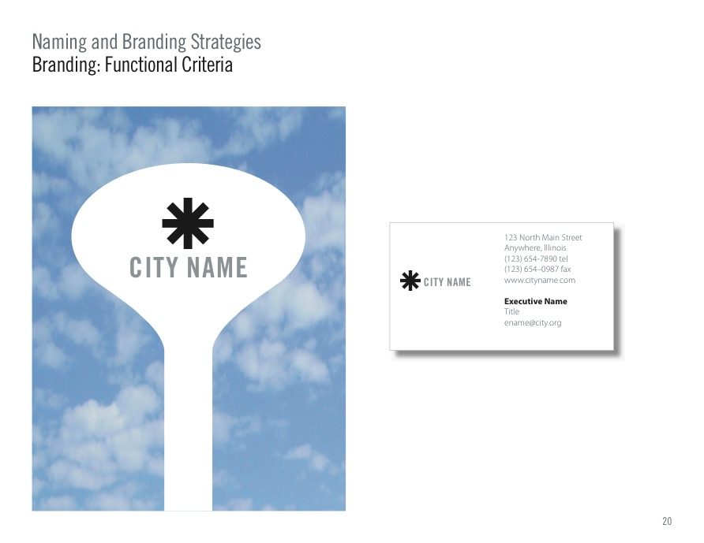

Slide 35
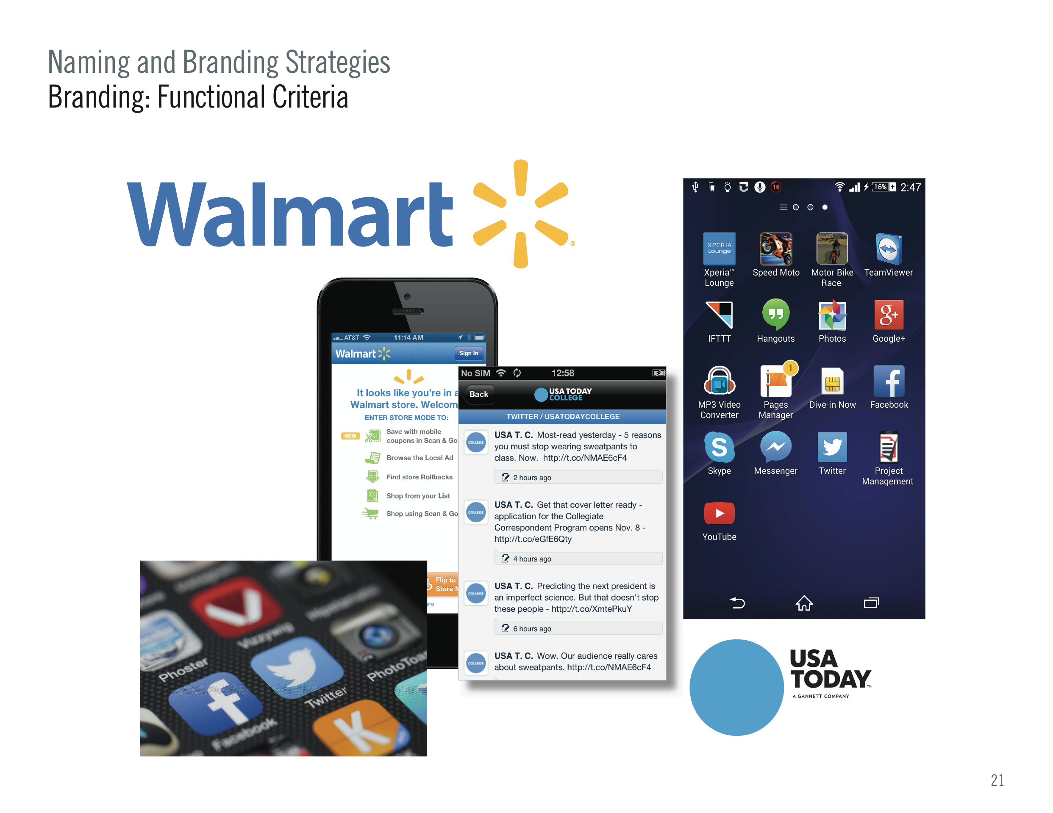

Slide 40
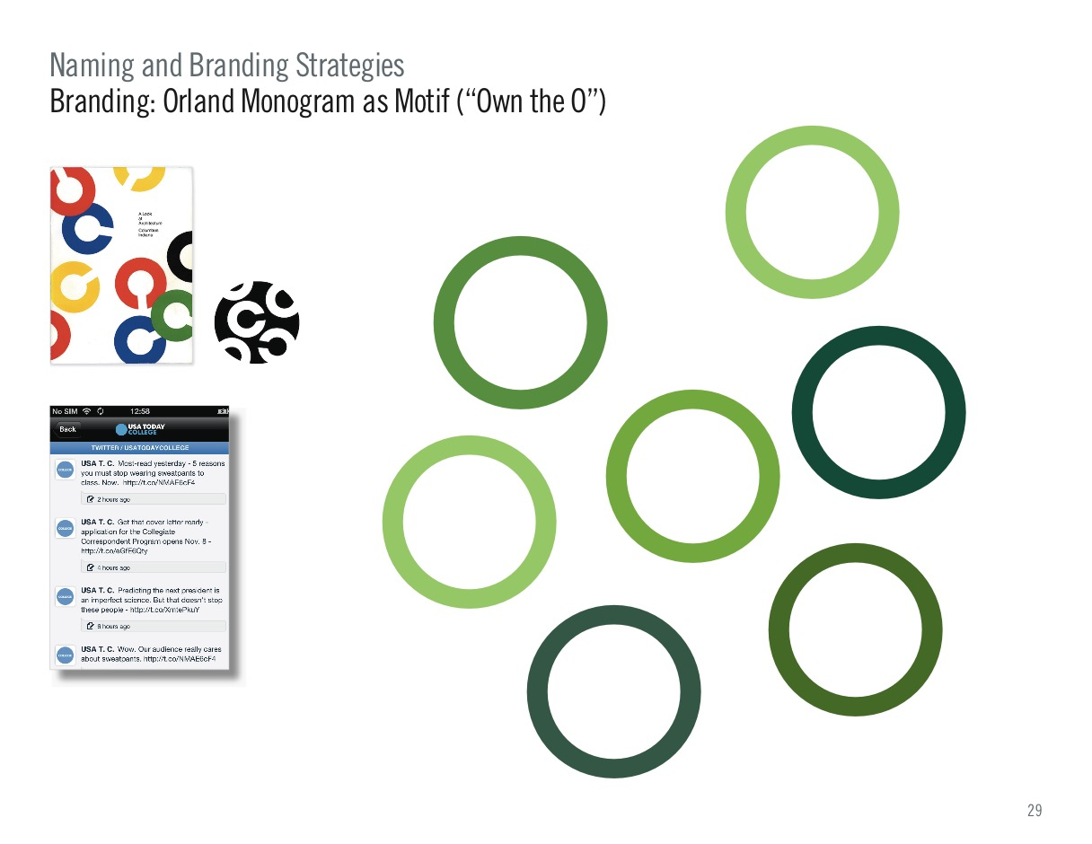

Slide 48
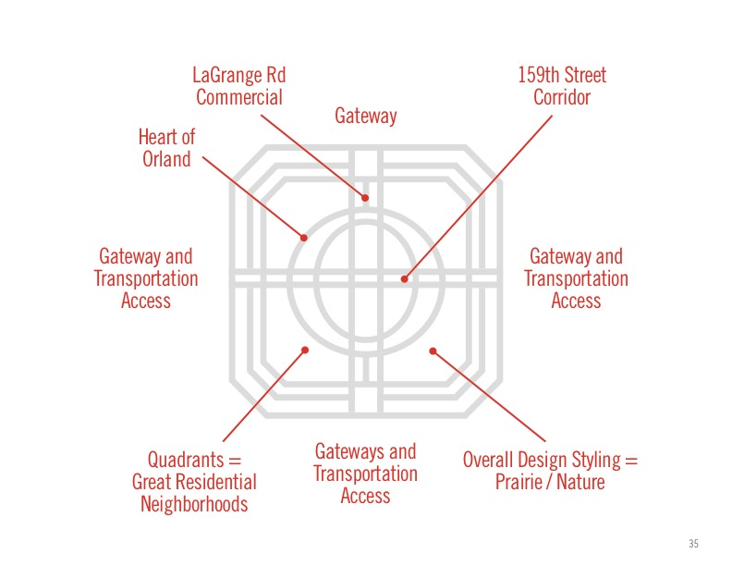

Slide 49
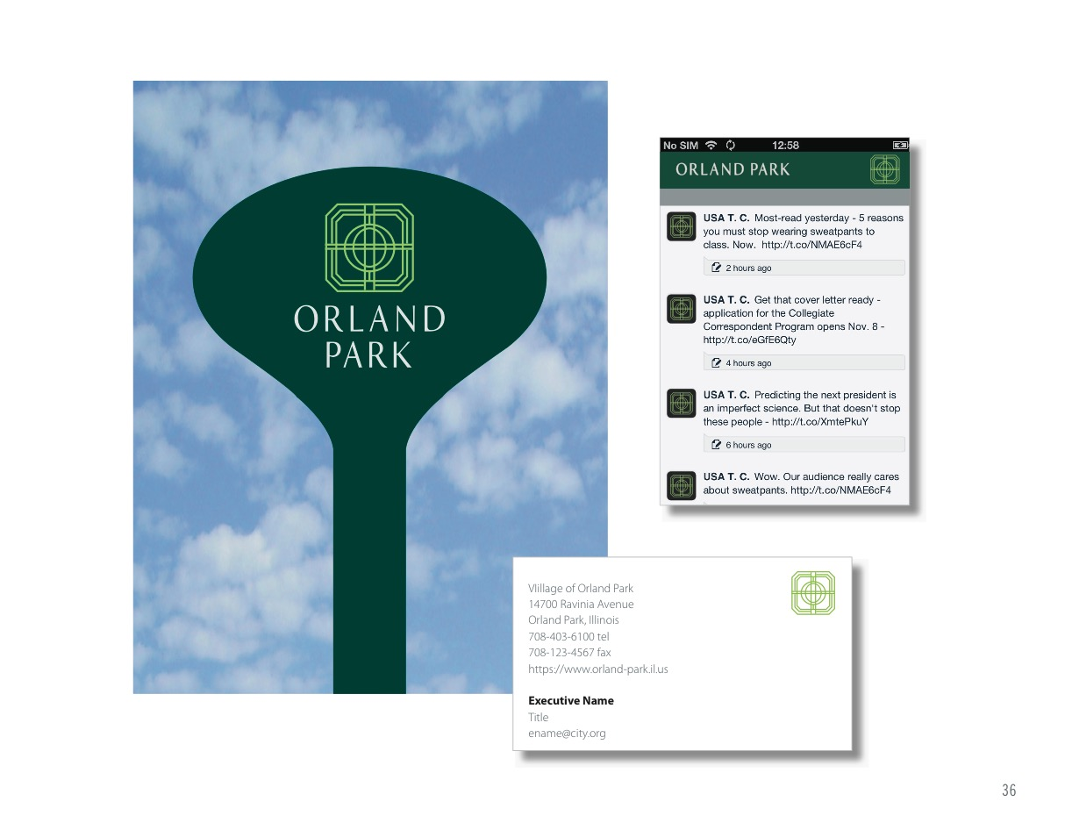

Slide 54
