Slide 1
Prairie State Local Government Sustainability Network (PSN)
MMC Environment Committee Meeting
September 19, 2017

Slide 2
What is PSN?
An “independent peer forum”
Members exchange ideas and information with peers who share a similar economy, culture, and regulatory framework
Members are “top-level municipal professionals in Illinois who manage staff and budgets related to sustainability, energy, and climate planning”
Provides a cost-effective, accessible, and consistent platform to discuss local government operations and programming
About 35 people on membership list

Slide 3
History of PSN
Started in 2011
Modeled after the Heartland Network → serving local governments in Missouri, Iowa, Nebraska, Kansas
Funded by Chicago Community Trust
CCT provided funding for a Coordinator
Funding ended in December 2015
Now fully coordinated by members on a volunteer basis → no funding or staff

Slide 4
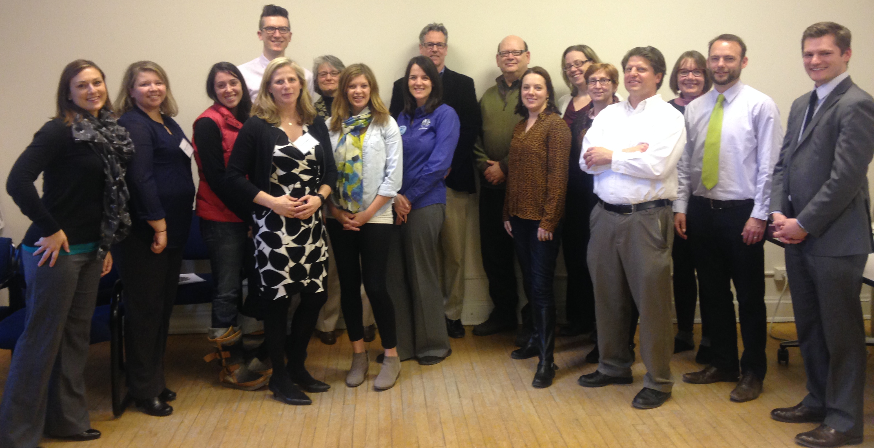
Benefits of PSN Participation
Monthly meetings (via conference calls)
Guest speakers to educate members on a variety of sustainability topics
Resources distributed following meetings/posted on website
Annual meetings → held in Chicago (2014) and Evanston (2015)
Addressing questions/issues as a group
Networking face-to-face
Opportunity for more hands-on or onsite learning with field tours, etc.
Attendees at 2015 Annual Meeting

Slide 5
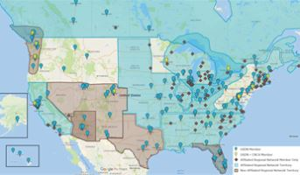
USDN Regional Partnership Program
Urban Sustainability Directors Network
Member-driven practitioner network established in 2008
9 regional networks affiliated with USDN
PSN became a partner network in 2016
Partner Networks are required to:
Adopt 6 Network Best Practices
Purpose, Goals & Vision
Governance & Steering Committee Structure
Communications Plan
Annual Meeting Plan
Membership Guidelines
Annual Work Plan
Participate in Partner Network Coordinating Committee
Have USDN members within the network
Participate in USDN partner surveys each year
www.usdn.org

Slide 6
www.prairiestatenetwork.com

