Slide 1
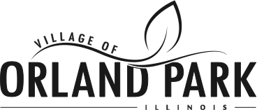
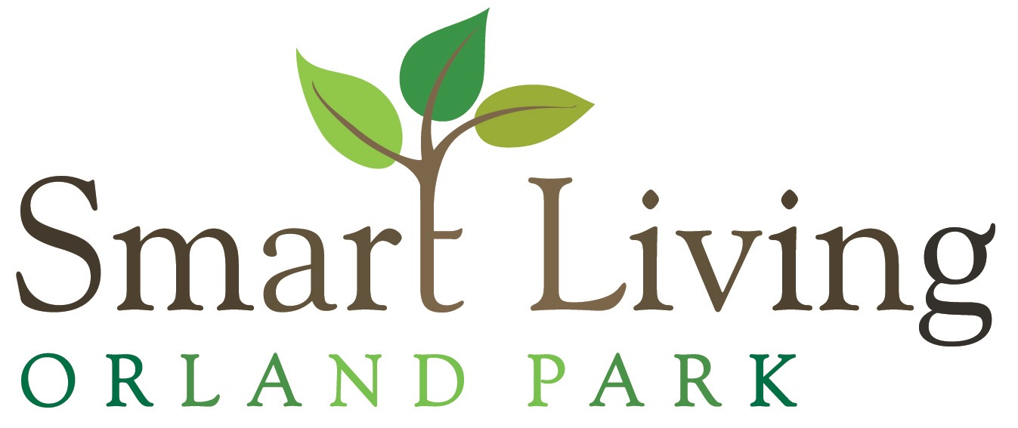
Environmental Achievements
Chicago Wilderness
Clean Air Counts Silver
Climate Action Plan
Community Energy Challenge
Curbside Recycling
Earth Hour City Challenge
Electricity Aggregation w/ Renewables
Environmental-focused Citizen Commission
Green Infrastructure Program
Green Initiatives Website
Smart Living
Municipal LEED Certified Buildings
No-Idling Policy/Program
Rain Barrel Program
Safe Route to School
Solid State Street Lighting Consortium
Sustainability Plan
Tree City USA
2000 trees in the year 2000, planted
Water Conservation Education
Water Conservation Pricing
Governor's Sustainability Award
Greenest Region Compact Signatory
DECO/MMC Energy Efficiency Grant
Energy Efficiency Community Block Grant Allocation
CFL Bulbs Giveaway
Public EV Charging Station
Adequate Access to Parks/Open Space
DNR OSLAD/Land & Water Conservation Fund (LWCF) Grant
DNR Bike Path Program
Farmer's Market
Tree City USA Sterling Award
Water Metering (100%)
Water Conservation Device Rebate
US Conference of Mayors, Climate Protection Agreement Signatory
Green House Gas (GHG) Inventory
New Purchase of Landscaping Property for Nature Center
Year-round Drug Recycling - keep away from kids and out of water supply
Partnership with Village of Orland Park Illinois Master Gardeners to help residents
Native Plant Demonstration Garden

Slide 2
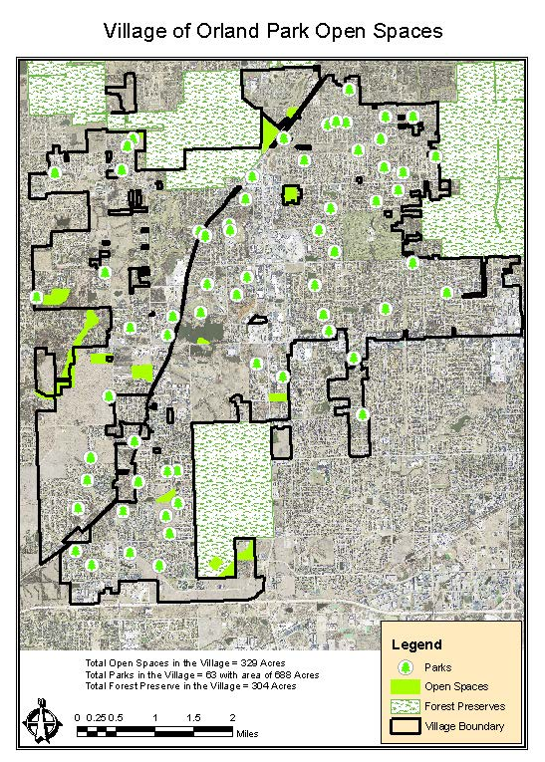
OPEN LANDS

Slide 3
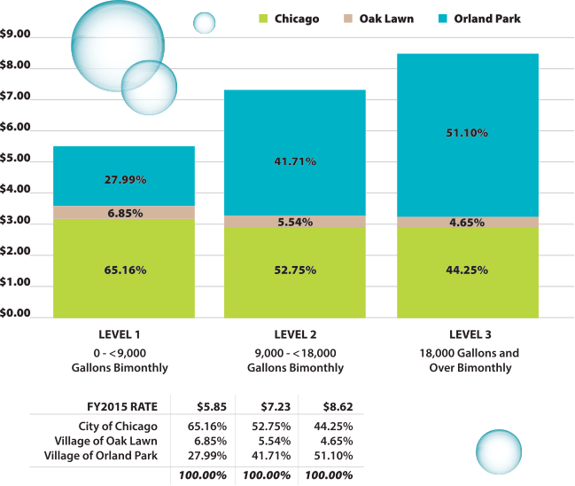
2015 water rates

Slide 4
smart living
“Orland Park will be a sustainable, healthy place with efficient and functional infrastructure that is balanced with nature and community.”
Smart Living Orland Park
Smart Living Orland Park is a program that connects residents and business with the village to promote sustainable green practices and to save resources like water and energy. The goal of the program is to reduce operational costs and living expenses, improve efficiency and conserve resources. The program is divided into five branches, which are linked to the left:
Smart Living
Smart Business
Smart Neighborhood
Smart Village
Smart Codes
Benefits of Smart Living Orland Park
Adds economic value to the natural ecology.
Enables local prosperity.
Makes the benefits of sustainability accessible to everyone.
Manages and improves shared and valuable environmental and economic assets.
2030 Vision
Smart Living Orland Park follows the 2030 Vision for Sustainability and Stewardship of the Orland Park Comprehensive Plan.

Slide 5
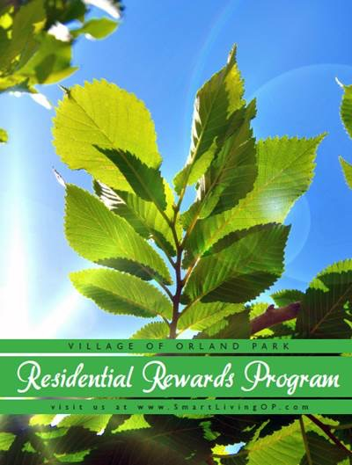
sustainability
The Village of Orland Park is utilizing InOurCommunity.com, an online community engagement platform, to promote local sustainability efforts. Residents are “rewarded” for reading about sustainability as well as directed to our website where they can learn more about the Village of Orland Park’s own Residential Reward Program.

