Slide 1

Your Community’s Journey Through SolSmart

Slide 2
SolSmart Program Structure

Slide 3
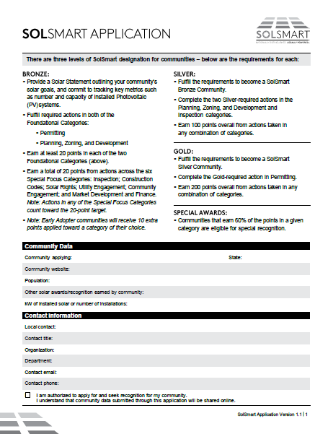
Getting Started
WHAT FORMS DO I NEED TO COMPLETE?
The SolSmart “Application” is the only form your community needs to complete to participate in the program and to receive no-cost technical assistance.
It’s not really an “application” in the usual sense. All communities are eligible for participation. Think of it as an iterative benchmarking exercise that tracks your community’s progress toward designation.

Slide 4
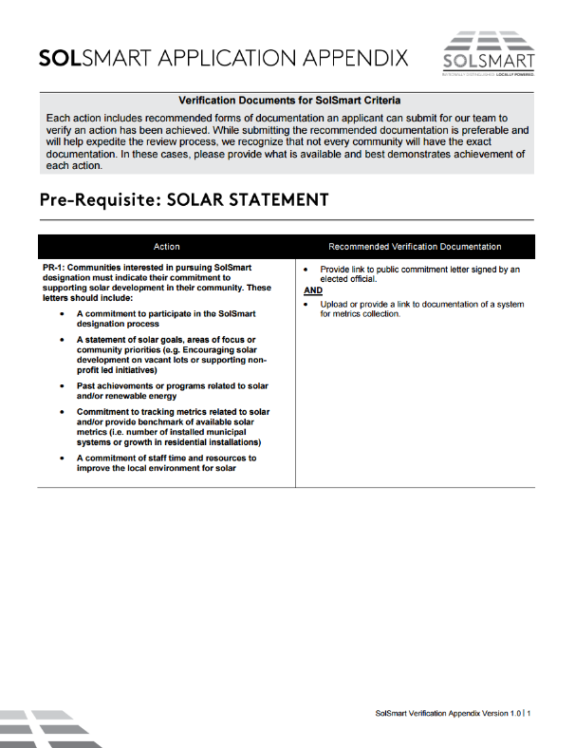
Points Verification
Communities “check off” the actions they’ve taken to reduce soft costs through the SolSmart Application.
In order to be awarded points for the actions indicated as complete, communities must submit evidence via a hyperlink or document attachment.
SolSmart provides an “Application Appendix,” which provides examples of acceptable documentation.

Slide 5

What are the steps to earn SolSmart Bronze designation?

Slide 6

Path to SolSmart Bronze
EXCLUSIVE PRIZE
STEP 1: Cut critical red tape via prerequisites.
STEP 2: Earn 20 points in the Permitting category.
STEP 3: Earn 20 points in the Planning, Zoning, and Development Regulations category.
STEP 4: Earn 20 points across any of the six “Special Focus” categories.
The first 35 SolSmart designees receive a decorative SolSmart panel to display in a public building!

Slide 7
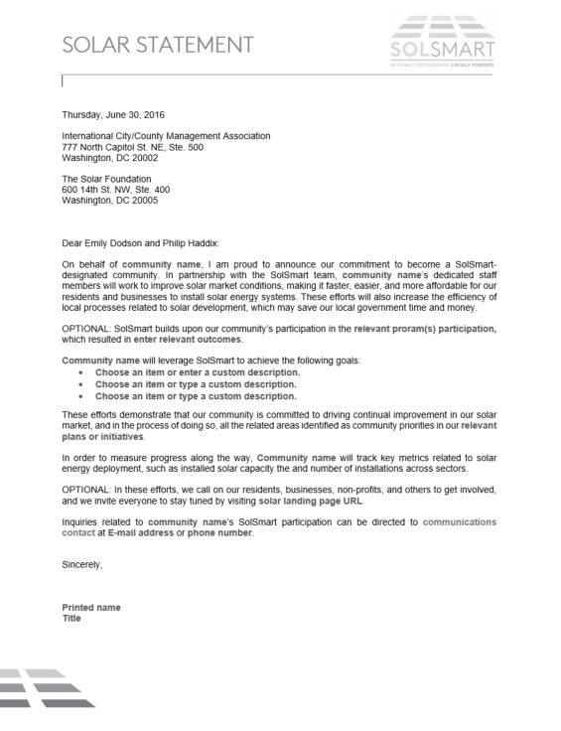
Path to SolSmart Bronze
STEP 1: Cut critical red tape via prerequisites
  Provide a statement of your community’s solar goals, including commitments to earn designation and to track key solar metrics.
  Create and put your community’s solar permitting checklist online.
  Review zoning requirements for solar PV. Commit to discussing barriers during next review.
STEP 1: Cut critical red tape via (3) prerequisites.

Slide 8
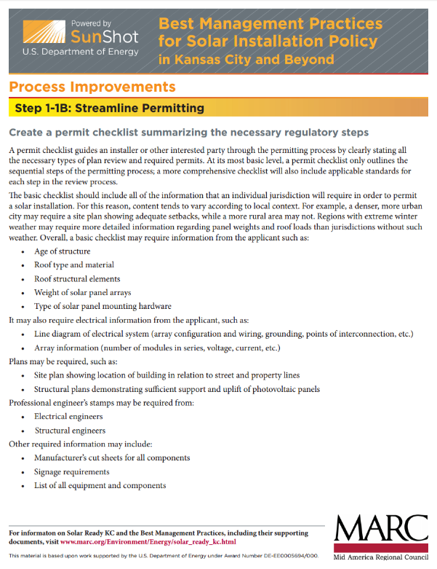
Path to SolSmart Bronze
STEP 1: Cut critical red tape via prerequisites
  Provide a statement of your community’s solar goals, including commitments to earn designation and to track key solar metrics.
  Create and put your community’s solar permitting checklist online.
  Review zoning requirements for solar PV. Commit to discussing barriers during next review.

Slide 9
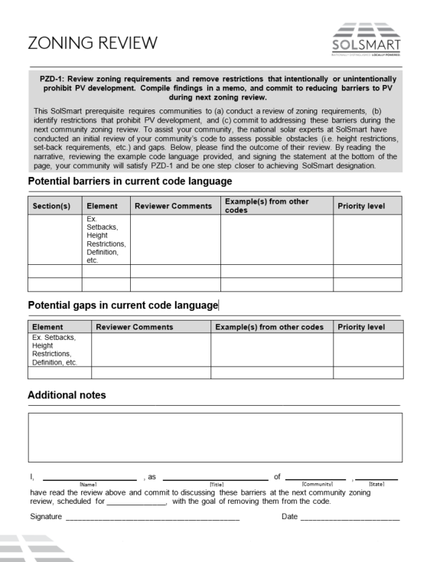
Path to SolSmart Bronze
STEP 1: Cut critical red tape via prerequisites
  Provide a statement of your community’s solar goals, including commitments to earn designation and to track key solar metrics.
  Create and put your community’s solar permitting checklist online.
  Review zoning requirements for solar PV. Commit to discussing barriers during next review.
STEP 1: Cut critical red tape via (3) prerequisites.

Slide 10
EXCLUSIVE PRIZE
Path to SolSmart Bronze
STEP 1: Cut critical red tape via prerequisites.
STEP 2: Earn 20 points in the Permitting category.
STEP 3: Earn 20 points in the Planning, Zoning, and Development Regulations category.
STEP 4: Earn 20 points across any of the six “Special Focus” categories.
The first 35 SolSmart designees receive a decorative SolSmart panel to display in a public building!

Slide 11

Path to SolSmart Bronze
STEP 2: Earn 20 points in the Permitting category.
  Require no more than one application form for a residential rooftop PV project. (5 PTS)
  Review solar permit fees for residential and commercial solar. (5 PTS)
  Train fire and safety staff on solar PV. (10 PTS)
  Review permitting process for efficiency improvements and reduce processing time to 10 days or fewer. (10 PTS)
  Train permitting staff on best practices for permitting solar PV and/or solar and storage systems. (10 PTS)
  NOTE: This is not a prescribed path, just an example.
OR

Slide 12
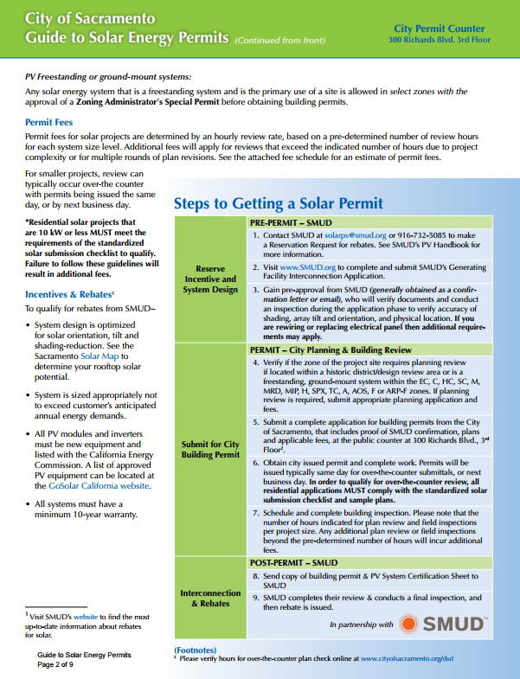
Path to SolSmart Bronze
STEP 2: Earn 20 points in the Permitting category.
  Require no more than one application form for a residential rooftop PV project. (5 PTS)
  Review solar permit fees for residential and commercial solar. (5 PTS)
  Train fire and safety staff on solar PV. (10 PTS)
  Review permitting process for efficiency improvements and reduce processing time to 10 days or fewer. (10 PTS)
  Train permitting staff on best practices for permitting solar PV and/or solar and storage systems. (10 PTS)
  NOTE: This is not a prescribed path, just an example.
OR

Slide 13
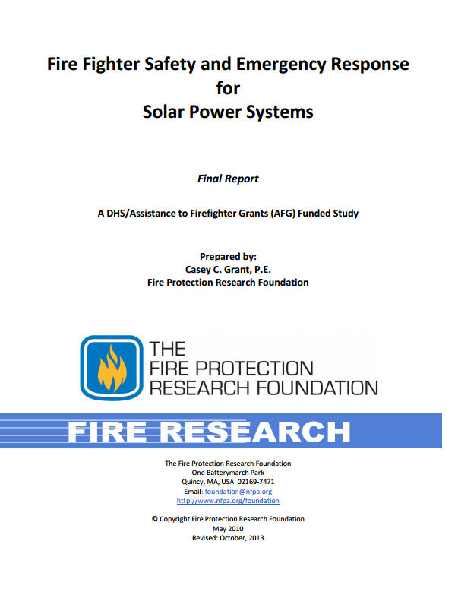
Path to SolSmart Bronze
STEP 2: Earn 20 points in the Permitting category.
  Require no more than one application form for a residential rooftop PV project. (5 PTS)
  Review solar permit fees for residential and commercial solar. (5 PTS)
  Train fire and safety staff on solar PV. (10 PTS)
  Review permitting process for efficiency improvements and reduce processing time to 10 days or fewer. (10 PTS)
  Train permitting staff on best practices for permitting solar PV and/or solar and storage systems. (10 PTS)
  NOTE: This is not a prescribed path, just an example.
OR

Slide 14
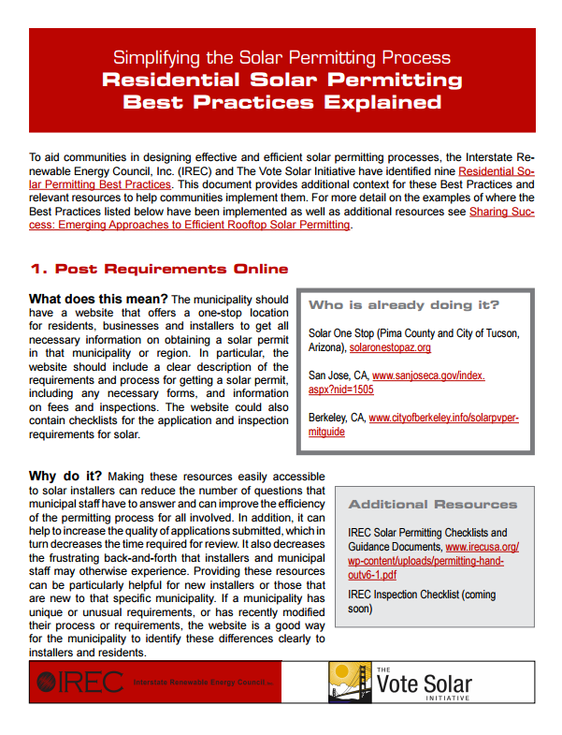
Path to SolSmart Bronze
STEP 2: Earn 20 points in the Permitting category.
  Require no more than one application form for a residential rooftop PV project. (5 PTS)
  Review solar permit fees for residential and commercial solar. (5 PTS)
  Train fire and safety staff on solar PV. (10 PTS)
  Review permitting process for efficiency improvements and reduce processing time to 10 days or fewer. (10 PTS)
  Train permitting staff on best practices for permitting solar PV and/or solar and storage systems. (10 PTS)
  NOTE: This is not a prescribed path, just an example.
OR

Slide 15
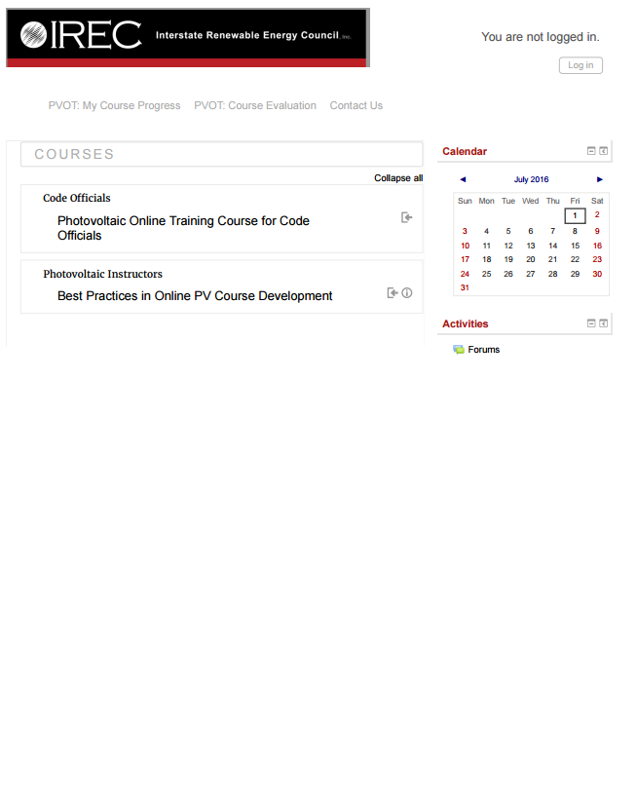
Path to SolSmart Bronze
STEP 2: Earn 20 points in the Permitting category.
  Require no more than one application form for a residential rooftop PV project. (5 PTS)
  Review solar permit fees for residential and commercial solar. (5 PTS)
  Train fire and safety staff on solar PV. (10 PTS)
  Review permitting process for efficiency improvements and reduce processing time to 10 days or fewer. (10 PTS)
  Train permitting staff on best practices for permitting solar PV and/or solar and storage systems. (10 PTS)
  NOTE: This is not a prescribed path, just an example.
OR

Slide 16
EXCLUSIVE PRIZE
Path to SolSmart Bronze
STEP 1: Cut critical red tape via prerequisites.
STEP 2: Earn 20 points in the Permitting category.
STEP 3: Earn 20 points in the Planning, Zoning, and Development Regulations category.
STEP 4: Earn 20 points across any of the six “Special Focus” categories.
The first 35 SolSmart designees receive a decorative SolSmart panel to display in a public building!

Slide 17
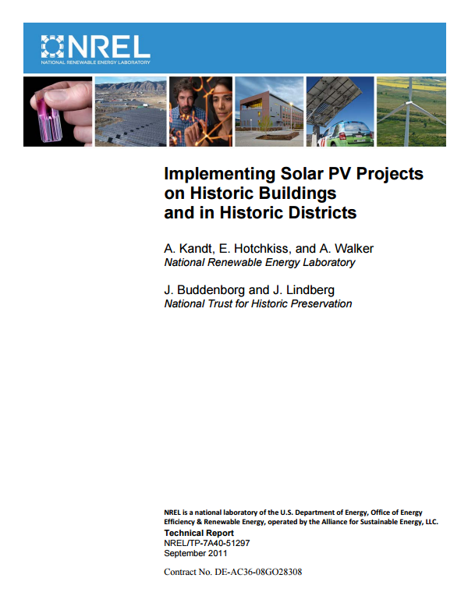
Path to SolSmart Bronze
STEP 3: Earn 20 points in the PLANNING, zoning, and development regulations category.
  Provide clear guidance for solar in historic and special-use districts. (10 PTS)
  Include considerations for active and passive solar in development regulations (e.g. providing guidance for orientation of structures in subdivision regulations). (10 PTS)
  Allow solar by-right and as an accessory use in all major zones, and implement any zoning ordinance adjustments identified through the zoning review to improve solar-friendliness. (20 PTS, SILVER+GOLD PREREQ.)
  NOTE: This is not a prescribed path, just an example.
OR

Slide 18

Path to SolSmart Bronze
STEP 3: Earn 20 points in the PLANNING, zoning, and development regulations category.
  Provide clear guidance for solar in historic and special-use districts. (10 PTS)
  Include considerations for active and passive solar in development regulations (e.g. providing guidance for orientation of structures in subdivision regulations). (10 PTS)
  Allow solar by-right and as an accessory use in all major zones, and implement any zoning ordinance adjustments identified through the zoning review to improve solar-friendliness. (20 PTS, SILVER+GOLD PREREQ.)
  NOTE: This is not a prescribed path, just an example.
OR

Slide 19

Path to SolSmart Bronze
STEP 3: Earn 20 points in the PLANNING, zoning, and development regulations category.
  Provide clear guidance for solar in historic and special-use districts. (10 PTS)
  Include considerations for active and passive solar in development regulations (e.g. providing guidance for orientation of structures in subdivision regulations). (10 PTS)
  Allow solar by-right and as an accessory use in all major zones, and implement any zoning ordinance adjustments identified through the zoning review to improve solar-friendliness. (20 PTS, SILVER+GOLD PREREQ.)
  NOTE: This is not a prescribed path, just an example.
OR

Slide 20
EXCLUSIVE PRIZE
Path to SolSmart Bronze
STEP 1: Cut critical red tape via prerequisites.
STEP 2: Earn 20 points in the Permitting category.
STEP 3: Earn 20 points in the Planning, Zoning, and Development Regulations category.
STEP 4: Earn 20 points across any of the six “Special Focus” categories.
The first 35 SolSmart designees receive a decorative SolSmart panel to display in a public building!

Slide 21
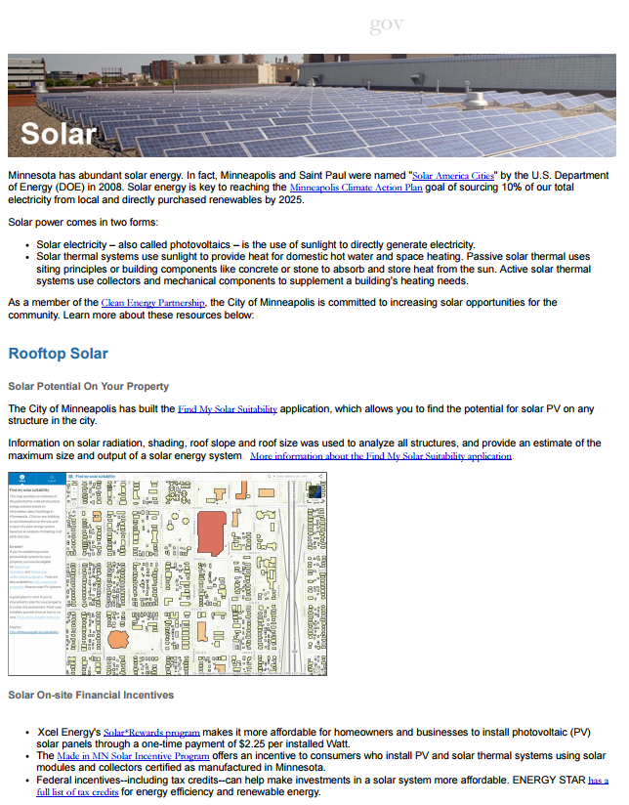
Path to SolSmart Bronze
STEP 4: Earn 20 points in SPECIAL FOCUS categories.
  Create a solar landing page on local government website with goals and local resources for solar development. (10 PTS)
  Discuss community or shared solar programs with the local utility. (U-2: 10 PTS)
  Provide consumer protection resources on solar. (5 PTS)
  Make inspection requirements for PV available online. (10 PTS)
  Provide resources on active solar installers and/or local incentives for solar. (5 PTS)
  NOTE: This is not a prescribed path, just an example.
OR

Slide 22

Path to SolSmart Bronze
STEP 4: Earn 20 points in SPECIAL FOCUS categories.
  Create a solar landing page on local government website with goals and local resources for solar development. (10 PTS)
  Discuss community or shared solar programs with the local utility. (10 PTS)
  Provide consumer protection resources on solar. (5 PTS)
  Make inspection requirements for PV available online. (10 PTS)
  Provide resources on active solar installers and/or local incentives for solar. (5 PTS)
  NOTE: This is not a prescribed path, just an example.
OR

Slide 23

Path to SolSmart Bronze
STEP 4: Earn 20 points in SPECIAL FOCUS categories.
  Create a solar landing page on local government website with goals and local resources for solar development. (10 PTS)
  Discuss community or shared solar programs with the local utility. (10 PTS)
  Provide consumer protection resources on solar. (5 PTS)
  Make inspection requirements for PV available online. (10 PTS)
  Provide resources on active solar installers and/or local incentives for solar. (5 PTS)
  NOTE: This is not a prescribed path, just an example.
OR

Slide 24

Path to SolSmart Bronze
STEP 4: Earn 20 points in SPECIAL FOCUS categories.
  Create a solar landing page on local government website with goals and local resources for solar development. (10 PTS)
  Discuss community or shared solar programs with the local utility. (10 PTS)
  Provide consumer protection resources on solar. (5 PTS)
  Make inspection requirements for PV available online. (10 PTS)
  Provide resources on active solar installers and/or local incentives for solar. (5 PTS)
  NOTE: This is not a prescribed path, just an example.
OR

Slide 25
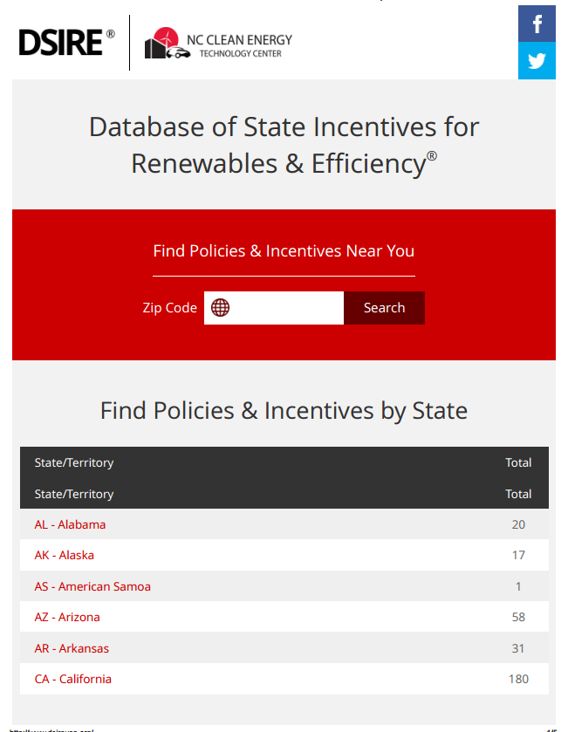
Path to SolSmart Bronze
STEP 4: Earn 20 points in SPECIAL FOCUS categories.
  Create a solar landing page on local government website with goals and local resources for solar development. (10 PTS)
  Discuss community or shared solar programs with the local utility. (10 PTS)
  Provide consumer protection resources on solar. (5 PTS)
  Make inspection requirements for PV available online. (10 PTS)
  Provide resources on active solar installers and/or local incentives for solar. (5 PTS)
  NOTE: This is not a prescribed path, just an example.
OR

Slide 26
EXCLUSIVE PRIZE
Path to SolSmart Bronze
STEP 1: Cut critical red tape via prerequisites.
STEP 2: Earn 20 points in the Permitting category.
STEP 3: Earn 20 points in the Planning, Zoning, and Development Regulations category.
STEP 4: Earn 20 points across any of the six “Special Focus” categories.
The first 35 SolSmart designees receive a decorative SolSmart panel to display in a public building!

Slide 27
SolSmart
Silver, Gold, & Beyond

Slide 28



SolSmart Designations & Awards
Special Awards:
Communities that earn 60%+ of the points in a given category are eligible for special recognition.
Earn SolSmart Bronze
Address Silver prerequisites
  Solar by-right in all major zones
  Cross-train inspection and permitting staff
Earn 100 total points from actions taken across any combination of categories
Address Gold prerequisites
  PV permitting turnaround for small systems ≤ 3 days
Earn 200 total points from actions taken across any combination of categories

Slide 29
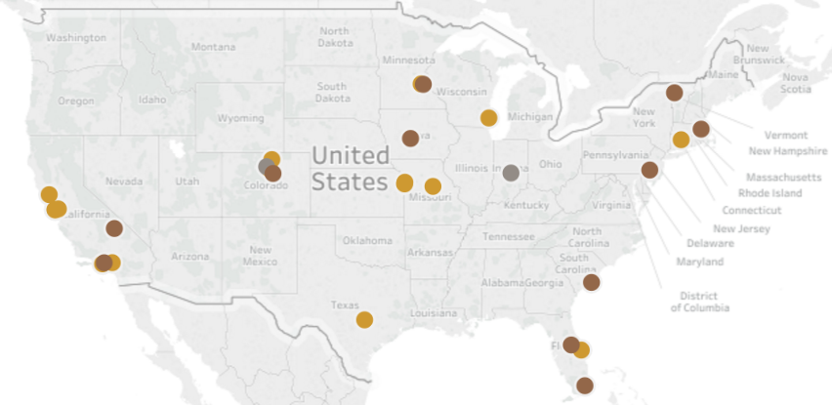
Join other designated communities!

Slide 30

Q & A
Any questions regarding SolSmart? Need help getting started? Let me know!
Zach Greene
Project Manager, SolSmart Technical Assistance Provider
The Solar Foundation
202-846-7504
zgreene@solarfound.org

