Slide 1

Communities Harnessing the Sun:
Solar Designation & Technical Assistance Through SolSmart
Zach Greene
Project Manager, The Solar Foundation
1/19/17

Slide 2
Common Barriers to Solar

Slide 3
The Cost of Solar PV
43% drop in price
2010 - 2015
Avg. for 2015: $3.50/W (SEIA)
Tracking the Sun VIII: The Installed Cost of Photovoltaics in the US from 1998-2014 (LBNL)

Slide 4
The Cost of Solar in the US
Source: NREL (http://www.nrel.gov/docs/fy14osti/60412.pdf)
LBNL (http://emp.lbl.gov/sites/all/files/lbnl-6350e.pdf)(http://www1.eere.energy.gov/solar/pdfs/sunshot_webinar_20130226.pdf

Slide 5
The Cost of Solar in the US
Source: NREL (http://www.nrel.gov/docs/fy14osti/60412.pdf)
LBNL (http://emp.lbl.gov/sites/all/files/lbnl-6350e.pdf)(http://www1.eere.energy.gov/solar/pdfs/sunshot_webinar_20130226.pdf )

Slide 6
The Cost of Solar in the US
Profits, Taxes, & Overhead
Source: NREL (http://www.nrel.gov/docs/fy14osti/60412.pdf)
LBNL (http://emp.lbl.gov/sites/all/files/lbnl-6350e.pdf)(http://www1.eere.energy.gov/solar/pdfs/sunshot_webinar_20130226.pdf )

Slide 7
The Cost of Solar in the US
Solar Soft Costs
Source: NREL (http://www.nrel.gov/docs/fy14osti/60412.pdf)
LBNL (http://emp.lbl.gov/sites/all/files/lbnl-6350e.pdf)(http://www1.eere.energy.gov/solar/pdfs/sunshot_webinar_20130226.pdf )

Slide 8
The Cost of Solar in the US
No change in soft costs between 2010 and 2012
$3.32
Soft costs remain nearly 2/3s of installed cost
$3.32
$3.28
$1.90

Slide 9



Soft Cost Takeaways
They often comprise a larger share of total installed cost than hardware.
They slow solar market growth and artificially shrink number of places in US where solar is financially viable.
Local governments have a big role to play in reducing barriers.

Slide 10


Slide 11
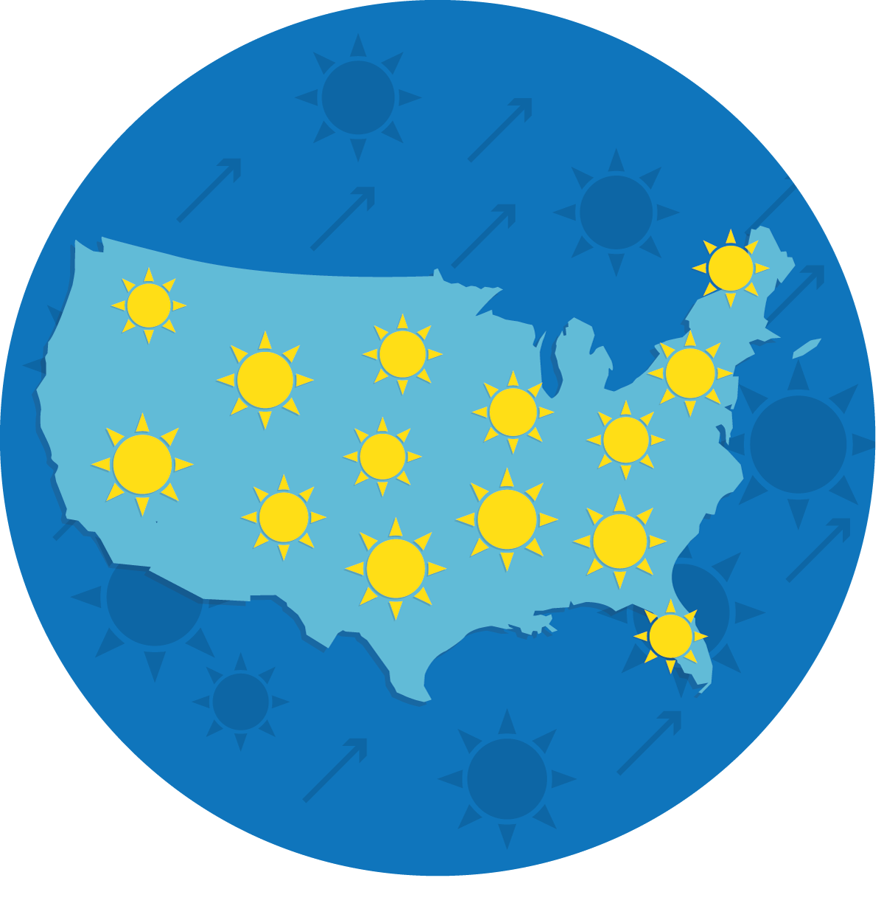
SolSmart Goals
To make it faster, easier, and more affordable for more Americans to choose solar energy, SolSmart will recognize at least 300 U.S. local governments with a nationally prestigious solar designation.
SolSmart designation demonstrates that a community is “open for solar business,” which makes designated communities more attractive to solar industries.
SolSmart provides targeted, no-cost technical assistance in critical soft cost reduction areas to help communities achieve soft cost reduction and SolSmart designation.

Slide 12




SolSmart Overview
Designation
Technical assistance
Communities self-assess soft cost best practice attainment in 8 categories through a “SolSmart Application.”
SolSmart designation team awards communities SolSmart Bronze, Silver, or Gold based on criteria scorecard and documentation.
Communities that do not meet designation criteria are eligible receive technical assistance in designation criteria areas.
Designated communities that wish to pursue a higher tier of designation can receive no-cost technical assistance, but at a lower level of program priority than non-designees.
All SolSmart TA is program-funded.

Slide 13
Benefits of Reducing Soft Costs
Reduced Installation Costs = Increased Return on Investment for System Owners
Streamlined processes can deliver a time and cost savings for local government staff
Opening your community for solar business can have positive impacts on jobs and economic development.
Reducing red-tape for solar can result in improved business prospects for solar companies.
Sources: Clean Power Finance (Spruce); The Solar Foundation, LBNL, NREL

Slide 14
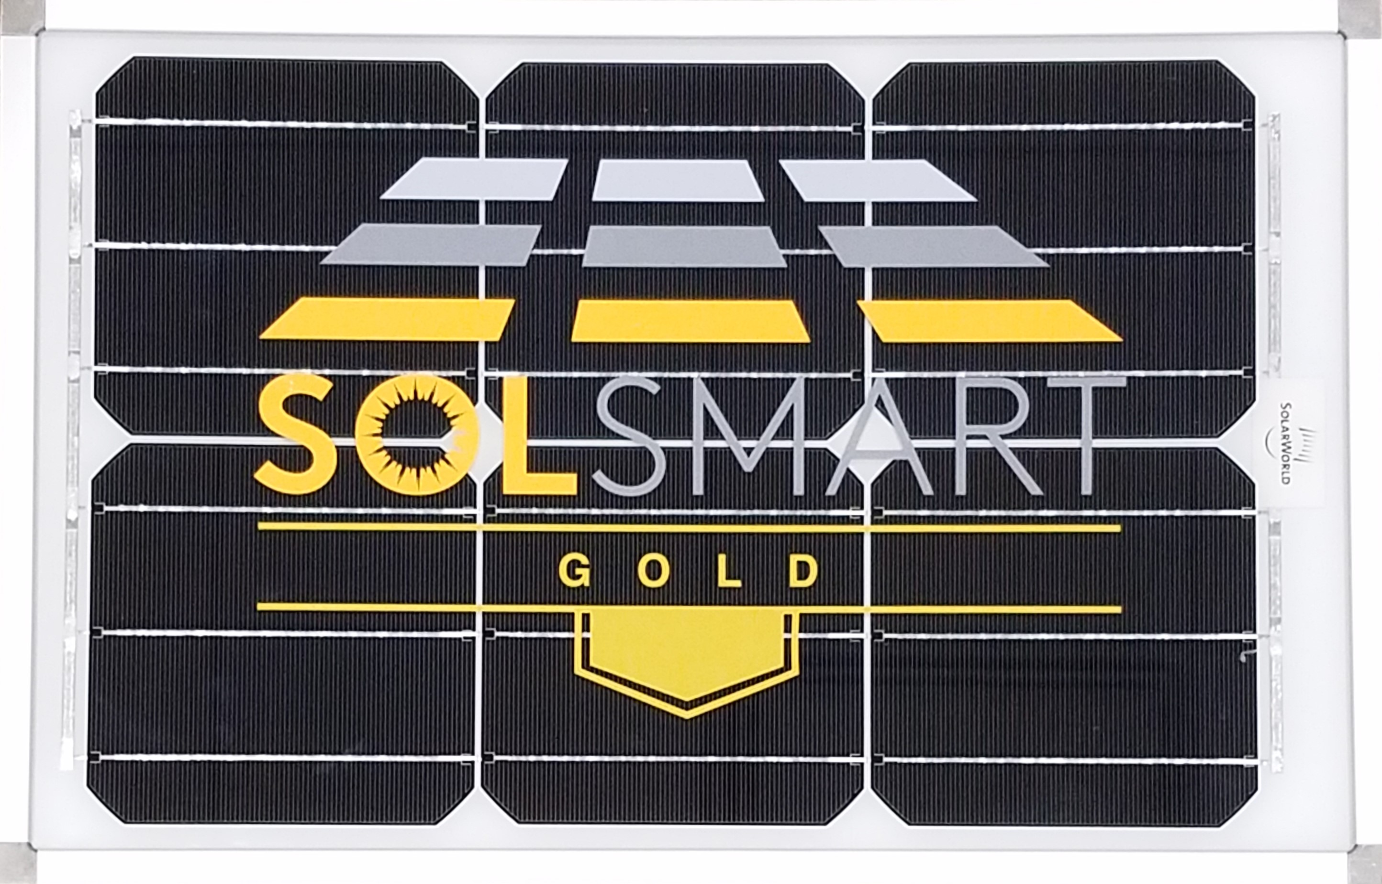
SolSmart Benefits
    Recognition on website (map/leaderboards)
    Press opportunities (events/press releases)
    Plaques (modules for first 35)
    Awards for outstanding achievement
    No-cost technical assistance

Slide 15
SolSmart
Role of Metropolitan Mayors Caucus

Slide 16

SolSmart Advisors
Program-funded temporary staff to help communities achieve designation.
Advisors will evaluate existing local government policies/processes and apply industry leading best practices that will move a community toward designation.
SolSmart Advisors will assist communities through engagements lasting up to six months.
Equates to hundreds of hours of in-person technical assistance for communities receiving an Advisor

Slide 17
SolSmart
Solar Profiles

Slide 18
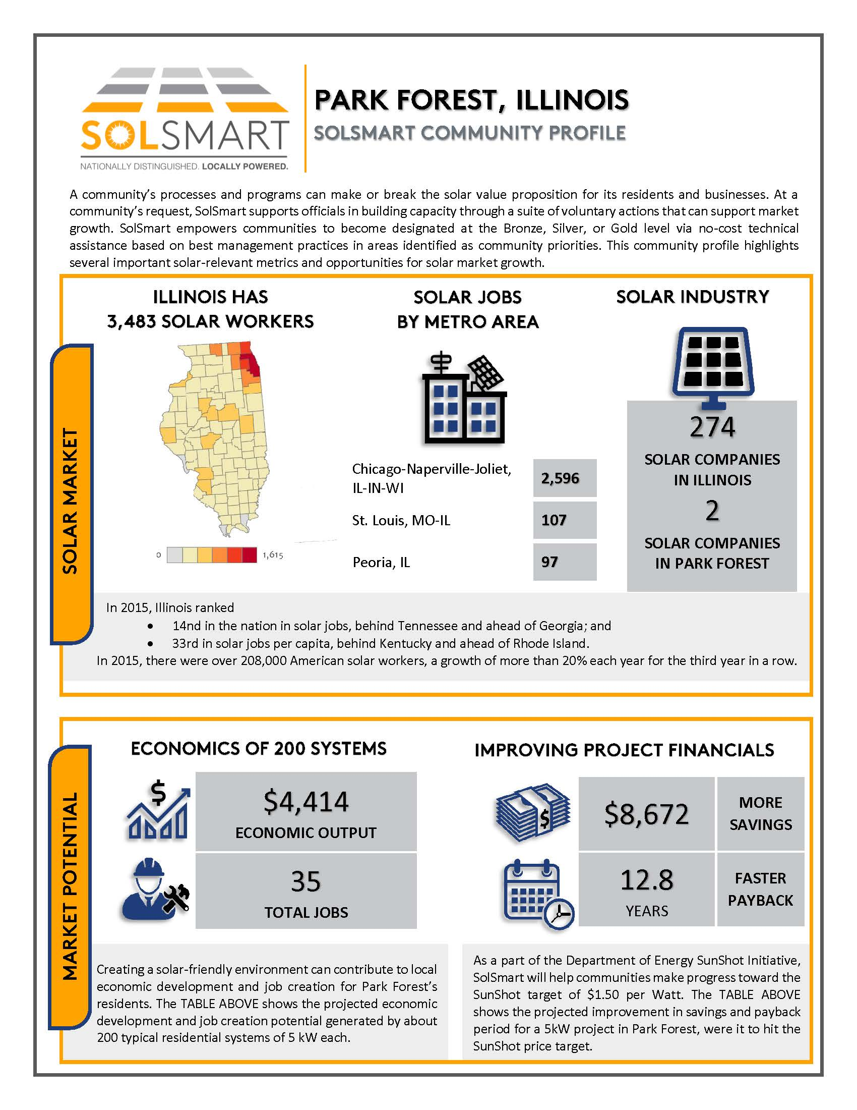
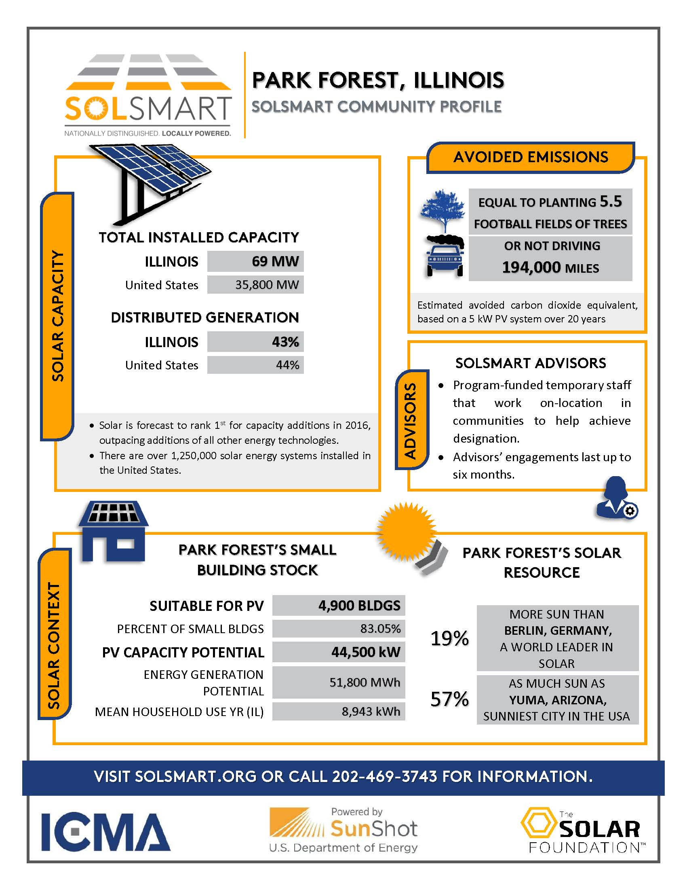
SolSmart Solar Profiles

Slide 19

Questions?
Stay for the afternoon session from 12:30 – 2:00pm

