Slide 1
Environment Committee November 29, 2016
Alternative Fuel Regional Fueling Infrastructure For Municipal Fleets

Slide 2
Drivers for Change
Compared to gasoline and diesel, Alternative Fuels (AF) can:
Operating cost
Emissions / Greenhouse Gas
→ Climate Change
→ Health problems
US dependence on oil
Trade deficit
National security risks
Costs of protection
Stimulate domestic economic growth
→ Increase revenues and profits
→ Job creation
→ Cash flow
Notes:
Technological advances in horizontal drilling deep underground have led to large-scale discoveries of natural gas reserves that are now economical to access. This, along with increases in oil prices, has fundamentally changed the relative price of oil and natural gas in the United States.
The discovery of large, economically accessible natural gas reserves has the potential to aid in a number of policy goals related to energy.
Replacing oil with natural gas can reduce U.S. dependence on oil, thereby reducing the vulnerability of the U.S. economy to macroeconomic downturns caused by oil shocks.
Because natural gas is cleaner in terms of greenhouse gas emissions and local pollutants compared to both coal and oil, replacing these other fossil fuels with natural gas can reduce U.S. greenhouse gas emissions and health problems associated with local pollution.
Replacing oil with natural gas can increase U.S. profits associated with fossil fuel production and create excellent opportunities for the U.S. economy. There are also compelling arguments for policymakers to consider policies designed to promote natural gas.

Slide 3
Regional Study Ideas for AFs and Municipalities
Consider a study to assess use of public funds to subsidize the AF market:
Quantify the economic and environmental impacts, benefits, costs and risks of changing some of the current regional fleet vehicles to Alternative Fuels (AF) and develop infrastructure capacity to support AFVs
Define stakeholders and how they might participate and benefit from the results
Define rationale for AF vehicular and infrastructure choices to meet regional needs
Estimate range of future demand for AF for the fleets of commercial, municipal and other organizations.
Characterize the range of supply requirements for retail and fleet infrastructure
Define preferred/logical locations with good access to transportation corridors and potential consumers
Incorporate economic and social justice components
Define how a Regional Infrastructure program would be deployed
Define requirements to establish viable business investments for both the fleet owners and the retail fuelers.
Define logical target locations (site specific and locational) for retail fueling outlets, that could best serve the general public.
Define timing of proposed build out of infrastructure
Define requirements for educational programs for communities, businesses and other organizations

Slide 4
CMAP Region
CMAP Region

Slide 5
Study Process
As-Is Assessment - define the current state of the Alternative Fuel Market in the Region – vehicles and infra
To-Be Vision – a set of ideas and recommendations which define a set of pathways for regional stakeholders to consider:
Define logical ideas for the transportation market for the Region
Create and evaluate practical and possible solutions, including costs, risks and benefits
Select most likely targets
Complete Gap Analysis - what is missing from the As-Is Assessment to move to the To-Be Vision
Develop roadmap
Define strategies and tactics

Slide 6
Alt Fuel Fleet Questions
Should my fleet invest in
AFVs only and rely on existing or future regional retail fueling or
Include fleet refueling infrastructure investments?
How much AF does my fleet need to consume to justify an investment in AFVs? In AF infra?
Which vehicles make sense for me or my organization to convert to AF?
Which AF(s) and why?
What AFV investments are required? Will we need new AF Facilities?
Will there be incentive funding available? How much? Timing?
What is our lifecycle Return On Investment (ROI)?
Where are the nearest existing or currently planned AFV refueling infrastructure?
Where are these locations relative to business, municipal and other potential fleet beneficiaries?
What alternative fuels are currently available, where and at what capacities?
Will future locations for refueling be convenient for my fleet and fit within acceptable logistical parameters for refueling?
What changes in daily processes?
Will the refueling process add or save labor cost for a given set of participants?
What are the environmental sustainability reasons for change?
How does or should a fleet business or organization value costs vs. improving the environment?
How can retail markets best be established to insure investments in infrastructure are viable for both the fleet owners and the retail fuelers?
What impacts on maintenance and safety practices?
What training needs?
Who needs to be involved in my fleet to make good decisions?

Slide 7
AF Stakeholders

Slide 8
AF Participants
Large fleet owners (e.g. business owners with over ~50 vehicles in regular use and/or high daily mileage)
Refuse companies
Delivery Companies
Livery Companies
Public Fleets
Large Municipalities
Medium Municipalities
Small Municipalities
Townships
Counties
Federal Agencies
Mass Transit
Bus
Paratransit
Rail
Special needs transport
School districts
Park Districts
Retail Refueling Companies
Electric Vehicle Charging Public and Private Locations

Slide 9
Regional Infrastructure Concept
12
c
6
3
c
P
12
Strategically locate regional Alt Fuel retail refueling sites near fleets w/ demand
Industrial fleets
Municipal fleets
Need access and egress
Indicates radial mileage (6) from center
Indicates existing stations (C-CNG, P=Propane)
Sites indicated are for illustration only – not complete
P
12
6
P
3
6
12
c
3
6
6
12
3
P
c
6
12
c
3
6
P
P
3
c

Slide 10
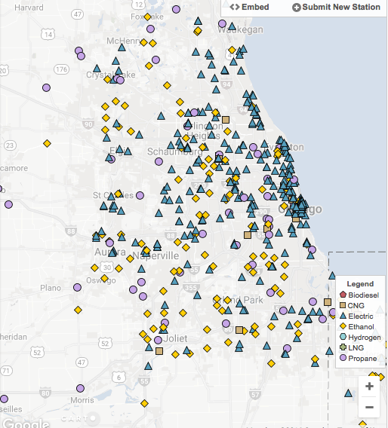
Current NE Illinois Alt Fuel Infrastructure
Alt Fuel | Public | Private
CNG | 18 | 37
LNG | 1 | 1
Propane | 42 | 2
E85 | 236 | 22
Biodiesel | 1 | 11
EV chargers | 920 | 198
Source:
www.afdc.energy.gov
November 2016
Compare: 9,400 Diesel stations and 8,000 gasoline stations listed in Yellow Pages

Slide 11
As-Is Assessment Flow

Slide 12
To Be Flow

