Slide 1
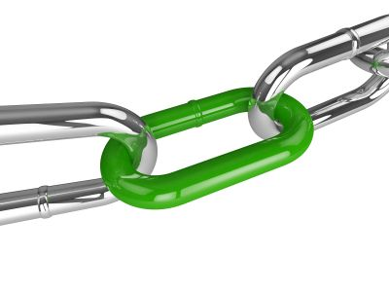
Link & Leverage: Fostering Sustainable Communities Through Partnerships
Metropolitan Mayors Caucus
Environment Committee Meeting
April 18, 2017

Slide 2
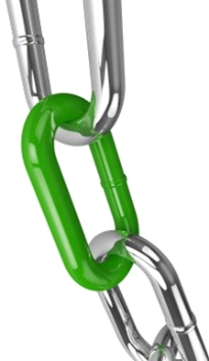
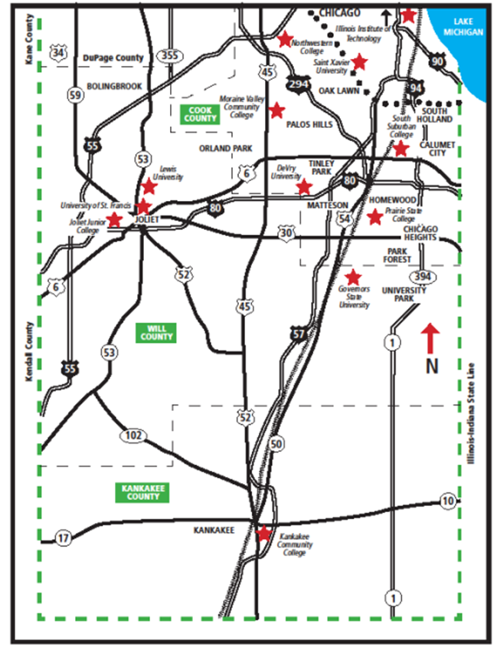
South Metropolitan Higher Education Consortium (SMHEC)
A unique, regional partnership of 11 higher education institutions.
5 community colleges
6 universities
1 public
5 private
1 for profit
SMHEC fosters new and enhanced educational services and programs to citizens, businesses and institutions in the region

Slide 3
Link & Leverage
Goal - Align environmental and social issues with resources and actions to help stakeholders achieve meaningful, measurable community sustainability and resilience. Make our region the GREENEST & most RESILIENT region.
Began - 2014

Slide 4
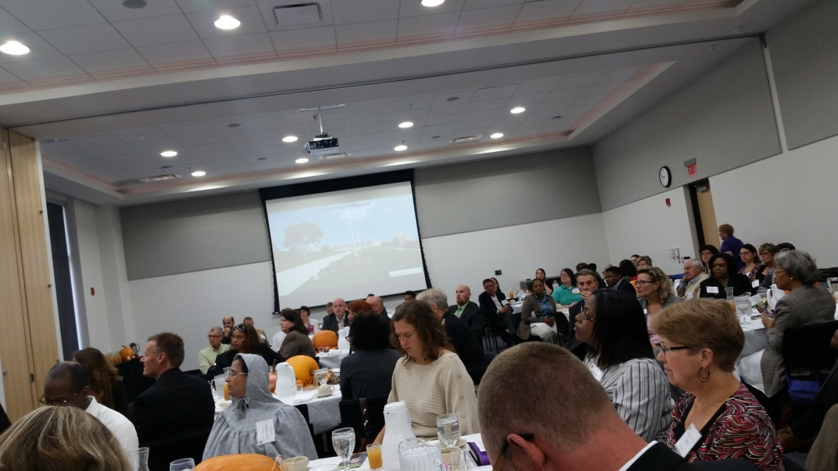
Who Is Participating?
The following key regional stakeholders were represented:
Government/municipalities (mayors, managers, public sector employees);
Citizen commissions
Nonprofits/ community-based
organizations;
Cultural/ recreational organizations;
Manufacturing/ business;
Healthcare; and,
Education institutions

Slide 5
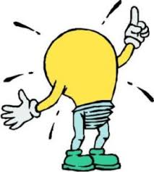
2015 Aha! Moment
Partner with Metropolitan Mayors Caucus on the
Greenest Region Compact 2

Slide 6
GRC2 Supports L&L Goals
Tells sustainable success stories and identifies areas of opportunity
Combining GRC2 with Link & Leverage in the Chicago Southland leverages municipal success with the efforts of other stakeholders
Builds relationships that move all communities collectively up the GRC2 ladder

Slide 7
2016 – 2017 Activities
Working with 3 sub-regions to meet their sustainability needs
Prairie State Community Partners for Sustainability
Alsip/Worth
Will County Regional Resilience Network

Slide 8
2016 – 2017 Activities
Southland Communities who have signed GRC2:
Alsip Orland Park
Blue Island Oswego
Diamond Park Forest
Frankfort Richton Park
Olympia Fields Thornton
Also working with:
Chicago Heights Flossmoor Homewood

Slide 9
L&L Results:
At every L&L, meaningful connections are formed.
Sample connections:
2 internships created to a local municipality and a non-profit
Municipal tree care issue resolved by a local non-profit resource
Non-profit recycling organization working w/ developmentally disabled adults is growing its effort through new partners
Village Librarian connected to programs at Morton Arboretum
Village created asset map of formal and informal groups
Connecting UI extension services to community groups and schools for gardening expertise
Connecting Millennium Reserve, Calumet Stormwater Collaborative, RainReady expertise and many other initiatives with local communities

Slide 10
Why Is This Important?
For our Community:
Growing L&L to make this the greenest & most resilient region, we set up
our region for success. The Southland becomes more sustainable, able to support the health & well-being of its residents while becoming more attractive to businesses, families, professionals and future students.
For our Colleges:
Provides opportunities for student/faculty/staff engagement in
community projects, internships, etc.
Helps schools better understand the needs for the communities where they reside

Slide 11
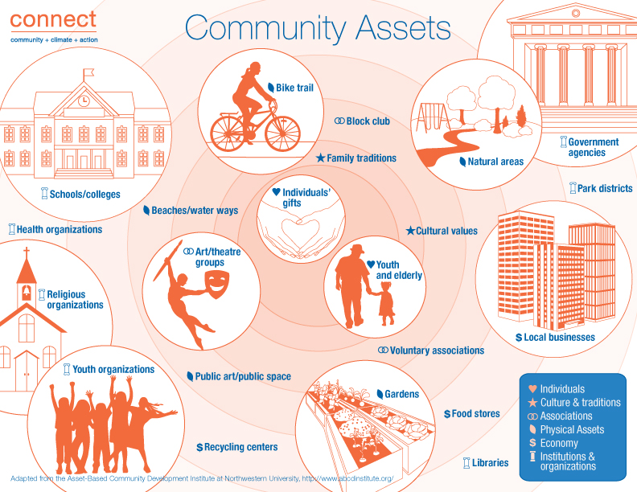
Community Asset Mapping
Social tech tool to identify & map all areas of interest valued in communities,
i.e., all things that make a community great, or
with the right resources, has potential to be part of something that will make a community great

Slide 12
THANK YOU!
Genny Boesen, Executive Director
South Metropolitan Higher Education Consortium
Gboesen@PrairieState.edu

