Slide 1
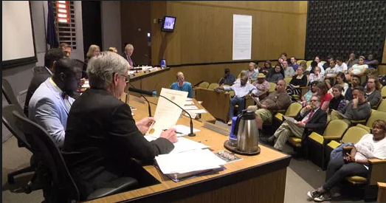
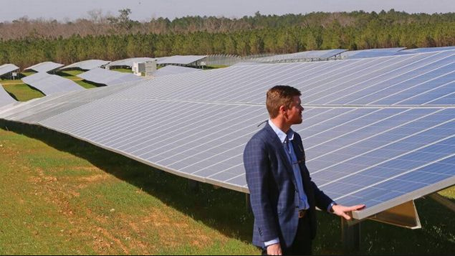
Lawyers for communities? Lawyers for clean energy?
Warren G. Lavey
Metropolitan Mayors Caucus
July 2018

Slide 2
The Weeds That Almost Killed the Sun

Slide 3
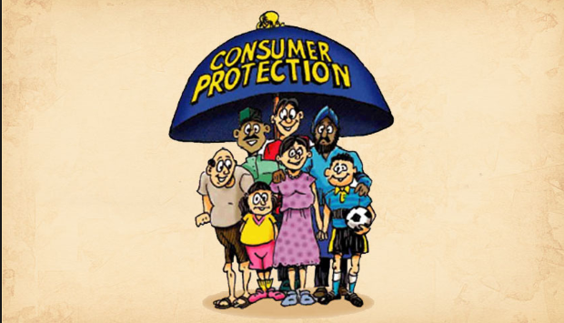

Slide 4
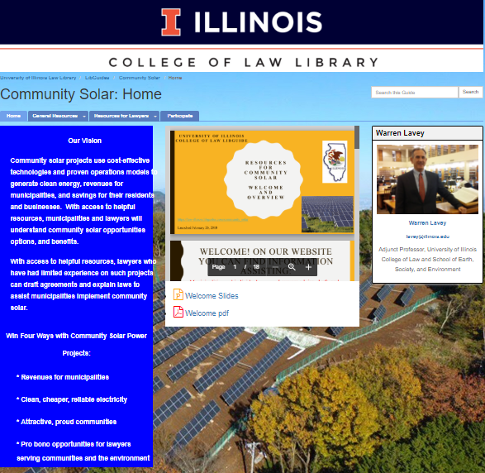
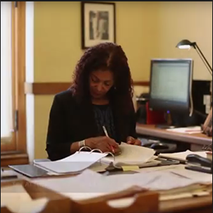
Help for your Village Attorney

Slide 5
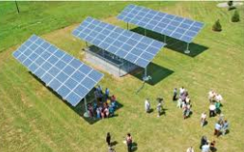
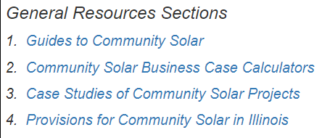

Slide 6
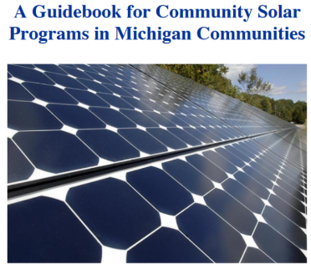
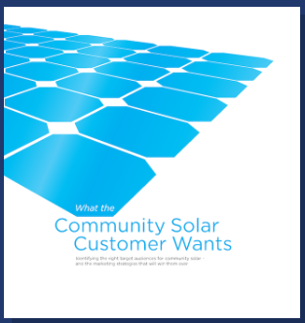
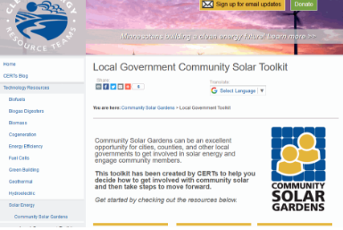
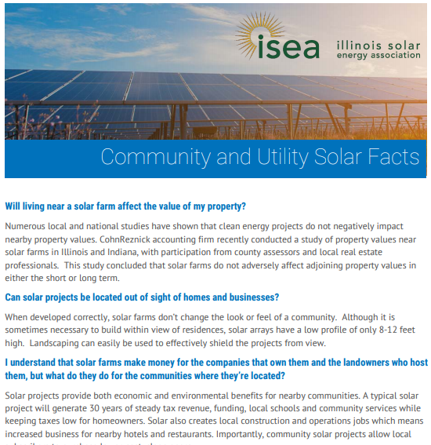
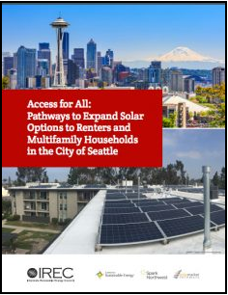
General Resources – Guides to Community Solar – Planning and Development of Community Solar Projects

Slide 7
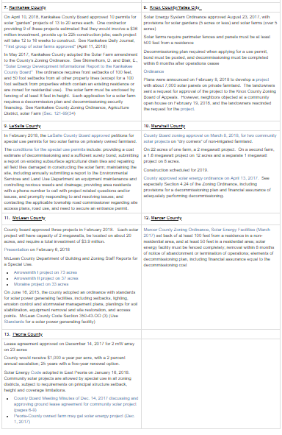
General Resources – Guides to Community Solar – Case Studies – Illinois Case Studies

Slide 8
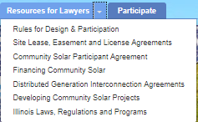

Slide 9
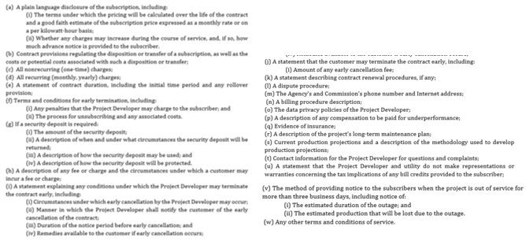
Resources for Lawyers – Community Solar Participant Agreement

Slide 10
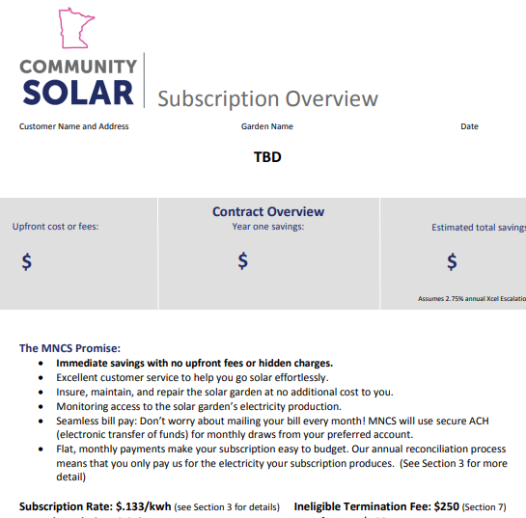
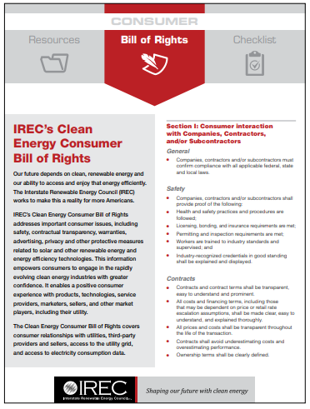
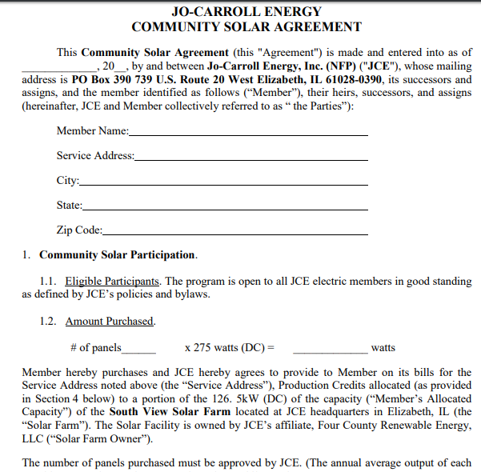
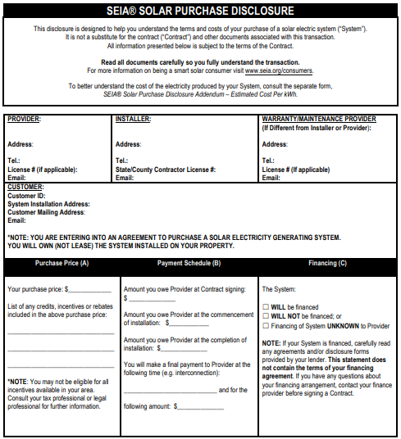
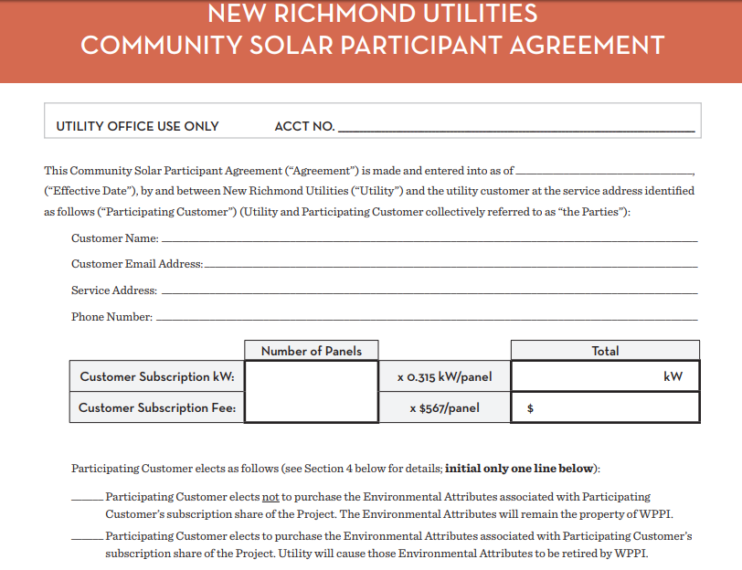
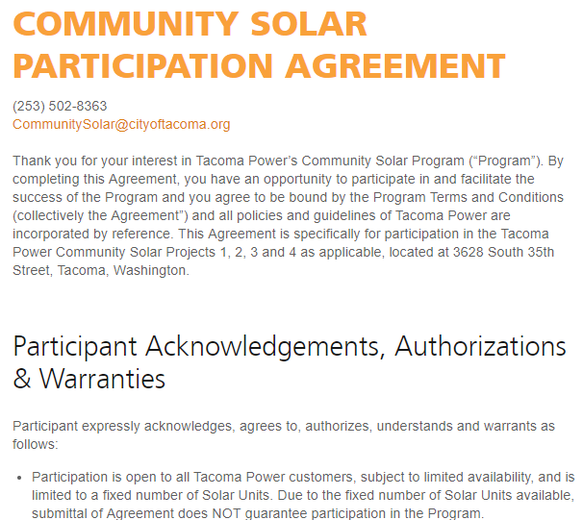
Resources for Lawyers – Community Solar Participant Agreement

Slide 11
Resources for Lawyers – Developing Community Solar Projects
7 examples of solar energy zoning ordinances adopted by Illinois counties and municipalities
Illinois Solar Energy Association’s zoning principles
Guidance and Models for Community Solar Ordinances
“Community Solar Power Decision Matrix”
Templates from NC and NY
RFP from CO

Slide 13
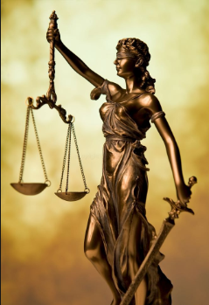
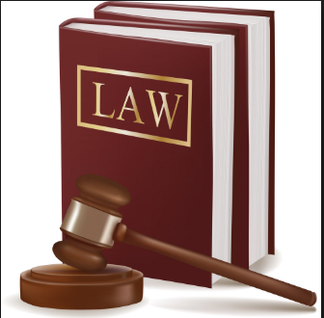

Slide 14
https://law-illinois.libguides.com/c.php?g=795745&p=5691564
LibGuides Community Solar

