Slide 2
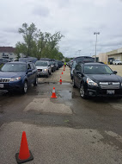
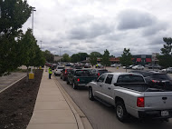
Monthly Collection Events

Slide 3
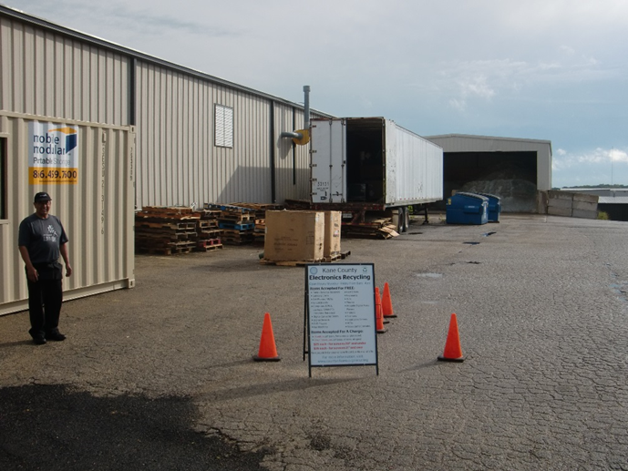
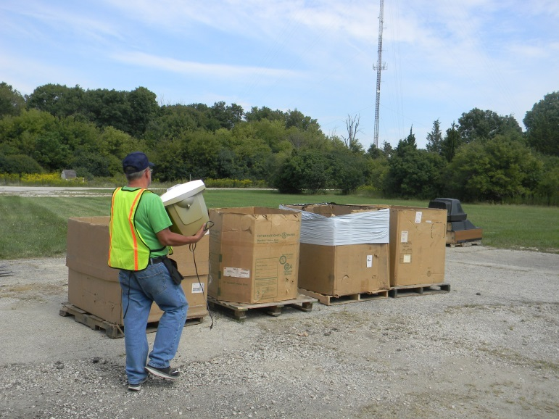
Three Drop-offs Monday-Friday
517 E Fabyan Parkway, Batavia 735 Martin Drive, South Elgin 900 Angle Tarn, West Dundee

Slide 4
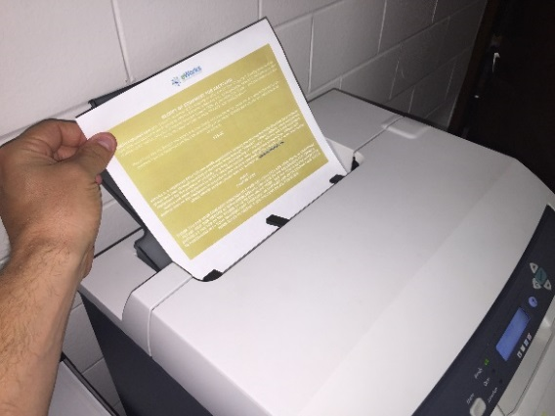
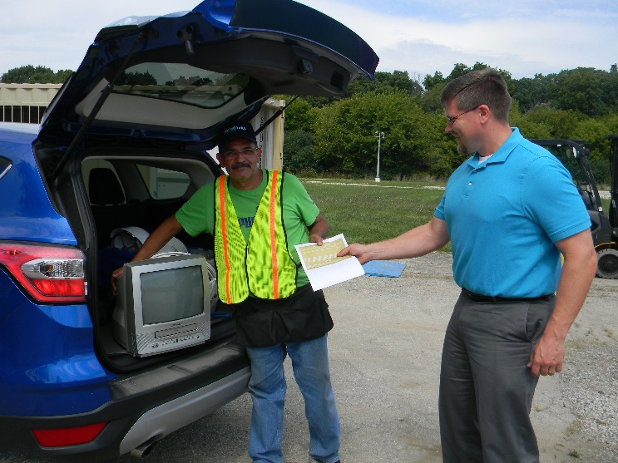
TVs and Monitors accepted for a fee
$25 fee for screens under 21 inches (measured diagonally)
$35 fee for screens 21 inches and over
Pay online in advance and print receipt
or pay at site with cash or card only.
This fee is paid directly to the County's contracted electronics recycler, eWorks, a non-profit that employs individuals with developmental disabilities.​

Slide 5
ELECTRONIC ITEMS ACCEPTED FOR FREE
Cable & Satellite Receivers
Cables & Cords
Cell Phones / PDAs
Circuit Boards
Computers, Laptops
Digital Converter Boxes
Digital Recorders
DVD Players
Fax Machines
Hard Drives
Keyboards
Mice
Phones
Portable Digital Music Players
Printers
Scanners
Small Scale Servers
VCRs
Video Game Consoles

Slide 6
Funding Mechanism:
Voluntary contribution requested from all municipalities
10 cents per capita annually
Pay in to allow your residents to participate
IGA with County
Will Reimburse drop-off hosts and cover programmatic costs

Slide 7
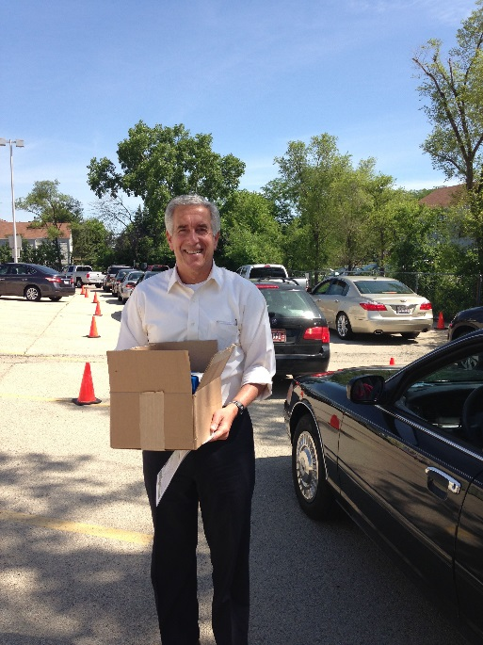
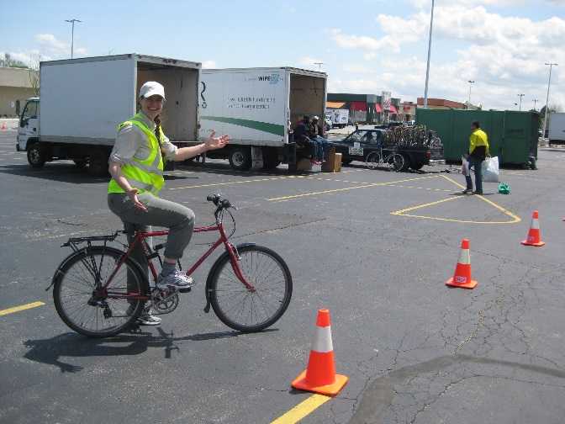
Jennifer Jarland Kane County Recycling Coordinator recycle@countyofkane.org 630-208-3841

