Slide 1
City of Highland Park
Green Alliance
Volume Based Trash

Slide 5
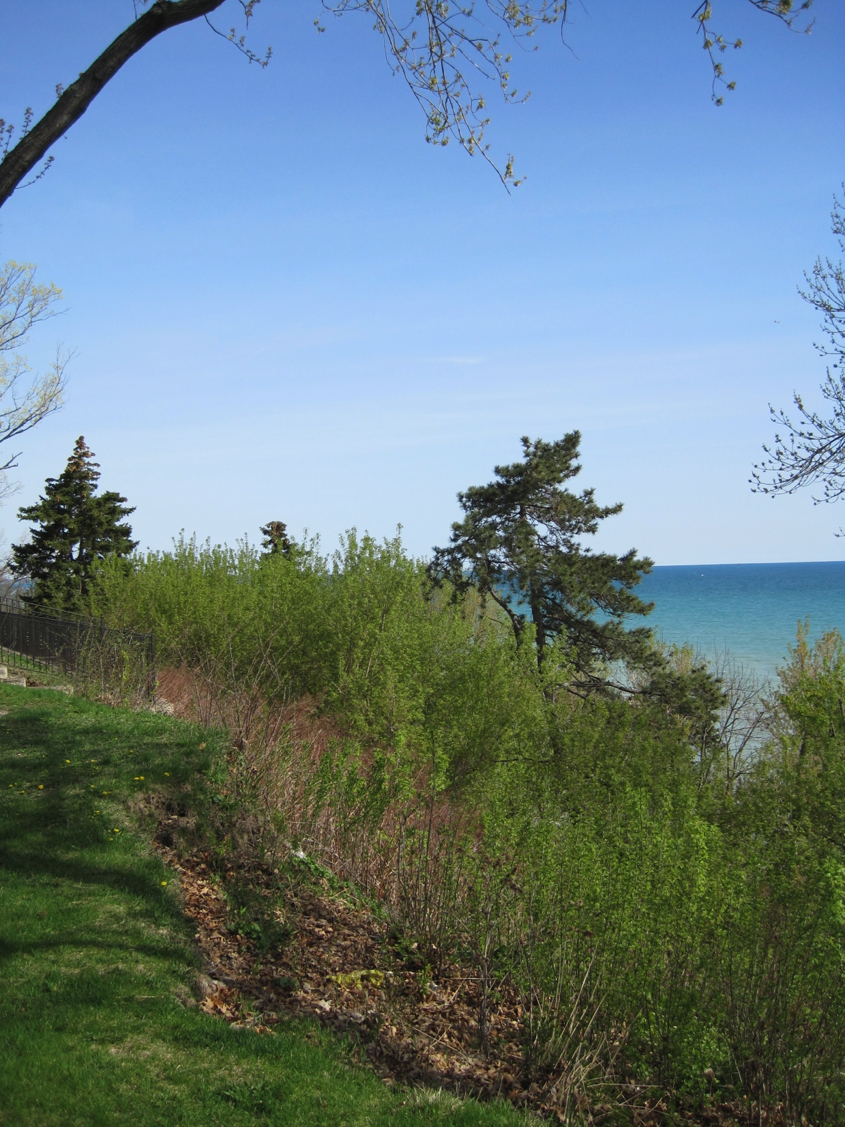

Slide 8
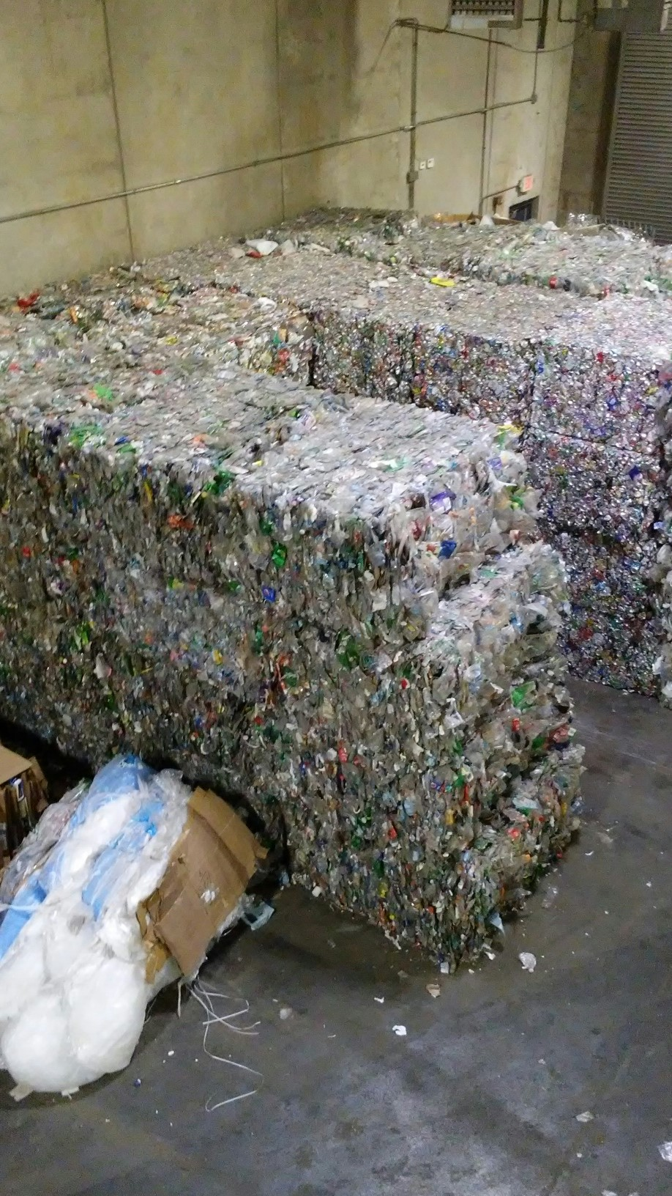

Slide 10
