Slide 1
Chicago Area Waterway System
David Ullrich
Great Lakes and St. Lawrence Cities Initiative

Slide 2
Great Lakes and St. Lawrence Cities

Slide 3
The Problem

Slide 4
Timeline
2009 - eDNA and Litigation
2010 - What Next
2011 – The Study
2012 – Restoring the Natural Divide

Slide 5
Chicago Area Waterway System

Slide 6
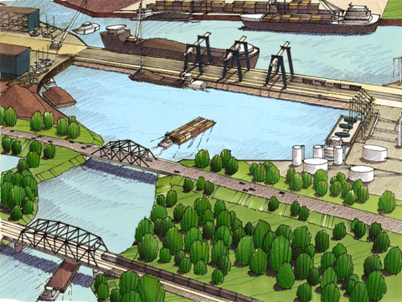
Barrier

Slide 7
Timeline
2013 – Continued Discussions
2014 – Great Lakes Mississippi River Inter-basin Study
2014 - Advisory Committee
2015 – More Discussions
Short term
Long term

Slide 8
NE Illinois and NW Indiana

Slide 9
