Slide 1
Partnering for Happy, Efficient Communities

Slide 2
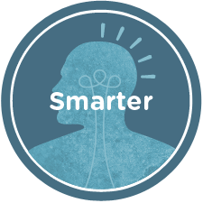
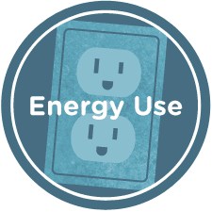
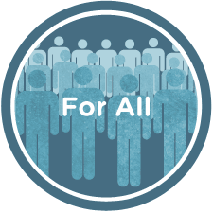
Our Mission
We promote smarter energy use for all.
We give people the resources they need to make informed energy choices.
We design and implement efficiency programs that lower costs and protect the environment.
We ensure the benefits of energy efficiency reach those who need them most.
Notes:
Too much text?? Add a photo of a bunch of happy, energy-efficient people?

Slide 3
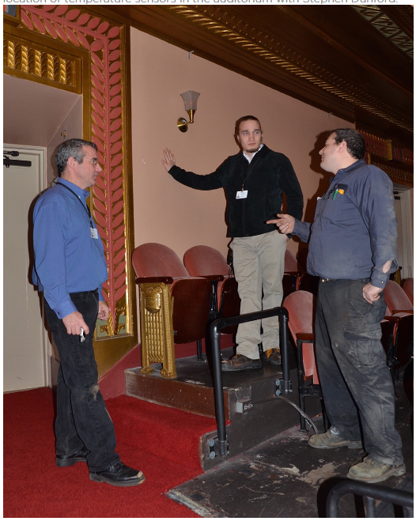
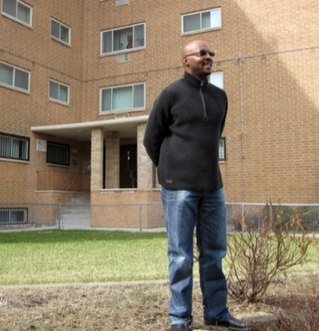
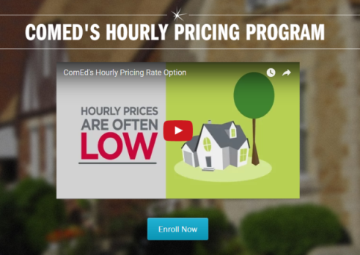
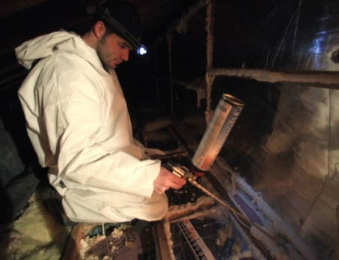
Our Programs
Communities
Energy planning
Solar PV
LED Street Lighting
Energy Benchmarking
Buildings
Single Family
Multifamily
Nonprofit
Senior/Supportive Housing
Childcare facilities
Smart Grid
ISEIF
ComEd’s Hourly Pricing program
Low-Income pilot
Research

Slide 4
Relationships With Key Partners & Stakeholders

Slide 5
How We Can Help Engage Residents
Planning
Outreach & Education
Programs

Slide 6
Program Details
Single Family
Assessments for $99 or free to house party hosts
Blower door
Safety check
Connect with vetted BPI Certified contractor
Monitoring and quality assurance
Home Energy Star certificate
Low-income Multifamily and Childcare, Nonprofit, and Senior/Supportive Housing
Assessment by Elevate BPI Certified energy analyst
Incentives for retrofit and upgrades (e.g. lighting)
Elevate vetted contractors
Monitoring and quality assurance

Slide 7
How We Partner With You
Community
Elevate
Identifies target audience
Sets goals
Defines metrics and process for measuring
Enlists internal and external resources
Helps identify options to reach targets and achieve goals
Partners with community resources for outreach
Connects residents and property owners to programs
Provides metrics

Slide 8
Together We Can…
Achieve your GRC2 energy efficiency goals
Help your residents and property owners:
Save money
Be more comfortable in their homes
Increase the value of their homes/properties
Help your community:
Reach the underserved
Put money back into the local community
Grow energy efficiency programs to create jobs and opportunity

