Slide 1
Founding Partners
Seven Generations Ahead
City of Aurora
Kane County
a5 Branding and Digital
…in collaboration with Fox Valley communities

Slide 2
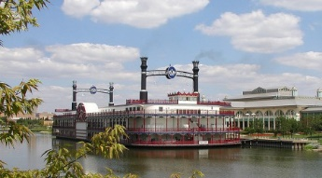
Funding
Grand Victoria Riverboat Fund
City of Aurora
Kane County
Private and Public Sector Sponsors

Slide 3
Fox Valley Sustainability Network Broad Goals
Create cross-community collaboration that builds a sustainable Fox Valley region.
Provide a vehicle for supporting and building upon existing initiatives.
Create new BIG IDEA projects that cut across communities and institutions (community solar parks; native garden corridors, residential curbside food scrap collection and composting throughout the Fox Valley, etc.).
Disseminate resources and programs that advance sustainability.
Share successes, build excitement and catalyze collaboration.

Slide 4
FVSN Forums 2016-17
March 16 – Green Infrastructure and Water
June 8 – Energy
October 7 – Economic Development
December 7 – Transportation
February 8 – Food & Waste
March 22 – Residential Curbside Food Scrap Composting
June 21 – Energy
August 29 – Green Infrastructure

Slide 5
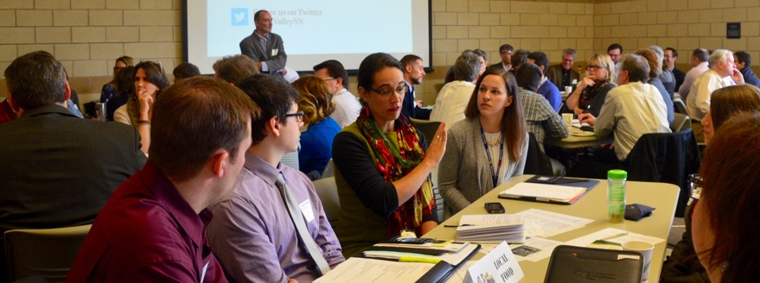
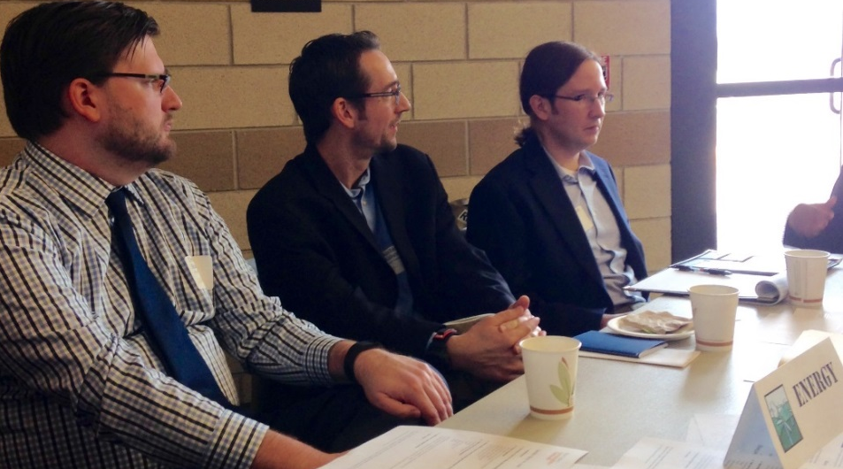
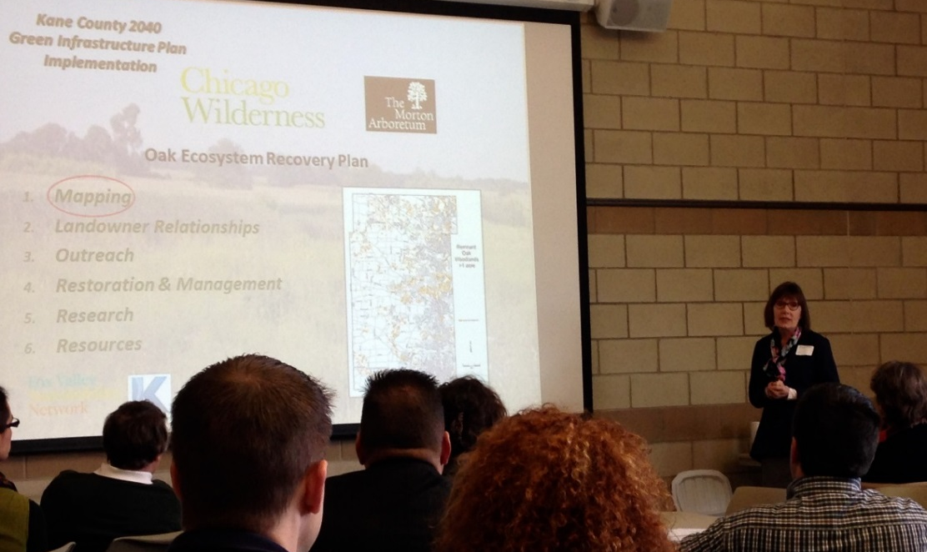
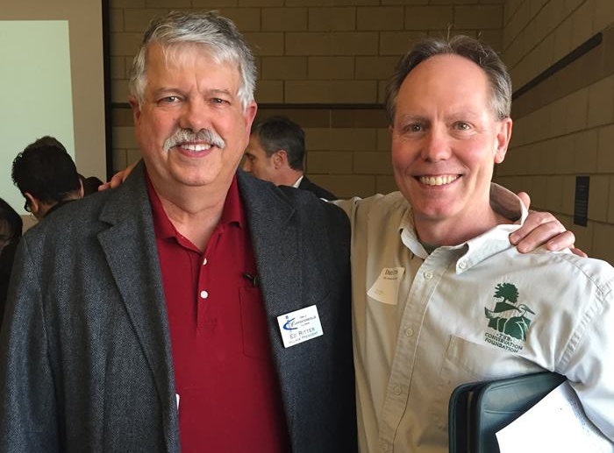
Launch Meeting—March 16th

Slide 6
GreenTown Fox Valley – April 27, 2017 at Two Brothers Roundhouse
Mayors’ Breakfast: Jos Szabo, CMAP; Mayor Weisner FVSN Award; Policy/Project Recommendations 1-minute Snapshots and Packet
Keynotes – Jack Darin, Sierra Club; Liz Doris, NREL
Idea Factory
Breakouts – 7 topic areas and Greenest Region Compact II
Mayors’ Breakfast – 35 attendees; GT – 160 registrants (130 attendees)

Slide 7
Projects
Zagster Bike Share Across the Fox Valley
Economic Develop Bike Tour Series (tourism, signage, business development)
Regional Education Campaign for Green Infrastructure (FREP)
Multi-County Local Food Access Website
Catalyzing Residential Curbside Food Scrap Collection/Composting Programs
Community Solar

Slide 8
Questions?
Contact:
Gary Cuneen,
Executive Director, Seven Generations Ahead
gary@sevengenerationsahead.org
OR
Kane County Staff

