Slide 1

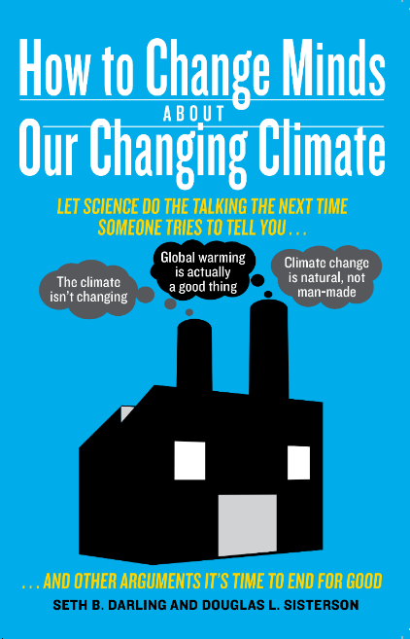
Climate Disruption
What We Can Do
Seth B. Darling, PhD

Slide 2


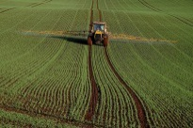
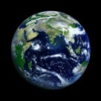
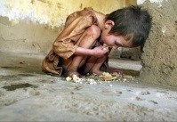
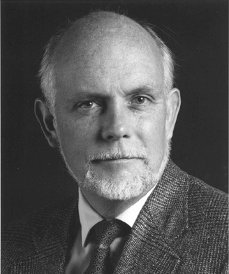
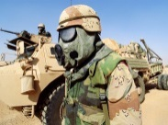



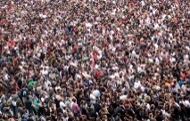
Top 10 problems facing humanity
Energy
Water
Food
Environment
Poverty
Terrorism & War
Disease
Education
Democracy
Richard Smalley
Population

Slide 3
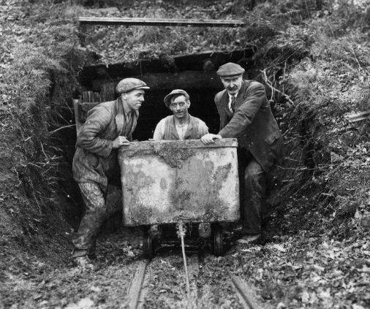
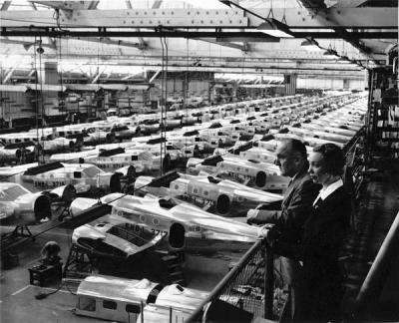
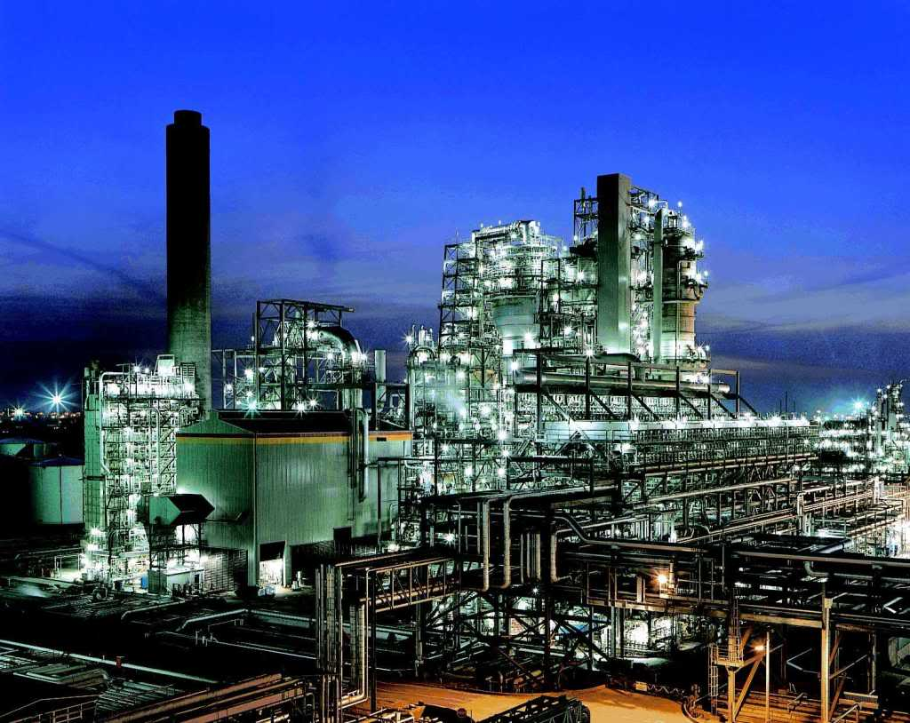
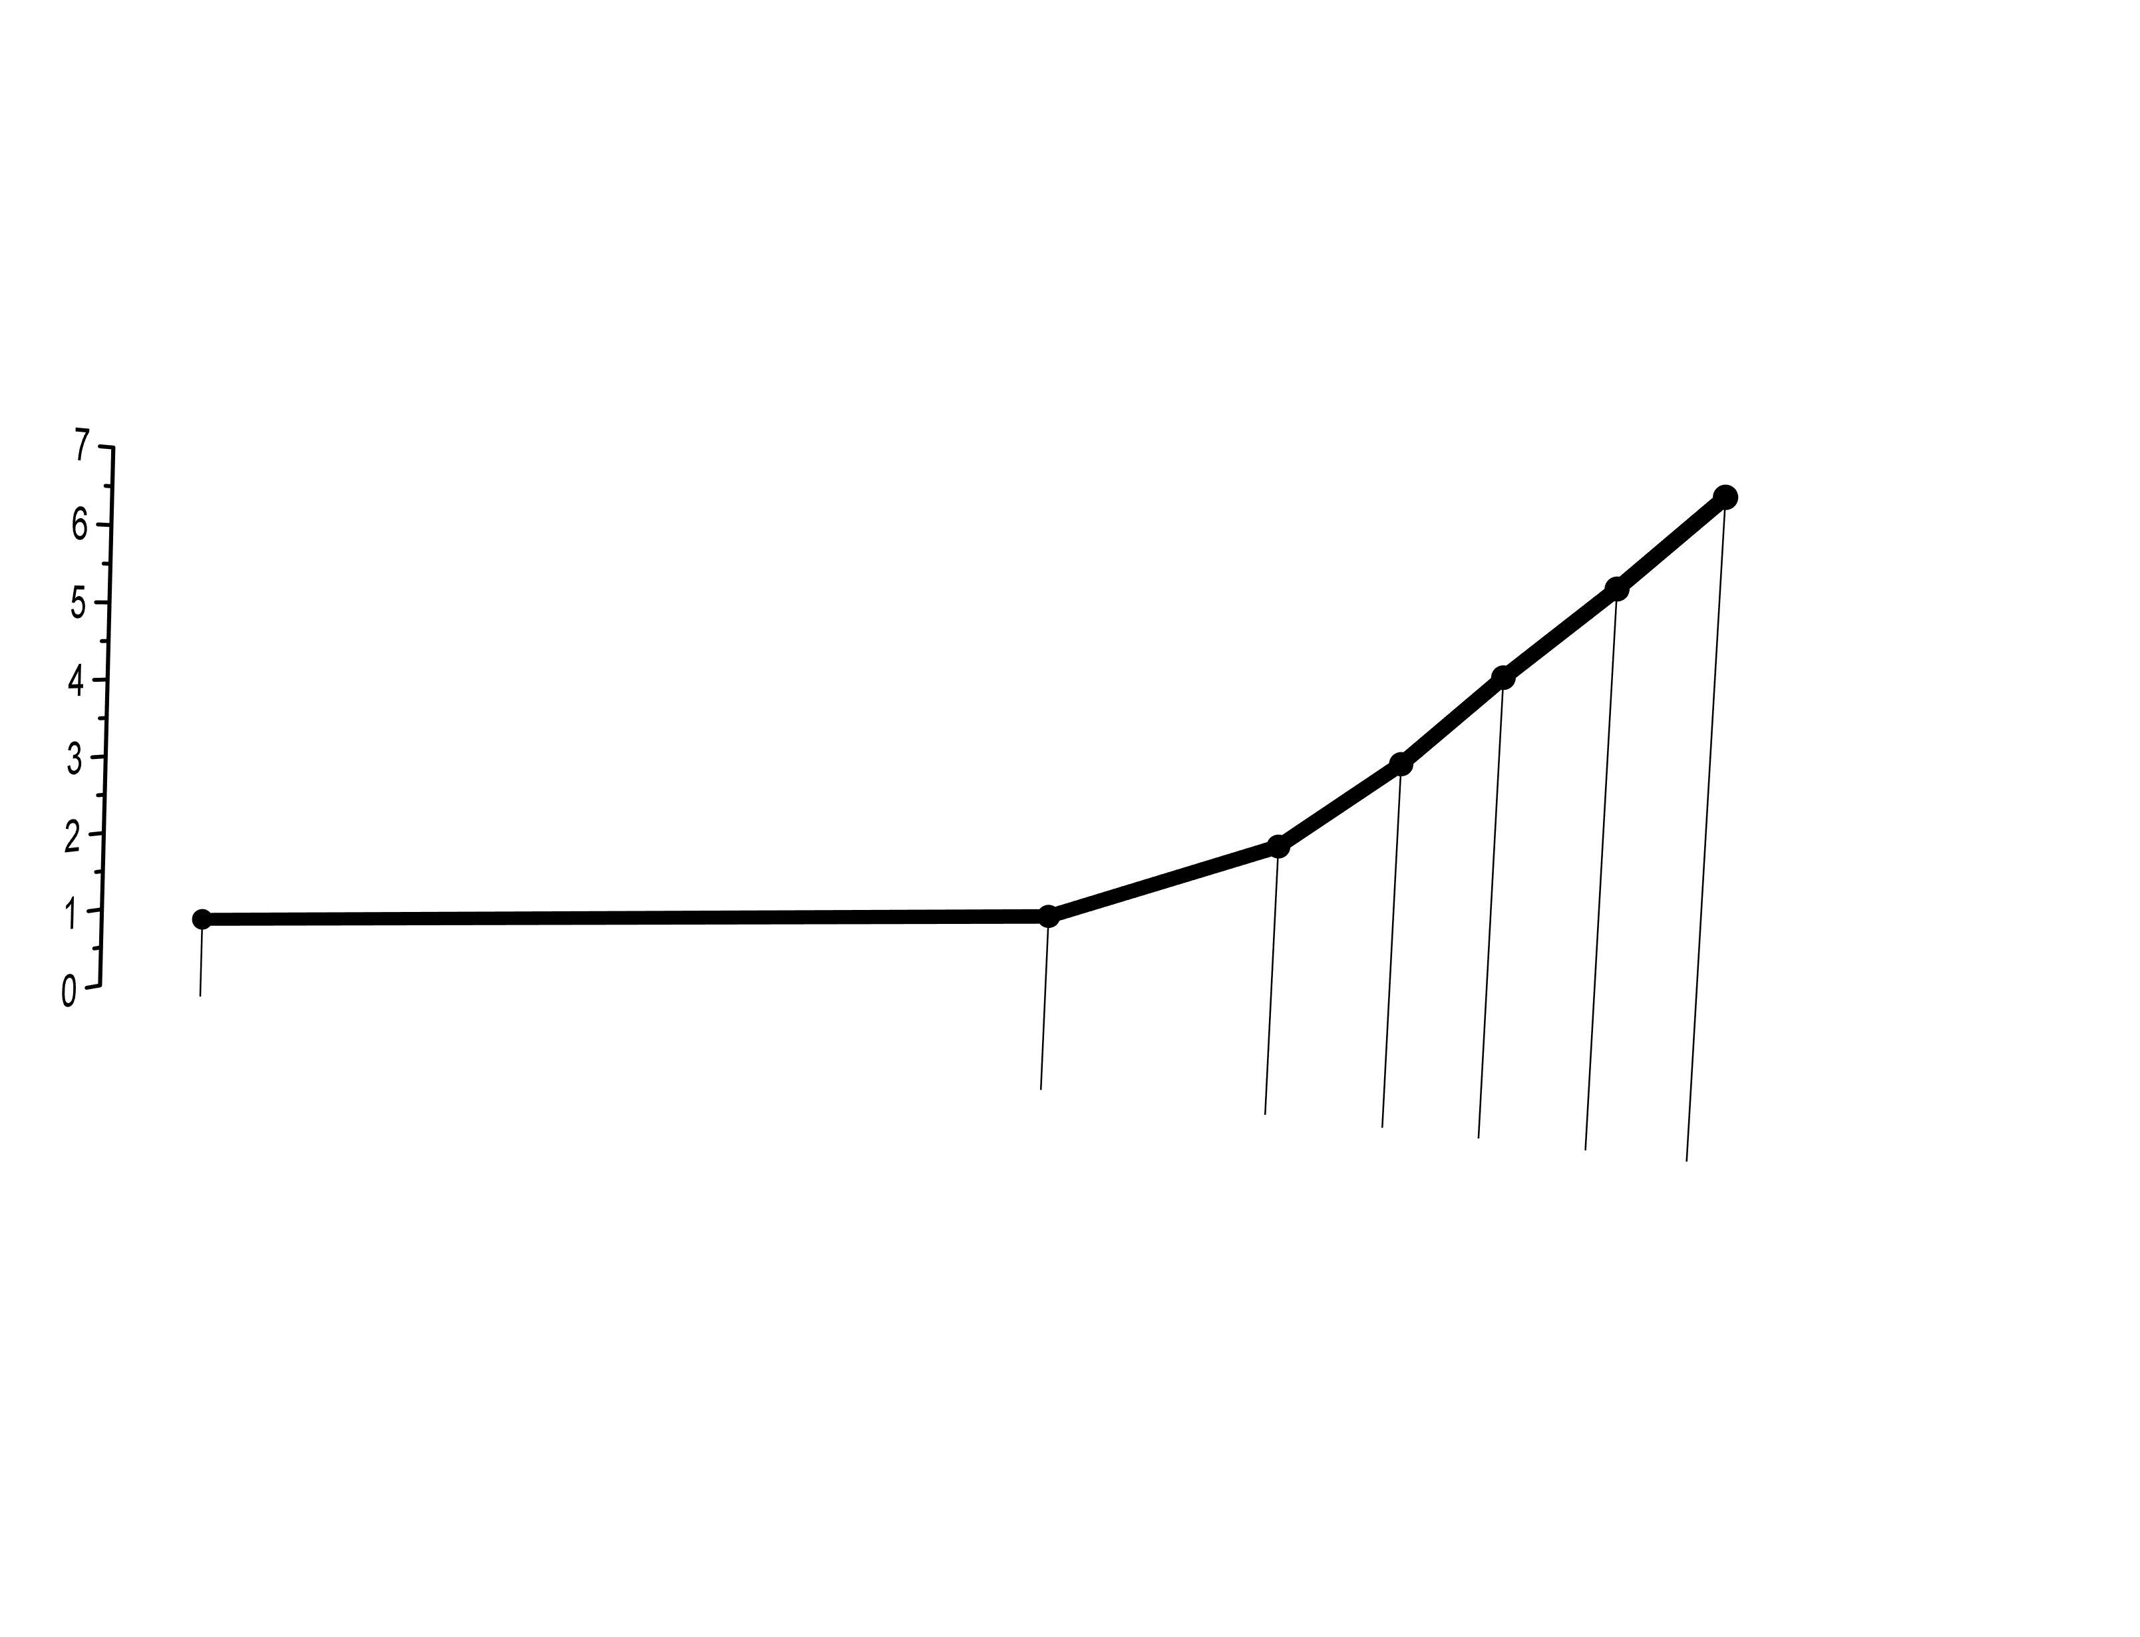
1800
1900
1950
2000
today
1850
Population (B)

Slide 4
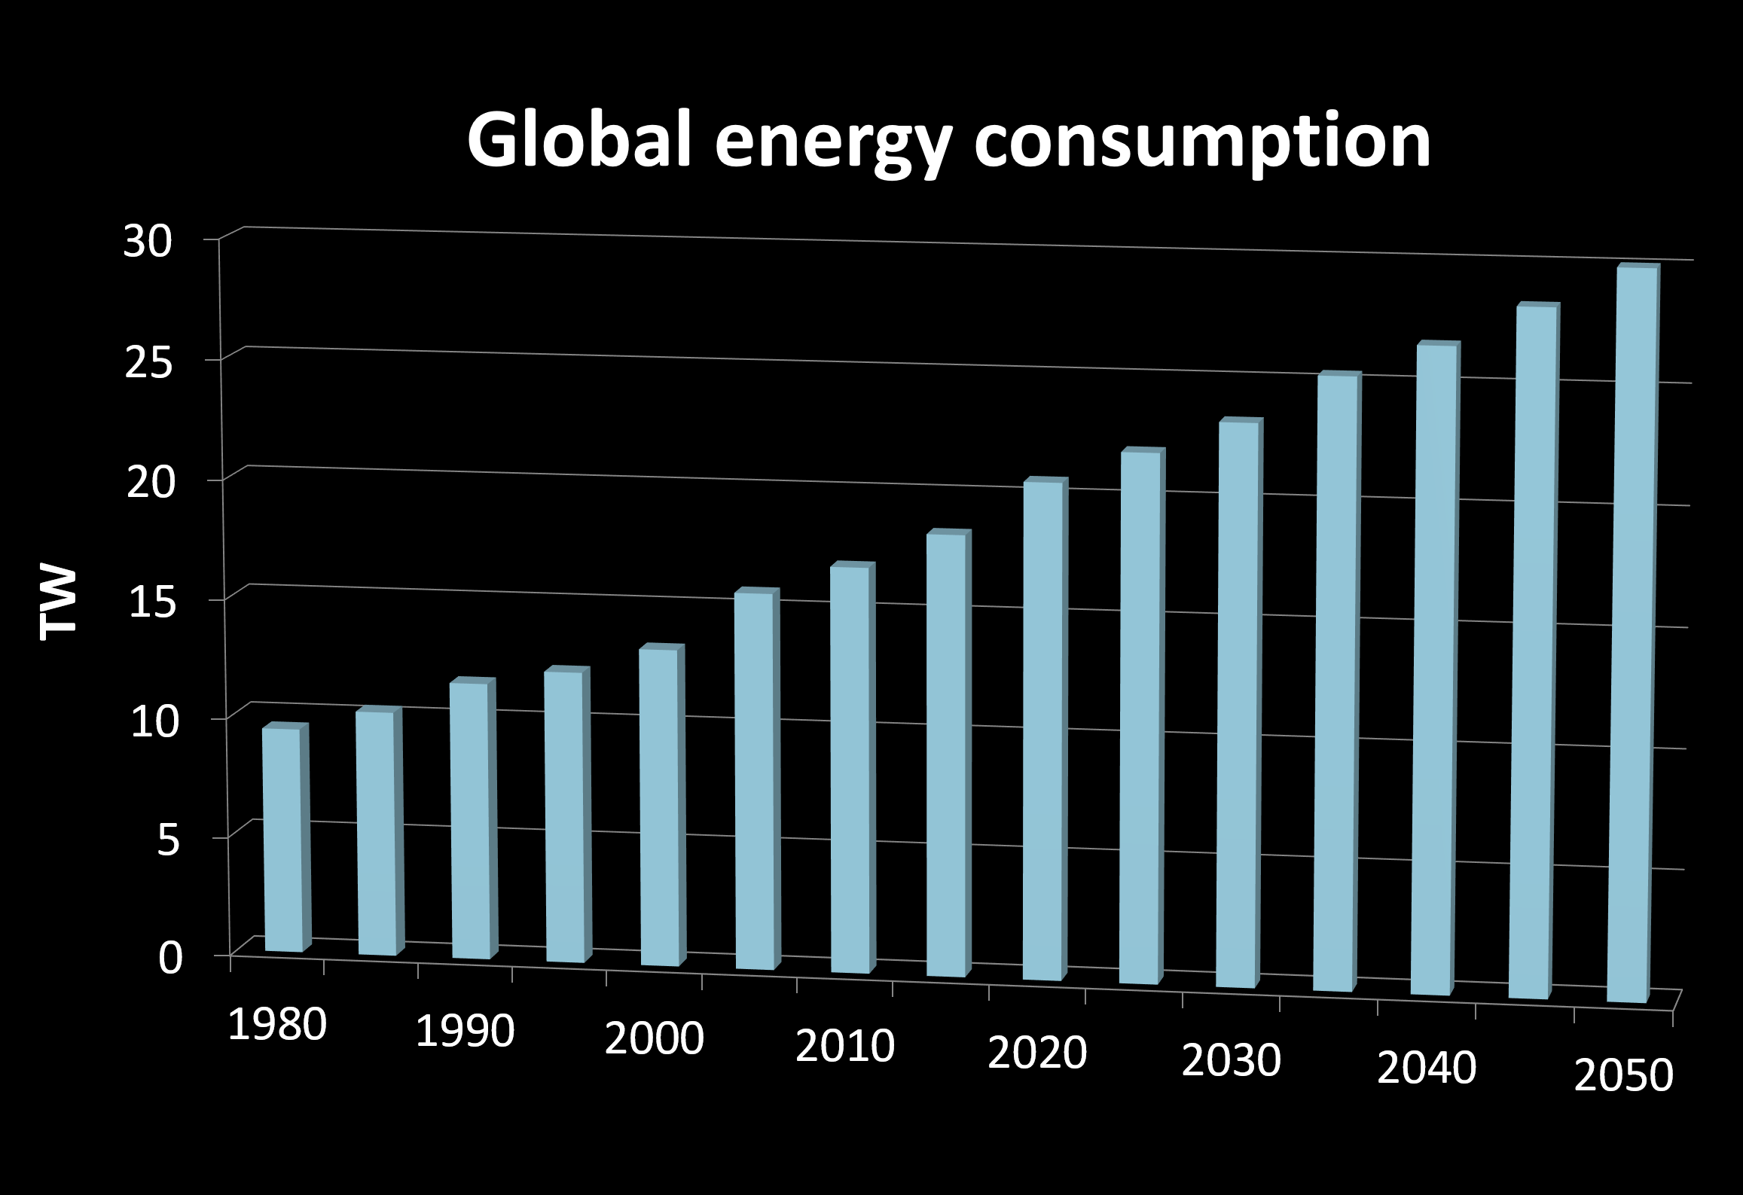

Slide 5
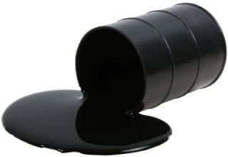

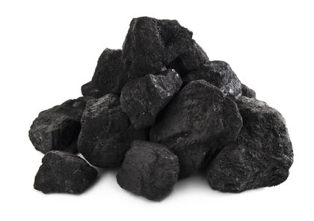

Slide 6
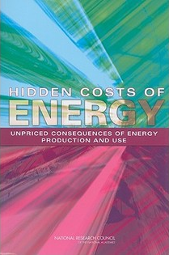
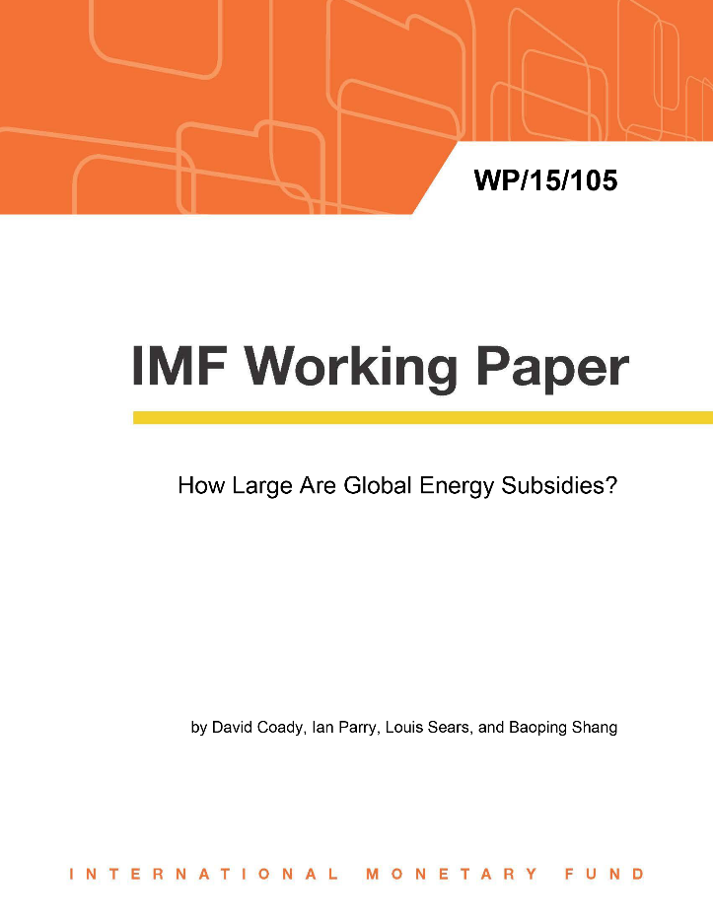
Energy costs more than you think it does
$5,300,000,000,000

Slide 7
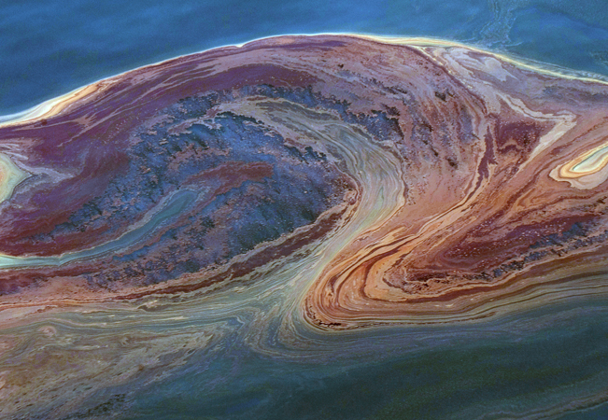
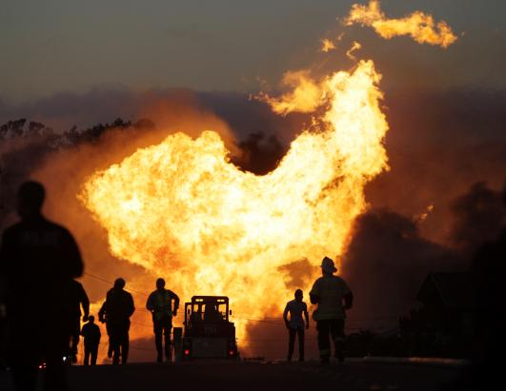
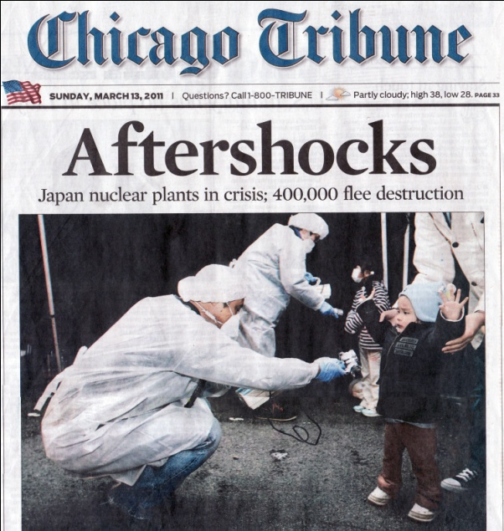
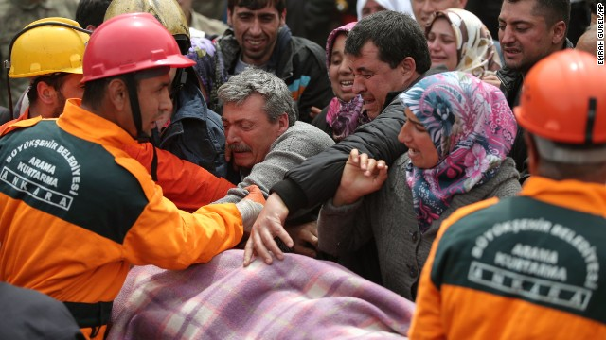
Deepwater Horizon
Gulf oil spill
San Bruno
natural gas explosion
Fukushima Daiichi
nuclear disaster
Soma, Turkey
coal mine explosion/fire

Slide 8
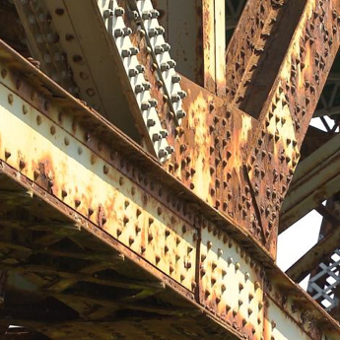
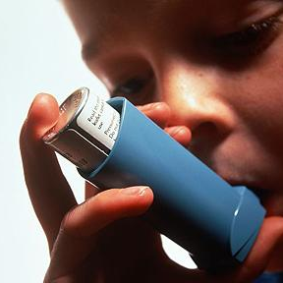
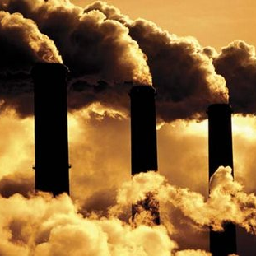
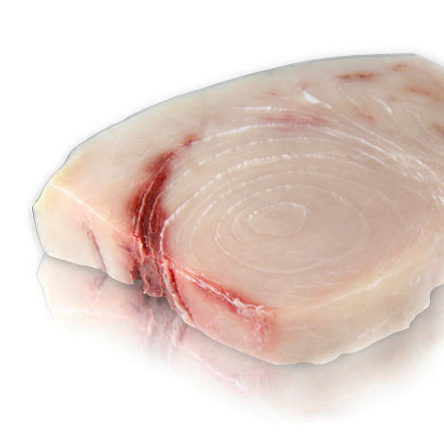
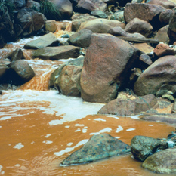
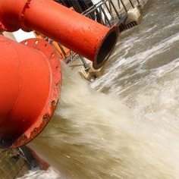
Health insurance
Acid rain
Particulates & ozone
Food
Water
Heavy metals
Notes:
Health
Asthma/bronchitis
Cancer
Developmental disorders
Food
Mercury in fish
Lower crop yields
Water
Thermal pollution
Loss of fresh water

Slide 9

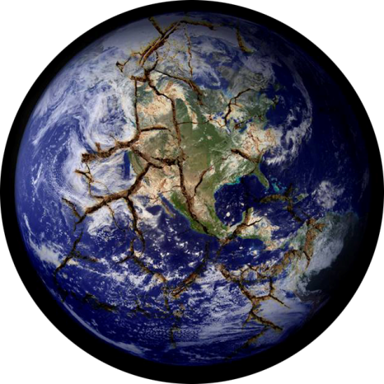
Global warming
Climate change
Climate disruption

Slide 10
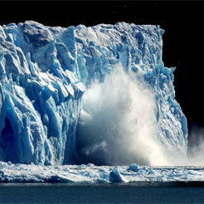
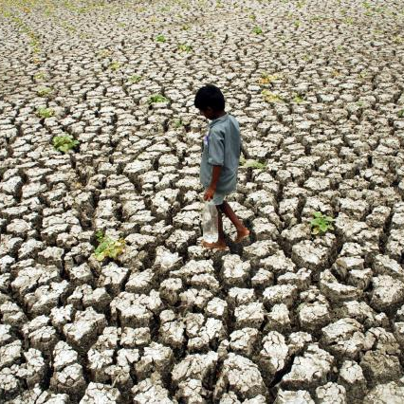
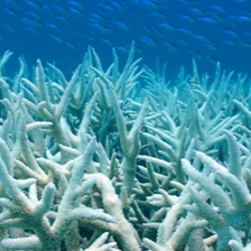
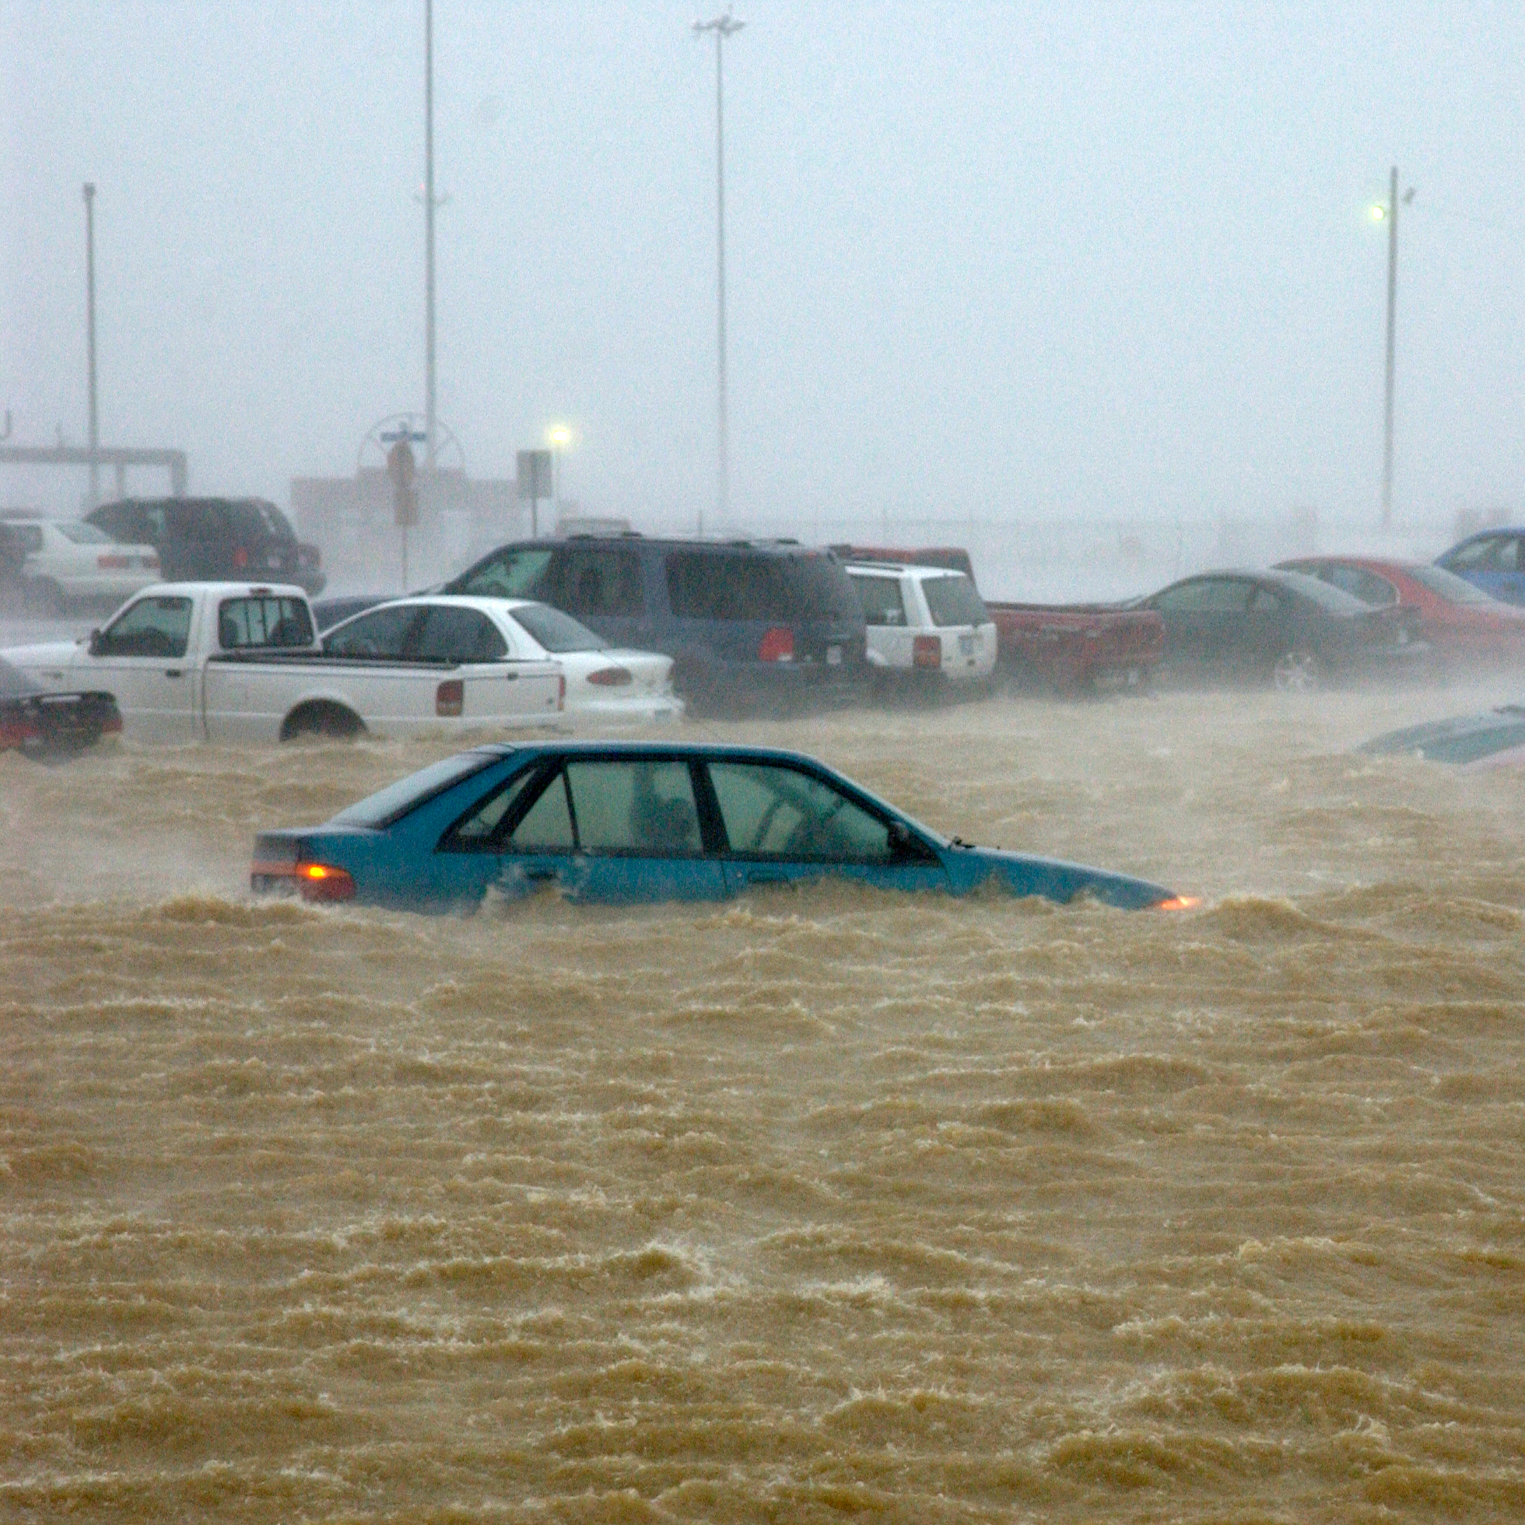
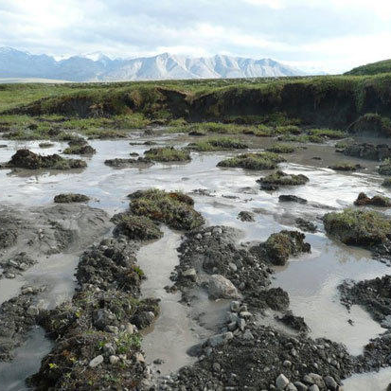
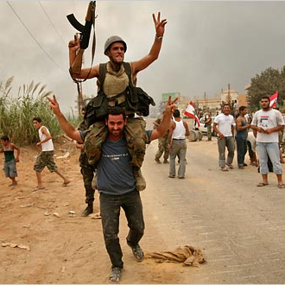
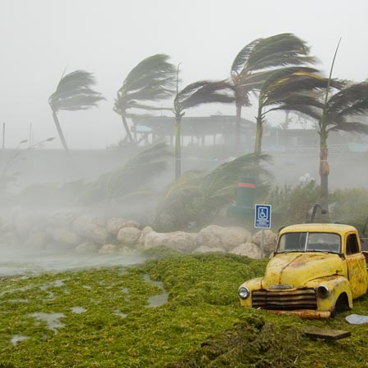
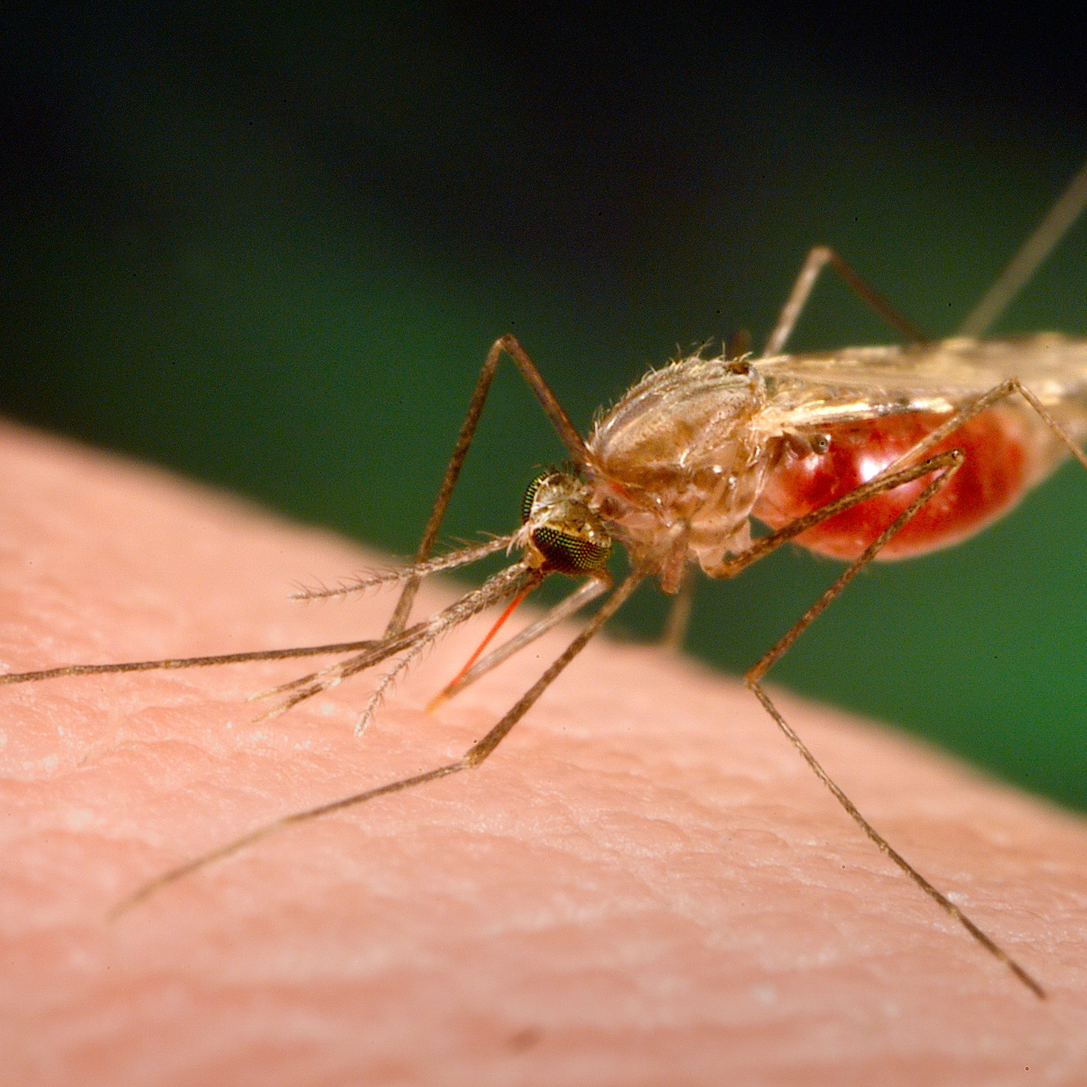
Agriculture
Melting glaciers
Ocean acidification
Sea level rise
Security
Polar melting
Extreme weather
Health
Notes:
Agriculture
Water supply disruption (floods, droughts, etc.)
Wildfires
Expanding deserts
Polar melting
Mobile ice is a shipping hazard
Loss of ice albedo is positive feedback on warming
Methane in arctic will be released (strong greenhouse gas)
Loss of habitats (biodiversity loss)
Ocean acidification
Coral bleaching
Loss of photoplankton
Loss of shellfish
Damage to entire ocean food chain
Melting glaciers
One sixth of world’s population depends on glacier melt for water
Sea level rise
Flooding
Mixing of salt and fresh water, polluting aquifers
Health
Disease-bearing insect migration
Heatwave deaths
Dramatic increase in pollen counts
Economic
Costs of climate disruption far outweigh the costs of preventing it
Massive migration, disruption to trade, storm damage, socioeconomic volatility (conflict)

Slide 12
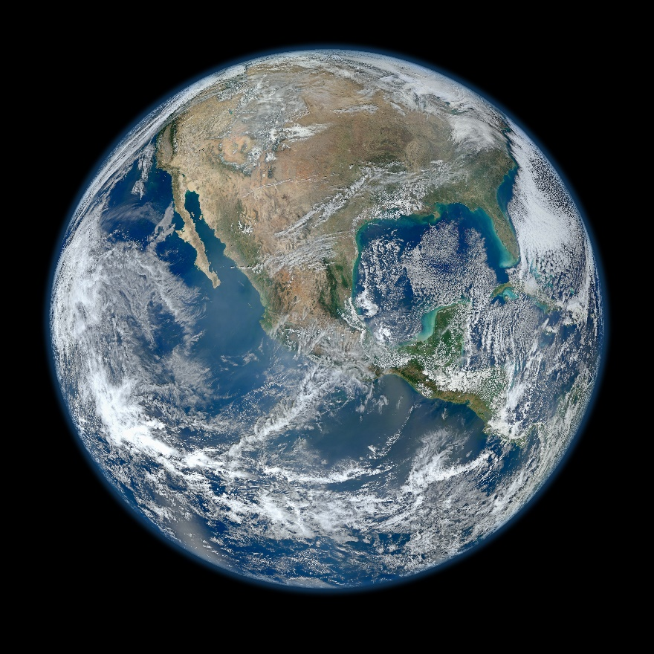
Greenhouse gases keep our planet at a livable temperature
60°F

Slide 13
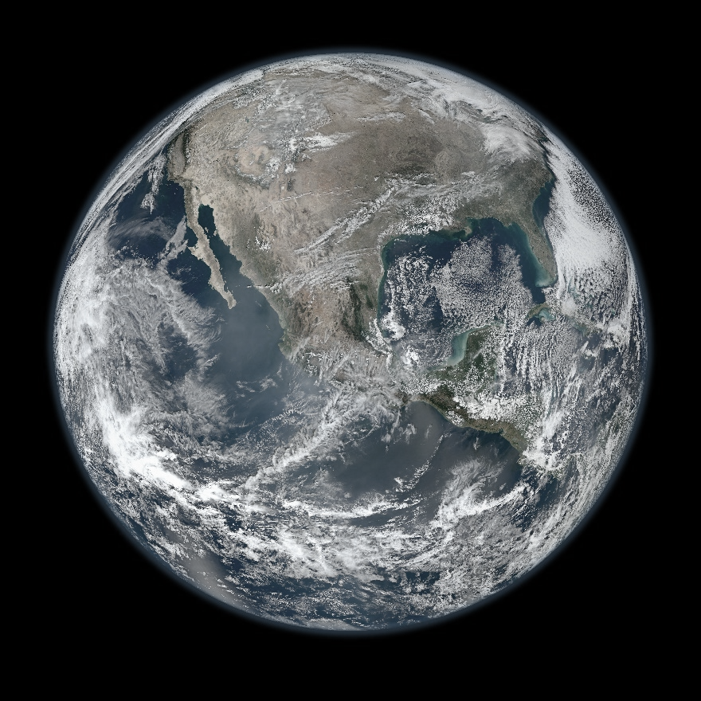
Without greenhouse gases, our planet would be 0°F on average
60°F
0°F

Slide 14
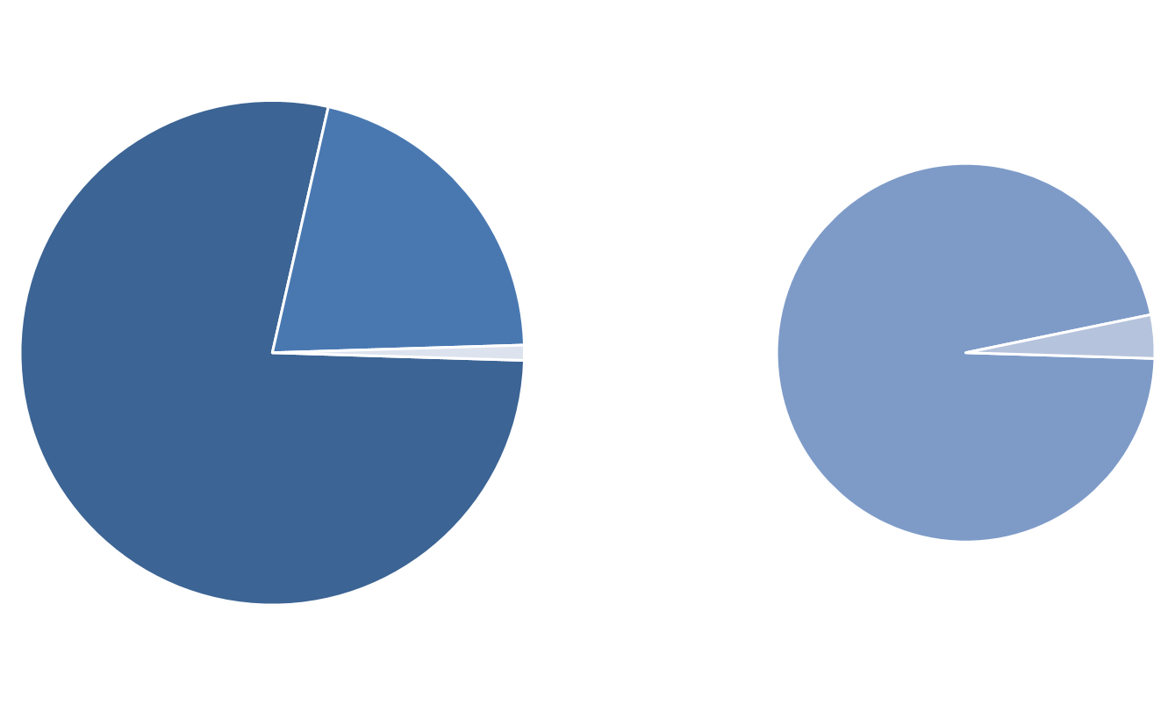
Greenhouse gases make up
less than 0.05% of our atmosphere*
Greenhouse gases
O₂
Ar
N₂
A little goes a long way…
* by mass, excluding water vapor

Slide 16
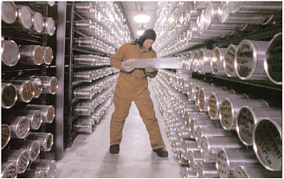
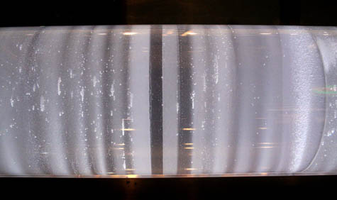
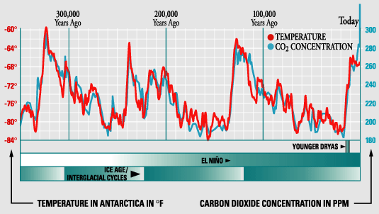
Vostok ice core
Note the maximum

Slide 18
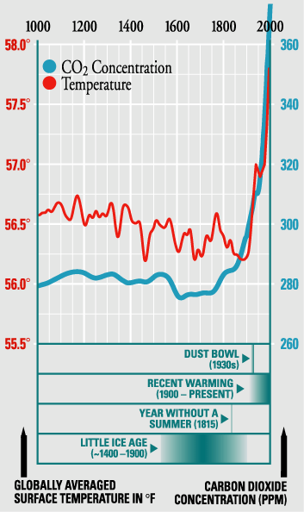
Vostok ice core

Slide 20
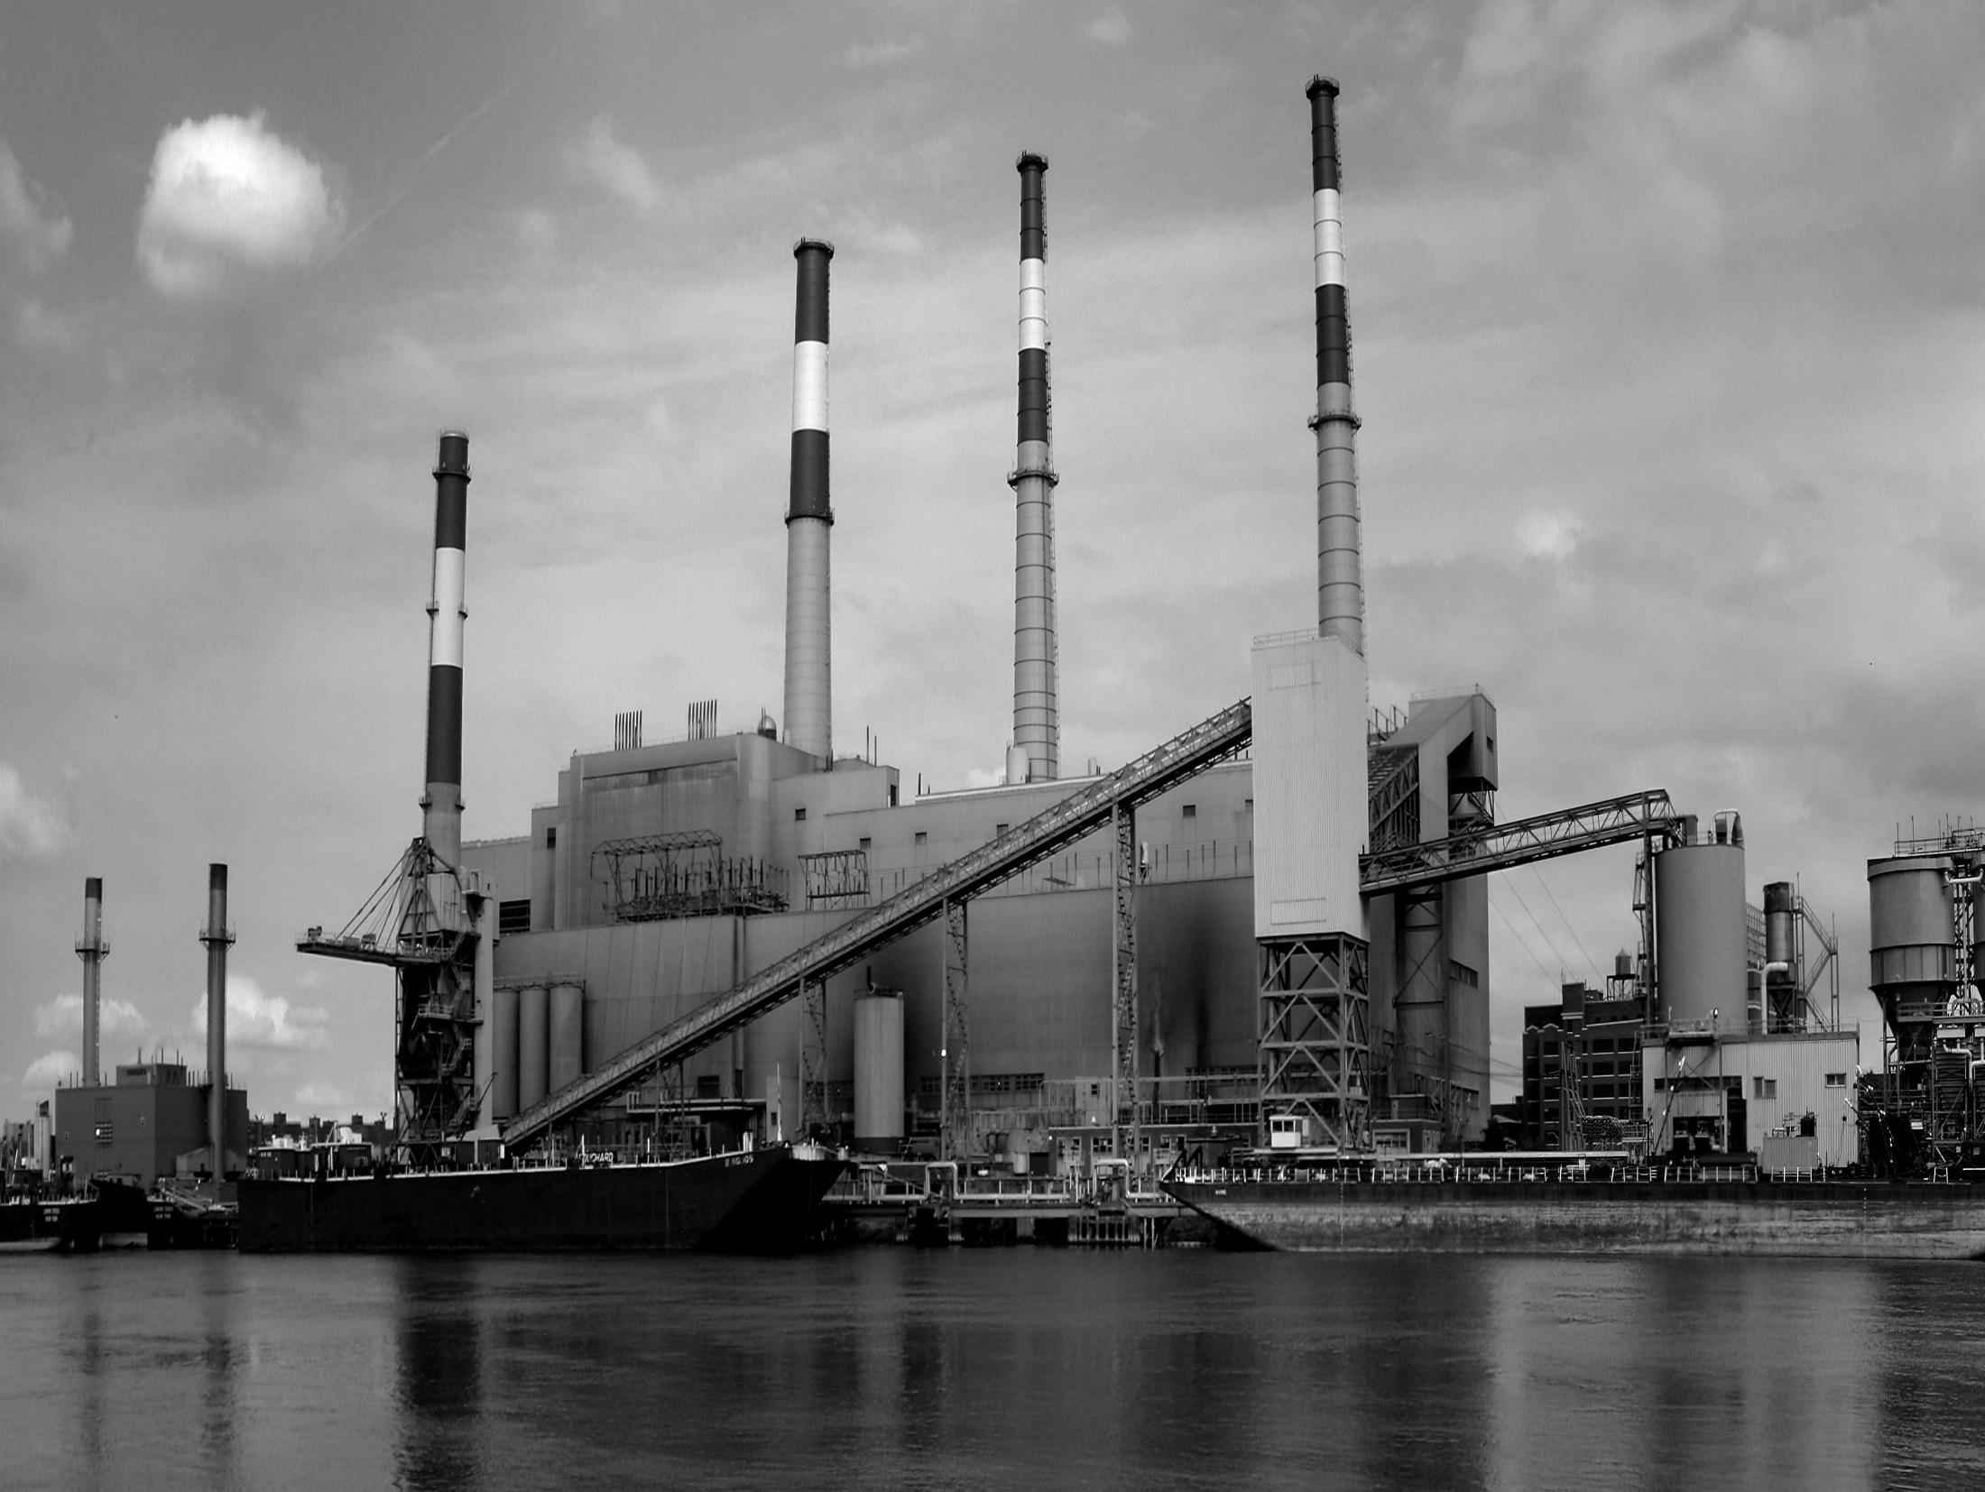

Slide 21
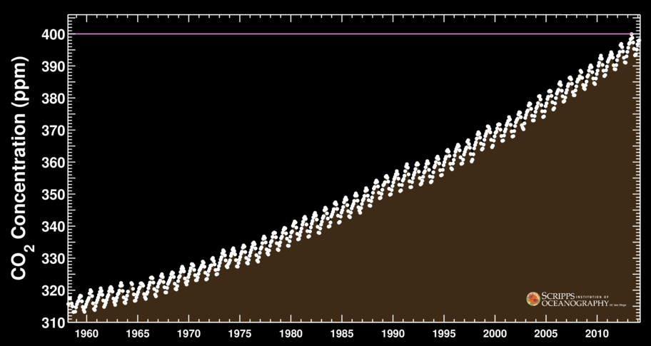
CO₂ concentration (Mauna Loa Observatory)

Slide 22
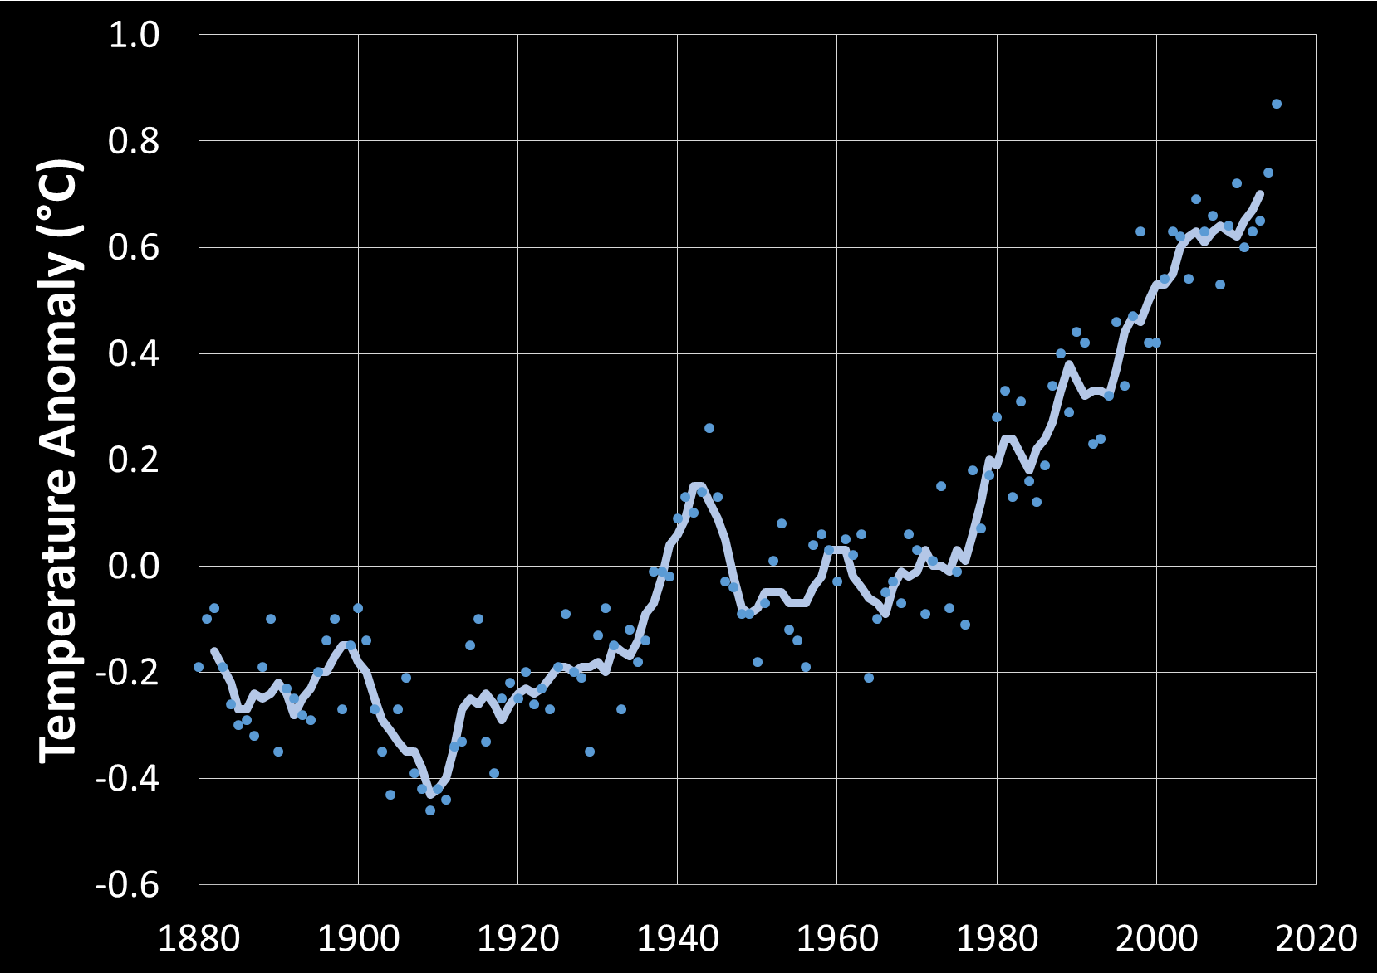
Global surface air temperature change
NASA GISS

Slide 23
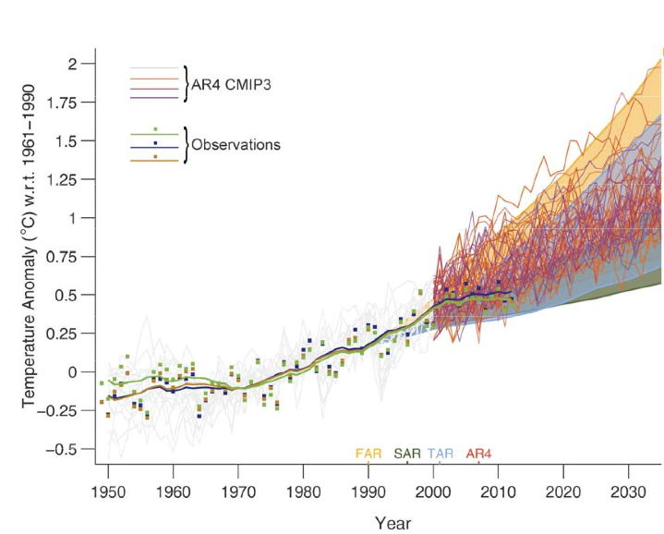

Slide 24
Where the heat is going
Guemas et al. Nature Climate Change (2013)
Lee et al. Nature Geoscience (2015)

Slide 25
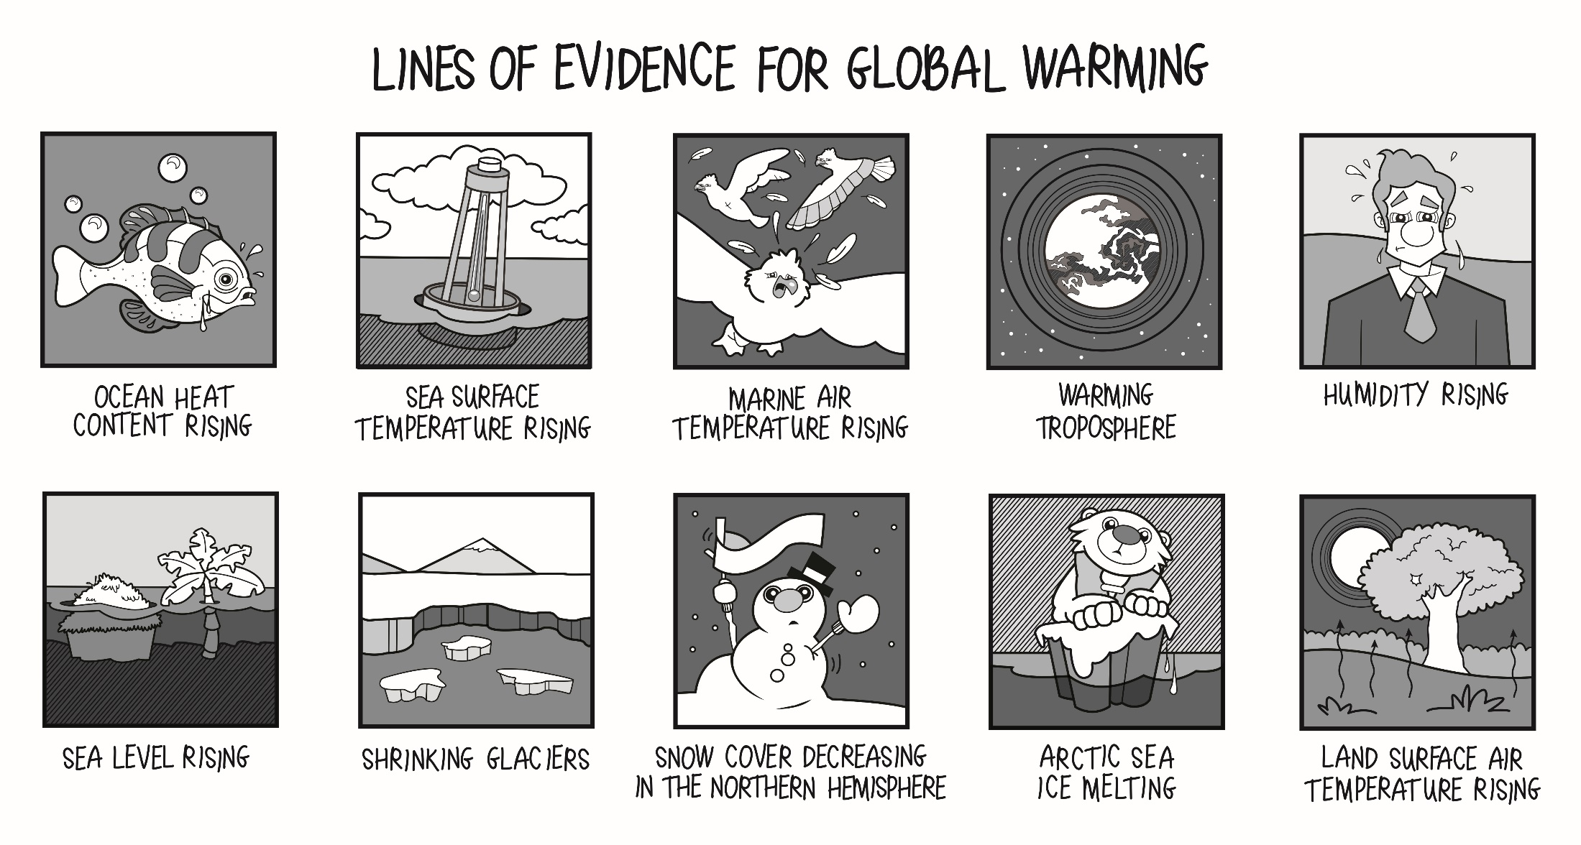

Slide 26
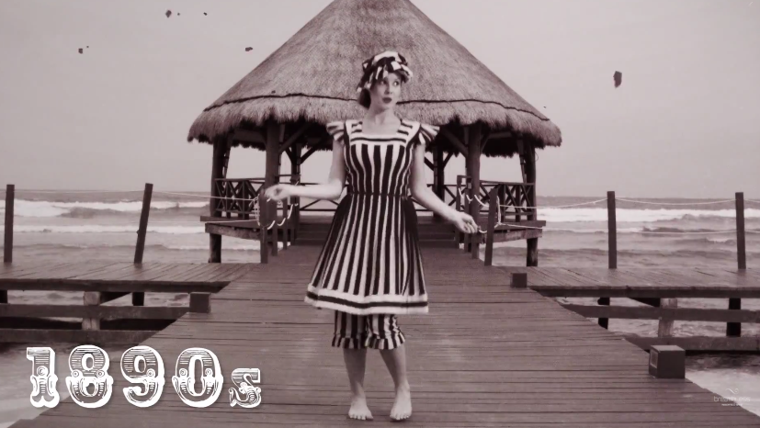
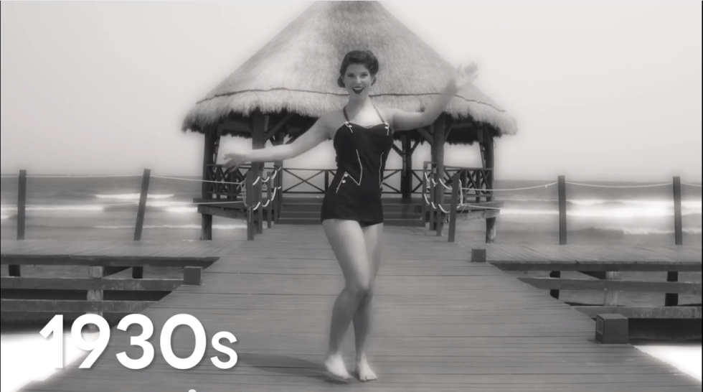
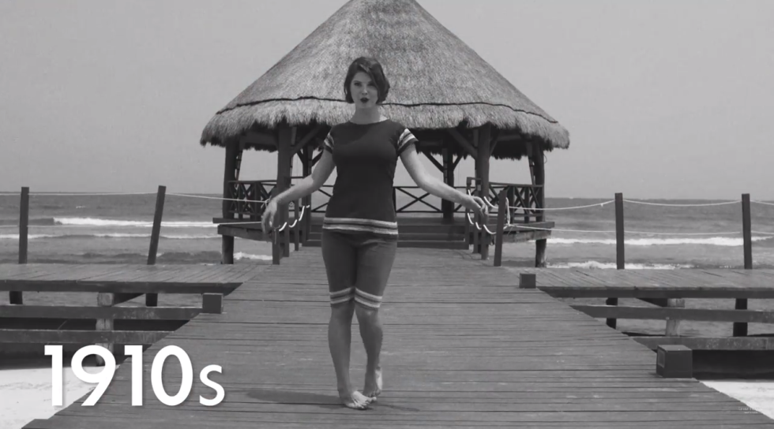




Undeniable proof of global warming
Images from Breathless Resorts & Spas

Slide 27

WEATHER
IS
not
climate

Slide 28

YOUR CITY
IS
not
the world

Slide 29

Chairman, Environment and Public Works Committee

Slide 30


Slide 31

Notes:
Plants have a lower ¹³C/¹²C ratio than in the atmosphere
If rising atmospheric CO₂ comes from fossil fuels, the ¹³C/¹²C should be falling

Slide 33


Notes:
Burning fossil fuels consumes oxygen

Slide 35
Zhou et al. Climate Dynamics (2009)
Notes:
Dirurnal temperature range (DTR) has decreased (night temps rose faster than day temps)…consistent with anthropogenic warming (but not with solar output changes)

Slide 38

Change in IR spectrum viewed from satellites from 1970 to 1996
Harries et al. Nature (2001)

Slide 39
It’s us.

Slide 40

American’s Belief that Effects of Global Warming are Already Happening
Which of the following statements reflects your view of when the effects of global warming will begin to happen—they have already begun to happen; they will start happening within a few years; they will start happening within your lifetime; they will not happen within your lifetime, but they will affect future generations; or they will never happen?

Slide 41
Worry about Global Warming/Climate Change
Please tell me if you personally worry about this problem a great deal, a fair amount, only a little or not at all—global warming or climate change.

Slide 42

Consensus
Doran et al. EOS (2009)

Slide 43


There is no consensus?
American Association for the Advancement of Science
American Astronomical Society
American Chemical Society
American Geophysical Union
American Institute of Physics
American Meteorological Society
American Physical Society
Australian Meteorological and Oceanographic Society
Australian Bureau of Meteorology and the CSIRO
British Antarctic Survey
Canadian Foundation for Climate and Atmospheric Sciences
Canadian Meteorological and Oceanographic Society
Environmental Protection Agency
European Federation of Geologists
European Geosciences Union
European Physical Society
Federation of American Scientists
Federation of Australian Scientific and Technological Societies
Geological Society of America
Geological Society of Australia
Geological Society of London
International Union for Quaternary Research (INQUA)
International Union of Geodesy and Geophysics
National Center for Atmospheric Research
National Oceanic and Atmospheric Administration
Royal Meteorological Society
Royal Society of the UK
Academia Brasiliera de Ciencias (Brazil)
Royal Society of Canada
Chinese Academy of Sciences
Academie des Sciences (France)
Deutsche Akademie der Naturforscher Leopoldina (Germany)
Indian National Science Academy
Accademia dei Lincei (Italy)
Science Council of Japan
Academia Mexicana de Ciencias (Mexico)
Russian Academy of Sciences
Academy of Science of South Africa
Royal Society (United Kingdom)
National Academy of Sciences (USA)
African Academy of Sciences
Cameroon Academy of Sciences
Ghana Academy of Arts and Sciences
Kenya National Academy of Sciences
Madagascar's National Academy of Arts, Letters and Sciences
Nigerian Academy of Sciences
l'Académie des Sciences et Techniques du Sénégal
Uganda National Academy of Sciences
Academy of Science of South Africa
Tanzania Academy of Sciences
Zimbabwe Academy of Sciences
Zambia Academy of Sciences
Sudan Academy of Sciences
Australian Academy of Science
Royal Society of New Zealand
Polish Academy of Sciences
Doran (2009)
Anderegg (2010)

Slide 44

Roy Lichtenstein, Drowning Girl

Slide 45

NASA GISS

Slide 46

Copenhagen Diagnosis 2009

Slide 47


Cosmic rays?
No correlation between cosmic rays and clouds
No correlation between cosmic rays and mean temperature
Laut et al. (2003)
NOAA, NCDC

Slide 48

“The Stone Age didn’t end because we ran out of stones.”
Sheik Ahmed Zaki Yamani
—Former Saudi oil minister

Slide 49
Our options
Mitigation
Geoengineering
Adaptation

Slide 50

Our options

Slide 51
Our options
Adaptation
Plan for impacts
Build resiliency
Improve response capacity

Slide 52
Our options
Fertilizing the ocean
Adding minerals to ocean to enhance its CO₂ absorption
Accelerating rock weathering (dissolves CO₂)
Capturing CO₂ from air
Planting forests
Deploying space mirrors
Injecting aerosols into stratosphere
Seeding marine clouds
Brightening ocean with microbubbles
Growing reflective crops
Whitening rooftops
Absorb CO₂
Reflect sunlight
Geoengineering

Slide 53
Our options
Mitigation
Reduce emissions

Slide 54
Feasible limits…
Fossil fuels
>30 TW
Nuclear fusion?
Biomass
5 TW
Nuclear fission
>30 TW
Biomass
5 TW
Fossil fuels
Wind
10 TW
Wind
10 TW
Oceans
<1 TW
Geothermal
<1 TW
Hydropower
2 TW
Global energy demand in 2015
18 TW
Today…

Slide 55
What about when my son is middle aged?
Fossil fuels
>30 TW
Nuclear fusion?
Biomass
5 TW
Fossil fuels
Nuclear fission
>30 TW
Biomass
5 TW
Wind
10 TW
Wind
10 TW
Oceans
<1 TW
Geothermal
<1 TW
Hydropower
2 TW
Projected scenario
Max only renewable scenario
Global energy demand in 2050
30 TW
(without solar)

Slide 56

Average conversion efficiency of 12%
Collect over 2% of land
Total striking
land/ocean
96,000 TW
Land area = 29.2% of Earth
28,000 TW
560 TW
67 TW

Slide 57
Solar
67 TW
Other renewables
Global energy demand in 2050
30 TW
Global energy demand in 2050
30 TW

Slide 58






Complementarity
Forecasting
Interconnection
Shift loads
Oversizing
Handling variable
energy sources
Storage

Slide 59



Tragedy of the commons
overfishing
use of freeways
Notes:
Depletion of a common resource by individuals, all acting rationally according to their best interest, despite their understanding that doing so is not in their long-term interest

Slide 60

We must act collectively

Slide 61

1995: COP 1, The Berlin Mandate
1996: COP 2, Geneva, Switzerland
1997: COP 3, The Kyoto Protocol on Climate Change
1998: COP 4, Buenos Aires, Argentina
1999: COP 5, Bonn, Germany
2000: COP 6, The Hague, Netherlands
2001: COP 6, Bonn, Germany
2001: COP 7, Marrakech, Morocco
2002: COP 8, New Delhi, India
2003: COP 9, Milan, Italy
2004: COP 10, Buenos Aires, Argentina
2005: COP 11/CMP 1, Montreal, Canada
2006: COP 12/CMP 2, Nairobi, Kenya
2007: COP 13/CMP 3, Bali, Indonesia
2008: COP 14/CMP 4, Poznań, Poland
2009: COP 15/CMP 5, Copenhagen, Denmark
2010: COP 16/CMP 6, Cancún, Mexico
2011: COP 17/CMP 7, Durban, South Africa
2012: COP 18/CMP 8, Doha, Qatar
2013: COP 19/CMP 9, Warsaw, Poland
2014: COP 20/CMP 10, Lima, Peru
2015: COP 21/CMP 11, Paris, France

Slide 62




carbon tax
cap &
trade
efficiency
R&D

Slide 63




How can mayors help?
Support incentives
Support net metering
Reduce bureaucracy
Educate voters

Slide 64

Notes:
Our atmosphere is a razor-thin, delicate layer protecting our planet…we should treat it with respect and care

Slide 65


Notes:
Doesn’t matter what church, mosque, synagogue, or temple you attend, or if you don’t attend at all
Doesn’t matter what party you vote for
We all want our children’s lives to be better than our own

