Slide 1
Metropolitan Mayors Caucus Environment Committee Meeting
January 27, 2015
Samantha Bingham, Chicago DOT & CACC Coordinator
John Walton, Black Dog Corp. & CACC Vice President

Slide 2
Discussion Outline
Clean Cities 101
Chicago Are Clean Cities Coalition Overview
Recent Coalition Accomplishment
Current Funding Opportunities
Local Government Outreach and Fleet Assessments
Questions for attendees:
How can CACC assist local communities reach their green fleet goals?
How can local communities promote green fleet funding incentives?

Slide 3
Clean Cities
Clean Cities Mission
To advance the energy, economic, and
environmental security of the U.S. by
supporting local decisions to reduce
petroleum use in transportation.
Energy Policy Act of 1992 (EPAct)
Provides a framework for businesses and government agencies to work together
Goal: Reduce U.S. petroleum use by 2.5 billion gallons per year
Notes:
Congress passed the Energy Policy Act of 1992 (EPAct) to reduce our nation's dependence on petroleum; this was the impetus for creating the Clean Cities program.
EPAct includes both mandatory and voluntary measures.
Mandatory measures include EPAct fleet regulations.
Voluntary measures are supported by Clean Cities.
Clean Cities is a community-based, voluntary program that fosters partnerships among stakeholders in the public and private sectors to reduce petroleum use.
Clean Cities has a nationwide goal to reduce U.S. petroleum use by 2.5 billion gallons per year by 2020.

Slide 4
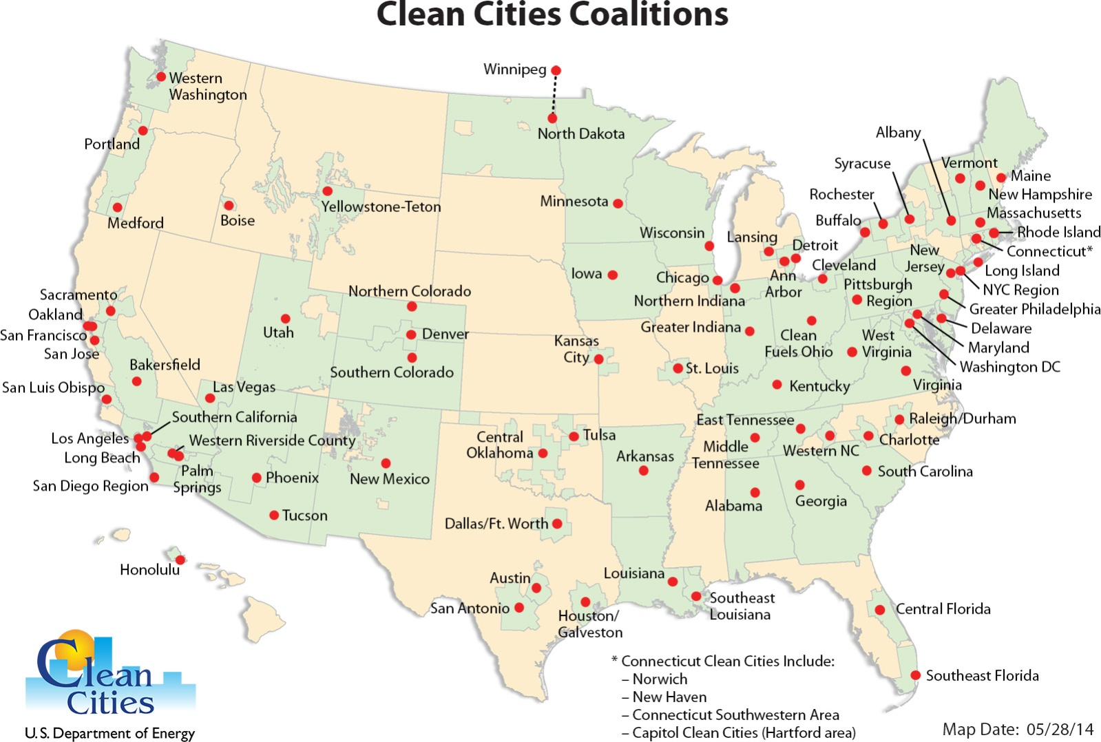
Clean Cities Coalitions
Nearly 100 coalitions throughout the United States
660,000 AFVs using alternative fuels
* Total includes more than 16,000 electric charging sites.
Notes:
Clean Cities activities are implemented by a national network of nearly 100 Clean Cities coalitions.
Led by Clean Cities coordinators, coalitions are comprised of businesses, fuel providers, vehicle fleets, state and local government agencies, and community organizations.
These stakeholders come together to share information and resources, educate the public, help craft public policy, and collaborate on projects that reduce petroleum use.
The boundaries of Clean Cities coalitions cover about 74% of the country's total population. The green areas on the map are areas covered by a Clean Cities coalition.
Clean Cities coalitions have been instrumental in the deployment of more than 660,00 alternative fuel vehicles.

Slide 5
Clean Cities Strategies
Replace petroleum with alternative and renewable fuels
Reduce petroleum use through fuel efficiency measures, smarter driving practices
Eliminate petroleum use through idle-reduction and other fuel-saving technologies and practices
Clean Cities has saved nearly 4.5 billion gallons of petroleum since 1993.
Reduce
Replace
Eliminate
Notes:
Clean Cities strategies to reduce petroleum use fall into three categories – replacement, reduction, and elimination.
Clean Cities provides a framework for coalitions to work within. The framework gives coordinators and stakeholders the flexibility to choose strategies that best meet their needs, take advantage of their available resources, and match their priorities.
Because Clean Cities coalitions employ multiple strategies to reduce petroleum use, they can adapt to changes in technologies and markets.
Since its inception in 1993, Clean Cities and its stakeholders have saved nearly 4.5 billion gallons of petroleum.

Slide 6
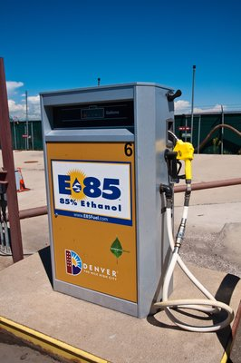
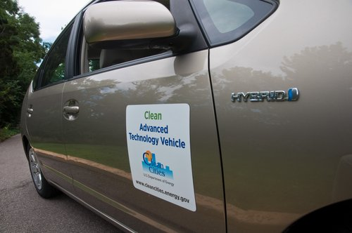
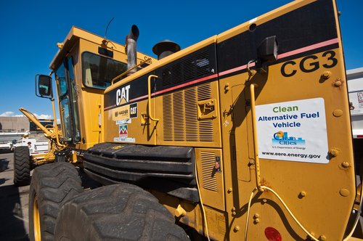
Clean Cities Portfolio of Technologies
Alternative and Renewable Fuels
Biodiesel
Electricity
Ethanol (E85)
Hydrogen
Natural gas
Propane
Fuel Economy
Fuel efficient vehicles
Driving habits
Vehicle maintenance
Idle Reduction
Technologies
Behavioral changes
Trip Elimination
Telecommuting
Ridesharing
Notes:
This slide shows the various technology areas supported by Clean Cities.
Clean Cities coordinators provide stakeholders with unbiased, objective information about these technologies.
Clean Cities is a fuel-neutral program--supporting all EPAct alternative fuels, including: biodiesel, electricity, ethanol, hydrogen, natural gas, and propane.
Clean Cities also supports fuel economy improvements and idle reduction, as well as trip elimination measures, like rideshare and telecommuting programs.
[Provide local examples of projects.]

Slide 7
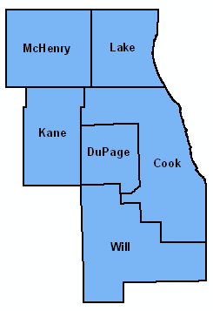
Chicago Area Clean Cities Coalition Background
History
Formed in 1992, designated 10th Clean Cities coalition, May 1994
Coordinator designated by the City of Chicago
Area
6-county Chicago area: Cook, DuPage, Kane, Lake, McHenry, and Will
Support state-wide legislation and education events
Lake Michigan Clean Cities Consortium
Coalition Structure
Coordinator housed within City of Chicago Department of Transportation
Executive Board directs activities and mission of the coalition
Over 650 stakeholders, 40 dues paying members
4+ coalition meetings per year coupled with educational event
Sponsorships and dues fund coalition activities
Grants support deployment and planning activities
Chicago 6-county area

Slide 8
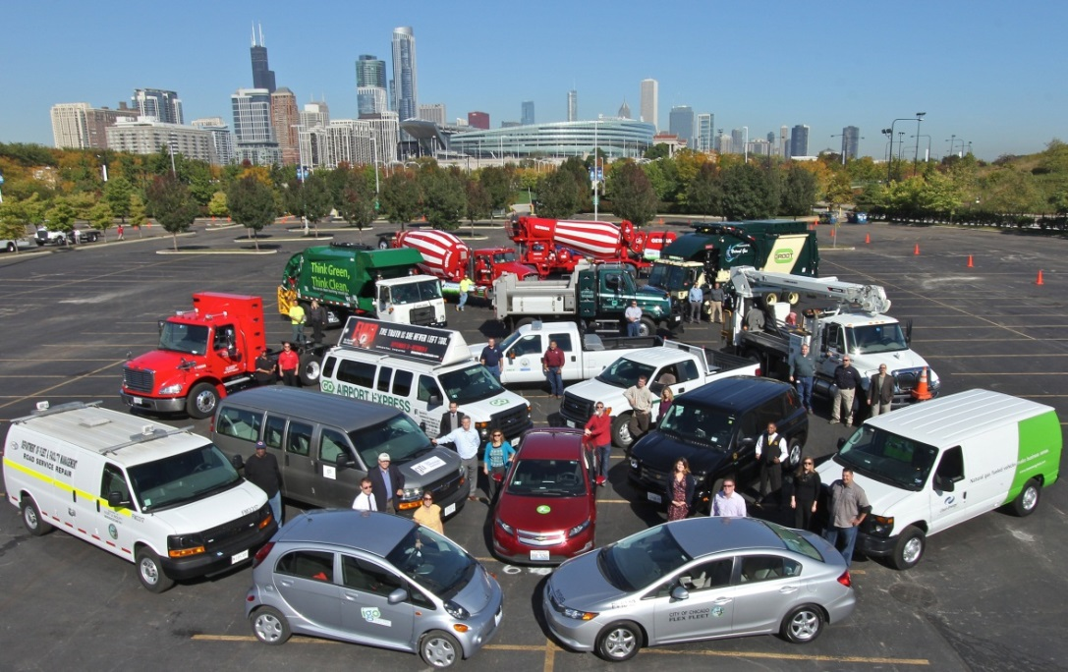
Program Longevity
1994
2014
www.ChicagoCleanCities.org

Slide 9
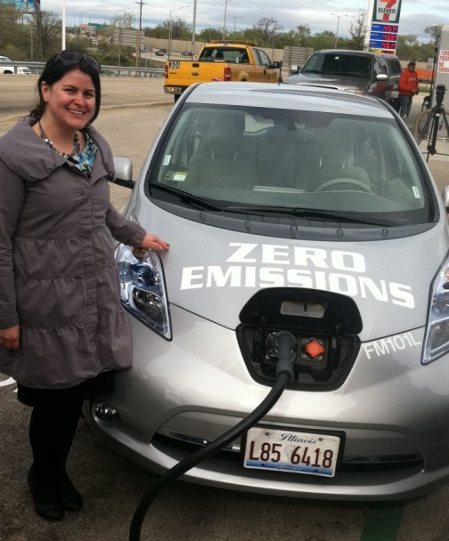
Coordinator Information
Samantha Bingham
Coalition Experience
Started with Chicago Dept. of Environment December 2006
Transitioned to Dept. of Transportation in 2012
Background
B.S. in Public Affairs from Indiana University: Bloomington, IN
5 years of environmental management experience with USEPA and private environmental firms
Relevant Experience
Coordinates and manages over $50M in grants supporting CACC’s mission
Collaborated in the development of:
City of Chicago Air Agenda
Chicago Climate Action Plan
Chicago’s Multi-Unit Dwelling EV Charging Station Guidelines
DC Fast Charger opening at Illinois Tollway Oasis Plaza March 2012
Chicago EV Roadmap
Chicago Diesel Idling Reduction Ordinance

Slide 10
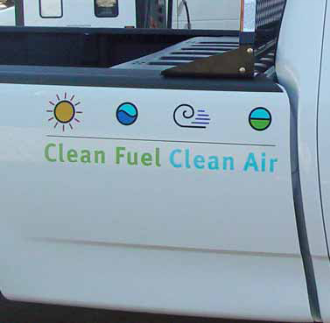
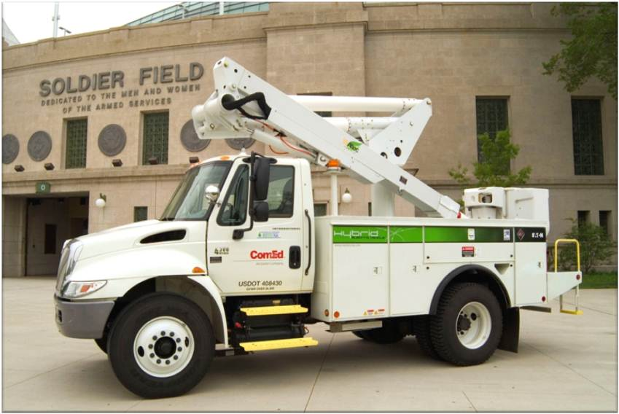
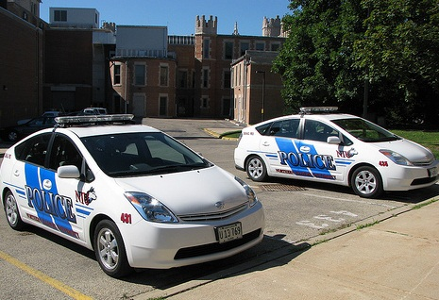
Meet Our Stakeholders
Local Governments
Cities: Arlington Heights, Aurora, Chicago, Crystal Lake, Downers Grove, Elgin, Franklin Park, Oak Park, Tinley Park and Wheaton
Forest Preserve Districts: Cook, DuPage, Lake and Will Counties
Counties: Cook, DuPage, Lake
Others: Chicago Transit Authority, Regional Transit Authority, Skokie Park District, Metropolitan Mayors Caucus, State of Illinois
Fuel Providers, OEMs & Utilities
AmeriGas, Bell Fuels, Black Dog, Carbon Day, Clean Energy, Clean N’ Green, Eaton, Ozinga Energy, and Trillium
Amp Electric Vehicles, BMW, Ford, GM, Nissan, Tesla, Odyne, and Via Motors
Commonwealth Edison, Peoples Gas and Nicor Gas
Colleges and Universities
Governors State University
University of Illinois, Chicago
Morton College
Northern Illinois University
City of Chicago CNG vehicle
ComEd hybrid aerial truck
NIU Campus Police hybrids

Slide 11
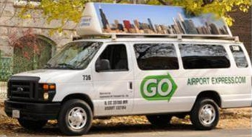
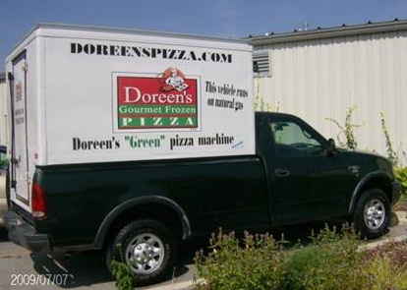
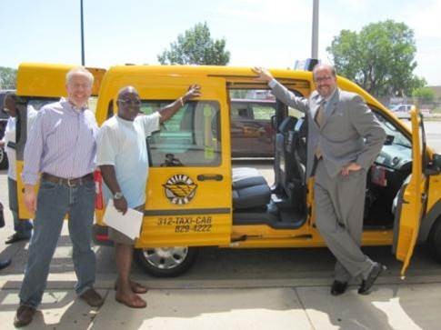
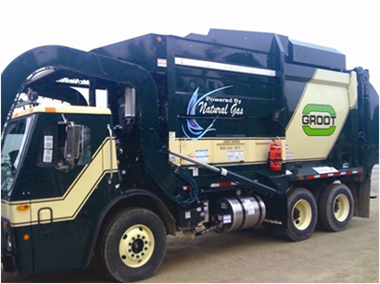
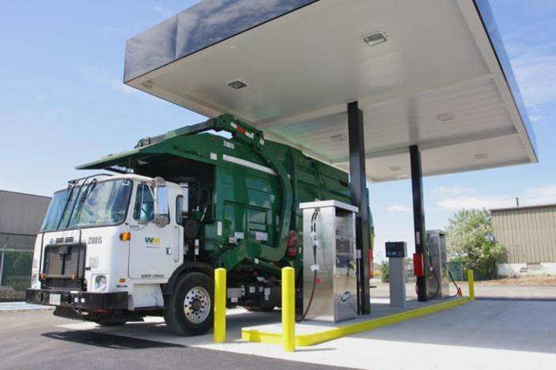
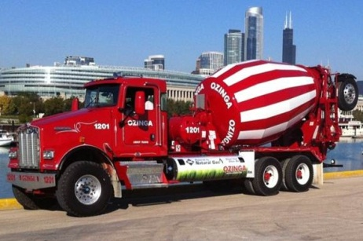
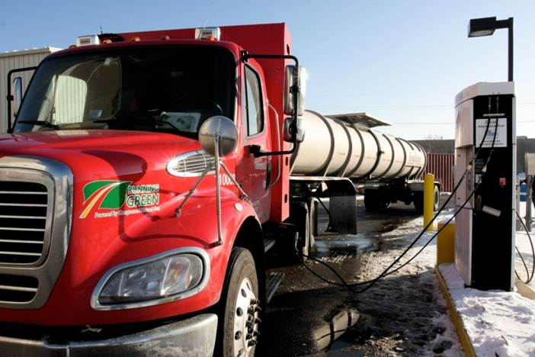
Meet Our Stakeholders
Private Fleets
American Airlines
Cook-Illinois Corp
Doreen’s Pizza
Foodliner
Groot Industries
GO Airport Express
Homewood Disposal
Huron Street Delivery
Others
American Lung Association
Sutton Ford – Lincoln
Enterprise Car Sharing
Lansing Cleaners
Ozinga
SCR Medical Transportation
Veolia Environmental Services
Waste Management
Gas Tech. Institute
Honda of Orland & Lisle
Roush Cleantech
Wendella Sightseeing Co.
Windy City Limousine and Bus Service
The Walsh Group
Yellow Taxi
Zipcar
U.S. General Service Administration
Jesse Brown VA Medical Center

Slide 12
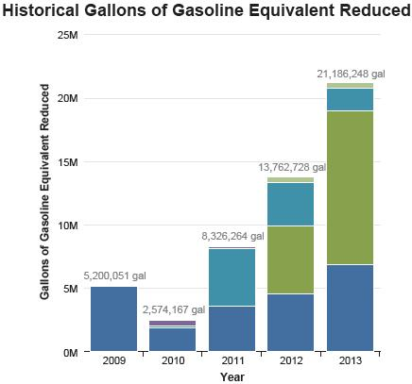
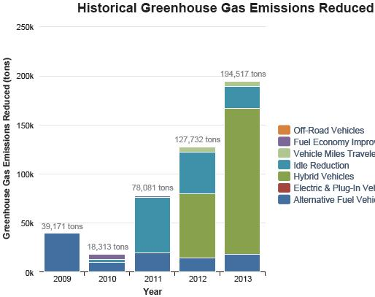
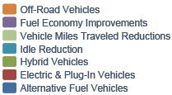
Coalition’s Performance Last 5 Years

Slide 13
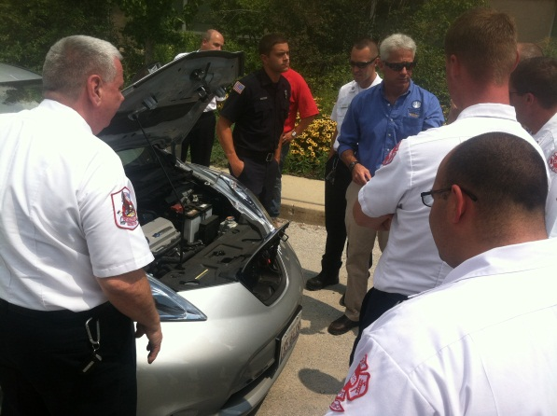
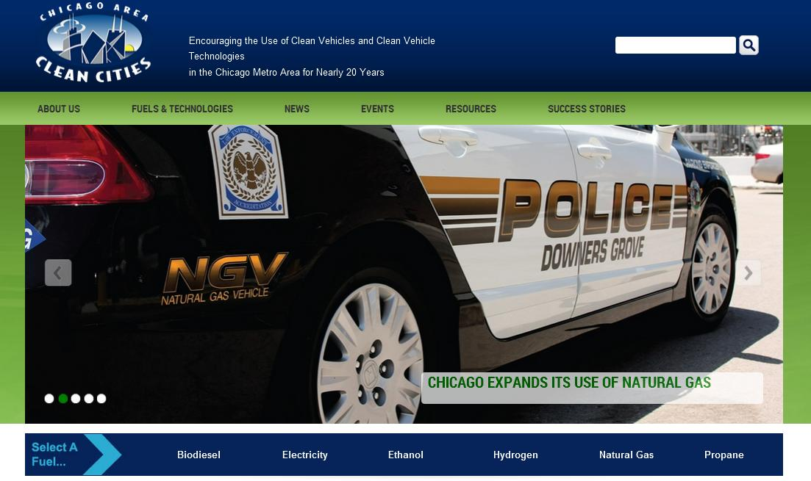
How Does Clean Cities Strengthen Markets?
Networking
Connecting fleets with fuel providers and industry partners
Training and information
Seminars and other events
Green Drives 2015, May 28
Website
Weekly emails
Technical assistance
Notes:
Clean Cities strengthens markets for alternative fuels and advanced vehicles in a variety of ways:
Networking opportunities with fleets and industry partners that have experience in alternative fuels and advanced vehicles.
Technical training, workshops, and webinars.
Publications and other information resources on alternative fuels, advanced vehicles, idle reduction, and other technologies and strategies that reduce petroleum use.
Individual consultation and technical assistance.
Funding opportunities from the U.S. Department of Energy.
Information about funding sources from state and local government agencies, nonprofits, and foundations.
Assistance with funding applications.
Public recognition for progress in reducing petroleum use.
Assistance with media outreach.
The Clean Cities program and individual coalitions educate stakeholders and the general public, enabling them to make informed decisions.

Slide 14
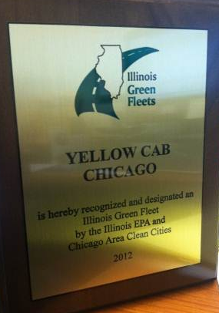
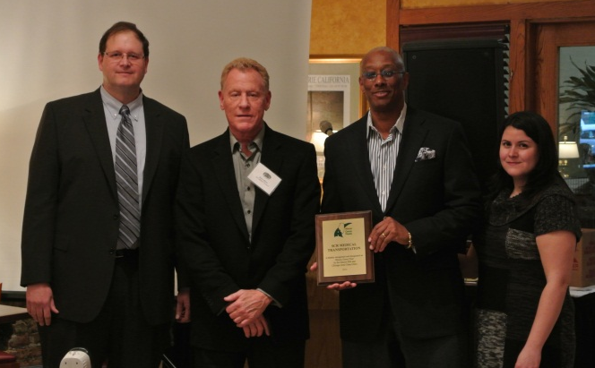
How Does Clean Cities Strengthen Markets?
Education and outreach to decision makers, fleets, and the public
Recognition
Third party validation
2014 Annual Report, March 6
Funding
Updates
Joint applications
Develop local programs
Notes:
Clean Cities strengthens markets for alternative fuels and advanced vehicles in a variety of ways:
Networking opportunities with fleets and industry partners that have experience in alternative fuels and advanced vehicles.
Technical training, workshops, and webinars.
Publications and other information resources on alternative fuels, advanced vehicles, idle reduction, and other technologies and strategies that reduce petroleum use.
Individual consultation and technical assistance.
Funding opportunities from the U.S. Department of Energy.
Information about funding sources from state and local government agencies, nonprofits, and foundations.
Assistance with funding applications.
Public recognition for progress in reducing petroleum use.
Assistance with media outreach.
The Clean Cities program and individual coalitions educate stakeholders and the general public, enabling them to make informed decisions.

Slide 15
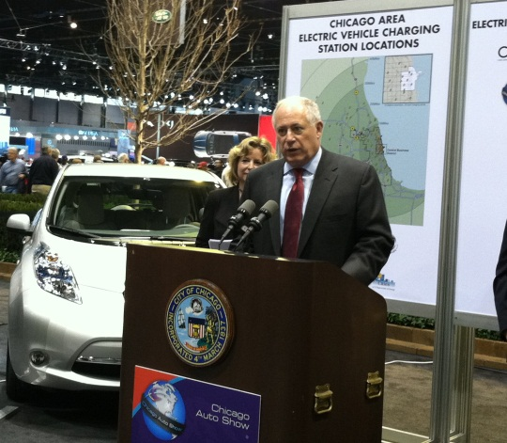
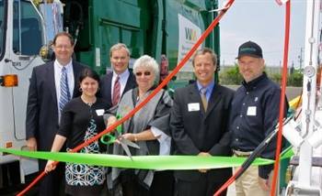
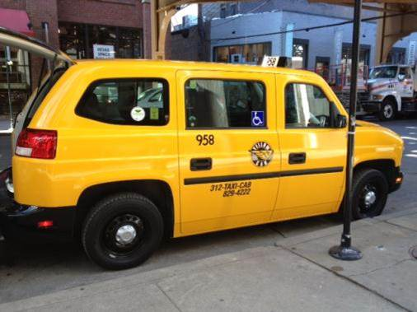
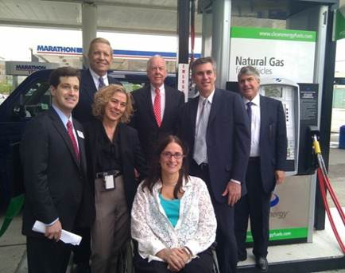
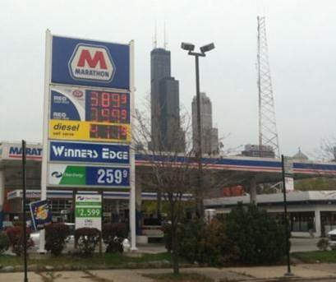
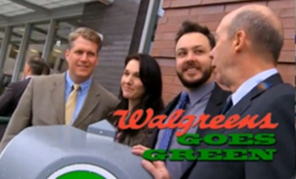
Recent Success: Clean Fuels Across Chicago
Chicago Area Alt Fuels Deployment Project
$15M USDOE Clean Cities ARRA award, 2010
$25M leveraged in local cost match
Implementing, preparing marketing campaign and collecting data
Game-changer for Chicago’s alternative fuels market
404 alternative fuel and hybrid vehicles
185 CNG and hybrid taxis and livery
22 CNG airport shuttles and paratransit
35 CNG refuse trucks
8 CNG heavy-duty delivery semi-trucks
57 CNG and hybrid utility
83 CNG local governments
14 CNG cement mixers

Slide 16
Current Incentives in Illinois
Chicago Area Green Fleet Grant Program
Administered by: IL EPA
www.IllinoisGreenFleets.org
50% of incremental or conversion cost CNG & Propane
Class 1-3 up to $10,000
Class 4< up to $20,000
EV Station Rebate
Administered by: ILDCEO
www.ChicagoCleanCities.org
- Level 1 and 2 stations- $3000 non-networked/$3750 for networked
- DC Fast Chargers included this round –$12,500 non-network, $15,000 networked
- Closes April 16, 2015
Drive Clean Chicago
Administered by: CDOT
www.DriveCleanChicago.org
- 80% incremental costs of electric & HYBRID Class 2 – 8 trucks, vans, & buses

Slide 17
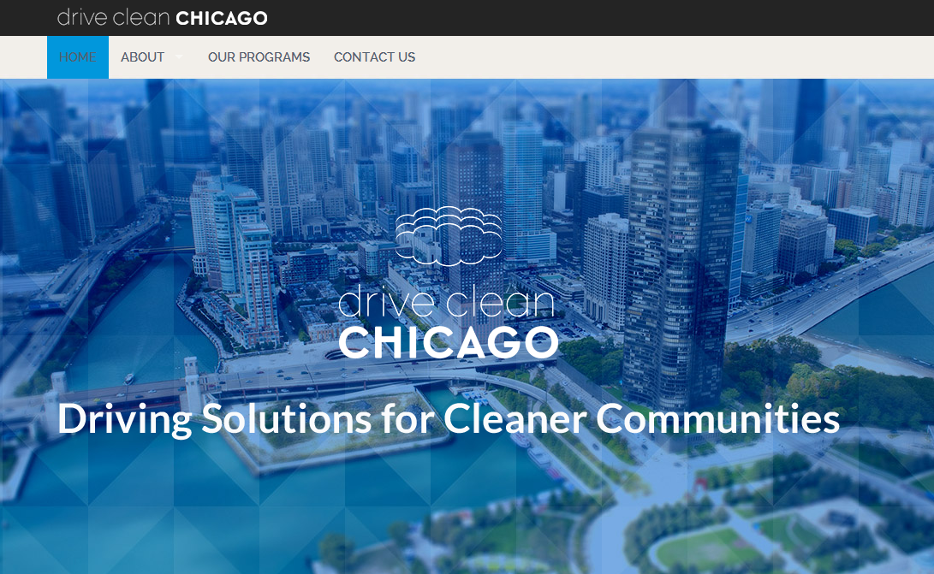
Website www.DriveCleanChicago.org

Slide 18
Drive Clean Truck Voucher Program Summary
$11.3 million in voucher funding
Voucher incentive is applied at purchase
Reduces purchase price to customer
Vouchers are based on incremental or conversion cost
Vendor (dealer) paid voucher amount at completion of sale and registration of vehicle

Slide 19
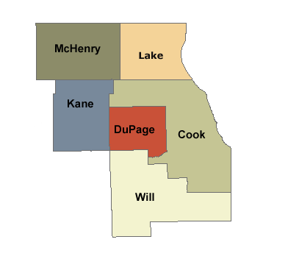
Drive Clean Truck Eligible Fleets
Domicile and operate >75% in six-county Chicago area
Agree to program terms & conditions
Agree to three-year reporting

Slide 20
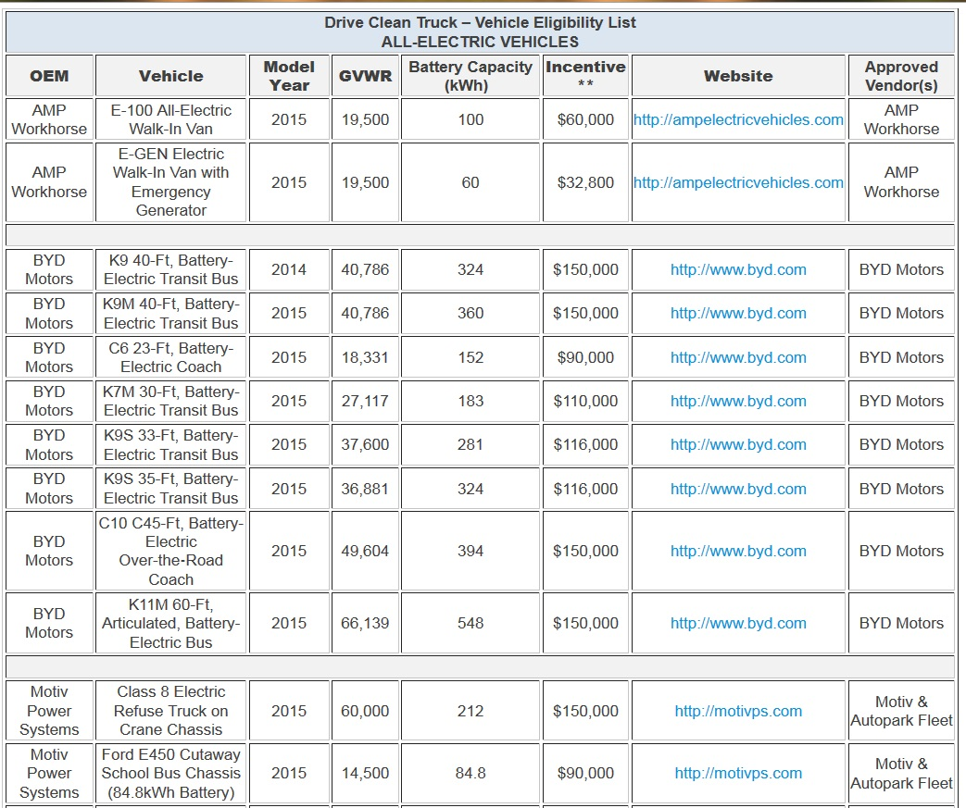
Drive Clean Truck Eligible Vehicles

Slide 21
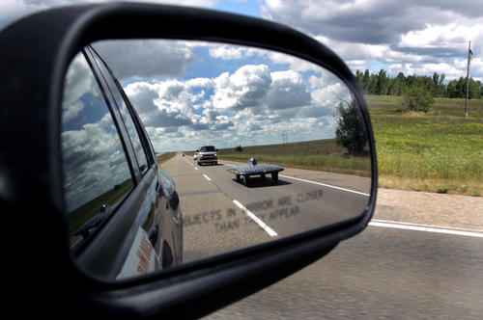
Future Collaboration

Slide 22
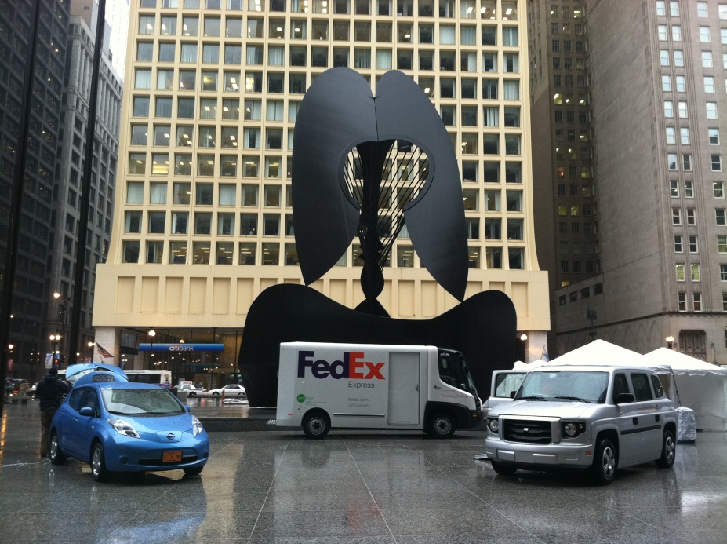
Contact Information
Samantha Bingham
312-744-8096
Samantha.bingham@cityofchicago.org
John Walton
630-240-8858
john@blackdogcorp.com
www.ChicagoCleanCities.org

