Slide 1

Planning and Sustainability in the
Chicago Metropolitan Region
Metropolitan Mayor’s Caucus Environment Committee
September 19, 2016

Slide 2
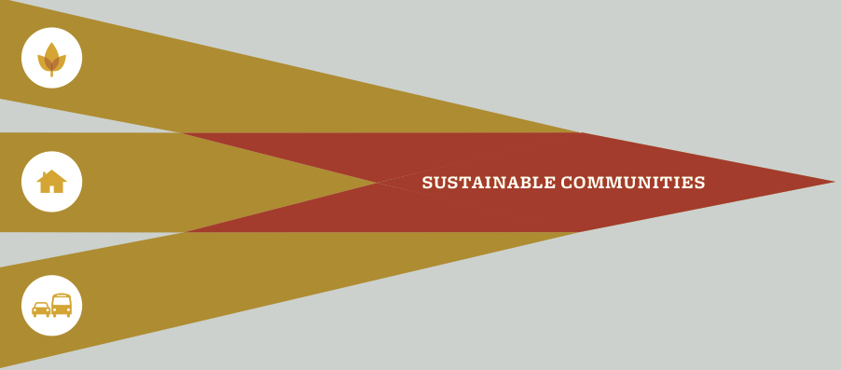
Change and transformation happen when …
… vision, leadership, policies, programs, legislation, financing, funding, and action are pointed in the same direction.
Notes:
(Source: DCEO study Building Successful Food Hubs) … huge unmet demand – over $10 B to be kept in-state if we produced more fruit and veg.

Slide 3
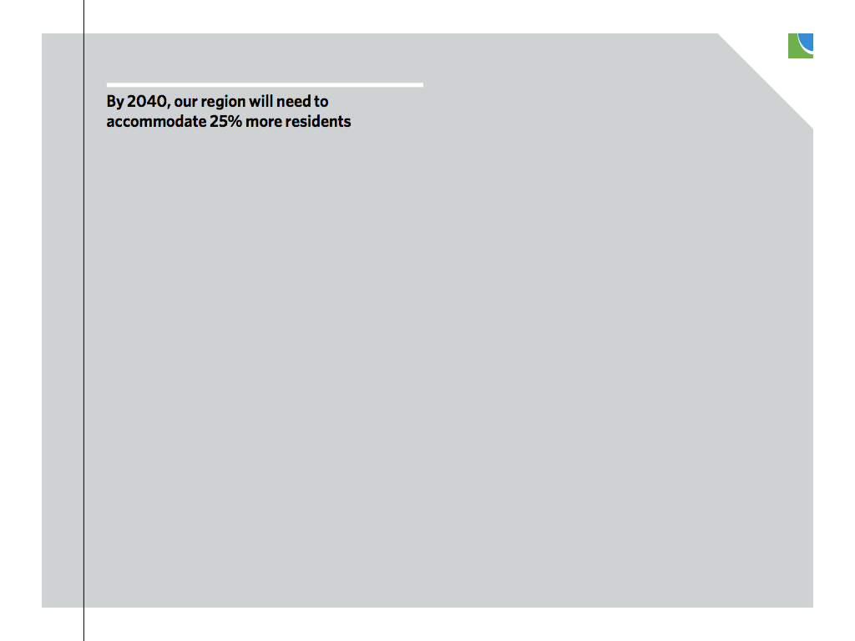
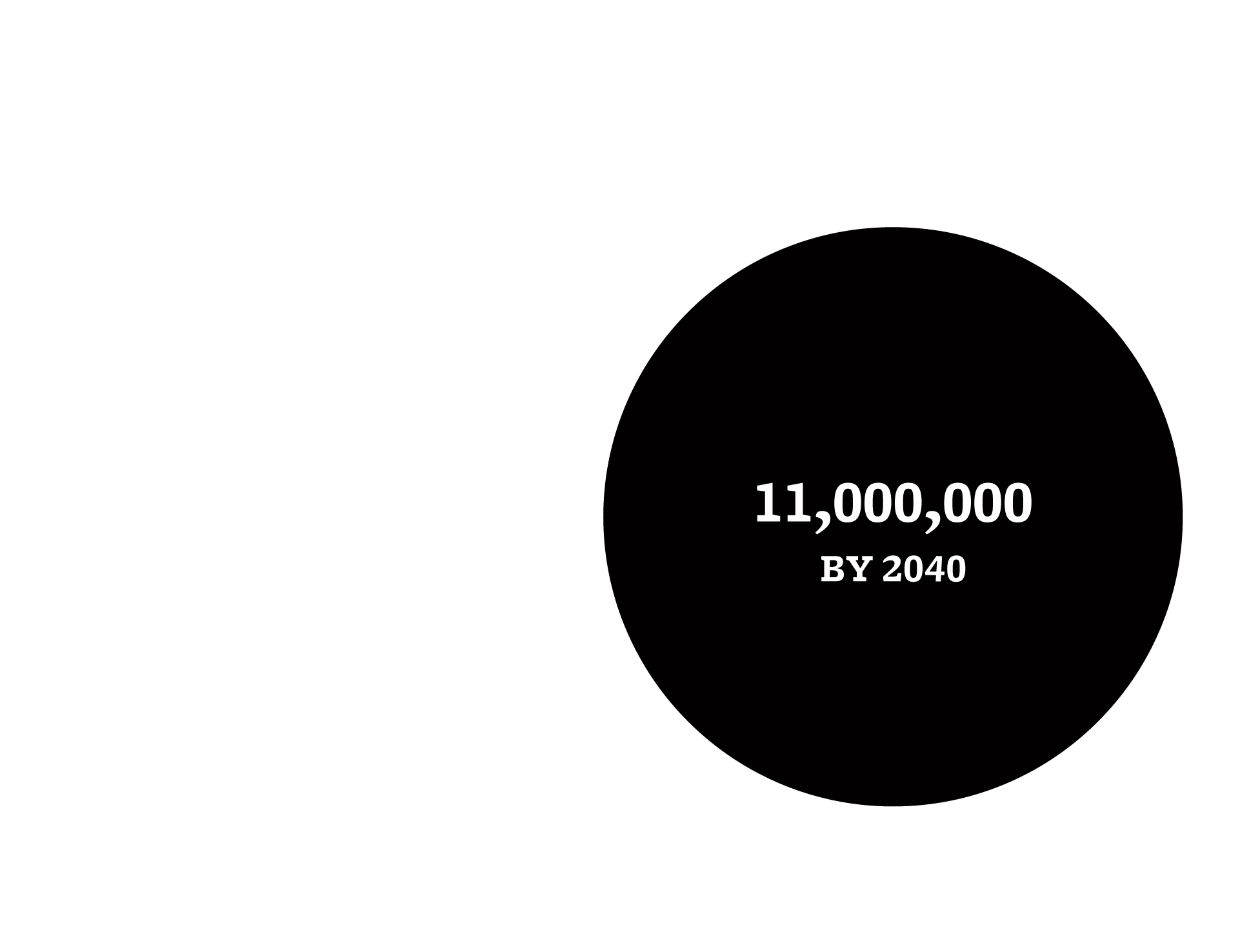


Slide 4
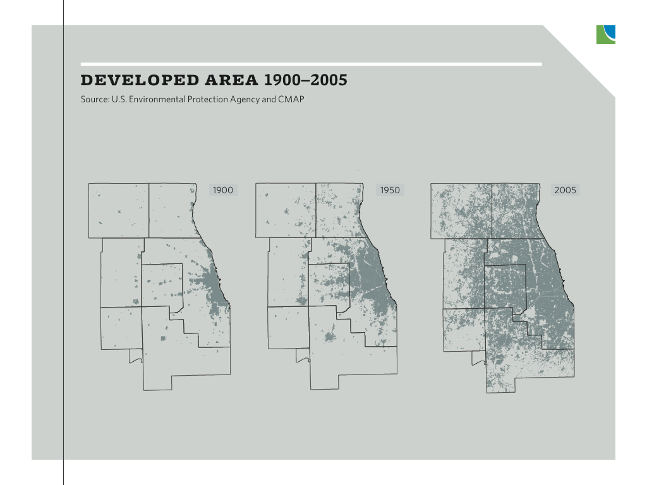

Slide 5
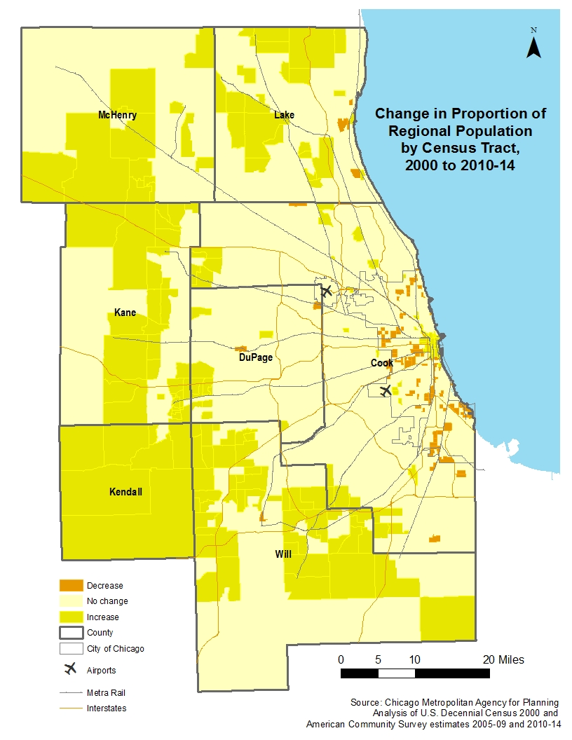
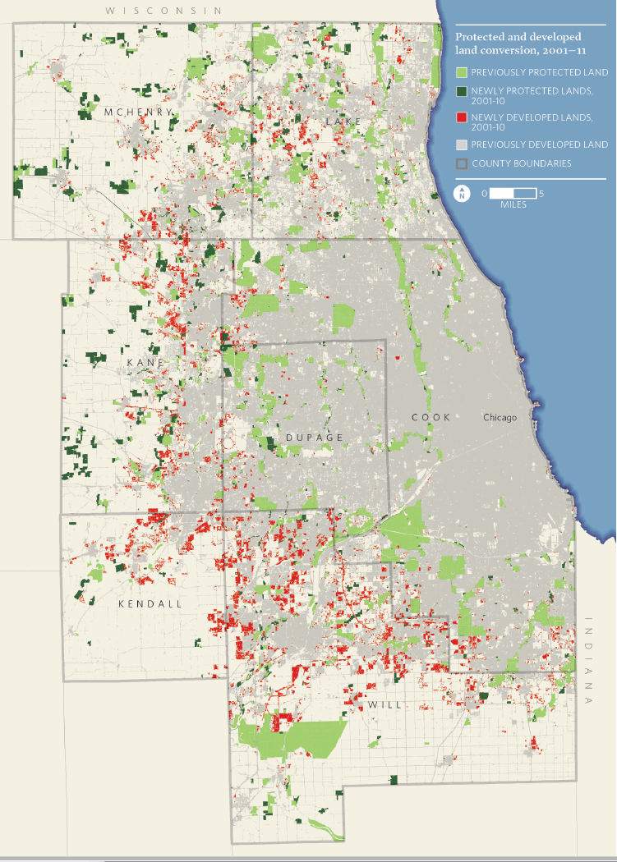
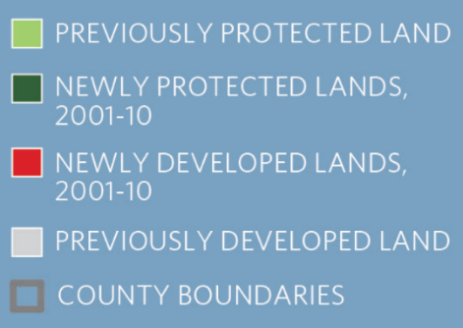

Population shift towards the edge of the region
Protected and developed land 2001 - 11
Notes:
GRAPHIC DESCRIPTION: This map shows the shift in population from 2000 to 2014, highlighting the areas that lost population in orange and areas the increased population in darker yellow. . Recent growth has also concentrated within the region’s urban core, well as the satellite cities of Elgin, Joliet, and Aurora.
TAKEAWAY: The trend of shifting population towards the collar counties continues, shifting past cook and most part of DuPage.

Slide 6
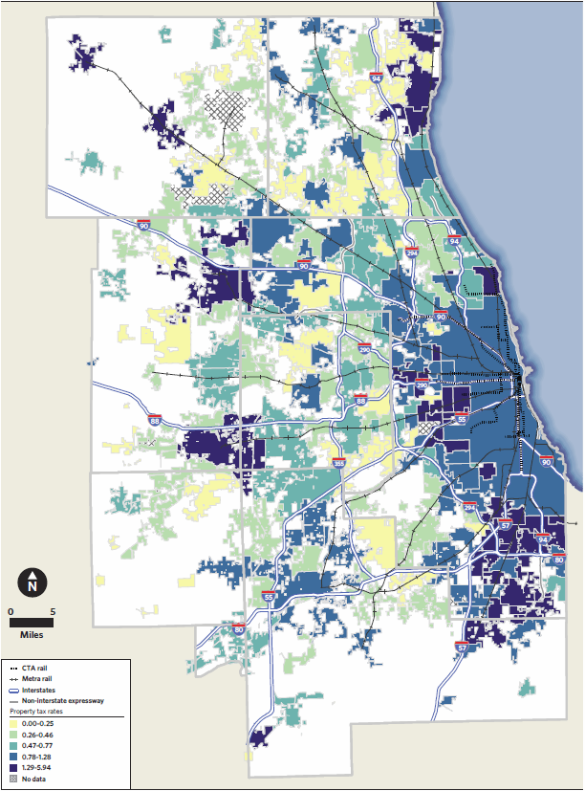
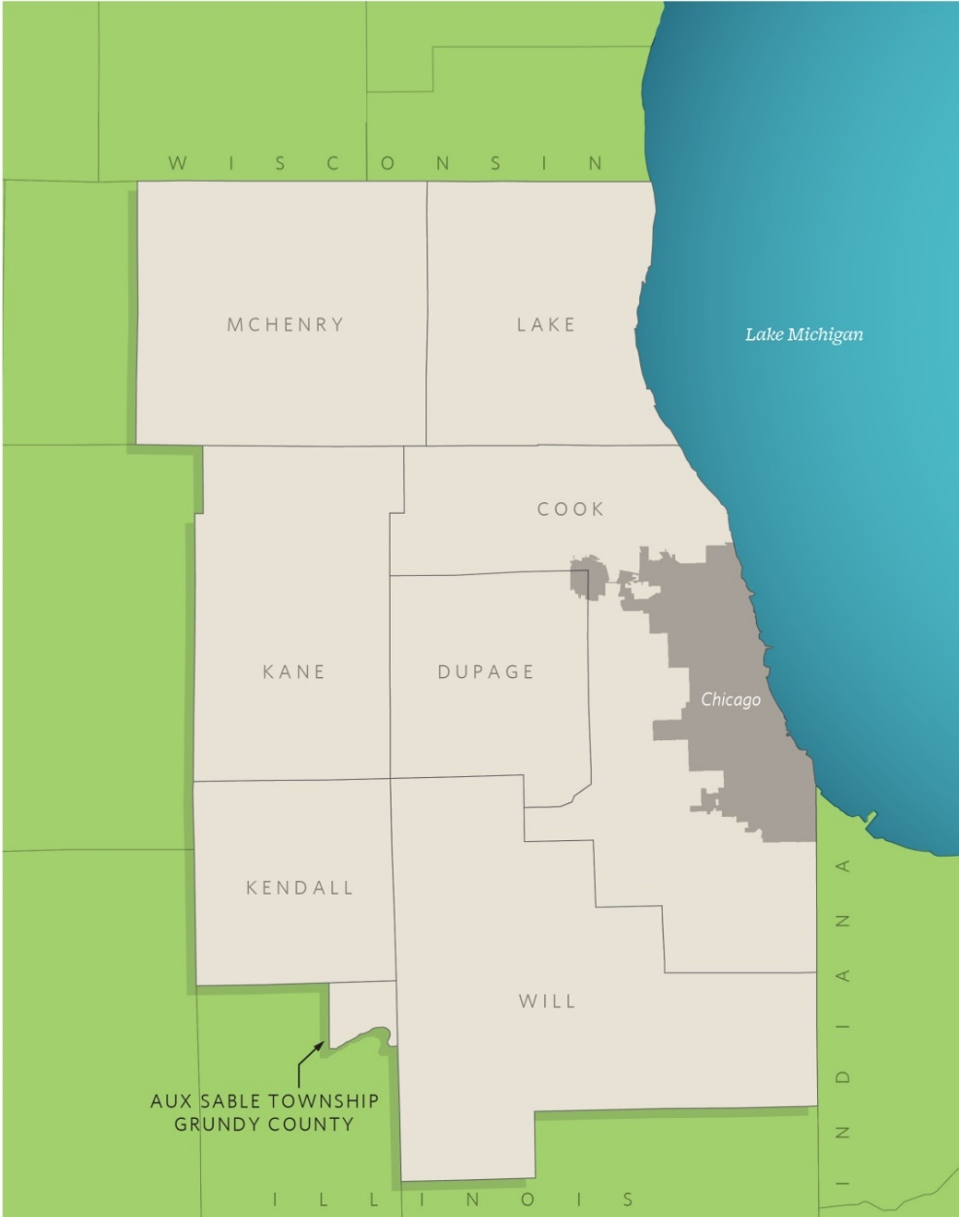
CMAP: Planning for the Future of our Region
Official regional planning organization and MPO for northeastern IL formed in 2005 to integrate transportation and land use planning
Emphasize comprehensive planning for the interrelated nature of transportation, land use, environment, and the regional economy
Work with partners to develop and implement coordinated strategies that lead to economic prosperity and quality of life for 7 counties and 284 municipalities of NE Illinois (over 1200 units of government in total)
Adopted GO TO 2040 regional plan and policy framework in 2010
CMAP Board, MPO Policy Committee, ENR and other working committees

Slide 7
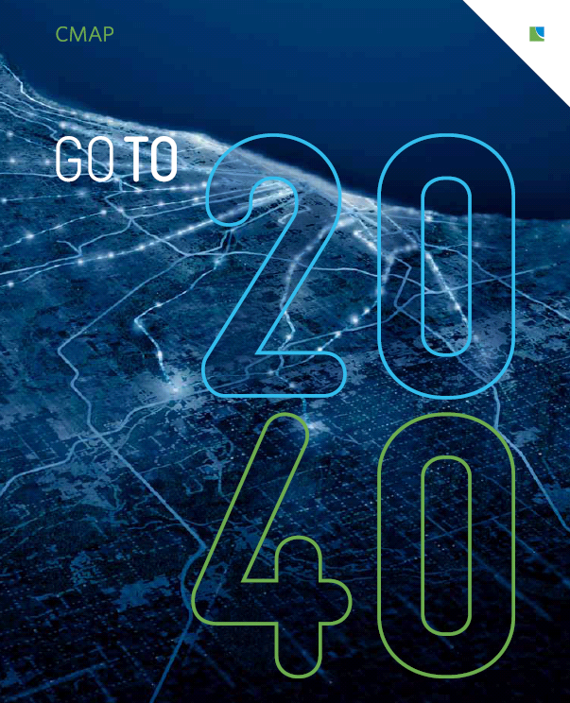
Comprehensive, long-range plan for Chicago metropolitan area
Adopted in October 2010
Establishes a vision for future of the region
Recommends policies, strategies, and actions (strategic plan)
Achieve a more livable, sustainable region through better decision making

Slide 8
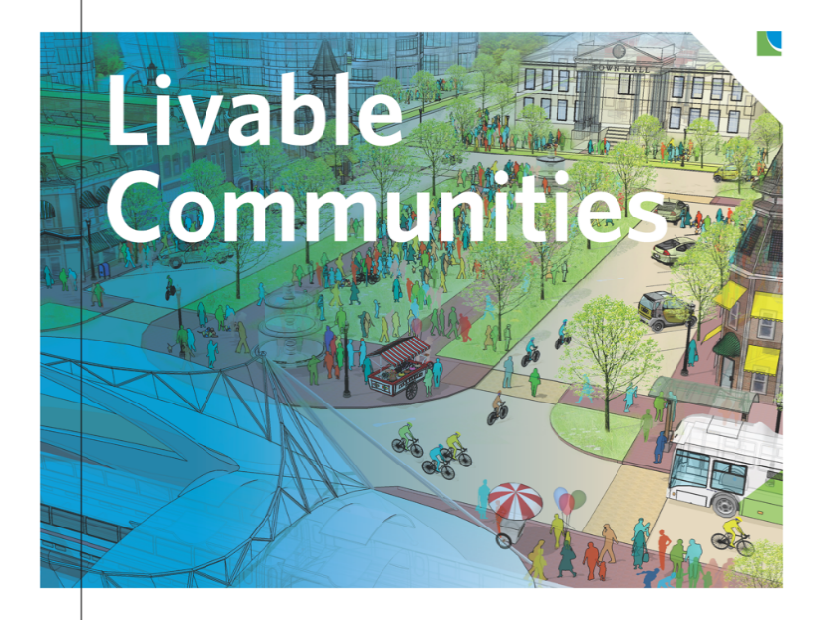
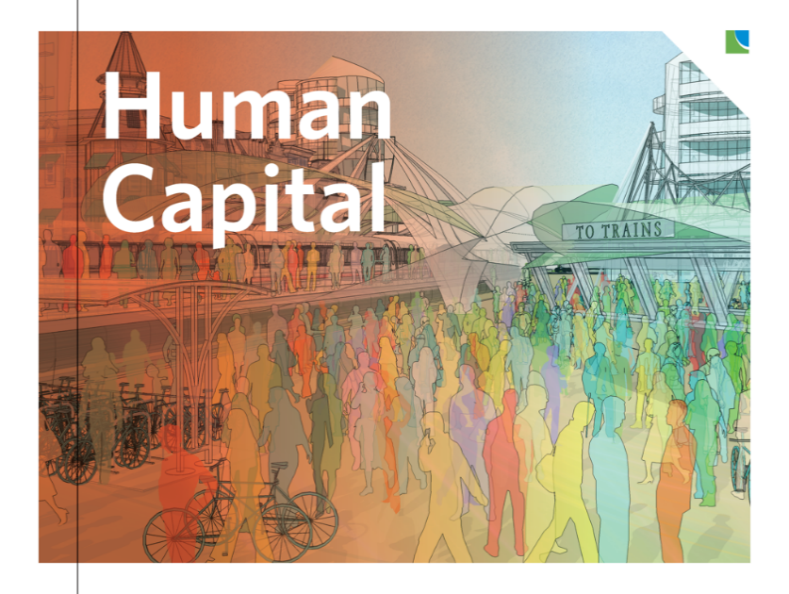
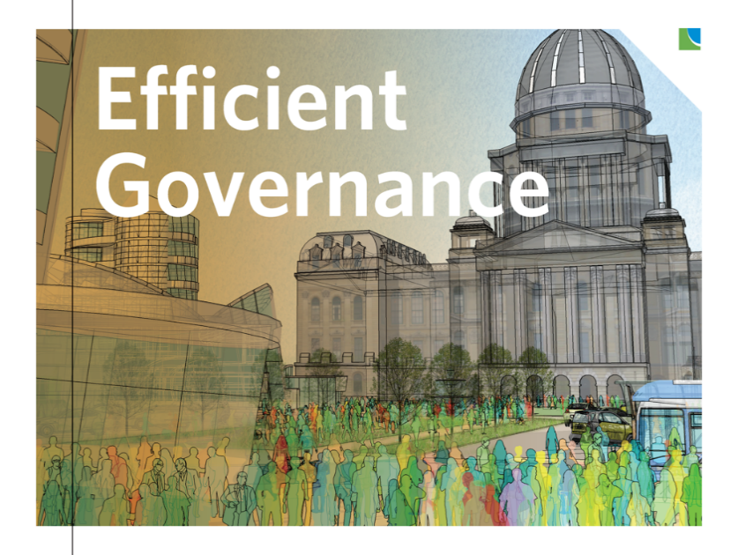
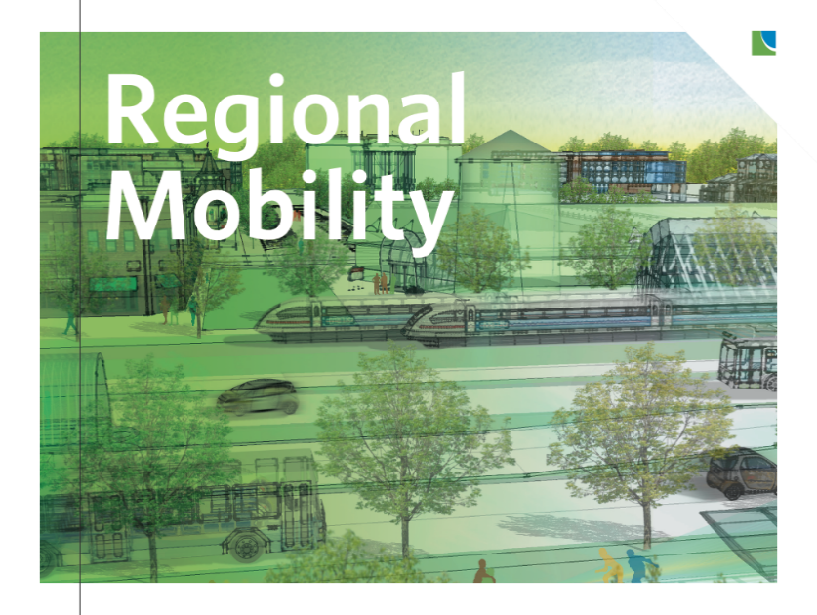
1. Land Use and Housing
2. Water & Energy Conservation
3. Parks and Open Space
4. Sustainable Local Food
5. Education and Workforce Development
6. Economic Innovation
7. Tax Policy
8. Access to Information
9. Coordinated Investments
10. Transportation Investments
11. Public Transit
12. Freight

Slide 9
Sustainability addressed not as an individual goal, but throughout the GO TO 2040 Plan
Preserve valuable environmental features, plants, habitat
Conserve energy, water, wetlands, streams, groundwater
Provide access to parks and open space for recreation
Support sustainable, local food systems
Support transit, walking, and biking
Encourage reuse of buildings and developed areas / encourage infill growth
Encourage compact, walkable, mixed-use neighborhoods
Encourage diversity of housing and jobs in close proximity
Notes:
(Source: DCEO study Building Successful Food Hubs) … huge unmet demand – over $10 B to be kept in-state if we produced more fruit and veg.

Slide 10
CMAP’s Environmental Activities
Climate change resilience and adaptation
Water resources planning
  water quality, water supply, stormwater and flooding
Green infrastructure / open space / conservation
Land use and transportation planning
Economic development and shared services
Greenest Region Compact 2
Climate
Economic development
Energy
Land
Leadership
Mobility
Municipal operations
Sustainable communities
Waste & recycling
Water

Slide 11
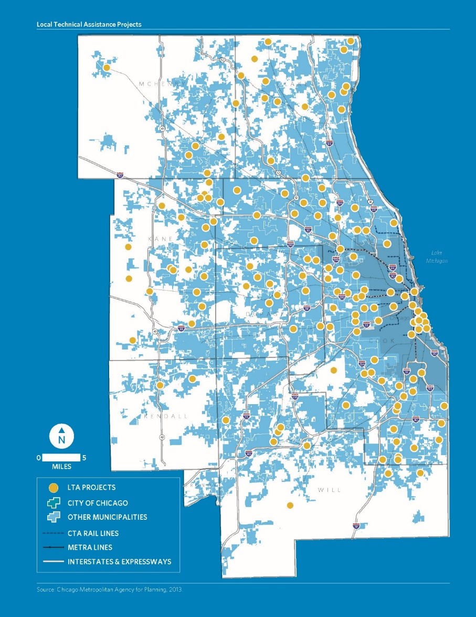
GO TO 2040 Implementation: Support better decision-making
Research market and public policy trends
Data collection and dissemination
Collaboration and facilitation
Training, information sharing, guides
Planning and policy resources
Local Technical Assistance and Capacity Building
  Collaborate with regional partners to provide planning support to local communities
  Over 160 projects on a range of planning issues and a variety of plan types
Notes:
Local Ordinances and Toolkits
ADA Transition Plans for Your Community
Arts and Culture Planning: A Toolkit for Communities
Climate Adaptation Guidebook for Municipalities in the Chicago Region
Complete Streets Toolkit
Form-Based Codes: A Step-by-Step Guide for Communities
Homes for a Changing Region Toolkit
Immigrant Integration Toolkit
Model Water Conservation Ordinance
Municipal Strategies to Support Local Food
Parking Strategies to Support Livable Communities

Slide 12
Local Technical Assistance Projects & Plans
Comprehensive Land Use Plans
Zoning Codes
Corridor Plans
Sustainability Plans
Stormwater Management
Water conservation
Watershed plans
Bicycle and Pedestrian Plans
Trails plans
Multimodal transportation plans
Vulnerability assessments

Slide 13

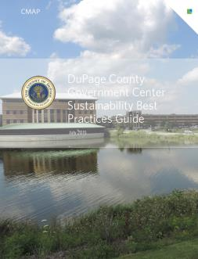
DuPage County Government Center
Sustainability Best Practices Guide
for Government Center Campus
Specific on-site strategies to improve
sustainability of operations
  Green building, transportation maintenance
  and fleet, waste disposal and composting,
  open space and ecosystems, water efficiency
  and use, energy and climate, education and
  awareness
Indicator guide and worksheet to track
County progress on a variety of indicators
designed to accompany the best practices

Slide 14
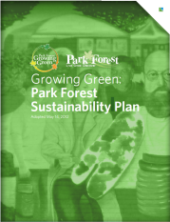
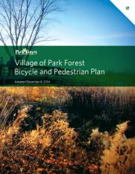
Park Forest
Growing Green Sustainability Plan (2012)
  Land use, transportation, open space,
  waste, water, energy, climate, economy,
  local food, municipal policies and
  practices, education, community health,
  housing, and arts and culture
Bicycle and Pedestrian Plan (2014)
Development Regulations Update (2016)

Slide 15
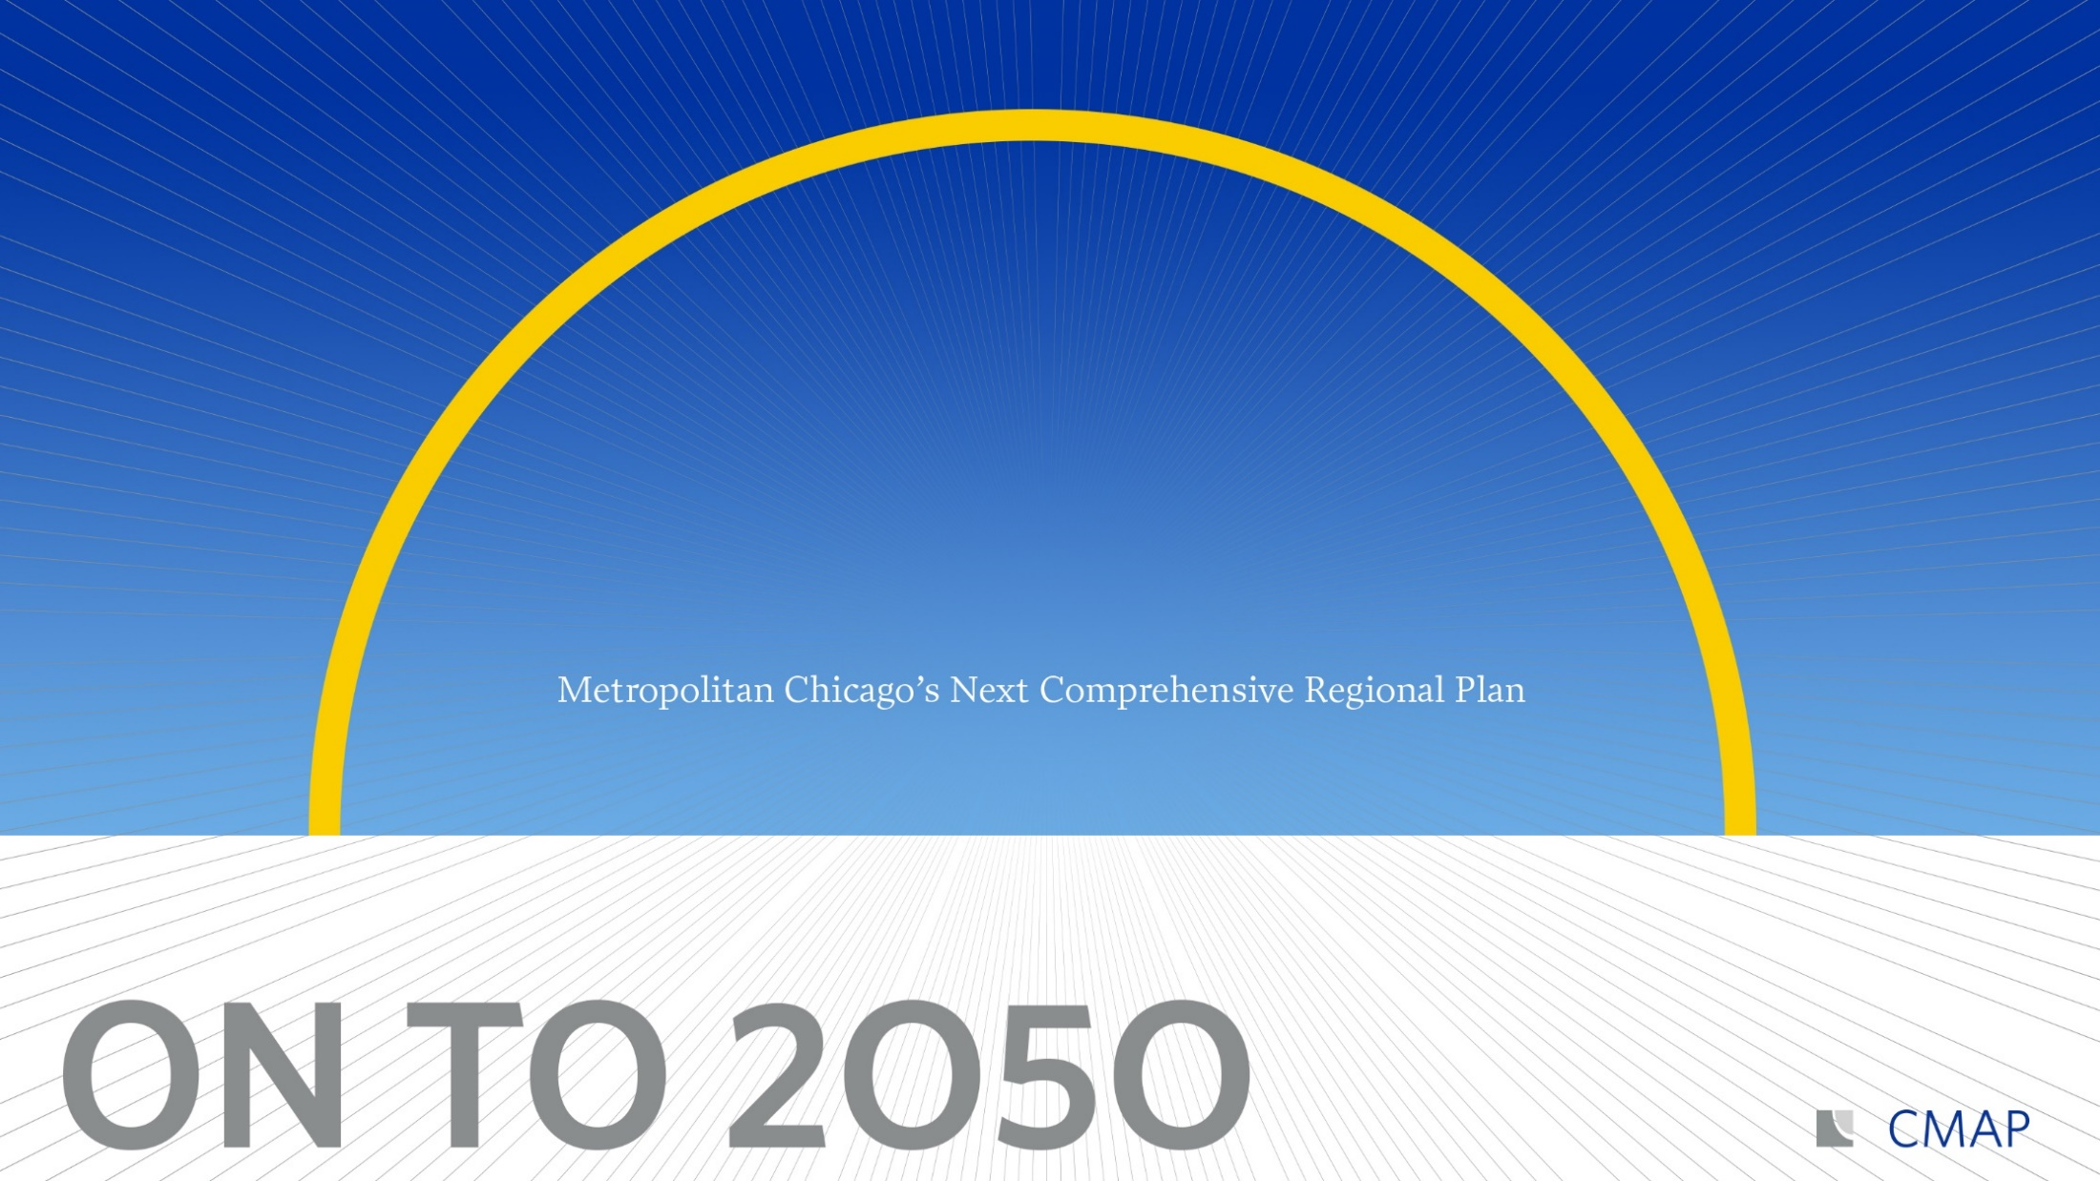
www.cmap.illinois.gov/about/involvement

