Slide 1
Metropolitan Mayors Caucus
March 17, 2015
Joel Brammeier
President & CEO
jbrammeier@greatlakes.org

Slide 2
Our vision is a healthy Great Lakes for people and wildlife, forever.
Our Supporters
More than 15,000 supporters throughout the region back the Alliance’s efforts through volunteerism and philanthropy.
Our People
22 member Board of Directors from across the region
25 staff in Chicago, Milwaukee, Detroit, Cleveland, Buffalo and Grand Haven, MI

Slide 3
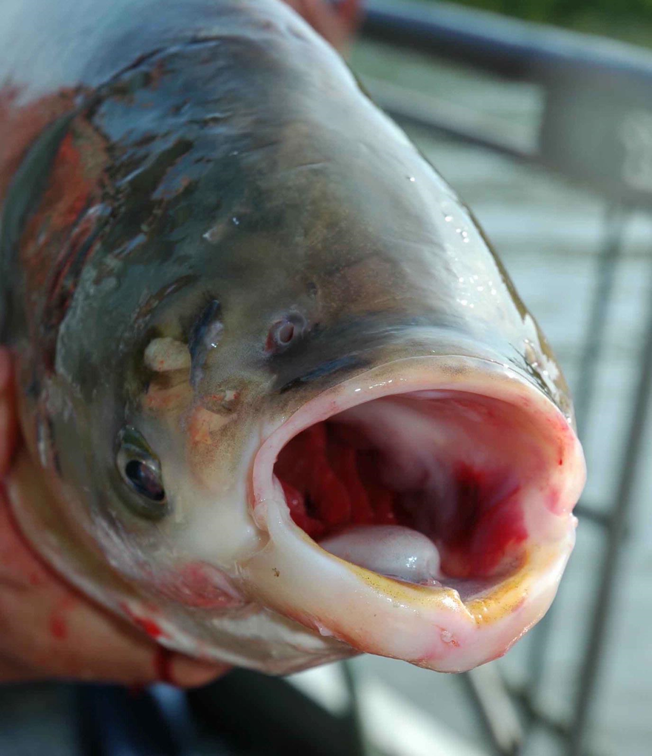

Slide 4
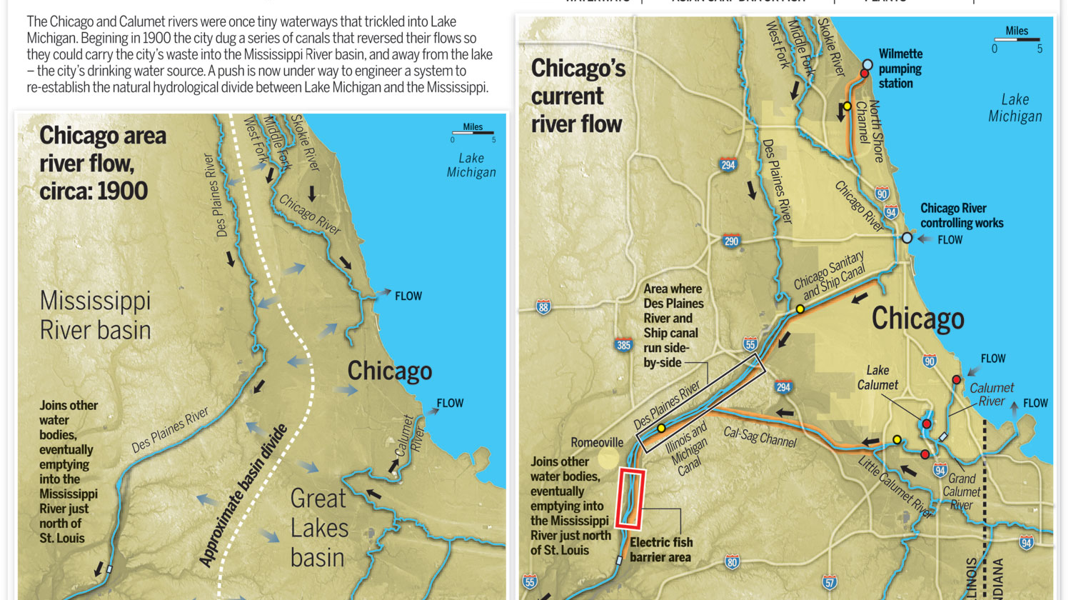
Source: Milwaukee Journal Sentinel

Slide 5
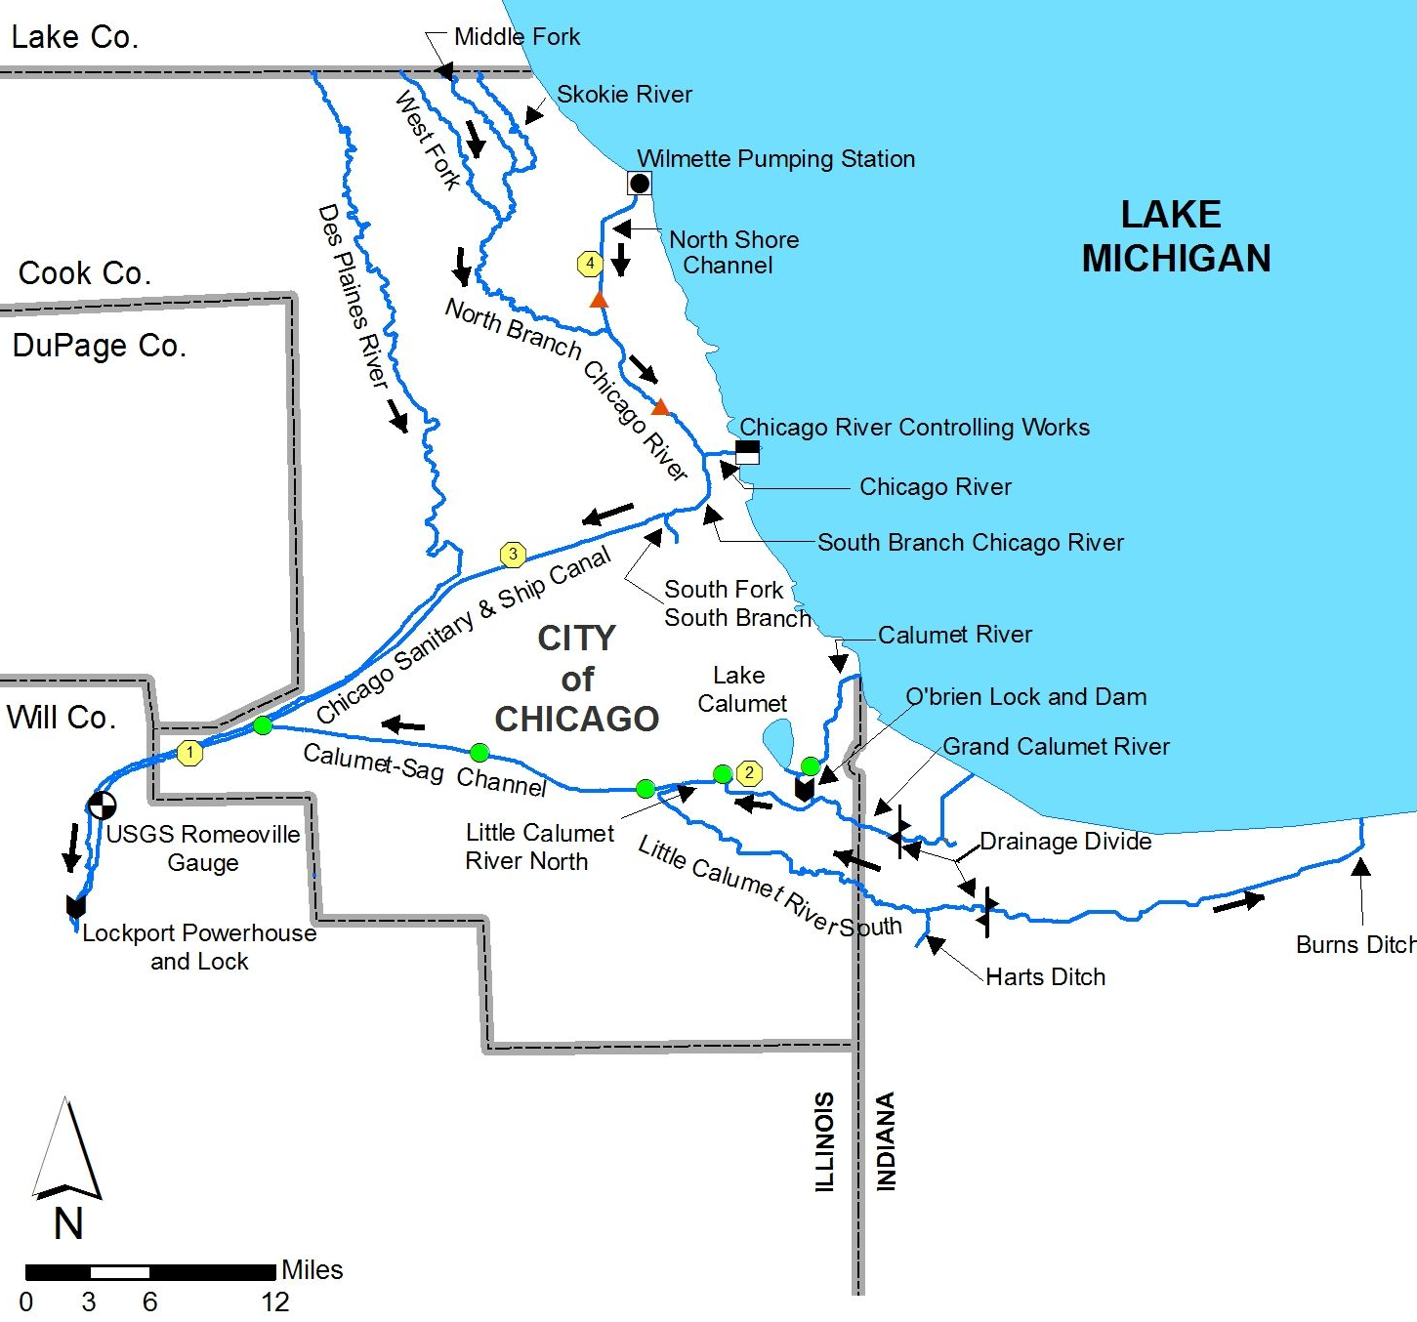

Slide 8
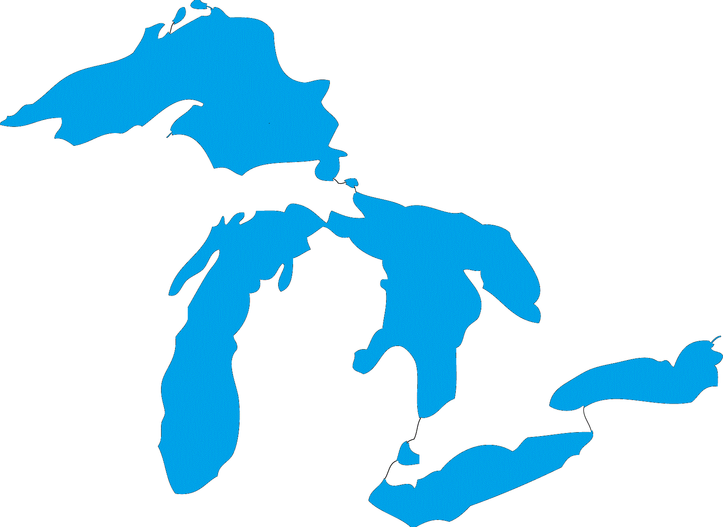
A REGIONAL
CONCERN

Slide 10
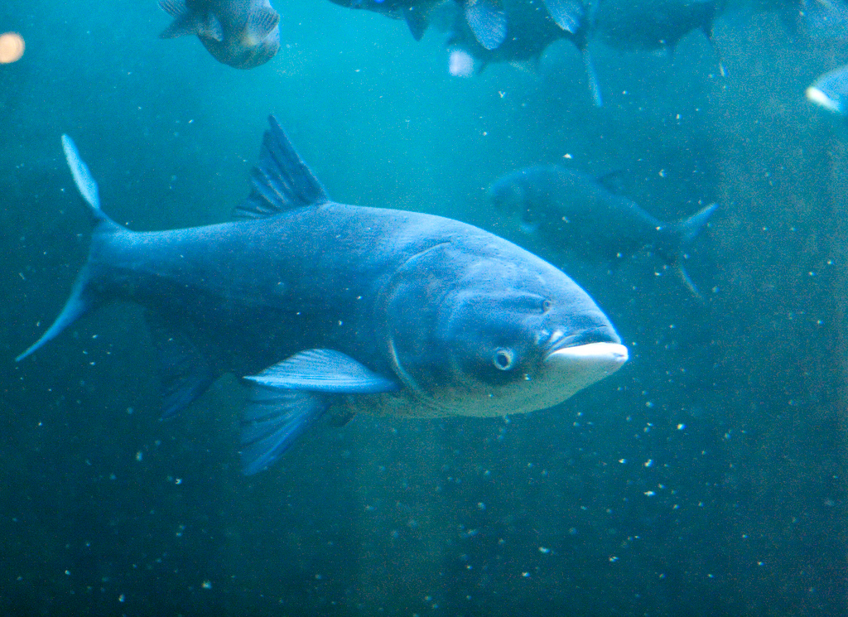
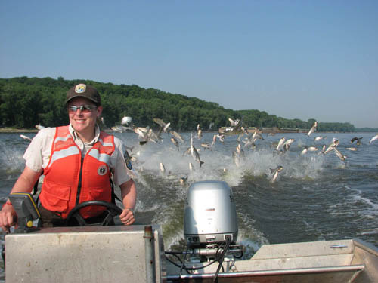
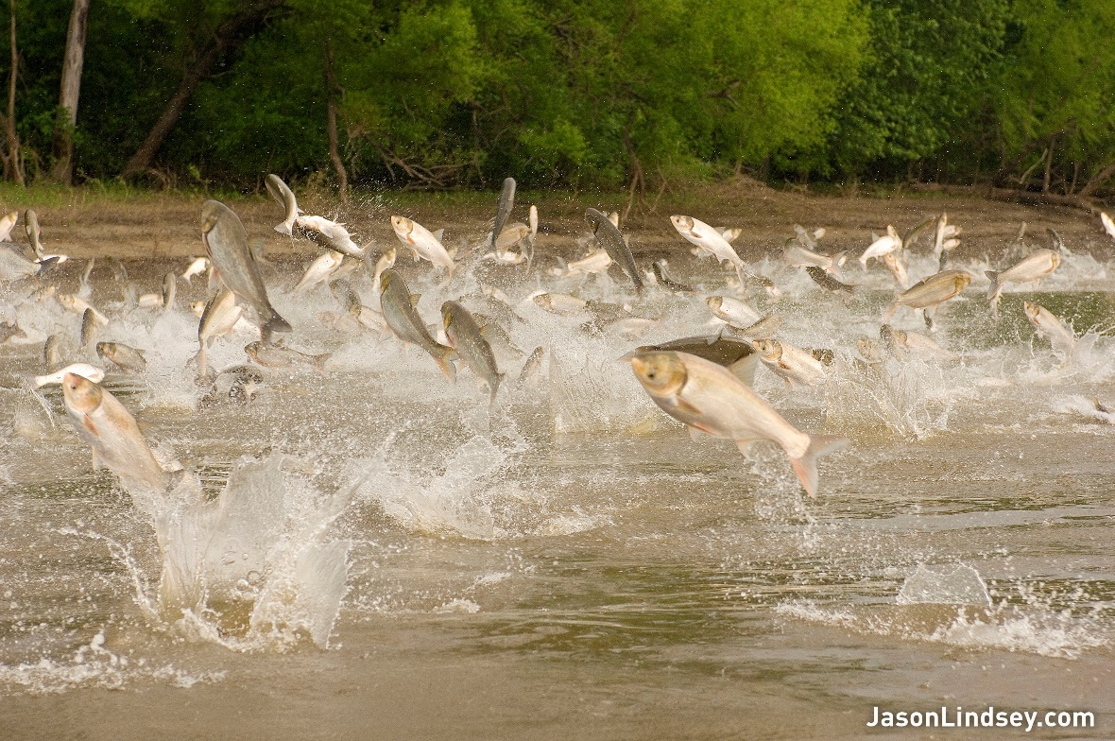
Aquatic Nuisance Species – Asian Carp

Slide 11
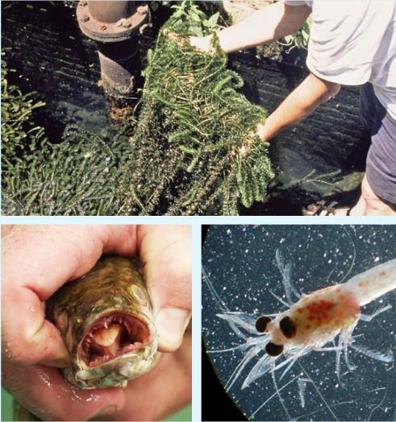

Slide 12
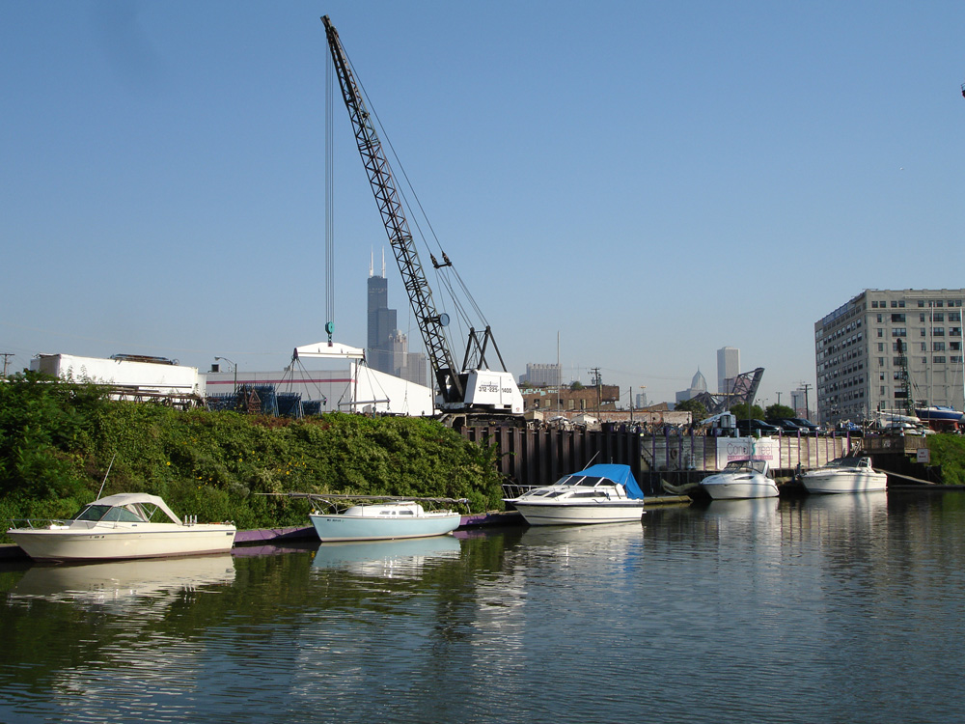
BOATING
Notes:
Brought in through the ballast water of ships
Brought in by humans and transported by birds and other wildlife
Can change water quality – for example zebra mussels clean the water which sounds good but in reality it’s not – Allows more light into the lakes which promotes dangerous alage growth in the lakes and upsets the feeding patterns of nearshore fish
Zebra mussels also accumulate pollutants as a result of filtering up to a liter of water per day-each. They are then eaten by birds and other fish which continue to concentrate poisons in their bodies. There has been evidence to bird botulism outbreaks killing thousands of birds on Lake Erie are a result of zebra mussels as well.
Invasive species also outcompete many of the native species which provide food and habitat for native plants and animals

Slide 13
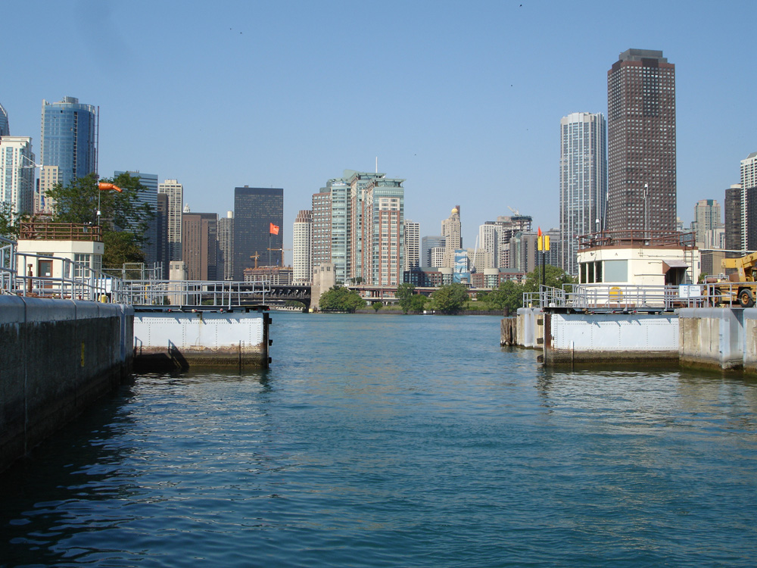
TOURISM
Notes:
Brought in through the ballast water of ships
Brought in by humans and transported by birds and other wildlife
Can change water quality – for example zebra mussels clean the water which sounds good but in reality it’s not – Allows more light into the lakes which promotes dangerous alage growth in the lakes and upsets the feeding patterns of nearshore fish
Zebra mussels also accumulate pollutants as a result of filtering up to a liter of water per day-each. They are then eaten by birds and other fish which continue to concentrate poisons in their bodies. There has been evidence to bird botulism outbreaks killing thousands of birds on Lake Erie are a result of zebra mussels as well.
Invasive species also outcompete many of the native species which provide food and habitat for native plants and animals

Slide 14
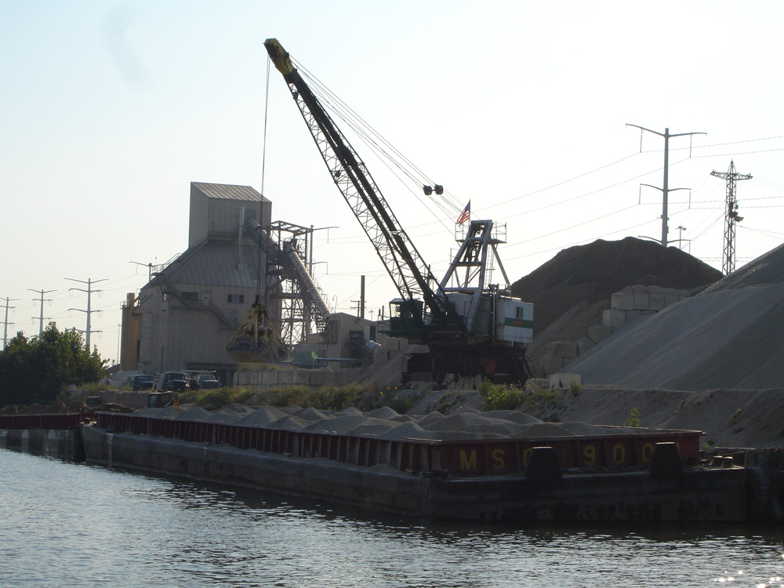
SHIPPING
Notes:
Brought in through the ballast water of ships
Brought in by humans and transported by birds and other wildlife
Can change water quality – for example zebra mussels clean the water which sounds good but in reality it’s not – Allows more light into the lakes which promotes dangerous alage growth in the lakes and upsets the feeding patterns of nearshore fish
Zebra mussels also accumulate pollutants as a result of filtering up to a liter of water per day-each. They are then eaten by birds and other fish which continue to concentrate poisons in their bodies. There has been evidence to bird botulism outbreaks killing thousands of birds on Lake Erie are a result of zebra mussels as well.
Invasive species also outcompete many of the native species which provide food and habitat for native plants and animals

Slide 15
Shallow Draft by Commodity 1994-2011
Notes:
slides illustrating current past the point info as well as 20 year barge movement trends broken out by lock and waterway segment would be most helpful, as would breakdown by commodity type.

Slide 16
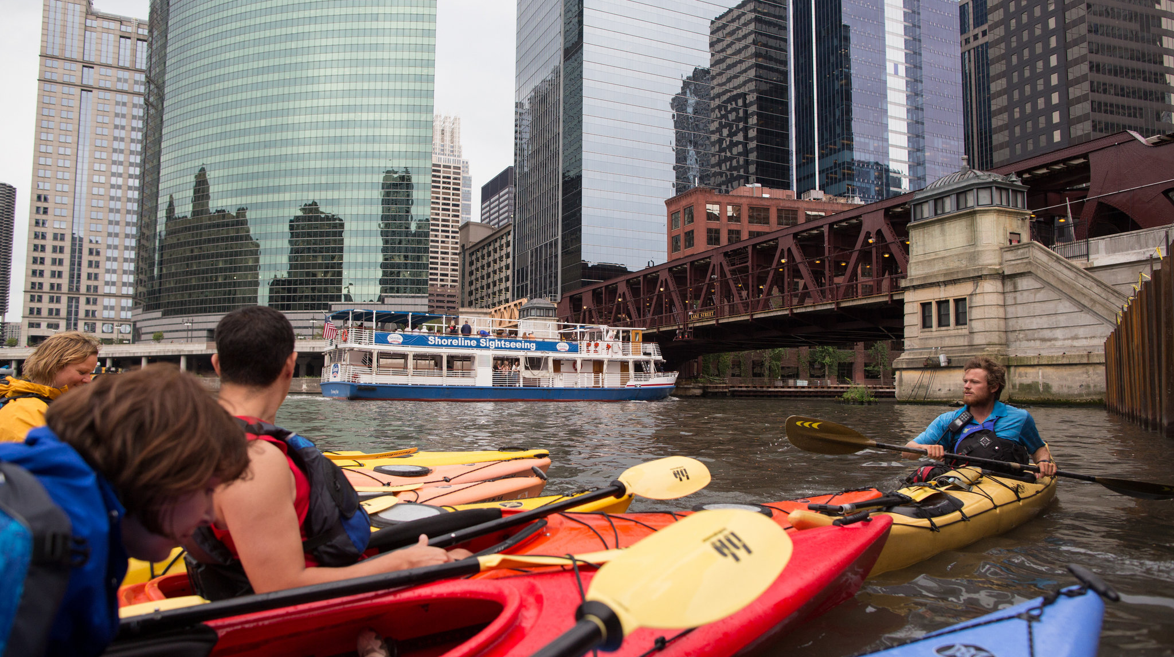
Source: AP
Notes:
Photo Credit: Michigan Sea Grant

Slide 17
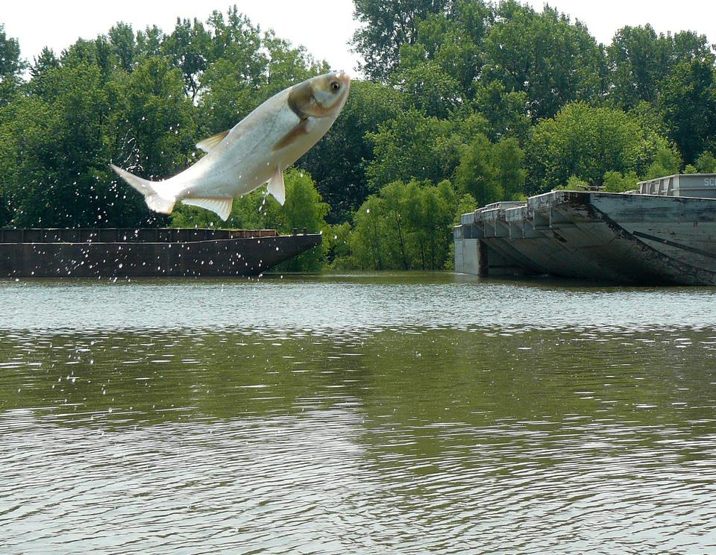
eDNA
Notes:
Photo Credit: Michigan Sea Grant

Slide 18
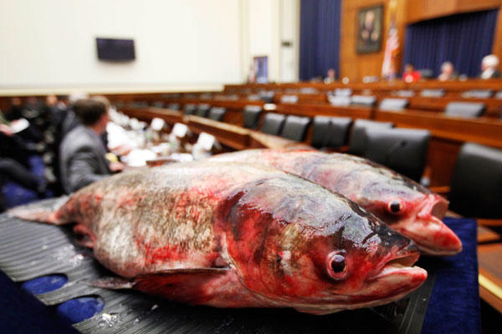
Notes:
Photo Credit: Michigan Sea Grant

Slide 19
Goal
Prevent Asian carp and other aquatic invasive species (AIS) from moving between the Mississippi River and Great Lakes basins through the Chicago Area Waterway System (CAWS).
Strategy
Continue all current actions that reduce the risk of Asian carp and other AIS reaching the Great Lakes through the CAWS, as appropriate;
Initiate additional immediate actions to reduce the risk of AIS transfer between the Great Lakes and the Mississippi River basin through the CAWS, as appropriate;
Conduct additional evaluation of the feasibility and efficacy of lock treatment approaches to prevent AIS transfer in both directions, and develop an implementation strategy for those determined to be viable;
Evaluate the feasibility and efficacy of near-term (two years) and mid-term (four years) actions at the Brandon Road lock and dam that can reduce the risk of Asian carp reaching the Great Lakes through the CAWS and develop an implementation strategy for those actions determined to be viable;
Evaluate, refine and improve upon long term solutions, such as those presented in the GLMRIS and Restoring the Natural Divide reports, to stop the interbasin transfer of invasive species while maintaining or improving water quality, transportation, recreational uses and flood protection, and develop an implementation strategy for those solutions determined to be viable; and
Develop partnerships for multi-jurisdictional and cross-sector cost-sharing.

Slide 20
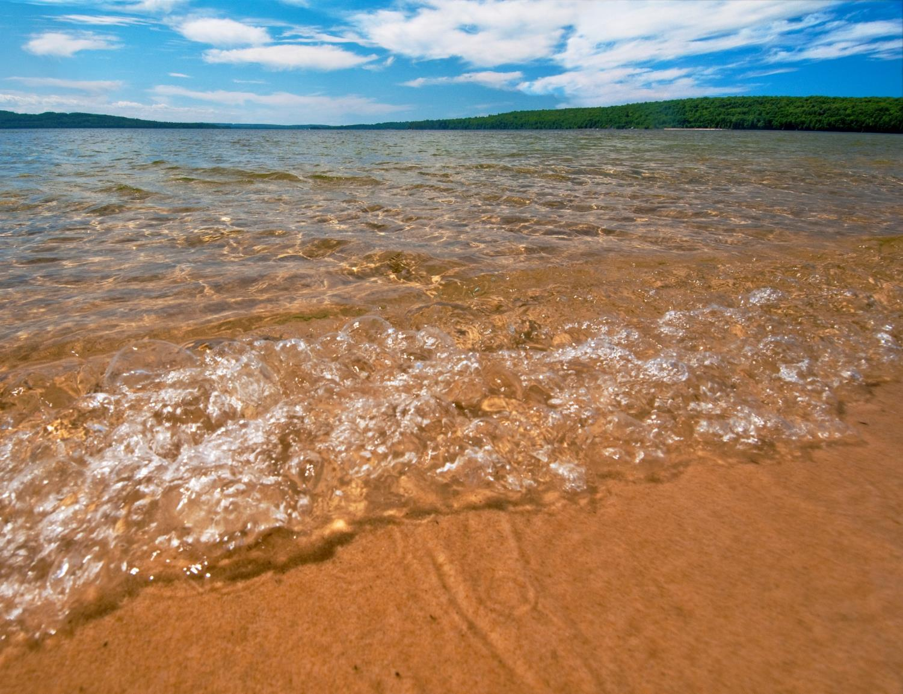
QUESTIONS?

