Slide 1
Plant Mix Asphalt Sustainability
Courtesy of Kevin Burke
Mayor Caucus – Environmental Meeting

Slide 2
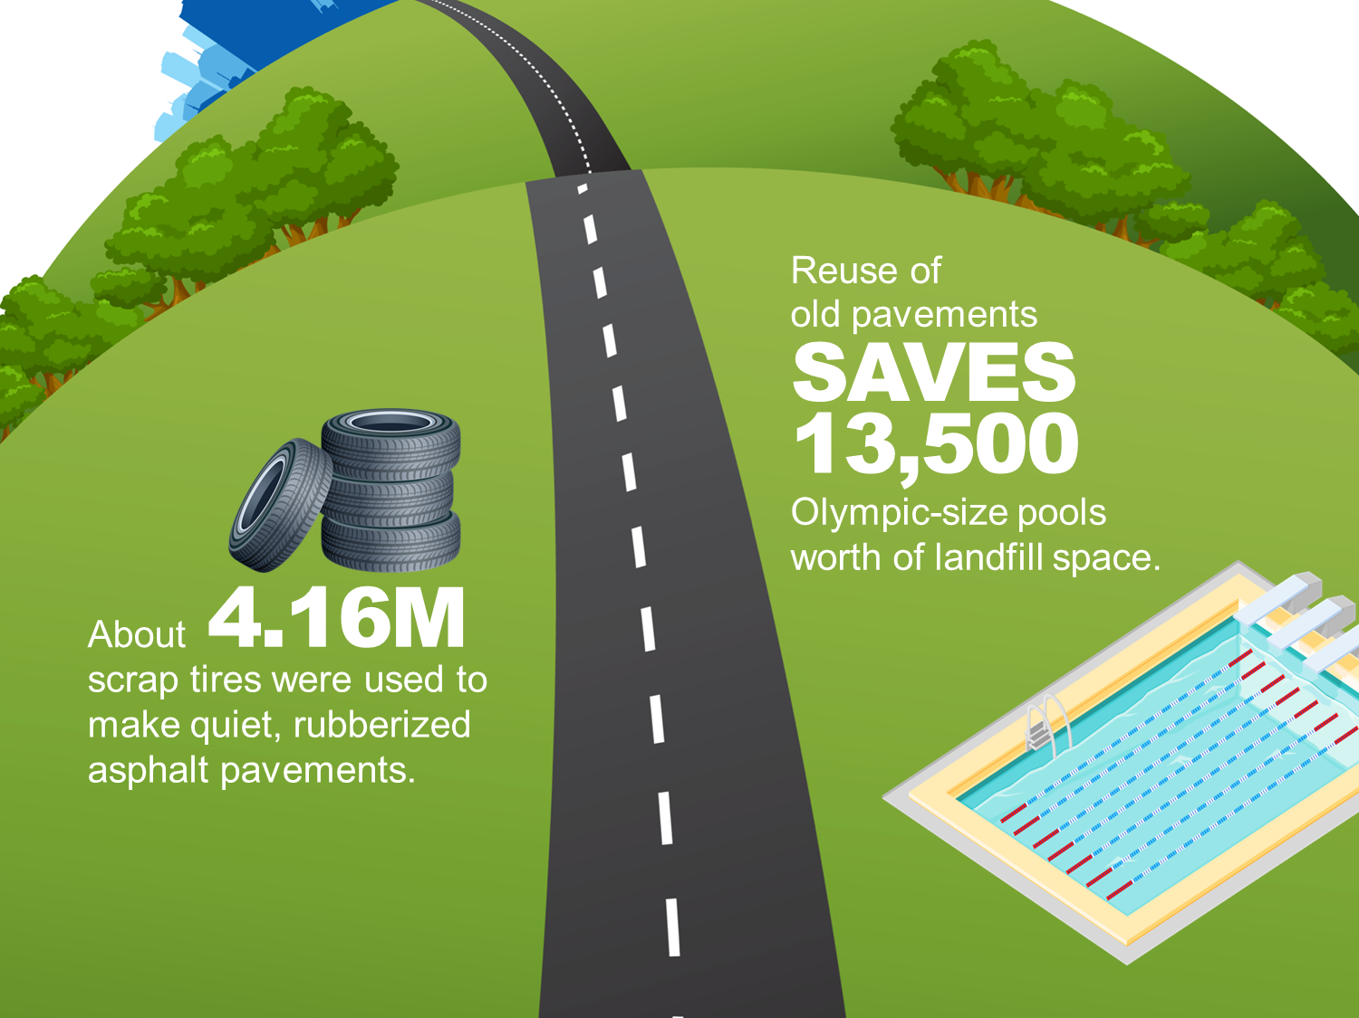
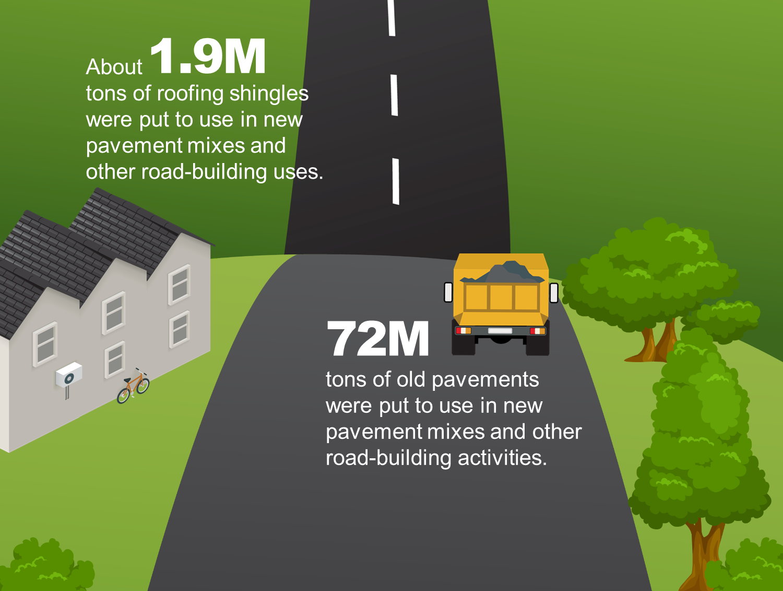
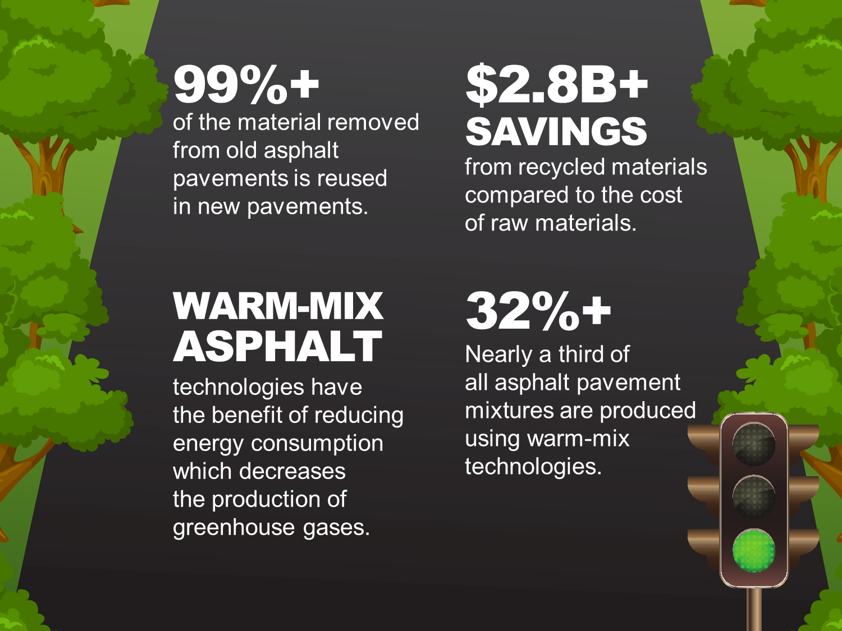
Plant Mix Asphalt Sustainability Efforts
Warm Mix Asphalt
Asphalt Binder Replacement
Recycled Asphalt Pavement
Recycled Asphalt Shingles
Other
Ground Tire Rubber
Preservation
Cold Central Plant
Notes:
Illinois Asphalt Pavement Association as well as the National Asphalt Pavement Association is committed to providing public agencies with high quality, low life cycle cost, and sustainable pavements. Sustainable efforts not only include Warm Mix Asphalt but also Recycled Asphalt Pavements, Recyceld Asphalt Shingles, Ground Tire Rubber, Preservation, and Cold Central Plant Recycling.

Slide 3
Plant Mix Asphalt Sustainability
Industry is committed to providing sustainable product with lower life cycle costs
WMA is one option for Contractors to use
Agencies should encourage innovation through permissive specifications
Artificial restrictions on RAP/RAS/WMA usage increases cost and decreases sustainability
Local agencies should consider using industry standard specifications for plant mix asphalt
Economy of scale
Consistency of production
Ensure latest design and construction technology is used
Notes:
In Illinois, warm mix is used to reduce plant temperatures. However, the temperatures are still in the low range for Hot Mix Asphalt 290 – 310 F. By adopting the standard IDOT mix design specifications, local agencies would see immediate sustainability improvements by allowing contractors to use warm mix technology, provide a more consistent production and laydown, and ensure quality pavements are provided at the lowest life cycle cost.

Slide 4
Contact
Kevin Burke
Executive Director
IAPA
burkeiii.kevin@comcast.net
217.523.2208

