Slide 1
July 9, 2018
Metropolitan Mayor’s Caucus
Environmental Committee and Energy Sub Committee Meeting
Community Solar & Brownfield Solar
Amy Antoniolli
aantoniolli@schiffhardin.com
312-258-5550
Alex Garel-Frantzen
Agarel@schiffhardin.com
312-258-5521

Slide 2
Today’s Agenda
Community Solar in Illinois
Brownfields Solar
Best Practices

Slide 3
Community Solar in Illinois

Slide 4
Developing new renewable energy resources in Illinois, including brownfield solar projects and community solar projects, will help to diversify Illinois electricity supply, avoid and reduce pollution, reduce peak demand, and enhance public health and well-being of Illinois residents. 20 ILCS 3855/1-5(6).

Slide 5
Community Solar: Why is it good policy?
Affordable renewable energy
Productive use for vacant land
Lower cost of entry
Reduction in demand during peak hours
RECs to support utility goals
Return on investment
Progress towards meeting community goals (e.g. Greenest Region Compact)

Slide 6
Illinois Definition of Community Solar
“Community renewable generation project”
Can be solar or another source of renewable energy
Credits the value of electricity generated to the subscribers of the facility
Subscribers must be in same service territory
2MW or less
ICC approved co-location
Two 2MW projects on one parcel
One 2MW on each of two contiguous parcels

Slide 7
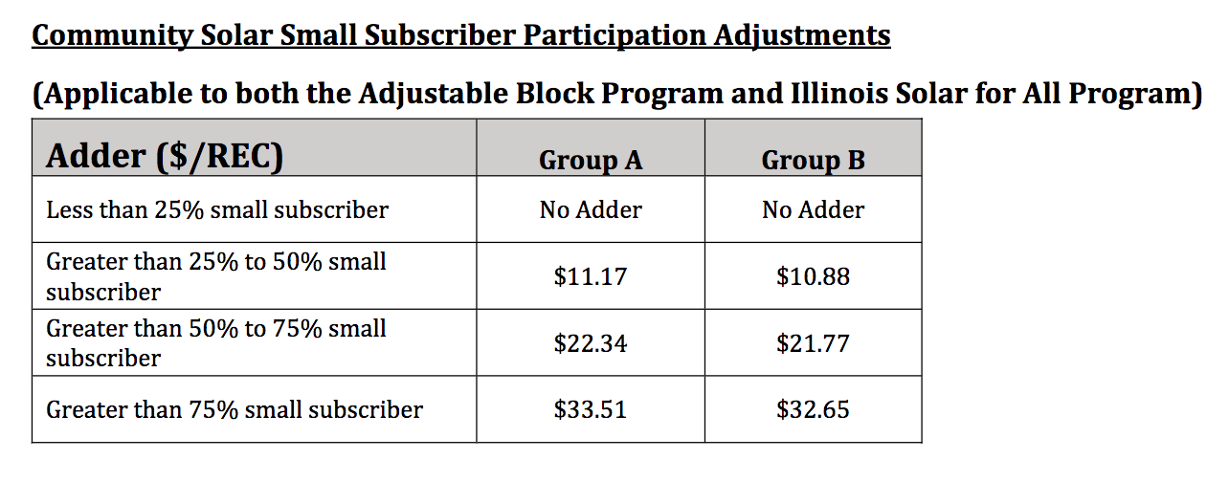
More Small Subscribers = Greater REC Prices

Slide 8
New Solar Legislation
Pollinator Friendly Solar Site Act (SB3214)
Passed both houses on 5/28/2018
Solar installations with generating capacity of 40+ kW
May claim solar site as “pollinator-friendly” if adherence to DNR scorecard
Benefits:
Promotes solar energy development
Encourages creation of habitat for pollinators within their solar sites
Reduces soil erosion and fertilizer runoff
Reduces costs

Slide 9
New Solar Legislation
Renewable Energy Facilities Agricultural Impact Mitigation Act (PA 100-0598)
Approved by Gov. on 6/29/2018
Solar installations of 500+ kW
Extends same agricultural impact requirements currently applicable to wind farms:
Agricultural impact mitigation agreement – USDA
Appropriate financial assurance mechanism – county governments

Slide 10
New Solar Legislation
Property Tax Amendments for Solar Energy Systems (SB486)
Passed both houses on 5/31/2018
Ground-mounted solar energy systems
How property taxes are calculated for land hosting ground-mounted commercial solar systems
Benefits:
Predictability for developers and property owners
Tax revenue for communities

Slide 11
Brownfields Solar

Slide 12
Purpose of brownfield site PV projects is to “return blighted or contaminated land to productive use” through the development of solar projects. 20 ILCS 3855/1‐5(8).

Slide 13
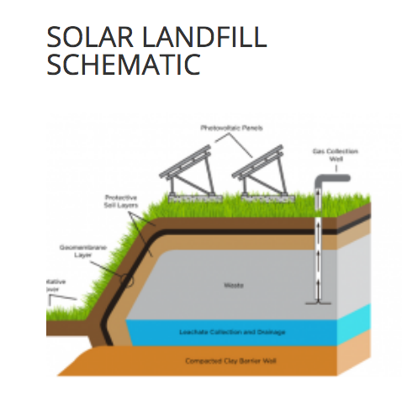
Brownfields Solar
What is a brownfield solar project?
Solar project located on abandoned or under-used industrial and commercial properties with actual or perceived contamination and an active potential for redevelopment.
No size limit.
Environmentally sensitive properties come with challenges.

Slide 14
IPA Act and Long-Term Renewable Resources Plan
A brownfield site PV projects is a PV project that is interconnected to an Illinois investor owned utility, cooperative, or municipal utility and regulated under any of four brownfield programs. 20 ILCS 3855/1‐10.
Sites may enroll in IEPA’s Site Remediation Program even when there is merely perceived (not actual) contamination.
ICC adopted stricter criteria:
Only projects that “currently feature or featured actual blight or contamination prior to remediation” are eligible.
What sites will qualify as Brownfields?

Slide 15
IEPA Brownfields Incentives
IEPA’s Municipal Brownfields Redevelopment Grant Program – no longer funded!
Redevelopment Assessments
Done by USEPA or IEPA
Will come to your community to perform an assessment to provide information about the environmental condition of a specific piece of property.
Local government must own the property or obtain permission from the owner and must document interest in developing the property.
IEPA can do 6-8 approximately assessments per year.

Slide 16
The Build Act Provides Added Protection and Incentives
President Trump signed on March 23, 2018
Clarifies that states and local governments that acquire properties through seizure or other law enforcement activities are also excluded from CERCLA’s definition of “owner and operator.”
Adds several new criteria to be considered in evaluating and prioritizing grant applications. For example, whether the brownfield redevelopment would generate renewable electricity from wind, solar or geothermal energy or would improve energy efficiency.

Slide 17
Encouraging Solar in your Community

Slide 19
Best Practices
Facilitate relationships between developers and landowners
Adopt supportive local policy
Adopt a solar ordinance addressing community issues
Streamline permitting and zoning requirements
Help identify subscribers

Slide 20
Amy Antoniolli
aantoniolli@schiffhardin.com
312-258-5550
Alex Garel-Frantzen
Agarel@schiffhardin.com
312-258-5521

Slide 21
Questions?

