Slide 1
Future Energy Jobs Act: Public Sector Impacts
Options and recommendations for municipalities Metropolitan Mayors Caucus
May 2017

Slide 2
Overview
Current Energy Policy & Players in Illinois
Statutes
Parties
Future Energy Jobs Act
Structure
Role for Municipalities
Property Assessed Clean Energy
Local Energy Policies
Solar Codes and Policies
Municipal Aggregation
Discussions
Next Meetings

Slide 3
Illinois Energy Policy
Renewables
Efficiency
EEPS
IPA Programs
Residential
Small Commercial
Utility
Commerce
Commercial
Residential
Industrial
Public Sector
Low Income
Utility Supply
Retail Service
Alternative Compliance Payments
REC Purchases
Long term PPA
REC Purchases
Current Energy Policy

Slide 4
Illinois Energy Policy
Renewables
Efficiency
EEPS
IPA Programs
Residential
Small Commercial
Utility
Commerce
Commercial
Residential
Industrial
Public Sector
Low Income
Utility Supply
Retail Service
Alternative Compliance Payments
REC Purchases
Long term PPA
REC Purchases
System:
Renewables
Annual goals are set by statute
Subject to cost cap
Annual purchase of Renewable Energy Credits
Efficiency
Annual goals set by statute
Subject to cost cap
Programs offering incentives to specific market sectors
Current Energy Policy

Slide 5
Illinois Energy Policy
Renewables
Efficiency
EEPS
IPA Programs
Residential
Small Commercial
Utility
Commerce
Commercial
Residential
Industrial
Public Sector
Low Income
Utility Supply
Retail Service
Alternative Compliance Payments
REC Purchases
Long term PPA
REC Purchases
Parties:
Renewables
Illinois Power Agency
Illinois Commerce Commission
Utilities
Retail Electricity Suppliers
Efficiency
Utilities
Illinois Power Agency
Stakeholder Advisory Group
Illinois Commerce Commission
Service Providers
Current Energy Policy: Parties

Slide 6
Illinois Energy Policy
Renewables
Efficiency
EEPS
IPA Programs
Residential
Small Commercial
Utility
Commerce
Commercial
Residential
Industrial
Public Sector
Low Income
Utility Supply
Retail Service
Alternative Compliance Payments
REC Purchases
Long term PPA
REC Purchases
Changes:
Renewables
Transfer of compliance from Retail Electricity Suppliers to utilities
Compliance in the form of long term REC purchases
Efficiency
Transfer of compliance from IPA and DCEO to utilities alone
Compliance in the form of higher spend & cumulative savings goals
Utilities earn ~9.4% return on capital if goals are met
Current Energy Policy: Changes

Slide 7
Illinois Energy Policy
Renewables
Efficiency
Utility
Low Income
Industrial (<10 MW)
Utilities
Illinois RPS
Rooftop Grants
Illinois Solar for All (low income)
Single Family
Community Solar
Pilot Solar
Utility
Distributed
Brownfield
Other
Municipal / Non-Profit
Residential
Commercial (Municipal)
Future Energy Jobs Act (FEJA)

Slide 8
FEJA & Public Sector (Caucus Positions)
Greenest Region Compact 2
Retrofitting public buildings for energy efficiency
Connecting residents to energy efficiency programs
Local solar installations
Clean Energy Agenda recommendations
Renewable Energy
Distributed Generation
Energy Efficiency
Jobs
Infrastructure investment and resilience
Ratepayer considerations

Slide 9
FEJA & Public Sector
Energy Efficiency (EE)
FEJA maximum EE budget for ComEd
2018: $ 351.7 million
2019: $ 351.7 million
2020: $ 351.7 million
2021: $ 351.7 million
$1.406.6 billion
Assume that the cost of EE from Public Sector is equal to the Cost of EE from all sectors
Public Sector = 10% of total EE costs
Public Sector EE budget of ~$140.7 million

Slide 10
FEJA & Public Sector
Energy Efficiency (EE)
Renewable energy (RE)
FEJA maximum EE budget for ComEd
2018: $ 351.7 million
2019: $ 351.7 million
2020: $ 351.7 million
2021: $ 351.7 million
$1.406.6 billion
Assume that the cost of EE from Public Sector is equal to the Cost of EE from all sectors
Public Sector = 10% of total EE costs
Public Sector EE budget of ~$140.7 million
Illinois Solar for All
~$200 million total budget
15% carve out for non-profits & public buildings
Not including community solar
Distributed generation
~$220 million/year in annual budget
Support ~$650 million in capital investment in small scale solar in commercial sites (including public sector) through 2021
Rooftop solar grant
$250/kW in nameplate capacity

Slide 11
FEJA: Role for Municipalities
Municipalities will be involved either directly or indirectly
Direct – To develop its own projects
Indirect – To respond to residents, approve aspects of proposed projects
Risks
Direct - Higher utility costs without receiving any offsetting benefit
Indirect - Being labeled as ‘anti’ when ill-conceived projects pop up without warning, residents working with unqualified developers
Opportunities
Direct – Efficiency & Renewable project grants, tax revenue, sustainable policy fulfillment
Indirect – Local economic development, reputation

Slide 12
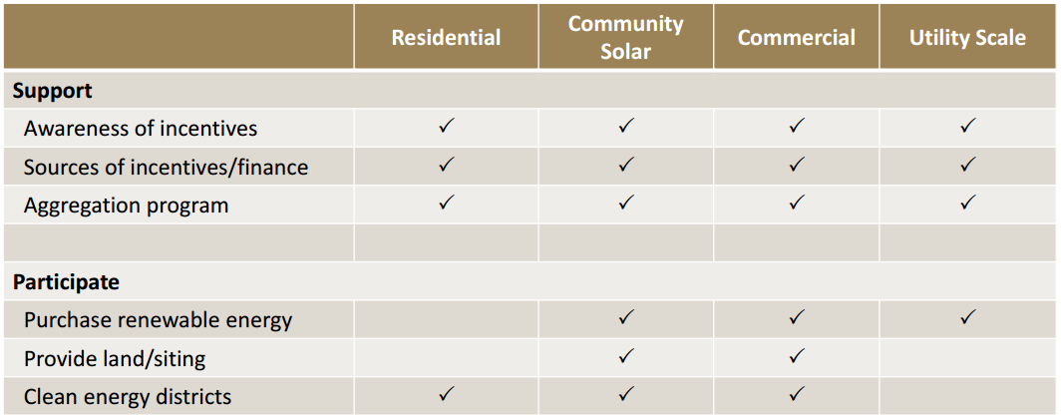
FEJA: Role for Municipalities

Slide 13
Next Steps
Plan
Select priorities / preferred positions
Participate
Monitor advocacy meetings
Contribute to utility planning processes
Participate in IPA planning processes
Intervene in ICC regulatory proceedings
Advocate
Practices
Processes
Budgets

Slide 14
Questions & Comments
The Power Bureau
Mark Pruitt
E – markjpruitt@thepowerbureau.com
P – 219/921-3828

Slide 15
Notes on Municipal Aggregation
Price to Compare
June – September 7.0¢/kWh
October – June 7.3¢/kWh
Subject to monthly adjustment of +/- 0.5¢/kWh
Supplier Price Range
Most communities could achieve 6.8-7.1¢/kWh
‘Savings Guarantee’ = 6.5¢/kWh

Slide 16
Notes on Municipal Aggregation
Opt-Out Municipal Aggregation.
City selects a single supplier to serve all consumer accounts with automatic enrollment
City sets preferred contract terms (e.g., no entry or exit fees, no credit limits, green options, etc.).
Opt-In Municipal Aggregation.
City selects a single supplier to serve all consumer accounts with voluntary enrollment
City sets preferred contract terms (e.g., no entry or exit fees, no credit limits, green options, etc.).
Voluntary Energy Choice Program - The City selects multiple suppliers to that meet minimum standards for service, pricing, contract terms and renewable content; and provides an online platform through which Chicago residents may review and select any offer from a qualified supplier.
City selects a list of suppliers that have low customer complaints (ICC, BBB), favorable standard offers (e.g., no entry or exit fees, no credit limits, green options, etc.), and competitive prices
Residents can review offers and select (or not select) from the approved offers

Slide 17
Notes on Municipal Aggregation
Electricity Supply Option Characteristics | Electricity Supply Program Options
 | Do Nothing | Municipal Aggregation Program (Opt-Out) | Municipal Aggregation Program (Opt-In) | Voluntary Energy Choice Program
Challenges
City responsible for setting a price higher than ComEd’s | No | Yes | No | No
City responsible for picking a ‘single winner’ | No | Yes | Yes | No
City must amend its Plan of Governance | No | Yes | Yes | No
City Council must approve a new contract | No | Yes | Yes | No
City must expend resources to manage a full procurement | No | Yes | Yes | No
City must expend resources to manage contracts | No | Yes | Yes | No
Late start against current ComEd Rate is a factor | No | Yes | Yes | No
Consumer confusion about automatic enrollment | No | Yes | No | No
Benefits
Consumers have access to a safe supplier | No | Yes | Yes | Yes
Sufficient existing expertise within City departments or consultants | N/A | Yes | Yes | Yes
Control over contract terms offered to residents | No | Yes | Yes | Yes
Control over ‘green’ content offered to residents | No | Yes | Yes | Yes
Achieve lower costs by leveraging volume | No | Yes | Yes | Yes

