Slide 1
Building Sustainable & responsive cities

Slide 2
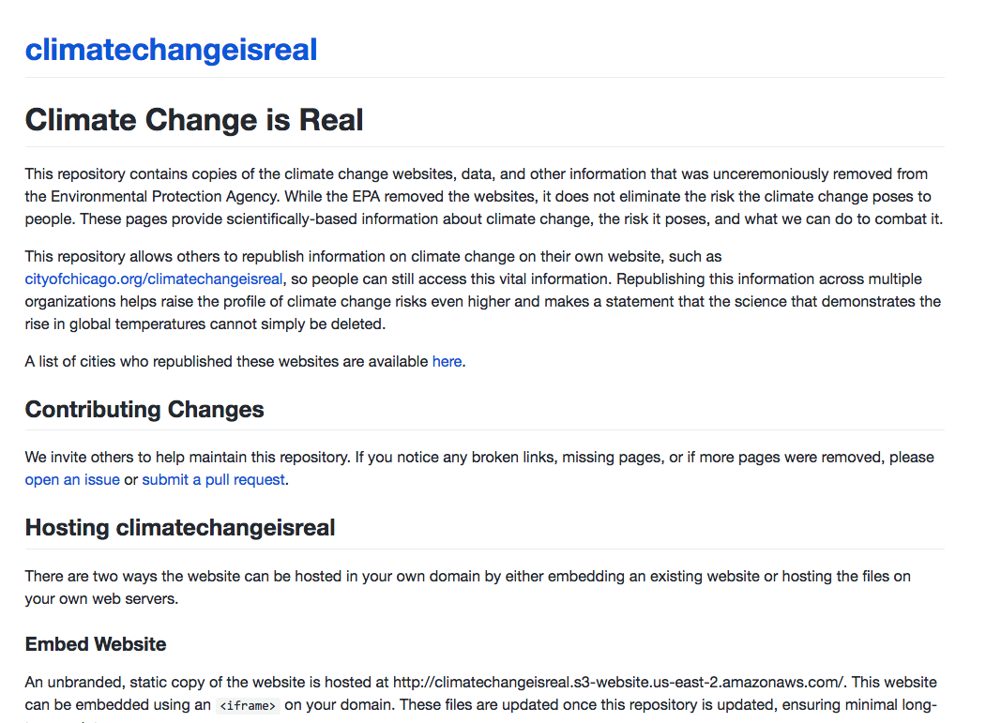
COLLABORATE & ADVOCATE
Preservation & Access
Local governments can take the lead to preserve and provide open access to information about climate change or other data that directly impacts our residents
cityofchicago.org/climatechangeisreal
github.com/chicago

Slide 3
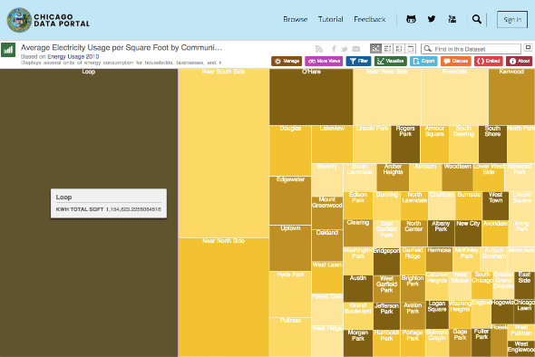
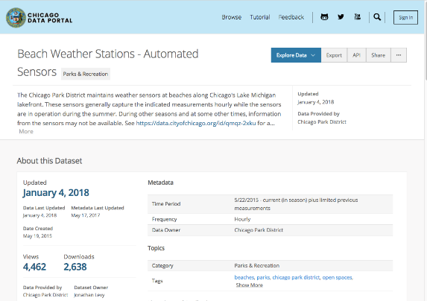
LEVERAGE DATA
Open Data
Chicago publishes over 600 datasets online in machine-readable formats about environmental complaints and inspections, energy consumption, energy benchmarking, water quality, environmental sensors, and transportation.
By making data openly available, governments can facilitate research, the creation of new applications, and measure progress.
data.cityofchicago.org

Slide 4
LEVERAGE DATA
Predictive Analytics
Applied to improve operations and public safety, including restaurant inspections, rodent baiting, E. Coli levels in Lake Michigan, and West Nile Virus cases
github.com/chicago

Slide 5
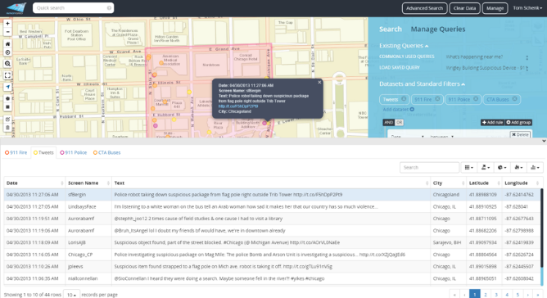
LEVERAGE DATA
Internal Operations: Situational Awareness & Incident Response
WindyGrid brings together previously siloed City data to enable departments to improve and better coordinate response to planned or unplanned events.
opengrid.io

Slide 6
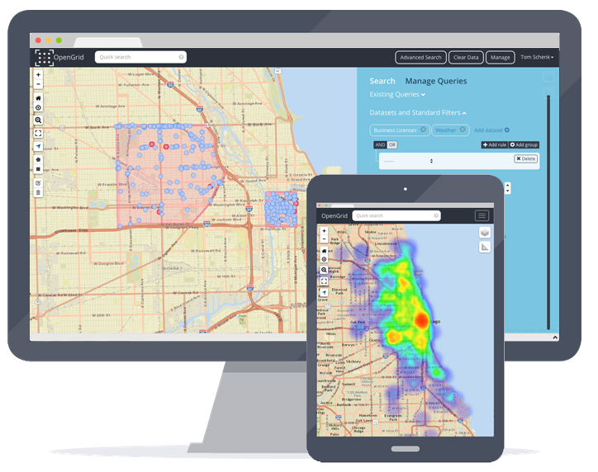
LEVERAGE DATA
For Residents:
Explore Your Community
OpenGrid lets your residents explore their community, making public data more accessible.
opengrid.io
github.com/chicago

Slide 7
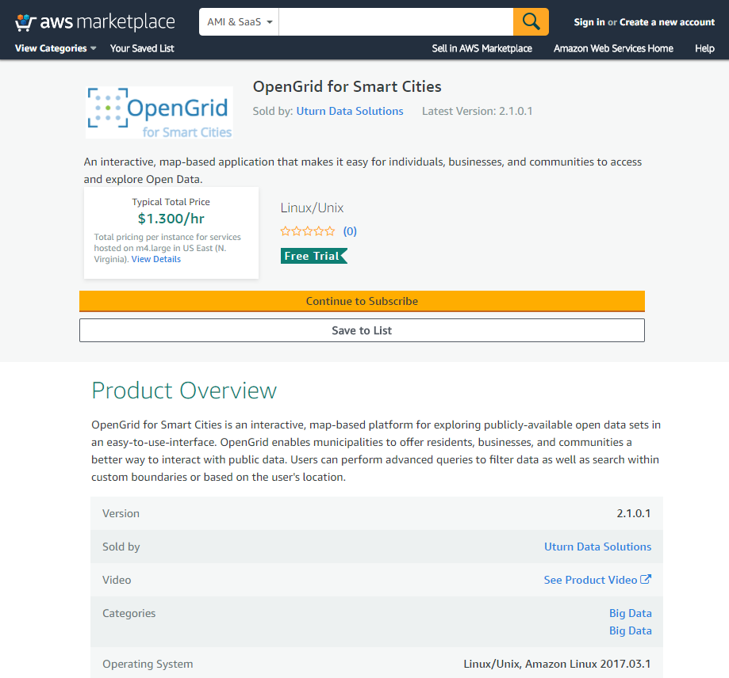
LEVERAGE DATA
Cities can click to deploy this application via AWS Marketplace. The subscription-based tool may be configured with multiple data sources including Plenar.io API and MySQL DB.
Search OpenGrid at aws.amazon.com/marketplace

Slide 8
OPENGRID PARTNERS

Slide 9
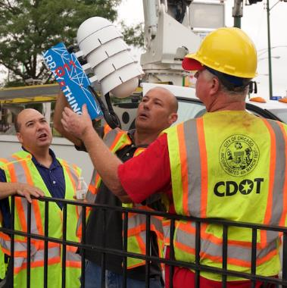
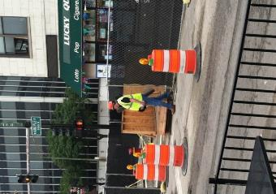
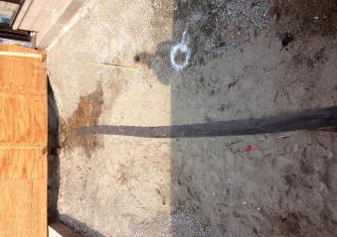
INTEGRATE TECH & PHYSICAL INFRASTRUCTURE
Sensors, connected technologies, and machine learning make it easier to collect real-time, hyperlocal information that can be used to address urban challenges
Optimize Existing Systems Prioritize New Investments Engage Communities

Slide 10
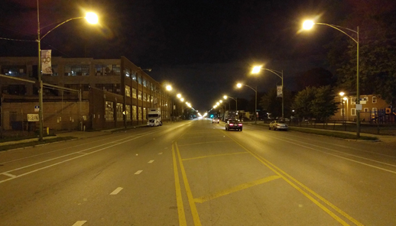
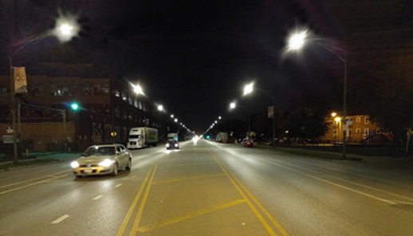
INTEGRATE TECH
& PHYSICAL INFRASTRUCTURE
Smart Lighting
Install new LED street lights in tandem with a networked lighting management system to increase energy efficiency, improve public safety, and be more responsive.
Control & monitor lights
Leverage energy & performance data to improve operations & target future investments
chicagosmartlighting.org

Slide 11
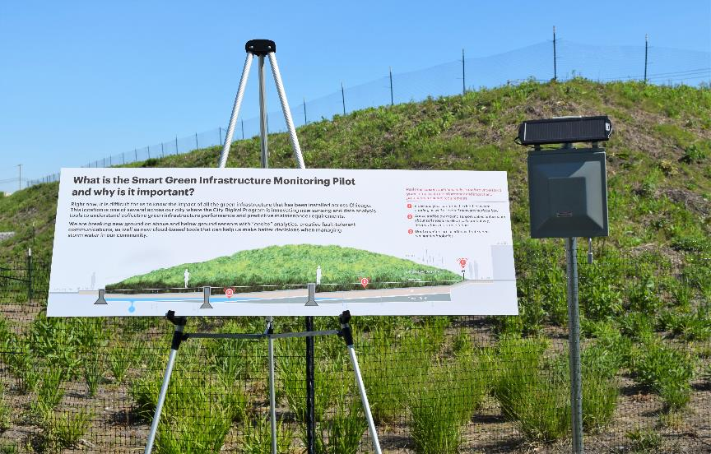
INTEGRATE TECH & PHYSICAL INFRASTRUCTURE
Stormwater Management
Leverage IoT to tackle flooding challenges, incorporating sensors into green infrastructure.
Data is transmitted with a secure network and analytics are available via cloud-based tool to help monitor performance and on the City’s Data Portal.
data.cityofchicago.org

Slide 12
Danielle DuMerer
CIO & Commissioner
Department of Innovation & Technology, City of Chicago
cityofchicago.org
techplan.cityofchicago.org
@CityChicagoCIO
danielle.dumerer@cityofchicago.org

