Slide 1
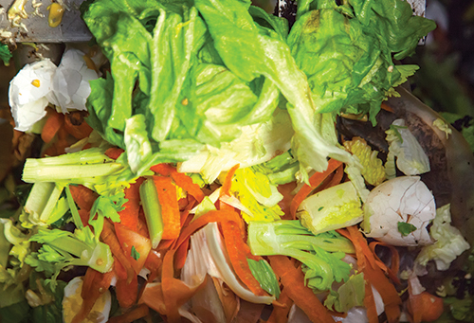
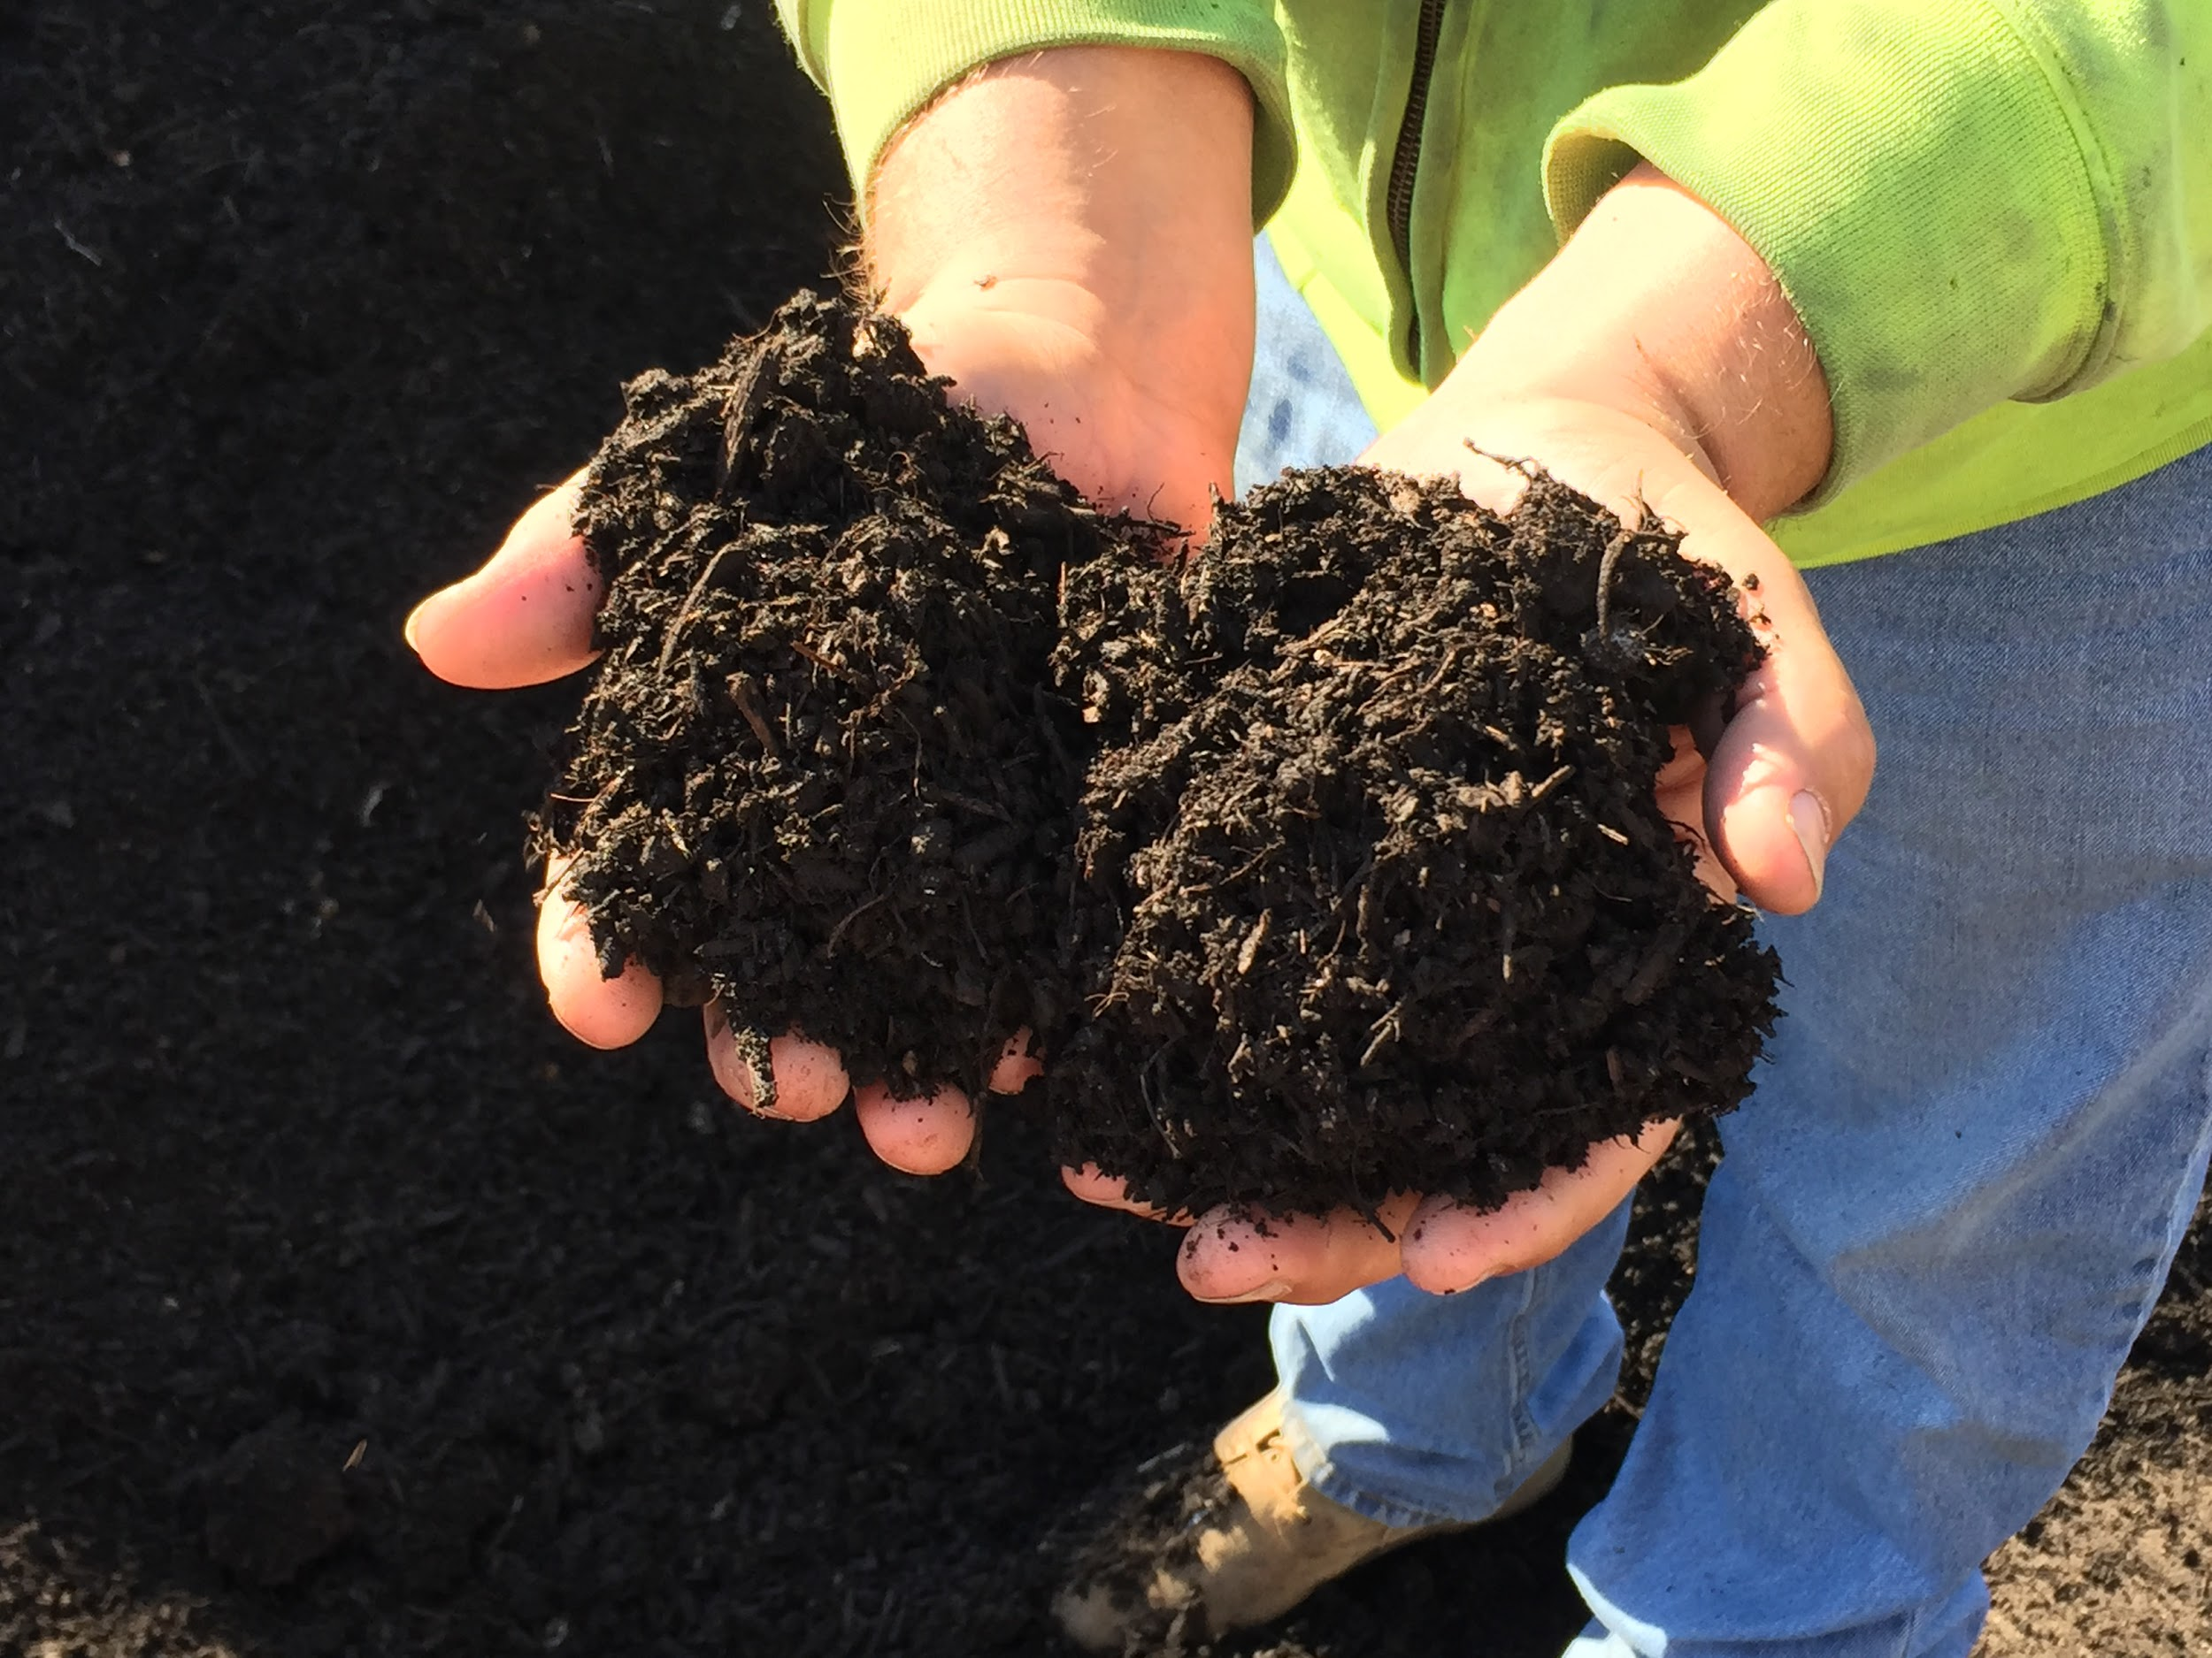
Metropolitan Mayors Caucus
Environment Committee
December 17, 2018
Role of Municipalities in
Reducing Wasted Food
Notes:
In recent years, cities everywhere have begun to grapple with the problem of food waste. In the United States, where an estimated 40% of food is wasted each year, the problem is particularly acute. The US Environmental Protection Agency has recognized this problem in recent years by releasing a number of tools and programs including their Food Recovery Hierarchy, an online Excess Food Opportunities Map, the Food: Too Good To Waste Toolkit and Guide, and the Food Recovery Challenge. Taking the right steps now will help increase economic development, provide a healthier and safer environment and engage residents in sustainability.
WELCOME AND INTRODUCTIONS US FOOD WASTE OVERVIEW COMPOSTING FOOD SCRAPS - Municipal Residential Composting Programs - Case Study - Curbside Composting Pick Up in Geneva - County Overview - Lake County’s Municipal Food Scrap Programs Encourage and Gain Support From Commercial Sector - Case Study - CompostAble Oak Park At Home Composting FEEDING HUNGRY NEIGHBORS THROUGH FOOD RECOVERY OPTIONAL TOUR OF NORTHERN ILLINOIS FOOD BANK - FOOD DONATION AND COMPOSTING

Slide 2
Sustainable Management of Food - A National Perspective
Julie Schilf US EPA Region 5
Metropolitan Mayors Caucus Environment Committee Meeting December 17, 2018

Slide 3
Summary
Wasted Food Issues and Impacts
National Efforts
Opportunities for Municipalities

Slide 4
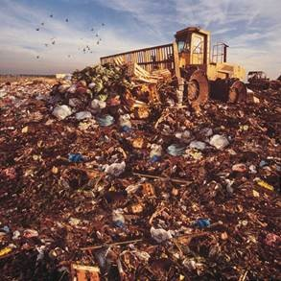
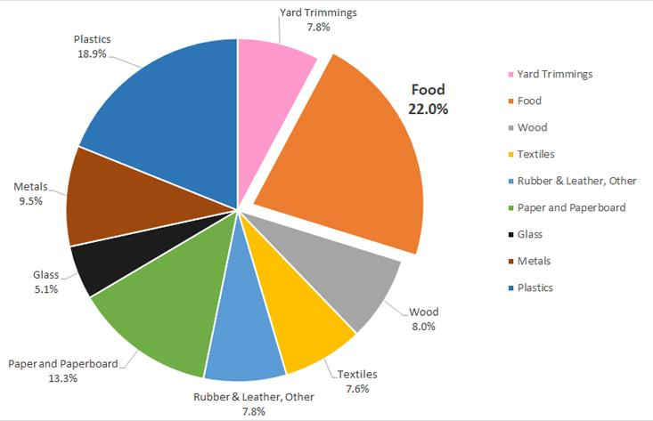
U.S. Wasted Food Profile
Total MSW Landfill by Material, 2015
(137.7 million tons)

Slide 5
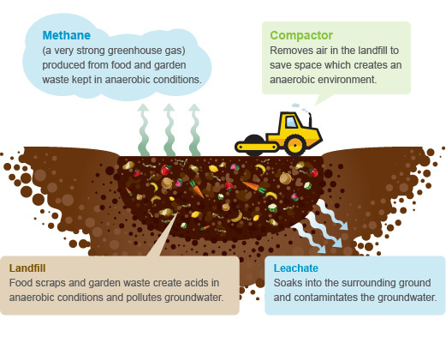
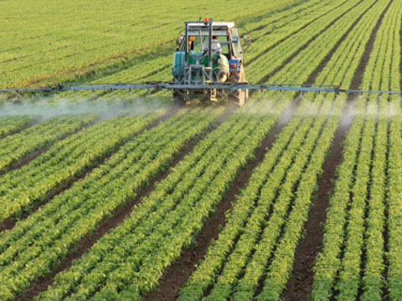
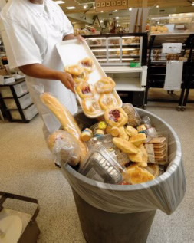
The Cost of Wasted Food

Slide 6
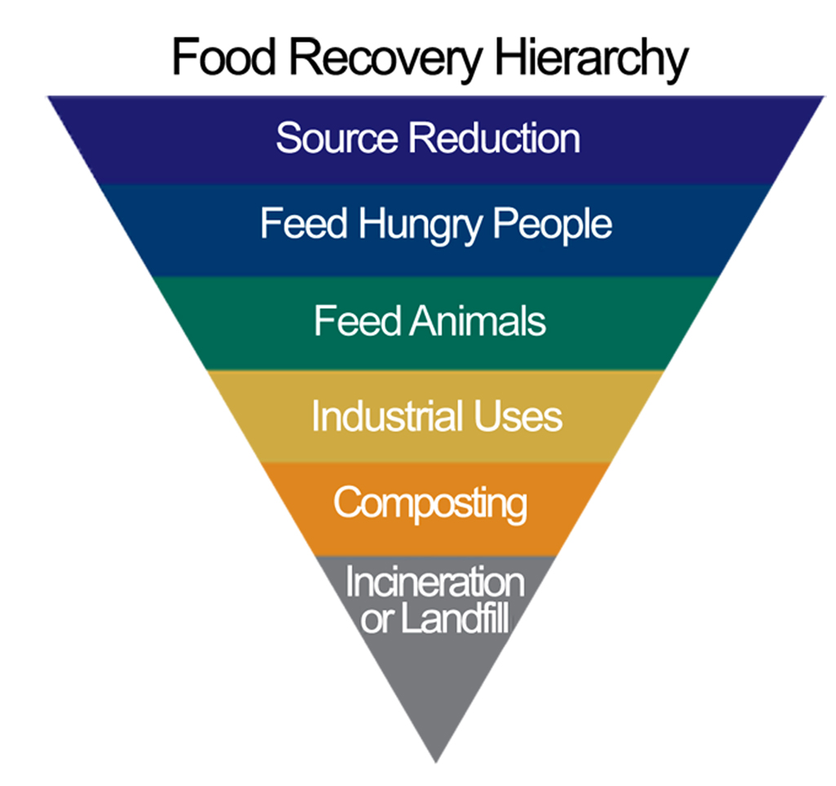
EPA’s Sustainable Management of Food Program
Most Preferred
Reduce the volume of surplus food
Donate extra food to food banks, pantries, shelters
Divert food scraps to animal feed
Convert waste oils and food scraps into fuels or energy
Create a nutrient-rich soil amendment
Landfill or incineration
Least Preferred

Slide 7
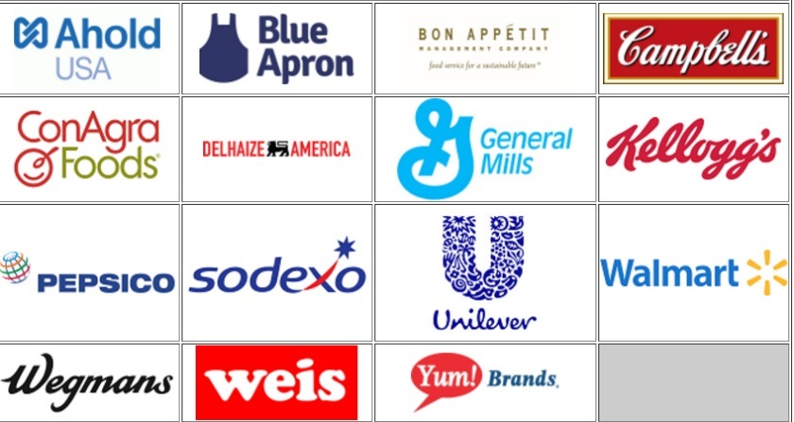
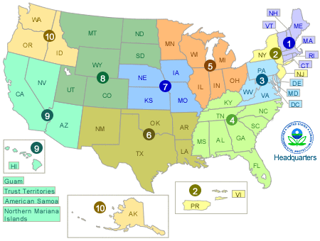
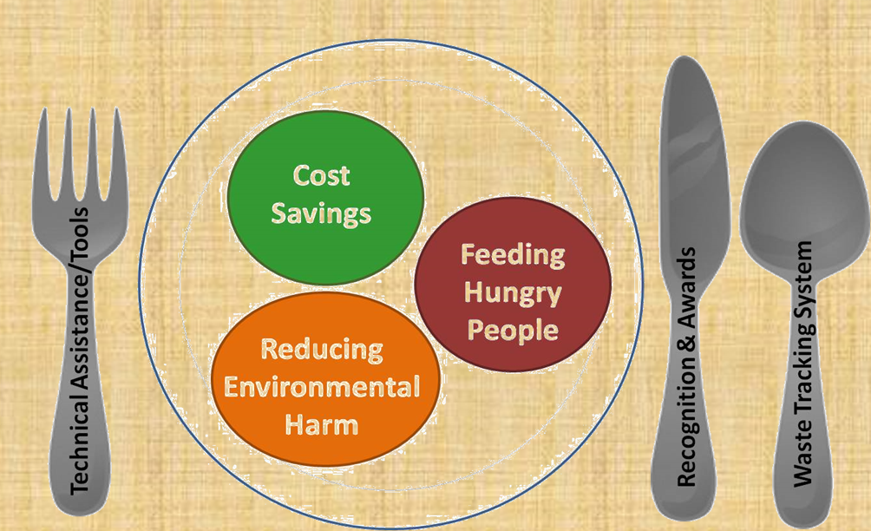
National Efforts - EPA
2030 Champions
Programs Across the U.S.
Food Recovery Challenge

Slide 8
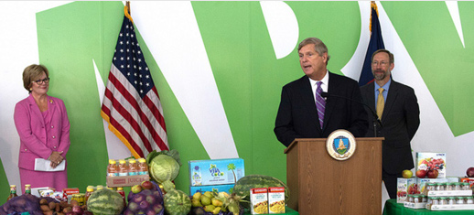
National Efforts – EPA and USDA
U.S. 2030 Food Loss and Waste Goal
On September 16, 2015, US EPA and USDA announced the first national food waste reduction goal.
Reduce wasted food by 50% by 2030

Slide 9
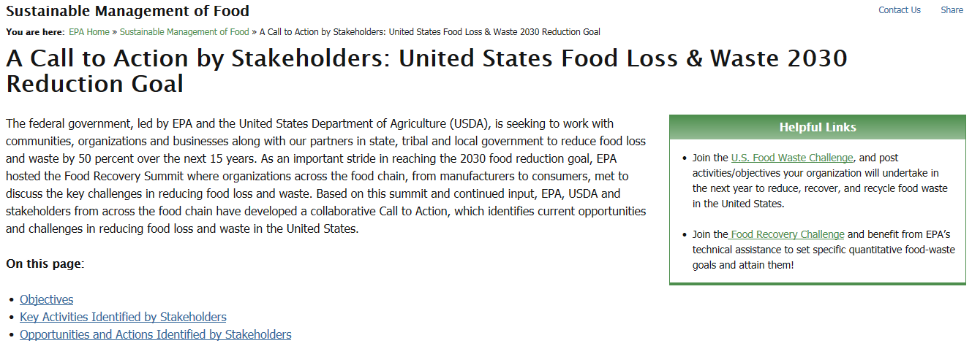
A Call to Action
https://www.epa.gov/sustainable-management-food/call-action-stakeholders-united-states-food-loss-waste-2030-reduction

Slide 10
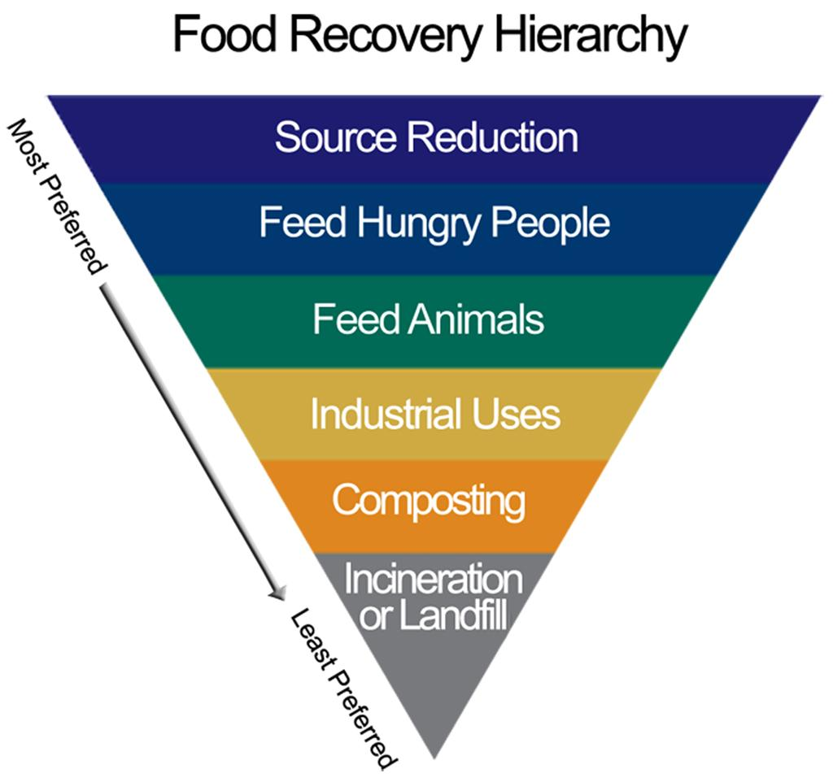
Other National Efforts
Food: Too Good To Waste (EPA)
Enhancing Food Donation through Federal Policy (NRDC, Harvard)
Leftovers for Livestock: A Legal Guide to Feeding Animals (U of Arkansas)
Excess Food Opportunities Tool (EPA)
Keeping Food Out of the Landfills: Policy Ideas for States and Localities (Harvard)

Slide 11
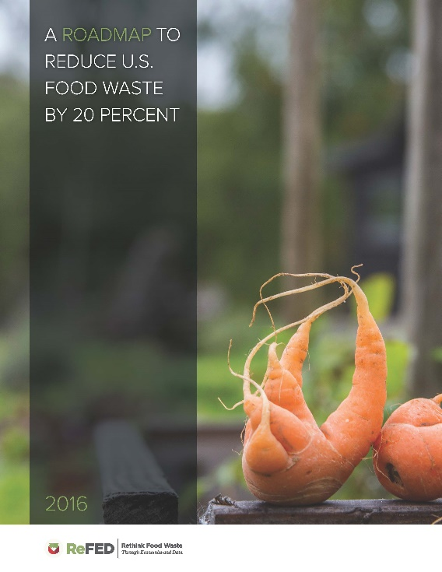
Driving Action to Reduce Wasted Food
Long term diversion and waste reduction goals
Vermont’s UW Recycling Law – 30% increase in donation
ReFED
Roadmap to Reduce Food Waste
Supports 2030 FLW Goal
Analysis of financial and non-financial impacts of solutions

Slide 12
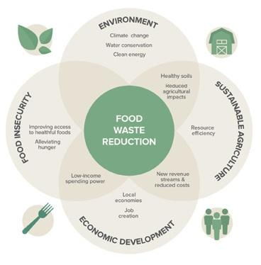
Opportunities for Municipalities
ReFED

Slide 13
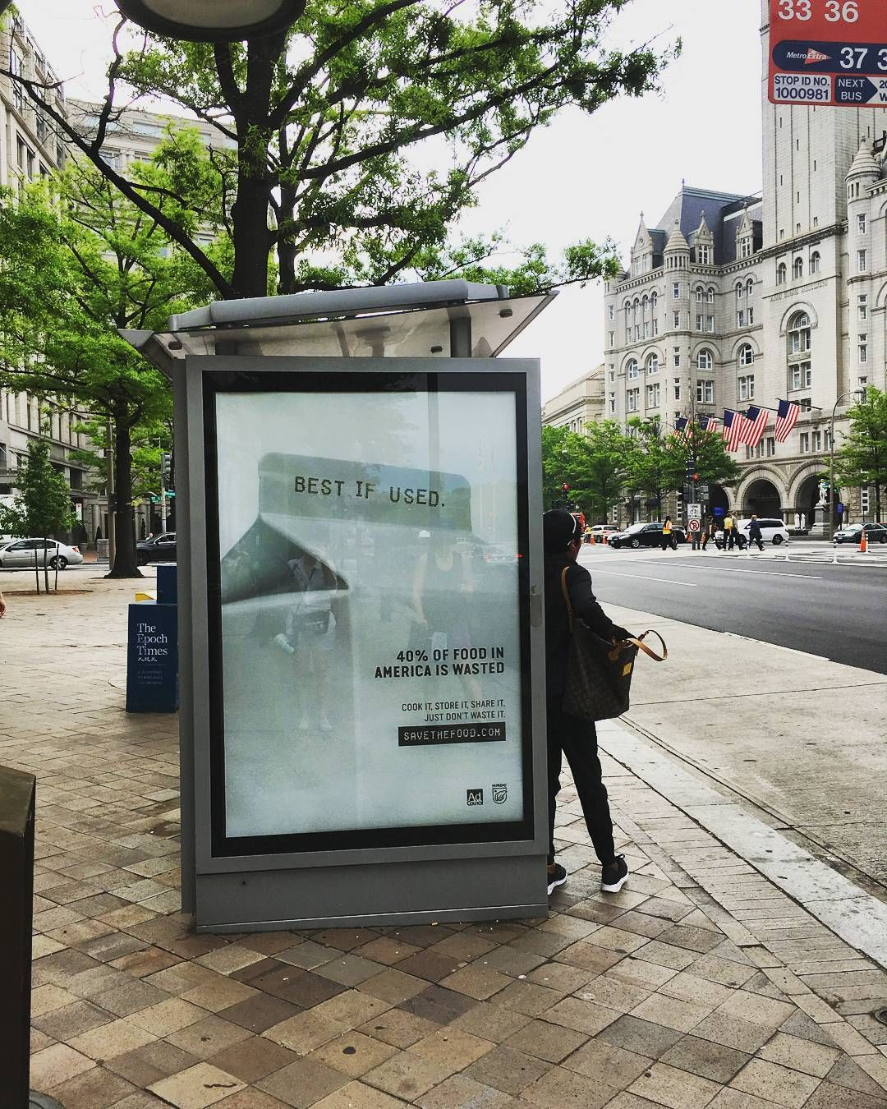
Consumer Education
Opportunities for Municipalities
NRDC/Ad Council’s Save the Food
Videos, print, out-of-home, digital, radio
Posts and graphics to share across social media
www.savethefood.com

Slide 14
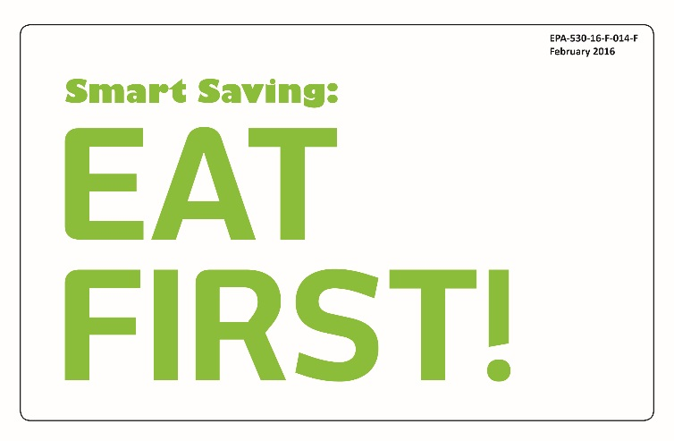
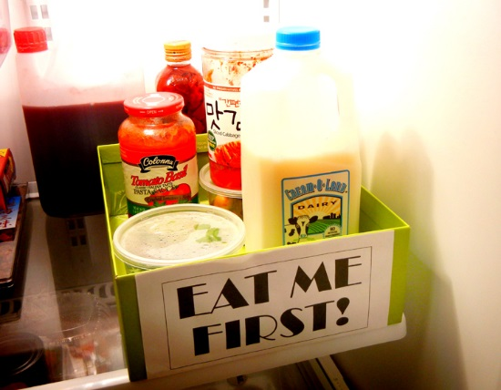
Opportunities for Municipalities
Consumer Education
EPA’s Food: Too Good to Waste Toolkit
Get Smart: See how much food (& money) you’re throwing away
Smart Shopping: Buy what you need
Smart Saving: Eat what you buy
Smart Storage: Keep fruits and vegetables fresh
Smart Prep: Prep now, eat later

Slide 15
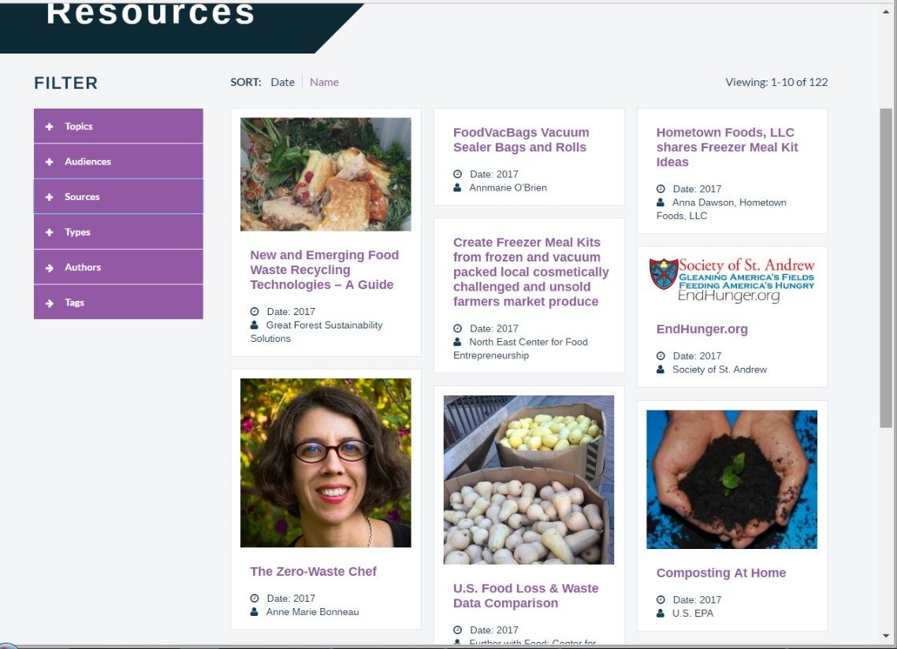
Opportunities for Municipalities
Consumer Education
Further with Food: Center for Food Loss and Waste Solutions
www.furtherwithfood.org

Slide 16
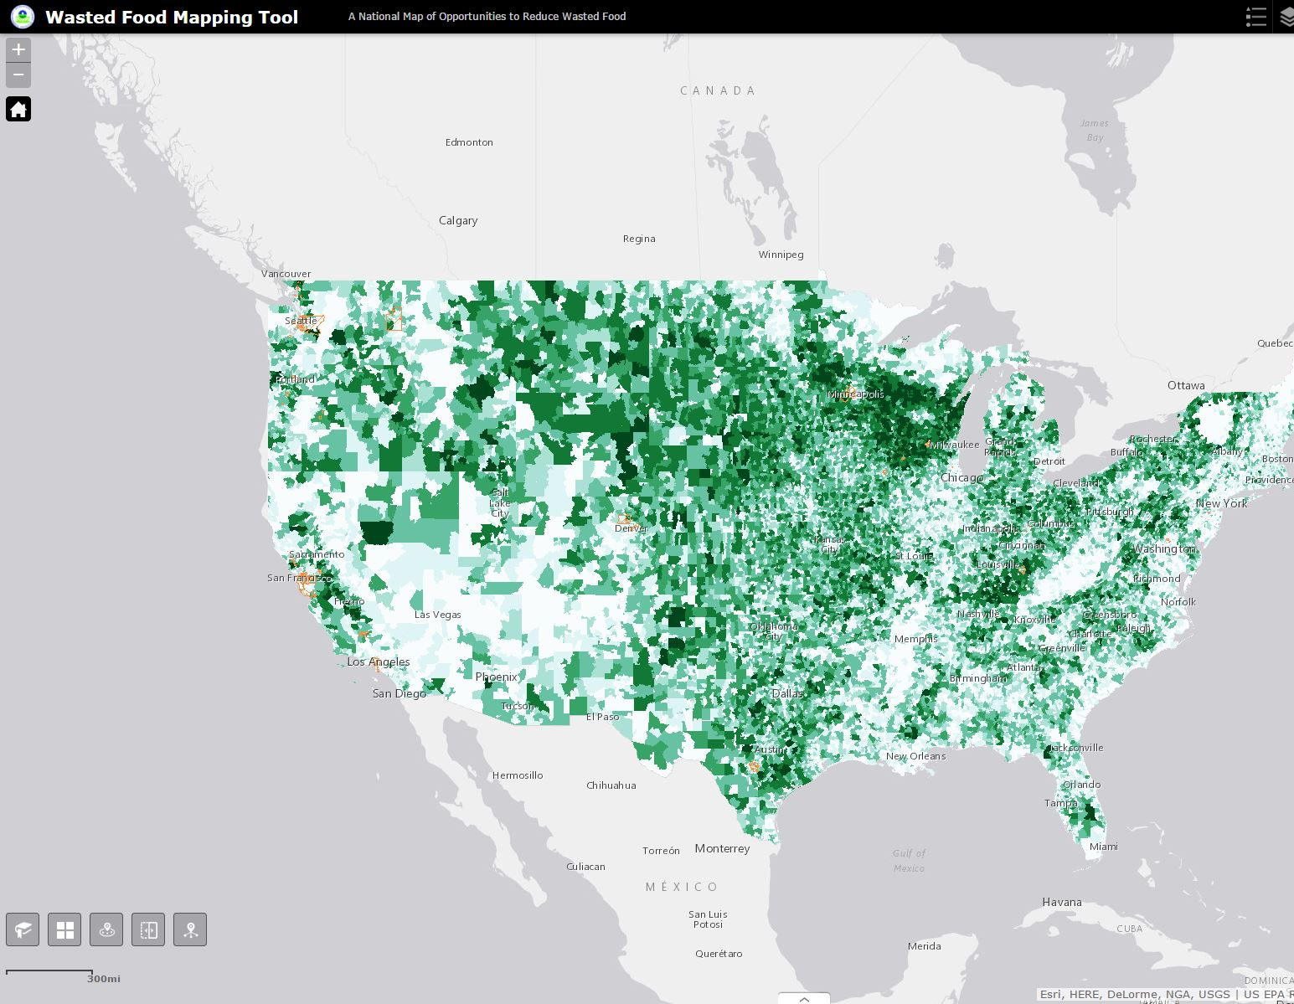
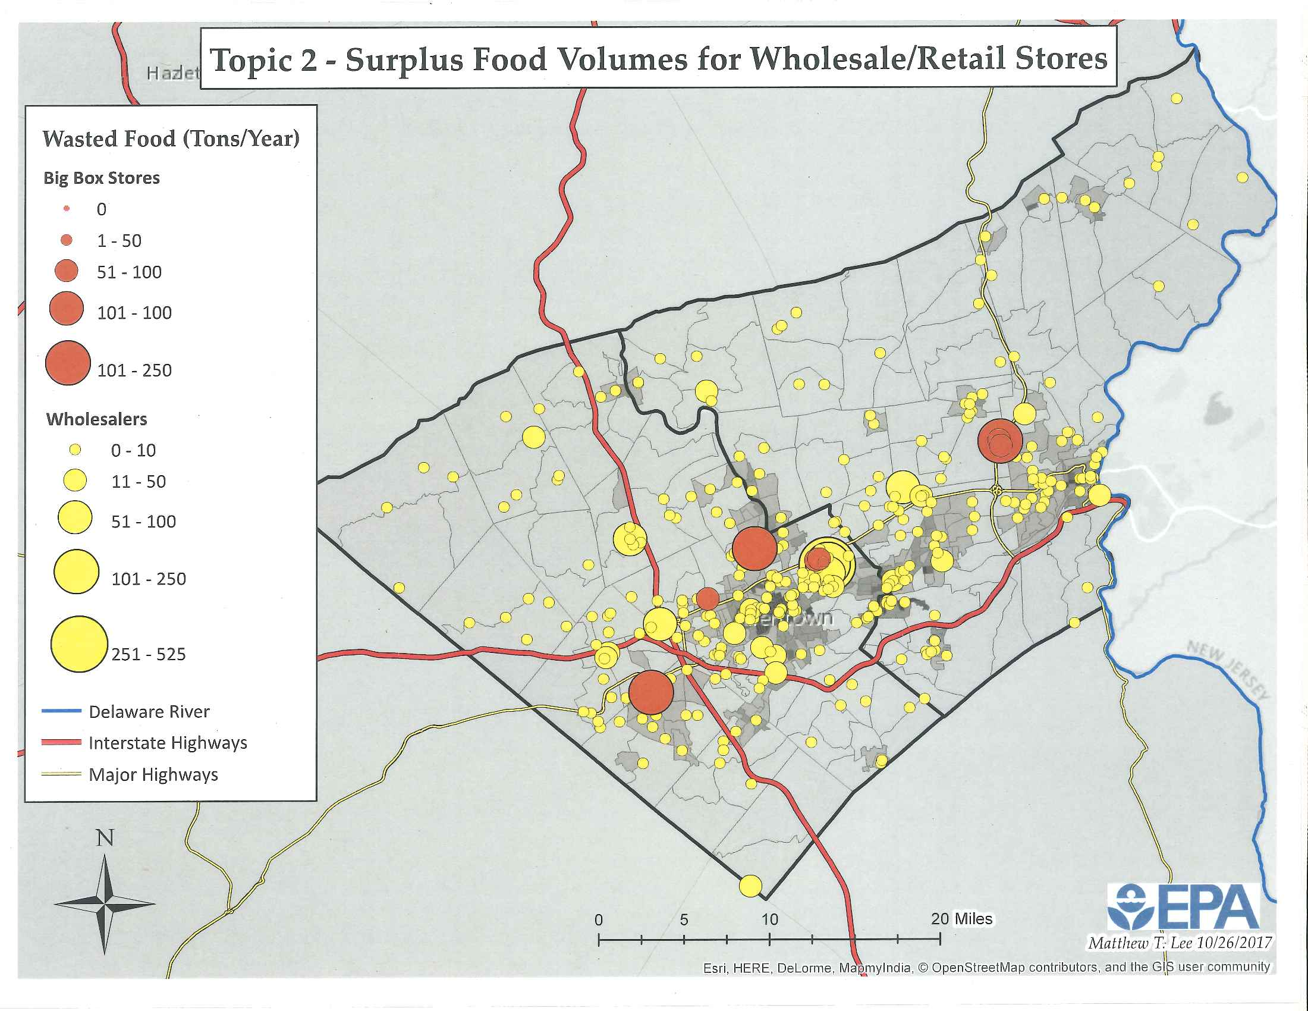
Address Food Insecurity
Opportunities for Municipalities
Bill Emerson Good Samaritan Act
Excess Food Opportunities Map

Slide 17
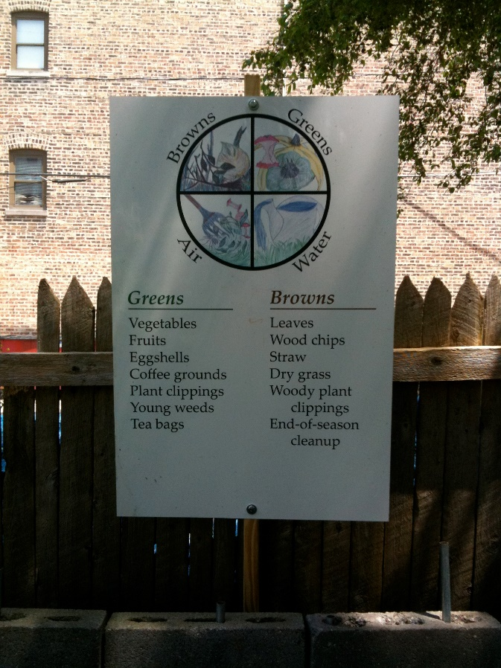
Promote Community and At-Home Composting
Opportunities for Municipalities
Local Non-Profits
SCARCE, IFSC

Slide 18
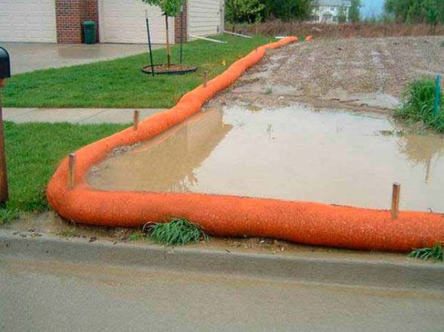
Compost Procurement
Opportunities for Municipalities
Stormwater Management
Construction, post-construction
Municipal landscape projects
Market Development
Expansion of programs

Slide 19
Thank you
Julie Schilf
312-886-0407 schilf.julie@epa.gov

Slide 20
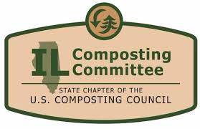
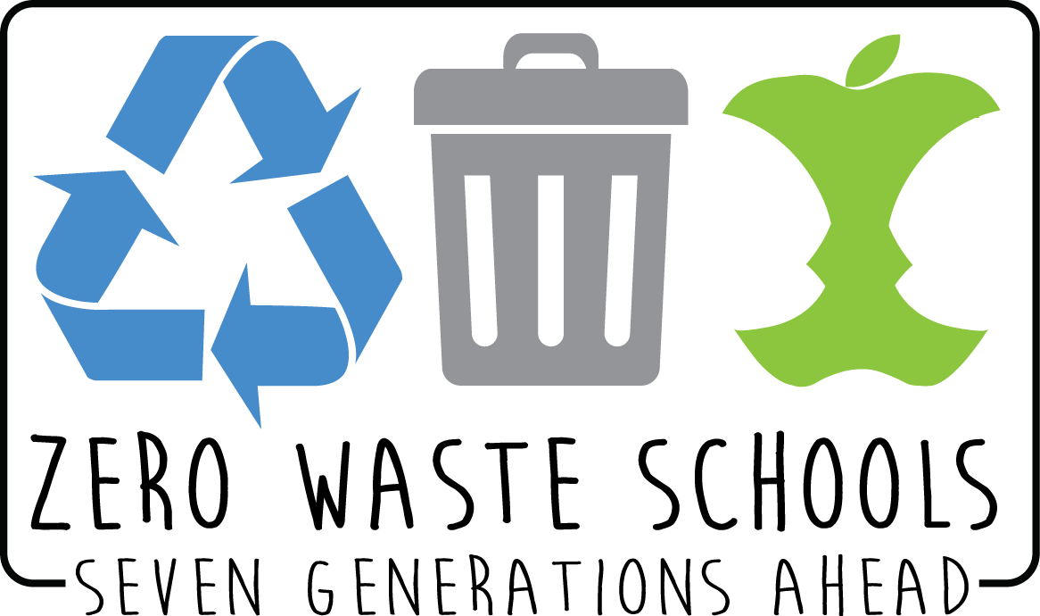
Jen Nelson
Seven Generations Ahead, Senior Program Manager
Illinois Food Scrap Coalition, Board Member and Education Committee Chair
Illinois Wasted Food Solutions Task Force, Member
jennifer@sevengenerationsahead.org
Illinois Update
Residential Food Scrap Composting
Notes:
BIO: Jen Nelson works for Seven Generations Ahead as their zero waste program expert. Jen works with communities, institutions, businesses, schools, events and residents to develop sustainability goals and to take those goals from idea to action. This includes strategic planning, analysis, outreach, education and more. She is a founding board member of the Illinois Food Scrap Coalition, working to advance food scrap composting through policy and infrastructure change. And Jen is a member of the Illinois Wasted Food Solutions Task Force.
Hello and welcome. Thank you for joining us today. Seven Generations Ahead is a 17-year-old nonprofit serving Chicago and the region. Our mission is to promote the development of healthy and sustainable communities. For almost 2 decades, SGA has been supporting schools, institutions, businesses and municipalities in reducing waste as well as supporting the collaboration of multiple partners to lead Illinois to maximize food waste reduction, recovery and composting. Much of our recent work in this arena is thanks to multiple years of funding for our project Building Illinois’ Local Food Shed Through Advancing Food Scrap Composting. We currently have grant funding to support institutions, counties and municipalities in assessing their waste reduction opportunities related to composting food scraps. The project’s long-term goal is to expand local, sustainable Illinois food production through development of a viable food scrap composting industry. The project is working to create demand for food scrap composting through education, policy and pilot projects, while driving infrastructure development and targeted investments.
This presentation is one of a series being done to share information to reduce food waste and encourage food donation and composting of food scraps across multiple sectors.

Slide 21
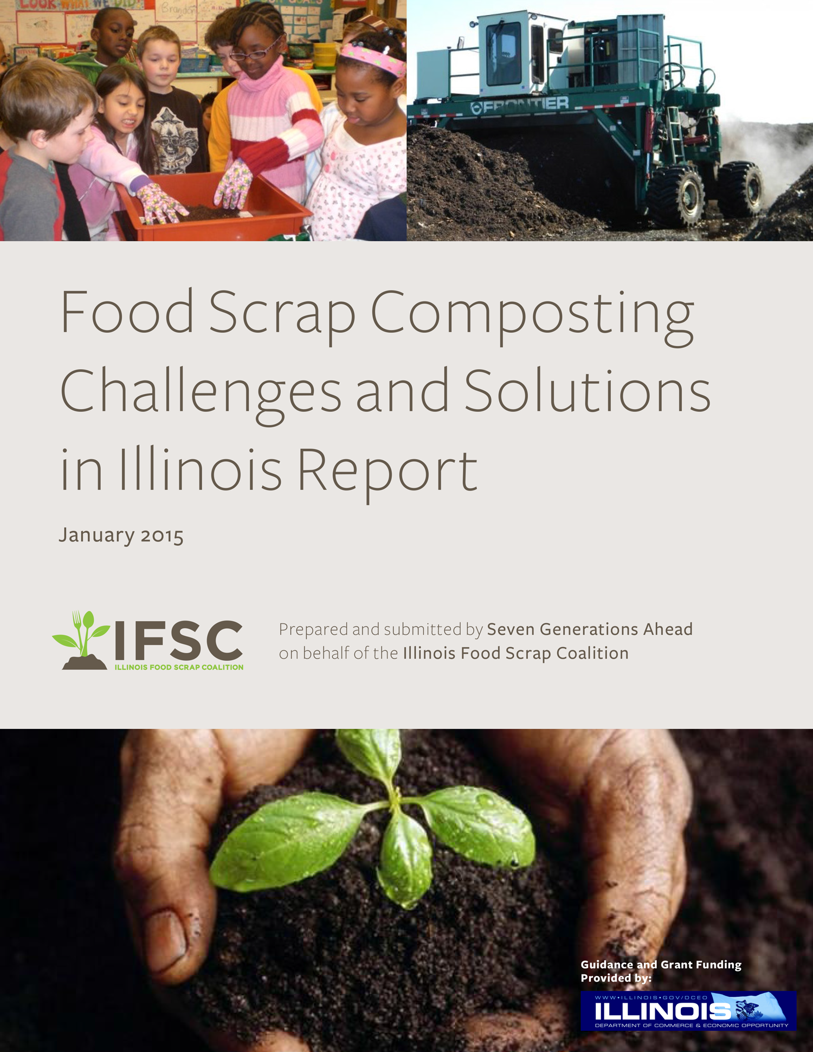
Outline
Food Scrap Composting in Illinois
Municipal Options
Planning and Partners
Education and Engagement
Municipal Use of Compost
Municipal Guide to Residential Food Scrap Composting
www.sevengenerationsahead.org
Notes:
I will provide a brief summary of where we are with food scrap composting infrastructure in Illinois, as well as the potential economic benefits were we to increase composting. To learn details about either of these, there are two reports which have been released and are available on our website. www.sevengenerationsahead.org
Food Scrap Composting Challenges and Solutions in Illinois Report is from 2015 and gives an overview of composting across the country and in Illinois and examines our local challenges and potential solutions. Read the Executive Summary for the Food Scrap Composting Challenges and Solutions in Illinois Report. Or read the report in it's entirety... IFSC Food Scrap Report 2015.
In December of 2016, an economic impact and market study report was conducted. The results and recommendations can be found here: ECONOMIC IMPACT AND MARKET STUDY REPORT: ELEMENTS OF THE CASE FOR ADVANCING FOOD SCRAP COMPOSTING INDUSTRY AND THE LINK TO BUILDING ILLINOIS’ LOCAL FOOD ECONOMY

Slide 22
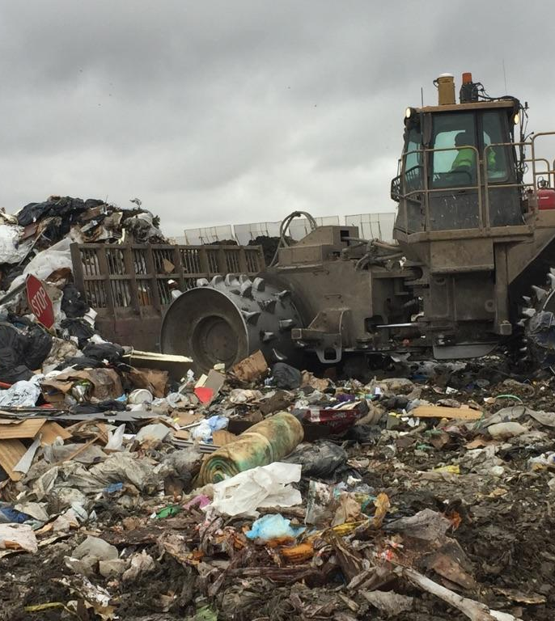
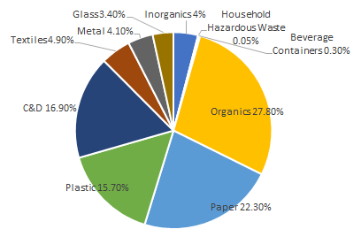
Illinois Waste Management
14 million tons of waste landfilled annually
3.4 million tons of compostable organics
nearly 20% of what is landfilled is food scraps
Of all compostable organics generated, only 15% were composted
59% of all yardwaste
only 1% food waste
Illinois landfill life expectancy is 20 years
2015 Illinois Commodity/ Waste Generation
and Characterization Study Update
Notes:
As the population grows and generates more solid waste our landfill capacity is rapidly decreasing. Landfill life expectancy in Illinois is approximately 20 years, at 2017 disposal rates, barring capacity adjustments, until capacity is depleted state-wide. For the region around the Chicago Metro area, this life expectancy is as low as 11 years. Reducing, recycling and composting waste is critical to help avoid the need for the development of more landfills and solid waste facilities. Taking the right steps now will help increase economic development and provide a healthier and safer environment and to engage students in sustainability education and operations.
I want to paint a picture of how Illinois is currently managing waste disposal and food scrap composting to set the stage for our discussion.
LANDFILL DATA
Illinois landfills 14 million tons of waste annually, and nearly 20% of that is food scraps
Compostable organics comprised 25% (by weight) of what was landfilled (4% paper, 3% yard waste, and 18% food scraps) - this is 3.4 million tons of compostable organics
Of all compostable organics generated, only 15% were composted (59% yard, and only 1% food)
On the bright side, Illinois has already established the building blocks for successful food scrap composting programs. Chiefly, Illinois has existing yard waste composting infrastructure and is home to 50 compost facilities, over a dozen of which accept food scraps in addition to yard waste. While Illinois has no mandates that enforce waste diversion targets or ban food scraps from landfills, the state does require composting of yard waste but not food scraps.

Slide 23
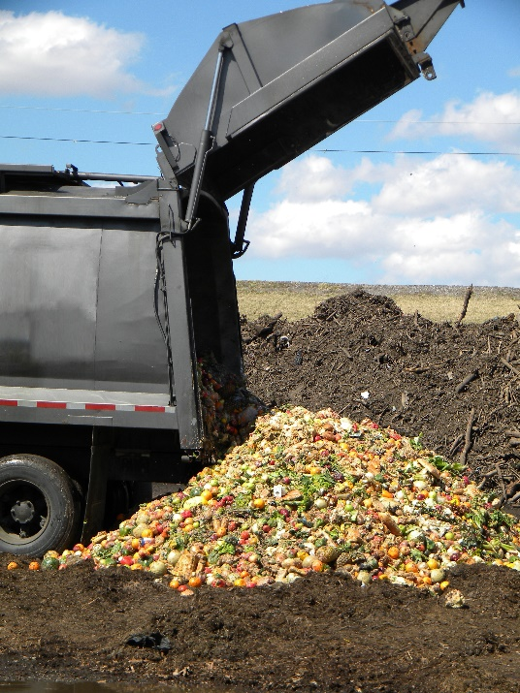
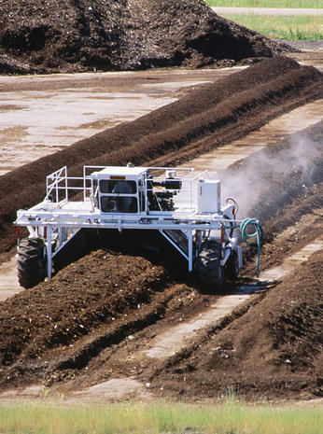
Commercial Food Scrap Composting
1. Sort food scraps
2. Haul to a compost facility
3. Food scraps decompose
4. Finished compost sold
Notes:
Composting is the natural process that converts organic material into nutrient-rich soil. Composting allows our post consumer food to shift from waste to a vital resource for soil. Although many municipalities across the nation have begun composting organic material, there is still a ways to go until it is mainstream. Whether you want to be a front runner in Illinois’ shift to composting or follow a plan already proven to be successful in other areas, this guide will help you uncover a strategy best for your municipality. Across the nation, composting is developing as a viable, locally-based industry that achieves multiple objectives related to economic development, job creation, cost savings, and environmental sustainability.
So what has changed in Illinois that led to the rapid development of municipal food scrap composting programs? Policy and infrastructure growth has been coupled with an increasing demand for this service.
So what is commercial food scrap composting?
With commercial composting, all food scraps and food-soiled paper is collected (this includes meat, dairy, bones, greasy pizza boxes, etc).
Then it’s hauled to a composting facility where the food scraps decompose and finished compost is sold commercially.
Since ALL food scraps can be collected with commercial composting, this type of composting generally results in a much greater waste diversion than on-site composting. And it is easier for people to sort and for institutions to have systems that collect food scraps with very little contamination.

Slide 24
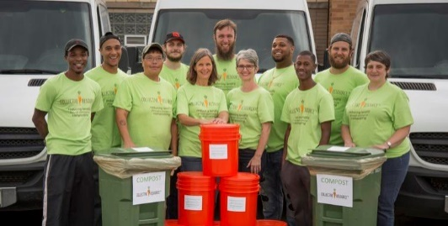
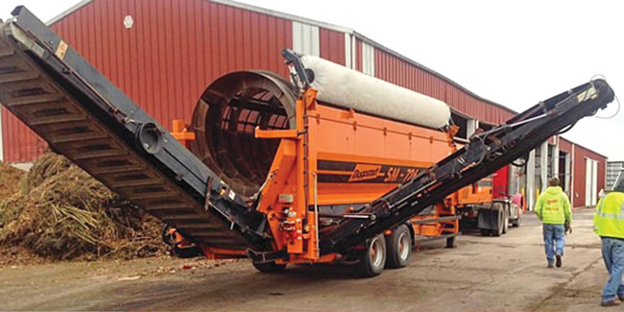
Projected Benefits in Illinois
If Illinois were to divert 65%, annually this will create:
JOBS
On a per-ton basis, composting in Illinois employs 5 times more workers than landfilling.
3,185 new jobs paying an average salary of $50k
New industries: opportunities for in-state manufacturing, urban food scrap processors and rural compost spreaders.
ECONOMY
$290 million in economic output for the state
$10.5 million in local and state tax revenue
ENVIRONMENT
Over 2 million tons of diversion away from landfills
Over 800k MTCO2e in GHG emissions reduction
Notes:
I would like to turn to the argument for why Illinois should increase food scrap collection and composting. This slide shows the projected economic and environmental benefits if Illinois were to achieve the moderate food scraps diversion goal of 65% (so to go from 1% diversion to 65% diversion)
JOBS
Job creation is occurring from new industries as well new jobs at existing businesses. The images show employees of IFSC partners Collective Resource and Compost Supply. On a per-ton basis, composting in Illinois (and across the country) employs 5 times more workers than landfilling. And, For every 12,250 tons of organics processed, 1 new business will be created and will sustain 18.3 employees annually with an average salary of $50k
ECONOMY
As of 2015, the compost sector (including all compostable organics) added $35 million in value to the Illinois state economy. The model projects that pursuing food scrap composting programs has significant impacts on tax revenues:
• On the local and state level, total tax revenues increased by a range of $3 million - $13.6 million for the different diversion scenarios.
These increased tax collections are not game-changers as far as total government revenues, but they do represent opportunities to recirculate tax money back into the industries from which it was generated and bolster market development through the funding of grant programs.
ENVIRONMENT
With 65% of organics (over 2 million tons) being diverted from landfills for composting, Illinois would see over 800k MTCO2e in GHG emissions reduction.

Slide 25
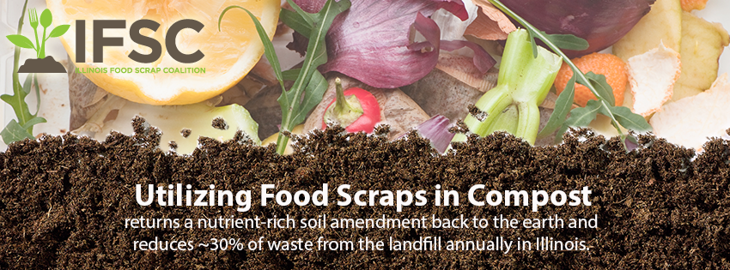
www.illinoiscomposts.org
Notes:
The Illinois Food Scrap Coalition is a coalition of community and government organizations, businesses, schools, institutions, service providers and processors throughout the state that are dedicated to advancing food scrap composting in Illinois. IFSC is also the Illinois Composting Committee of the US Composting Council.
We Compost is a free recognition program through the IFSC that supports Illinois municipalities, restaurants, institutions, businesses, and schools that are doing commercial food scrap composting. We Compost works to share best practices and promote these businesses.
www.illinoiscomposts.org

Slide 26
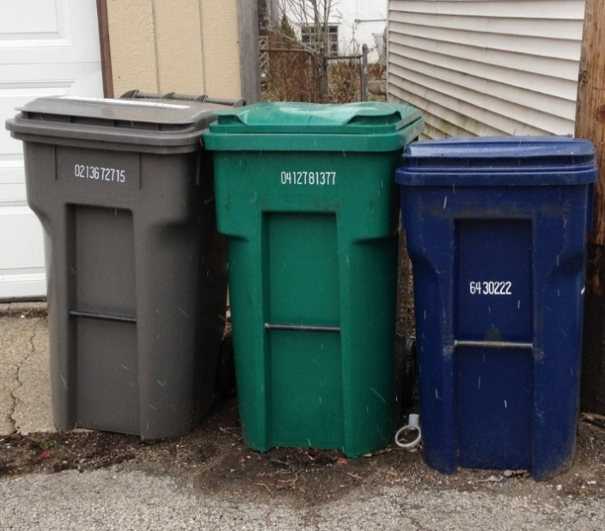
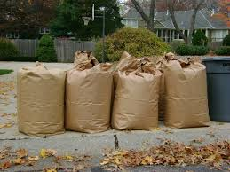
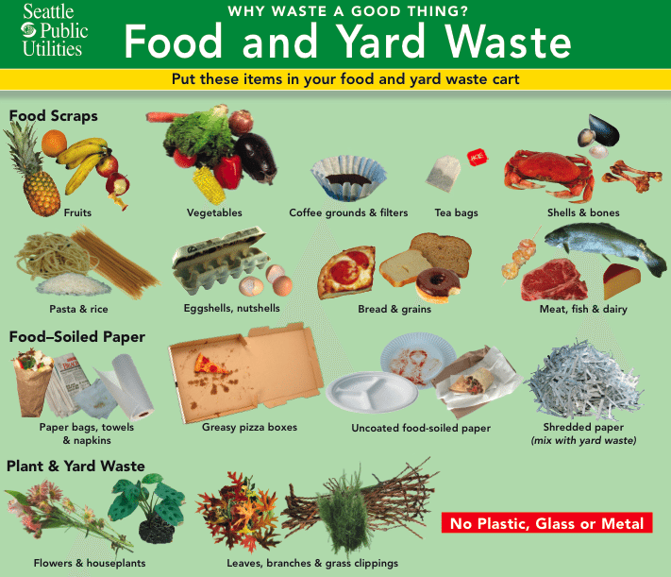
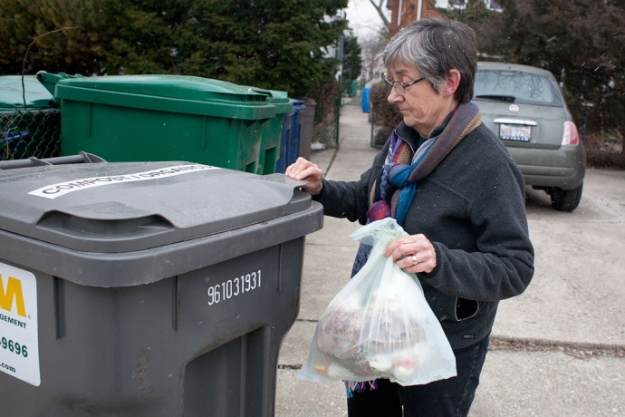
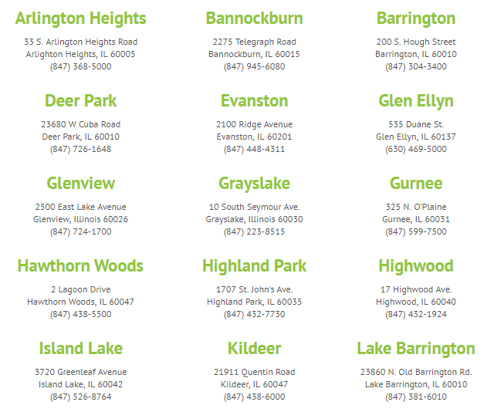
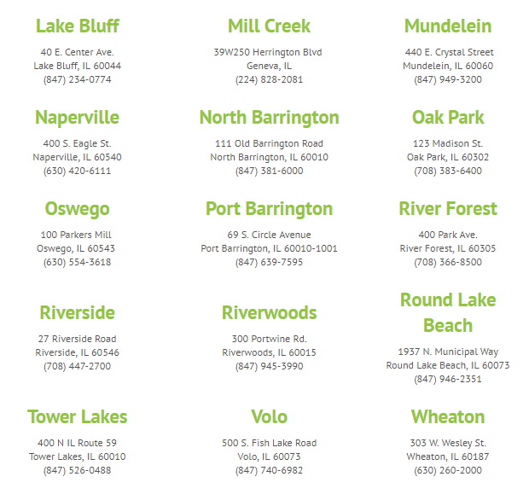
Illinois Municipalities with Residential
Food Scrap Composting
Notes:
These 30 municipalities are recognized as We Compost partners for providing residential food scrap composting. For some, this may include a 3rd bin to accompany landfill and recycling. For others it may be a program through which food scraps ride along with yardwaste during the yard waste season.

Slide 27
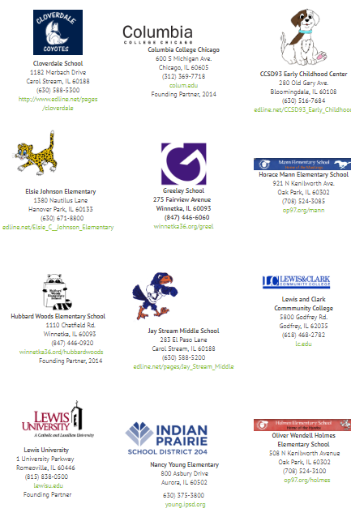
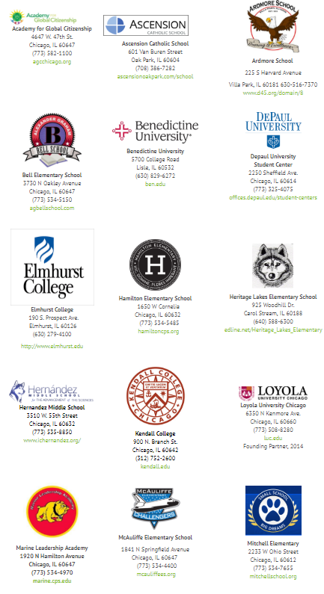
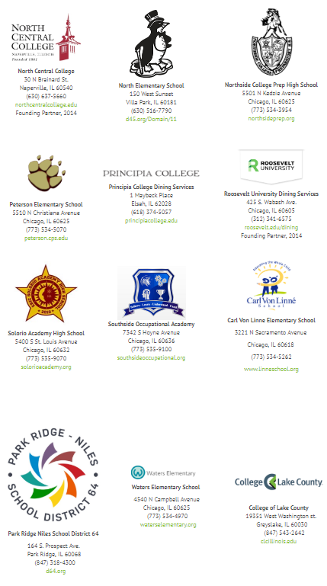
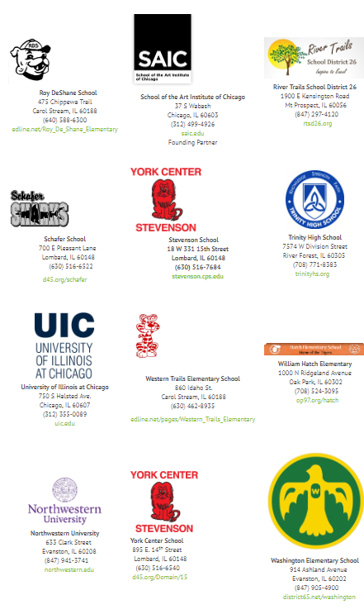
Illinois Schools and Universities
Food Scrap Composting
Silver
Gold
Notes:
The following schools and universities are recognized as We Compost Gold and Silver partners.
Gold partners are those able to compost food scraps throughout their operations - front of house and back of house
Silver partners are those with a program focusing on composting only part of the food scraps - often this may be kitchen rather than cafeteria, or an institution taking a scaled approach to composting.
This list represents only those Illinois schools and universities that have applied for recognition through the IFSC We Compost program. There are many others out there that could be added to this list.

Slide 28
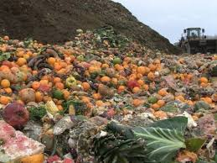
Food Scrap Composting
in Illinois
50 IEPA permitted compost processors
12-14 of these accept food scraps
187 We Compost partners
restaurants, institutions, businesses, schools and municipalities compost food scraps
30 Municipal food scrap programs
State policies enacted to support hauling and processing of food scraps
Notes:
6 years ago most “experts” in Illinois said we would not have residential composting – that it was just a “West Coast thing”. Things have changed significantly since then impacting both infrastructure and policy that allow for cost effective food scrap composting.
1990
Landscape waste was banned from landfills in Illinois in 1990. There are many landscape waste composting facilities and jobs in Illinois as a result of this effort. Currently there are:
50 IEPA permitted compost processing facilities, over a dozen accept food scraps http://epa.illinois.gov/topics/waste-management/permitted-facilities/compost-facilities/index
2009 - permit requirements for Commercial Food Scrap Composting were lowered in 2009, making this type of business more accessible for Illinois.
2015 - HB437 was passed to allow for temporary and permanent sites to collect organics for composting.
187 We Compost Partners
41 businesses
11 grocery stores & farmers
9 institutions
30 municipalities
45 restaurants & caterers
51 universities & schools
Illinois currently has 30 municipal residential food scrap composting programs, the 4th largest number in country.

Slide 29
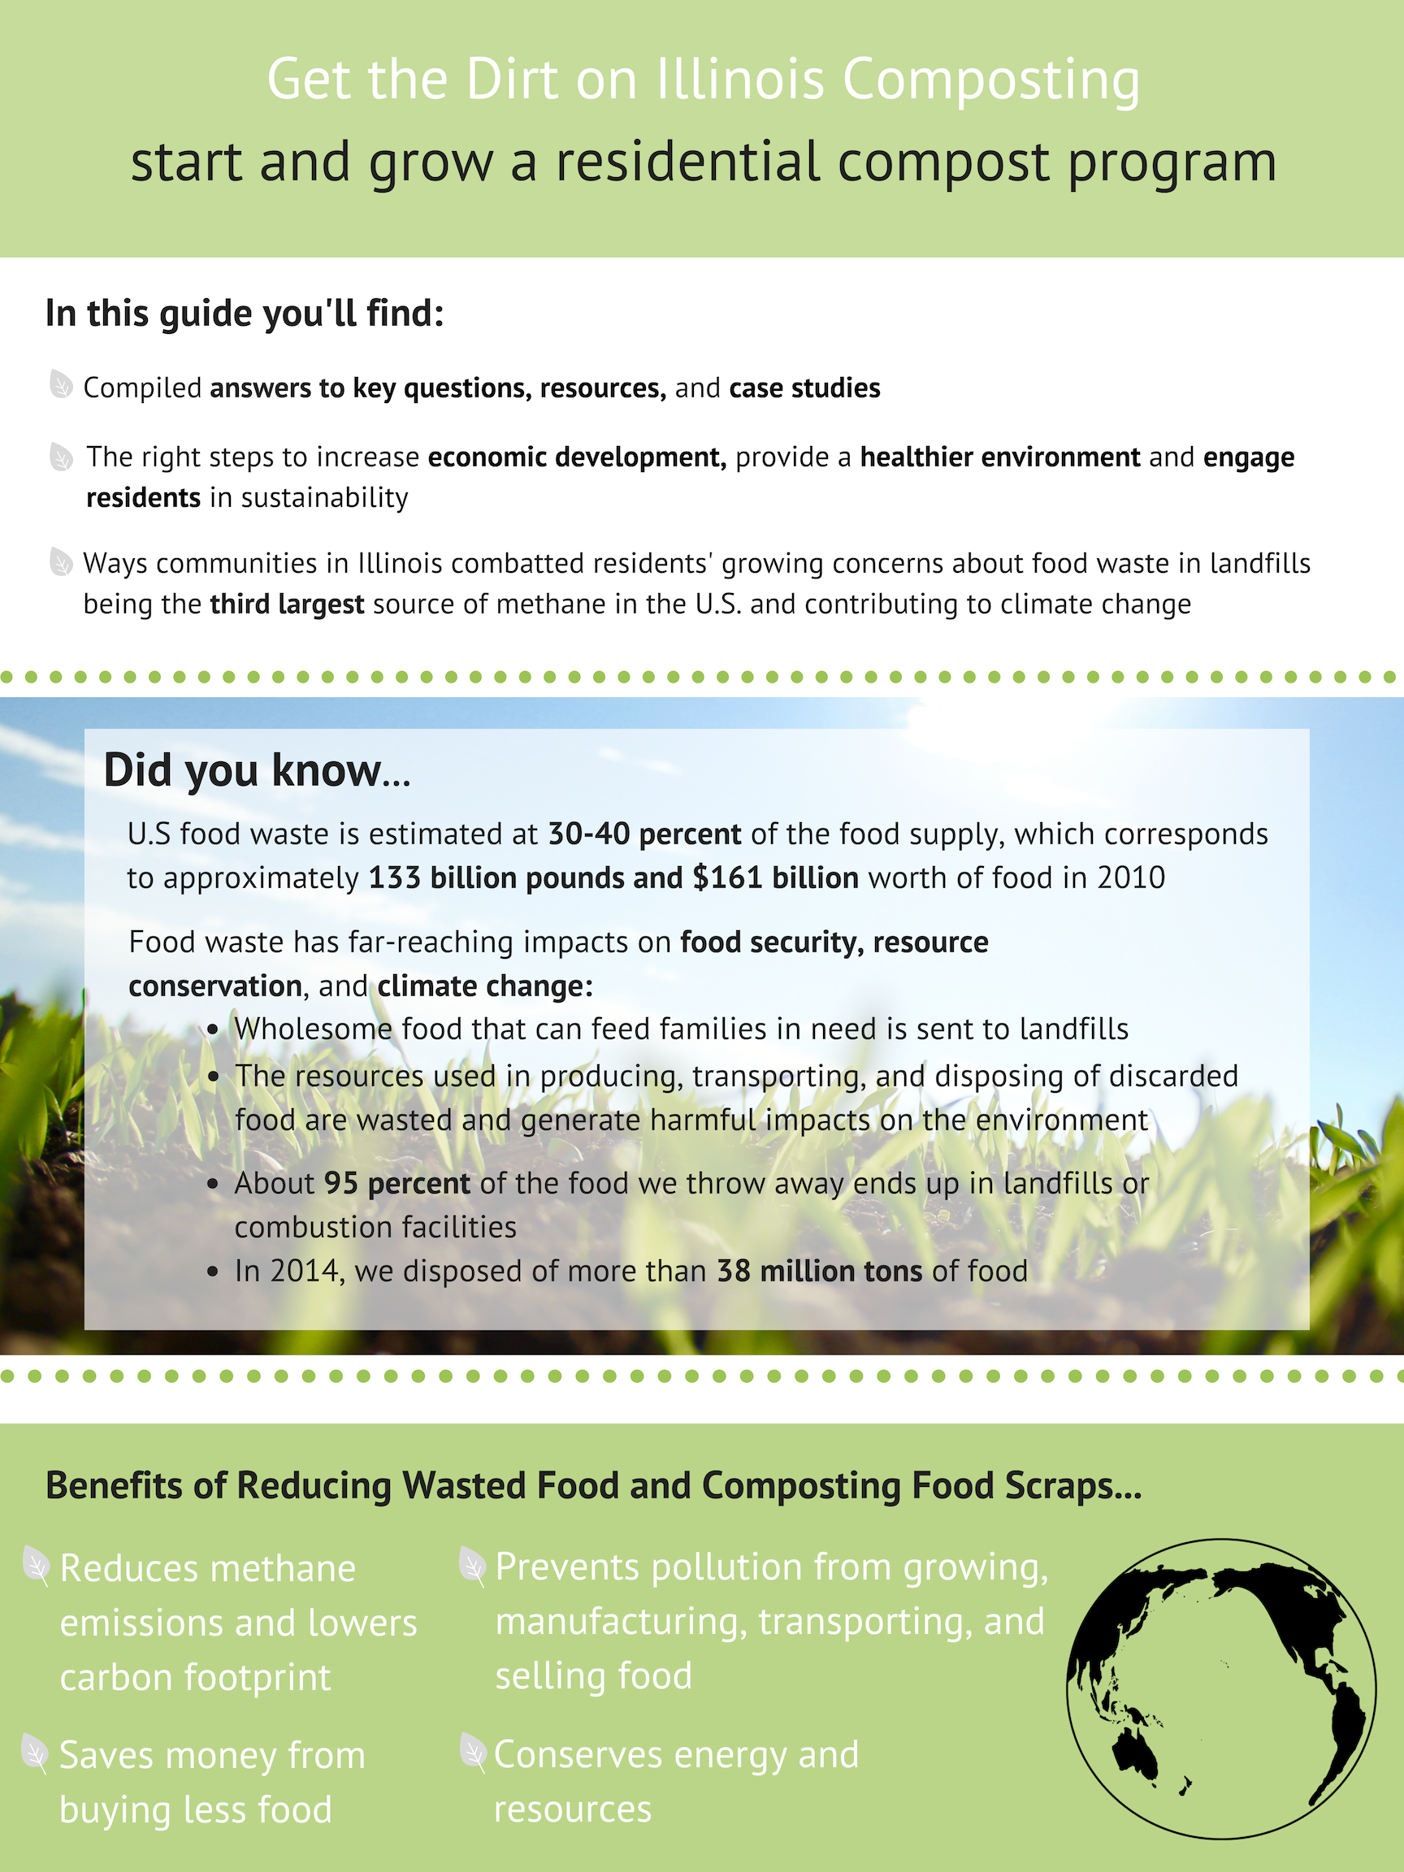
Illinois Municipal Guide to Residential
Food Scrap Composting
Get the Dirt on Illinois Composting
start and grow a residential compost program

Slide 30
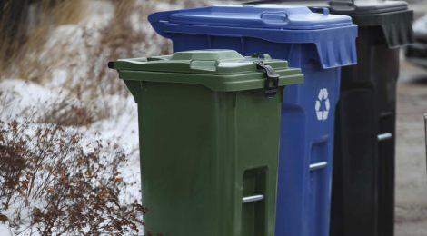
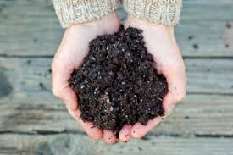
Municipal Guide Topics
Municipal composting options
Steps to take: planning and engagement
Is your municipality ready?
Partners and programs
Education and engagement
Potential challenges and solutions
Compost procurement
Benefits to composting
Best Practices: Illinois case studies
Notes:
In order to support municipalities considering food scrap composting programs, we are collaborating with the IFSC, SWALCO, SWANCC and others to develop a Municipal Guide to Commercial Food Scrap Composting. A Municipal Guide is in development to document and share strategies and resources to encourage municipal food scrap composting
Steps to Take: Planning and Engagement Is Your Municipality Ready? Composting programs vary from community to community and are impacted by the available infrastructure. Urban, suburban and rural settings offer different infrastructure and economics. Overview of existing state, county and local policy.
Partners and Programs: Contract language and partner collaboration; Education and Engagement: communication strategy, best practices, sample communication pieces Potential challenges and solutions: case studies and solutions related to resident engagement and the “yuck factor”, contamination and cost
Compost Procurement: Compost procurement guide
Best Practices: Illinois case studies comprehensive survey of existing Illinois municipal programs
This guide is being shared today as well as with a broader group of municipalities seeking input into its effectiveness.

Slide 31
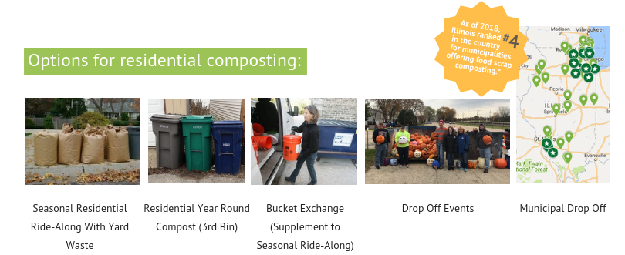
Municipal Food Scrap Options
Collection of food scraps (compostable food-soiled paper, compostable serviceware and other organic wastes) sometimes through adding these to an existing yard waste collection program
Notes:
Seasonal Residential Ride-Along With Yard Waste Bucket Exchange (supplement to seasonal ride-along) Residential Year Round Compost (3rd Bin) Municipal Drop-Off Drop-Off Events
The majority of Illinois municipal residential programs are what can be called seasonal ride-along programs. This means that food scraps ride along with yardwaste.
Seasonal Residential Ride-Along With Yard Waste Description: This program allows residents to include compostable material in their existing yard waste container, which is picked up between April and November. Pros: Residents add food scraps to their yard waste without having to add any bins; No route changes made for haulers Cons: Only seasonal; Increased contamination potential; If there is no financial incentive, more education will be needed for residents; Critters and smell Example: Supplement to Ride Along for Winter Months Description: Businesses that provide door-to-door pickup of food scraps during the period it is not available with yard waste. These scraps are then taken to a commercial compost site. Pros: Easy for residents to participate Picked up weekly or biweekly Clean bucket is provided with each pick up Includes multi-unit buildings, restaurants and commercial businesses Cons: Increased contamination potential If there is no financial incentive, more education will be needed for residents Critters and smell Example: Residential Year Round Compost (3rd Bin) Description: A curbside yard waste ride-along pick up is when landscape waste is collected with the city’s weekly collection program. Homeowner’s dispose of their yard waste in a clearly labeled bag or bucket each week similar to their recycled and landfill waste. Since organic materials are already being picked up by haulers, a seamless transition into adding food scraps to these bins can result in efficient and sustainable disposal of organic material. Pros: Easy for residents because they simply put their waste outside similar to their current system of disposal Reduce Landfill Pickup Frequency Raise awareness of trash/ more education Year-round pickup Cons: Increased contamination potential Critters and smell If there is no financial incentive, more education will be needed for residents (https://www.opb.org/news/blog/ecotrope/the-pros-and-cons-of-curbside-composting-in-portland/) Collaborate closely with haulers to establish a compost pickup schedule that complements existing collection schedules, which may be more difficult to establish since it requires greater intervention on behalf of the hauler in organizing their trucks, pickup schedules, and compost facility drop-offs. Example: Municipal Drop-Off Description: This program requires a drop-off site where residents bring their food scraps. There are many different options for these sites like street corners or public spaces. This drop off can also be a one-day event or on a regular basis. Pros: Provide an opportunity for education about the importance of food scrap composting Decreases contamination Coordinating a select number of drop-off locations may be easier to coordinate with local haulers Year-round composting Many local sites accept compost drop-offs Cons: Inconvenient for residents Low participation rate Example:
BENEFITS
There are reduced costs for having food scraps ride along with yard waste: - The hauler can use the same truck that already has a route to haul yard waste. - Organic materials go to the same processing facility so there are reduced transportation costs and impacts.
CHALLENGES:
- Yard waste services are often not year round so residents either stop composting in the winter or there is a need for additional infrastructure and cost to continue the program.
- Not all compost processing facilities accept food scraps.
- Not all compost processing facilities operate year round

Slide 32
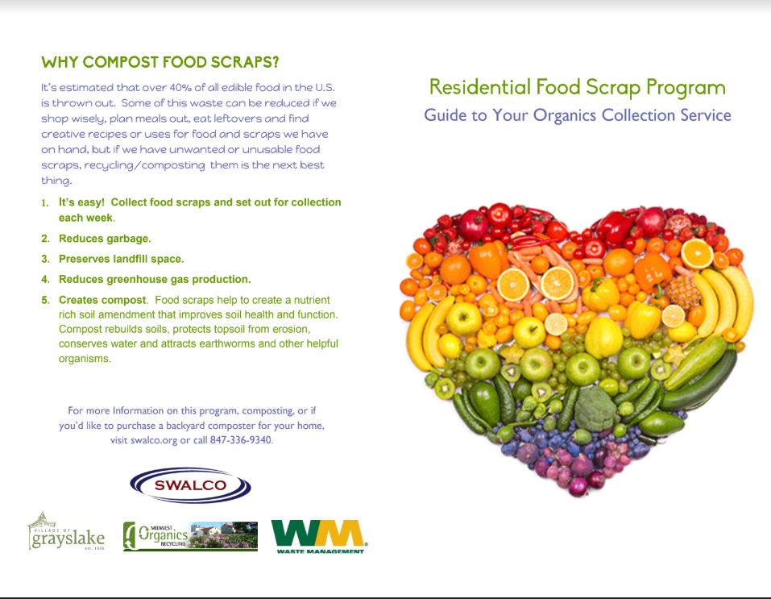
Education and Engagement

Slide 33
Notes:
Reducing food waste and composting are ways to build community empowerment, resilience, workforce skills, and address pressing food desert challenges. Almost half the typical garbage set out at the curb each week in the city consists of food waste and other organic materials that could either be rescued to feed people or converted into compost, a valuable soil amendment.

Slide 34
Municipal Opportunities
Municipalities can play a key role:
reducing food waste
recovering/donating food to feed hungry neighbors
recycling/composting food scraps
procuring compost for stormwater management; construction, municipal landscape projects
educating community members about reducing food waste
Notes:
RESOURCES: State collaborations supporting food waste reduction, donation and composting: Illinois Food Scrap Coalition, Illinois Wasted Food Solutions Task Force, Fresh Taste, IL EPA, etc Municipal role – review hauler contract to determine if ride along program is available; future hauler RFPs to include quote for organics/composting service Municipal role - identify opportunity for municipal drop off program for food scraps (permanent or temporary) Municipal role - develop and support resident education and engagement campaign Municipal role – Incorporate BMPs from USEPA on stormwater management
Learn from other municipalities Identify key partners What do your residents want? What do your institutions and businesses want? Look at your hauler contract and those of your municipalities What are the costs and benefits?

Slide 35
Next Steps
Assess options for residential compost program:
Review hauler contract to determine if ride along program is available
Future hauler RFPs to include quote for organics/composting service
Identify opportunity for municipal drop off program for food scraps (permanent or temporary)
Develop and support resident education and engagement campaign
Incorporate BMPs from USEPA on stormwater management
Notes:
RESOURCES: State collaborations supporting food waste reduction, donation and composting: Illinois Food Scrap Coalition, Illinois Wasted Food Solutions Task Force, Fresh Taste, IL EPA, etc

Slide 36
Possible Municipal Ordinances and Practices
Create a waste reduction policy or goal for city government (procurement, energy, waste diversion, recycling, composting)
Create a food donation policy for city government cafeterias, events, conferences
Provide incentives to businesses that donate leftover food
Conduct a waste audit of any local government institutions to identify opportunities to reduce, donate, recycle and compost
Notes:
RESOURCES: State collaborations supporting food waste reduction, donation and composting: Illinois Food Scrap Coalition, Illinois Wasted Food Solutions Task Force, Fresh Taste, IL EPA, etc

Slide 37
Thank You!
Jennifer Nelson
Senior Program Manager, Seven Generations Ahead
jennifer@sevengenerationsahead.org
Founding Board Member, Illinois Food Scrap Coalition
Founding Member, Illinois Wasted Food Solutions Task Force
Notes:
RESOURCES: State collaborations supporting food waste reduction, donation and composting: Illinois Food Scrap Coalition, Illinois Wasted Food Solutions Task Force, Fresh Taste, IL EPA, etc

Slide 38
Curbside Composting Pick-Up in Geneva
Kevin Burns, Mayor
Rich Babica, Director of Public Works
Josh McConnell, LakeShore Recycling Systems
rbabica@geneva.il.us

Slide 40
add content here

Slide 42
Walter Willis Solid Waste Agency of Lake County, Executive Director
Illinois Food Scrap Coalition, Board Member
Illinois Wasted Food Solutions Task Force, Member
wwillis@swalco.org
Food Scrap Composting in Lake County

Slide 43
Food Scrap Collection Programs in Lake County, IL
Metropolitan Mayors Caucus, Env. Committee, December 17, 2018

Slide 44
Lake County SWMP
60% recycling goal by 2020, organics diversion is essential to reaching goal
Encourages residential collection programs
Evaluate need for infrastructure

Slide 45
Food Scrap Collection Options
Landscape Waste/Food Scrap Ride Along
(8 Month Subscription or sticker)
Residents with this program may mix food scraps with landscape waste by placing food scraps along with the landscape waste and “ride along” thereby reducing costs to participate in food scrap diversion and introducing residents to food scrap diversion with the long term goal of having year round programs.

Slide 46
Food Scrap Collection Options
Year round organics collection as part of base service
In 2017, residents in Highwood and Lake Bluff became the first residents in the State with year round organics collection in a third cart, as part of the base service. This is not an opt in program, all residents are charged for the service and were provided a container to participate in Highwood.

Slide 47
Food Scrap Collection Options
Year round organics collection as part of base service
Highwood Program Specifics:
Program began May 1, 2017 and includes a 35 gallon cart for landscape waste and food scraps. Additional cost is $3.90/hh/month, total cost for all materials/waste is $22.40/month
Negotiated to reduce cost by $1/hh/month by moving all residents to a 65 gallon refuse cart instead of a 95 gallon cart, limited program
Key selling point was each resident would have 35 gallons of capacity for yardwaste and food scraps, many residents bought stickers for yardwaste at $2.50 per sticker, that cost is now reduced or eliminated

Slide 48
Food Scrap Collection Options
Year round organics collection as part of base service
Lake Bluff Program Specifics:
Historically had year round landscape waste collection, added ride along to it, total cost for collection is $18.45/month, actually lower costs under new contract. First such program in IL, began in March 2017.
Owns the compost site where material will be taken, cost for site not included in monthly bill to resident
No cart provided, residents must use own containers/Kraft bags

Slide 49
Food Scrap Collection Options
Recycling Center Food Scraps Drop-Off Service
Starting May 1st, 2016 the Village of Grayslake’s Public Drop Off Recycling Center begin accepting food scraps, the first such year round drop off in the State. This is a FREE service to residents of Lake County.
A second drop off for food scraps is provided by Prairieland Disposal at its office located in Lake Barrington.
Village of Gurnee added a drop off in its latest contract extension, will open in 2019.

Slide 50
Negotiating Food Scrap Collection Into Your Hauling Contract
The municipal decision to re-negotiate an extension or go out to bid provides key leverage to add food scrap programming, THIS IS YOUR CHANCE TO UPGRADE THE SERVICES.
Each Lake County food scrap program has been the result of an extension or RFP
Many haulers are more willing to expand services (e.g., food scrap collection) in return for a contract extension.
Most haulers are still moving slowly into food scrap collection, but will respond if that is what their clients want
If going out to bid, add the food scrap options you want into the RFP, get quotes on several programs to provide options to your board.
Write options/costs into the contract that can be implemented later during the contract term
The “ride along” program is easiest program to implement and “sell” to the village board/city council due to its very low or no cost.
First step towards a year round program

Slide 51
Food Scrap Collection Expansion
2016
Village of Bannockburn
Village of Deer Park
Village of Grayslake
Village of Hawthorn Woods
City of Highland Park
Village of Island Lake
Village of Mundelein
Village of North Barrington (year round, appr. 150 homes)
Village of Port Barrington
Village of Riverwoods
Village of Tower Lakes
2017
City of Highwood (year round)
Village of Lake Bluff (year round)
Village of Volo
Fox Lake
2018
Gurnee
Kildeer
Lake Barrington
Round Lake Beach

Slide 52
Food Scrap Program Expansion
In 2018, Lake County Jail implements food scrap/recycling program, cut waste by over 50% and reduced costs.
The seven commercial franchises in Lake County all have food scrap pricing in the contracts. In 2018 hired Bright Beat to initiate food scrap programs in Highland Park and Grayslake, plan to expand to other towns in 2019.
Midwest Organics Recycling made a significant investment in expanding its site in 2017, the largest in Lake County.
Route density and reduced costs can be achieved when businesses, institutions and schools within a town begin food scrap diversion programs.

Slide 53
Food Scrap Program Expansion
Key factors to consider:
Need infrastructure to reduce costs (both landscape waste transfer stations and compost sites)
Local government must work to develop markets for compost through local use, market growth will prompt compost sites to invest and help grow organics diversion programs
Ride along can be done at no cost, depending on negotiations, the goal is for ride along programs to become year round
It takes one or two towns to begin a bigger movement
Hauler’s willingness to work with you is key
Education, Education, Education, this will be a long term effort to change behavior

Slide 54
Thank you! Questions?
For More Information Contact:
Walter Willis, wwillis@Swalco.org
(847) 377-4951

Slide 55
Katie Friedman Sustainability Fellow, Highland Park
Greenest Region Corps
Highland Park Composts!

Slide 56
Highland Park Composts!
Highland Park Composts! is an initiative of the City of Highland Park, SWALCO, and LRS to support the implementation of food scrap composting at select businesses.
Project began in November 2017
Inspired by program in Grayslake
Co-funded by SWALCO and Highland Park’s Sustainability Fund
$5,000 contract with Bright Beat

Slide 57
Business Selection
Needed to demonstrate community interest in the project
Strategic outreach to local businesses who are known to be leaders and examples for other restaurants and organizations in Highland Park
Phone calls to restaurant owners
Establish value of the program over the phone
Explain why Highland Park is involved
Explain why we want them
Optional to participate
No cost to the restaurant for waste audit and recommendation process
Optional to compost after process is over

Slide 58
Participants in Pilot Program
Bluegrass
Little Szechwan
La Casa de Isaac and Moishe
Michael’s Red Hots
Norton’s
Sunset Foods

Slide 59
Identifying Partners
Professional support throughout pilot program
Analysis of current waste generation at restaurants
Recommendations for best practices to increase diversion, gain recognition, and reap the benefits of composting
Waste Hauler
Competitive recycling and organics contracts previously negotiated with the city
Year-round residential composting in Highwood
Rates per tip: $10 per 96g cart (3 or less) / $8 per cart (4 or more)
Co-funding for the program
Free compostable Commit to Green bags for restaurants
Compost servicer and producer

Slide 60
Consultation and Recommendation
Consultation Process
Initial meeting with Bright Beat
Walk-through of operations and waste audit
Strategic ordering of follow-up meetings: most eager → most resistant
Recommendation Process
Increase and improve recycling practices
Introduce organics pick-up once a week
Option to introduce organics gradually
Decrease landfill pickup
GOAL: Achieve a recommendation which offers a net zero or a minimal cost increase

Slide 61
Summary of Recommendations
Decrease in Price
Little Szechwan = potential savings of $8 or potential additional expense of $35 or $77 per month
Norton’s = potential savings of $10 per month
Sunset Foods = potential savings of $220 per month
Increase in Price
Michael’s Red Hots = potential additional expense $60 per month
Bluegrass = potential additional expense of either $5 or $22 per month
La Casa de Isaac and Moishe = potential additional expense of either $35 or $77 per month
$
$

Slide 62
Materials Provided
IFSC Bilingual Restaurant Training Guide
3 11 x 17 laminated posters
Communications Cheat Sheet
Compostable Commit to Green bags (courtesy of SWALCO)

Slide 63
Successes
Bluegrass
Little Szechwan
La Casa de Isaac and Moishe

Slide 64
Logistical Concerns and Challenges
Restaurant
Space for additional bins, both inside and out
Cost of adding organics pickup
Training and Education of staff
Operational Logistics
Health and Sanitation
Adequately accounting for all waste generated
Contamination of waste by other restaurants or residents
Waste Hauler
Route density
Communication between business owner, landlord, and hauler
Know requirements and specifications of compost site
Municipality
Strategic outreach requires more staff time and effort
Finding support amongst elected body
Slow process
Coordinating meetings between waste haulers, busy restaurant owners, consultant, and city representative(s)
Cost of paying Bright Beat

Slide 65
Next Steps
Follow-up meeting with businesses not yet composting
Check-in meeting with businesses currently composting
Begin marketing and communications campaigns
Register restaurants with the Illinois Food Scrap Coalition
Training and education of restaurant staff where needed
Begin outreach for new restaurants

Slide 66
Mary Allen Solid Waste Agency of Northern Cook County
Recycling and Education Director
Illinois Food Scrap Coalition, Member
Illinois Wasted Food Solutions Task Force, Member
mary@swancc.org
Backyard Composting Ordinances
Notes:
Backyard composting is a way for residents to recycle select food and landscape organics that has a lower carbon footprint than transporting them to a commercial facility for processing. The first step is to have municipal guidelines. The second step is to promote those guidelines.

Slide 67
Update Municipal Ordinance Promote on Website
Evanston’s Website
Notes:
How many of you know whether there is an ordinance in your Village/City that stipulates guidelines for backyard composting?
Show SWANCC’s handout - being updated

Slide 68
Education and Training
Notes:
In spring of 2012, SWANCC staff built a four sectional compost system on the grounds of its Glenview Transfer Station and held workshops for two consecutive years during summer months. I worked with a Master Gardener and Composter to provide the education for about 200 residents and municipal staff.
Additionally, I developed a short video that can be posted on a community’s website and aired on cable access tv channels, as well as produced the Eco-Landscaping Guide that offers information about backyard composting and marinating yards without using traditional chemicals, and offer a selection of books, media and guides for loan.

Slide 69
Selecting a Compost Bin
Notes:
There are a wide-variety of outdoor bins for backyards. Research what would work best for your space.
Provide an incentive or subsidize the bin cost
SWALCO Bin Sales – Earth Machine
Skokie reimbursement of $25

Slide 70
Other Options to Consider
Establish a Drop Off
Municipal Building
Community Garden
Farmer’s Market
Vermi-Compost all year long indoors
Notes:
Be creative and look at other possibilities to collect residential/commercial food organics for composting.

Slide 71
Contact Information Mary S. Allen mary@swancc.org (847) 724-9205
swancc.org

Slide 72
Alyson Wright
AmeriCorp Sustainable Business Fellow
Greenest Region Corp
City of Evanston
alwright@cityofevanston.org
Save the Food

Slide 73
Storage guide with tips and tricks for storing anything from meat and fruits to spices and nuts
Recipes to bring new life into leftovers, food scraps, and overripe fruits and vegetables
Guest-Imator to buy the right amount of food for dinner parties
Ask Alexa for food-saving tips
Notes:
· buy the food you need and don’t waste it
· change behavior is important (should have been said by Julie earlier) and munis can help
· Toolkits and clever messages are ready to go
· Use in your municipal communications
Storage ex: Berries – do not wash until ready to eat and store strawberries on shelf in the fredge and leave green caps on (edible and good in a smoothie)
Guest ex:
Recipe ex: Sour milk into sour milk pancakes

Slide 75
Jordan Francisco
Sustainability Advisor
Greenest Region Corps
Village of Libertyville
Food Too Good to Waste

Slide 76
Food: Too Good To Waste
What is it?
FTGTW is a toolkit for community organizations to help educate the public on food waste.
Goals
Reduce food waste (constitutes 21% of waste stream, 2013)
Allow people to make smarter choices and save money
Promote sustainable practices that reduce our carbon footprint and conserve resources
What is included?
Activities for workshops
Studies and other information on food waste
Strategies for organization and implementation of food waste education
https://www.epa.gov/sustainable-management-food/food-too-good-waste-implementation-guide-and-toolkit

Slide 78
Food Recovery
Presentation for Metropolitan Mayors Caucus Environmental Committee
December 17, 2018
Jeannine Kannegiesser

Slide 79
About the Food Bank
Founded 1983, 2018 marked our 35th year of solving hunger in Northern Illinois
13 counties
More than half a million people
are served by the Food Bank every year
900+ pantries, soup kitchens & program sites
4 warehouses, including the newly opened South Suburban Center

Slide 80
How the Food Bank works

Slide 81
FY18 Results
Nearly 66 million meals distributed
More than 1.6 million meals to children
More than 529,000 meals to seniors
More than 2.1 million meals distributed via 433 mobile pantries
81% donated food
33.2 million pounds of food rescued
205,000 gallons of 1% milk
136,000 hours of donated time
25,000 unduplicated volunteers

Slide 82
79% of our meals distributed in Caucus Counties
FY2018 Results | Number of Agencies and Programs | Number of Mobile Pantry Distributions | Number of Meals FY2018 | % of overall Food Bank Distribution
DuPage | 158 | 57 | 13,881,955 | 23%
Kane | 139 | 55 | 9,398,016 | 16%
Kendall | 12 | 2 | 1,412,169 | 2%
Lake | 173 | 78 | 8,607,169 | 14%
McHenry | 60 | 50 | 4,528,482 | 8%
Will | 127 | 75 | 9,860,103 | 16%
Notes:
Will have county fact sheets and strategy sheets along to share

Slide 83
Northern Illinois Food Bank Strategic Goal
Mission: Lead the northern Illinois community in solving hunger by providing nutritious meals to those in need through innovative programs and partnerships.
Strategic goal: In 90% of the communities in our service area, provide enough meals to meet at least 75% of the meal gap – turn our service area “green.”
Last year, we distributed nearly 66 million meals. Our network of 900+ agencies and program sites serves 71,500 people each week.

Slide 84
FY14 PRAN vs FY18 PRAN
Stephenson
Winnebago
Boone
McHenry
Lake
Kane
Ogle
DuPage
DeKalb
Kendall
Will
Grundy
FY14 PRAN
FY18 PRAN
Kankakee

Slide 85
Our neighbors face tough choices
Compared with the national findings, households in Northern Illinois are particularly struggling to afford utilities, housing, and education.
Notes:
Our neighbors face tough choices – having access to free food assistance helps them to direct their limited resources towards other important needs. The Food Bank is committed to sustaining distribution in the green areas and increasing in the communities that are yellow, orange and red. County-specific strategies are developed each year with focus on the growth areas.

Slide 86
Retail Food Recovery
81% of the food we distribute is donated
350 stores donated more than 30 million pounds of food in FY18
Over 500,000 pounds donated each month

Slide 87
Why is food available to recover?
Farmers grow more than they can sell
Short-coding
Off-specification
Mislabeled
Stock rotation in stores
Overruns on packaging lines
Surplus to need
Not “perfect” enough for retail

Slide 88
Retail Food Recovery
Our Retail Food Sourcing team works closely with the stores to ensure they know what can be donated.

Slide 89
What do we do with it?
Our drivers pick it up - they made more than14,000 food recovery and donor pick-ups last year!
Direct Connect – Agencies pick up at stores on days when the Food Bank does not
Wholesome food is distributed through our network of food pantries, soup kitchens, shelters, on mobile pantries

Slide 90
We want to put food to its best use
We do this really well! Most of the food we recover feeds our hungry neighbors in northern Illinois
Some of the food we rescue gets turned into animal feed by partner organizations or goes to a wild animal sanctuary. In FY18, animals received 161,622 pounds from the Food Bank
Since 2015, the Food Bank has diverted food scraps to a commercial composting facility: Last year, we diverted 325,027 pounds of food scrap
Notes:
FY19 through 12/11/2018
Compost 280,230
Animal Feed 23,906

Slide 91
At the stores: rotating stock/saving good food

Slide 92
Loading up the truck with food

Slide 93
Sort…repack…distribute…

Slide 94
How much?
In 2018, the Food Bank recovered 33.2 million pounds of food from retail stores for distribution to our hungry neighbors.
This FYTD (July – November 2018), 15.3 million pounds of food has been recovered from retail.

Slide 95
Composting at Northern Illinois Food Bank

Slide 96
Leadership on Food Insecurity and Food Waste Reduction
Hunger Action Month Proclamations to inform and motivate action in your communities
Share food assistance resources with social service departments to share with clients
Some communities contribute financially through CDBG, county or city funds allocated to non-profits for support of LMI residents
DuPage County
Will County
Kane County
Lake County
City of Aurora
Elgin Township
North Chicago
Waukegan
Notes:
Coalitions for health: Kane Fit for Kids; FORWARD DuPage
When creating municipal food waste programs, encourage food donation of wholesome food – to food pantries, soup kitchens, shelters, etc. or the food bank – this is the best use of food and accomplishes waste reduction while more importantly feeding those in need

Slide 97
Leadership on Food Insecurity and Food Waste Reduction
Partner with social services organizations and coalitions and healthcare systems to Build Health Communities
Food Bank offers SNAP Outreach and application assistance in our counties – share where your community could use help
Collaborate with farmers who want to donate food or are interested in gleaning

Slide 98
Jeannine Kannegiesser
Development Officer
jkannegiesser@northernilfoodbank.org
630-443-6910 ext. 118

