Slide 1
Overview of Sierra Club’s Ready for 100 Campaign
Rebecca Judd
Clean Energy Advocate
Sierra Club Illinois
rebecca.judd@sierraclub.org
September 18, 2018

Slide 2
Clean Energy is Already Here and Happening in Illinois
According to the American Wind Energy Association, as of the end of 2016, Illinois had 48 utility-scale wind projects operating, producing over 4300 MW annually (ranking 6th nationally)
According to a September 2017 report, 120,000 Illinoisans working in clean energy as of 2016
Historic clean energy law, the Future Energy Jobs Act (FEJA), passed in Illinois in 2016
More utility-scale wind and solar projects already in the queue to be developed and more on the way
Significant on-site (rooftop) and community solar projects will be developed as these incentive programs open up early in 2019 and beyond!
Even more jobs and projects are coming!
Notes:
Act requires at least 4,300 megawatts of new solar and wind power—enough electricity to power millions of homes—to be built in Illinois by 20
SOLAR: Illinois currently has 100 MW of solar power
Under FEJA, additional 3000 MW of new solar power to be built = 4000% increase!
WIND: Illinois currently has ~4000 MW of wind power
Under FEJA, additional 1300 MW of new wind power to be built = 33% increase
(so more projects and jobs coming!)
4 of the 8 utility-scale projects we know info about:
Alta Farms Wind Project II, LLC – located near Clinton, IL (200 MW)
Broadlands Wind Farm, LLC – located near Broadlands, IL (200 MW)
Cardinal Point Wind Farm, LLC – located near Macomb, IL (150 MW)
Prairie State Solar Project, LLC – located in Perry County, IL (99 MW)

Slide 3
FEJA and its 25% statewide clean energy goal by 2025 is only the FIRST STEP…

Slide 4
…So how do we go even further? Let Local Communities Take the Lead!
Communities can organize at the local level to get their own cities to commit to 100% clean, equitable energy
We can then amplify these successes across the state to demonstrate 100% is not only possible but it’s happening now
We hope that cities moving to 100% will also inspire businesses, universities, places of business, and other institutions to go 100%
As more cities and institutions declare 100% clean energy, and more people take action to demand it, it will raise policymaker ambition at the state level to increase the statewide goals

Slide 5
Sierra Club RF100 Campaign - Mayoral Pledges
Mayors For 100% Clean Energy: Mayors from communities who have pledged their support for a vision toward a community-wide transition to 100% clean, renewable energy
Over 200 mayors have made this pledge, including several from IL: Evanston, Village of Montgomery, Village of Chicago Ridge, Park Forest, Urbana, Granite City, Alton, Edwardsville
Not an actionable goal or commitment with near-term steps to implement
Notes:
Also had a Lake County Climate Action Plan that asked local leaders, including mayors, county board members, county commissioners, General Assembly members to make a pledge to move Lake County beyond coal, embrace a 100% clean energy vision for their communities, and develop sustainable infrastructure and transportation initiatives:
Village of Deerfield
City of Zion
City of Highland Park
Village of Lake Bluff
City of North Chicago

Slide 6
vs. Actionable Commitments to
100% Renewable Energy
The Ready for 100 Campaign recognizes community commitments as places where a city’s leadership has established an actionable goal to transition the entire community to 100% clean, renewable energy
Commitment can be announced through a stand-alone Resolution or Proclamation, city ordinance, or integrated into a community's Climate Action Plan or Energy Action Plan
Community is committed to pursuing near-term steps to implement this goal

Slide 7
Core Elements of Commitment
When crafting a commitment to 100% renewable energy, the adopted goal should include the following core elements:
Community-wide Electricity Use: A full transition of the electricity sector to clean, renewable energy;
By 2035: A target year for when this commitment will be achieved no later than 2035 for electricity and 2050 for all energy sectors;
Ensure Justice, Equity, Affordability, and Access: Include measures that prioritize equity, affordability, and access for all members of the community, prioritizing low income communities, environmental justice communities and communities burdened by the fossil fuel industry;
Clean and Renewable Resources Only: Clear definition of clean and renewable resources that includes carbon- and pollution-free energy that is sustainably collected from renewable sources such as wind, solar, and geothermal; and
Transparent and Inclusive Planning and Implementation Process: A commitment to a transparent and inclusive process for planning and implementation, ensuring that all members of the community and local businesses have an opportunity to participate.
Notes:
Low-impact, small hydro and some forms of biomass may be included after being evaluated for sustainability and environmental justice implications. Nuclear, natural gas, coal, oil based, or any other forms of carbon-based energy should not be included.

Slide 8
Number of Commitments
To Date, 82 cities have made the commitment
6 of those cities have already hit their targets – Aspen, CO; Burlington, VT; Georgetown, TX; Greensburg, KS; Rockport, MO; and Kodiak Island, AK
9 counties in the U.S. have also committed to 100% renewable energy: Buncombe County, NC; Floyd County, VA; Multnomah County, OR; Orange County, NC; Pueblo County, CO; Summit County, UT; Summit County, CO; Taos County, NM; Whatcom County, WA
2 states have made the commitment – both Hawaii and California have committed to 100% renewable electricity by 2045
Notes:
Flag that Evanston has put out a draft commitment in their draft climate action and resiliency plan

Slide 9
Examples
Denver, CO: Good example of commitment in climate action plan
In July 2018, Denver released its new Climate Action Plan that commits to transitioning the city to 100% clean, renewable electricity by 2030. The Plan also incorporates strategies for land use and development, home and business efficiency upgrades, and mass transit planning to meet an additional 80% carbon reduction goal by 2050.
Minneapolis, MN: Good example of use of ordinance with an equity lens
In April 2018, Minneapolis became the largest city in the Midwest to date to commit to 100% clean and renewable electricity by 2030. The resolution also calls for a blueprint for how to reach this goal, including the public engagement that is necessary, updates to the city’s existing Climate Action Plan, and strategies for facilitating training and hiring from within communities of color and women, along with strategies for ensuring economic benefits for all consumer, income, and racial groups
Notes:
Concord, NH: Good example of use of ordinance with a focus on public process
On July 9, 2018, the Concord City Council voted unanimously to work toward 100% clean electricity by 2030 and 100% renewable energy for heating, cooling, and transportation by 2050. Concord’s resolution states that the Concord Energy and Environment Committee will lead preparation of a strategic plan to achieve the goals and create a stakeholder committee, with input from the broader community, to help shape the plan.

Slide 10
Pathway Options for Achieving a 100% Commitment
A community is powered with 100% renewable energy when the amount of energy generated from renewable energy sources in the community (or brought into it) equals or exceeds 100% of the annual energy consumed within the community – various options for how to achieve:
Increasing Energy Efficiency Programs
Incentivizing and Supporting Local Development of Distributed Renewable Generation (on-site) and Community Solar systems
Pursuing Municipal Aggregation
Incentivizing and Supporting Business and Corporate Commitments to Clean Energy Development & Procurement
Virtual Power Purchase Agreements
**Don’t need to have this all figured out when making the commitment – more important to have an inclusive, transparent implementation planning process that engages the public, reflects the needs of the individual community, and prioritizes equity, affordability, and access
Notes:
Energy efficiency reduces the electricity consumption for residents and businesses in the community, and as such is the lowest cost energy resource and should be the centerpiece of any plan to transition to 100% clean energy.

Slide 11
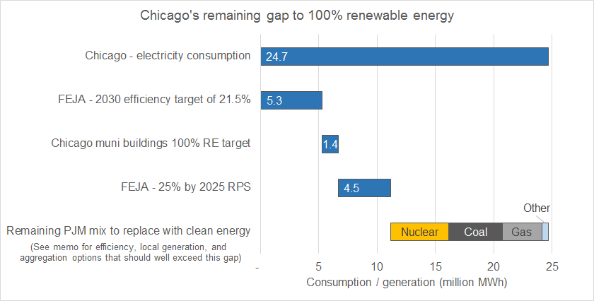
Example of How Chicago is Thinking about Commitment

Slide 12
How is Sierra Club Thinking about RF100 Commitments in Illinois?
Immediate focus is thinking about the 5 coal plant cities in Illinois: Chicago, Waukegan, Springfield, Peoria, and Alton/Metro East
These are the communities who have had to bear the disproportionate burden of coal plant pollution, so we want to make sure these communities have access to clean energy development and can benefit from the economic transition to clean energy jobs
However, we are also supporting communities and places who have done some of their own organizing around this issue and have shown some leadership and interest in exploring a commitment - e.g. Evanston, DuPage County, Aurora, Will County
Notes:
These cities have already done the work on organizing and bringing a diverse coalition of people to the table. And as we learn the lesson from these 5 cites, we’ll then be able to pivot to help support other places.
Evanston – draft plan includes achieving 100 percent renewable electricity for all Evanston properties by 2035
Will County - very recently approved a three-year municipal aggregation contract with Constellation Energy to supply the county’s load with 50 percent renewable energy

Slide 13
Lessons from other 100% Commitments:
Do your homework/Adapt to local circumstances: Each community has a unique mix of stakeholders, concerns, and opportunities/barriers to achieving 100% clean energy. What works in liberal Portland, OR may not in conservative Georgetown, TX.
Highlight relevant themes: In most communities, climate change is not a motivational rationale for a 100% goal. Emphasizing local benefits (such as cleaner air/reducing carbon pollution, boosting economic development and jobs), energy savings (such as lower utility bills/electricity rates), and values (such as economic justice) is more important.
Equity lens: For many cities, reforming energy policy surfaced longstanding concerns about economic and environmental justice, from disparate health effects of fossil fuel emissions and regressive green energy billing proposals, to interest in leveraging clean energy-related job growth in disadvantaged communities.
Work for the long haul: Process is central, not secondary, and as important as the policy details of a community’s 100% pledge. Taking the time to develop authentic (rather than transactional) partnerships with local stakeholder groups, soliciting community-wide input, and sharing local ownership of the initiative leads to durable coalitions that support the policy.

Slide 14
Any questions?
Check out 3 minute Video (from March 2018):
Check out our just released 2018 Case Studies Report
Check out our RF100 website
Contact Info:
Rebecca Judd
rebecca.judd@sierraclub.org
(312) 229-4691

