Slide 1
STAR Communities
Village of Park Forest, IL
Certified 3-STAR Community
April 2015

Slide 2
What is the STAR Community Rating System
The STAR Community Rating System is the first framework and certification for local sustainability, built by and for local governments. STAR provides a clear data-driven approach to assessing social, economic, and environmental progress.
Certification Levels | Points range
Certified 3-STAR Community Recognized for sustainability leadership | 250 – 449
Certified 4-STAR Community Recognized for national excellence | 450 – 649
Certified 5-STAR Community Recognized as top tier achiever in national sustainability | 650+

Slide 3
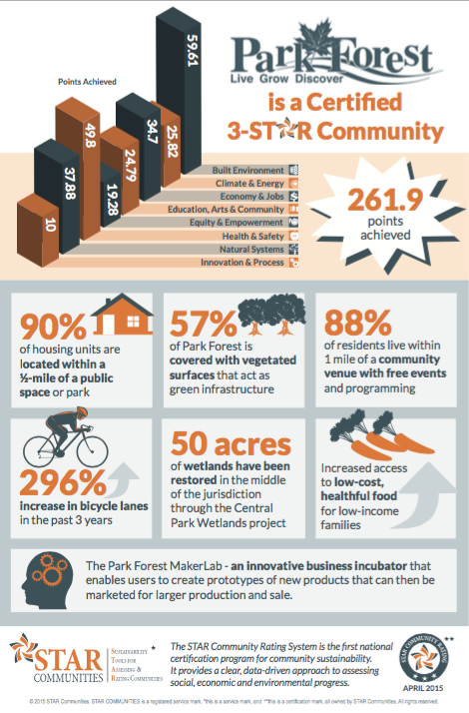
Park Forest STAR certification
The Village of Park Forest joined the STAR network as a Leadership Community in January 2014.
As a member of the Leadership Program, the Village worked towards certification with a cohort of other communities from across the country. On April 16, 2015, Park Forest received recognition as a 3-STAR Community.
Recertification is in progress- the final submission is due in April, 2019. The Village is working toward becoming a 4-STAR Community.

Slide 4
Reasons Park Forest Joined STAR
Align local plans and priorities with a national sustainability framework
Strengthen local metrics
Demonstrate a commitment to data-driven performance management
Increase transparency and accountability through public-facing reporting
Identify gaps and prioritize future investment
Gain competitive advantage and attract funding
Catalyze action in implementing solutions and best practices for sustainability
Communicate resilience and risk management to municipal bond agencies
Integrate health and equity into existing sustainability or environmental efforts
Build and brand a culture of local sustainability
Improve sustainability communication and education
Celebrate local progress and achieve national recognition

Slide 5
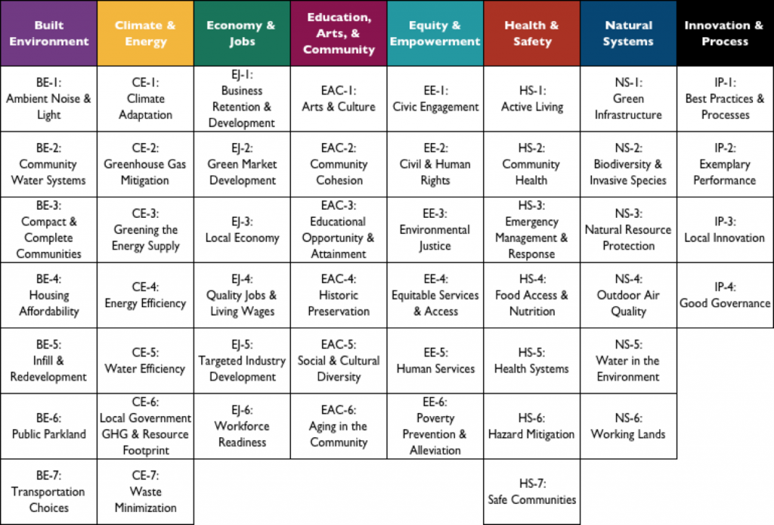
THE STAR COMMUNITY RATING SYSTEM Version 2.0 Released October 2016
Goal Areas & Objectives, helping local leaders set goals and measure progress across all areas.
Aging in the Community
Notes:
The STAR Community Rating System (STAR) is the nation’s first comprehensive framework and certification program for measuring local sustainability. STAR was built by and for local governments and the communities they serve.
The framework of the Rating System includes: 7 sustainability goal areas supported by 44 objectives. An innovation and process category allows for creativity and bonus points.
The rating system was developed by more than 200 volunteer tech experts working in committees between 2008-2012. The Health & Safety committee, for example, had representatives from several local governments, CDC, FEMA, the Prevention Institute, the American Planning Association, and the Atlanta Regional Commission.
The Rating System was released publicly in the fall of 2012.

Slide 6
The STAR Framework
GOALS
Example: Built Environment
Broad sustainability themes with community-level aspirations
OBJECTIVES
Demonstrate progress towards 80% reduction
In energy use by 2050
Achievement intended to move the community GOAL toward the goal
OUTCOME MEASURES
Indicators that show progress toward the
Goal – trend lines, thresholds, targets
e.g. – Demonstrate progress towards 80%
Reduction in energy use by 2050
ACTION MEASURES
Decisions, Investments, Activities taken by
Community to achieve the Outcomes
e.g. – plan or ordinance revisions, education,
partnerships, programs, incentives, capital
improvements
Notes:
The framework for the rating system is the 7 goals at the top. Under each goal is multiple Objectives, which are areas of focus or specific desired aims that help a community achieve the goal.
Each objective is measured through community level outcomes and local actions.

Slide 7
Climate
Reduce greenhouse gas emissions
Maintain clean & healthful air
Develop resiliency to climate change impacts
Engage community in climate change mitigation & adaption
Economic Development
Promote innovation & a competitive workforce
Cultivate local & sustainable development, jobs, & businesses
Energy
Use energy for buildings and facilities efficiently
Advance renewable energy
Reduce energy consumption
Enact policies that support clean energy
Engage the community in clean energy policies
Land
Encourage strategic development that upholds sustainability practices
Conserve, restore & enhance natural features & ecosystems
Support networks of accessible, well-used, & enjoyable parks
Sustain a robust urban forest canopy
Sustain beautiful landscapes that provide ecosystem services
Achieve greater livability through sustainable land use & housing policies
Cultivate a conservation ethic in the community
Leadership
Enlist support for GRC2 goals through regional, state & national leadership
Advocate for policies that align with & advance the GRC2
Work collaboratively towards a sustainable region

Slide 8
Mobility
Support safe & effective active transportation
Maintain a diverse, safe, & efficient transportation network
Support efficient transportation that uses resources wisely
Integrate sustainability into transportation policies, programs & regulations
Promote public & sustainable transportation choices
Municipal Operations
Lead by demonstrating sustainable values & practices
Integrate sustainability into all municipal operations
Operate a safe, clean & efficient fleet
Collect & manage data to advance sustainability
Sustainable Communities
Promote cultural vibrancy in the community
Foster a culture of health, safety & wellness
Increase access to sustainably grown local food
Sustain community principles that are welcoming, inclusive & equitable
Promote a sustainable identity for the community
Ensure local policies & codes support sustainability
Cultivate community values based on principles of sustainability
Waste and Recycling
Support sustainable material management
Recycle materials across all sectors
Divert waste from landfills
Enact policies that cause sustainable material management
Engage the community in waste reduction & recycling
Water
Use & distribute water efficiently
Protect & improve water quality
Manage water system assets sustainably
Optimize the use of natural & built systems to manage storm water
Practice stewardship of water resources
Enact policies to protect water resources
Engage the community in water stewardship

Slide 9
Certification Process
REPORT
Built team of staff and local partners to gather data
Application for verification submitted January 20, 2015
STAR Technical Team verified all submittals for accuracy
Initial verification completed in March 2015, edits made
Final verification complete
April 16, 2015
GET VERIFED
STAR awarded certification on April 16, 2015
GET STARTED
Park Forest signed up for a STAR subscription
STAR Orientation in January 2014 in Ft. Lauderdale
Reporting process took about one year
Gathered data based on requirements in Technical Guide
ACHIEVE
CERTIFICATION
Community outreach around certification Summer 2015
Received access to Online Reporting Tool
Entered all submittal requirements into Online Tool
Gaps analysis and prioritization of next steps

Slide 10
STAR Recertification Process
Equity & Empowerment
Review Initial Verification and Resubmit
6/2018
2/2019
Built Environment
Economy & Jobs
Health & Safety
Innovation & Process
Recertification
2/2018
4/2018
7/2018
9/2018
Climate & Energy
Education, Arts & Community
Natural Systems
Application Review
Initial Submission
3/2018
5/2018
8/2018
10/2018
12/2018
4/2019
2018
Day 1
60
119
178
237
296
355
2019
Weighting of Goal Areas:
Goal Area | Points
Built Environment | 100
Climate and Energy | 100
Economy &Jobs | 100
Education, Art, &Community | 100
Equity & Empowerment | 100
Health & Safety | 100
Natural Systems | 100
Innovation & Process | 50

Slide 11
Hildy L. Kingma, AICP
Director of Economic Development and Planning
hkingma@vopf.com
Raja Alfraihat
Sustainability Coordinator
ralfraihat@vopf.com

