Slide 1
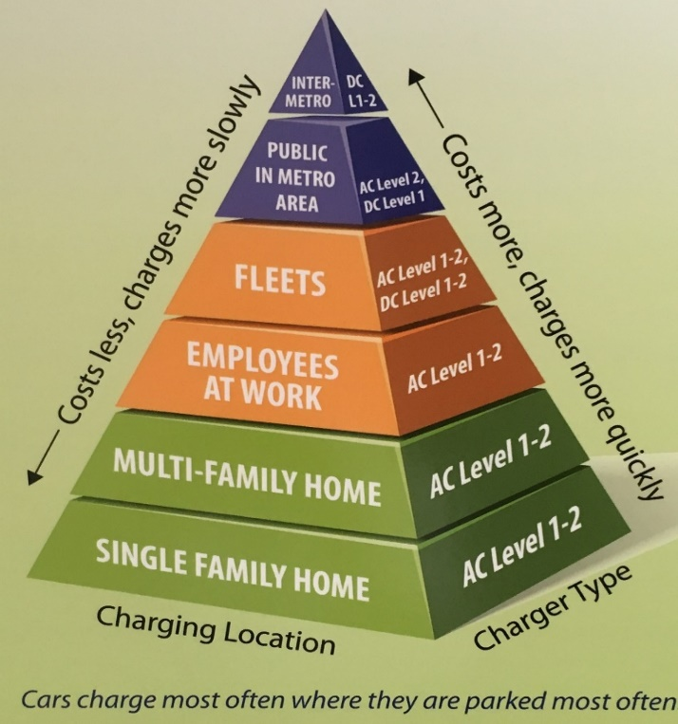
Building the Charging Pyramid: What Cities Can Do to Grow the Market
Marcy Rood, Clean Cites Team Lead
Dan Santini, Retired, Senior Economist
Yan (Joann) Zhou, Principal Transportation Analyst
Argonne National Laboratory
October 29, 2018

Slide 2
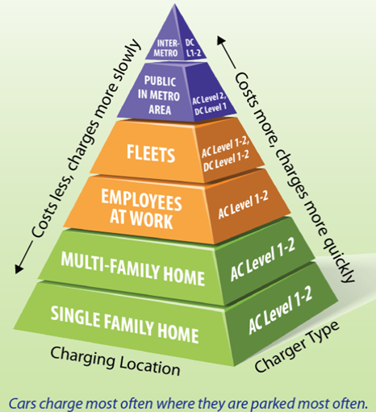
Charging Infrastructure Overview
Charging pyramid reflects current and near-term vehicle technology demand
  Over 80% of charging is likely to occur at home when available
  Workplace and public used much less frequently than home charging
Workplace and Public Charging
  Substitute when home charging is unavailable
  Increases electric mile share for PHEVs
  Extend daily travel for BEVs
Public DFDC
  Most relevant for BEVs
  Needed for long distance BEV travel
  Important for interregional travel
Deployment costs almost inverse of charging pyramid
Source: Idaho National Laboratory (2015)
Source: T. Bohn, Argonne National Laboratory
Notes:
Charging infrastructure is evolving with the vehicle technology. At the outset of the market, expectations were that nearly all charging would occur at home and that public or workplace charging would be of limited use. Those assumptions have proven accurate with the first generation of the technology. As the market expands out of early adopters and the vehicles sold can travel further on a charge, public charging will grow in importance. Although most charging should still occur at home, long range BEVs will need reliable access to fast charging infrastructure for some trips. In addition, drivers without easy access to home charging, such as multi-unit dwellers, residents without a garage, and renters, may rely on public charging or workplace charging to accommodate their daily driving needs.
For PHEV drivers, the top of the pyramid related to DC fast charging is not relevant as current PHEVs do not support this charging technology. These vehicles rely on their gasoline engines for long distance travel.
The key challenge for public charging is the business case, as the expected direct revenue from a typical station’s use is unlikely to be profitable for investors. Innovative partnerships between charging providers, electric utilities, retailers, automakers, and/or government is needed to capture indirect value streams into the business model for public charging.

Slide 3
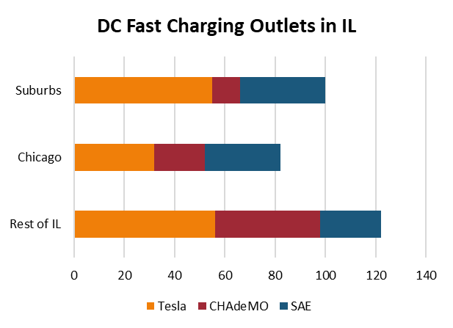
Level 1 & 2 charging is at residence & workplace. The purpose of Tesla’s high power DC fast charging is long distance travel. Other DCFC is more urban & local.
1-2 kW
3-19 kW
Least $
Residential &
Workplace
~ 120 kW
Most $
~ 50 kW
~ 50 kW
Public charging
Notes:
(1) “AC” Level 1 infrastructure charges at the slowest rate, delivering the energy required to drive 3-5 miles of driving distance per hour. “AC” Level 1 chargers operate at 120 V and are similar to a toaster in power (up to 1.4 kilowatts). Because they can use existing standard outlets, they are the cheapest option with no installation costs.
(2) “AC” Level 2 infrastructure charges at a medium rate, delivering the energy required to drive 12-75 miles of driving distance per hour. “AC” Level 2 chargers operate at 240 V, therefore requiring a high-voltage circuit, and are similar to an electric clothes dryer in power (up to 19.2 kilowatts). Equipment and installation costs are intermediate and variable, ranging from $2,000 for a home consumer model to $6,500 for a public model.
(3) “DC” fast charging (DCFC) infrastructure charges at the fastest rate, delivering the energy required to drive 100-300 miles of driving distance per hour. DC fast chargers operate at high voltages and a single station can draw power at a rate equivalent to the power demands of 15 homes. The maximum technical power rating depends on the system (CHAdeMO is 62.5 kW, SAE Combo is 100 kW, and Tesla is 120 kW). Actual peak power levels for most existing CHAdeMO and SAE Combo DCFC are about 50 kW. They are significantly more expensive than ”AC” Level 2 chargers, with equipment and installation costs up to $90,000 per station. The SAE Combo standard can also be referred to as DC Level 2.
Public charging has grown substantially in recent years. The U.S. now has over 6,000 DC fast charging ports and over 40,000 Level 2 charging ports. Using data from the U.S. DOE on stations with known open dates, DC fast charging ports grew by 12% and Level 2 ports grew by 6% in the last 12 months (8/2016-8/2017). Number of outlets in WI: 256 stations and 457 outlets.

Slide 4
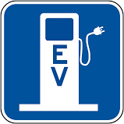

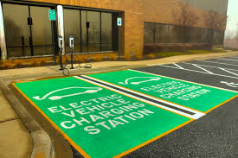
Municipal Role
Leadership
Planning PEVs & infrastructure for fleets, employees, TNCs, and all citizens
Setting policies – to help all participants
  Inspection, permitting, safety, codes
  Setting zoning ordinance
  Parking garages, On-street parking
  ADA and enforcement
  Siting, signage, space marking
  New construction
  Disadvantage populations
Training
  Municipal staff
  First responders
Notes:
Leadership: Demonstrating forward thinking tech-savy and green community by implementing a PEV program
Planning for all those in the community:
And this can take the form of having PEVs in city fleet vehicles or transit;
workplace charging program for city employees and
having accessibility for disadvantage communities…this could be linking a Uber or Lyft EV program for first mile or last mile transit to or from train station
Or possibly a EV car share program or incentives for purchase of EVs or used EVs.
And then setting policies to streamline permitting and inspection
Stations in public parking spaces; on-street parking is more of a challenge
ADA and enforcement of those in a PEV space that doesn’t belong there.
New construction is one way to make future infrastructure more cost-effective.
Training for first responders, municipal staff, employees and salvage yards.

Slide 5
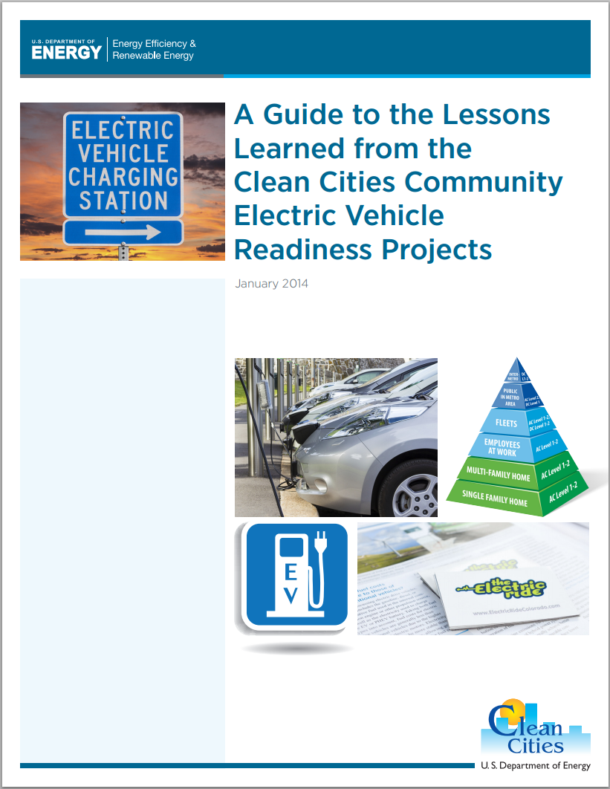
report: A Guide to the Lessons Learned from the Clean Cities Community EV Readiness Projects
Purpose of this report:
  Synthesize EV readiness lessons learned
  Highlight key grantee activities and outcomes
  Help readers easily connect with the resources most relevant to them
  Designed to be accessible to and useful for a broad, general audience
  Public sector policymakers and staff, stakeholders, and the general public in communities across the country
Notes:
In 2011 DOE issued 16 grants for various communities and regional/state PEV readiness programs. While this report is a compilation of all of these efforts and somewhat dated, it could serve as an important guide book for communities.

Slide 6
Local Governments: Toolkits
Local governments can be powerful supporters of charging station deployment
  Toolkits providing case studies, model ordinances, and planning guidance
    Master plan language
    Standard definitions of PEV-related terms in local codes
    Zoning ordinance updates
    Building and electrical codes: clarification and/or active support
    Prudent streamlining of permitting and inspection
  Public parking regulation, enforcement, and signage
  Consumer Education
Notes:
In this set of grants communities constructed toolkits for all of these areas and were part of communities outreach efforts in partnership with CC.

Slide 7
PEV Readiness Grants had consistent positive and generally significant impacts
Varying sets of variables to be significantly correlated with each PEV market segment (mass, medium, luxury) at county level.
Negative effects of extreme temperature were particularly strong for the total market and for the mass-market BEVs
State and federal monetized benefits were twice as important for BEVs as for PHEVs
Level 2 public charging availability shows significant positive impacts in the mass and total PHEV markets, but not in BEV markets.
Workplace charging shows a positive but lower coefficient for BEVs than for PHEVs
PEV Readiness Grants had consistent positive and generally significant impacts in all PHEV market segments, as well as mass-market and total BEVs
HOV lane subsidies appear to be very important in the mass market
Income has significantly positive impacts in EVERY market segment, dominating the education effect.
Fuel Cost: Interestingly, gasoline prices are negatively correlated to the luxury BEVs, luxury PHEVs and mid-market PHEVs, but not mass-markets or total markets.
Longer Work Travel Time significantly decreases luxury BEV and mid-market PHEV market adoption, but not mass markets.
Notes:
And a couple of years ago we looked at success of various communities around the country. PEV Community Readiness had a positive impact.

Slide 8
Pathways to EV: Preparing cities for the transition to electric vehicles
Key questions to ask your team when planning a program:
  What are the characteristics of the city?
  What is the composition of the housing stock?
  What are the renewable resources of the city?
  Is the city near a regional corridor?
Source: Cadmus Group, Pathways to EV: Preparing cities for the transition to electric vehicles, PREPARED FOR THE URBAN SUSTAINABILITY DIRECTORS NETWORK, CITY OF COLUMBIA, MISSOURI & PARTICIPATING COMMUNITIES, JUNE 2018
Source: Cadmus Group. PREPARED FOR THE URBAN SUSTAINABILITY DIRECTORS NETWORK, CITY OF COLUMBIA, MISSOURI & PARTICIPATING COMMUNITIES, June 2018
Notes:
Just recently, I became aware of this study, which I think would be very helpful to all of you.
Some cities have explored codifying a “right to charge” that allows electric vehicle owners to install charging stations on their properties without condominium or homeowners’ associations banning or placing unreasonable regulations on such EVSE installations.

Slide 9
Planning
Research: Capture & compile best practices
Stakeholder Outreach and Engagement:
Gain existing insight from industry and nonprofit stakeholders
Opportunity, Barrier, and Issues Identification: to add EVs to municipal fleets and EV Chargers to municipal operations, public parking, workplace charging, TNCs and disadvantaged neighborhoods
EV Readiness
Streamline and standardize processes and tools for municipalities to consider electrification, define and document :
  Develop Roadmap – plan for municipalities to follow
  Develop Toolkit
Develop EV Ready Program
Recognition: Develop and apply a rating system or awards for leadership
Local Outreach and Education: Support efforts for member municipalities to educate staff, elected officials and the general public
Training Programs
Deployment

Slide 10
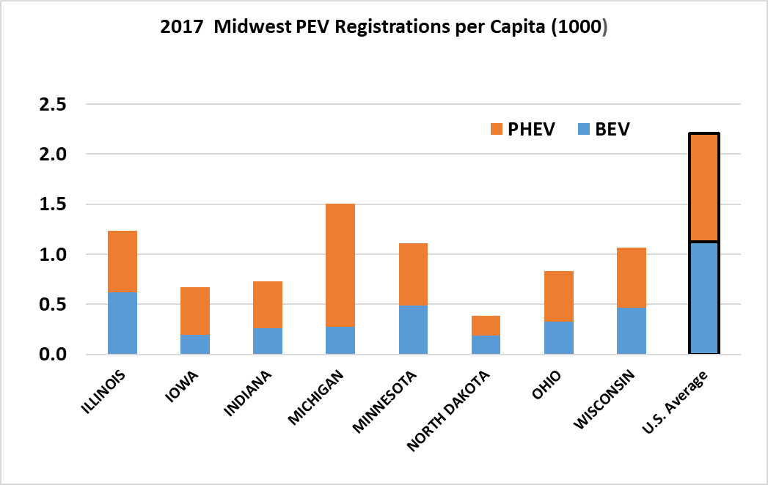
PHEVs are proportionately more common in the Upper Midwest, but WI & IL are similar to the U.S.
Notes:
PHEVs are more common in most of the upper Midwest but the mix of Plug-in hybrid electric vehicles vs all electric is changing in terms of new sales, Tesla, Leafs. Nationally, as of June 2018 BEVS are 52% of the market vs 48% PHEVs.
llinois 2014 to 2017 saw a 34% growth rate; but for BEVs in this same time period saw a 131% rate in sales.

Slide 11
The Model 3 has caused sales of BEVs with > 200 mi. range to jump. PHEVs < 30 mi. range that could benefit from workplace charging are also growing rapidly.
Growth in annual sales rate by PEV EV range, 2013 to 2018
PHEV share of 2018 Market, by EV Range
Notes:
Let’s switch to Workplace Charging another way municipalities can show ledership:
The Model 3 effect in July and August is big, taking Tesla shares of PEVs above 50%. PHEVs are still growing in total in 2018, though losing share.
PHEV 20 to 30 mile range include: Ford Fusion, Prius Prime, New Outlander
PHEV 9-19 mile range include: BMW, Porche, Volvo and Mercedes line.

Slide 12
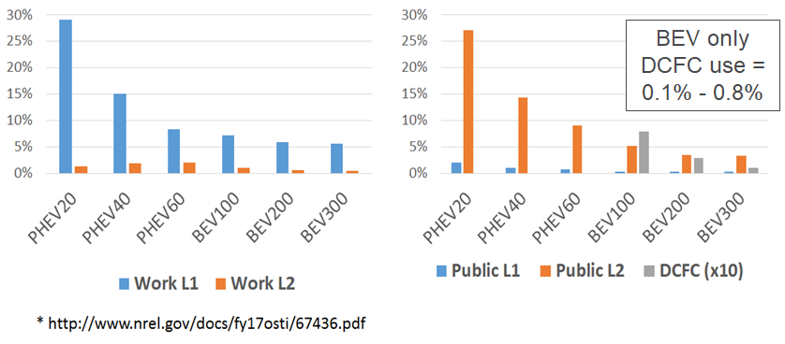
Recent NREL Study Projections*: PHEV20-40 mi. > 2X as likely as BEV100-300 to use Work & Public Charging. DCFC is only for BEVs.
Notes:
A recent study done by our sister laboratory National Renewable Energy Laboratory that Plug-in hybrids are 2 x more likely than all electric long range vehicles to use work and public charging.

Slide 13
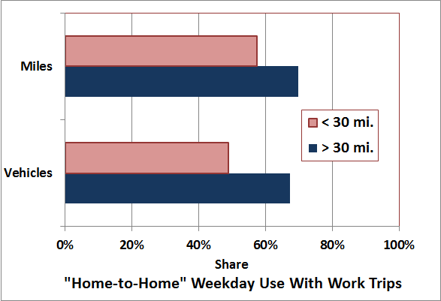
Among vehicles driven > 30 miles on weekdays, work use strongly dominates. Thus … charging vehicles at work can electrify a lot of miles.
Notes:
This can be a big way to show leadership.

Slide 14
How much charging capacity can you provide and when can you provide it?
How much?
  Is any parking already served by electrical outlets? (probably no)
  How many parking spots are close to existing electrical panels?
  Do you plan to shuffle vehicles at charging spots with high kW, or
  Are you going to assign/rent parking for a day, week, month, year?
  What is your your property’s excess capacity on peak days?
  Will those considering PEVs know how many can be served?
When?
  Will early arrivals be able to charge longer? Late departures?
  Will charging be allowed on weekends and holidays? Late nights?
  Are you going to curtail charging on peak days?

Slide 15
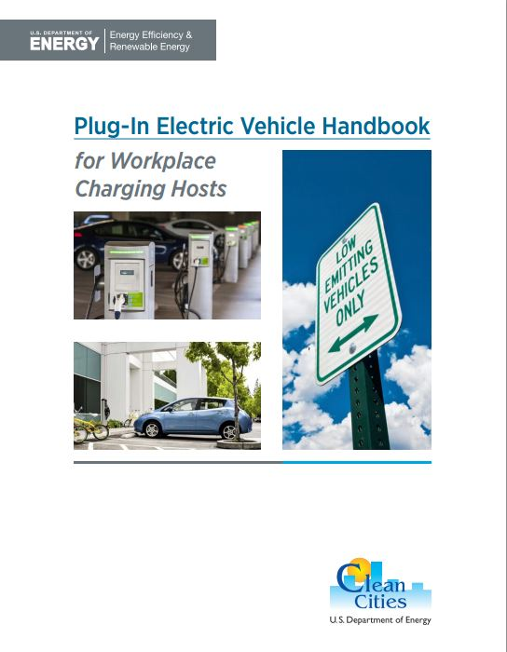
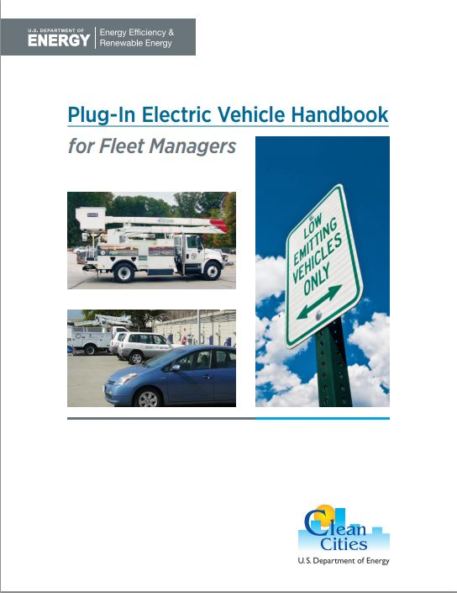
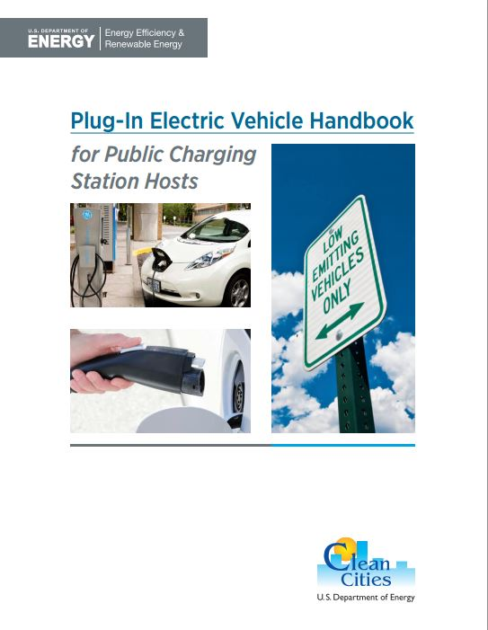
Getting Started: PEV Handbooks
Helpful Resource:
Clean Cities PEV Handbooks are great resources for fleet managers, station owners, and individuals who are ready to start using PEVs and infrastructure.
afdc.energy.gov/publications
Workplace Charging Materials
https://cleancities.energy.gov/technical-assistance/workplace-charging/
Notes:
There are several Clean Cities handbooks which are great resources for fleet managers, station owners/operators, and drivers:
The Clean Cities Plug-In Electric Vehicle Handbook for Fleet Managers
The Clean Cities Plug-In Electric Vehicle Handbook for Workplace Charging Hosts
The Clean Cities Plug-In Electric Vehicle Handbook for Public Charging Station Hosts

Slide 16
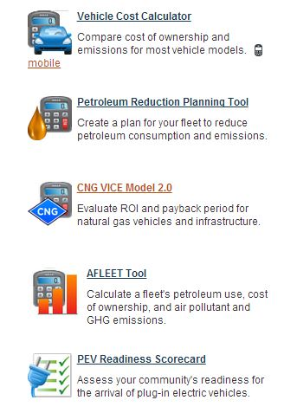
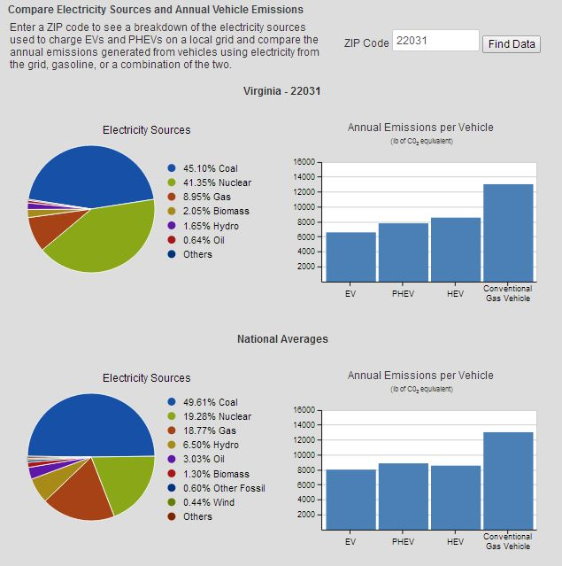
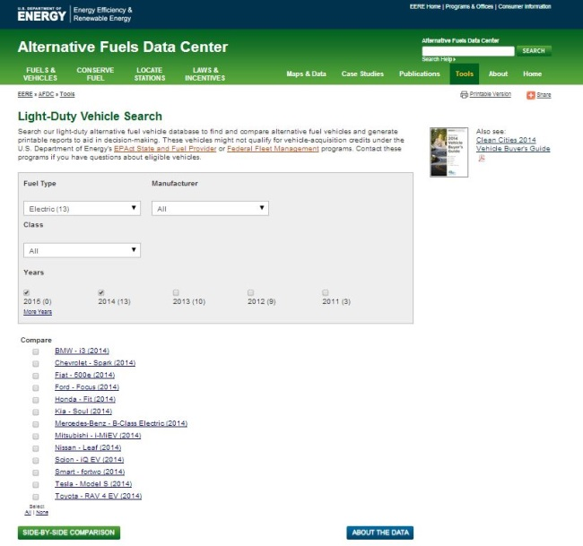
Tools
afdc.energy.gov/tools
Notes:
All links will be provided in a slide at the end of the presentation. The final slide can be distributed to the audience for further information.
Return on investment tools: Especially tailored for fleets.
Alternative Fuels Data Center (AFDC) Vehicle Cost Calculator, which allows users to compare cost of ownership and emissions for most vehicle models.
Emissions tools:
The life cycle emissions of an EV or PHEV depend on the sources of electricity used to charge it, which vary by region. HEVs have similar life cycle emissions to conventional vehicles.
The AFLEET tool, which calculates a fleet's petroleum use, cost of ownership, and air pollutant and GHG emissions, is helpful for determining a vehicle’s or fleet’s emissions over the lifetime of the vehicle.
The AFDC EV Emissions page can help determine the breakdown of the electricity sources used to charge EVs and PHEVs in your area, and the resulting life cycle emissions.
AFDC PEV Readiness Scorecard:
The Plug-In Electric Vehicle Readiness Scorecard helps communities assess their readiness for the arrival of PEVs and EVSE, and helps communities by suggesting next steps in areas they can potentially improve.
Fleets and individuals are encouraged to use these customizable tools to find their own payback and emissions outputs.
For a current list of available electric drive vehicles, see the AFDC Light- and Heavy-Duty Vehicle searches.
Other resources include the FuelEconomy.gov’s alternative fuel vehicles (AFV) page, Plug-In America’s Vehicle Tracker, and the Clean Cities Vehicle Buyer’s Guide.

Slide 17
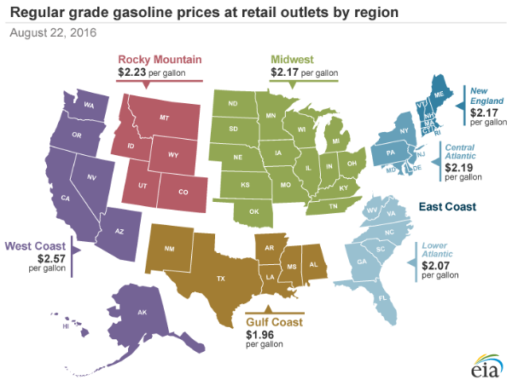
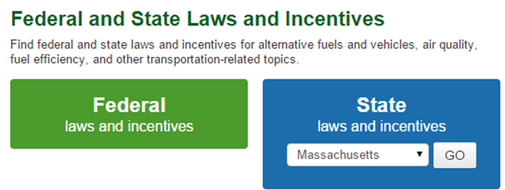
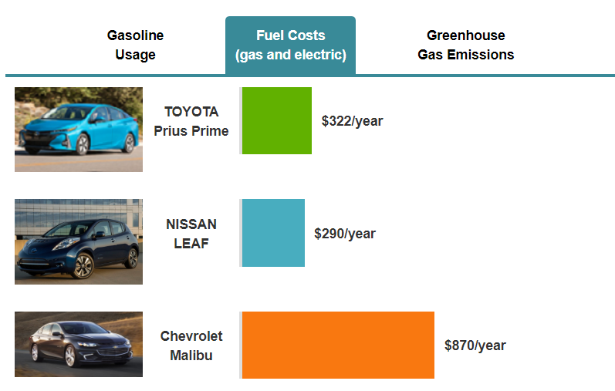
EVolution: Education on E-Drive Vehicles: 6 Interactive Steps leads to customized results and information http://evolution.es.anl.gov
Vehicle Selection
Type, size, seats, price range
Comparison across powertrains, maker and models
Allows for 2 alternative powertrains compared to ICE
Location Details (Specific to zipcode)
Timely fuel price (gasoline, electricity)
Average travel time, speed
Links to Workplace/Public charging locations
Links to local incentives
Travel and Charging
Workday travel and other travel (speed, duration, etc)
Home, workplace and other charging (duration, charger type)
Other information (financial, ownership, etc)
Educational Information about PEVs
Types of charging vs. Charging time
Weather Effects on performance and range
Energy saving depends on travel pattern, charging rate/time
Outputs
Savings in $ and gallons
Total Cost of Ownership
Savings as a function of average speed
Notes:
The tool start with consumers’ basic needs in terms of vehicle type (car or light truck), size, seats, price range.
It asked consumer to compare ICE with two more alternative powertrains (definition is given)
Based on consumer’s needs, it suggest a list of models cross not only different powertrains but also different maker and models. (price information from fueleconomy.gov, our suggestions are based on consumer’s inputs, no intention to favor one maker/model than others)
Inputs are specific to zipcode in terms of price, default travel time/speed (state level information).
Based on the zipcode, we provide educational information, such as the weather affects on range, charging locations, local incentive by connecting the tool with existing information from AFDC
We show the output in both gallons and $ since different consumers may have different perspectives for gasoline price. Total cost of ownership information is from AFDC cost calculator.
An unique output we have is the saving as a function of average speed, trying to educate consumers how their saving can vary by how they drive the vehicles (example chart shown in the right bottom)

Slide 18

BEV and PHEV have lower annual emissions than national average due to cleaner electricity generation
Comparison from Argonne’s EVOLUTION tool
State Averages for IL

Slide 19
Thanks!
Marcy Rood, mrood@anl.gov
About Argonne National Laboratory
Argonne is a U.S. Department of Energy laboratory managed by UChicago Argonne, LLC under contract DE-AC02-06CH11357. The Laboratory’s main facility is outside Chicago, at 9700 South Cass Avenue, Argonne IL 60439. For information about Argonne and its pioneering science and technology programs, see www.anl.gov
Disclaimer
This presentation was prepared as an account of work sponsored by an agency of the United States Government. Neither the United States Government nor any agency thereof, nor UChicago Argonne, LLC, nor any of their employees or officers, makes any warranty, express or implied, or assumes any legal liability or responsibility for the accuracy, completeness, or usefulness of any information, apparatus, product, or process disclosed, or represents that its use would not infringe privately owned rights. Reference herein to any specific commercial product, process, or service by trade name, trademark, manufacturer, or otherwise, does not necessarily constitute or imply its endorsement, recommendation, or favoring by the United States Government or any agency thereof. The views and opinions of document authors expressed herein do not necessarily state or reflect those of the United States Government or any agency thereof, Argonne National Laboratory, or UChicago Argonne, LLC.
The submitted manuscript has been created by Argonne National Laboratory, a U.S. Department of Energy laboratory managed by UChicago Argonne, LLC, under Contract No. DE-AC02-06CH11357. The U.S. Government retains for itself, and others acting on its behalf, a paid-up, nonexclusive, irrevocable worldwide license in said article to reproduce, prepare derivative works, distribute copies to the public, and perform publicly and display publicly, by or on behalf of the Government

Slide 20
What kind of money are we talking about?
  PHEVs & BEVs allocated ~ 8 kWh/day and using Level 1 charging at 1.4 - 2 kW
    $220 to $650/yr. per vehicle (11 cents/kWh to 33 cents/kWh)
  BEVs & “guzzler” PHEVs of “garage orphans” allocated ~ 20 kWh /day using Level 2 charging at 3 to 6 kW
    $600 to $2420/yr. per vehicle (12 cents/kWh to 48 cents/kWh)

Slide 21
If you can increase use of your chargers, amortized charger installation cost per vehicle served drops
Locations with multiple shifts can benefit
Locations with in-house fleets charged overnight benefit
24/7 businesses with chargers for employees can benefit
If 2 x vehicles charged/day ($ 0.10/kWh + installation)
  8 kWh/day using Level 1 charging at 1.4 - 2 kW
    $220 to $650/yr. per vehicle drops to $210 to $425/yr.
    Range of 11 cents/kWh to 33 cents/kWh drops to 10.5 to 21
  20 kWh /day using Level 2 charging at 3 to 6 kW
    $600 to $2420/yr. per vehicle drops to $550 to $1460/yr.
    Range of 12 cents/kWh to 48 cents/kWh drops to 11 to 29

Slide 22
Winter and summer kWh/mile needs for the daily commute will exceed published averages
More energy consumption per mile with heat or AC on leads to less range, and need for more kWh per commute
Total kWh for test, by temperature
HIGHWAY CITY
COLD
Avg. rated range: 87 miles
Cold
Hot
Argonne BMW i3 Tests (kWh per test)
Argonne Nissan Leaf Tests (range)

Slide 23
Remember, one size does not fit all. Your employees’ PEV kW & kWh desires can differ from your interests.
PHEVs without enough range for a full day of travel want “topping up”
Long range PHEVs can show up with differing kWh needs
  If leaving the residence full, they won’t be empty on work arrival
  If they preferentially choose work to fill up, you can force (encourage) them to do some charging at home by “only” meeting commuting needs
BEVs that have no residential charging (garage orphans) will want as much as they can get, especially if it is free.
Long range BEV owners may want high power fast charging on site – consider this desire very carefully. Suggestion – leave it to others.

Slide 24
Provide only needed kW & kWh. Do not match PEV kW capabilities.
Hours parked at workplaces in day 2nd to residences at night. Combined with residential, needed kWh for PEV commuting can easily be provided, with timing flexibility.
Be sure to increase hours of use of existing capacity and avoid installing seldom used kW of capacity
Spread the charging out (and time it) to minimize (1) demand charges imposed by the utility and (2) EVSE construction costs on your property
Use low kW charging. High kW charging is only needed at public charging locations where dwell time is much less than at the workplace and residence.
Time charging to enhance use of renewables

