Slide 1

100% CAMPAIGNS &
DATA DRIVEN ENERGY DECISION-MAKING
Edith Makra, Director of Environmental initiatives,,
Metropolitan Mayors Caucus

Slide 2
100% Renewable Energy (RE) CAMPAIGNS
GRC CONTEXT
ENERGY PLANNING
MUNICIPAL ROLE
CASE STUDIES – National Renewable Energy Lab (NREL)

Slide 3


Illinois Environmental Council & League of Conservation Voters
Drive to get 100% renewable commitments from candidates
Asking candidates to commit to 100% clean energy by 2050 on social media
“Having candidates post these messages on social platforms not only provides a measure of accountability going forward, but also grows the public audience that is exposed to positive messages about clean energy in Illinois. “
Public forums
Editorial Boards, Interviews & Debates

Slide 4
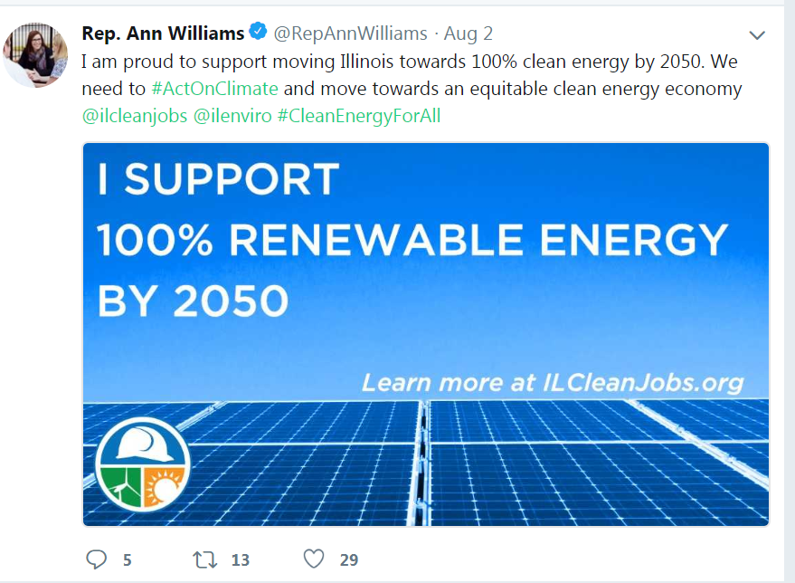

Slide 5
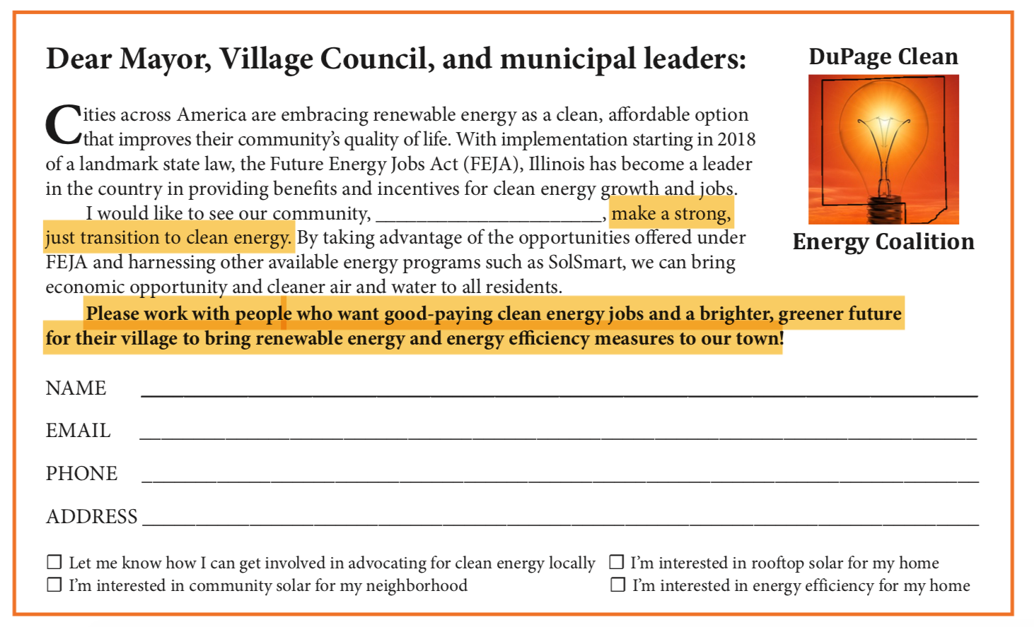

Slide 6


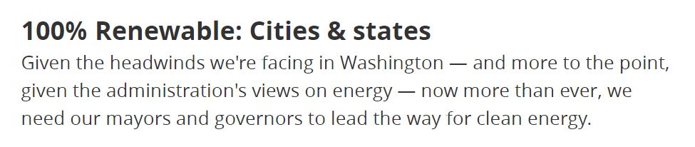

Slide 7
GRC GOALS RELATED TO CLEAN ENERGY

Slide 8
GRC GOALS RELATED TO CLEAN ENERGY

Slide 9
GRC GOAL CATEGORIES
MUNICPAL PRACTICES (LEAD BY EXAMPLE)
POLICIES AND CODES
COLLABORATIONS
COMMUNITY ENGAGEMENT

Slide 10
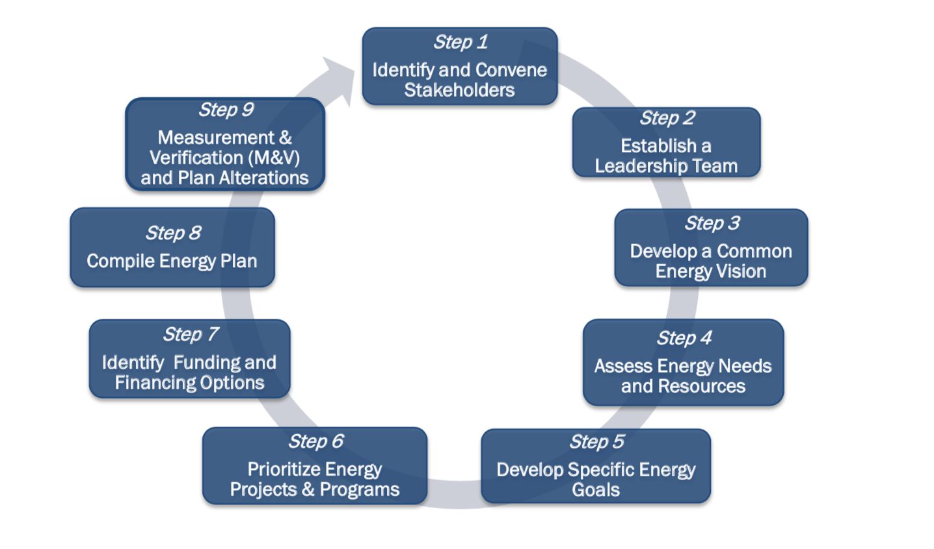
Strategic energy planning
Source: NREL

Slide 11
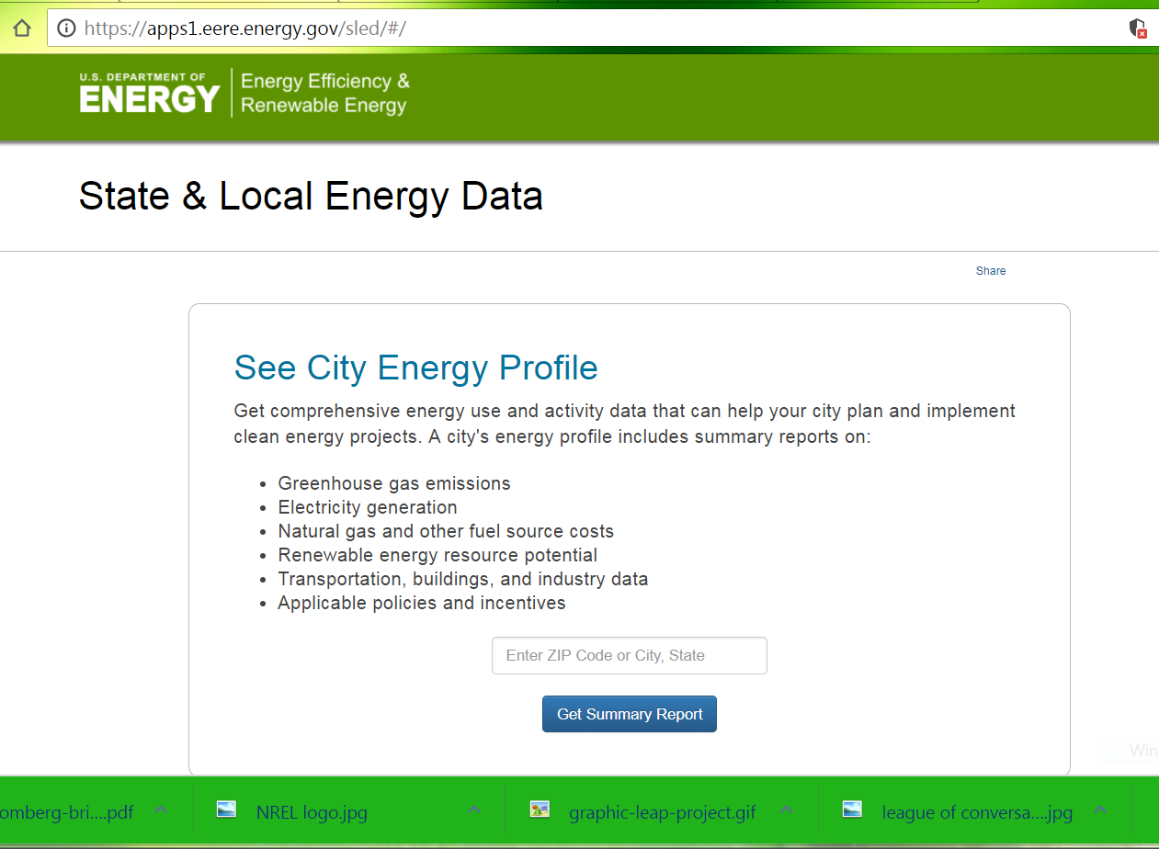
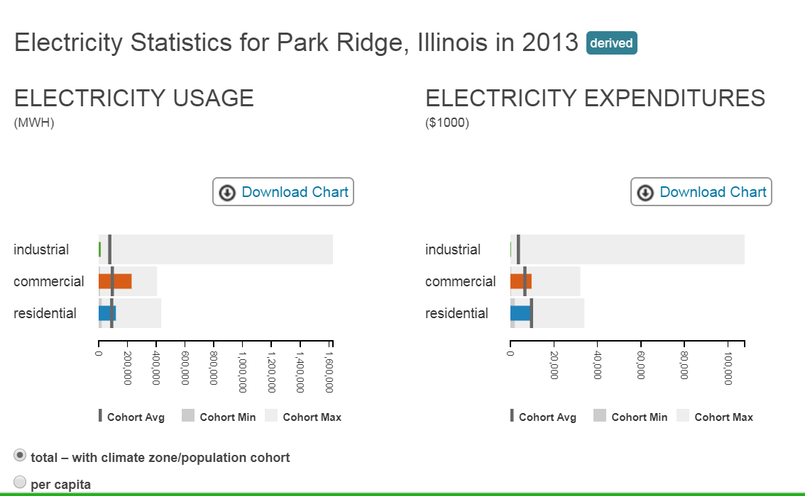
Analyze Energy Needs and Resources
NREL Community Energy Profile-Park Ridge
Biggest energy Users
Municipal energy use = 1.5 – 2%

Slide 12
SET TARGETS
Greenhouse gas reductions (GHG)
Energy/Cost Savings
Improve Performance (i.e. LED streetlights)
Energy Source – renewable
‘SMART’ Targets –
  Specific
  Measurable
  Actionable
  Realistic
  Time-bound

Slide 13
Prioritize Energy Actions
What is the municipal role?
Where do municipalities have to most influence?
What accomplishes goals most effectively – lease amount of resources?
What is of greatest benefit to constituents?
Consider full life time costs/benefits (total resource cost test)

Slide 14

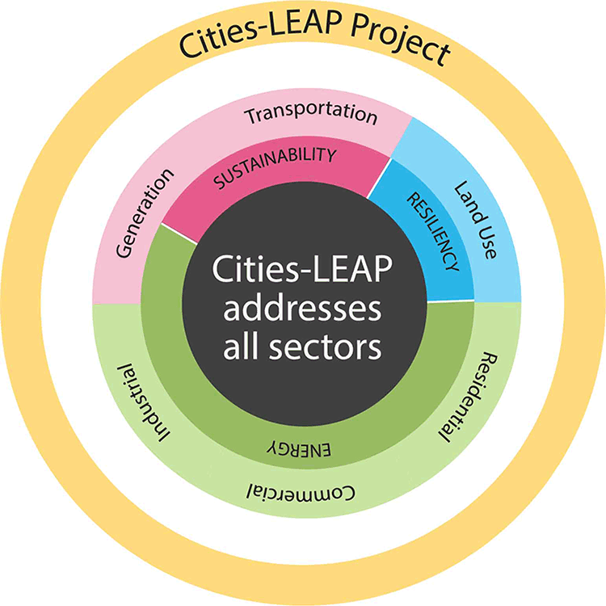
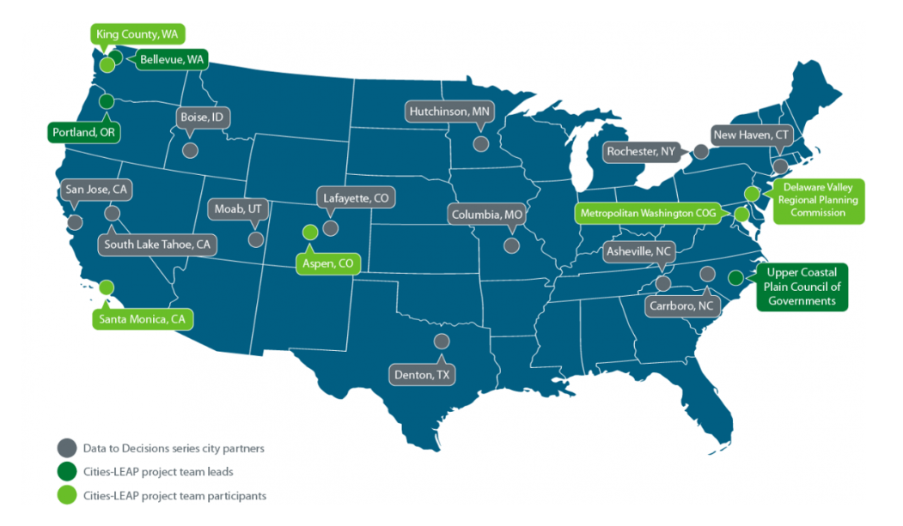
NREL EERE Cities LEAP project
Notes:
Leading through energy analysis and Planning

Slide 15
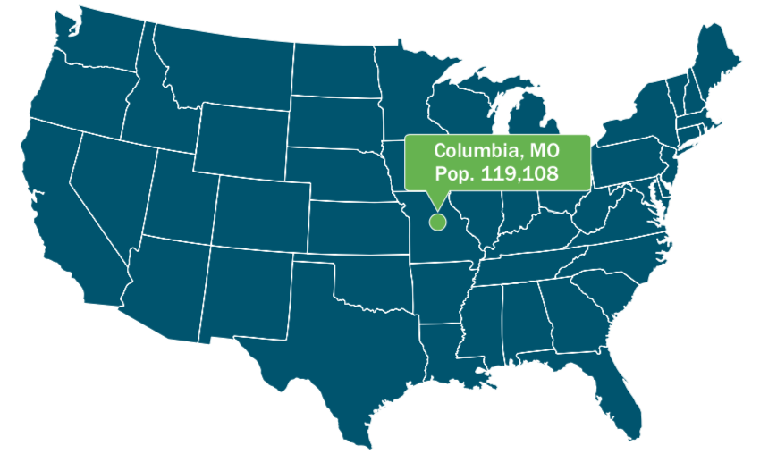
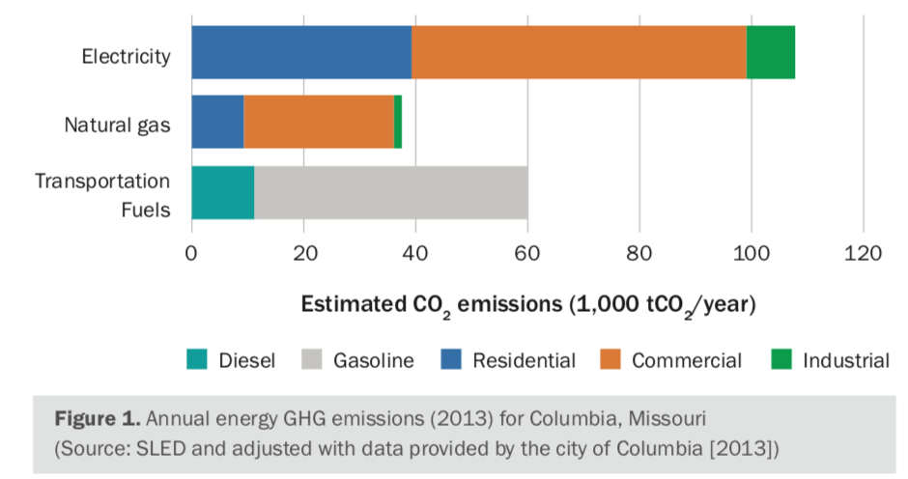
Columbia, Missouri: Using Energy Data to Reduce Emissions and Achieve Low- Income Household Energy Savings

Slide 16
Low- Income Household Energy Savings
Energy Efficiency
Smart thermostats
Wall insulation
Energy Star washers
Variable speed heat pumps
Building Codes
Adopt most recent codes
Time of sale efficiency upgrade
Weatherization programs

Slide 17
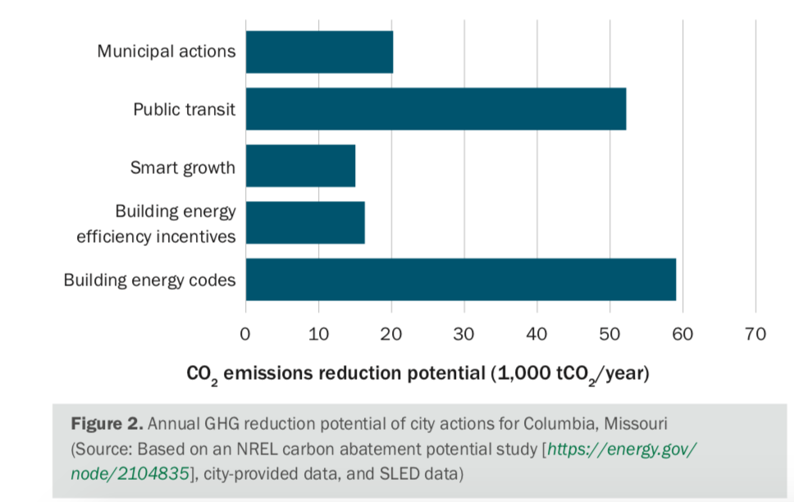
Best actions to reduce GHG – Columbia, MO

Slide 18

Municipal Codes & Processes - SolSmart
Solar Soft Costs
Source: NREL (http://www.nrel.gov/docs/fy14osti/60412.pdf)
LBNL (http://emp.lbl.gov/sites/all/files/lbnl-6350e.pdf)(http://www1.eere.energy.gov/solar/pdfs/sunshot_webinar_20130226.pdf )
Notes:
The remaining 50% of the costs are commonly grouped together as “soft costs”. These soft costs include the cost of handling processes such as permitting and interconnect, marketing costs including customer acquisition, and installation costs including design, financing, and labor costs.
In the US, we pay a significant premium on these solar soft costs. And local governments play a critical role in reducing these soft costs.

Slide 19
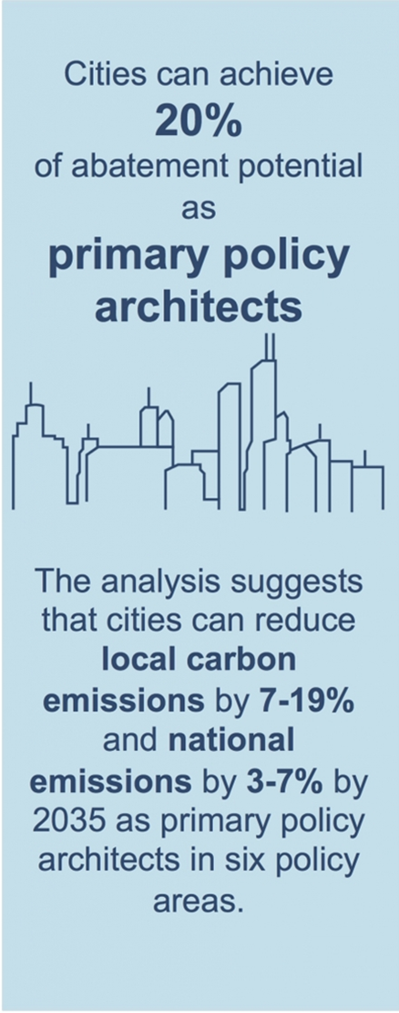
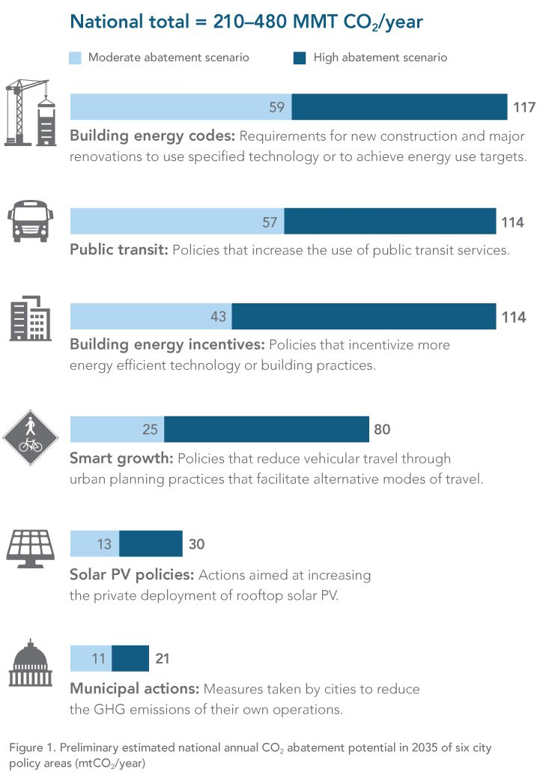

Slide 20
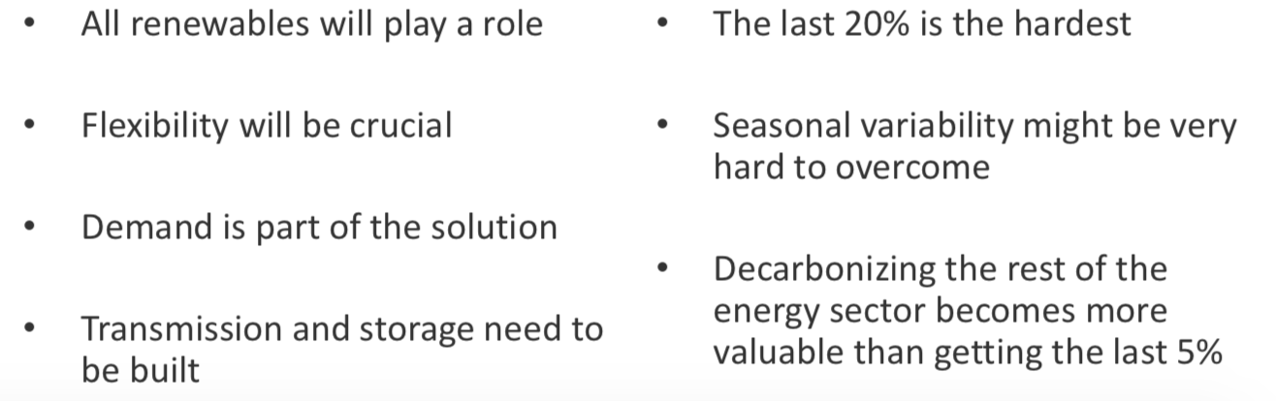
NREL studies – 80% RE is feasible

Slide 21


Data Driven Energy Decisions
Edith Makra
Director of Environmental Initiatives
emakra@mayorscaucus.org

Slide 22


James Critchfield
Office of Air & Radiation
US EPA

