Slide 1


Evolution of the GRC
Edith Makra, Metropolitan Mayors caucus
June 19, 2018

Slide 2
Roots of GRC
Clean Air Counts
  Tracked clean-air actions & reported metrics
  Recognized achievers - Gold, Silver, etc level
Original Greenest Region Compact (2007)
  No reporting or actions
Greenest Region Compact (2) replaces both
Notes:
Ostenburg
Caucus has strong history with environmental program
Clean Air Counts – began in 1999
Very successful for many years
Demonstrated how we can all take small actions to make a measurable difference
Local actions were aligned with the regional objective – Clean Air
First GRC – strong participation
THE NEW GRC2 REPLACES CLEAN AIR COUNTS & original GRC
Talk about -
The need for mayoral leadership
Role of sustainability planning
Environmental concerns are more imperative than ever

Slide 3

GRC2 Goal
To align environmental issues, resources, and actions at the local, regional and national levels to guide municipalities to achieve greater environmental sustainability.
Notes:
Ostenburg
Ok to read the goal –
Bottom line.
We have to work together and strategically.
Not enough resources to get much done without aligning efforts

Slide 4
Building the GRC for Success
Inventoried programs already underway
Synthesized plans already made
Designed to streamline future reporting
Aligns with local, regional, state & national programs
Energy E5

Slide 5
Now let’s report:
kW & therms saved?
CO2 avoided?
$ savings

Slide 6
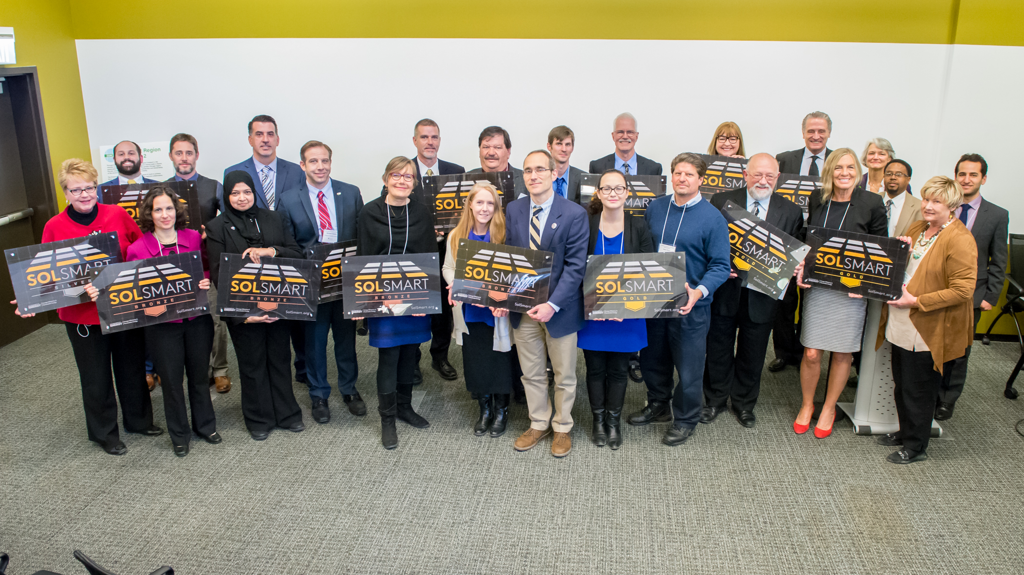
Tracking SolSmart - Example

Slide 7
Ready for GRC Reporting – Why Now?
Reporting & Tracking were always intended
99 GRC Communities serving 5.05 million residents!
Taking a few collaborative actions – but missing more
Municipal leadership & action increasingly valued lacking federal
Climate pledges (Chicago Climate Charter) require reporting
Institute for Sustainable Communities can help now
Thank you!

