Slide 1
Electric Vehicle Looking to the Future
Metropolitan Mayor Caucus
Environmental Committee
October 29, 2018

Slide 2
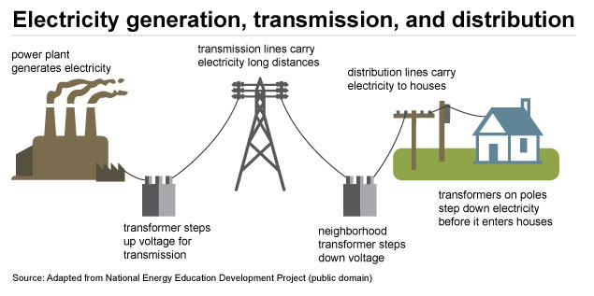
Grid System
Power plants
Transmission lines
Local transformers
Homes – 20 to 100 kW
Commercial Businesses – 50 to 500 kW
Industrial Businesses – 100 to 5000⁺ kW
Electrical service panels, breakers
Conduits and wiring
EV Supply Equipment
EV Charging

Slide 3
Evolution of EV Power
Current: Mainly use existing capacity of facility (e.g. spare circuit breakers)
Sometimes: need to transform power within facility or pull new wires from local transformer into facility
Coming: add more utility local high voltage power lines and supporting infrastructure, based on demand
Future: add more high voltage transmission lines to areas with EV demand
More distant future: add more generation capacity?

Slide 4
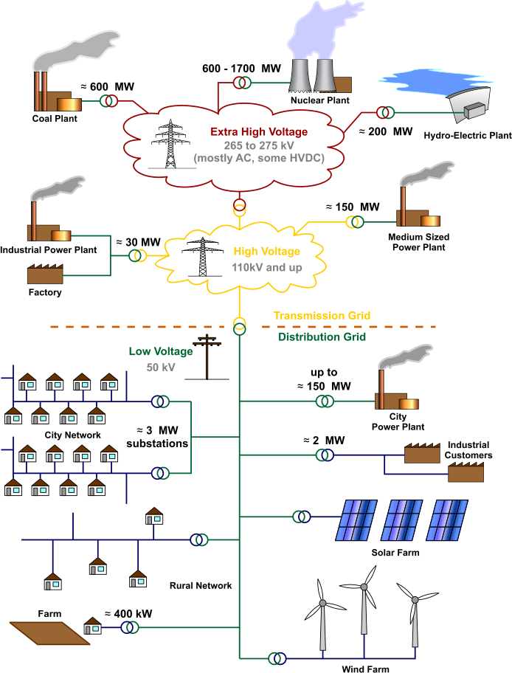
Overall Power Grid
EV Charging

Slide 5
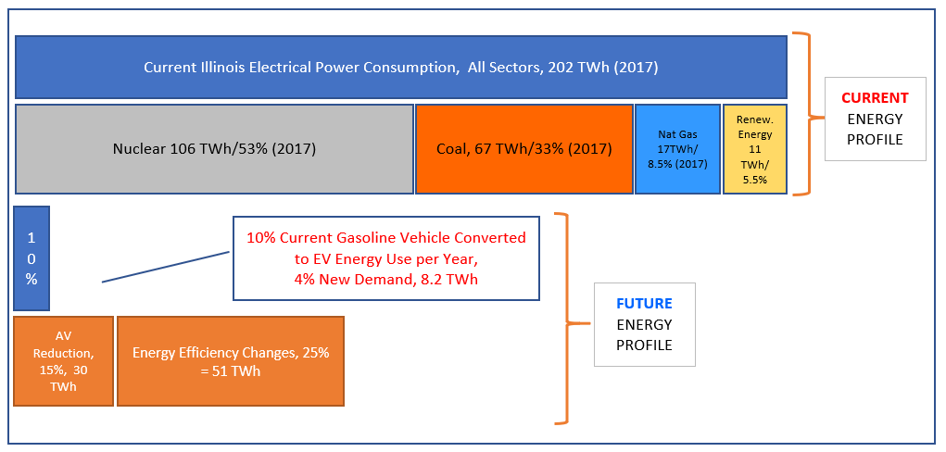
Illinois: How much power?
If 10% vehicles are electric
Source: US EIA

Slide 6
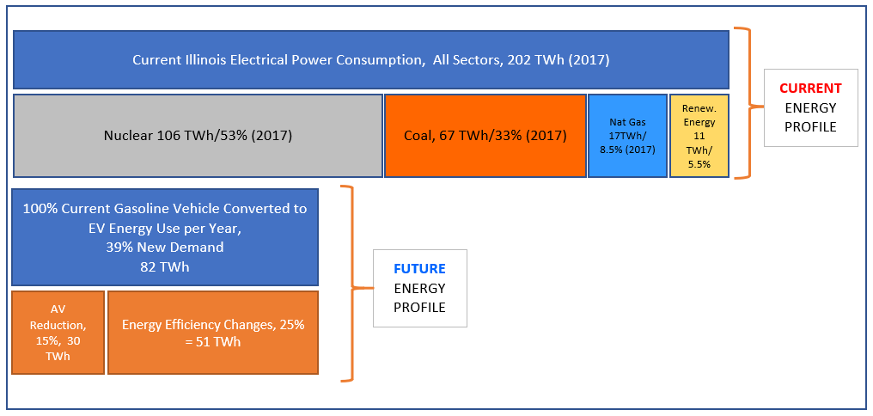
Illinois: How much power?
If all vehicles are electric
Source: US EIA

Slide 7
Grid Evolution & EV Factors
Rate of growth of EV adoption
Technology advances
EV and Infra cost reductions
Incentive programs
Climate events, public perception and willingness
Changes in usage of the grid
Distributed generation
Coal plan retirements and Renewable power growth
Energy efficiency
Impacts of Autonomous Vehicles mass transit, etc. on congestion
Adoption of managed charging (“V1G” and “V2G”)
Adoption of On-demand transportation (Uber)
Adoption of more demand response programs
Integrations of smart technologies – PCs, handheld, vehicle, etc.

Slide 8
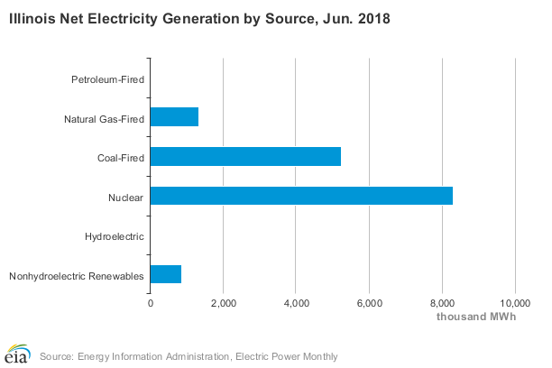
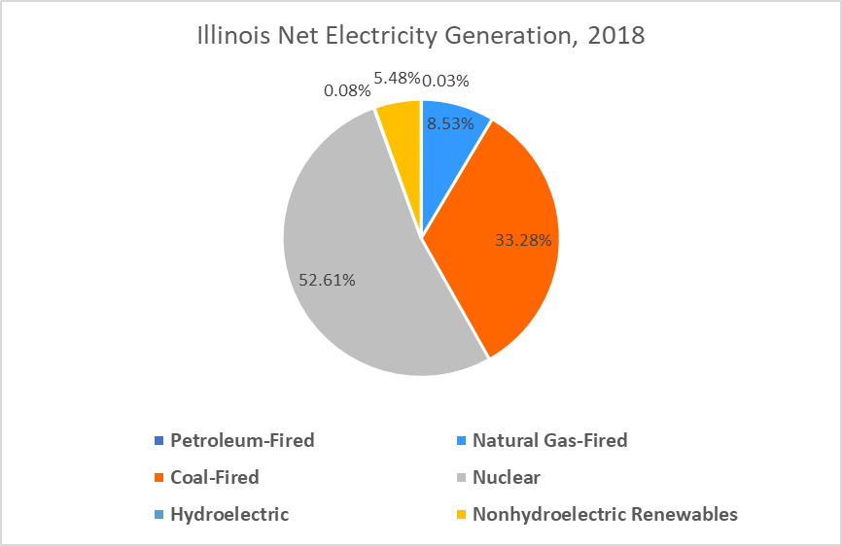
Illinois Energy Mixes
Source: US EIA

Slide 9
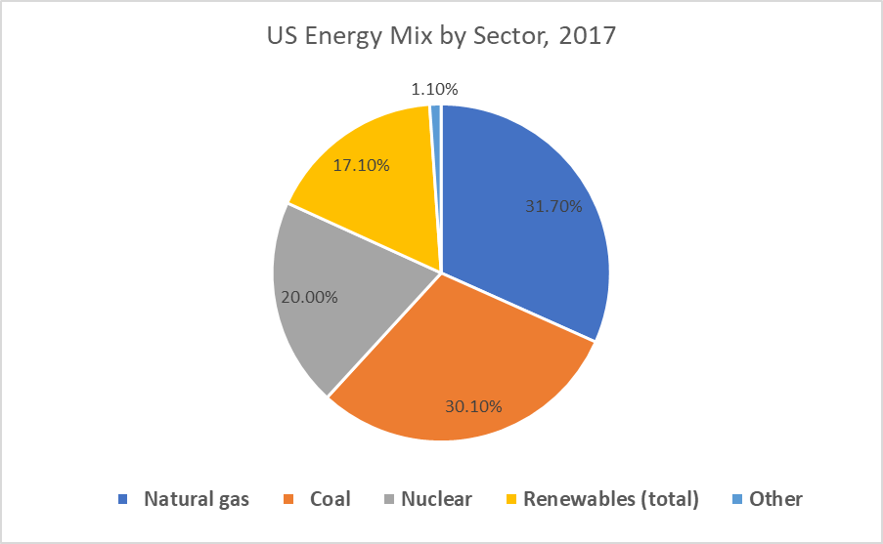
US Energy Mixes, 2017
Source: US EIA

Slide 10
THANK YOU! Tim Milburn 847-823-9205 tim.milburn@greenways2go.com www.greenways2go.com

