Slide 1
Challenges, Trends and Ideas for Mobility
Current Mobility Challenges
Costs and vehicle usage optimization
Energy Independence
Rate of Accidents
Congestion & Lost time
Pollution, GHGs, Health & Sustainability
Use of land
Notes:
Current Mobility System
86% of Americans commute by car
Mobility Challenges
Expensive
2nd highlights expense for U.S. families
Does anyone know how much the average cost to own a car is?
Average total cost to own is $9,000 a year
Underutilized
Vehicles sit idle 95% of the time
Energy Independence
Accidents
Automobile accidents kill over 1,000,000 people each year, 37,000 in the US alone
Congestion
According to a study conducted by the Texas A&M Transportation Institute Americans waste 42 hours a year stuck in traffic
That cost the average motorist $960 in wasted time and fuel
The Chicago area is not immune to congestion – I probably don’t need to discuss this very much
Pollution
The American Lung Association estimates that for every gallon of gas consumed there is a $1.15 in health and climate change costs.
Poor use of Land
We have over 1 Billion parking spaces in the US

Slide 2
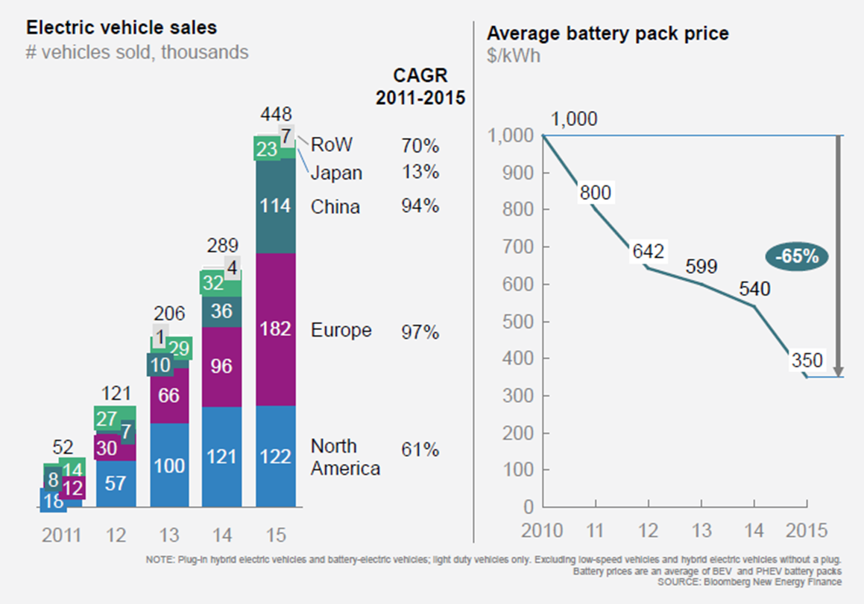
Current Trends in Automotive Industry
Global Trends
Emerging Sustainability Policies
Urbanization
Changing priorities
Consumer preferences
Emerging technologies
Notes:
Global Trends
Emerging Sustainability Policies
Air quality is a growing concern in cities because of human health impacts
Cities are introducing policies that favor low emissions vehicles
Low-emissions zones are defined as areas where access by some polluting vehicles is restricted
Over 200 cities and towns operate or are preparing low emissions zones
Seattle Airport requires ride sharing vehicles to get 45 miles per gallon or greater to pickup passengers
Urbanization
By 2030, 60% of global population will live in cities.
More people, more vehicles & more stressed infrastructure.
Solutions will need to be found
Changing priorities
Let me see a show of hands – how many people raced out to get their drivers license at the age of 16?
When I ask this question in a class of college students, you only see half of the hands go up.
Fewer 16-year old’s are getting their drivers license
85.3% of high school seniors had their drivers license in 1996
71.5% of high school seniors had their drivers license in 2015
As ride sharing services improve, we may see a getting a license become an even lower priority
Consumer preferences
Ride sharing services came out of nowhere and are growing rapidly – Lyft is growing at 40% year over year
By mid 2016 $21 billion had been invested
Emerging technologies
60% rise in EV’s globally in 2015 compared to 2011
Average price of Li-ion battery packs dropped 65% between 2010-2015
Proces are now around $200 a kWh
Perfect example of moores law
By 2025 EVs should be the same price as ICE without incentives
Total cost to own an EV can be less right now for some applications such as ride sharing
Rapid advancements in autonomous vehicles – full self-driving L4 by 2025 (L3-L4 on the market by 2020-2021)

Slide 3
Current Trends in Automotive Industry
Automotive Trends
Notes:
Automotive Trends
Electric Cars
Can reduce pollution
Ridesharing
Growing trend with the capability to provide shared rides or even microtransit
Autonomous and Connected cars
Who has ridden in an autonomous vehicle?
Integrated mobility as a service
Pilots are starting with Mass and micro transit organizations

Slide 4
Current Trends in the Automotive Industry
Notes:
This showcases the expected adoption rates
Most MMC communities fall within the urban and suburban geographies which will see the fastest adoption rates

Slide 5
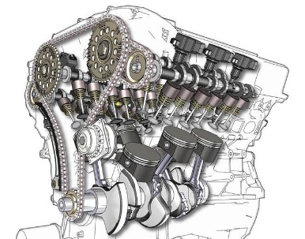
EV Market Entry Points
Fewer Moving Parts
Hundreds
One
Low Maintenance Cost
Lower Fuel Cost
Gasoline / mile Electricity / mile
$0.08 -$0.12 $0.04 -$0.06
Vehicle Electrification Economics
Rocky Mountain Institute 2015
Notes:
Electric vehicles are the economic choice for high mileage applications
Expect to see more ride sharing vehicles go electric
High battery cost is the last remaining economic barrier for low mileage personal cars
By 2025 we expect electric vehicles having a lower cost without any subsidies that ICE vehicles

Slide 6
Why Support Electrification
Mobility Challenges | Potential
Expensive and Underutilized
Energy Independence
Accidents
Congestion
Pollution
Use of Land
Notes:
Mobility Challenges
Expensive
Strong potential to reduce transportation costs
Underutilized
Vehicles are utilized 50% plus percent of the time and shared 40% of the time
Energy Independence
Gas is imported, electricity is produced locally
Accidents
Autonomous vehicles don’t drink, text or yell at kids in the back seat
Autonomous vehicles could reduce accidents by as much as 90%
Congestion
If planned properly, congestion can be reduced
Shared rides and encouragement of mass transit has helped San Francisco reduce congestion by 5%
Pollution
Zero emissions form the vehicle which is often in the most congested areas
Overall greater efficiency form the vehicle
Cleaner grid will reduce the impacts of charging an EV
Poor use of Land
Repurpose the land for better purposes

Slide 7
Public Sector Planning
“Electric mobility is like an upside-down ketchup bottle. You know that at some point something will come out. You don’t know when, but once it comes, it really does. Then it’s bad if your not prepared.” ~Dr. Dieter Zetsche, CEO, Mercedes-Benz
Notes:
I have to give Fleet Carma credit for this image
I saw this in one of their presentations and it really stuck with me and it is relevant to our discussion today

Slide 8
Planning – Charging
Notes:
This is a typical demand curve
There is plenty of capacity on the grid to charge the electric vehicles being added
The issue is if everyone plugs in and charges at 6:00 PM when they get home from work
Electric vehicles typically have more range than they need for everyday use.
A typical person will use less than half of the electricity in the battery – probably closer to 25% of the battery
Electric vehicles are a flexible load
On a typical day, do you need to charge right when you get home?
These vehicles can charge at night or during the day - as long as you have a charged car for tomorrow
Managed charging
You can shape EV load with price signals such as rebates, real time pricing, and rewards
There are also ways to allow utilities to have a more active load control, but this can be more complex
This is done with building controls such as AC cycling
This is important for individuals but also commercial vehicles like ridesharing and buses
These vehicles will see more fast charging taking place

Slide 9
Planning – Charging
Notes:
The duck curve is created as more solar is added into the grid
This is what is happening in California
Illinois is poised to add a lot of solar capacity in the coming years
We also see opportunities for vehicle to grid applications
The batteries in the vehicles can function as energy storage components
Vehicle to load
The vehicles can serve as backup power for the certain applications
Example: If a Highrise looses power – a vehicle could be used to power an elevator

Slide 10
Planning – Highland Park
Drive EV Adoption Rates
Install EV Charging Station
Promote & Educate
Incentives
Vendor Engagement
Builders & Multifamily
Electrify City Fleet
Notes:
Planning and Market Barriers
This is based on am EV Expansion Strategy that I put together for Highland Park in 2012
Install Charge Station - Showed leadership by installing a charge station
Took a regional approach and worked with other municipalities
Allowed for a piggy back option so additional municipalities can add chargers
Promoted & Educate
Provide resources in community newsletters, website, press releases, ribbon cutting, etc.
Educate staff
Provide Incentives
Consider things like tiered vehicle registration pricing
Perhaps workplace charging for employees
Vendor Engagement
Encourage vendors to go electric
Add language to RFPs
Builders and Multifamily
Consider policies to get charging in new and multifamily buildings
Electrify City Fleet
Run a pilot
We learn the real-world experiences when we run pilots
Look at life cycle costs rather than up front costs
Results
Three-fold growth in Chargers and EVs in Highland Park
Honorable mention in the US Conference of Mayors – Climate Protection Award
Bronze in the Institute for Supply Management Sustainability Award
Saw Tesla open a showroom in Highland Park
It can positively impact business

