Slide 1

Electric Vehicle &
Charging Background
Metropolitan Mayor Caucus
Environmental Committee
October 29, 2018
Notes:
Intro GW2G
How many of you have EV chargers in your town? How many munis have EVs in their fleets? Plan to?
How many are familiar w/ terms L1, L2, L3?

Slide 2
Why Plug-In Electric Vehicles?
System Level Challenges
Opportunities with EVs
Fuel Diversity (petroleum independence)
Electricity from domestic sources
Global Climate Change
Reduced Lifecycle GHG
Local Air Quality
Lower or Zero Tailpipe Emissions
Economic Development
Technology Innovation, Jobs, Cash Flow
Electric Grid Management
Optimize utilization of electrical power assets

Slide 3

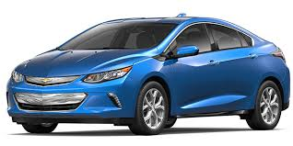
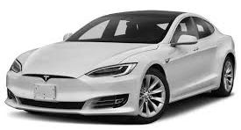
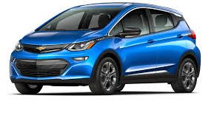
PEV Terminology: Vehicle Choices
Plug-in Electric Vehicles (PEV)
  Plug-in Hybrid Electric Vehicle (PHEV) aka Extended Range Electric Vehicles (EREV)
    Can run on electricity or internal combustion engine (ICE)
    Primary power source is electricity
    Internal combustion engine automatically
    engages when battery runs low
    Zero tailpipe emissions when running on battery only
    ICE feature alleviates range anxiety
  All Electric Vehicle (AEV)
  aka Battery Electric Vehicles (BEV)
    100% electric battery powered
    Range limited (Leaf:150/Bolt:240/Tesla:310)
      Constrained by battery
    Zero tailpipe emissions
    Quiet
    Lower maintenance
  PEVs Different from Hybrid Electric Vehicles (HEVs)
    Petroleum primary with electric assist for efficiency
Notes:
Nissan offers a warranty covering loss of battery capacity below 66 percent over eight years or 100,000 miles

Slide 4
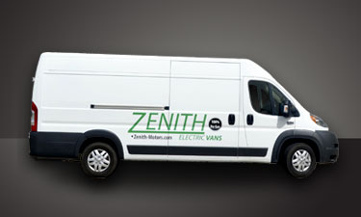
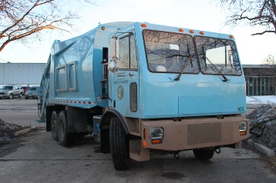
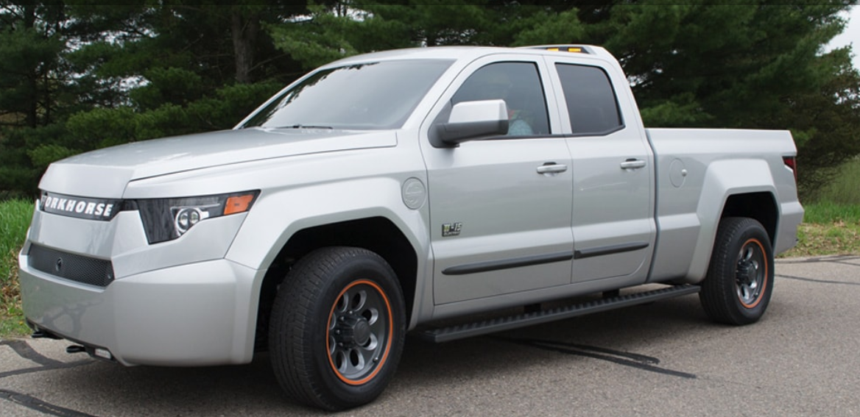
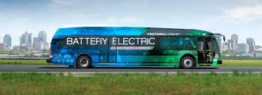
Municipal PEVs: 2018
Passenger EV Models: 26 PHEVs and 17 AEVs – w/ rebates, some are cost competitive with Internal Combustion Engine Vehicles (ICEVs)
SUVs/Vans – 4 PHEVs (<33 e-miles), 3 Tesla X models
Small, Medium and Large Trucks
  Several models available from Class 1 to 8
  Combination of PHEVs and AEVs
  Most OEMs actively developing solutions
  Challenges with cost, range, payload, charge times, operational flexibility
E-buses
  Appealing for schools and public transit: better air quality, less noise
  Operation based charging – versatility, on route & dynamic charging, range planning
Notes:
https://www.truckinginfo.com/312230/why-electric-trucks-why-now
Zenyth Van http://www.zenith-motors.com/
Chicago Garbage truck
Workhorse e-truck
Jacksonville, FL E bus
PHEV - Volvo (2), Mitsubishi, Chrysler Outlander
Tesla X – 3 different battery packs

Slide 5
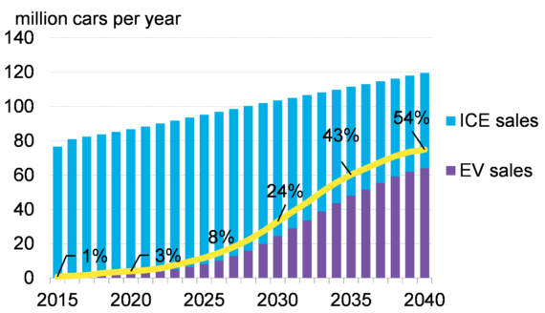
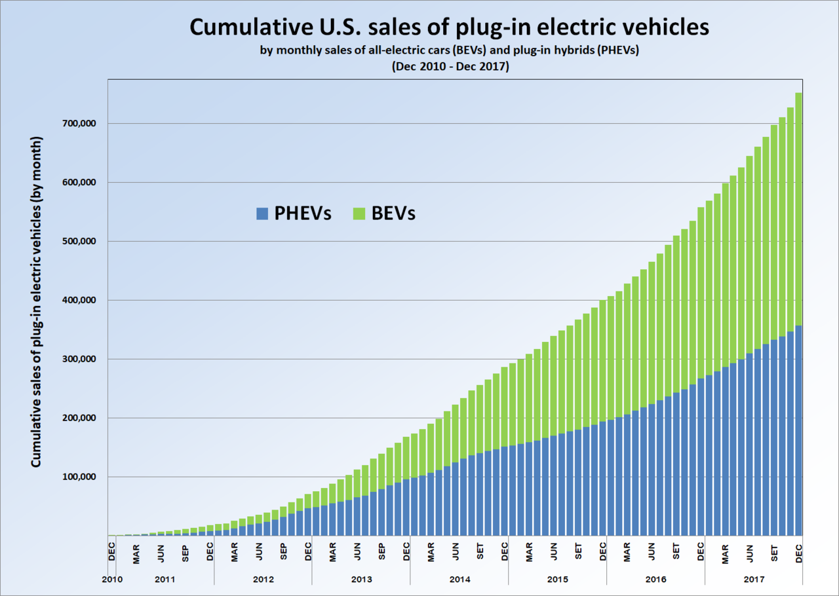
PEV Sales Forecasts
Forecast
250 MM total vehicles on the road globally (2017)
EVs
  3.2 MM - Globally
  750,000 - US
Several major cities, countries, automakers eliminating Internal Combustion Engine Vehicles (ICEVs) in next few years
History
Sources: Bloomberg New Energy Finance
Statistica.com
Notes:
https://www.statista.com/statistics/801263/us-plug-in-electric-vehicle-sales/
More than nine countries and a dozen cities or states have announced what the media has called “bans” in the last few years. Copenhagen mayor Frank Jensen wants the city to end all new diesel cars starting next year. Last December, Paris, Madrid, Athens and Mexico City said they would remove diesel cars and vans by 2025. Norway will phase out conventional cars by 2025, followed by France and the United Kingdom in 2040 and 2050, respectively.
Volvo and Tesla – 100% electric

Slide 6
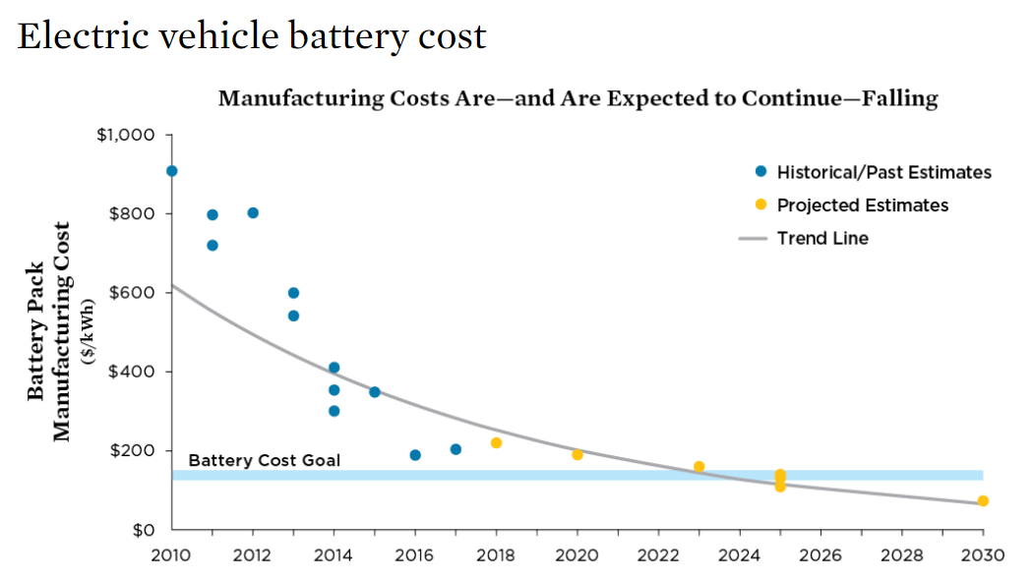
US DOE and Original Equipment Manufacturers (OEMs)
R&D is Bringing Down Battery Costs of PEVs
Reducing Battery Costs
US DOE R&D
  Supported significant battery cost reductions (3X) since 2008
  Worked with OEMs universities, others
Goal: $100-150/kWh by 2025- basis for cost parity with ICEV
Year
https://www.energy.gov/eere/vehicles/batteries
SOURCES: ARB 2017; SOULOPOULOS 2017; VOELCKER 2017; SLOWIK, PAVLENKO, AND LUTSEY 2016; VOELCKER 2016; NYKVIST AND NILSSON 2015.
Notes:
Along with auto manufacturers, the U.S. Department of Energy’s R&D program has significant cost goals…and the cost per kilowatt-hour of batteries has declined far faster than expected. Long range EVs were introduced many years ahead of schedule.
According to Bloomberg New Energy Finance, prices have declined over 70% from 2010 to 2016.
DOE’s goal is to get the cost of EV batteries to less than $100/kWh, increase range to 300 miles, and decrease charge time to 15 minutes or less.
Most analysts claimed lithium-ion battery technology was not capable of powering a robust market for long range vehicles. The belief was that new chemistries with much higher energy densities were needed for EVs to reach their full potential. While this may still be true for batteries to power all vehicles, the cost per kilowatt-hour of batteries has declined far faster than expected and resulted in long range EVs being introduced many years ahead of expert opinions. A good example is the 2012 and 2017 California Air Resources Board analyses for its ZEV program. The 2012 analysis assumed 100-mile BEVs would be the norm out to 2025 while the 2017 analysis assumes vehicles capable of traveling over 200 miles on a charge will be common in that timeframe.
Can reduce cost of EV batteries to less than $100/kWh, increase range to 300 miles, and decrease charge time to 15 minutes or less
Ultimate goal is $80/kWh for cost competitiveness
Current Battery Pack Cost Estimates from Two Automakers (Usable Energy)
GM: ~$220-235/kWh
Tesla: ~$223/kWh
http://www.automotivebusiness.com.br/abinteligencia/pdf/EV-Price-Parity-Report.pdf- cost parity
https://www.ucsusa.org/sites/default/files/attach/2017/09/cv-factsheets-ev-incentives.pdf?_ga=2.108452610.1630188791.1517413160-1434713090.1436805699SOURCES: ARB 2017; SOULOPOULOS 2017; VOELCKER 2017; SLOWIK, PAVLENKO, AND LUTSEY 2016; VOELCKER 2016; NYKVIST AND NILSSON 2015.

Slide 7
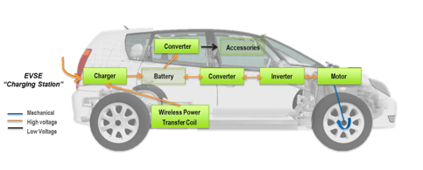
US DOE and Vehicle OEMs
Bringing Down Costs of PEVs
Reducing Other Costs
All components
Apply Innovation
Mature Supply chain management
Optimize production methods and leverage volume
https://www.energy.gov/sites/prod/files/2017/06/f34/edt000_boyd_2017_o.pdf
Goals
Charge times <15 min
Range 300 miles
Cost parity with Internal Combustion Engine Vehicles by 2025, no incentives
Notes:
Along with auto manufacturers, the U.S. Department of Energy’s R&D program has significant cost goals…and the cost per kilowatt-hour of batteries has declined far faster than expected. Long range EVs were introduced many years ahead of schedule.
According to Bloomberg New Energy Finance, prices have declined over 70% from 2010 to 2016.
DOE’s goal is to get the cost of EV batteries to less than $100/kWh, increase range to 300 miles, and decrease charge time to 15 minutes or less.
Most analysts claimed lithium-ion battery technology was not capable of powering a robust market for long range vehicles. The belief was that new chemistries with much higher energy densities were needed for EVs to reach their full potential. While this may still be true for batteries to power all vehicles, the cost per kilowatt-hour of batteries has declined far faster than expected and resulted in long range EVs being introduced many years ahead of expert opinions. A good example is the 2012 and 2017 California Air Resources Board analyses for its ZEV program. The 2012 analysis assumed 100-mile BEVs would be the norm out to 2025 while the 2017 analysis assumes vehicles capable of traveling over 200 miles on a charge will be common in that timeframe.
Can reduce cost of EV batteries to less than $100/kWh, increase range to 300 miles, and decrease charge time to 15 minutes or less
Ultimate goal is $80/kWh for cost competitiveness
Current Battery Pack Cost Estimates from Two Automakers (Usable Energy)
GM: ~$220-235/kWh
Tesla: ~$223/kWh
http://www.automotivebusiness.com.br/abinteligencia/pdf/EV-Price-Parity-Report.pdf- cost parity

Slide 8
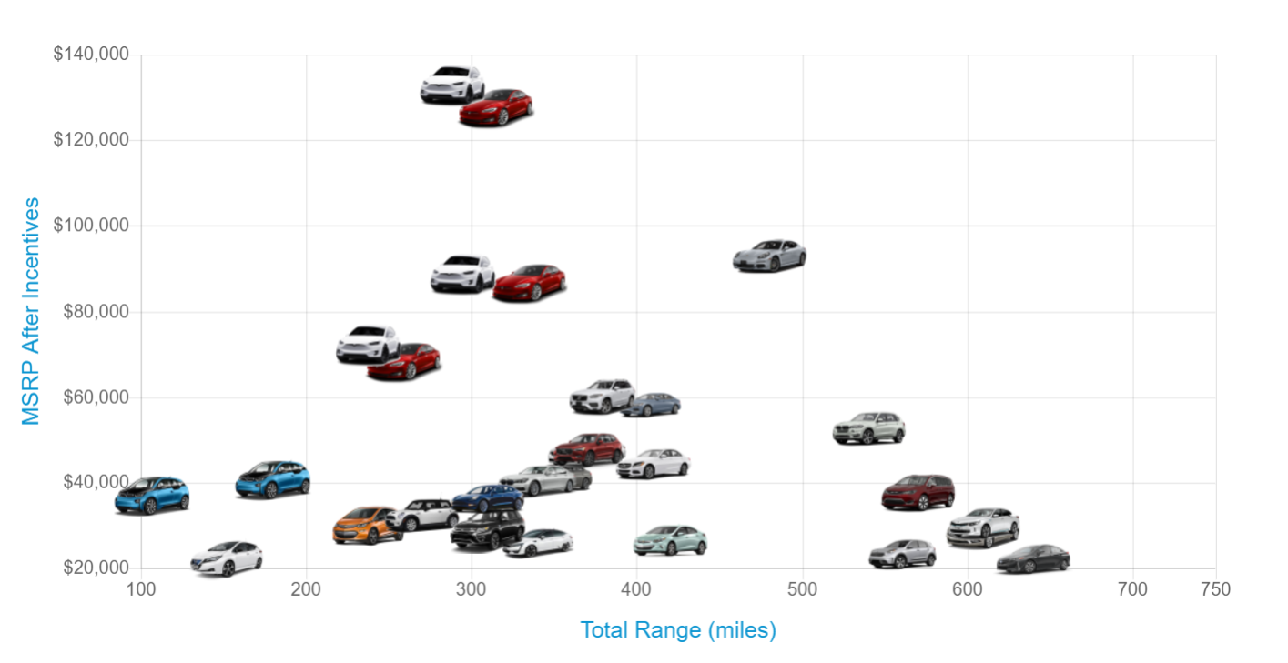
Today’s PEVs: Total Range
AEVs
~17 models avail.
PHEVs
(~ 26 models avail.)
2018 Tesla X and S
Porsche Panamera (16/480)
BMW i3
PHEV (97/180)
BMW X5 (16/480)
BMW i3
Mitsubishi SUV (33/570)
Chevy Volt (53/420)
Ford Fusion (21/610)
Chevy Bolt
Prius (25/640)
Leaf
2018
Tesla 3
Kia (26/560)
Source Plugstar

Slide 9
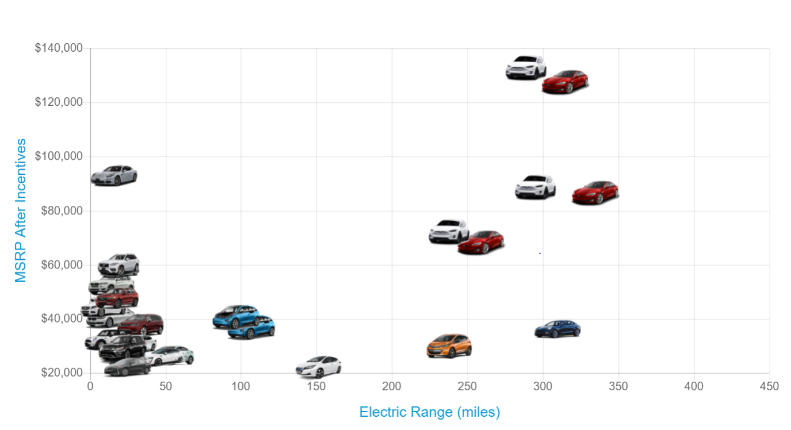
Today’s PEVs : Electric Only Range
PHEVs
AEVs
2018 Tesla X and S
BMW i3
2018 Leaf
Chevy Bolt
2018 Tesla 3
BMW i3
PHEV
Source Plugstar
Notes:
https://plugstar.zappyride.com/cars/browse

Slide 10
Annual fuel costs are considerably lower for PEVs than for conventional counterparts
*based on 15,000 miles/year, OR averages of gasoline price of $2.94/gallon and $0.12/kWh of electricity
Notes:
In 2016, transportation costs the average American household over $9k, second only to housing. (see BLS: https://www.bls.gov/news.release/cesan.nr0.htm).
Even with gas prices under $3/gallon, EVs can save consumers money nationwide…significant fuel costs savings when comparing gasoline and electricity costs on an energy-equivalent basis. The figure here with average energy costs from 2011 to 2016 and shows that EVs have saved consumers (on average) more than $1.20 per gallon of gasoline equivalent.

Slide 11


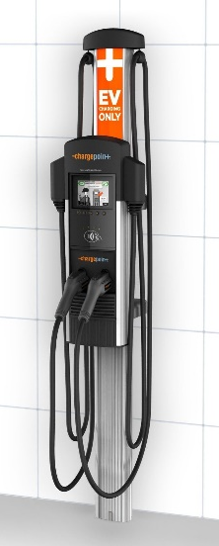
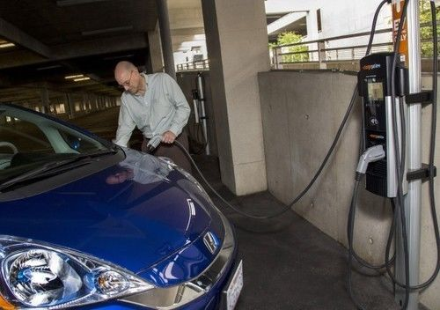
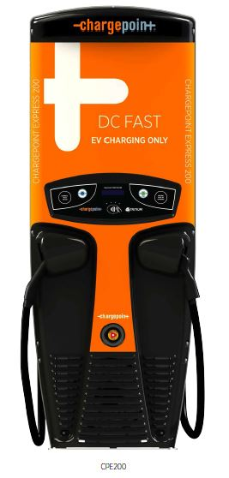
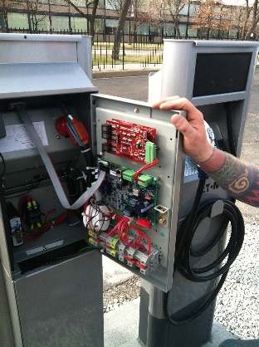
EV Charging
Electric Vehicle Supply Equipment (EVSE)
  Level 1: 110 VAC in and out of charging
  Level 2: 208/240 VAC in and out of charging
  Level 3: 480⁺ VAC
    AC into charging station
    DC out of charging station
    = DC Fast Charger
Notes:
IIT power pack

Slide 12
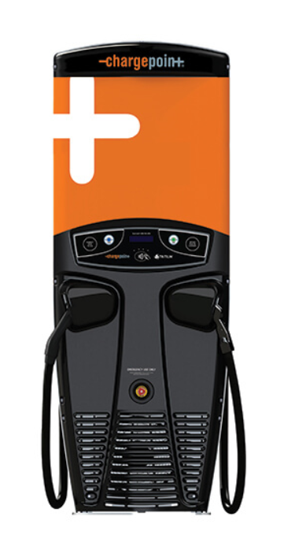

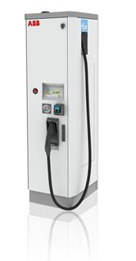
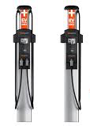
EV Charging Summary
3 standard charging power levels:
  Level 1: home/mobile – overnight charging
  Level 2: public, fleet, workplace or home
  Level 3: retail or fleet, aka “DC Fast Charging”
  top off in 10-20 minutes
  Charge time depends on EV Charging Station power, EV battery capacity and battery power management
EV Supply Equipment (EVSE) = Charging Station
  Networked or non-networked
    Networking (wireless, cloud-based) allows GPS location, reservations, reporting and automated billing
    Non-networked – only locally controls power
  Conductive (corded) or Inductive (plugless)
  Single or multiple

Slide 13
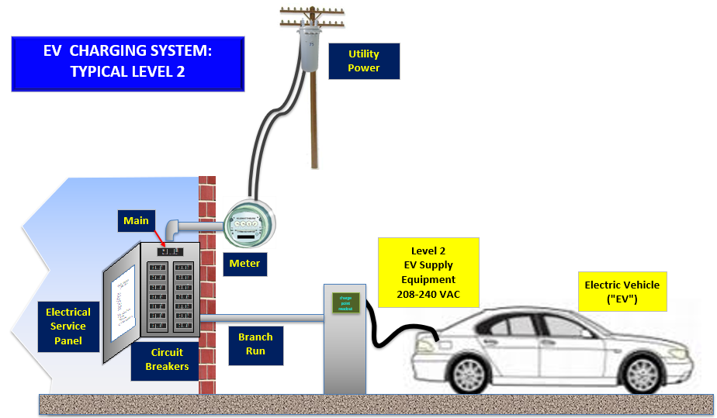
Typical Level 2 Charging Installation

Slide 14
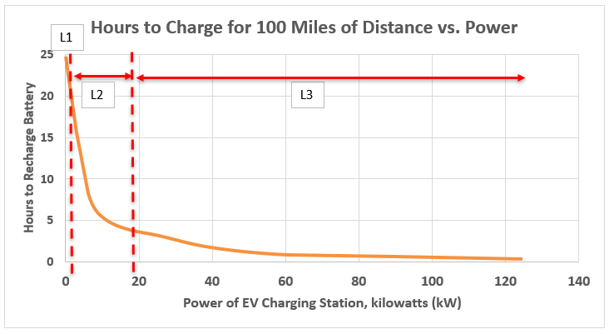
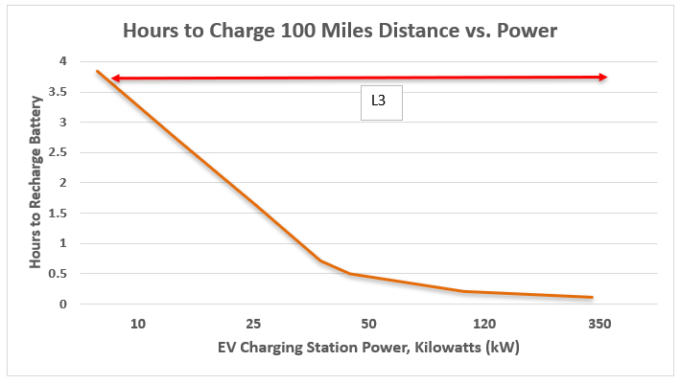
Charging Level vs. Charging Speed
Level 1: 1 to 2 kW
Level 2: 3.3 to 19 kW
Level 3: 10 - 350 kW and up
kW= kilowatt

Slide 15
Where to Charge?
Charge Point Level 2 Chargers Owned by Municipalities
Batavia | Glen Ellyn
Carol Stream Park District | Kane County Forest Preserve District
Chicago | Highland Park
Des Plaines | Kane County
DuPage County | Lake County
Elgin | Lake Forest
Elmhurst | St. Charles
Evanston | Oak Park
Frankfort | Park Forest
Franklin Park | Skokie
Wheeling
EV Charging Station Owners | Types of Users
Workplace | Employees Business and public fleets
Retail | Patrons
Professional Offices | Patrons, employees
Parking Garages | Patrons
Public parking lots | General public
Health Care | Patrons, employees
Residential | EV Owners

Slide 16
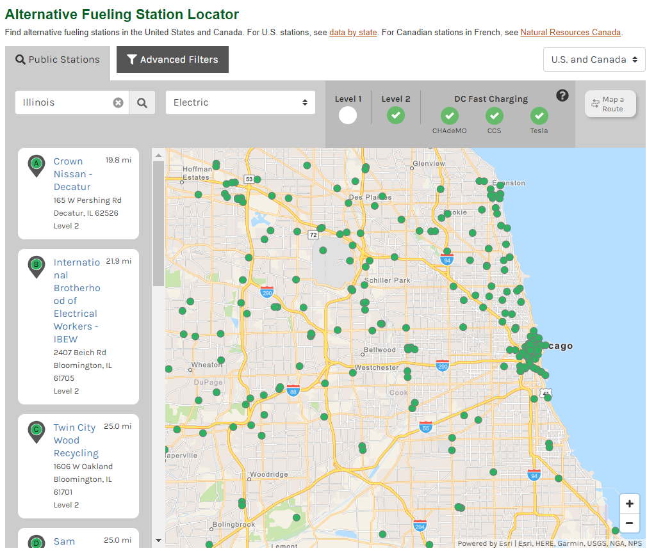
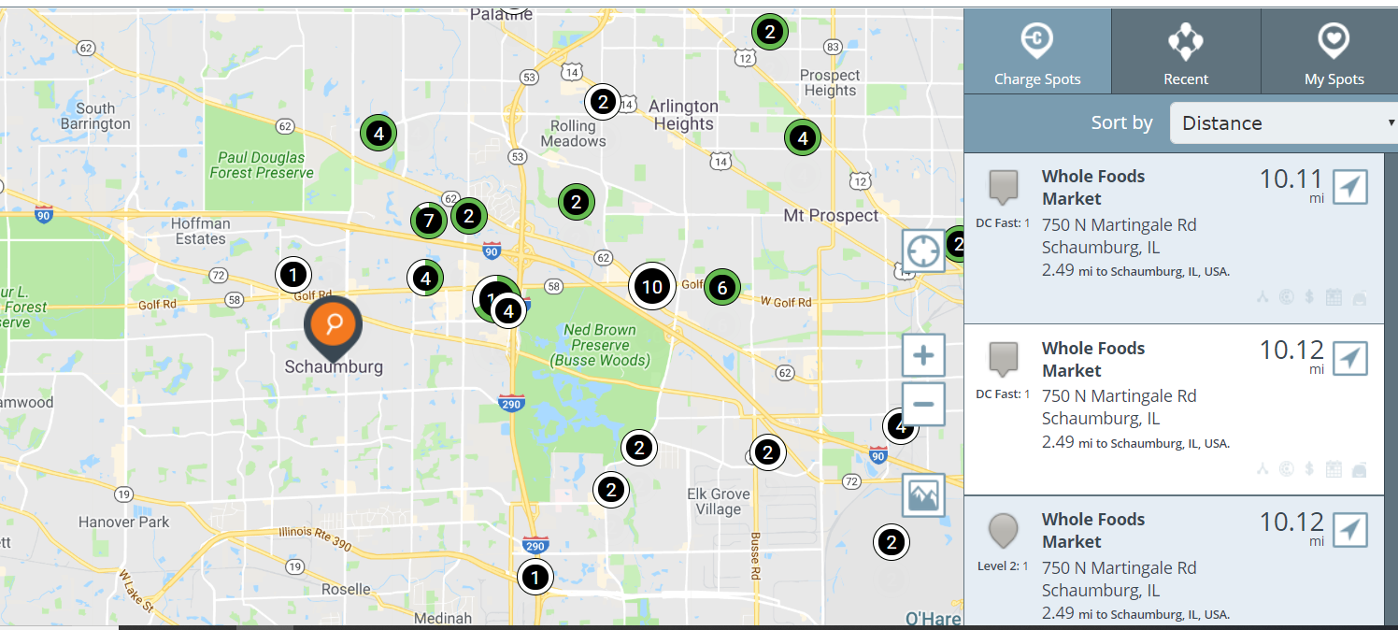
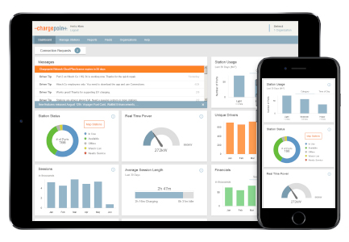
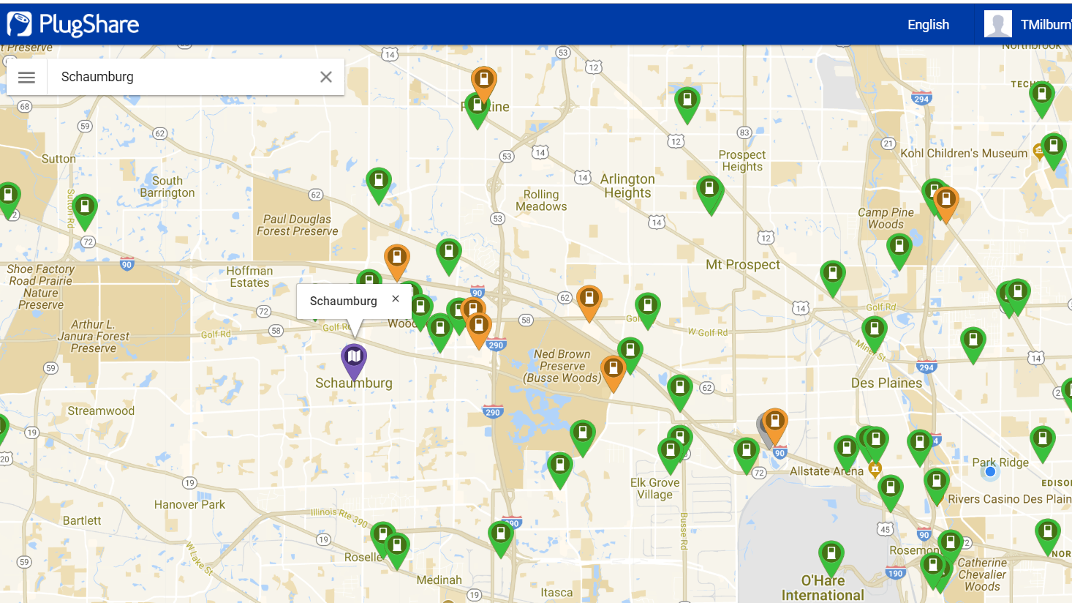
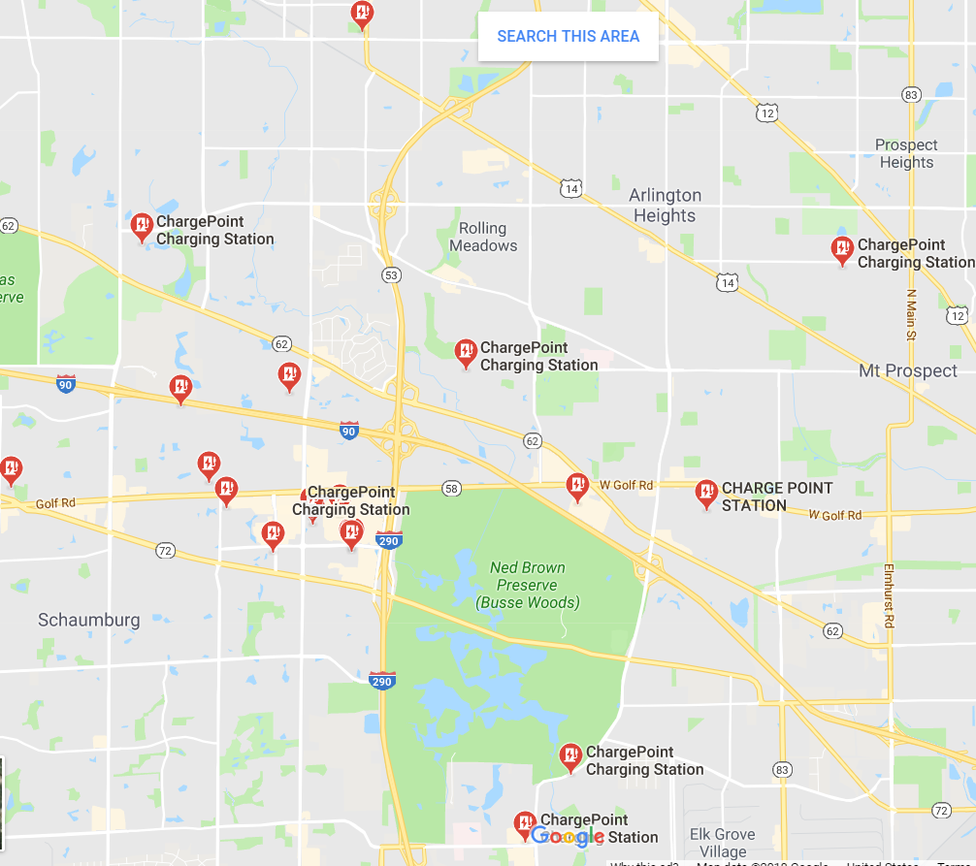
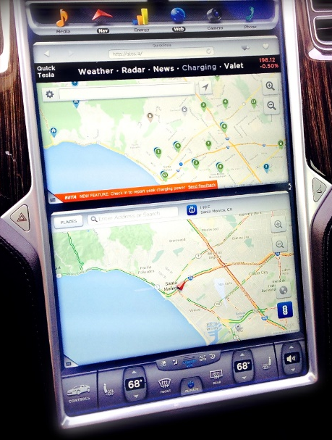
Finding Stations
US DOE Alt Fuel Data Center
ChargePoint
Mobile Apps
Google Maps :
“EV charger near me”
PlugShare
Dashboard
Notes:
https://www.plugshare.com/

Slide 17
EV Charging Infrastructure Costs
L1: comes with EV, $150 to $400 to buy
 | Cost of EVSE and Installation, no rebates
Level | Residential | Non-Residential
2 (240 V) | $1,000 to $2,500 | $2,000 to $20,000
Level | Residential | Single | Multiple | Large Transit System
3 (480 V) | N/A | $50,000 to $80,000 | $100,000 to $1,000,000 | > $1million
Voltage
Distance between power and EVSE
Indoor vs. outdoor
Type of EVSE
Existing power capacity
Key Variables:

Slide 18
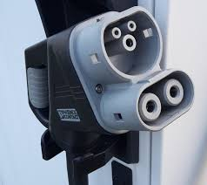
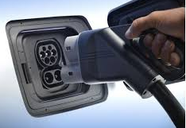
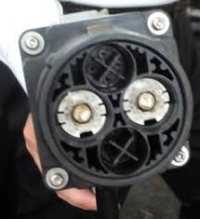
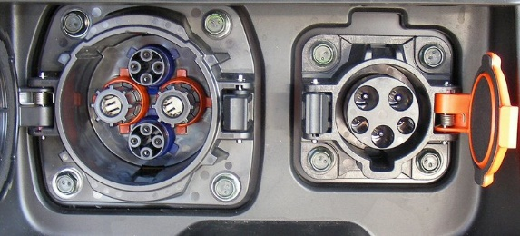
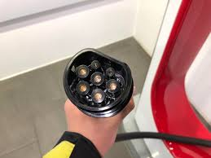
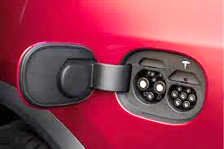
EV Charging Connectors
L1 & L2 – J1772 – AC
→ All Evs (Universal)
L3 – Combo Charging
System (“CCS”) - AC & DC
→ Some BEVs
L3 – CHAdeMo – DC
→ Some BEVs
L3 – Tesla Supercharger- DC
→ Tesla BEVs ONLY
Notes:
CHAdeMo "CHArge de MOve", equivalent to "move using charge" or "move by charge" or "charge 'n' go", a reference to the fact that it's a fast charger. The name is derived from the Japanese phrase O cha demo ikaga desuka, translating to English as "How about a cup of tea?", referring to the time it would take to charge a car.

Slide 19
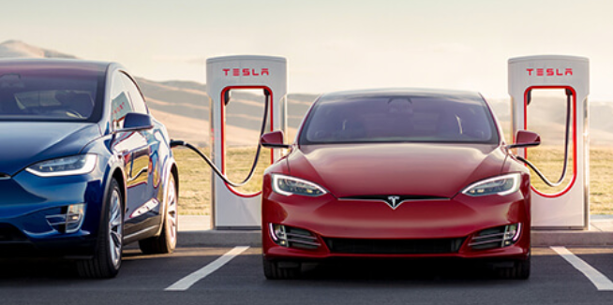
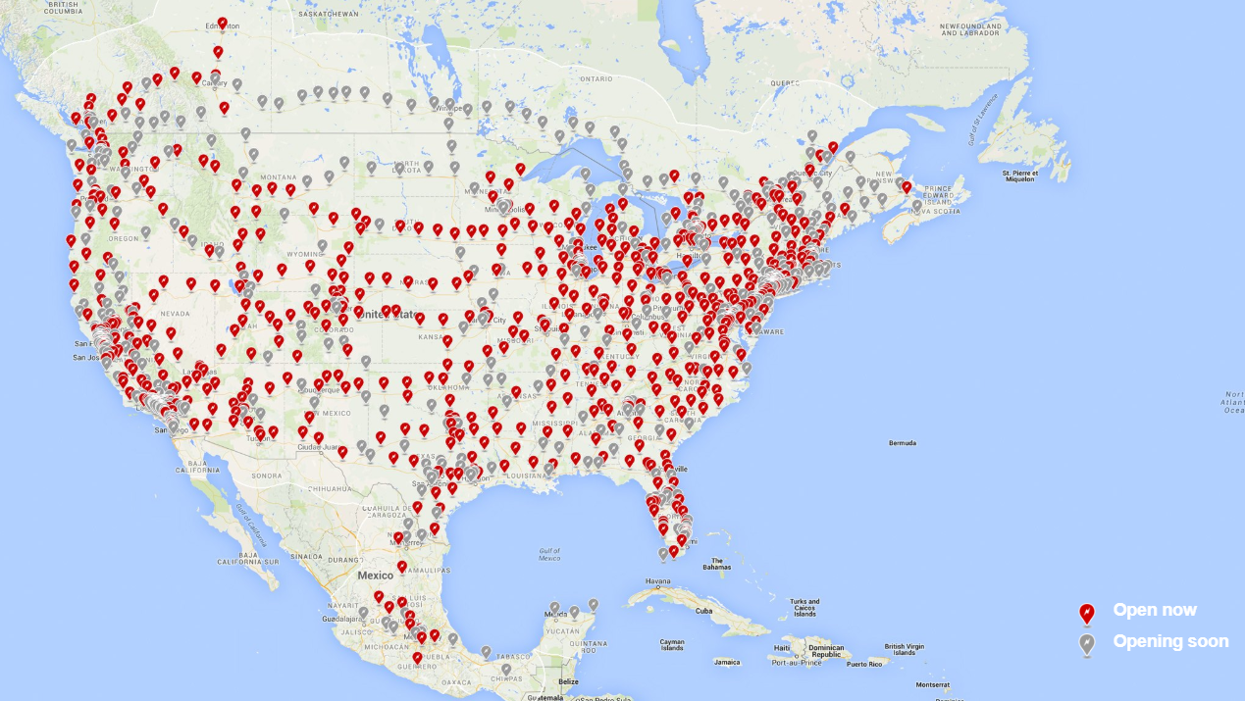
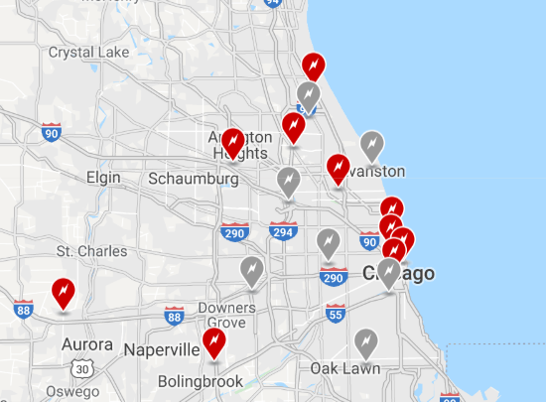
Tesla Superchargers
Network: system of 480-volt DC fast-charging stations
300 mile range from “empty”
  20 minutes → 50%
  40 minutes → 80%
  75 minutes→ 100%
Notes:
https://www.tesla.com/findus?v=2&bounds=42.60962251537978%2C-86.3806991286213%2C41.23807797109101%2C-90.5994491286213&zoom=9&filters=supercharger&location=merrillvilleinsupercharger

Slide 20
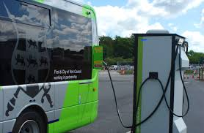
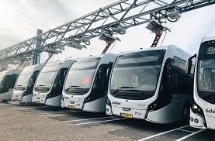
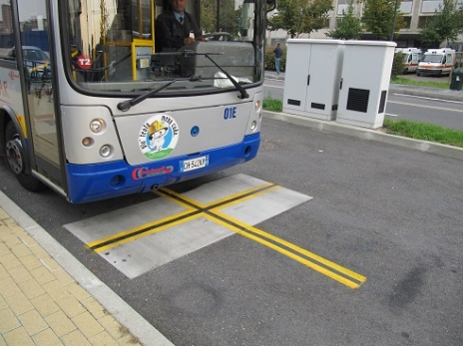
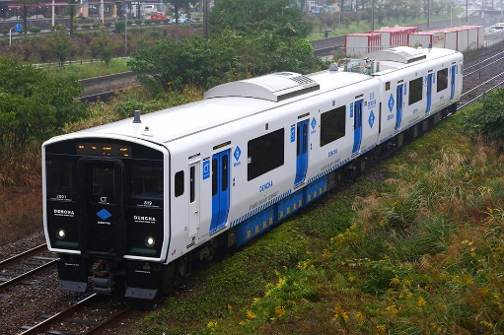
High-Powered L3 Charging
50 to 600 kW⁺
Retail and e-Bus applications, maybe rail
Vehicle and charging designed to suit operations
  Battery size
  Recharge frequency and access to charging
  Routes
Depot
Inductive-Static
On Route
Conductive
Conductive
Inductive
Static
Dynamic
Static
Dynamic
Notes:
China adds about 9,500 EV buses every five weeks
CapEx and OpEx changes
Time-of-use charging benefitsFactoring in lower operation and maintenance costs, the tab for an electric bus is only about $33,000 more than a traditional one over an eight-year period, according to calculations by the World Bank

Slide 21
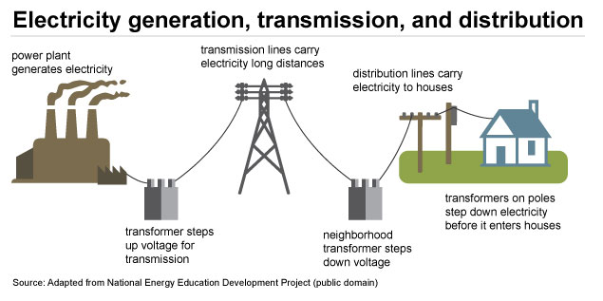
Power to EVs
Power plants
Transmission lines
Transformers
Distribution /delivery lines
Electrical service panels, breakers
Conduits and wiring
EV Supply Equipment (EVSE)
Local energy capacities (typ.)
  Homes – 10 to 50 kW
  Commercial Businesses – 50 to 500 kW
  Industrial Businesses – 100 to 5000⁺ kW
EV Charging
Level 2 – typically <10kW
Level 3 can be up to 150 kW

Slide 22
Evolution of EV Power
Current: Mainly use existing capacity of facility (e.g. spare circuit breakers)
Sometimes: need to transform power within facility or add capacity into facility
Coming:
  Add more utility local high voltage power lines and supporting infrastructure, based on demand: at specific sites
  Add more central and /or distributed generation capacity (renewable, micro power plants)
  Smarter energy management – demand / time of use management, energy storage
  Grid tied EV batteries- helps manage power assets

Slide 23
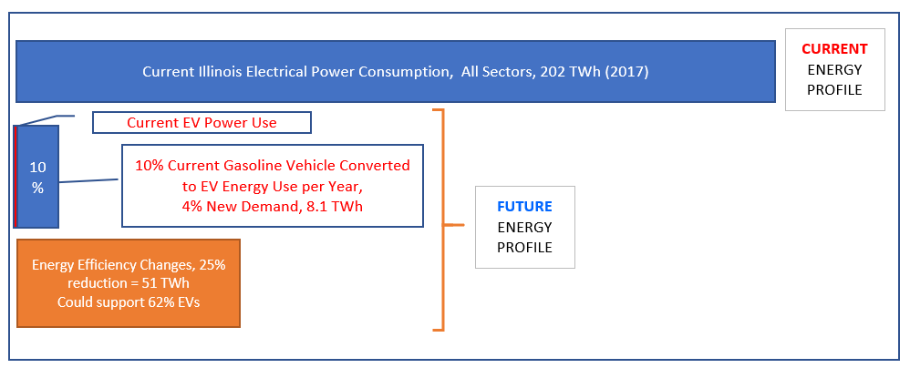
Illinois: How much power for EVs?
If 10% vehicles are electric:
Challenges:
  Local capacities, distributed solutions
  Leveraging new technologies to optimize
Source: US EIA

Slide 24

THANK YOU!
Tim Milburn
847-823-9205 tim.milburn@greenways2go.com www.greenways2go.com

