Slide 1
Municipal Planning / Regional Planning for Electric Vehicles
October 2018
Metropolitan Mayors Caucus
Environmental Committee Meeting

Slide 2
AGENDA
Introduction
II. Highland Park Electric Vehicle Planning
III. Mobility Trends
IV. Public Sector Planning

Slide 3
Highland Park Electric Vehicle Planning
2013 Electric Vehicle Expansion Strategy
Drive EV Adoption Rates
Install EV Charging Station
Promote & Educate
Incentives
Vendor Engagement
Builders & Multifamily
Electrify City Fleet
Notes:
Planning and Market Barriers
This is based on am EV Expansion Strategy that I put together for Highland Park in 2012
Install Charge Station - Showed leadership by installing a charge station
Took a regional approach and worked with other municipalities
Allowed for a piggy back option so additional municipalities can add chargers
Promoted & Educate
Provide resources in community newsletters, website, press releases, ribbon cutting, etc.
Educate staff
Provide Incentives
Consider things like tiered vehicle registration pricing
Perhaps workplace charging for employees
Vendor Engagement
Encourage vendors to go electric
Add language to RFPs
Builders and Multifamily
Consider policies to get charging in new and multifamily buildings
Electrify City Fleet
Run a pilot
We learn the real-world experiences when we run pilots
Look at life cycle costs rather than up front costs
Results
Three-fold growth in Chargers and EVs in Highland Park
Honorable mention in the US Conference of Mayors – Climate Protection Award
Bronze in the Institute for Supply Management Sustainability Award
Saw Tesla open a showroom in Highland Park
It can positively impact business

Slide 4
AGENDA
Introduction
II. Highland Park Electric Vehicle Planning
III. Mobility Trends
IV. Public Sector Planning

Slide 5
Mobility Trends
Challenges and Trends
Current Mobility Challenges
Costs and Vehicle Usage Optimization
Energy Independence
Rate of Accidents
Congestion & Lost Time
Pollution, GHGs, Health & Sustainability
Use of Land
Notes:
Current Mobility System
86% of Americans commute by car
Mobility Challenges
Expensive
2nd highlights expense for U.S. families
Does anyone know how much the average cost to own a car is?
Average total cost to own is $9,000 a year
Underutilized
Vehicles sit idle 95% of the time
Energy Independence
Accidents
Automobile accidents kill over 1,000,000 people each year, 37,000 in the US alone
Congestion
According to a study conducted by the Texas A&M Transportation Institute Americans waste 42 hours a year stuck in traffic
That cost the average motorist $960 in wasted time and fuel
The Chicago area is not immune to congestion – I probably don’t need to discuss this very much
Pollution
The American Lung Association estimates that for every gallon of gas consumed there is a $1.15 in health and climate change costs.
Poor use of Land
We have over 1 Billion parking spaces in the US

Slide 6
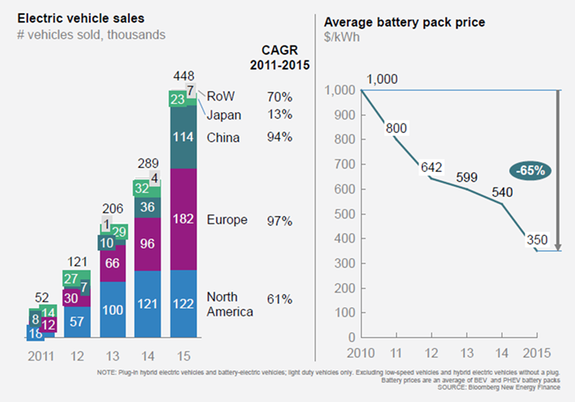
Mobility Trends
Global and National Trends
Global Trends
Emerging Sustainability Policies
Urbanization
Changing Priorities
Consumer Preferences
Emerging Technologies
Global Trends
Emerging Sustainability Policies
Urbanization
Changing priorities
Consumer preferences
Emerging technologies
Notes:
Global Trends
Emerging Sustainability Policies
Air quality is a growing concern in cities because of human health impacts
Cities are introducing policies that favor low emissions vehicles
Low-emissions zones are defined as areas where access by some polluting vehicles is restricted
Over 200 cities and towns operate or are preparing low emissions zones
Seattle Airport requires ride sharing vehicles to get 45 miles per gallon or greater to pickup passengers
Urbanization
By 2030, 60% of global population will live in cities.
More people, more vehicles & more stressed infrastructure.
Solutions will need to be found
Changing priorities
Let me see a show of hands – how many people raced out to get their drivers license at the age of 16?
When I ask this question in a class of college students, you only see half of the hands go up.
Fewer 16-year old’s are getting their drivers license
85.3% of high school seniors had their drivers license in 1996
71.5% of high school seniors had their drivers license in 2015
As ride sharing services improve, we may see a getting a license become an even lower priority
Consumer preferences
Ride sharing services came out of nowhere and are growing rapidly – Lyft is growing at 40% year over year
By mid 2016 $21 billion had been invested
Emerging technologies
60% rise in EV’s globally in 2015 compared to 2011
Average price of Li-ion battery packs dropped 65% between 2010-2015
Proces are now around $200 a kWh
Perfect example of moores law
By 2025 EVs should be the same price as ICE without incentives
Total cost to own an EV can be less right now for some applications such as ride sharing
Rapid advancements in autonomous vehicles – full self-driving L4 by 2025 (L3-L4 on the market by 2020-2021)

Slide 7
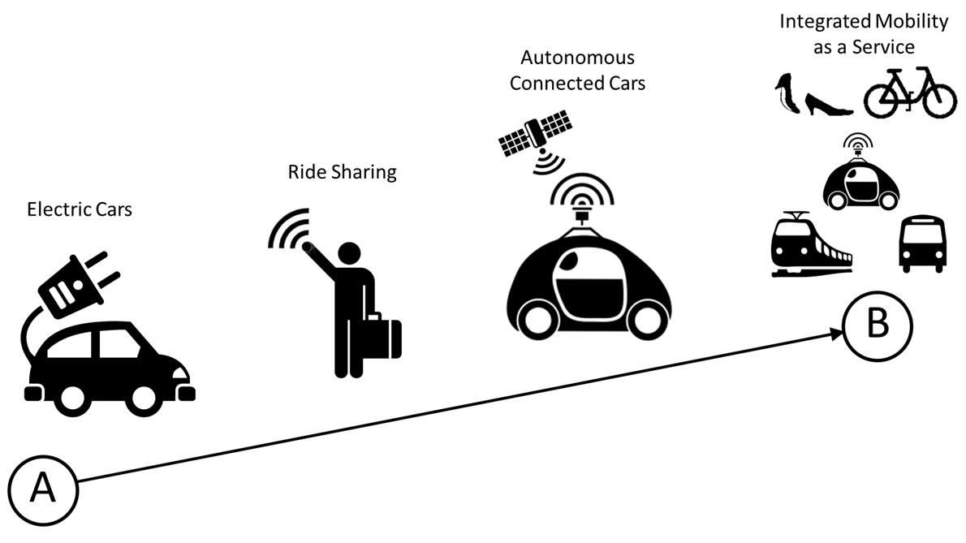
Mobility Trends
Integrated Mobility as a Service
Global Trends
Emerging Sustainability Policies
Urbanization
Changing priorities
Consumer preferences
Emerging technologies
Notes:
Automotive Trends
Electric Cars
Can reduce pollution
Ridesharing
Growing trend with the capability to provide shared rides or even microtransit
Autonomous and Connected cars
Who has ridden in an autonomous vehicle?
Integrated mobility as a service
Pilots are starting with Mass and micro transit organizations

Slide 8
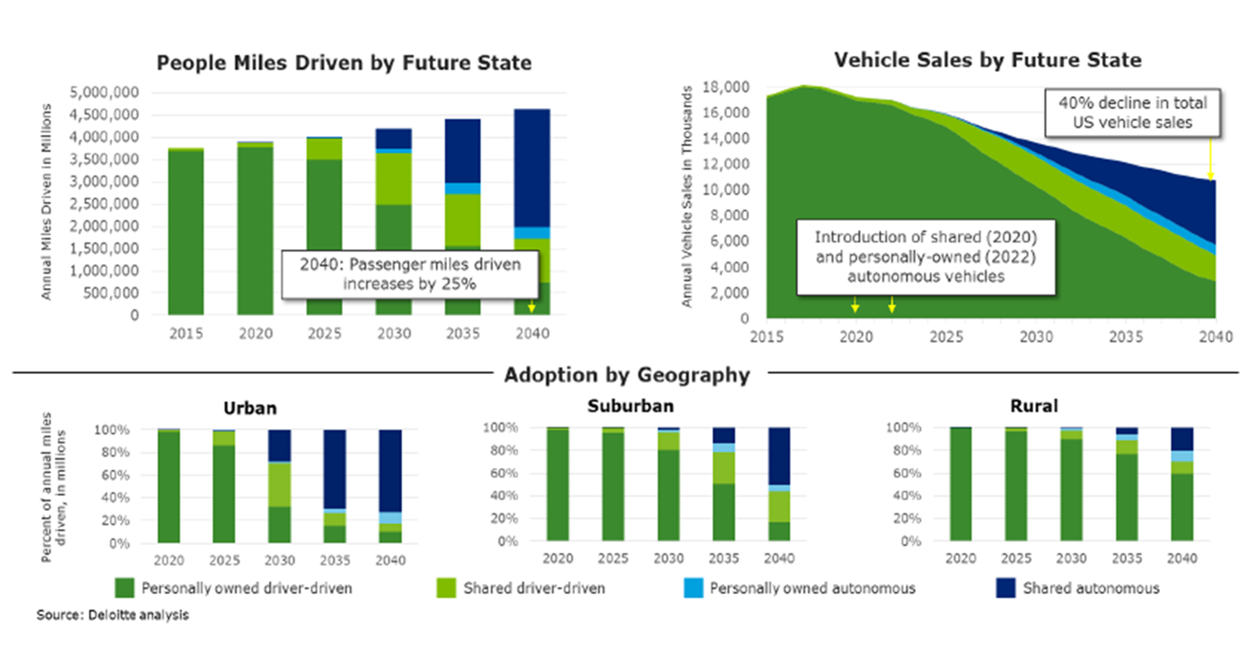
Mobility Trends
Planning for the Future
Global Trends
Emerging Sustainability Policies
Urbanization
Changing priorities
Consumer preferences
Emerging technologies
Notes:
This showcases the expected adoption rates
Most MMC communities fall within the urban and suburban geographies which will see the fastest adoption rates

Slide 9
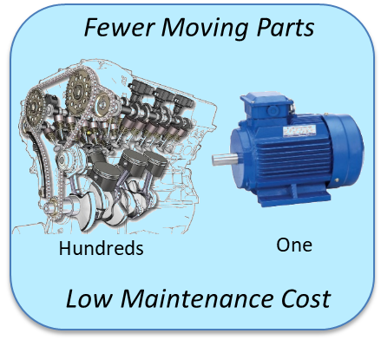
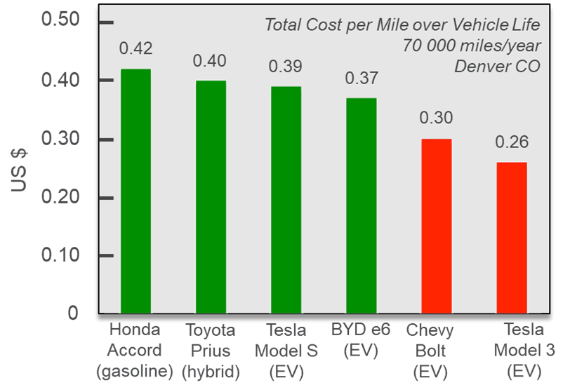
Mobility Trends
Planning for the Future
Global Trends
Emerging Sustainability Policies
Urbanization
Changing priorities
Consumer preferences
Emerging technologies
Lower Fuel Cost
Gasoline / mile Electricity / mile
$0.11 -$0.12 $0.03 -$0.05
Vehicle Electrification Economics
Rocky Mountain Institute 2015
Notes:
Electric vehicles are the economic choice for high mileage applications
Expect to see more ride sharing vehicles go electric
High battery cost is the last remaining economic barrier for low mileage personal cars
By 2025 we expect electric vehicles having a lower cost without any subsidies that ICE vehicles
Low fuel cost
25 MPG @ $2.82 a gallon (Illinois average according to AAA) = $0.11.28
3 miles per kWh @ $0.12 per kWh = $0.04 per mile

Slide 10
AGENDA
Introduction
II. Highland Park Electric Vehicle Planning
III. Mobility Trends
IV. Public Sector Planning

Slide 11
Public Sector Planning
Planning for the Future
“Electric mobility is like an upside-down ketchup bottle. You know that at some point something will come out. You don’t know when, but once it comes, it really does. Then it’s bad if your not prepared.”
~Dr. Dieter Zetsche, CEO, Mercedes-Benz
Notes:
I have to give Fleet Carma credit for this image
I saw this in one of their presentations and it really stuck with me and it is relevant to our discussion today

Slide 12
Public Sector Planning
CMAP - On To 2050
Outcome 1
Outcome 2
Personal Ownership of AVs
1. Inefficient land development
2. Less public transit use
3. Increased traffic
Fleets of shared vehicles
1. Reduce individual car ownership
2. Facilitate more dense walkable development patterns
3. Increase transit ridership, walking, and biking

Slide 13
Public Sector Planning
CMAP – On To 2050
Recommendations
Make decisions and policies now that smooth the transition to new mobility solutions
Support inclusive growth
Support public transit, shared mobility, and automated vehicles
Focus on lower income residents, seniors, and people with disabilities
Improve access to jobs, healthcare and other essential destinations
Make inclusive growth a cornerstone for policy development
Establish pricing and regulatory framework to positively shape the potential mobility outcomes
Influence the deployment of emerging technologies through strategic and coordinated policies
Improve electric vehicle charging infrastructure

Slide 14
Public Sector Planning
Electric Vehicle Charging
Public Charging – Determining Location
Community Wide Charging
DC fast charging
Highways
Level 2 chargers
Public buildings
Homes
Shopping centers
Level 1 chargers
Homes
Train stations
Multifamily buildings
Policies needed
Workplace charging
Engage and encourage businesses
Single family
Equip homes with charging infrastructure

Slide 15
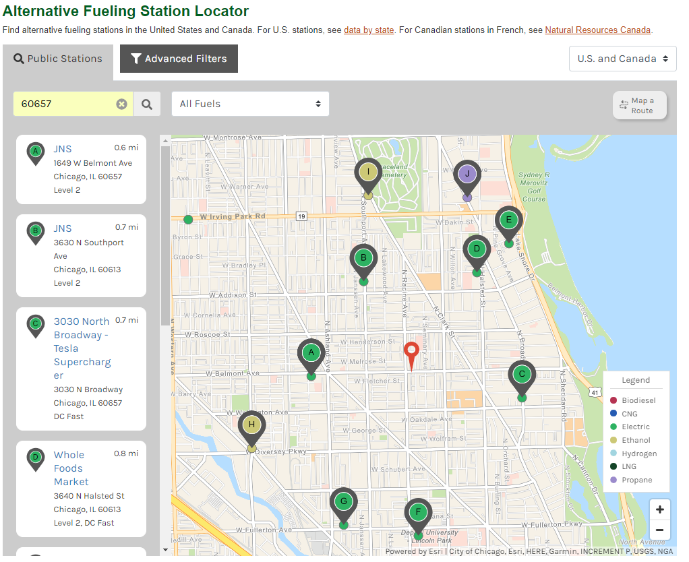
Public Sector Planning
Finding a Station
Alternative Fueling Data Center
Useful tool to locate alternative fueling stations
Charge station locators
Google maps
Plugshare
EVSE Providers and OEMs
Charge Point
Tesla
Notes:
- Google maps can help find stations, just type in charge stations

Slide 16
Municipal Planning / Regional Planning for Electric Vehicles

