Slide 1
Greetings from La Grange
Metropolitan Mayors Caucus Environment Committee
David McCarty, Trustee Village of La Grange
The Framework & Community
A Conversation
June 19, 2018

Slide 2
Our little town
Population of about 15,000 with 4,500 households.
Typically tossed together with our local neighbors La Grange Park, Brookfield, Western Springs, and Countryside.
A solid history of regional cooperation and sharing.
We are accustomed to looking over the fence to see what our neighbors are doing.

Slide 3
Why GRC? The GRC identified existing initiatives and best practices through an extensive study of municipal, regional, national, and global priorities, and sustainability programs
The Framework is clearly organized and easy to understand
Allows the Village to leverage off larger regional resources
Is a clear statement that we are not alone or working in a vacuum
Is broadly considered but also provides detail scope for guidance on specific programs
Provided guidance without politics and worked within existing Village initiatives

Slide 4
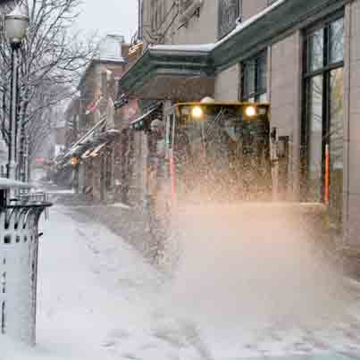
Plowing through the avalanche of information

Slide 5
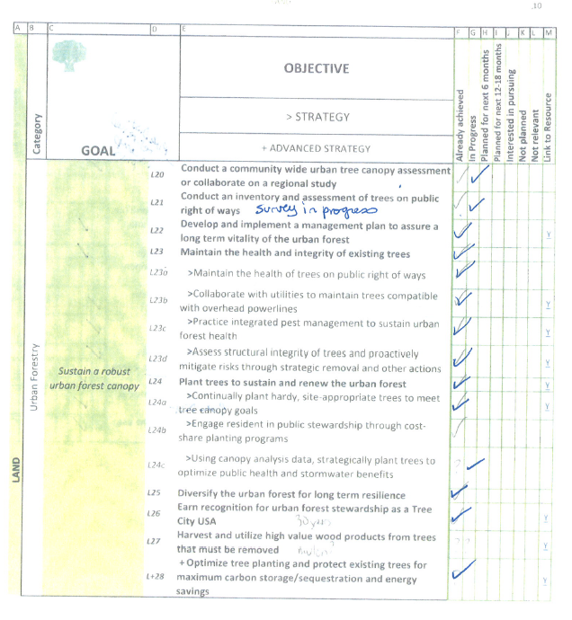
Not a new beginning Refine and advance existing programs
Recognize good work being done
Acknowledge effective programs
Limit and reduce burden on staff
Inventory and organize so Environmental Quality Commission can monitor and advance
Establish system for prioritizing and reporting

Slide 6
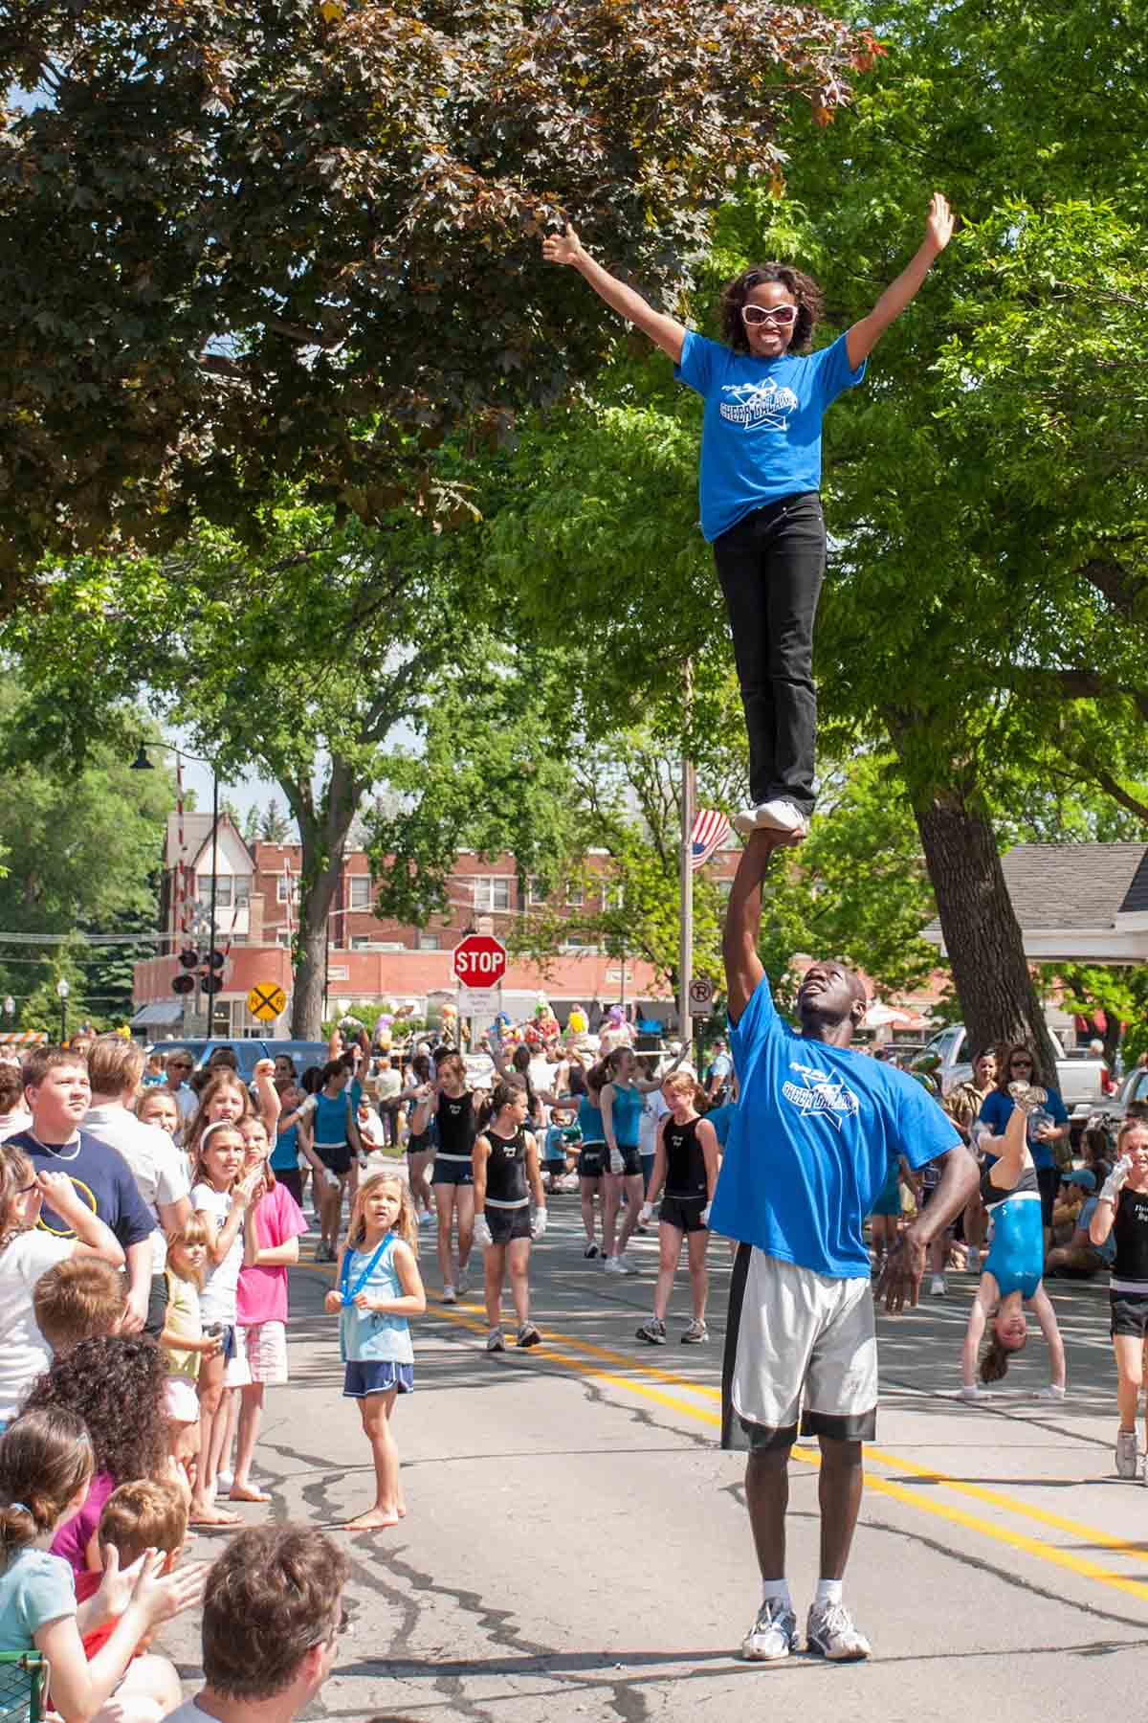
Operational roll out – Program support Optimizing functionality & minimizing staff time
Establish a lead communication team to interface with staff
Divide Framework into 4 subcommittees
Mobility & Municipal Operations
Leadership & Economic Development
Sustainable Communities, Waste Reduction & Recycling
Land, Water, Energy
All proposals will begin and end with the communication team for vetting with staff and Village Board

Slide 7
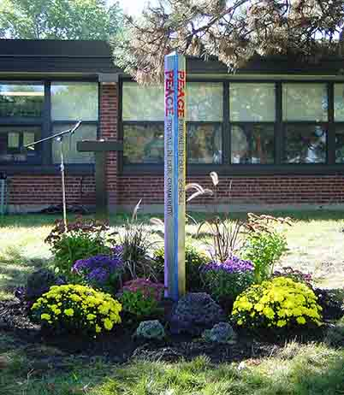
A Community Conversation
Commissioners may be part of more than 1 committee
Programs or proposals may be assigned to more than 1 committee
Committee of the whole establishes goals and priorities
Programs, goals and meeting topics to be posted on EQC page of Village web site to encourage resident participation

Slide 8
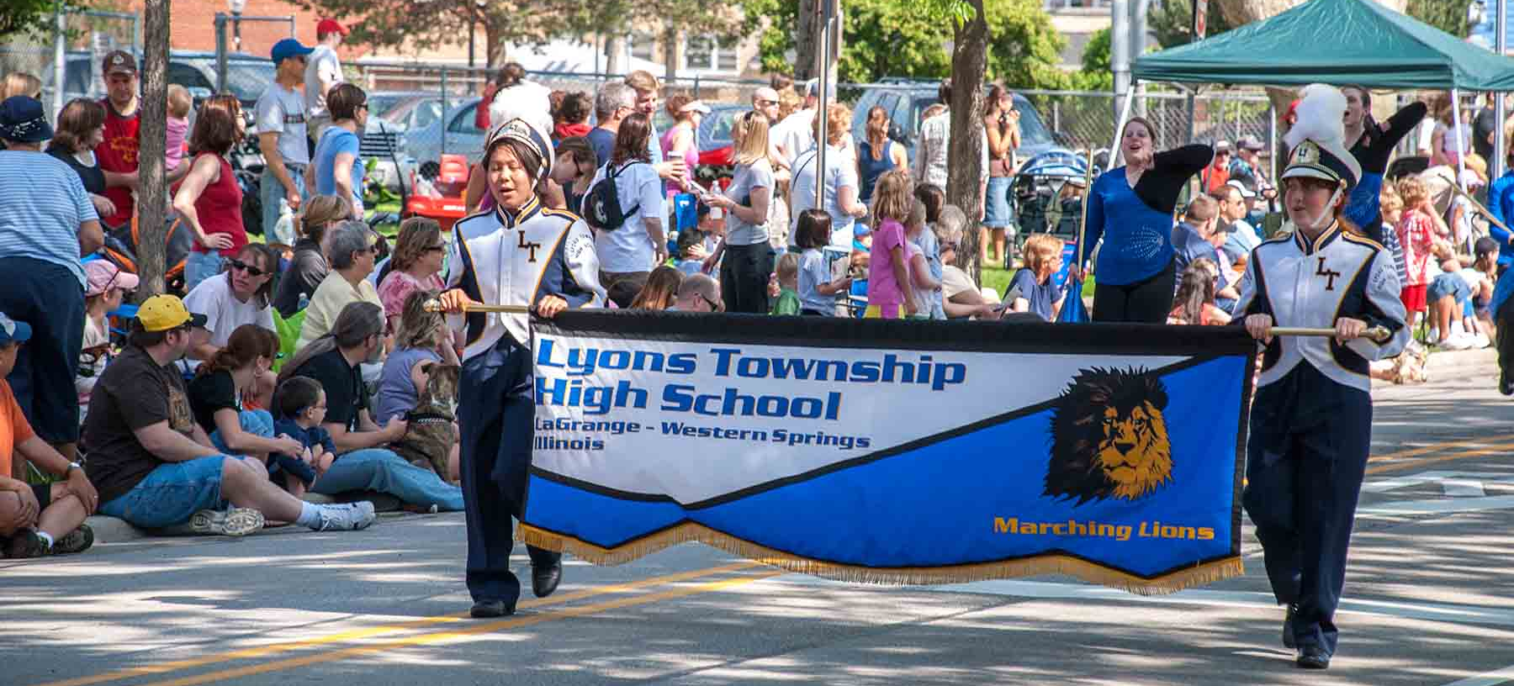
Moving forward as a team
Departments will continue to enact green efforts as appropriate
EQC will support the Village staff by providing research, public education, people power and relevant activities

Slide 9
The conversation is the most important part of a greener community and more sustainable world.

Slide 10
Thanks Hope to see you in greener La Grange

