Slide 1
Edith Makra
Metropolitan Mayors Caucus
Tim Milburn
Green Ways 2Go
April 3 , 2018
Green Municipal Fleets
Background and Context

Slide 2

Background
Greenest Region Compact Study
  - green fleet goals in 43% of municipal sustainability
    emissions reductions for public well-being and climate
    Lead by demonstrating sustainable practices
GRC2 sustainability pledge now adopted by 70+ municipalities includes this goal -
    “operate a safe, clean and efficient fleet”
Notes:
Members of the Metropolitan Mayors Caucus (“Caucus”) have articulated a common goal to operate safe, clean, and efficient municipal fleets. This goal is formalized in the Greenest Region Compact, a consensus sustainability pledge now formally adopted by 61 municipalities in the greater Chicago metropolitan area.
The Caucus wishes to accelerate progress towards this shared goal of cleaner, more efficient fleets through collaboration and innovative solutions. Key drivers of this goal are to reduce air pollution, reduce gasoline consumption, and improve quality of life in communities. At the same time, municipalities seek to reduce fleet operating costs and maintain or improve vehicle and operational performance.
Decisions about moving from traditional fuels (gasoline and diesel) to alternative fuels (natural gas, propane, biofuels, electricity and others are complex. While there has been occasional adoption of some alternative fuels by member municipalities, there are barriers to widespread adoption. Private sector fleets show greater conversion to cleaner fuels, but little collaboration among public and private fleets is currently underway

Slide 3
Preparing for Greener Fleets
Municipal Alt Fuel Survey – 2016
Caucus Environment Committee discussion
Facilitated Municipal Fleet Managers Assoc (MFMA) Forum – 2017
Advocating with Chicago Area Clean Cities Coalition & IEPA
Proposed Regional Muni Alt Fuel Study
Notes:
EM

Slide 4
Municipal Alt Fuel Survey
Objective: Characterize fleet and infrastructure needs and priorities based on municipalities’ inputs
Sent to over 30 municipalities
  60% response
Questions about
  Alternate fuels
  Perceived barriers
  Operational
  Financial
  Sustainability
Notes:
Tim

Slide 5
Key Survey Results
  Sustainability programs widely exist and generally transportation is a part of the objectives
  Alternative Fuel Vehicle preferences:
    EV (100%) → Biodiesel (67%) → CNG (44%) → Propane (11%)→ Ethanol (0%)
  Alt Fuel Infra preferences:
    EV (90%)→ Biodiesel (63%) → CNG (45%) → Propane (10%)
  Barriers to entry - Vehicles:
    Access to refueling infra (63%) →ROI (55%) → Price uncertainty and difference between AF and petroleum (36%) → O&M impacts (27%)→Vehicle performance (10%)→ Other (18%) - resale market, budget
  Barriers to entry - Refueling Infrastructure:
    ROI (56%)→ lack of interest (10%), Other (45%) = budget constraints, space, resale value, add’l fueling infra maintenance, high cost vs. limited vehicle qty, gallons fuel.
Notes:
Tim

Slide 6
Survey Results
  If refueling were nearby – would this influence AFV decision?
    Would consider in planning (64%), Yes if incentives were available (18%), no influence (18%), strong influence (10%) – Comments: would need to be near, funding is barrier
  Interest in collaboration?:
    Park District (90%), Schools (80%), local business (45%), NFPs (22%), other (25%)
  Farthest distance:
    1 to 10 miles
  Self fueling investment AF (ownership):
    EV (45%), Not sure (45%), CNG (36%), Propane (9%), Biodiesel (9%), No investment (9%), Ethanol (0%)
  Collaboration with other municipalities:
    Depends on level of commitment (55%), depends on incentives (27%), would not influence (11%), Strongly influence (0%)

Slide 7
Proposed Regional Study
Purpose
  Determine paths for muni green fleets
  Aggregate demand to spark investment
Components
  Regional - Plan alt fuel infrastructure regionally & collaboratively – both public & private
  Municipal – assess public fleets and recommend ‘greening’ strategies
Notes:
EM

Slide 8
Regional Study Objectives
Quantify the current and projected regional aggregate demand for energy for mobile sources, with a focus on municipalities
Capture current transportation energy consumption behaviors, logistics, driving and refueling behaviors
Define best pathways for comprehensive regional solutions for converting existing vehicles from petroleum-based to alternative fuels, integrating infrastructure requirements
Quantify the environmental and economic impacts and opportunities based on recommended solutions
Define risks and constraints associated with recommended range of solutions
Document recommendations for municipalities between leveraging regional 3rd party infrastructure resources vs. investing in municipal infrastructure, as functions of type of alt fuel and location
Develop recommendations towards planning for and defining associated policies, incentives and programs
Notes:
The Metropolitan Mayors Caucus proposes to complete a study to consider these goals, along with Green Ways 2 Go (GW2G) as the lead technical partner. Caucus member communities are the focus of the study, but it will integrate businesses and other organizations into comprehensive regional solutions. The results are intended to also benefit public and private fleet owners and individual alternative fuel vehicle owners in the region. The key areas of the study will include evaluation and recommendations for regional alternative fuel infrastructure, fleet assessments for a select number of communities and a set of recommendations that will benefit Caucus member communities.
To make informed transportation energy decisions, the questions being asked apply similarly for public and private vehicle owners: “which vehicles make sense for me or my organization, how and where does one “fill up”, and what investments are required?” Also, we must ask who needs to be involved, why such changes be might good ideas (or not), how will this impact me or my organization and when and how to make such decisions? Required investments may be significant and perceived as prohibitive for some, when looked at through a Return On Investment (ROI) prism. When environmental sustainability is considered, the decisions are normally weighted in favor of these changes. When incentive funding is available, the ROI decisions also shift in the direction towards change, and the incentives invariably contain a component which requires sustainability considerations. Another key question becomes, how to best develop public policy and allocate public funding in ways that benefit the public, businesses and government entities in a fair manner, i.e. how and where should alternative fuel infrastructure be located in order to equitably provide transportation energy and still make business sense?
Such solutions must evaluate and quantify the positive environmental impacts and economic benefits related to jobs to build, operate and maintain the vehicles and infrastructure. Further, social and environmental justice will be considered.
This Study and essential engagement activities would require a collaborative public-private effort including the involved communities, businesses and other stakeholders. It is to be completed in these steps:
Regional Study
The basic study process recommended is to first quantify and qualify the baseline of the Region’s vehicles, infrastructure, transportation energy consumption behaviors, logistics, driving and refueling behaviors, stakeholders and other information, referred to as an “As-Is Assessment”. Next, some logical and possible ideas for the future are set for these studied areas, or a “To-Be Vision”. The difference between these two conditions represents possible pathways for the Region to move forward, referred to as a “Gap Analysis” or a “Needs Analysis”. This Gap Analysis defines a logical roadmap going forward. Finally, a comprehensive report will be developed of the findings, strategy and recommendations for regional alternative fuel solutions.
Municipal Fleet Assessments
To better inform regional solutions and to guide municipal decision-making around alternative fuel options, municipal fleets will be assessed. Support will be provided to guide future planning to a selected group of municipalities. These municipalities will ultimately be selected based on interest and representation of a range of operational and demographic profiles. These profiles are referred to as “Cohorts”, which will be defined as part of the Study. Once defined, professional Fleet Assessments that are typical of the character of Caucus member fleets, will be completed. The Municipal Fleet Assessment results, which will include ideas for future planning of alternative fuel solutions (“Future Planning") will be shared to benefit the candidate communities and other similar municipalities that might leverage the knowledge gained. The Study, the Fleet Assessment and Future Planning results will be collectively applied and communicated as guidance for communities in the Region.
Additional information on the reasons and considerations is provided in Supporting Materials, intended to provide context for the proposed study and provide background for those that may not be familiar with the interacting factors.

Slide 9
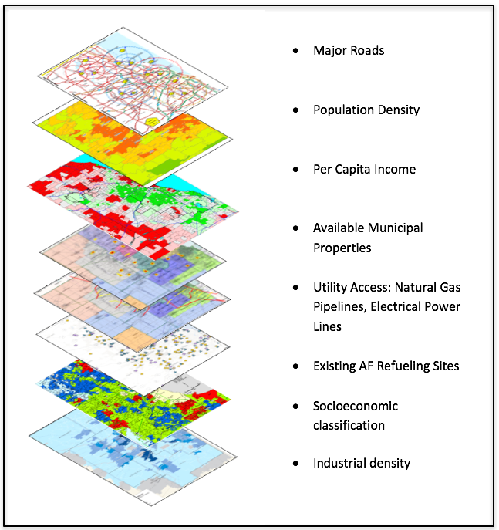
Outputs: Regional Mapping
Evaluate multiple factors for location to quasi-optimize location of regional fueling center
Maximize benefits to municipalities
Notes:
Tim

Slide 10
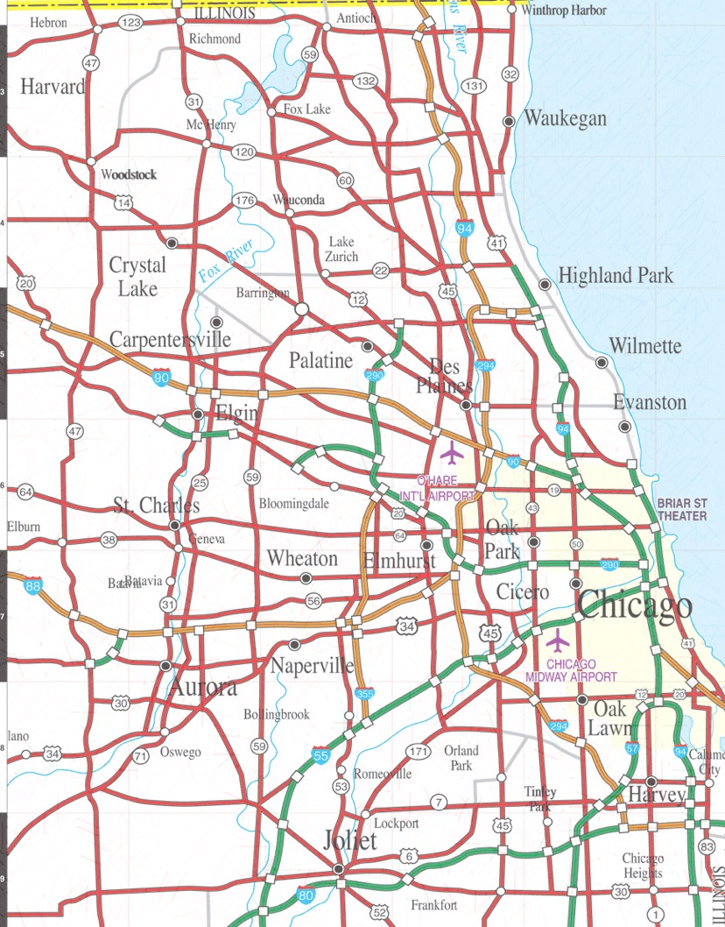
Output: Regional
Infrastructure
Concept
c
E
P
12
ET
E
P
6
c
P
c
3
B
ET
E
12
E
P
Strategically locate regional Alt Fuel retail refueling sites near fleets w/ demand
  Industrial fleets
  Municipal fleets
  Need access and egress
Indicates radial mileage (e.g. 6 mi.) from center
Indicates existing (light) or proposed (dark) stations (C-CNG, P=Propane, E = EV, ET = Ethanol, B= Biodiesel)
Sites indicated are for illustration only – not based on analysis
E
P
12
6
ET
c
3
E
6
c
12
6
c
3
6
P
12
c
P
3
ET
6
P
12
E
E
c
3
E
ET
6
c
3
Notes:
Tim

Slide 11



Thank you!
Edith Makra
Metropolitan Mayors Caucus
312-201-4506
emakra@mayorscaucus.org
Tim Milburn
Green Ways 2Go
847-826-3314
tim.milburn@greenways2go.com
www.greenways2go.com

Slide 12
Ken Crowley, Superintendent of Fleets,
Village of Oak Park
Highlights of the MFMA Green Fleet White Paper

