Slide 1
MMC Environment Committee VW Mitigation Plan Briefing
April 3, 2018
Tony Lindsay, Executive Board Member, Chicago Area Clean Cities Coalition

Slide 2
Clean Cities Strategies
Reduce
Replace
Eliminate
Notes:
Clean Cities is a community-based, voluntary program that fosters partnerships among stakeholders in the public and private sectors to reduce petroleum use.
Clean Cities has a nationwide goal to reduce U.S. petroleum use by 2.5 billion gallons per year by 2020.
Clean Cities activities are implemented by a national network of nearly 100 Clean Cities coalitions.
Clean Cities coalitions are comprised of businesses, fuel providers, vehicle fleets, state and local government agencies, and community organizations.
These stakeholders come together to share information and resources, educate the public, help craft public policy, and collaborate on projects that reduce petroleum use.
Over the years, Clean Cities has kept up with a rapidly changing industry on its mission to cut petroleum use. The program’s activities fall under a trifecta of strategies:
Replace petroleum with alternative and renewable fuels, including biodiesel, electricity, ethanol, hydrogen, natural gas, propane, and other fuels;
Reduce petroleum consumption through smarter driving practices and fuel economy improvements; and
Eliminate petroleum use through idle reduction and other fuel-saving technologies and practices.
Chicago Area Clean Cities is your local, unbiased, fuel-neutral resource to help you navigate clean vehicle projects & policies.

Slide 3
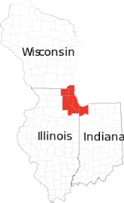
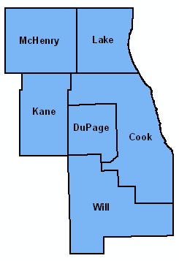
Coalition Snapshot
History
Formed in 1992
Designated 10th Clean Cities coalition, May 1994
Coordinator designated by the City of Chicago
Area
6-county, non-attainment area
Support state-wide legislation and education events
Lake Michigan Clean Cities Consortium
Coalition Structure
Executive Board & Steering Committee
Over 500 stakeholders, public and private orgs
2 to 4 general membership meetings per year
Chicago 6-county area

Slide 4
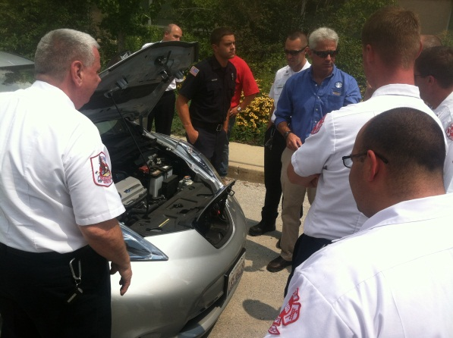
How Does Clean Cities Strengthen Markets?
Networking
Training and information
Technical assistance
Education and outreach to decision makers, fleets, and the public
Recognition
Funding
Updates
Joint applications
Develop local programs
Leverage other funding
Notes:
Clean Cities strengthens markets for alternative fuels and advanced vehicles in a variety of ways:
Networking opportunities with fleets and industry partners that have experience in alternative fuels and advanced vehicles.
Technical training, workshops, and webinars.
Publications and other information resources on alternative fuels, advanced vehicles, idle reduction, and other technologies and strategies that reduce petroleum use.
Individual consultation and technical assistance.
Funding opportunities from the U.S. Department of Energy.
Information about funding sources from state and local government agencies, nonprofits, and foundations.
Assistance with funding applications.
Public recognition for progress in reducing petroleum use.
Assistance with media outreach.
The Clean Cities program and individual coalitions educate stakeholders and the general public, enabling them to make informed decisions.

Slide 5
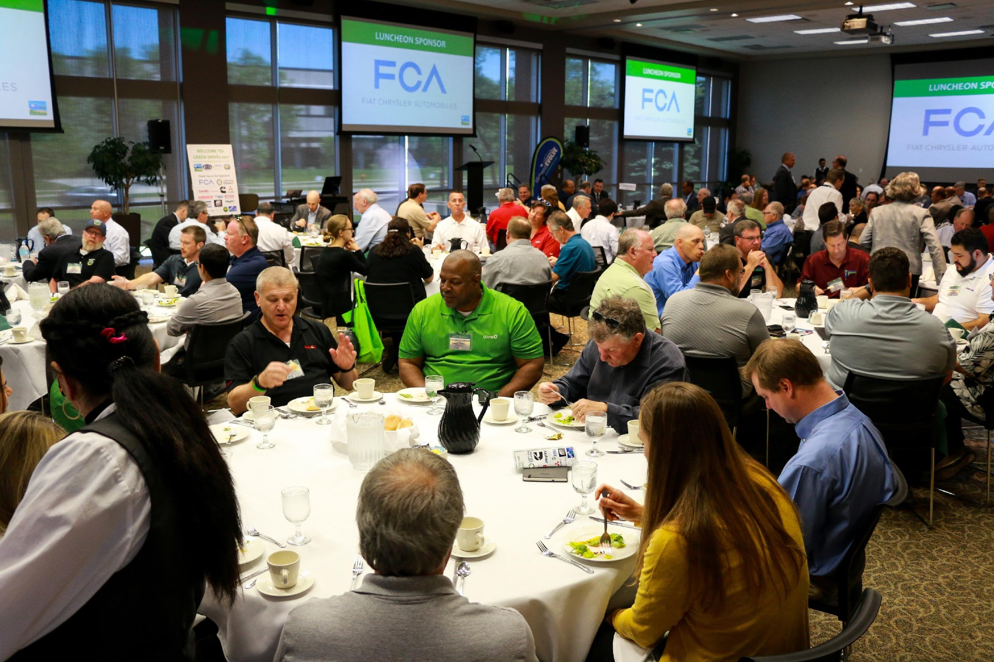
Green Drives 2018
2017 Green Drive$ Expo & Conference

Slide 6
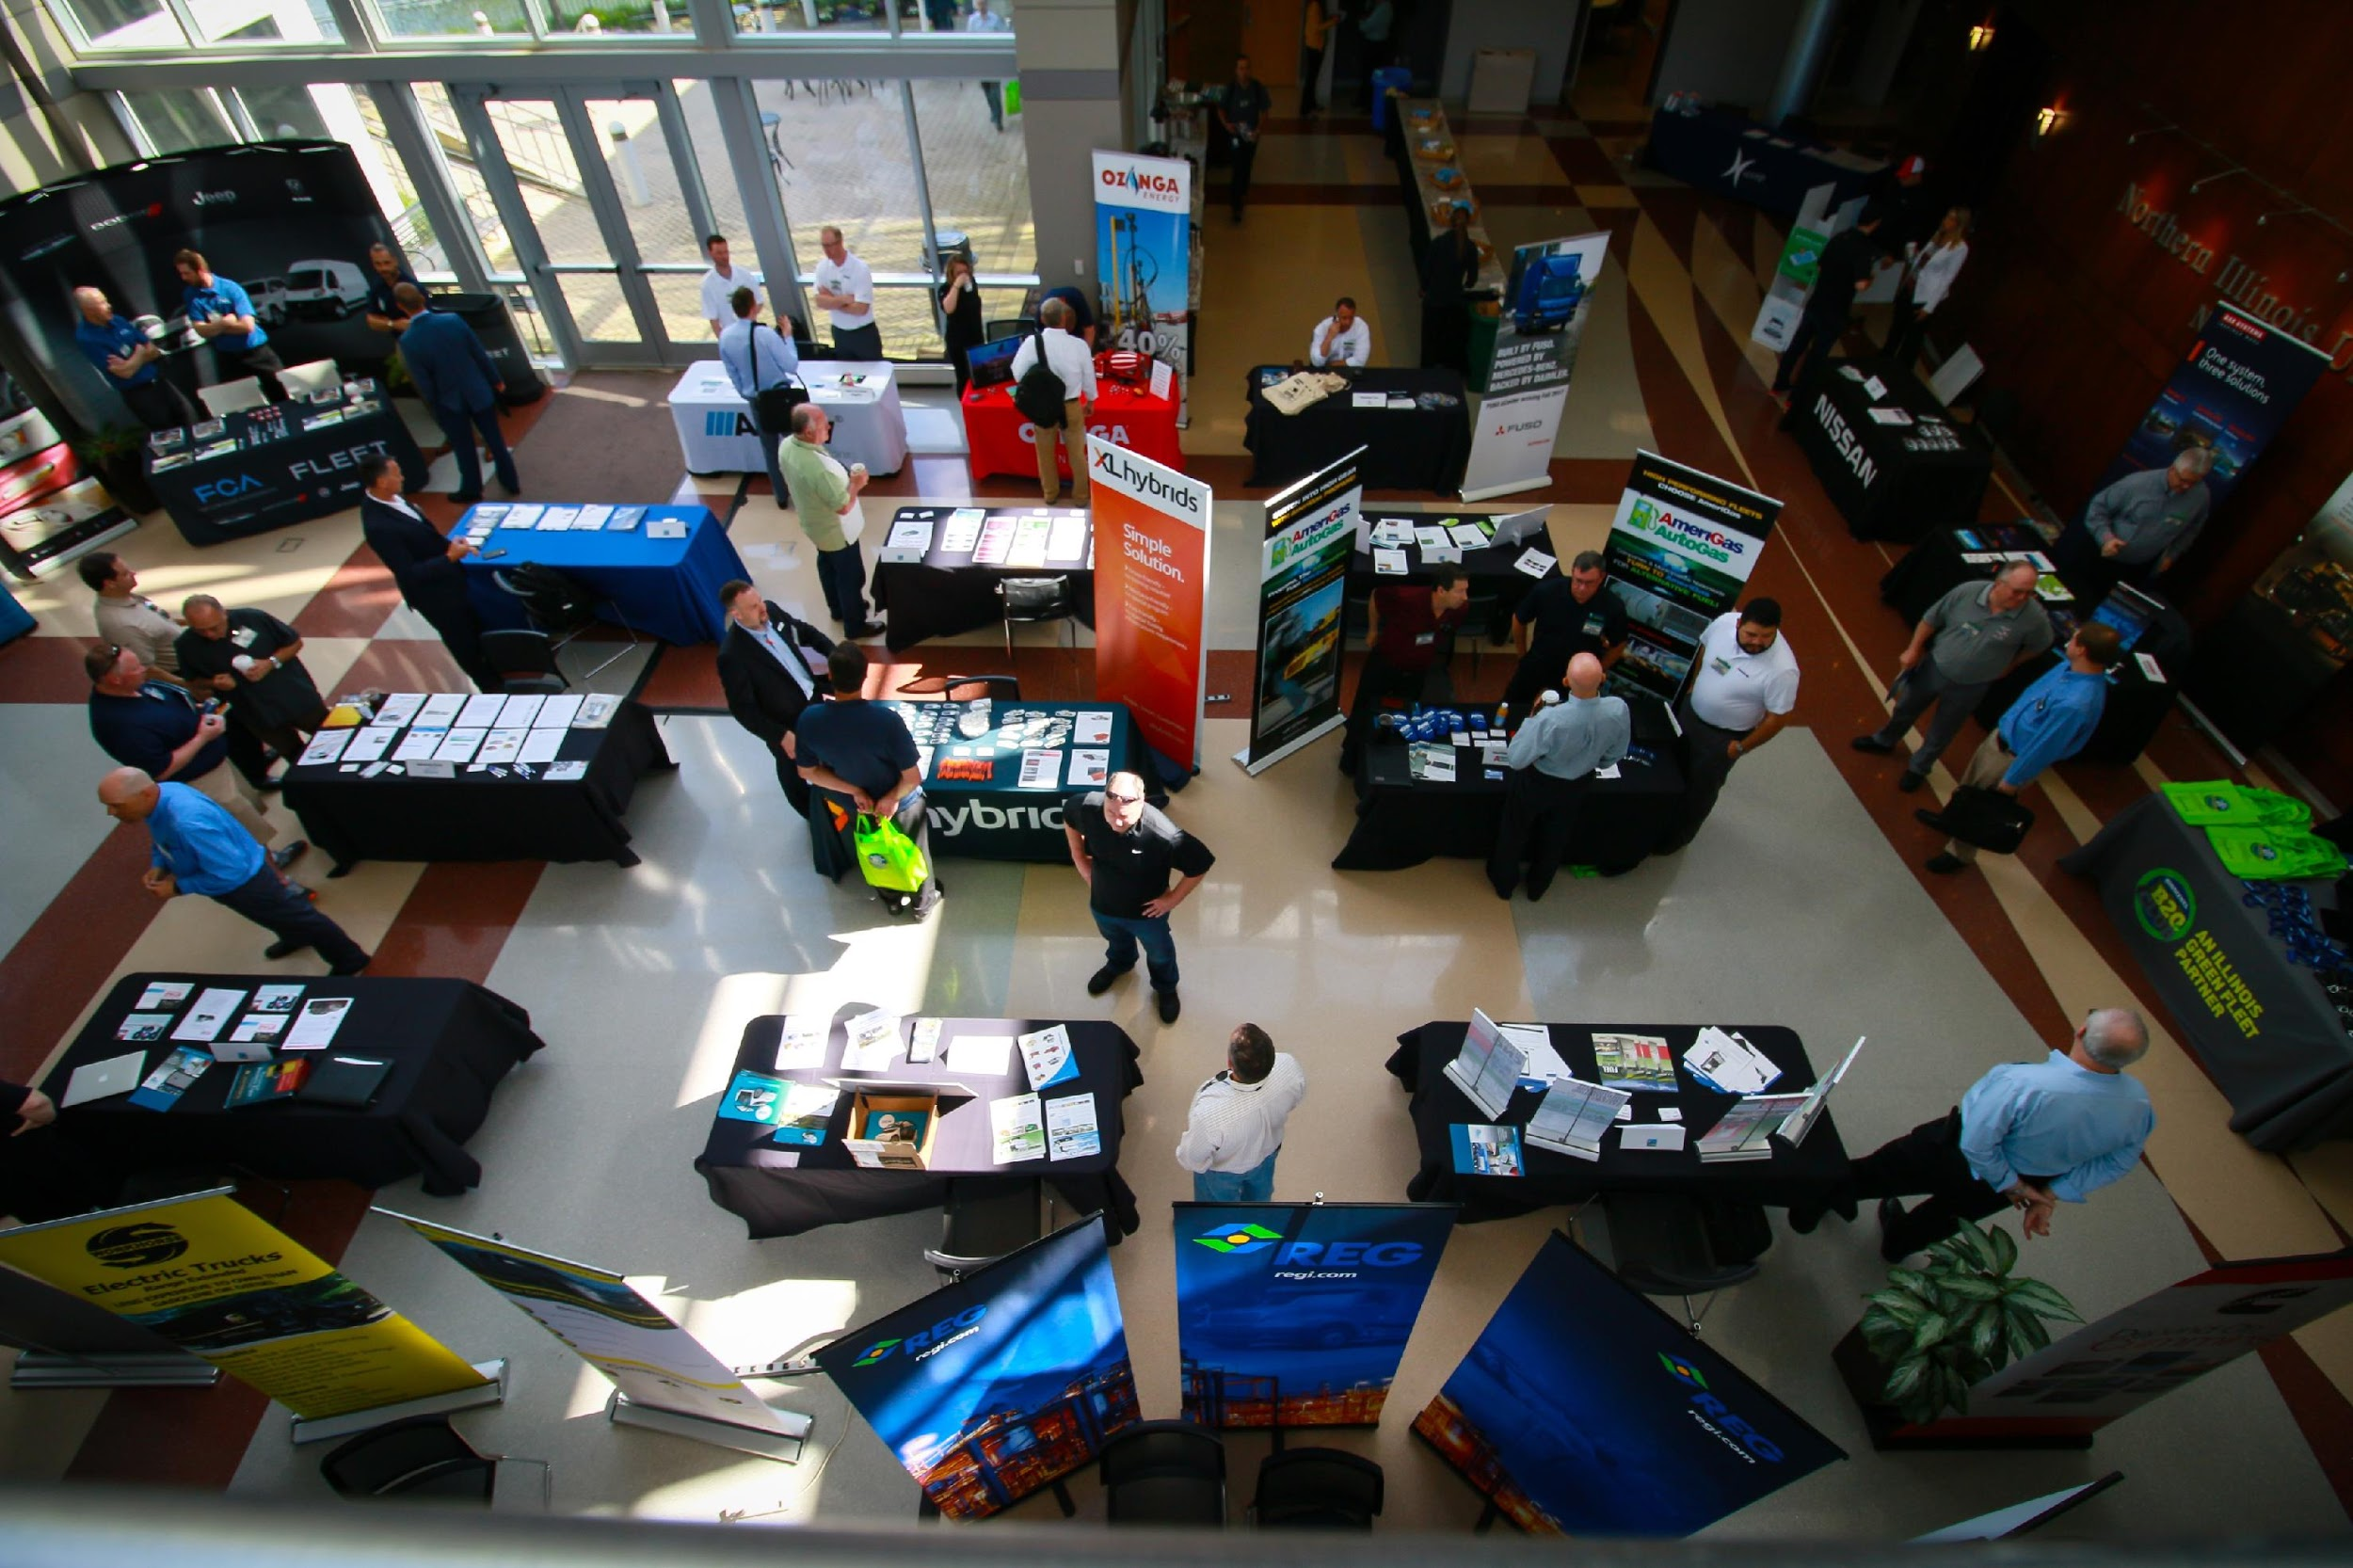
Green Drives

Slide 7
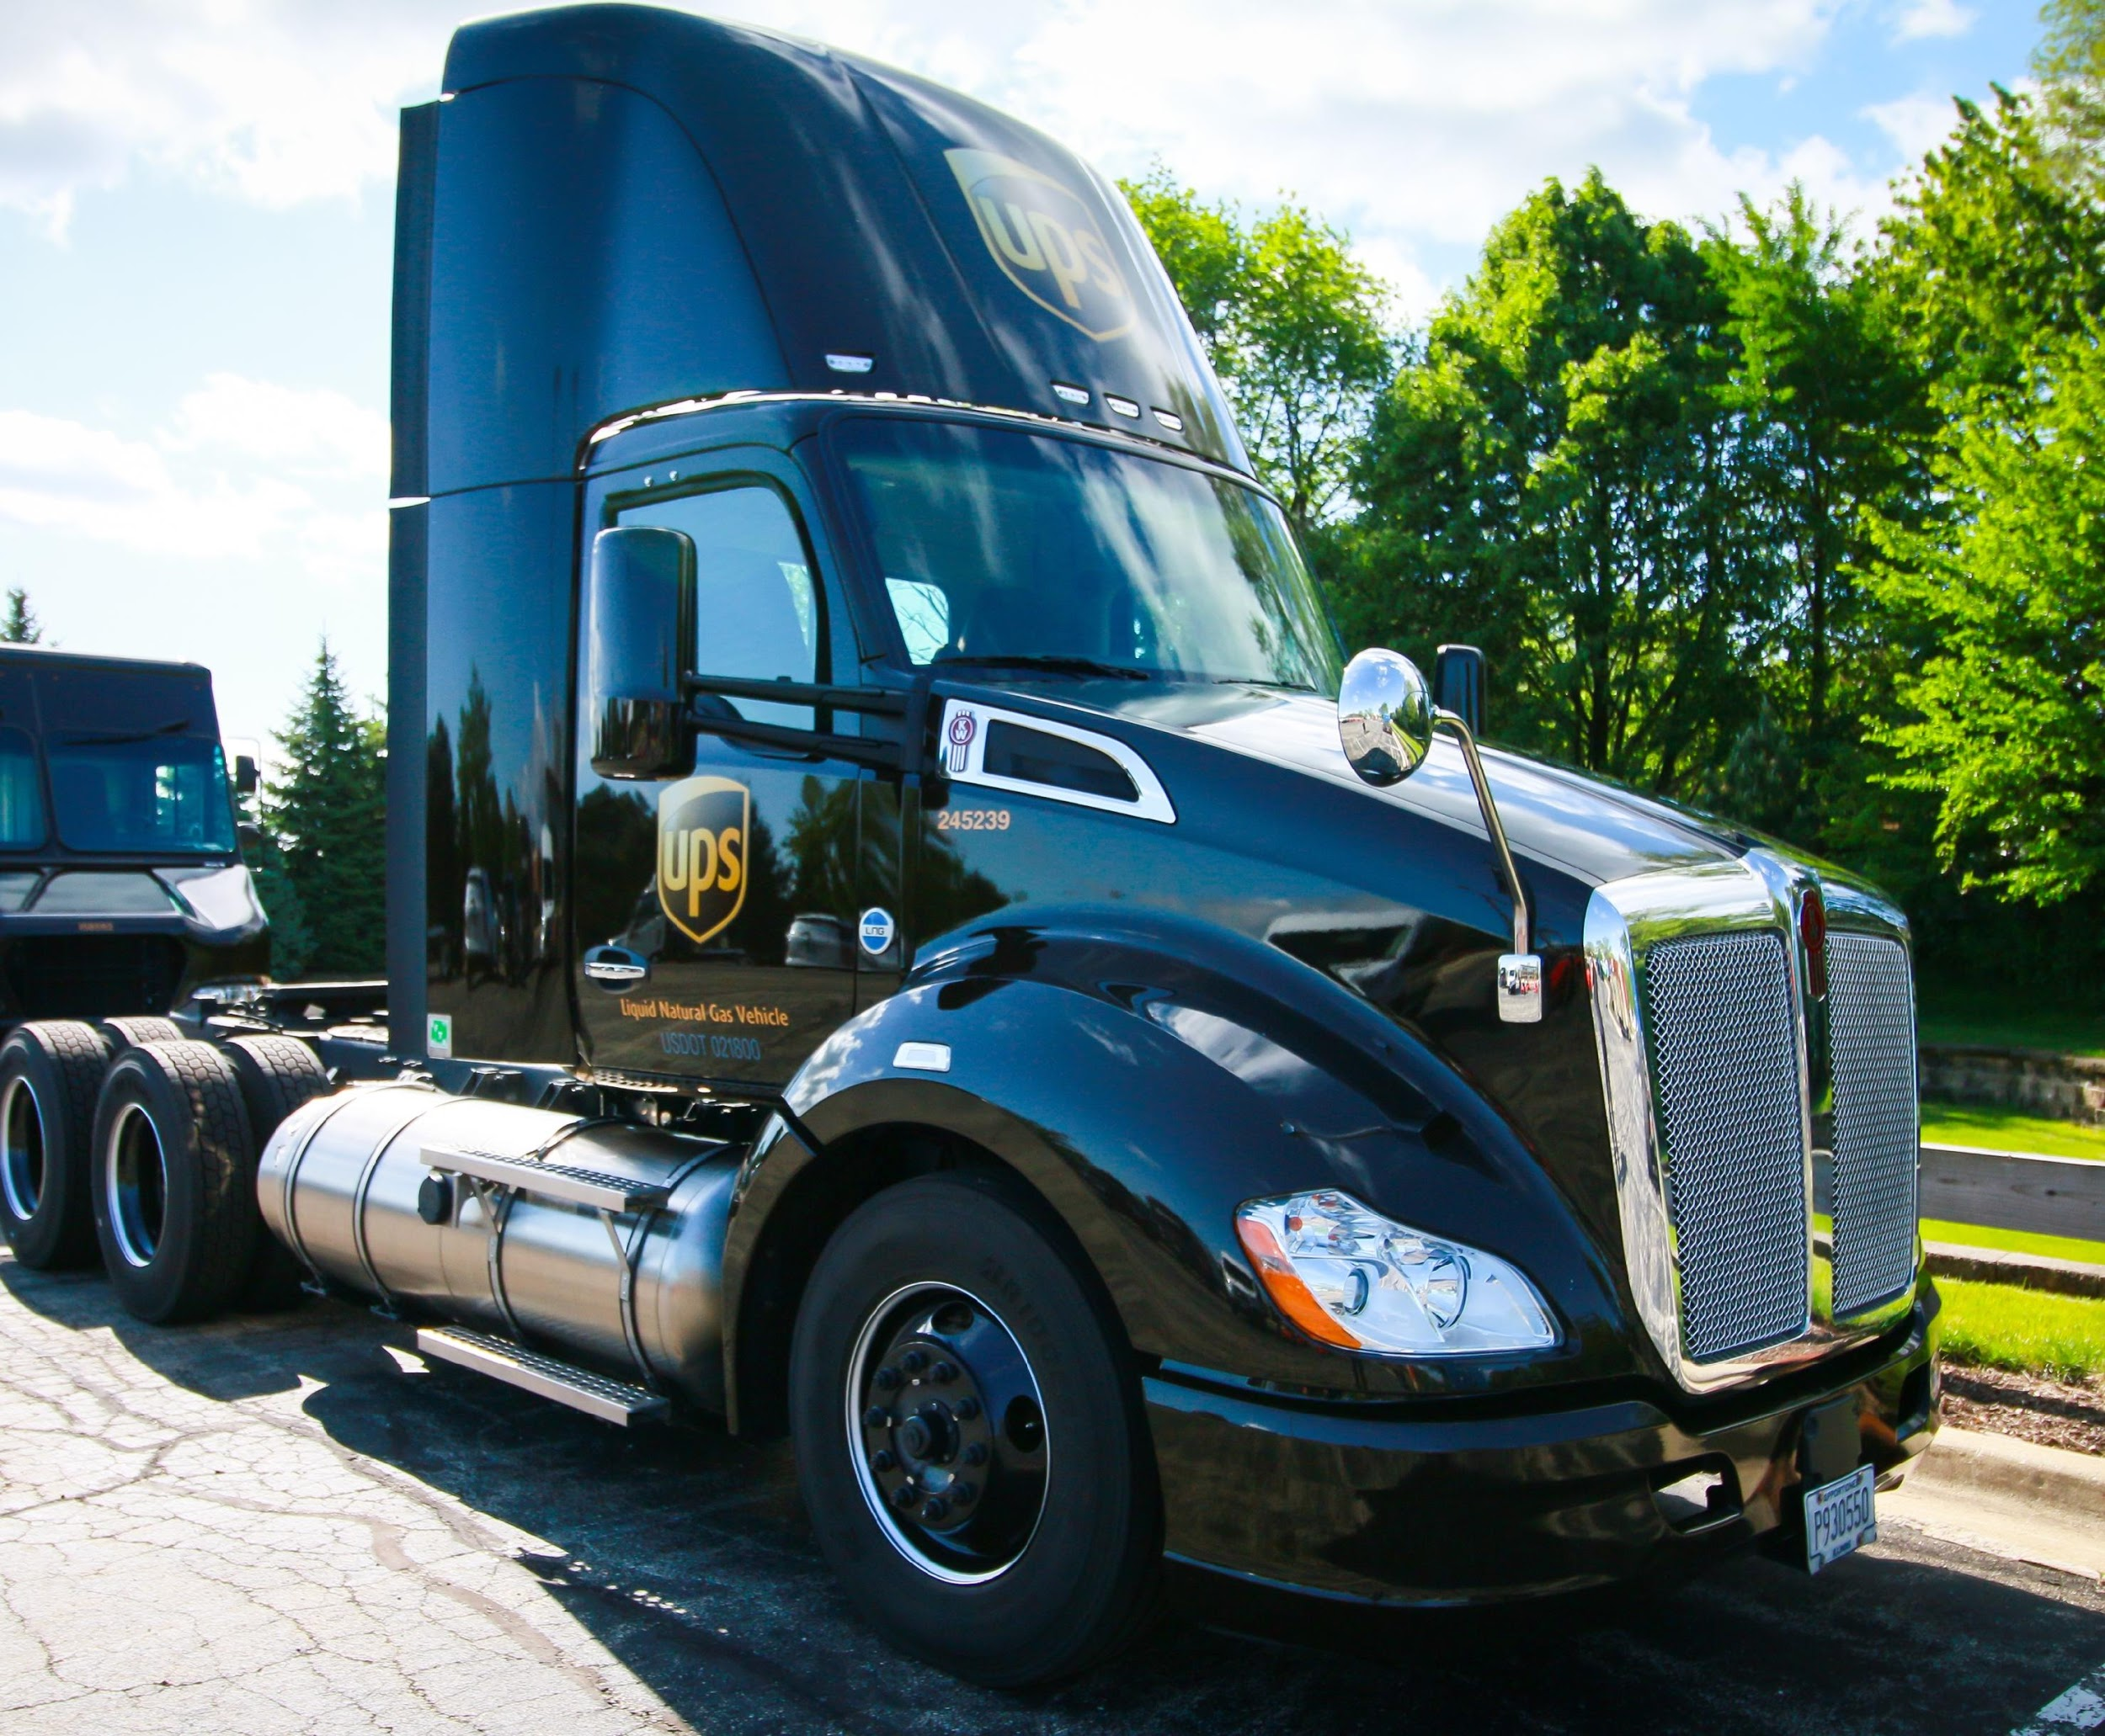
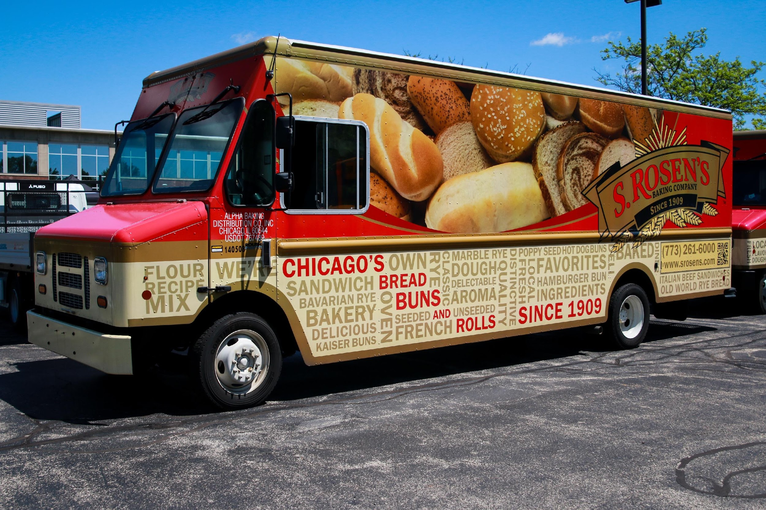
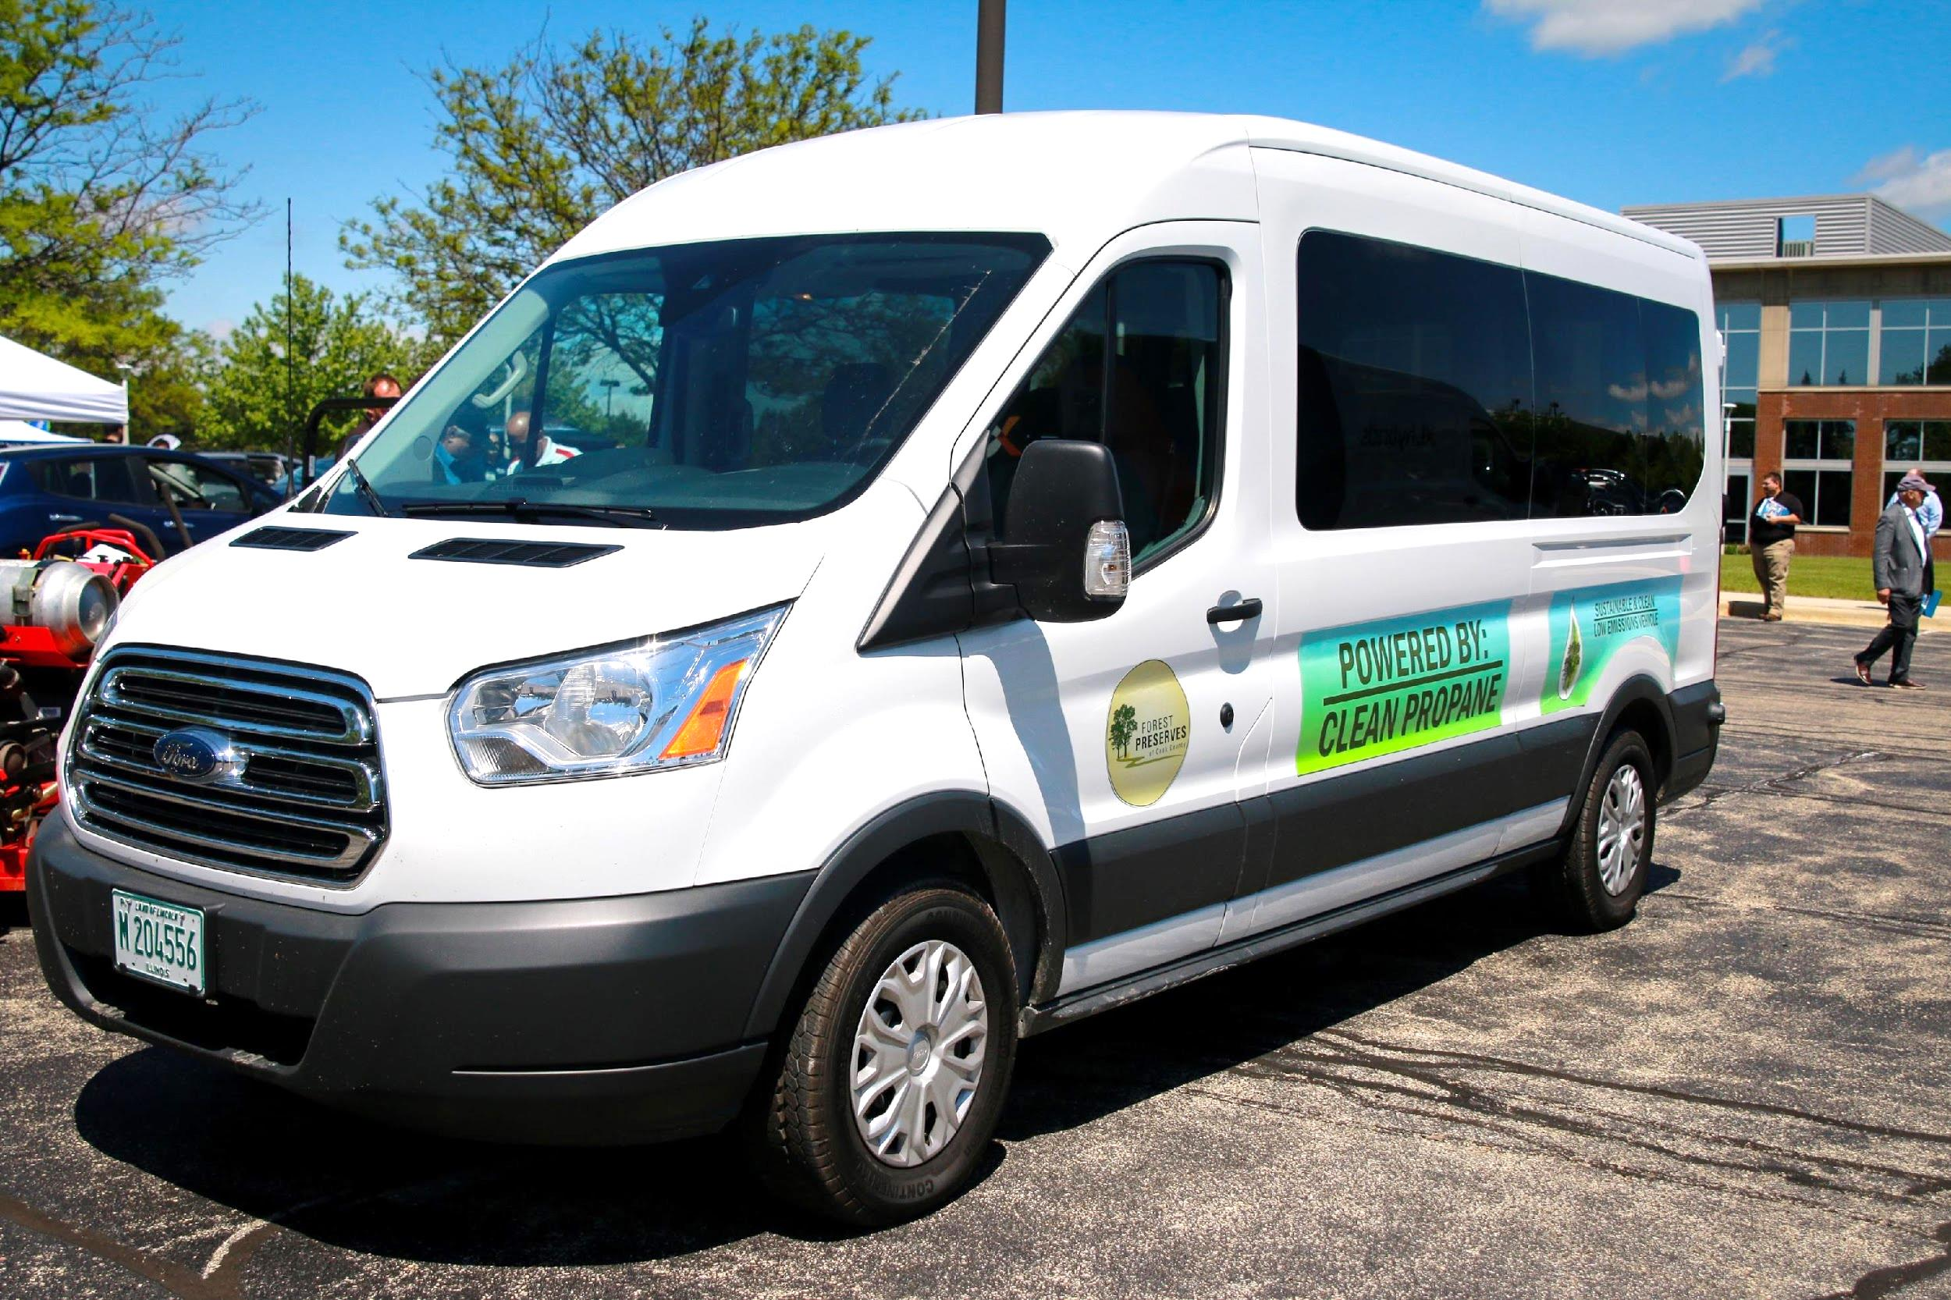
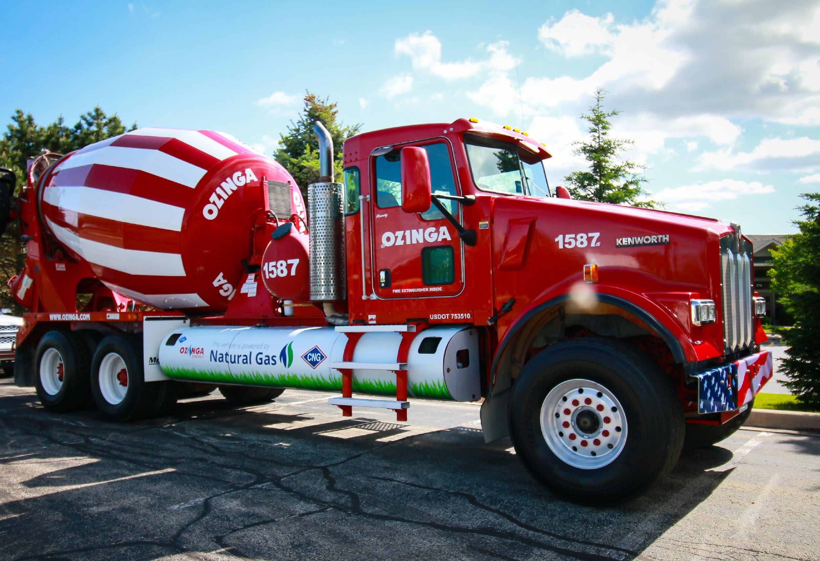
Green Drives
GREEN DRIVE$ 2018
Conference & Expo
Thursday, May 17, 2018
NIU Conference Center | Naperville, IL

Slide 8
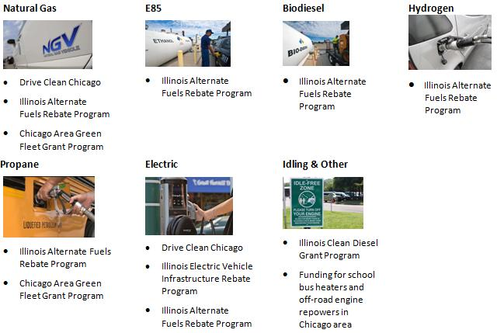
Current Local Funding
Current Local Funding - IL
State sales tax exemption
State sales tax exemption
Notes:
Chicago Area Green Fleet Grant Program (managed by IEPA)
– Competitive grant process, selections made quarterly
- Government and private fleets are eligible
$3 million current round of funding
$7 million awarded for a 2nd round in 2017
Illinois Clean Diesel Grant Program (managed by IEPA)
Must reduce emissions from diesel powered vehicles
Local governments, schools, transit districts, private fleets eligible
Technologies must be on USEPA or CARB list

Slide 9
Current & Planned Incentives in Illinois
Administered by: IL EPA
Chicago Area Green Fleet Grant Program (CMAQ) - $8M
www.IllinoisGreenFleets.org
50% of incremental or conversion cost CNG & Propane
Class 1-3 up to $10,000
Class 4 &> up to $20,000
Illinois Clean Diesel Grant Program (CMAQ + DERA) ~ $300k/Year
www.IllinoisGreenFleets.org
Direct-fired heaters
Engine repowers or engine upgrades to higher U.S. EPA tier for off-road
Other projects
Administered by: CDOT
Drive Clean Chicago – Drive Clean Truck Voucher Fund (CMAQ) - $20M
www.DriveCleanChicago.org
80% incremental costs of electric & hybrid Class 2 – 8 trucks, vans, & buses
Point of sale discount on purchased or leased vehicles

Slide 10
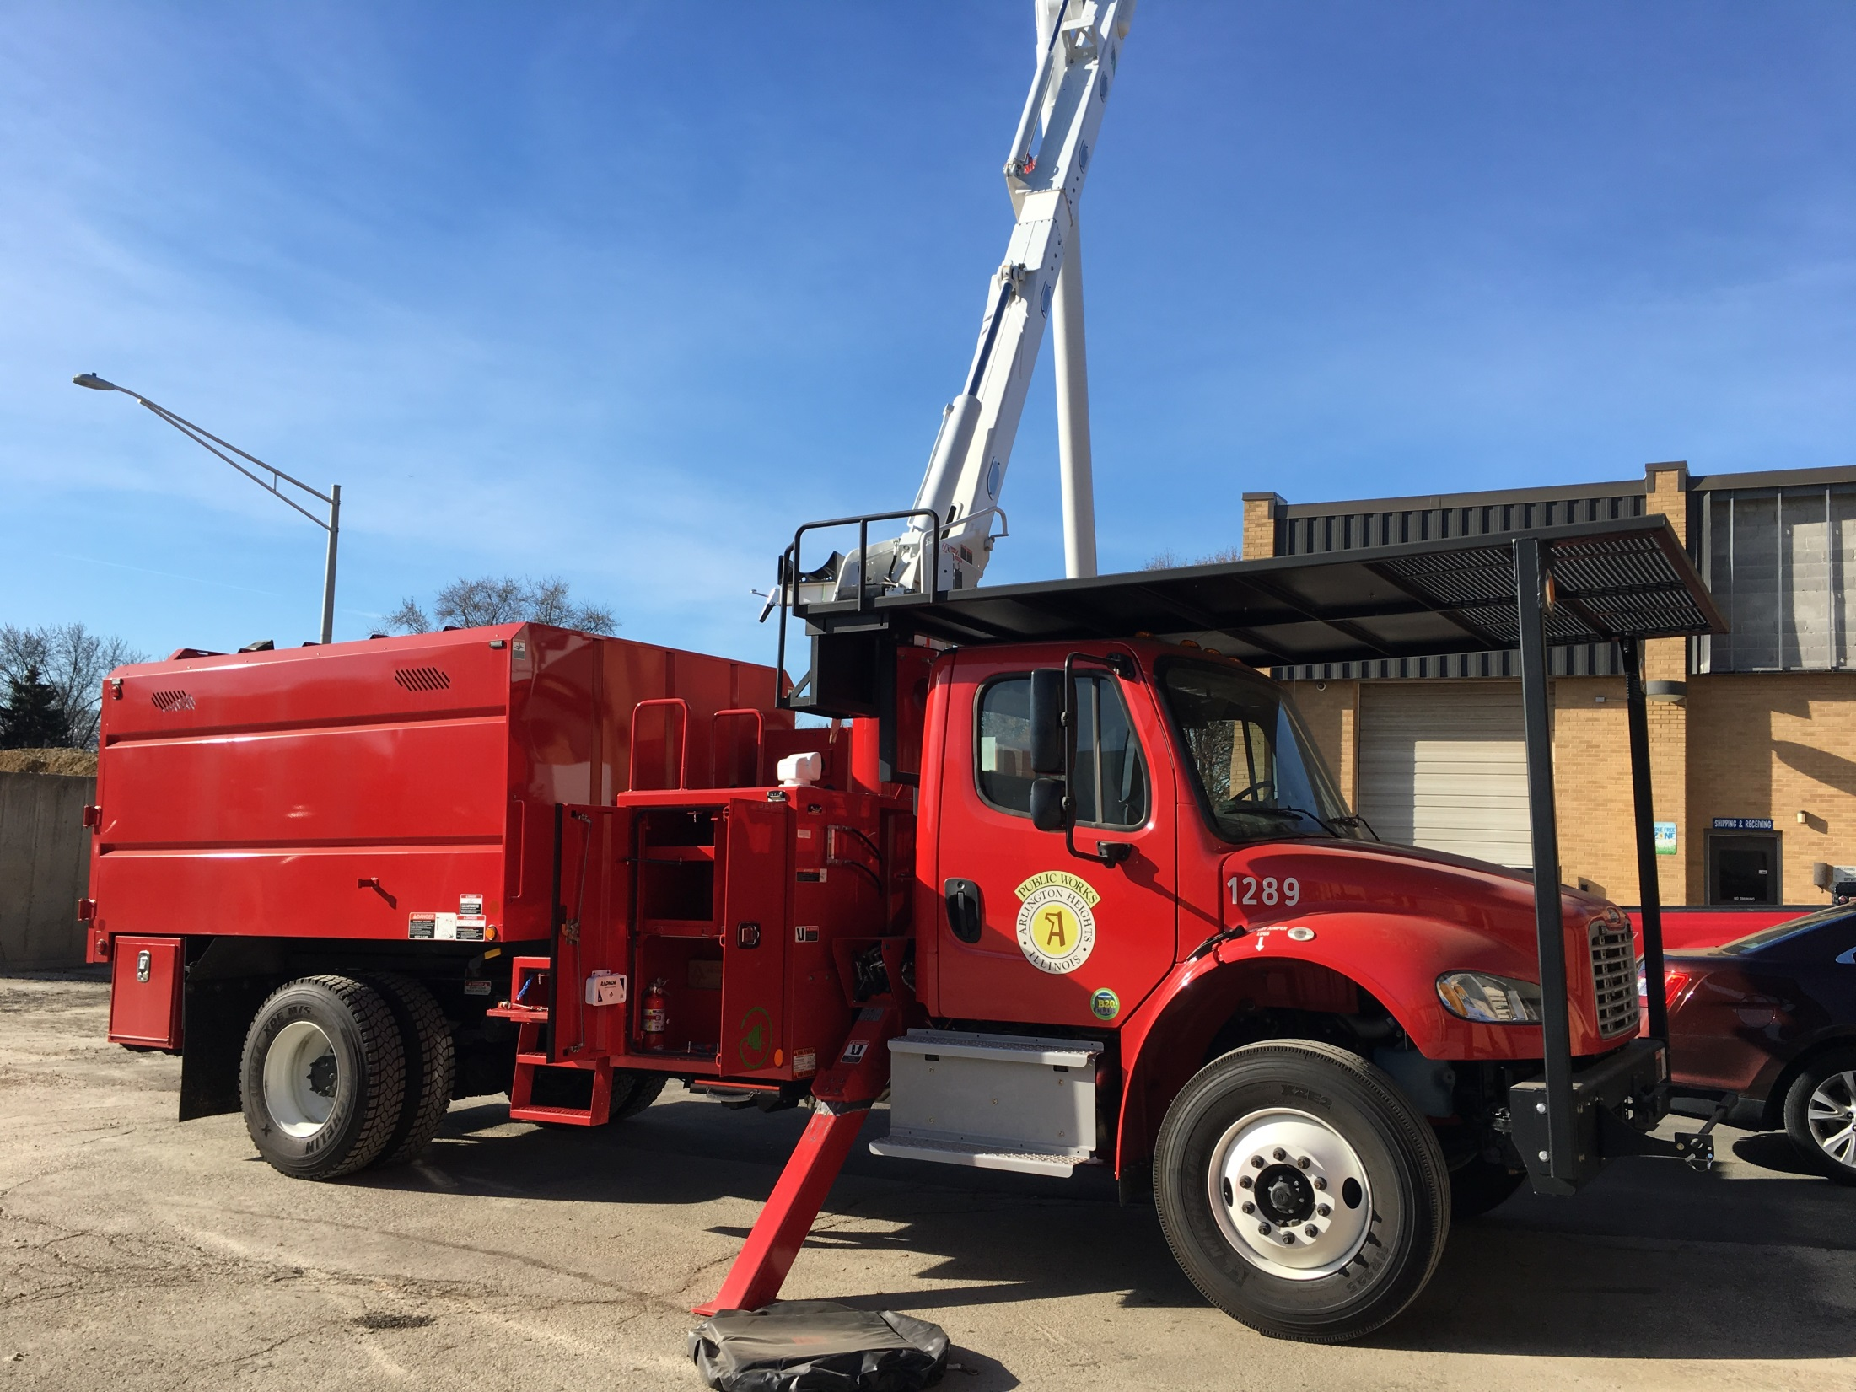
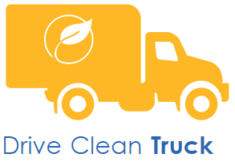
Drive Clean Chicago
Drive Clean Truck
Class 2-8 HEV, PHEV, & BEV
Notes:
Drive Clean Truck: How does it work?
Vehicle operator works with approved vendor/dealer to select eligible vehicle or conversion
Vendor/dealer requests voucher
Incentive discount is applied at time of purchase

Slide 11
Drive Clean Truck : Eligible Vehicles
Notes:
Extremely transparent.
Eligible vehicles and incentive amounts are all found on website.
Work with an eligible vendor who will do the paperwork for you.
List of eligible vehicles and vendors is just a snapshot. If you don’t see a qualifying vehicle or vendor you want to use we can help them through our approval process to be added to the program.

Slide 12
Backup Slides – Success Story

Slide 13
Success Story:
Chicago Area Alternative Fuels Project
American Reinvestment and Recovery Act (ARRA)
$15 million
$24 million
+
in US DOE ARRA funding received by City and partners
leveraged in additional project investments
Project Timeline
Deployments: January 2010 – December 2013
Data Collection and Reporting: January 2014 –
September 2014
Notes:
13

Slide 14
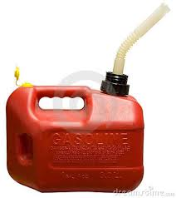
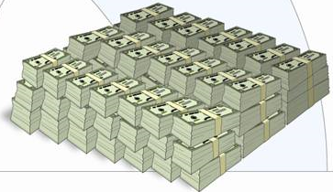
Project Summary – Triple Win
400 Vehicles Deployed
225 Stations Operational
300 CNG Vehicles
100 Gasoline Hybrids, Heavy Duty Diesel Hybrids and PHEVs
200 Electric Charging stations
15 CNG stations
10 E-85 Stations
Environment
18,000 Tons of CO2 emissions removed
Equivalent to removing 3,750 cars from the road
Energy Security
7.5 Million Gallons of Gasoline Displaced
Distance from Chicago to Waco, TX if 7.5 M gas cans were lined end-to-end
Economic
$8 Million in Fuel Savings
Notes:
14

Slide 15
Planting the Seed —US DOE Funds Lead to Additional Investments and Initiatives
Total additional investments were well over $15 Million
More than 200 additional CNG taxis (and more than 2,000 additional hybrid taxis) were deployed
City created new policies to incent cleaner taxis
City released RFP for “green” multi-fuel station at O’Hare
City was able to lock out Flex Fuel vehicles
Waste Management: 80 additional trucks and 1 public station
Groot: 10 additional waste haulers
Four additional local refuse fleets deployed more than 65 refuse haulers and three CNG fueling stations
Notes:
15

Slide 16
Planting the Seed —US DOE Funds Lead to Additional Investments and Initiatives
Ozinga: 100 additional CNG vehicles and 4 public CNG stations
Peapod and Abt began using alternative fuels
AT&T deployed more than 100 CNG vehicles locally
A major U.S. auto manufacturer moved up the Illinois launch of its new electric vehicle by an entire year
New businesses were formed or opened local branches serving the emerging alternative fuel market
Ozinga Energy
World CNG
JNS Electric
Advanced V-Tech
Notes:
16

Slide 17
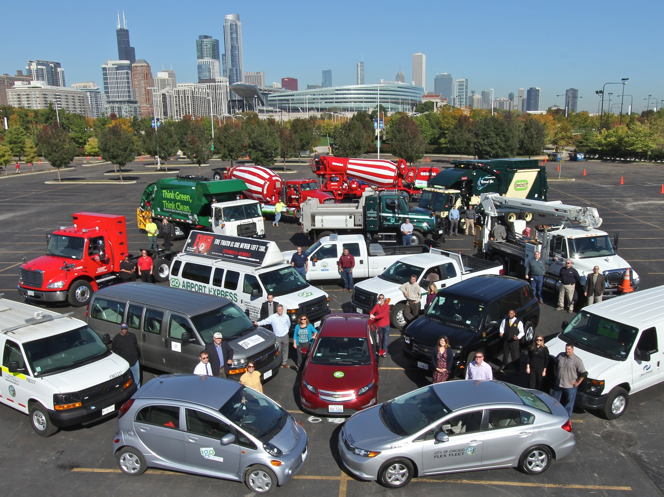
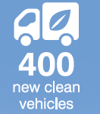
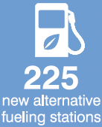
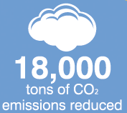
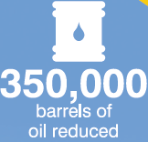
Notes:
17

