Slide 1
VW Settlement
Illinois’ draft Beneficiary Mitigation Plan

Slide 2
Draft Beneficiary Mitigation Plan (BMP)
$108 Million to Illinois
Reduce NOx emissions
Replace old diesel engines
New diesel
Alternative Fuels
Electric, must have access to or include infrastructure
Flexible
Can be modified in future
Accepting Public Comment till April 20*

Slide 3
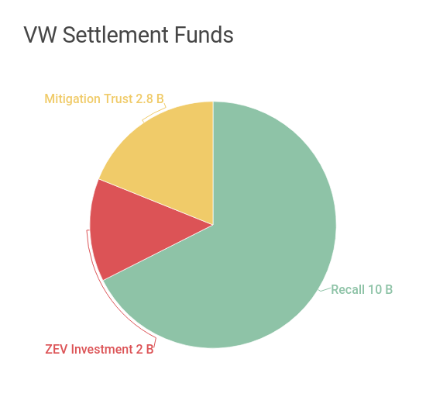
A vehicle recall and repair program - $10 billion to buy back or repair at least 85 percent of the unlawful vehicles. Zero Emission Vehicle (ZEV) Investment Commitment - $2 billion to support the use of zero emissions technology such as battery electric vehicles, plug-in hybrid electric vehicles, and fuel cell vehicles and charging infrastructure over the next 10 years. An Environmental Mitigation Trust Fund – $422 million to California and $2.44 billion to be dispersed to the other states and tribes to fund projects to reduce nitrogen oxide (NO_{x}) emissions as mitigation for the unlawful emissions.

Slide 4
Zero Emission Vehicle Investment
Mandate to Build-out ZEV Capability
4 Rounds over 10 years
Community Charging – Chicago is a 1st Round Priority
Long Distance Highway Network - I-80, I-90, I-70, I-24, I-94, I-64, I-39 and I-55

Slide 5
Transportation in Illinois
the second largest public transportation system,
the second largest rail system,
the third largest interstate system,
the fourth largest highway system, and
one of the busiest airport systems.
Large multimodal networks

Slide 6
Eligible Projects
Class 8 Local Freight Trucks and Port Drayage Trucks (Eligible Large Trucks)
Class 4-8 School Bus, Shuttle Bus, or Transit Bus (Eligible Buses)
Freight Switchers
Ferries/Tugs
Ocean Going Vessels (OGV) Shorepower
Class 4-7 Local Freight Trucks (Medium Trucks)
Airport Ground Support Equipment
Forklifts and Port Cargo Handling Equipment
Light Duty Zero Emission Vehicle Supply Equipment
Diesel Emission Reduction Act (DERA) Option

Slide 7
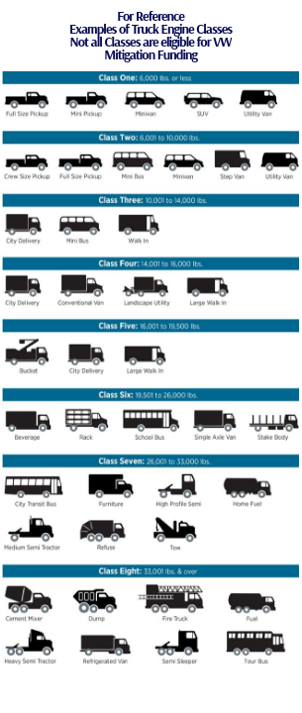

Slide 8
1. Size of the Engine
2. Number of Hours Operated/Miles Travelled

Slide 9
Beneficiary Mitigation Plan
Goals
Categories to achieve goals
Potential beneficial impact on air quality in areas that bear a disproportionate share of the air pollution burden
Expected ranges of emission benefits
The process to seek and consider public input

Slide 10
Goals
Reduce NOx emissions in areas where the affected Volkswagen vehicles are registered while taking into consideration areas that bear a disproportionate share of the air pollution burden, including environmental justice areas;
Maximize emissions reductions; and
Maximize and leverage funding.

Slide 11
BMP Development
Where the VW cars were located
Mobile Source Emissions
Disproportionate impact
Non attainment areas
EJ areas

Slide 13
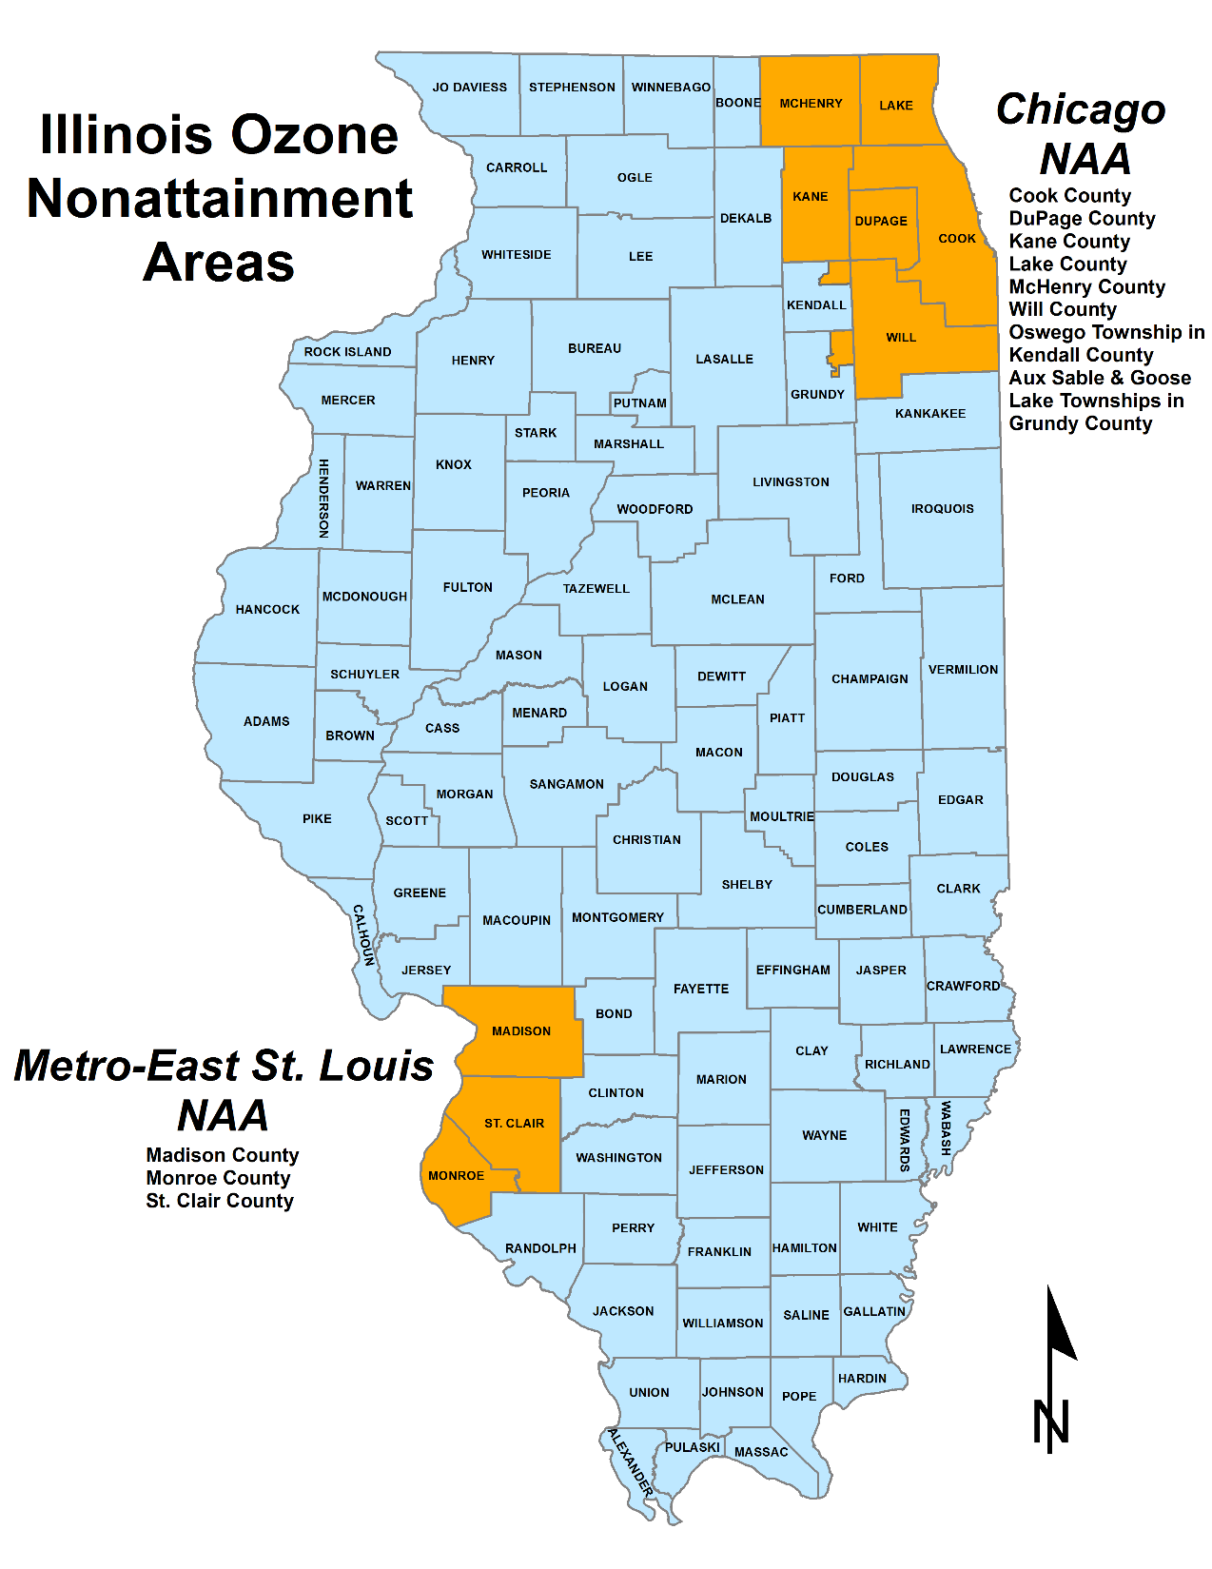

Slide 16
Priority Areas
Chicago Non-attainment area
Metro-East St. Louis non-attainment area
Seven Counties that had 1% or more of cars
Champaign, DeKalb, LaSalle, McLean, Peoria, Sangamon, Winnebago

Slide 17
Project Categories
On-road - $21,735,935
All-electric school bus - $10,867,968
Off-road - $70,641,789
For all categories will require electric infrastructure if not available

Slide 18
Cost Share
Public: 25% or higher w/DERA
Non-Public: 50% or higher as specified by trust or DERA
To spread the Trust funds to as many projects as possible

Slide 22
Comments
Accepting public comments until April 20, 2018
Survey
Projects
Priorities
Applicant needs

Slide 24
Takeaways
3 pieces to the Settlement
Recall
ZEV Development
NOx Reductions (Mitigation)
Projects will drive the allocations
Plan flexible
Plan can be modified in future years
Take the Survey
tell us what projects you have

Slide 25
Resources
http://www.epa.illinois.gov/topics/air-quality/vw-settlement/index
EPA.VWSettlement@illinois.gov
https://www.surveymonkey.com/r/JXCVXWK
Brad Frost Illinois EPA (217 ) 782-7027
Brad.frost@illinois.gov

