Slide 1

Climate Action for MMC Municipalities
Edith Makra
Metropolitan Mayors Caucus January 2018

Slide 2
What do We Mean by Climate Action for Municipalities
Pledges
Greenhouse Gas (GHG) Inventory & Reporting
Sustainability Plans
Mitigation
Public Engagement
Adaptation & Resilience
Notes:
Spectrum of activities to slow the impacts of climate disruption and respond to the changing climate.
Climate action for biz & institutions is very simllar, though munis have different impacts & strengths

Slide 3







Pledge Only Pledge & Reporting
Notes:
Reporting
Most challenging for the majority of municipalities b/c it requires dedicated expertise & resources
But, without reporting, can’t quanitfy impacts of our mitigation work

Slide 4









The Greenest Region Compact
Consensus Sustainability Goals in 10 Categories
Climate
Economic Development
Energy
Land
Leadership
Mobility
Municipal Operations
Sustainable Communities
Water
Waste
Notes:
Plan
Did the work for you. Synthesized all plans PLUS existing actions.
62 munis adopted.
No reporting – only supportive.

Slide 5

GRC2 Adopters
61 municipalities
10 COGS
Algonquin | Frankfort | Naperville
Algonquin Twnshp | Franklin Park | Niles
Alsip | Geneva | Northfield
Arlington Heights | Glencoe | Northlake
Aurora | Grayslake | Oak Brook
Bannockburn | Hainesville | Oak Forest
Barrington | Hanover Park | Olympia Fields
Blue Island | Hawthorn Woods | Orland Park
Brookfield | Highland Park | Oswego
Buffalo Grove | Hoffman Estates | Park Forest
Burlington | Homer Glen | Park Ridge
Campton Hills | Island Lake | Richton Park
Carol Stream | Lake Bluff | River Forest
Cary | Lake Forest | Round Lake Beach
Chicago | Libertyville | Schaumburg
Countryside | Lincolnwood | South Barrington
Crystal Lake | Lombard | South Chicago Heights
Diamond | Long Grove | Streamwood
Elgin | McCullom Lake | Thornton
Fox Lake | Mount Prospect | Westchester
 |  | Wheeling
Barrington Area Council of Governments
Lake County Municipal League
McHenry County Council of Governments
Metro West Council of Governments
Northwest Municipal Conference
South Suburban Mayors & Managers
Southwest Conference of Mayors
West Central Municipal Conference
Will County Government League
DuPage Mayors and Managers Conference

Slide 6
Climate Mayors
Uphold goals of Paris Agreement
Non-binding, only that “only that cities are pursuing meaningful actions to drive climate progress ”
Speak with one voice
Pursue collective action
Bloomington | Montgomery
Champaign | Normal
Chicago | Savanna
Evanston | Skokie
Elgin | Urbana
Highland Park | Waukegan

Slide 7
launched at the 2014 UN Climate Summit
Builds on existing global initiatives for greater impact
Standardizes measurement & reporting
report climate data/actions through two major platforms—Climate Disclosure Project (CDP) and carbonn Climate Registry

Slide 8




To commit cities must:
Register commitment
Take inventory
Create reduction targets and establish a system of measurement
Establish an action plan
Alton
Chicago
Evanston
Urbana

Slide 9
Created Dec 2017 by Mayor Emanuel
Commitments:
  Achieve % reduction at least Paris NDC
  Quantify, track & publicly report
  Advocacy & inclusion
  Integrate with infrastructure planning
  Support strong policies
Aurora | Montgomery
Chicago | Oak Park
Evanston | Park Forest
Franklin Park | River Forest
Geneva | South Barrington
Hanover Park | Waukegan

Slide 10
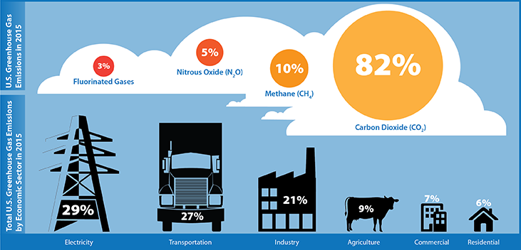
GHG INVENTORY & TARGET SETTING
SET TARGET OVER BASELINE
Notes:
EPA has tools & expertise to help. So does ICLEI /Global Covenant of Mayors
CMAP has done a regional GHG and is just updating.
Most munis will have very similar profile – 40% building energy, 30% trans, waste. Not really essential at the local level.

Slide 11
Mitigation
Reducing GHG emissions through direct actions:
Use less energy and water
Use less petroleum fuel
Increase renewable energy
Reduce consumption
Sustain recycling
etc
Example:
Energy efficiency retrofits
131 municipalities
32,540,000 kWh electricity saved
76 millions lbs of CO2 avoided

Slide 12
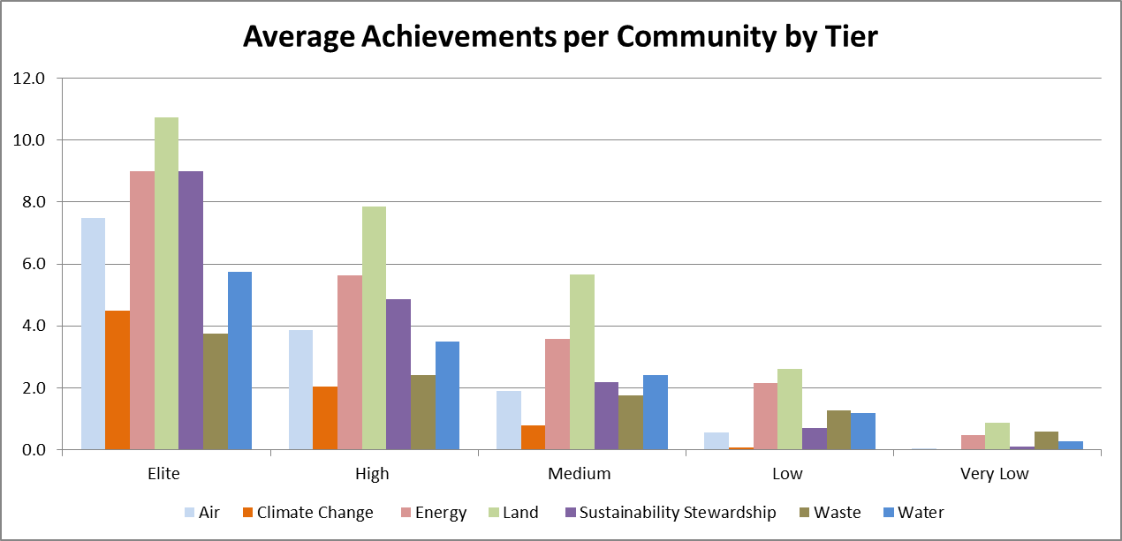
Sustainable Mitigation Actions Underway by Region’s Municipalities
9%
71%
1%
Notes:
Mitigation/ Actions
Access to open space
EE
Water efficiency
Tree City USA
Farmers markets

Slide 13

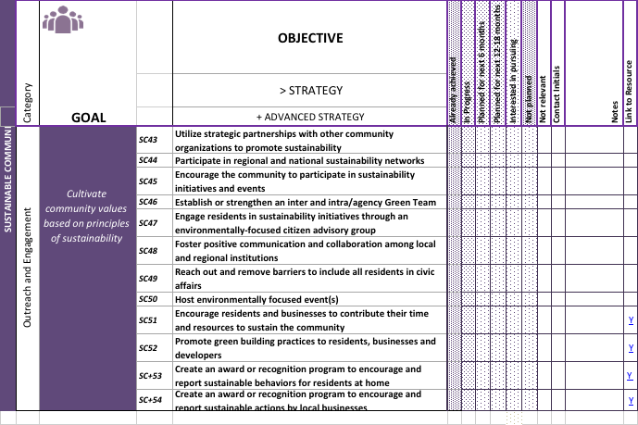
Public Engagement
Notes:
Munis excel –
People parts
Educating, supporting, leading, helping consituents take actions. Doesn’t have to be labeled climate. Residential EE – Mayor Rogero great example. Our citizen commissions – Mayor O at Public Engage table Civic Leadership Academy

Slide 14
Public Engagement Partner – Eco America
American Climate Leadership Summit
Focus on messaging
Broad participation of sector leader, i.e. faith, public health

Slide 15

Adaptation & Resilience
Notes:
People stuff. Engineers, public works, water, public health
Dale Sands at resiliency tabel Pres of Deer Park

Slide 16
Edith Makra
Director of Environmental Initiatives
312-201-4506
emakra@mayorscaucus.org
http://mayorscaucus.org/initiatives/environment/rec/
Notes:
Next frontier – integrate GRC with climate reporting & strategic actions
GRC adopters working collaboratively – Sol Smart

Slide 17
Climate Action Discussion Questions
What are priority actions for MMC members/GRC adopters?
Should members take a climate pledge?
Do we need GHG inventory(s)? At what scale?
How do we manage reporting? Collectively?
How do we develop capacity for setting targets and reporting?
Is GRC a suitable foundation for climate action & reporting?
What are next steps?

